Slide 1


1. 插值 与 逼近/曲线拟合 Numerical Interpolation and approximation
Yahui Wang, Jie Li, Yu Ma
Sino-French Institute of Nuclear Engineering & Technology, SYSU
1

Slide 2
Overview
什么是插值 What's interpolation ?
拉格朗日插值 Lagrangian interpolation
多维插值 Interpolations for multi-dimensions
曲线拟合 Curve fitting

Slide 3
0. What's interpolation?
For some scattered points, as shown in the table, find the values
A brave try is
x | y(x)
0 | 0.0000
0.1 | 0.0998
0.2 | 0.1987
0.3 | 0.2955
0.4 | 0.3894
0.5 | 0.4794
y(0.25)= ? (inter-polation)
y(0.60)= ? (extra-polation)
( In fact, y(x)=sin(x) )
y(0.25) = 0.5*( y(0.2) + y(0.3) ) = 0.2421, cf, sin(0.25)=0.2474
y(0.60) = 2*y(0.5) – y(0.4) = 0.5694, cf, sin(0.60)= 0.5646
Not exactly, but comparable!
想一想： 具体来说，插值有什么用？

Slide 4
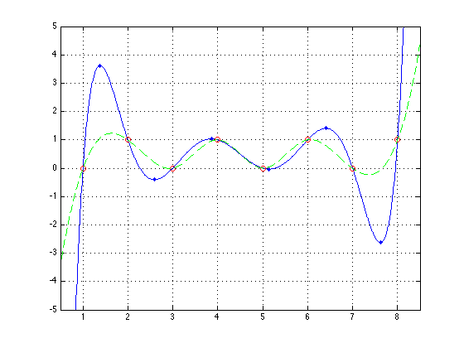
插值定义General definition of interpolation
Given n points,
find a smooth function,
satisfying
How to construct？

Slide 5
1. 多项式插值Interpolation with polynomials
N-th order polynomial interpolation
Assume function , and at n+1 different points x₀,x₁,…,x_{n} with values y_{k}(k=0,1,…,n), if there exists a polynomial of order <=n
satisfying
P_{n}(x) is called the n-th order polynomial interpolation.

Slide 6
Uniqueness
According to the n-th order polynomial definition, we have the equations
And the coefficients a₀, a₁,…,a_{n} are the solution. Since the (n+1)th order Vandermonde determinant
D≠0,the coefficients are unique.

Slide 7
插值的截断误差
Accuracy
Note the truncation error term
Theorem
Assume that , P_{n}(x) is the nth order interpolation polynomial at n+1 points x_{k}(k=0,1,…,n), we have the following truncation terms for all
Proof:

Slide 8
Proof ※
If x=x₀ or x₁,…or x_{n} , both right and left are 0.
For any other fixed x∈[a,b], define an auxiliary function
Obviously, G∈C^{(n+1)}[a,b].
if t=x₀,x₁,…,x_{n} and x, G(t)=0. G(t) has n+2 different roots.
According to Rolle theory, G’(t) has n+1 different roots, … G^{(n+1)}(t) has one root, and assume ξ = ξ (x) is the root,
So we have
since

Slide 9
a₀, a₁,…,a_{n} ?
Solved by solving linear equation?
Too expensive
Others methods as long as satisfying conditions

Slide 10
2. 拉格朗日插值Lagrangian interpolation
For the data points
Construct a polynomial P_{N}(x) of order N,
Where the basis is given by
In fact, the value of Lagrangian basis on the interpolation point is Kronecker operator

Slide 11
An example
x | 1/3 | 1/4 | 1
y | 2 | -1 | 7

Slide 12
精度分析
theorem
Assume that f (x)∈C[a,b] , P_{n}(x) is the n-th order interpolation polynomial at n+1 points x_{k}(k=0,1,…,n), we have the following truncation terms for all x∈C[a,b]
If the points are uniform,

Slide 13
编程Implementation
Prototype
Natural language description
double lagrange(double xx, double x[], double y[], int n);
// xx: the value of x required to evaluate
// x[n],y[n], n points for interpolation
// return value: p(xx)
Giving the value of n points and the target value
Loop i=1,N
loop k=1,N and k≠i
Lx *= (xx-xk)/(xi-xk)
endLoop
yy= yy+ yi*Lx
EndLoop

Slide 14
code
Interpolation.h:
#ifndef INTERPOLATION_H
#define INTERPOLATION_H
double lagrange(double xi, double x[], double y[], int n);
#endif
Interpolation.c:
#include “Interpolation.h”
double lagrange(double xi, double x[], double y[], int n)
{
}
Main.c:
#include “Interpolation.h”
int main( int argc, char *argv[])
{
double yi,xi, x[10]={??},y[10]={??};
yi= lagrange(xi,x,y,10);
}

Slide 15
Efficient implementation
Code
Interpolate.h:
#ifndef INTERPOLATE_H
#define INTERPOLATE_H
// 获得牛顿插值多项式的系数（即计算差商）
void NewtonCoef( double x[],double y[], int n, double dd[]);
// 利用插值函数估计
double NewtonEva ( double x[],double dd[],int n, double xx);
#endif
Main.c
#include <stdio.h>
#include "interpolate.h"
int main( int argc, char *argv[] )
{
double x[10]={?}, y[10]=[?], dd[10], xx= ?, yy;
NewtonCoef(x,y,10,dd);
yy = NewtonEva(x,dd,10,xx);
return 0;
}
Interpolate.c:
#include "interpolate.h"
void NewtonCoef( double x[],double y[], int n, double dd[] )
{
}
double NewtonEva ( double x[],double dd[],int n, double xx )
{
}

Slide 16
龙格现象 Runge phenomenon
※Weierstrass approximation theorem
Suppose ƒ is a continuous complex-valued function defined on the real interval [a,b].
For every ε > 0, there exists a polynomial function p over C such that for all x in [a,b], we have | ƒ(x) − p(x) | < ε, or equivalently, the supremum norm || ƒ − p || < ε.
If ƒ is real-valued, the polynomial function can be taken over R.

Slide 17
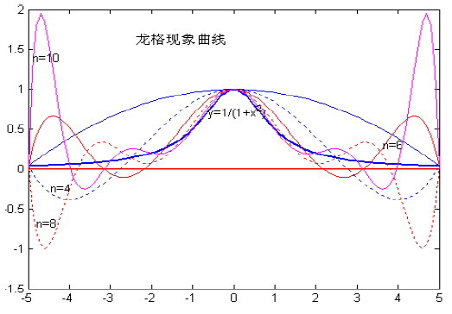
Question:
Rising of interpolation order will decrease the truncation error
An example
Lagrangian interpolation

Slide 18
Error analysis
Using equidistant interpolation nodes
Runge phenomenon
A problem of oscillations at the edges of an interval that occurs when using polynomial interpolation with polynomials of high degree

Slide 19
Solutions to the problem of interpolating over many points
Use piecewise polynomial interpolation. Restrict ourselves to a string of lower degree polynomials each of which are only applied over one or two subintervals
Change interpolation points. High degree polynomials are generally unsuitable for interpolation with equidistant nodes. Using the Chebyshev nodes, the maximum error in approximating the Runge function is guaranteed to diminish with increasing polynomial order.
Approximation. Smooth the wrinkles in the interpolating polynomial by fitting a lower degree polynomial

Slide 20
3. Curve fitting (曲线拟合/函数逼近)
Curve fitting
Given a set of tabulated data, find a curve or a function that best represents the data.
Components
The tabulated data
The form of the function
The curve fitting criteria
Work:
Find the unknown coefficients

Slide 21
最小二乘拟合Least-square curve fitting
Theorem
Suppose that {x_{k},y_{k}},k=1,…,N are N points, where the abscissas {x_{k}} are distinct. The coefficients of the least-squares line
are the solution of the following linear system, known as the normal equations:
y=Ax + B

Slide 22
Proof
The L₂ error for the curve fitting would be
The minimum value of E₂(A,B) is determined by setting the partial derivatives to zero,
Substitute the expression of E₂(A,B), and get
Simplify and we have the normal equations.
Why to choose L2 instead of L1 or L∞ ?

Slide 23
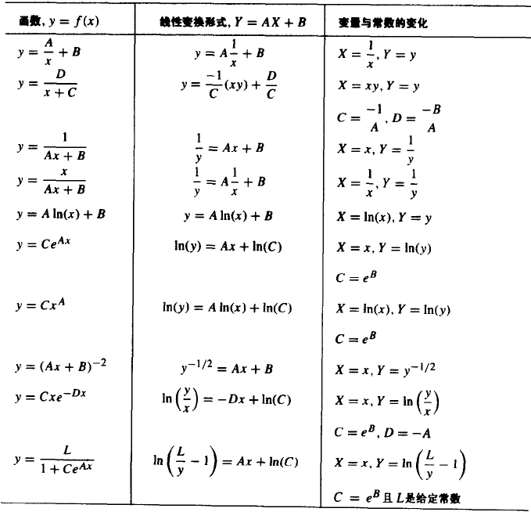
Transformations for data linearization
x=x(X,Y),y=y(X,Y)
Y=AX + B
Curve fit

Slide 24
线性最小二乘法Linear least-square fitting
The form of the function
Find the values c_{j}.
The L2 error would be
Minimizing the error would give
Simplify and get the normal equation

Slide 25

Write in matrix form
How to solve this linear equations ?

Slide 26

Review the problem
Over-determined system
Linear equations
Using the normal equations is one way for solving the over-determined system. The Single Value Decomposition (SVD) is suggested as an alternative more efficient way.

Slide 27
polynomial fitting
Common choosing for the basis
And this would be called polynomial fitting.
What are the differences between polynomial interpolation and polynomial fitting ?

Slide 28
讨论问题：逼近方法的必要性
If M>N,
When equations forming from the interpolation points are ill-conditioned, it’s necessary to use the approximation method.
If M=N, approximation = interpolation
If M<N, approximation = M-th order interpolation

Slide 29
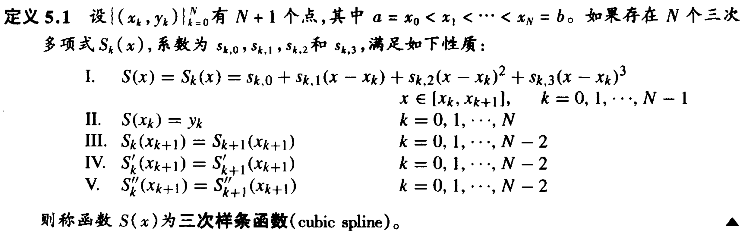
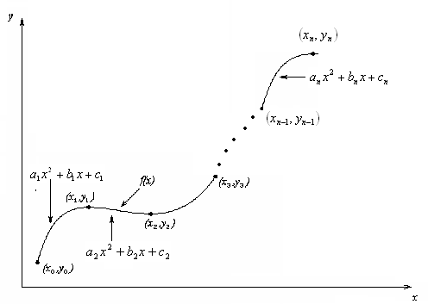
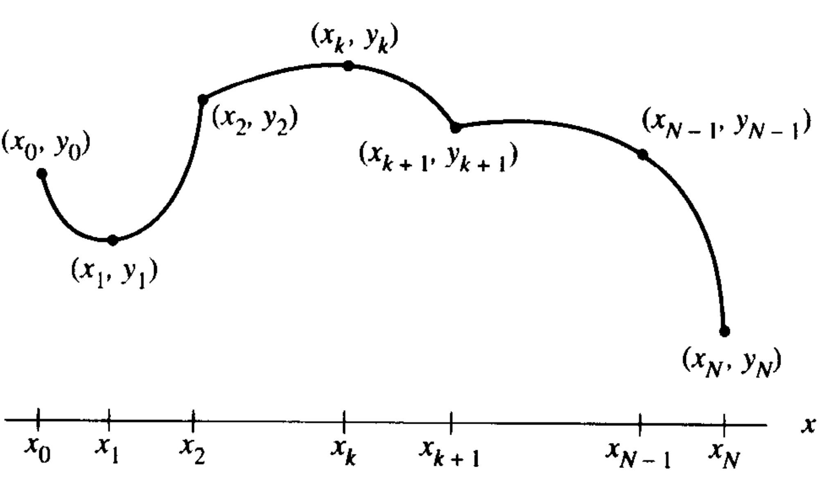
More fitting skills …
Spline interpolation (样条插值) ※
如果少这个，则称S(x)二次样条函数
与普通的分段三次/二次插值有什么异同呢？连接处更光滑了！
2(n+1) equs
(n-1) equs
2-end-node derivatives
分段二次插值
二次样条插值
3(n+1) unknows and equs

Slide 30
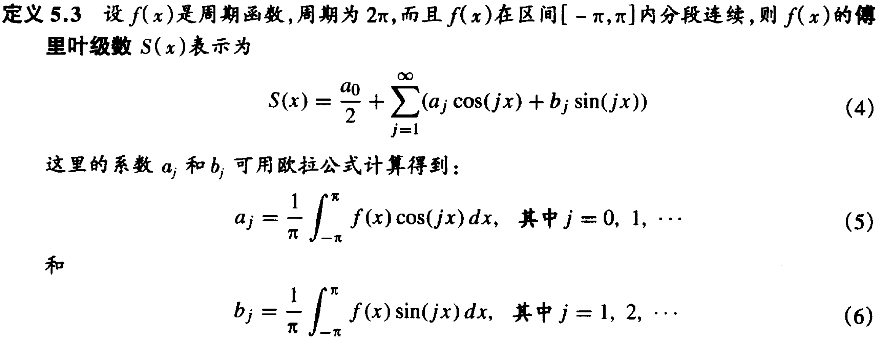
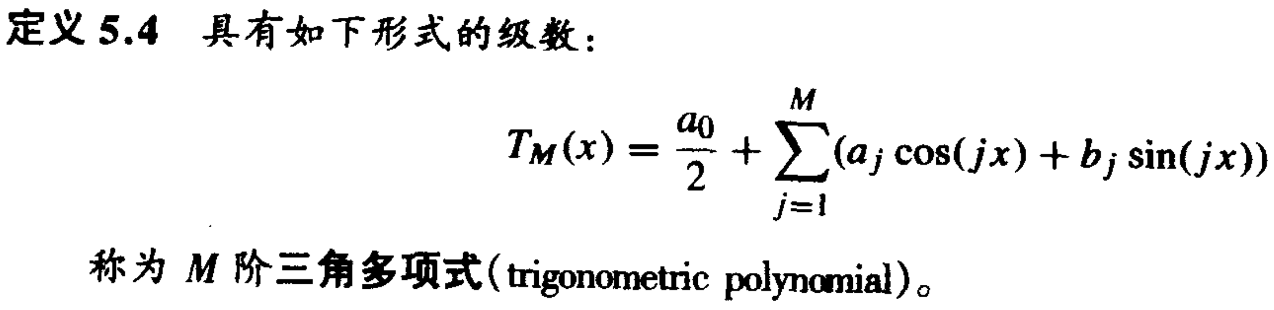
Fourier Series and Trigonometric polynomials ※

Slide 31
