Slide 1


4. 数值微分和积分 Numerical differentiation & integration
Yahui Wang, Jie Li, Yu Ma
Sino-French Institute of Nuclear Engineering & Technology, SYSU
1

Slide 2
Overview
数值微分公式 Numerical differentiation formula
一阶导数 First order derivatives
高阶导数 High order derivatives
偏微分Partial derivatives
积分公式 Integration rule
梯形/辛普森公式 Trapezoid/ Simpson formula
高斯-勒让德公式 Gauss-Legendre formula
多维积分问题 Integration on multi dimensions

Slide 3
1. 一阶导数Approximation of 1st order derivative
The definition of limit
According to Taylor expansion
First order approximation
Truncation error

Slide 4
前差 Forward difference O(h)
后差 Backward difference O(h)

Slide 5
中心差分 Central difference O(h²)
How to derive the specific form of the truncation error?

Slide 6
高阶近似 High order O(h^{n}) approximation
Method of undetermined coefficients
Stencils points. Symmetric to central point
1st order
i i+1
2nd order
i-1 i i+1
3rd order
i-1 i i+1 i+2
4th order
i-2 i-1 i i+1 i+2
5th order
i-2 i-1 i i+1 i+2 i+3

Slide 7
Method of undetermined coefficients
Formula derivation. E.g., 4th order
4 equations, 4 unknown variables

Slide 8
Homework
Derivation the 5th order approximation for f’(x), and validate its order
Are there any other methods to derive the arbitrary high order O(h^{n}) approximation?
1. Use polynomials Interpolation and calculate the first order derivative using polynomial.

Slide 9
2. Richardson extrapolation*
Theorem
Suppose that two approximations of order O(h^{2k}) for f’(x₀) are D_{k-1}(h) and D_{k-1}(2h) and they satisfy
And
Then an improved approximation has the form

Slide 10
2. ※高阶导数Higher order derivatives
2nd order derivative: f ⁽²⁾(x)

Slide 11
3rd & 4th order derivatives, O(h²)

Slide 12
数值积分Numerical integration

Slide 13
1. Integration
Indefinite integrals
Symbolic operation is another subject other than numerical calculation
Definite integrals
A definite value will be given
√

Slide 14
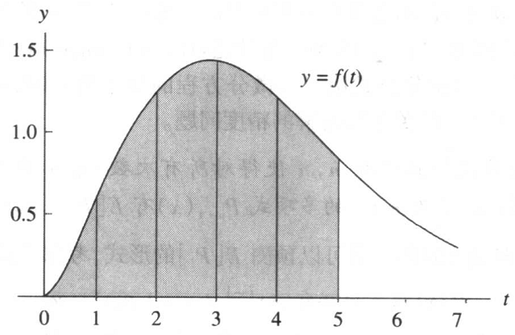
Basis idea of numerical integration
One interpretation of the definite integral is:
Integral = area under the curve
f(x)
How to compute the area efficiently?

Slide 15
2. Newton-Cotes 积分公式 (quadrature rule)
Suppose that a=x₀<x₁<…<x_{M}=b. A formula of the form
with the property that
is called a numerical integration or quadrature rule.

Slide 16
Newton-Cotes quadrature formula
There exists a polynomial P_{M}(x) passing through the M+1 equally spaced points {(x_{k},y_{k})}_{k=0…M}.
P_{M}(x) is used to approximate f(x) over [a,b], the formula is called a Newton-Cotes quadrature formula

Slide 17
Equidistant interpolation
Linear
a
b
x₀
x₁
Quadratic
x₀
x₁
x₂
Cubic
x₀
x₁
x₂
x₃
Fourth-order
x₀
x₁
x₂
x₃
x₄

Slide 18
Trapezoid quadrature
Simpson quadrature
Simpson 3/8 quadrature
Bool quadrature
K points at least K-th order, but might be better

Slide 19
How to validate the order ? *
Refer to Chap 7.1 , 例7.4

Slide 20
3. 组合梯形积分Composite Trapezoidal rule
To improve the accuracy, an intuitive method of finding the area under curve y=f(x) over [a,b] is by approximating the area of trapezoid that lie above the intervals {[x^{k},y^{k}]}.
f(x)
x
a
b

Slide 21
Accuracy*(实际工程中没有显式表达，不实用)

Slide 22
Accuracy
Proof
The truncation error in Lagrangian interpolation is
Then the truncation error in quadrature would be
When the region is divided into M parts, error becomes

Slide 23
Error estimate
Estimate the number of equally spaced intervals to the integral to the required accuracy, e.g., 8 decimal digit.

Slide 24
组合辛普森积分Composite Simpson’s quadrature
Formula
Accuracy. O(h⁴)
Error estimation

Slide 25
编程Implementation
code
Quadrature.h:
#ifndef QUADRATURE_H
#define QUADRATURE_H
// functions
double ComTra_quadrature( double fun(), double a,double b, int M);
#endif
Quadrature.c:
#include <math.h>
#include "quadrature.h"
double ComTra_quadrature( double fun(), double a,double b, int n)
{ }
Main.c:
#include "quadrature.h“
double fun()
{
}
void main()
{
int ss;
ss= ComTra_quadrature(fun,1.,10.,100);
}

Slide 26
4. 高斯积分 Gauss quadrature
Basis
High order approximation with fewer points

Slide 27
Gauss-Legendre translation
Suppose that the abscissas and weights are given for the N-point Gauss-Legendre rule over [-1,1]. To apply the rule over interval [a,b], use the change of variable
Then following relationship is used to obtain the quadrature formula
The problem becomes finding the weights and points on [-1,1]

Slide 28
两点积分 Two-point Gauss-Legendre quadrature
The quadrature formula
is exact for cubic polynomials, f(x)=a₃x³+ a₂x²+ a₁x+ a₀. Since four coefficients w₁,w₂, x₁,x₂, need to be determined in equation, we can select four conditions to be satisfied.
Solve these equations and we have the results
This implies it’s true for arbitrary 3rd order polynomials
Order: 3rd order polynomial, O(h⁴)

Slide 29
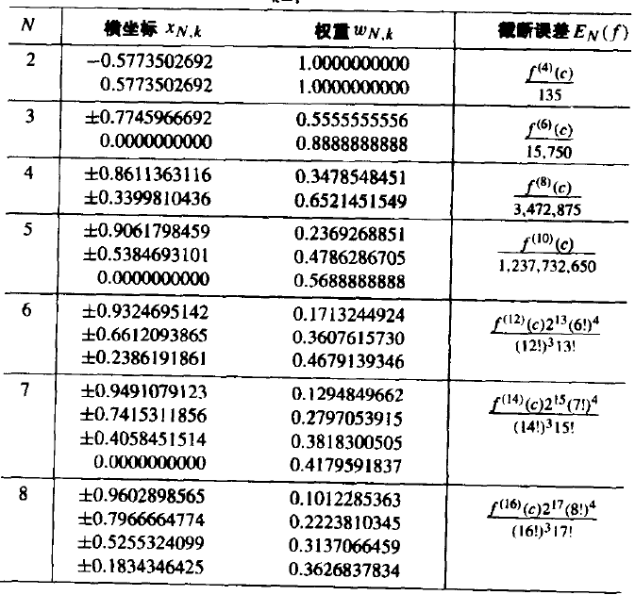
High order G-L Rule
N-point G-L rule is exact for (2N-1) order polynomial, whose error is O(h^{2N}).
These weights and integration points can be computed using similar methods for 2-point rule. Or use the Mathematica program provided. http://pomax.github.io/bezierinfo/legendre-gauss.html

Slide 30
Implementation
Code. N-point quadrature for function fun() at [a,b]
Quadrature.h:
#ifndef QUADRATURE_H
#define QUADRATURE_H
// quadrature points and weights
double GL_abscissa[5][5],GL_weight[5][5];
// functions
double GL_quadrature( double fun(), double a,double b, int n);
#endif
Quadrature.c:
#include <math.h>
#include "quadrature.h"
//2nd order
GL_abscissa[0][0] = 0.;
GL_weight[0][0]= 2.;
//4th order
GL_abscissa[1][0] = -1./sqrt(3);
GL_abscissa[1][1] = 1./sqrt(3);
GL_weight[1][0]= 1.;
GL_weight[1][1]= 1.;
//6th order
//8th order
//10th order
double GL_quadrature( double fun(), double a,double b, int n)
{ }

