Slide 1


5. 常微分方程 Ordinary differentiation equations (ODE)
Yahui Wang, Jie Li, Yu Ma
Sino-French Institute of Nuclear Engineering & Technology, SYSU
1

Slide 2
Overview
ODE介绍 Introduction to ODEs
一阶ODE初值问题 Methods for 1st order IVP problem
欧拉方法 Euler method
泰勒级数法 Taylor series method
龙格-库塔法 Runge-Kutta method
多步法Multiple step Method (predict-correct method)
ODE方程组 Methods for ODE system
一阶ODE方程组 Solving systems of 1st order ODEs
高阶ODE方程组 High order ODEs
边值问题 Boundary value Problems
打靶法 Shooting method
有限差分方法 Finite difference method
精细积分方法

Slide 3
1. What’s numerical solution for ODE?
Analytical solutions can only be obtained in some special equations.

Slide 4
Whereas, for complicated nonlinear differential system
only the numerical solutions are given on a series of scattered points
Lotka-Volterra equation
Analytical solutions
Numerical solutions

Slide 5
The basis problem for solving ODE
First order ODE problem with the initial value (IVP)
where f(t,y) is the given algebraic equation, and (2) is the initial value.
This chapter focus on the solving of this equation using different kinds of methods

Slide 6
Two remaining questions
The existence and uniqueness for the solution of this ODE
The solutions of other types of ODE

Slide 7
Existence and uniqueness for the ODE
1. Lipschitz condition
Given the rectangle R={(t,y):a≤t≤b,c≤y≤d}, assume that f(t,y) is continuous on R. The function f is said to satisfy a Lipschitz condition in the variable y on R provided that a constant L>0 exists with the property that
whenever (t,y₁),(t,y₂) ∈R. The constant L is called a Lipschitz constant for f .

Slide 8
2. Theorem
Suppose that f(t,y) is defined on the region R. If there exists a constant L>0 so that
then f satisfies a Lipschitz condition in the variable y with Lipschitz constant L over the rectangle R.
Proof.

Slide 9
Theorem (existence and uniqueness).
Assume that f(t,y) is continuous in a region R={(t,y):a≤t≤b,c≤y≤d}. If f satisfies a Lipschitz condition on R in the variable y and (t₀,y₀)∈R, then the initial value problem (6),
has a unique solution y=y(t) on some subinterval t₀≤t≤ t₀ + δ.
Proof.
y’=f (t,y) , y(t₀)=y₀
Coddington, Earl A., and Norman Levinson (1955), Theory of Ordinary Diferential equations, McGraw-Hill, New York

Slide 10
Other types of ODE
1. 1st order ODE-s

Slide 11
2. High order ODE
Change to 1st order ODEs
First let

Slide 12
3. boundary value problem
The main idea is changing to ODEs with initial values
For linear ODE

Slide 13
2. 欧拉方法 Euler method
Euler method
Truncation error

Slide 14
Precision of Euler method
Assume that y(t) is the solution to the I.V.P. y=f(t,y). If y(t)∈C²[t₀,b] and {(t_{k},y_{k})}_{k=0,…,M} is the sequence of approximations generated by Euler’s method, then
The error at the end of the interval is called the final global error (F.G.E):
Remarks:
Global discretization error
Local discretization error

Slide 15
Example. Solve the differential equation
and evaluate y(1.01), y(1.02) and y(1.03).

Slide 16
2. 泰勒级数法 Taylor Series method
Taylor theorem
Assume that y(t)∈C^{N+1}[t₀,b] and y(t) has a Taylor series expansion of order N about the fixed value t=t_{k}∈[t₀,b]:
where
and y^{(j)}(t)= f^{(j-1)}(t,y(t)) denotes the (j-1)-th total derivative of the function f with respect to t. The formulas for the derivatives can be computed recursively:

Slide 17
where P is the derivative operator

Slide 18
Computation steps
(1). Give the initial value t₀, y₀
For k=0, 1, 2, … , N
(2). Evaluate the first to N-th derivatives of y(t)
(3). Compute the y_{k} value using

Slide 19
Example.
Use second order Taylor series method to solve
Solve
The first and second derivatives are
Then the iterative scheme is

Slide 20
Steps are
i | t_{i} | x_{i}
0 | 0.00 | 1
1 | 0.01 | 0.9901
2 | 0.02 | 0.9807
3 | 0.03 | 0.9716

Slide 21
The problem of Taylor series method
Although it can achieve arbitrary high order accuracy, the derivatives are hard to compute manually. It’s not convenient to implement with codes
Any other ways to replace the computation of derivatives ?

Slide 22
3. 龙格-库塔法 Runge-Kutta methods
Basis idea
Taylor series method Runge-Kutta method
the derivatives → Midpoint evaluation
By choosing different parameters, make these two methods equivalent !

Slide 23

2nd order Runge-Kutta method
formula
y
t
t+h
t
The reason to choose such mid-point of function f.
Why not just f(t+P, y+Q) ?

Slide 24
Using Taylor expansion with two variables
Substitute into the linear combination formula
On the other hand, the Taylor series method gives

Slide 25
Compare these two formula, we have
3 equations, 4 variables
(i). A=1, B=0, Euler method, no way to solve P,Q
(ii). A=1/2, B=1/2, P=1, Q=1. Heun method
(iii). A=0, B=1, P=1/2, Q=1/2. Modified Euler-Cauchy method

Slide 26

Discussion
What’s the difference between Heun and modified Euler-Cauchy method in terms of CPU time and resolution, etc ?

Slide 27
3rd order Runge-Kutta method
Third order R-K, N=3
Use the Taylor expansion and compare to the 3rd order Taylor series method

Slide 28
6 equations, 8 variables. The solutions are not unique. And the following is one of the solutions
3rd order R-K method

Slide 29
4th order R-K method
One commonly used formula
Look for parameter relations in Textbook Sec 9.5

Slide 30
Relations of R-K and quadrature rules
Section 9.5.1
Using the integration form, we have
And the quadrature right-hand-side is computed as

Slide 31
Heun method Trapezoid quadrature
Modified Euler-Cauchy 1 point Gauss quadrature
3rd & 4th order Simpson quadrature

Slide 32
4 多步法(预测-校正法) predicted-corrected method
Or called multi-step methods
The defect of one-step methods
When evaluating y_{k+1}, only the information of y_{k} is used, other values y_{k-1}, y_{k-2}, y_{k-3} are wasted.
t_{i-2} t_{i-1} t_{i} t_{i+1}

Slide 33
The general framework of multi-step method
where y_{n+1}=y(t_{n+1}), f_{n+i}=f(t_{n+i}, y_{n+i}), t_{n+i}=t_{n}+ih. It’s called k-th step method.
From the formula, it takes much less computation than one step methods for the same order
t_{i-2} t_{i-1} t_{i} t_{i+1}

Slide 34
Adams-Bashforth-Moulton method
Predicted step
t_{k-3} t_{k-2} t_{k-1} t_{k} t_{k+1}
3rd order Newton interpolation
Explicit method

Slide 35
Adams-Bashforth-Moulton method
Corrected step
y_{k-2}
y_{k}
y_{k-1}
p_{k+1}
t_{k-2} t_{k-1} t_{k} t_{k+1}
Implicit method
推导参考《数值分析原理》6.2节

Slide 36
Computational efficiency
Number of function evaluations is the Computational Speed or Efficiency
How many evaluations per step?
No need to repeat the evaluation of function f at previous points
Only one new function evaluation in the predictor
One function evaluation per correction step
# of function evaluations = 1+ number of corrections

Slide 37
Practical consideration
Using the truncation error of P3 Newton interpolation
Time step restriction. (according to fixed point iteration condition)
final error

Slide 38
5. ODE方程组Systems of differential equations
Solving a System of First Order ODEs
Methods discussed earlier such as Euler, Runge-Kutta, … are used to solve first order ordinary differential equations.
The same formulas will be used to solve a system of first order ODEs.
In this case, the differential equation is a vector equation and the dependent variable is a vector variable.

Slide 39
Euler method in solving 1st order ODE
Change the scalar to vector in the formula
Other methods, e.g., R-K methods, can also be used for solving system of ODEs in this way.

Slide 40
Example. Use R-K 2 method to solve the following ODEs

Slide 41
高阶ODE
Change to 1st order ODEs
Using more variables to represent higher order derivatives
Change to 1st order ODEs

Slide 42
Example. Convert the following 3rd order ODE into 1st order ODEs
Choose the auxiliary variables to be
Then the original 3rd order ODE can rewritten as

Slide 43
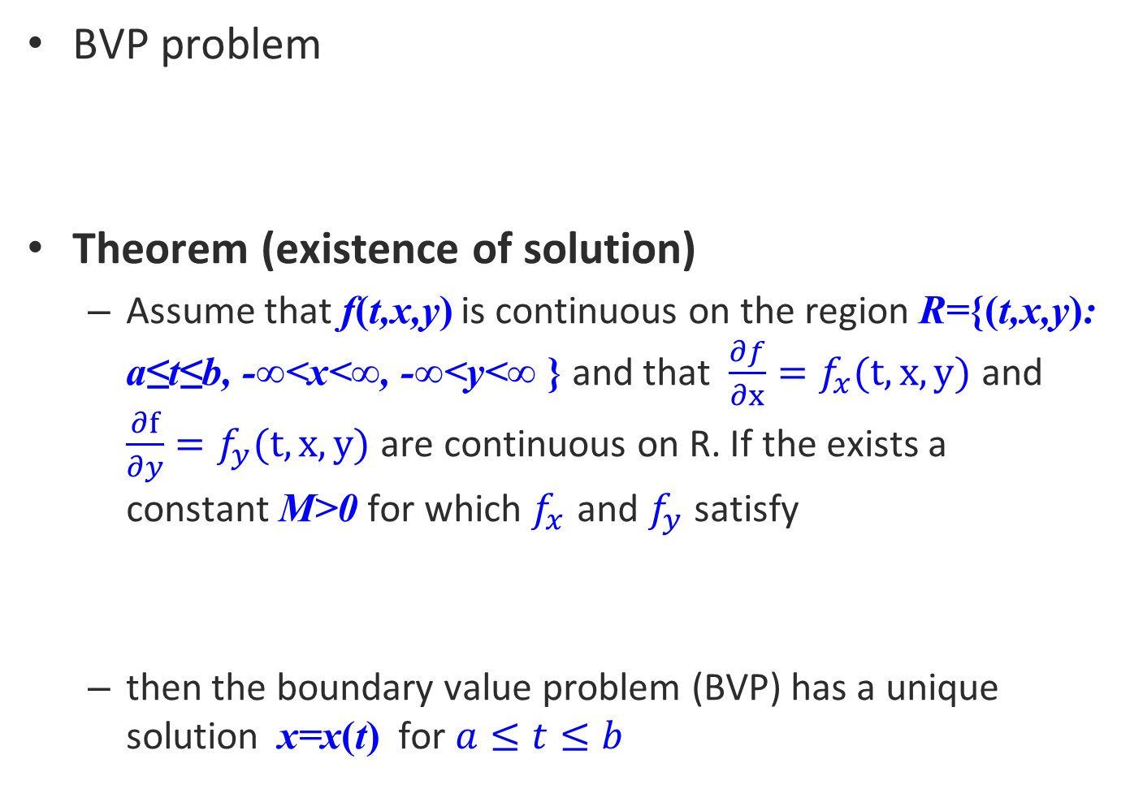
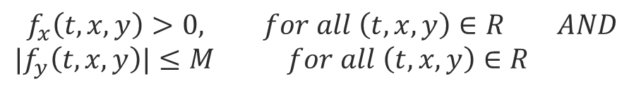
6. 边值问题Boundary value problem (BVP)
BVP problem
Theorem (existence of solution)
Assume that f(t,x,y) is continuous on the region R={(t,x,y): a≤t≤b, -∞<x<∞, -∞<y<∞ } and that $\frac{∂f}{∂x}=f_{x}(t,x,y)$ and $\frac{∂f}{∂y}=f_{y}(t,x,y)$ are continuous on R. If the exists a constant M>0 for which $f_{x}$ and $f_{y}$ satisfy
then the boundary value problem (BVP) has a unique solution x=x(t) for $a≤t≤b$
$$f_{x}\left(t,x,y\right)>0, for all \left(t,x,y\right)∈R AND$$
$|f_{y}\left(t,x,y\right)|≤M$ $for all \left(t,x,y\right)∈R$

Slide 44
※打靶法Shooting method
Basis idea: Change the BVP to IVP
Problem is, determination of s to satisfy x(b,s)=β, or
ε is the error given manually.

Slide 45
Graphical explanation
x=x(t,s₁)
y
(b, β₁)
x=x(t)
(b, β)
x=x(t,s₀)
(b, β₀)
a
b
t

Slide 46

The solving of unknown s ( Newton iteration method, secant method, etc)
Secant method (why not choose the Newton’s? )
Solve the IVP problem and get it!

Slide 47
Example. Solve the BVP
First change to IVP problem
Then convert to system of 1st order ODEs
This equations are solved using R-K 2 solver with h=0.01.

Slide 48
Step 1. guess s₀=0
Step 2. guess s₁=1
Step 3. iteration begin, k=1,2,3,….
s=1.5743

Slide 49
有限差分方法求解BVP
BVP
Equidistantly distributed solution points
Using the numerical differential equation (Chapter 3)

Slide 50
If the ODE is linear, i.e.,
The discretization would be
Tri-diagonal linear equations

Slide 51
The solving of tri-diagonal linear system

Slide 52
(补充材料)
※求解三对角方程组的追赶法Chasing method in solving tri-diagonal equations
Given the linear equations
Using Crout decomposition,

Slide 53
(1)
(2)

Slide 54
Other types of BVP
Type-1:
Type-2:
Type-3:
想一想：
Type-2, Type-3如何构造打靶法所需要的参数、求解方程？
如果任意高阶边值问题，且边界条件为边值的某些线性组合条件呢?

