Slide 1

RESEARCH IMPLEMENTATION • CLOUD COMPUTING ASSIGNMENT
IoV Trajectory Prediction
Improving the LSTM under relative motion and missing V2X information
ORIGINAL MODEL
OBJECTIVE 1
OBJECTIVES 4 + 4-RELATIVE
SUMO + dual-channel imputation
Relative-displacement prediction
Missingness-aware LSTM training
Baquar Hassan • Aneesh Sharma • Sundram Dev Pandey
October 2026
Notes:
Introduce the presentation as a continuation of the original IoV trajectory prediction project. We will briefly explain the original SUMO and imputation pipeline, then focus on three completed model-side experiments: relative displacement, missing follower speed, and their combination.
1

Slide 2
Problem, dataset and experimental setup
Input history
Future ground truth
Scenarios
X_gt: (N, 30, 7)
30 past steps × 7 features
Y: (N, 50, 2)
50 future positions × (X, Y)
penetration_10, _20, _30
Seeds 1–20 per scenario
Training
Validation
Test
Seeds 1–14
27,987 samples
Seeds 15–16
3,932 samples
Seeds 17–20
8,084 samples
Seven input features: ego_speed, ego_accel, ego_x, ego_y, gap_to_leader, leader_speed, follower_speed.
08
Notes:
The original LSTM predicts a sequence of global XY coordinates. Our relative model predicts a movement vector from the previous time step for every future step. To compare against ground truth, we reconstruct global positions by cumulative summation starting at the last observed ego location.
8

Slide 3
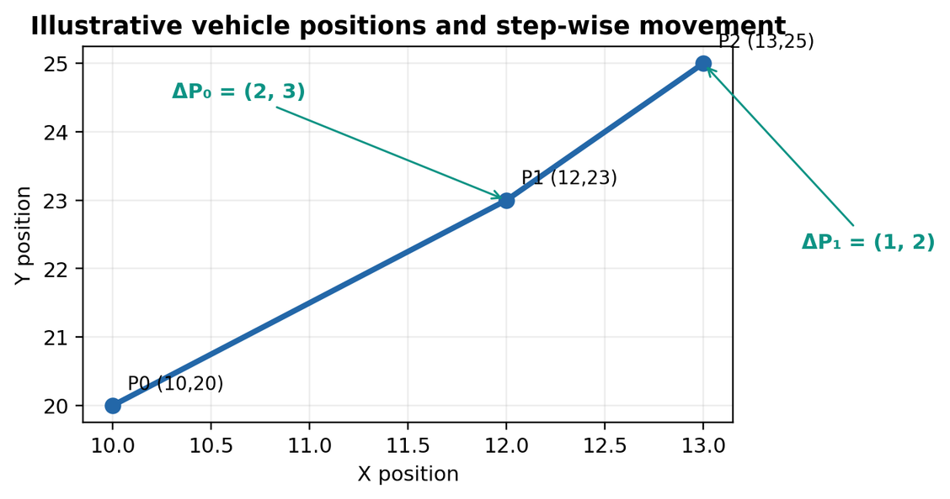
OBJECTIVE 1
What we changed: absolute position → relative displacement
The LSTM architecture is retained; the target representation changes.
Absolute-coordinate baseline
Relative-displacement model
Predicts future positions directly: (x₁,y₁), …, (x₅₀,y₅₀).
Predicts movement at each step: (Δx₁,Δy₁), …, (Δx₅₀,Δy₅₀).
Step 1
P_last=(10,20), P₀=(12,23)
ΔP₀=P₀−P_last=(2,3)
Step 2
P₁=(13,25)
ΔP₁=P₁−P₀=(1,2)
Reconstruction: P̂ₜ = P_last + Σᵢ₌₀ᵗ ΔP̂ᵢ
09
Notes:
We load clean ground-truth historical X_gt and future Y. The first displacement is computed from the last observed XY; later ones are differences between successive future coordinates. The same seed split and model architecture are preserved; the validation-best checkpoint was from epoch twelve.
9

Slide 4
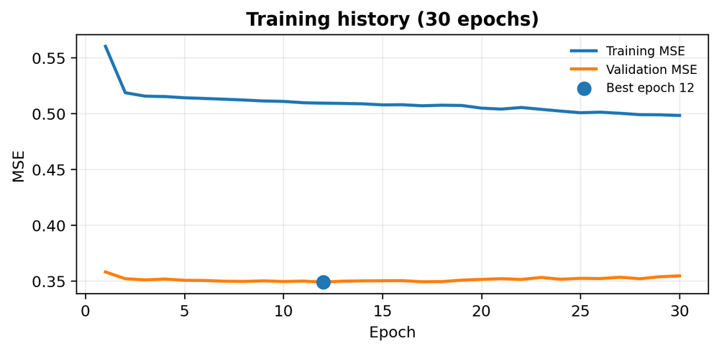
OBJECTIVE 1
How we implemented and trained the model
Input
LSTM 1
LSTM 2
FC
Reshape
30 × 7
hidden 128
hidden 128
128 → 100
50 × 2
Training settings
Normalization
Checkpoint selection
Adam • learning rate 0.001
MSE loss • batch size 128
30 epochs configured
Fit scalers on training data.
Reuse them for validation/test.
Normalize inputs and Δ targets.
Validation MSE checked each epoch.
Best checkpoint selected at epoch 12.
Best validation MSE
0.3491335952
Training and validation history covers all 30 epochs.
10
Notes:
This is the main Objective 1 finding. Both original and relative checkpoints are evaluated with their own scalers on exactly 8,084 held-out X_gt histories. The relative model reduces average displacement error by about 66 percent and final error by about 42 percent; do not describe this as imputation robustness.
10

Slide 5
OBJECTIVE 1
How predictions are evaluated
X_gt
Relative LSTM
Inverse scale
Cumulative sum
Prediction
30×7 history
predict Δx, Δy
metre units
rebuild path
50×2 positions
ADE — Average Displacement Error
FDE — Final Displacement Error
Mean Euclidean error across all 50 future steps and all test samples.
Mean Euclidean error at the final (50th) future step.
Lower ADE/FDE means the predicted vehicle trajectory is closer to the ground-truth trajectory. Both metrics are in metres.
11
Notes:
The sample presentation and comparison CSV show lower aggregate ADE and FDE across each of the three penetration scenarios. Evaluation uses shared held-out samples, correct checkpoint scalers, and reconstructs displacement predictions to positions before calculating ADE/FDE. These results are from a single submitted training run, so we avoid claiming statistical significance.
11

Slide 6
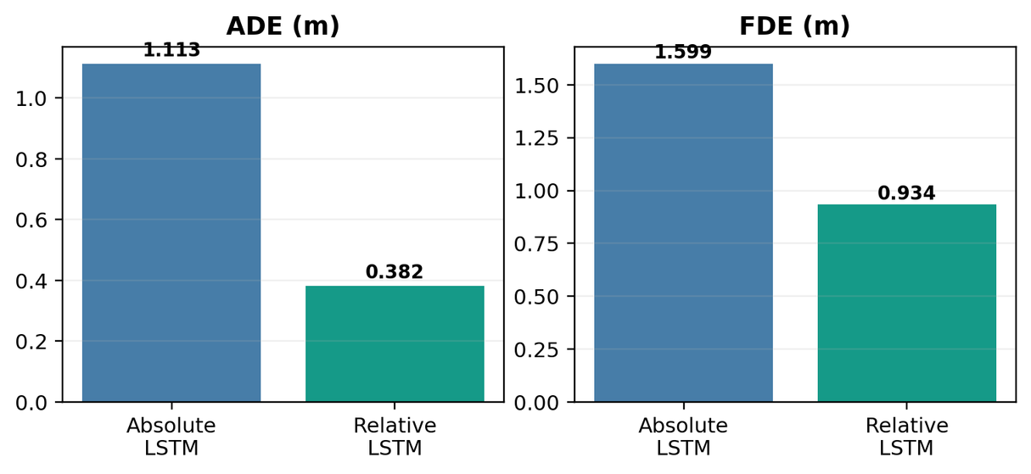
OBJECTIVE 1
Main result: relative model performs better on this test
Aggregate comparison from baseline_compaison.csv — same 8,084 X_gt samples.
ADE improvement
65.703282% lower
1.112899 → 0.381688 m
FDE improvement
41.610380% lower
1.599128 → 0.933725 m
Test set
8,084 samples • seeds 17–20
Positive improvement percentage means the relative-displacement model has lower error.
12

Slide 7
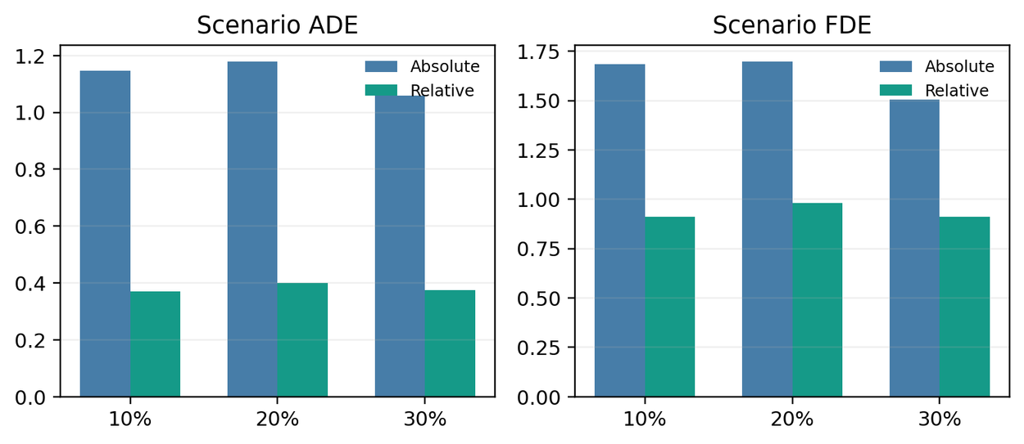
OBJECTIVE 1
Scenario-wise evidence and full test coverage
Test coverage
3 penetration scenarios
4 held-out seeds per scenario
8,084 shared test samples
Per-group result
Relative model has lower ADE and FDE in each of the 12 scenario–seed groups.
13

Slide 8
OBJECTIVE 4
Why did we retrain the LSTM?
The predictor was trained with complete follower-speed data, but that information is usually absent at evaluation.
ORIGINAL TRAINING
REALISTIC EVALUATION
Clean X_gt input
Masked / imputed input
Follower speed is supplied at all 30 steps.
Column 6 is absent for most of the history.
Conceptual 30-step windows: teal = available, red = missing
TRAIN–TEST MISMATCH: the model may rely on a feature that disappears at test time.
Our question: If we retrain the same LSTM under the measured follower-speed absence, do ADE and FDE improve?
IoV • LSTM TRAJECTORY PREDICTION
14
Notes:
Start with the reason for Objective 4. The original downstream LSTM is trained on complete X_gt windows, where follower speed in column 6 is always supplied. But V2X cannot provide that information for most following human-driven vehicles. This creates a mismatch between the input distribution during training and during realistic evaluation. We are not changing the imputation algorithm or the prediction target here. We ask whether training the same LSTM to cope with missing column 6 reduces trajectory error. These mini-windows are illustrations, not exact sampled windows.
15

Slide 9
OBJECTIVE 4
Measuring absence directly from the NPZ files
We obtained the follower-speed missingness rate from saved observation masks, not from an assumed CAV percentage.
1 NPZ SOURCE
2 EXTRACT COLUMN 6
3 BUILD MASK BANK
data_corrupted/
X_mask[:, :, 6] == 0
9,269 × 30
penetration_20/
9,269 windows × 30 history steps
run_seed_1.npz ... run_seed_14.npz
0 = missing | 1 = observed
MEASURED ABSENCE
HOW WE USED THE BANK
99.002769%
We measured p from these original NPZ masks, then sampled new independent masks at that same p for training.
Mask mean = 0.99002769
IoV • LSTM TRAJECTORY PREDICTION
15
Notes:
We did not just assume that 20 percent CAV penetration meant 80 percent missing follower speed. Our objective4_data.py script opened the actual data_corrupted/penetration_20/run_seed_1.npz through run_seed_14.npz files. Each file contains X_mask with a shape of N by 30 by 7. We extracted X_mask[:, :, 6] == 0; zero in the observation mask indicates missing follower speed. Concatenating those arrays created a bank of 9,269 by 30 booleans. Its mean was 0.99002769, or 99.002769 percent absent. Important distinction: the bank supplies the measured probability; the retraining script creates fresh independently sampled mask positions rather than replaying exact bank patterns.
16

Slide 10
OBJECTIVE 4
How we retrained and evaluated fairly
Only follower speed (column 6) is changed in training; the other six features and future labels are preserved.
1
2
3
4
Load clean inputs
Apply measured p
Fill and scale
Train fresh LSTM
X_gt + future Y
all 3 scenarios
Bernoulli mask for
each timestep of col 6
NaN → physical zero
before normalization
Same 2-layer, 128 units
absolute (x, y) target
Applied absence: 98.9937% train (27,987 windows) • 99.0014% val (3,932 windows)
MATCHED EVALUATION
Original clean-trained vs. masked-trained checkpoints • 20% penetration, seeds 17–20
Both evaluated on identical zero-fill, spline, Channel 1 and dual-channel input windows.
IoV • LSTM TRAJECTORY PREDICTION
16
Notes:
For retraining, we loaded clean X_gt and Y across the 10, 20 and 30 percent scenarios. The mask bank provided a measured probability p = 0.99002769. A new Bernoulli decision was generated for each history window and time step, and only column 6 was set to missing. The other six columns and Y were unchanged. Missing values were encoded as physical zero before normalization. Then a new absolute-coordinate 2-layer LSTM was trained from random weights with the same architecture and MSE-Adam procedure. The realized absence rate was 98.9937 percent in training and 99.0014 percent in validation. Finally, the original and new checkpoints were tested on the same 20 percent penetration held-out windows under four input conditions. Both test scripts reapply the real column-six absence mask after imputation, making the input comparison matched.
17

Slide 11
OBJECTIVE 4
ADE results: average prediction error falls
20% penetration, matched held-out windows. Lower ADE means better accuracy across the full 5-second forecast.
AVERAGE DISPLACEMENT ERROR (ADE) • METERS
DUAL-CHANNEL ΔADE
Original
Masked trained
29.806 m
Zero-fill
67.8
39.7
31.370 → 1.564 m
Spline
43.5
12.1
Channel 1
53.8
DUAL-CHANNEL ΔFDE
32.5
30.350 m
Dual-channel
31.4
1.6
0
20
40
60
80
33.015 → 2.665 m
IoV • LSTM TRAJECTORY PREDICTION
17
Notes:
ADE stands for average displacement error. It averages the distance between the predicted and true coordinates over all 50 future steps and all evaluated windows. Across zero-fill, spline, Channel 1 and dual-channel inputs, the masked-trained model performs better. In the dual-channel condition, ADE dropped from 31.370 to 1.564 metres, a decrease of 29.806 metres. The conditions are matched and the new model still predicts absolute future positions.
18

Slide 12
OBJECTIVE 4-RELATIVE
Combining the two changes
Apply missingness-aware training to the relative predictor from Objective 1.
OBJECTIVE 1
OBJECTIVE 4
Relative (Δx, Δy) output
99% masked follower speed
OBJECTIVE 4-RELATIVE
Scratch-trained relative LSTM + observed-position anchor
IoV • LSTM TRAJECTORY PREDICTION
22
Notes:
Objective 4-Relative repeats the masking experiment but uses the relative-displacement target. This is not fine-tuning the Objective 1 model: it trains a new LSTM from random weights and compares that against the original Objective 1 checkpoint. The reconstruction anchor must come from observed input data, not hidden ground truth.
21

Slide 13
OBJECTIVE 4-RELATIVE
Result: masked relative model performs best
Observed anchor • 20% penetration • 2,685 test windows. All errors in meters.
AVERAGE DISPLACEMENT ERROR (ADE)
DUAL-CHANNEL ADE
Original relative
Masked relative
0.642 m
Zero-fill
15.99
5.53
13.45
2.305 → 0.642 m • 72.2% lower
Spline
1.82
6.61
WHAT THE GRAPH SHOWS
Channel 1
5.42
Masked training reduced average error in all four input conditions.
Dual-channel
2.31
0.64
0
5
10
15
20
3.759 → 1.183 m • 68.5% lower
IoV • LSTM TRAJECTORY PREDICTION
24
Notes:
Under a deployable observed anchor, the masked relative model gets dual-channel ADE 0.642 metres and FDE 1.183. The original relative model under the exact matched condition had ADE 2.305 and FDE 3.759. This is a 72.2 percent ADE reduction and 68.5 percent FDE reduction. We should not directly compare the absolute Objective 4 and relative Objective 4 experiments as a strict ablation because anchors and scaling differ.
23

Slide 14
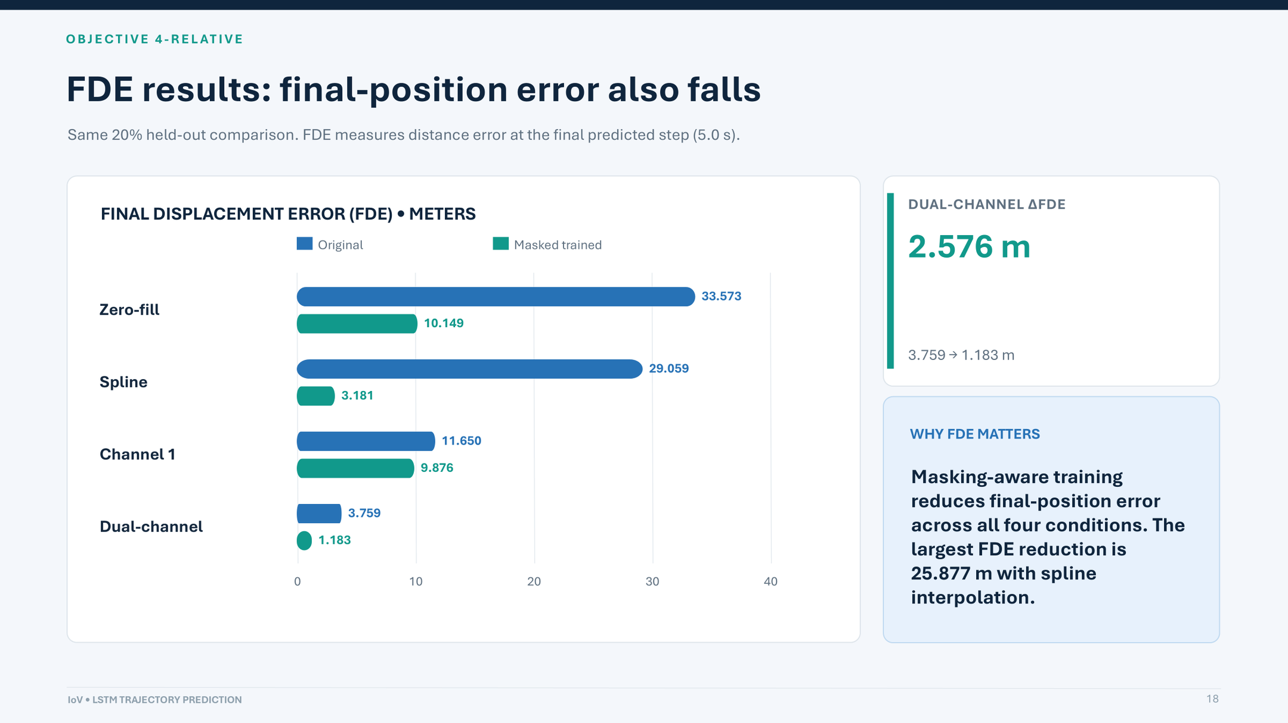
Notes:
FDE stands for final displacement error. Unlike ADE, which averages the entire forecast, FDE measures how far the final predicted position is from the true position at five seconds. The model trained with column 6 masked gets lower FDE under all four conditions. In the dual-channel evaluation, FDE goes from 33.015 metres to 2.665 metres — 30.350 metres lower. This confirms the improvement extends to the final point of the predicted path, not just average positions.
19

Slide 15
OBJECTIVE 4-RELATIVE
Prediction error over the five-second horizon
Dual-channel inputs: mean positional error at each forecast step.
POINTWISE ERROR (m) — DUAL-CHANNEL
AT 5.0 SECONDS
Original relative
Masked relative
68.5%
4
3
Lower final error
2
1
Original
3.759 m
0
Masked
0.1
0.5
1
2
3
4
5
1.183 m
Seconds ahead
IoV • LSTM TRAJECTORY PREDICTION
25
Notes:
The time-horizon curve makes the value clearer. Both models start with relatively small error; the unmasked-trained relative model accumulates much more error as the five-second forecast proceeds. At five seconds the errors are 3.759 and 1.183 metres, with the masked model performing better across the entire horizon. The initial error also reflects the observed anchor.
24

Slide 16
COMBINED FINDINGS
What changed, and what each result proves
These are separate controlled comparisons — their absolute metric values should not be pooled.
EXPERIMENT
MODEL CHANGE
MAIN RESULT
EVALUATION
Objective 1
Relative output
ADE 1.112899 → 0.381688
Clean X_gt • 8,084 windows
Objective 4
Masked column 6, absolute output
Dual ADE 31.370 → 1.564 m
Matched 20% evaluation
Objective 4-Relative
Masked column 6, relative output
Dual ADE 2.305 → 0.642 m
Observed anchor • 2,685 windows
IoV • LSTM TRAJECTORY PREDICTION
26
Notes:
This slide is the most important final comparison: Objective 1 changes the target and tests clean input; Objective 4 keeps absolute output but changes training input distribution; Objective 4-Relative combines the ideas using an observed anchor. Avoid directly comparing all three numerical scores as if they came from identical test protocols.
25

