Slide 1

Sprint 2
Devin Brown, Bryan Pauken, Sam Maryland, Noah Gleason

Slide 2

Sprint 2 Summary
Switched to waffle.io for issue tracking
Finalized color scheme and overall app design
Nearly finalized Home, Favorites, and Updates Tabs
Link entire front-end to database
Challenges:
Firestore asynchronous querying
Fields and collections not auto-populated
Balancing workload with other classes

Slide 3
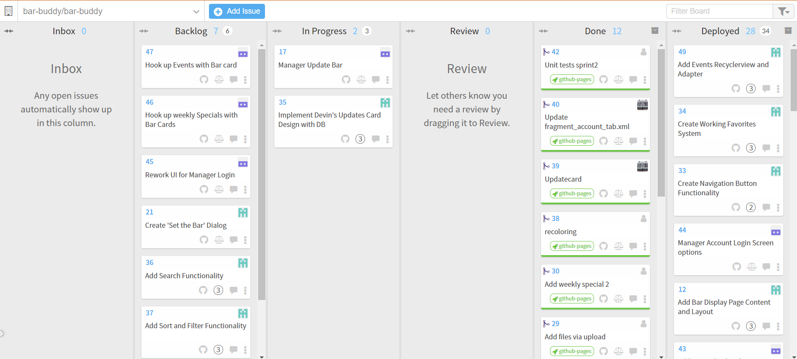

Slide 4
Sprint Backlog Progress - Sam
Create account functionality for different user types
Login functionality for different user types
Loading database with data for testing
Writing unit tests for Sprint 2
Next sprint:
Work on “Setting the Bar”
Design process for data input

Slide 5
Sprint Backlog Progress - Bryan
Weekly Specials and Events backend
Bar Cover and Wait time backend
Designed Manager Main screen
Next Sprint:
Implement Manager Main Screen new design
Hook backend up to new design

Slide 6
Sprint Backlog Progress- Devin
Layout Design of Updates Bar Card
Layout Design of Account Page
Implementation of new Designs and functionality for Updates page and Account Page
Recoloring of implementations
Next Sprint
Finalize design tweaks and implement more functionality for Account Page

Slide 7
Sprint Backlog Progress - Noah
Bar card design and implementation
Favorites System
Refresh for updates
Loading all data from db
Adding updates and events to bar home page
Next Sprint:
Listen for changes
Set the Bar Dialog
Search and Filter

Slide 8
Sprint Reflection
What went well
Integration with database
Finalized design theme
Accomplished over 90% of our backlog goals
What did not go well
Firestore
Asynchronous database querying

Slide 9
Sprint Reflection
What could be improved
Time management - spread work evenly throughout the sprint
Working more together instea
Challenges
Firestore
JUnit Tests

Slide 10
Live Demo

