Slide 1

CSCI E-25 Computer Vision
Attention and Transformers
Steve Elston
Copyright 2023, 2024, 2025, Stephen F Elston. All rights reserved.

Slide 2
Transfer Learning

Slide 3
Transfer Learning
Transfer learning transfers the training of deep NNs from one problem to another
Large scale models are trained on massive data sets
For examples see the pretrained models available in Keras
More advanced pretrained models can be found in KerasHub Model Architectures
The pre-trained models often learn considerable general information which applies to other situations
Patterns of edges, corners, etc.
Textures and colors
Etc…
An example of using a pretrained MobileNet model in Kares, including data augmentation
Assignment 7 used pretraining on EfficientNet B0

Slide 4
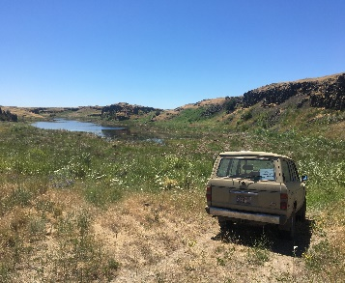
Convolutional Neural Networks
CNN creates feature map in inference pipeline
Backbone Network
CNN Layers
Flatten feature map
Inference
Input Image
Each of K output channels is a part of feature map
Task-specific head
NN
SVM
Etc.

Slide 5
Transfer Learning
Transfer learning work flow
Start with pre-trained backbone with frozen weights
Pre-trained on large datasets
Add untrained task-specific head (top)
Or, use pretrained task-specific head?
Fine tune pretrained task-specific head?
Train task-specific head using task-specific dataset
Use pre-trained backbone feature map
Unfreeze (some?) backbone weights and fine-tune all weights using task-specific dataset
Fine-tune both backbone and head weights
Feature map can become more task-specific

Slide 6
Transfer Learning
Freeze weights
One possible transfer learning workflow
Workflow must fit problem!
First test is model is adequate as is
If not, try tuning the classifier alone – feature map frozen
Finally tune convolutional and classifier layers together if required
Is performance Adequate?
Yes
Done
Unfreeze weights classifier weights only
Tune classifier weights
Is performance Adequate?
Yes
Done
Unfreeze all weights
Tune model
Done
Notes:
Data small but similar. Can’t fine tune, we will overfit. Just learn the top layers using a linear classifier.
Data large and similar. No concern with overfitting. Fine tune the whole network.
Data small and not similar. Overfitting problems if we were to finetune the whole network. Data not similar, so only earlier filters are applicable, not the later ones. Fine tune from somewhere in the middle.

Slide 7
Transfer Learning
Transfer learning: example using learned feature map
from tensorflow.keras.applications import EfficientNetB0
inputs = layers.Input(shape=(IMG_SIZE, IMG_SIZE, 3))
x = img_augmentation(inputs)
model = EfficientNetB0(include_top=False, input_tensor=x,
weights="imagenet")
# Freeze the pretrained feature map
model.trainable = False
# Rebuild top by training output classifier layers on specific dataset
x = layers.GlobalAveragePooling2D(name="avg_pool")(model.output)
x = layers.BatchNormalization()(x)
top_dropout_rate = 0.2
x = layers.Dropout(top_dropout_rate, name="top_dropout")(x)
outputs = layers.Dense(NUM_CLASSES, activation="softmax", name="pred")(x)
Notes:
Data small but similar. Can’t fine tune, we will overfit. Just learn the top layers using a linear classifier.
Data large and similar. No concern with overfitting. Fine tune the whole network.
Data small and not similar. Overfitting problems if we were to finetune the whole network. Data not similar, so only earlier filters are applicable, not the later ones. Fine tune from somewhere in the middle.

Slide 8
Data Augmentation

Slide 9
Data Augmentation
Data Augmentation applies a collection of methods to the generation of new labelled training examples
Goal is creating training examples with wider distribution
Generative models create new cases given randomized input
Generate completely new cases with known labels
Complex to create and evaluate
May not give desired distribution properties
Transformation of existing cases
Can apply one or more transformations to create unique cases
Must be sure transformations do not change labels

Slide 10
Data Augmentation
A few image transformation examples
Projective transforms: change camera pose: rotation, translation, scale..
Resampling and cropping
random patches, crop left, crop right
Need to ensure don’t change label
Flip image right to left – mirror images
Not medical images or other cases where lateral asymmetry is important
Blurring filters – e.g. Gaussian filter
Color – Change intensity ratio of color channels
Use random gamma adjustment
Random noise – add random noise to one or more color channels
Combine the above….
Etc….

Slide 11
Data Augmentation
Keras/TensorFlow supports data augmentation
Example, of augmentation
from tensorflow.keras.models import Sequential
from tensorflow.keras import layers
img_augmentation = Sequential([
layers.RandomRotation(factor=0.15),
layers.RandomTranslation(height_factor=0.1,
width_factor=0.1),
layers.RandomFlip(),
layers.RandomContrast(factor=0.1),
],
name="img_augmentation",)

Slide 12
Introduction to Transformers

Slide 13
Transformers for Computer Vision
Transformers are seen as an alternative to CNNs
Transformers are seen as a possible alternative to CNNs
Transformers have revolutionized natural language processing (NLP)
But, CV is not the same as NLP
NLP is a 1-dimensional problem
NLP tokens less dense than pixels in an image
Global attention range is greater in images

Slide 14
Transformers for Computer Vision
Transformers are seen as an alternative to CNNs
Transformers are seen as a possible alternative to CNNs
CNNs have inherent inductive biases
Locality
Translation invariance
Transformers exhibit global attention
Transformers have limited inductive biases
Transformers are rotationally invariant

Slide 15
Transformers for Computer Vision
Transformers are seen as an alternative to CNNs
But…………
Transformer architectures have only recently shown superior performance for limited tasks compared to CNNs
Transformers have higher computational complexity when compared to CNNs
Training transformer models requires massive amounts of data compared to CNNs

Slide 16
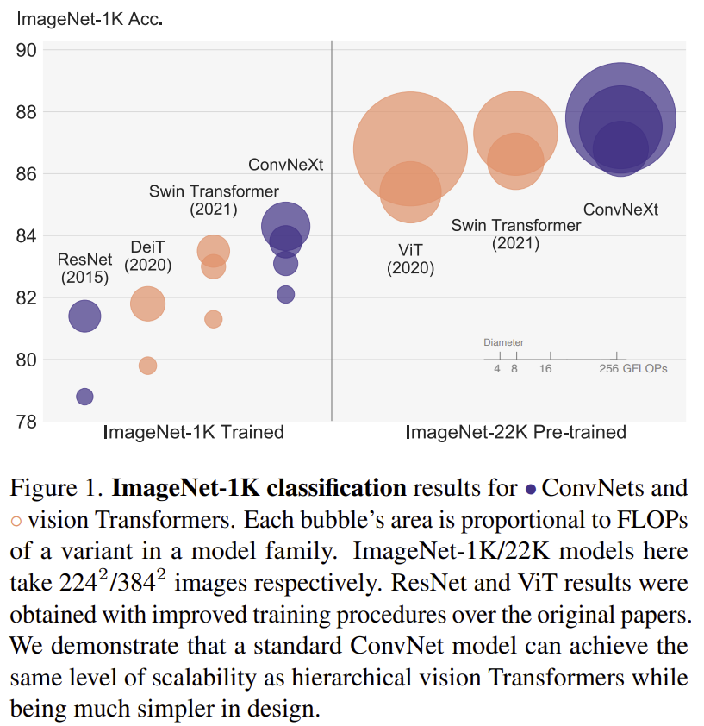
Transformers for Computer Vision
Transformers are seen as an alternative to CNNs
But…………
Generally, CNNs using advanced, efficient, architectures can provide equal or better performance
CNNs have lower latency in real-time solutions
From Liu, et. al, 2022

Slide 17
Convolutional Neural Networks
Transformer creates feature map in inference pipeline
Stem
Flatten feature map
Inference
Input Image
K output channel
feature map
Task specific head

Slide 18
Transformers for Computer Vision
Key components of transformer architecture
Multi-head attention
Recurrent architecture
Training on massive datasets
Self-supervised training
Prue transformer architectures use no convolutional layers
Hybrid architectures combine convolutional and transformer layers

Slide 19
Attention for Computer Vision

Slide 20
Attention for CV
Images of real-world scenes have a significant spatial extent
Non-local attention adds non-local behavior to model
Attention map weights which pixels are most important in scene
Attention map contains pixel specific activations
Attention is computed using Tokens

Slide 21
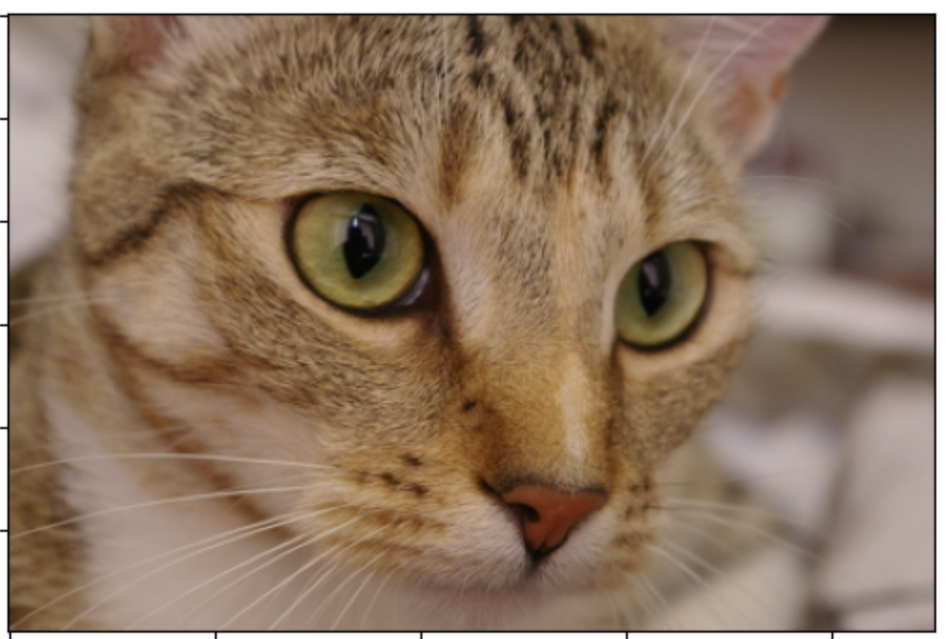
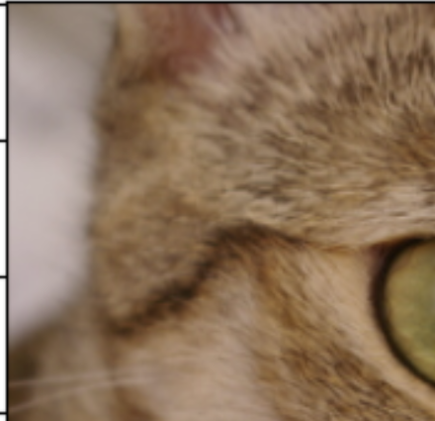
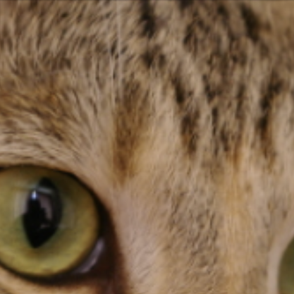
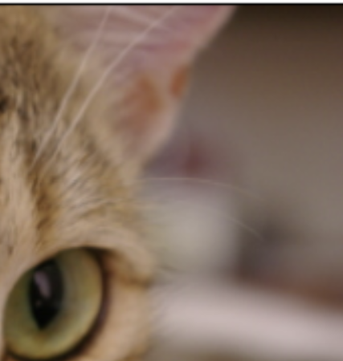
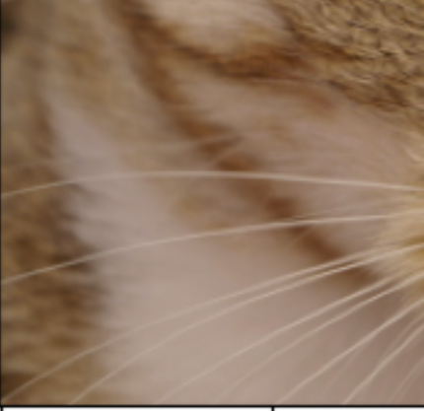
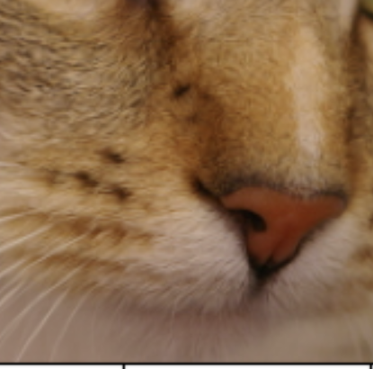
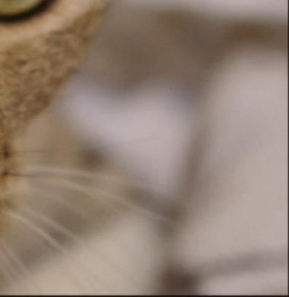
Attention for CV
Transformers operate on tokens
Tokens are a natural concept for NLP
We can tokenize an image by dividing into patches
Patches are flattened into token vectors with concatenated color channels
Tokenize Image

Slide 22
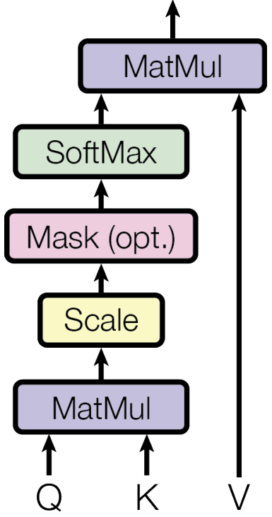
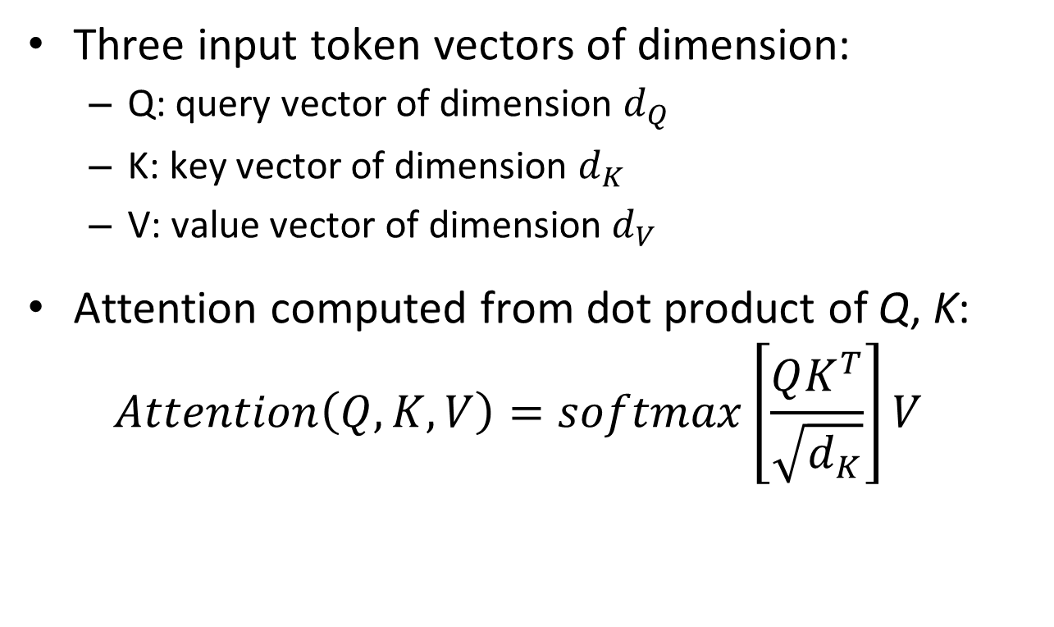
Attention for CV
Transformer architecture uses scaled dot product attention
Three input token vectors of dimension:
Q: query vector of dimension $d_{Q}$
K: key vector of dimension $d_{K}$
V: value vector of dimension $d_{V}$
Attention computed from dot product of Q, K:
$$Attention\left(Q,K,V\right)=softmax\left[\frac{QK^{T}}{\sqrt{d_{K}}}\right]V$$
From Vaswani, et.al., 2016

Slide 23
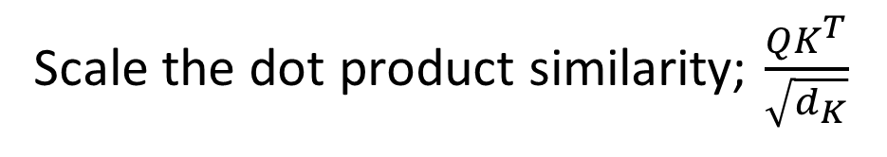
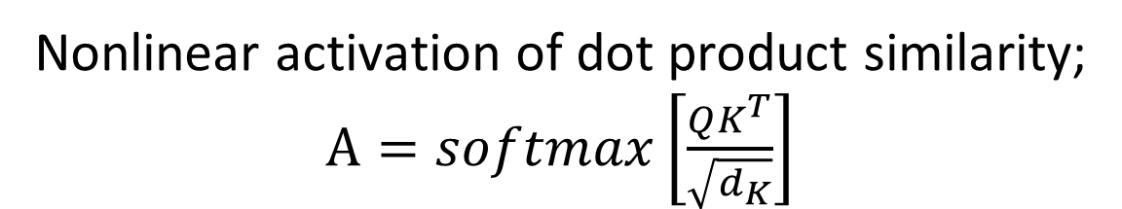
Attention for CV
Transformer architecture uses scaled dot product attention
Attention is applied to the values; $Attention\left(Q,K,V\right)=AV$
Nonlinear activation of dot product similarity; $A=softmax\left[\frac{QK^{T}}{\sqrt{d_{K}}}\right]$
Mask prevents ‘backward’ information leakage in token sequence
Scale the dot product similarity; $\frac{QK^{T}}{\sqrt{d_{K}}}$
Dot product similarity between the query and key; $QK^{T}$
From Vaswani, et.al., 2016

Slide 24
Attention for CV
Transformer architecture uses scaled dot product attention
Attention arises from the similarity between the query and the key
What types of queries might we try?
A text string or prompt
Example, “Find animals in this image”
Another image token from the same or a different image
A similarity search over patches

Slide 25

Attention for CV
Transformer architecture uses scaled dot-product self attention
For self attention $Q=K=V$
Where $Q, K, V=$ vector pixel values
In other words, self attention is dot product attention of the image token with itself
From Vaswani, et.al., 2016

Slide 26
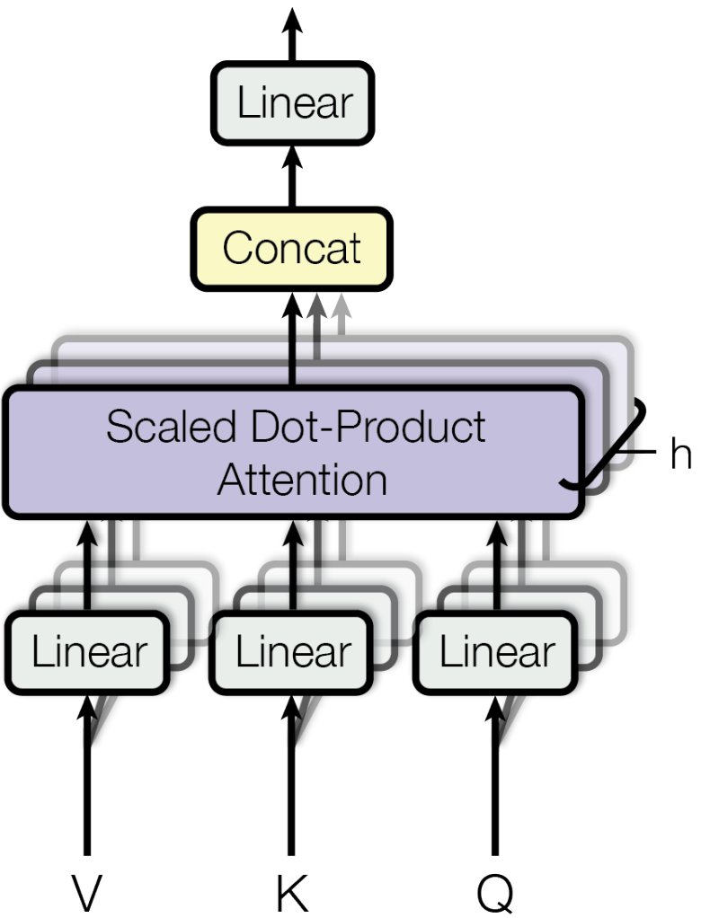
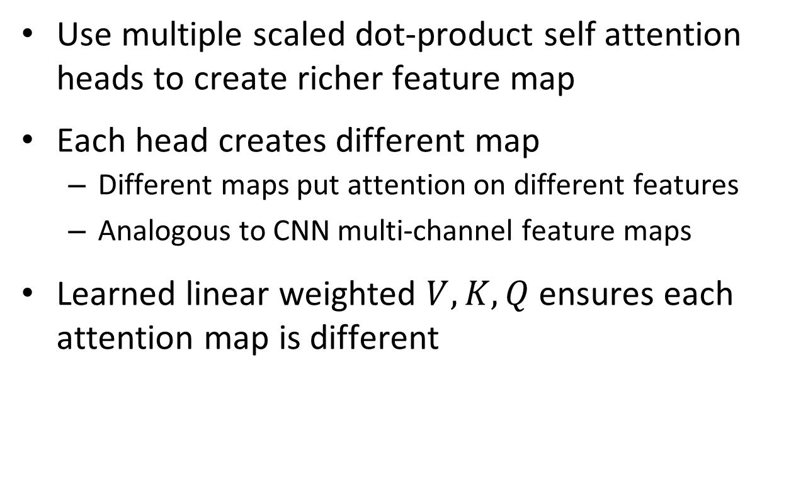
Attention for CV
Transformer architectures use multi-headed self attention
Use multiple scaled dot-product self attention heads to create richer feature map
Each head creates different map
Different maps put attention on different features
Analogous to CNN multi-channel feature maps
Learned linear weighted $V,K,Q$ ensures each attention map is different
From Vaswani, et.al., 2016

Slide 27
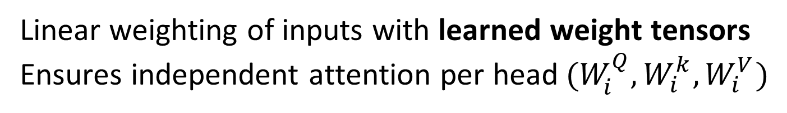
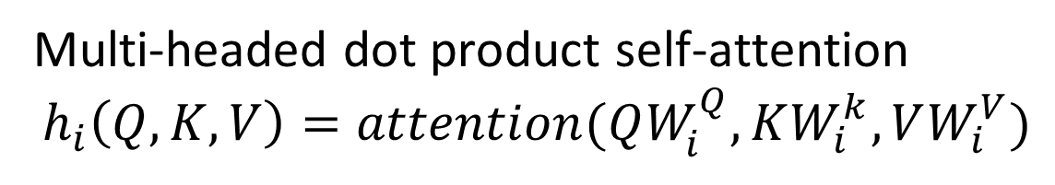
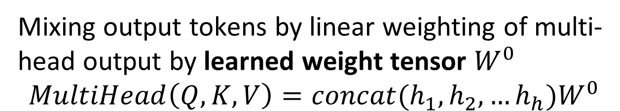
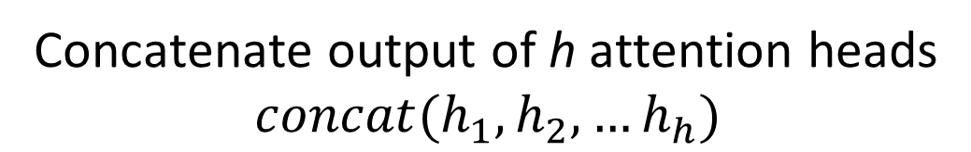
Attention for CV
Transformer architecture multi-headed self attention
Mixing output tokens by linear weighting of multi-head output by learned weight tensor $W^{0}$
$$MultiHead\left(Q,K,V\right)=concat(h_{1},h_{2},…h_{h})W^{0}$$
Concatenate output of h attention heads
$$concat(h_{1},h_{2},…h_{h})$$
Multi-headed dot product self-attention
$$h_{i}\left(Q,K,V\right)=attention(QW_{i}^{Q},KW_{i}^{k},VW_{i}^{V})$$
Linear weighting of inputs with learned weight tensors
Ensures independent attention per head$(W_{i}^{Q},W_{i}^{k},W_{i}^{V})$
From Vaswani, et.al., 2016

Slide 28
Transformer Architecture

Slide 29
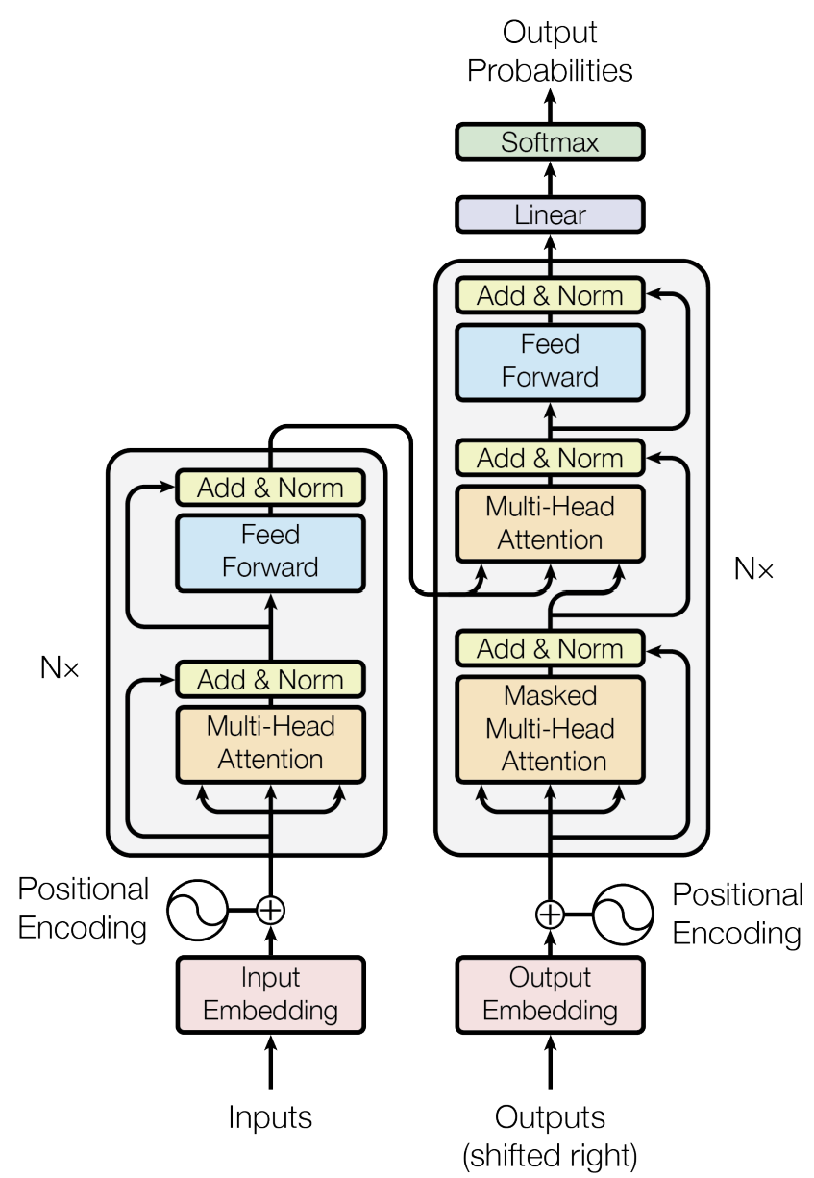
Transformer layer
Transformer architecture comprises multiple transformer layers
Transformer architecture uses multiple transformer layers
Is an encoder-decoder architecture
Each transformer layer is composed of three units
Encode inputs of new data values – image
Encode outputs from previous layers
Output decoder producing probabilities
From Vaswani, et.al., 2016

Slide 30
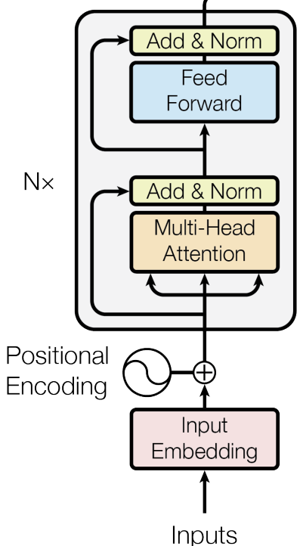
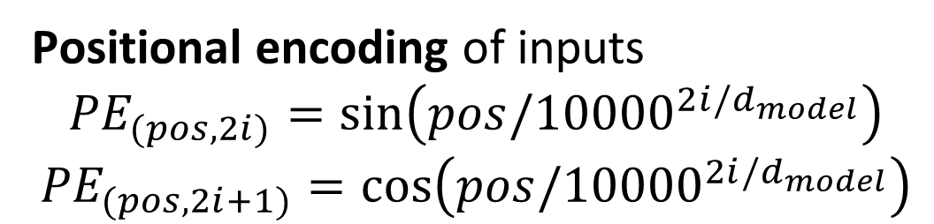
Transformer Layer
Dot product self attention head for input encoder
Residual loops
Fully connected layer with learned weight tensor
Multi-head dot product self-attention
Positional encoding of inputs
$${PE}_{(pos,2i)}=\sin\left(pos/{10000}^{2i/d_{model}}\right)$$
$${PE}_{(pos,2i+1)}=cos⁡\left(pos/{10000}^{2i/d_{model}}\right)$$
Linear embedding with learned weight tensor
From Vaswani, et.al., 2016

Slide 31
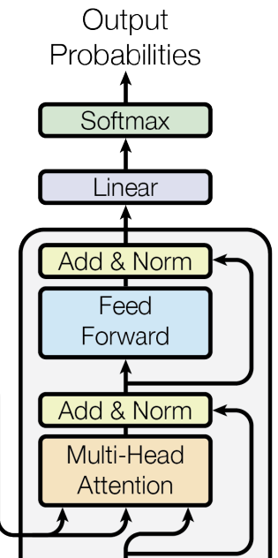
Transformer Layer
Dot product multi-headed self attention output decoder
Softmax squashes output to probabilities
Linear weighting of multi-head output by learned weight tensor
Residual loop
Fully connected network with learned weight tensor
Residual loop of V from previous layer encoder
Multi-head self-attention with K, Q from input encoder and V from previous layer encoder
K, Q
V
From Vaswani, et.al., 2016

Slide 32
Vision Transformer (ViT) Architecture

Slide 33
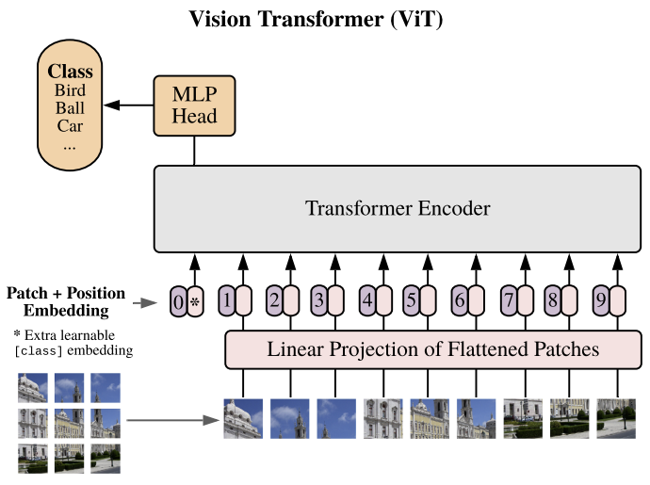
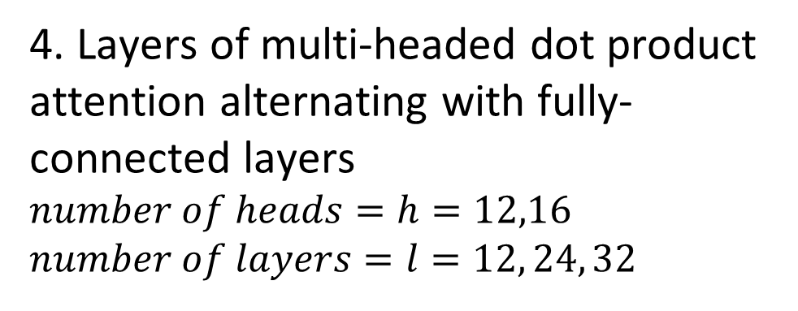
Vision Transformer (ViT) Architecture
We now have all the components to put the ViT model together
5. Fully connected multi-layer classifier uses attention feature map
4. Layers of multi-headed dot product attention alternating with fully-connected layers
$number of heads=h=12,16$
$number of layers=l=12, 24, 32$
3. Sequence of linear position encodings
1. Partition input image into patches
From Dosoviskiy, et.al., 2021
2. Sequence of patches, tokens

Slide 34
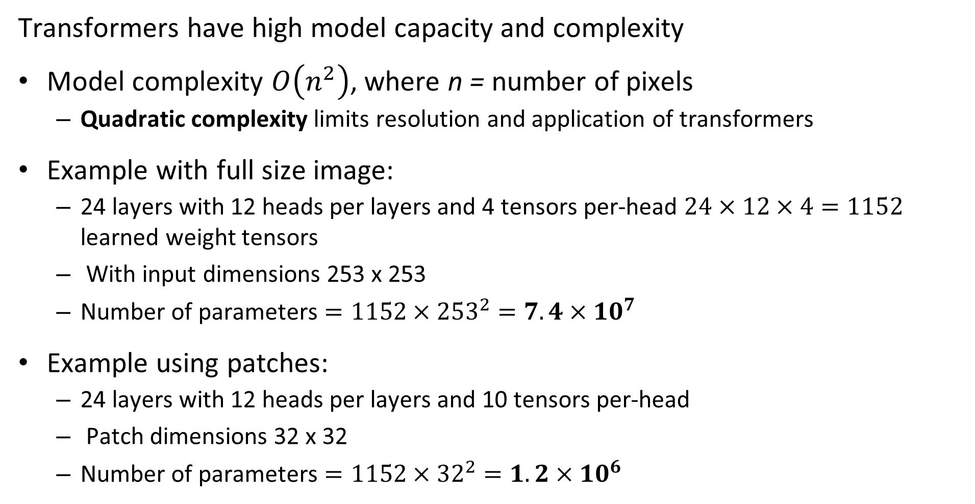
Why Use Patches?
Transformers have high model capacity and complexity
Model complexity $O\left(n^{2}\right)$, where n = number of pixels
Quadratic complexity limits resolution and application of transformers
Example with full size image:
24 layers with 12 heads per layers and 4 tensors per-head $24×12×4=1152$ learned weight tensors
With input dimensions 253 x 253
Number of parameters $=1152×{253}^{2}=7.4×{10}^{7}$
Example using patches:
24 layers with 12 heads per layers and 10 tensors per-head
Patch dimensions 32 x 32
Number of parameters $=1152×{32}^{2}=1.2×{10}^{6}$

Slide 35
Why Do We Need Positional Encoding?
Transformer models are permutation invariant with respect to the tokens
Tokens for a transformer model can be created with any spatial relationship
Tokens created from these patches are the same since transformer is permutation invariant

Slide 36
Why Do We Need Positional Encoding?
Transformer models are permutation invariant with respect to the tokens
Image patch and token ordering should preserve spatial relationships
CNNs are not permutation invariant and naturally preserve spatial relationships
We apply positional encoding to tokens
Position in color channel, x and y dimensions
Append positional encoding vector to image patch token

Slide 37
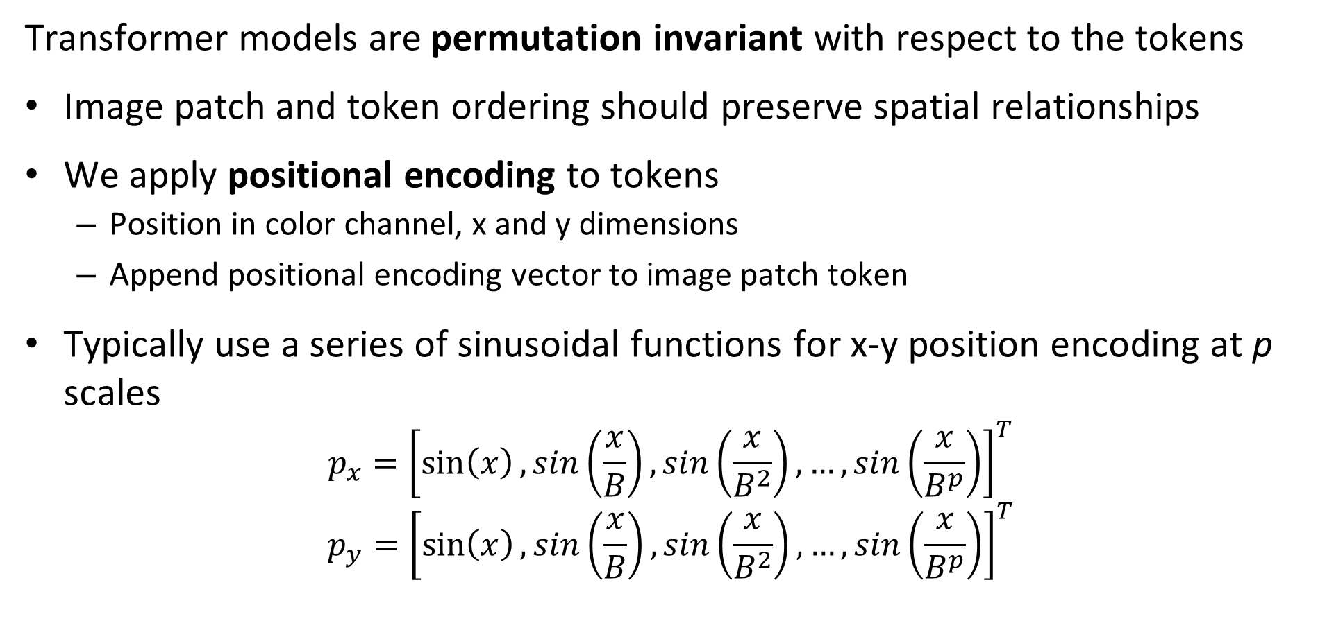
Why Do We Need Positional Encoding?
Transformer models are permutation invariant with respect to the tokens
Image patch and token ordering should preserve spatial relationships
We apply positional encoding to tokens
Position in color channel, x and y dimensions
Append positional encoding vector to image patch token
Typically use a series of sinusoidal functions for x-y position encoding at p scales
$$p_{x}={\left[\sin\left(x\right),sin\left(\frac{x}{B}\right),sin\left(\frac{x}{B^{2}}\right),…,sin\left(\frac{x}{B^{p}}\right)\right]}^{T}$$
$$p_{y}={\left[\sin\left(x\right),sin\left(\frac{x}{B}\right),sin\left(\frac{x}{B^{2}}\right),…,sin\left(\frac{x}{B^{p}}\right)\right]}^{T}$$

Slide 38
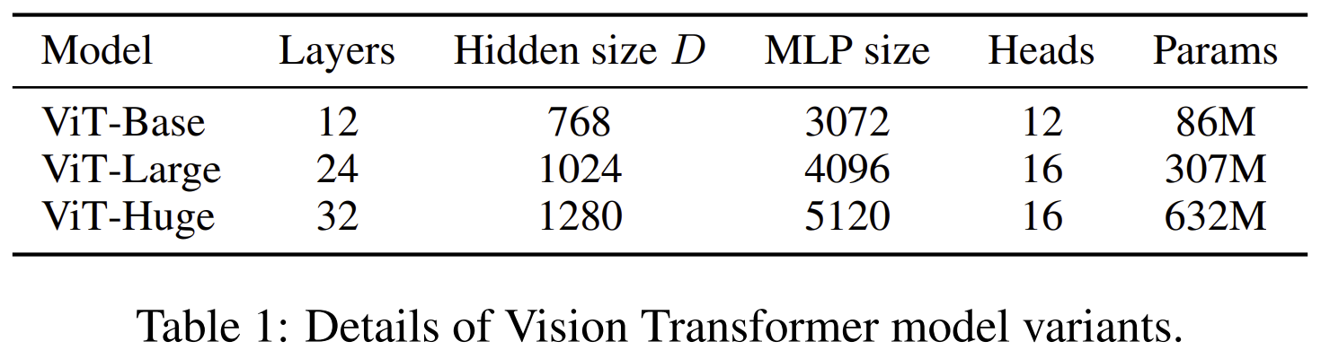
Family of ViT Architectures
Can trade-off model complexity for accuracy with ViT model
From Dosoviskiy, et.al., 2021

Slide 39
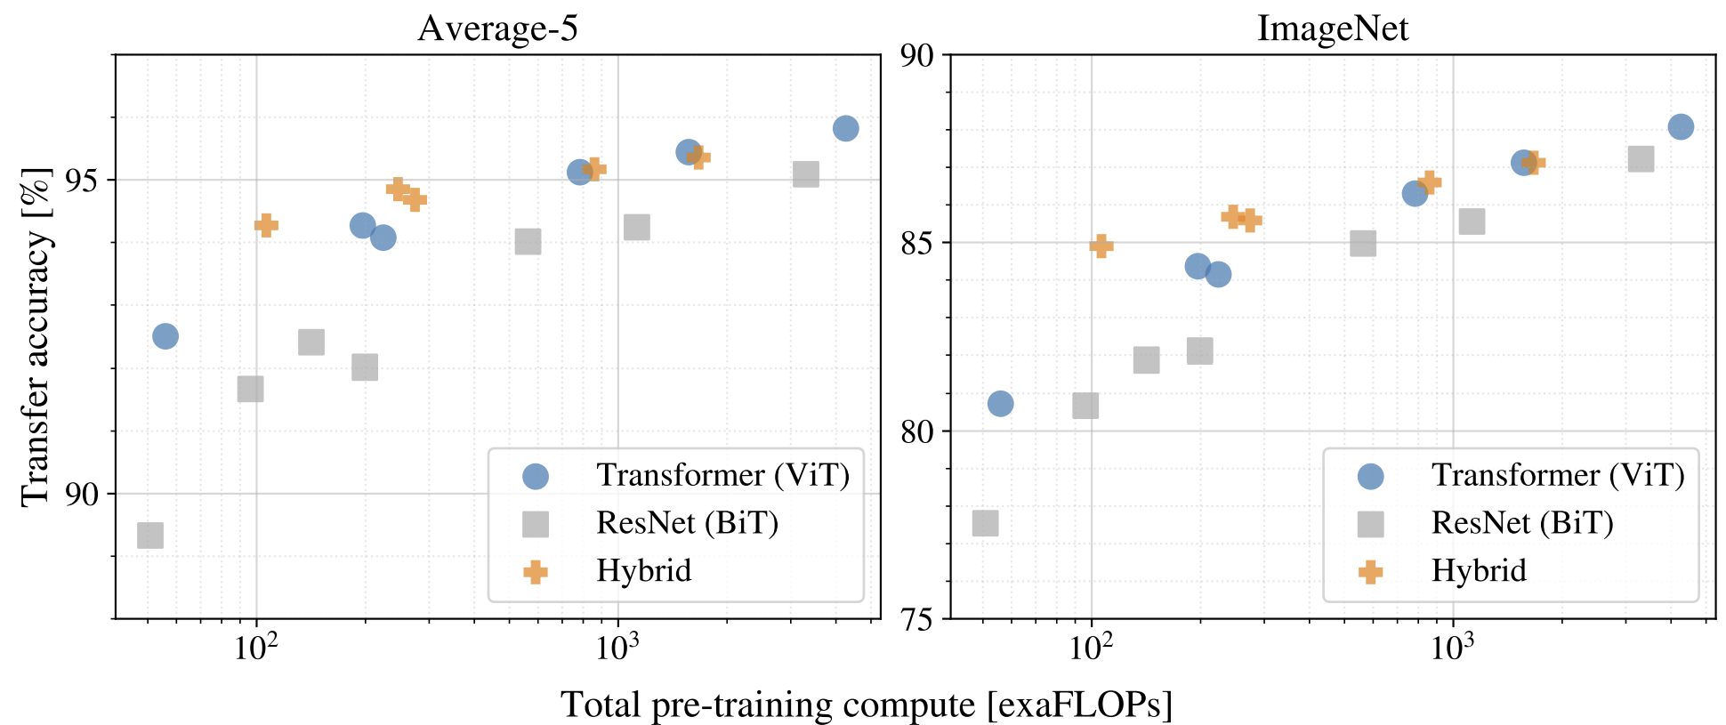
How Does the ViT Performance Compare?
From Dosoviskiy, et.al., 2021
Trade-off od complexity and accuracy comparable to CNN models

Slide 40
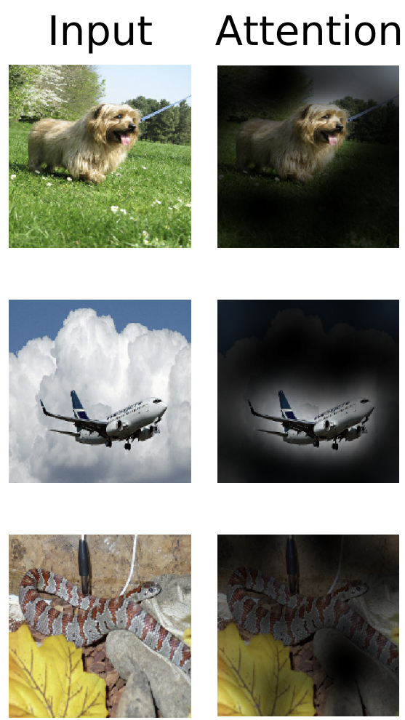
Attention Activations
What do the activations of the ViT model look like?
Compare input image to attention
Attention high for regions with objects of interest
From Dosoviskiy, et.al., 2021

Slide 41
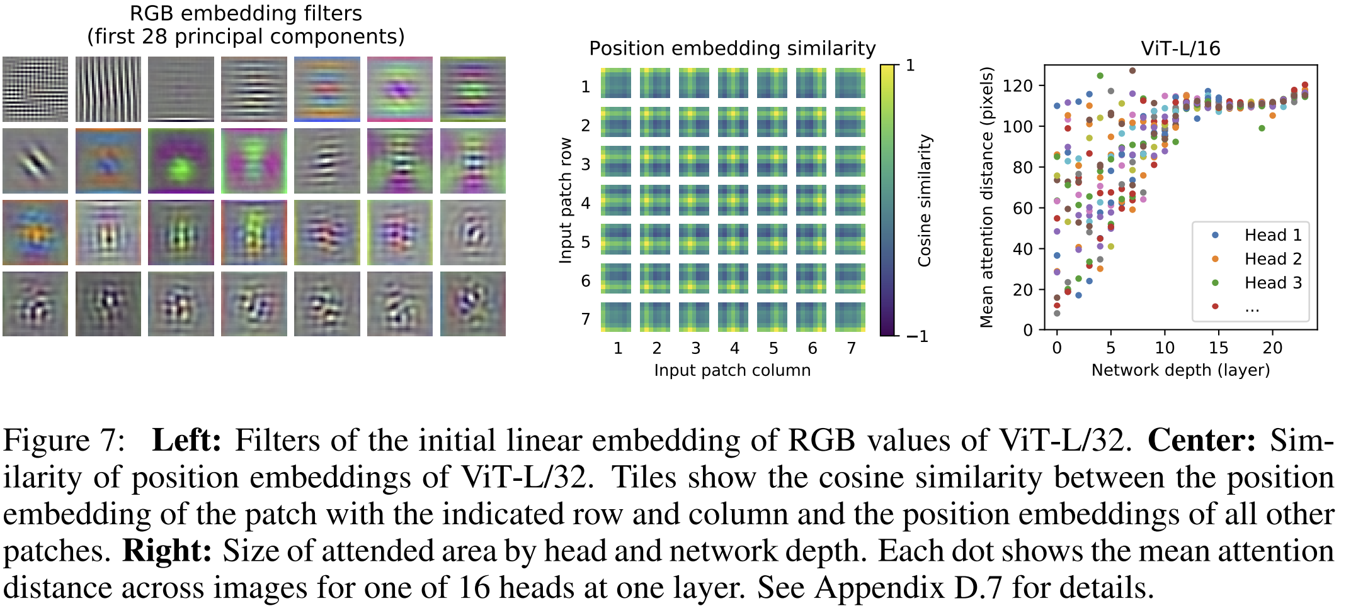
Attention Characteristics
What are the characteristics of the embedding and attention?
PCA of embedding and distance in attended area
From Dosoviskiy, et.al., 2021

Slide 42
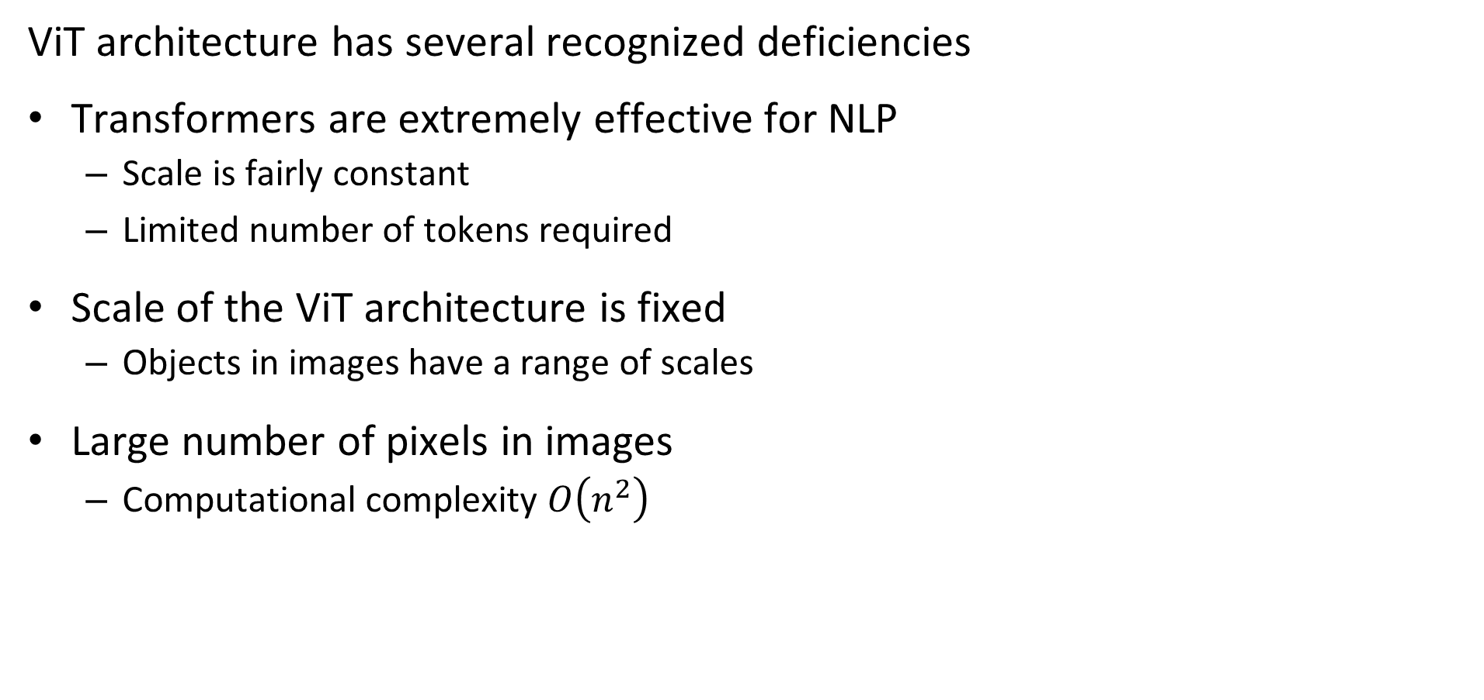
Deficiencies of ViT Architecture
ViT architecture has several recognized deficiencies
Transformers are extremely effective for NLP
Scale is fairly constant
Limited number of tokens required
Scale of the ViT architecture is fixed
Objects in images have a range of scales
Large number of pixels in images
Computational complexity $O\left(n^{2}\right)$

Slide 43
Self-Supervised Learning for CV

Slide 44
How Do We Train a CV Transformer Model?
Transformer models require massive training dataset
Transformer models have very large number of parameters
Sufficient labeled dataset are not available
Use self-supervised learning to pre-train models
Learn from tasks that do not require labels
Self-supervised learning is now being apply to SoA CNN models!

Slide 45
How Do We Train a CV Transformer Model?
Learn from tasks that do not require labels
Self-supervised pretext tasks used to learn feature set from inherent properties of images
Discriminative tasks:
Order tiles or jigsaw cuts of image
Recognize same object after image transformations
Generative tasks:
Fill in holes in image
Generate higher resolution image – super resolution
Colorize a gray scale image

Slide 46
Self-Supervised Learning
Generative tasks learn feature map by creating new images
Generative tasks use encoder-decoder architecture
Encoder learns a feature set
Keep encoder as pre-trained backbone for other tasks
Add new task-specific head and task-specific training
Decoder generates images
Uses learned features from encoder
Discard decoder after pretext training
Loss function is difference between target and generated image

Slide 47
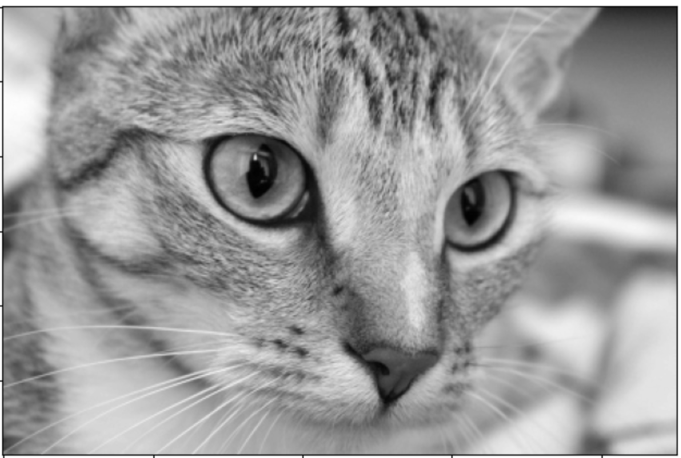
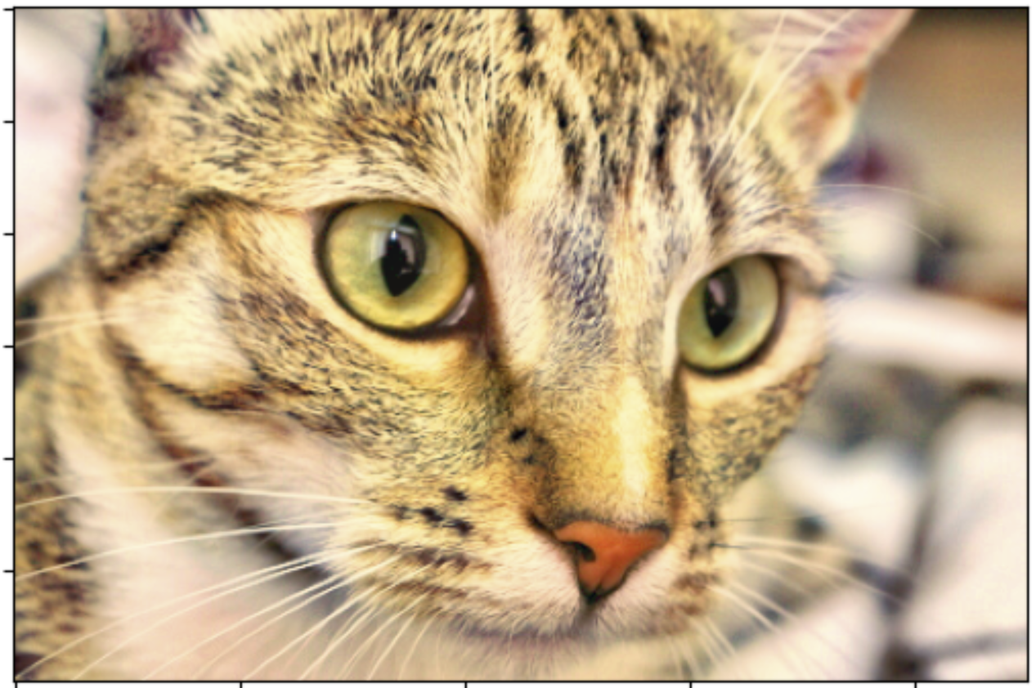
Self-Supervised Learning
Generative task example: color a gray-scale image
Original Image
1. Convert to gray-scale
4. Compute Loss
2. Encoder
Learns feature map
Pre-trained model
3. Decoder
Learns to generate image from feature map

Slide 48
Self-Supervised Learning
Discriminative tasks learn to discriminate between same and different images
Discriminative tasks employ an encoder backbone and a task specific decoder head
Backbone encoder learns a feature set
Keep encoder as pre-trained backbone for other tasks
Add new task-specific head and task-specific traning
Specific unsupervised pretext task performed by decoder head
Uses learned features from backbone to perform task
Discard decoder after pretext training
Loss function is based on discrimination accuracy

Slide 49
Self-Supervised Learning
Discriminative task example: recognize and reassemble image from random tiles
Original Image
1. Random Tile Image
4. Compute Loss
2. Backbone
Learns feature map
Pre-trained model
3. Head
Learns task using feature map

Slide 50
Contrastive Self-Supervised Learning
Contrastive self-supervised learning learns features by minimizing contrast loss
Discriminative tasks employ a backbone and a pretext task specific head
Backbone learns a feature set
Keep encoder as pre-trained backbone for other tasks
Add new task-specific head and task-specific training
Specific unsupervised pretext task performed by head
Uses learned features from backbone to perform pretext task
Discard decoder after pretext training
Loss function is based on discrimination accuracy

Slide 51
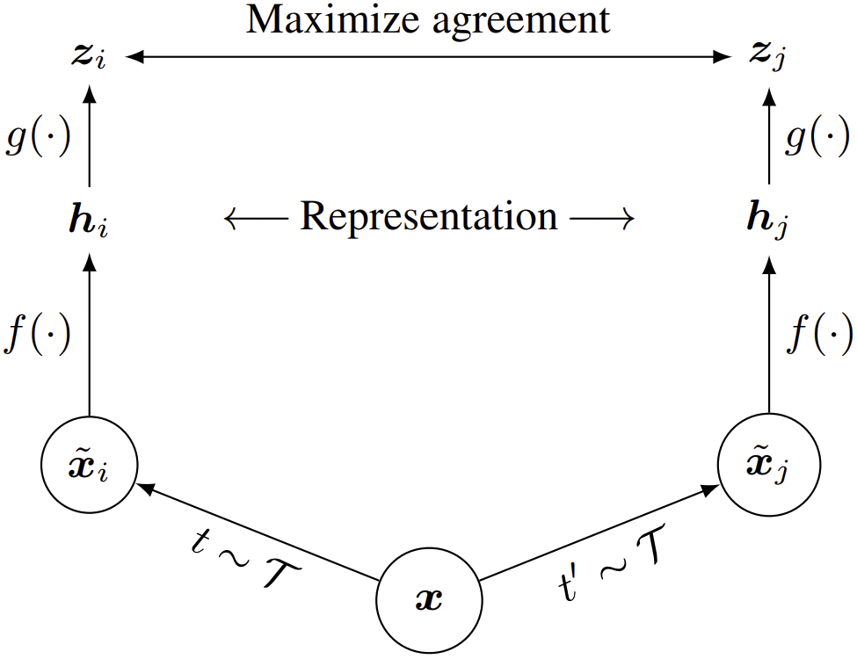
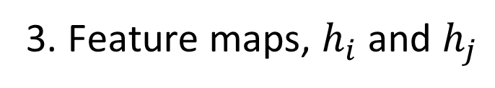
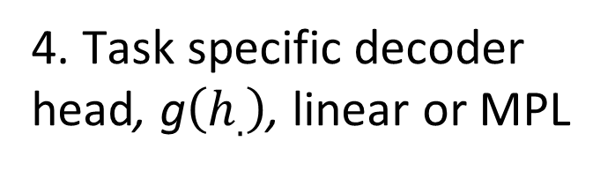
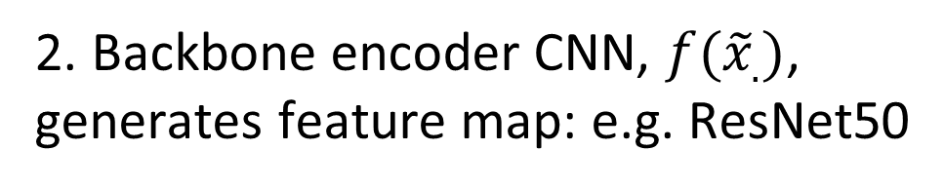
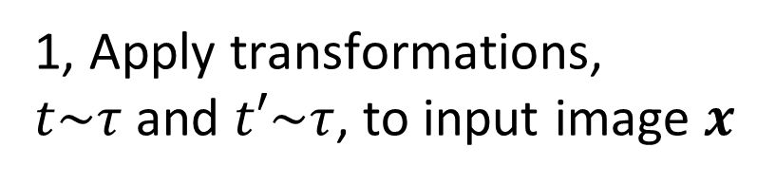
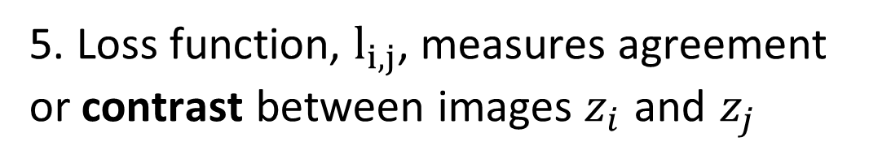
Contrastive Self-Supervised Learning
Contrastive self-supervised learning learns features by minimizing contrast loss
5. Loss function, $l_{i,j}$, measures agreement or contrast between images $z_{i}$ and $z_{j}$
4. Task specific decoder head, g$\left(h_{.}\right)$, linear or MPL
3. Feature maps, $h_{i}$ and $h_{j}$
2. Backbone encoder CNN, $f({\tilde{x}}_{.})$, generates feature map: e.g. ResNet50
1, Apply transformations,
$t\sim τ$ and $t′\sim τ$, to input image $x$
From Chen, et.al., 2020

Slide 52
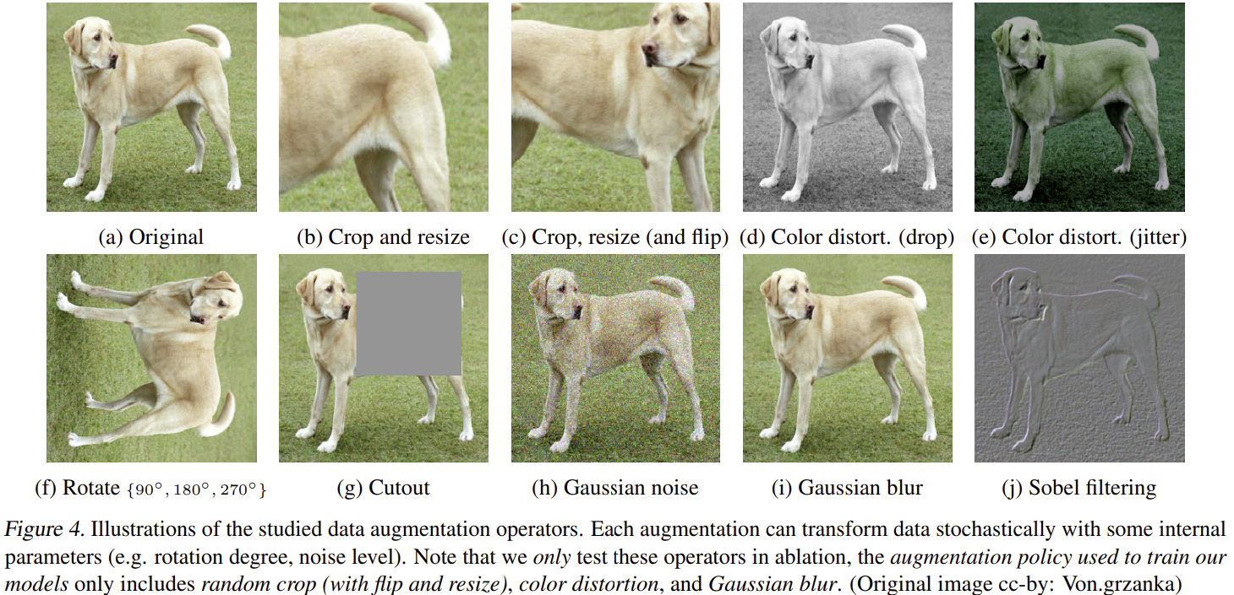
Contrastive Self-Supervised Learning
Examples of image transformations for contrastive self-supervised learning
From Chen, et.al., 2020

Slide 53
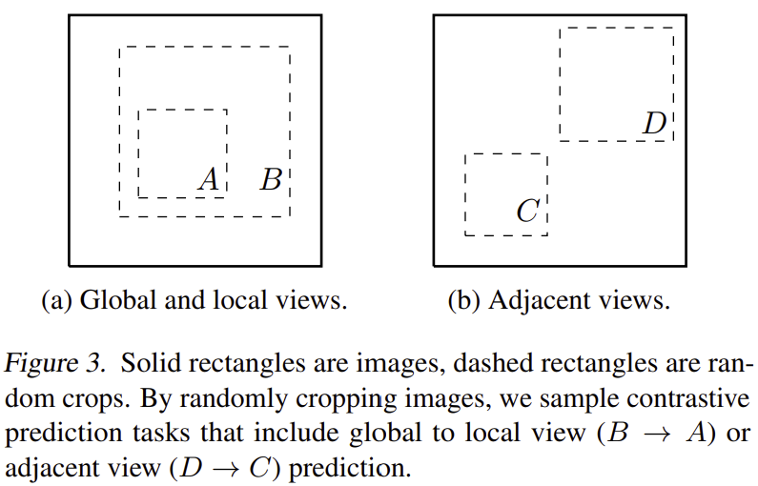
Contrastive Self-Supervised Learning
Examples possible image crops
A few of an infinite number of possibilities
From Chen, et.al., 2020

Slide 54
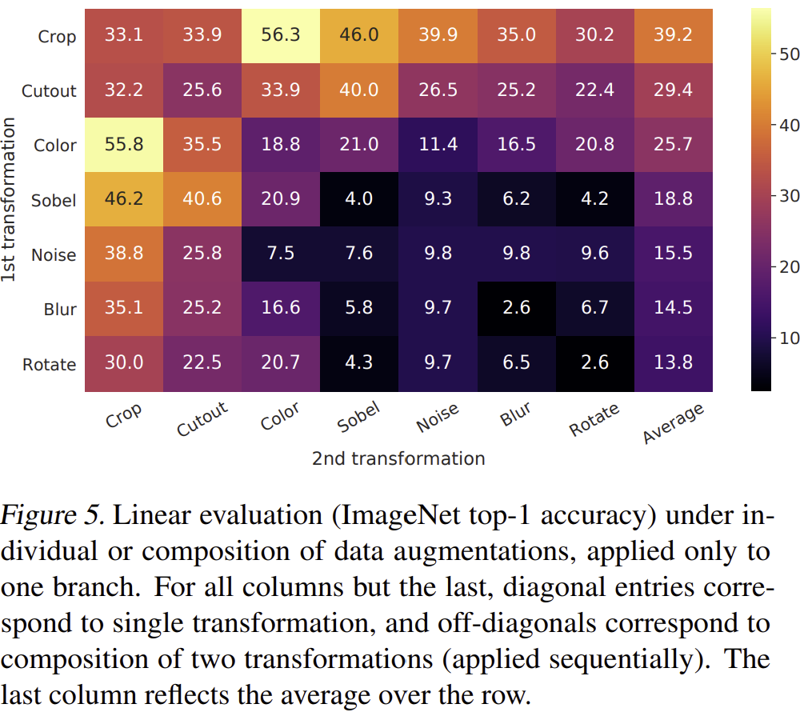
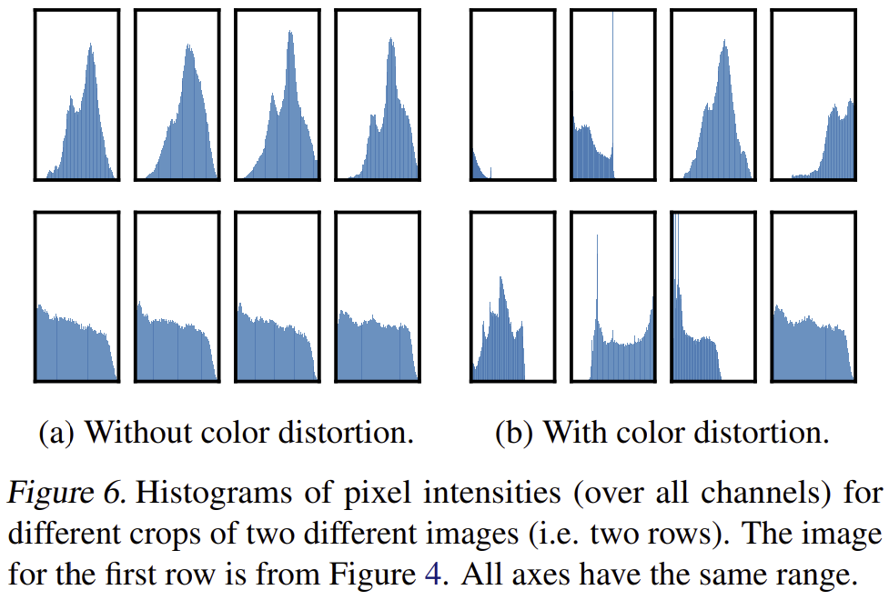
Contrastive Self-Supervised Learning
How do some of the possible transformations behave?
Interactions between transformations
Importance of color distortion
From Chen, et.al., 2020

Slide 55
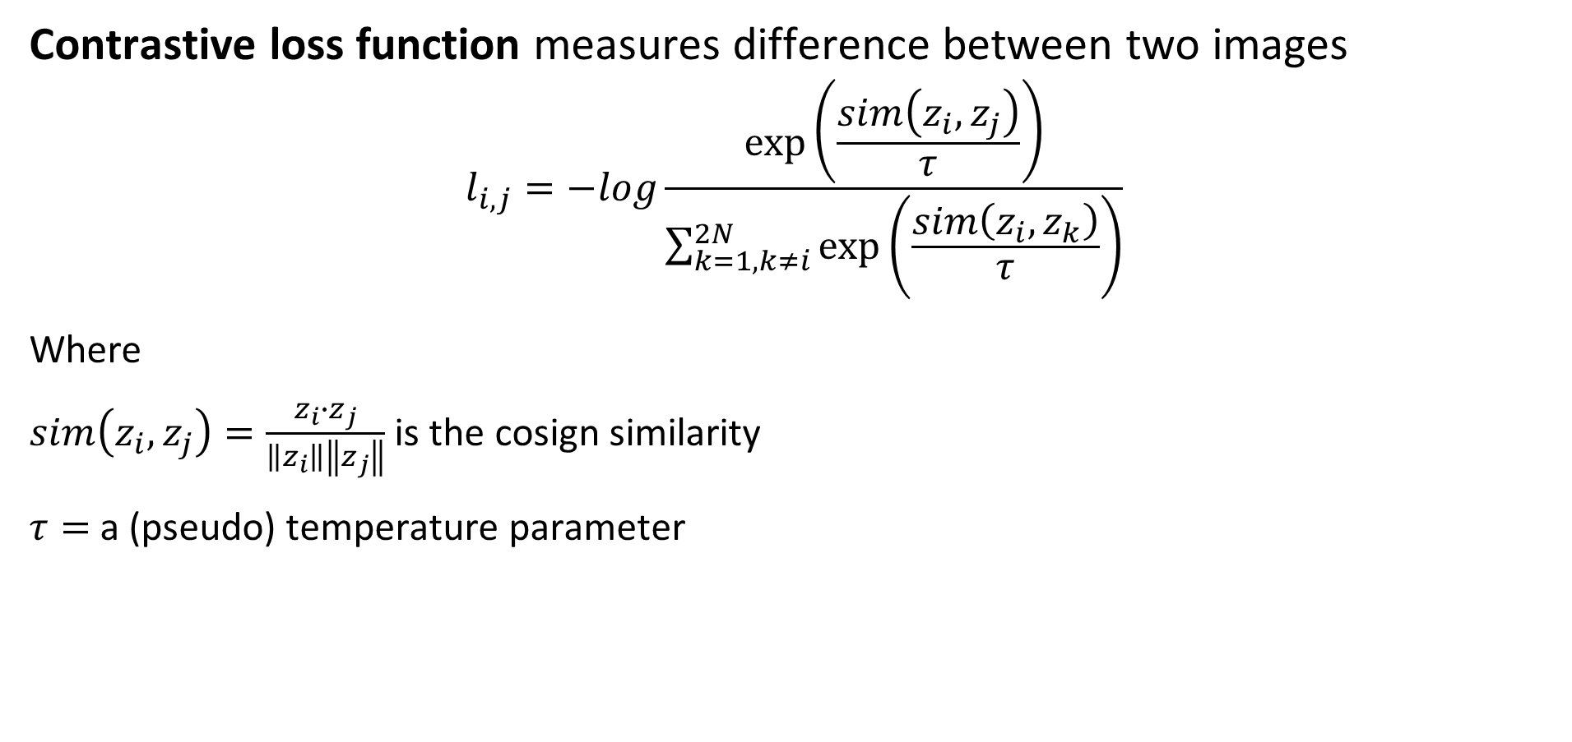
Contrastive Self-Supervised Learning
Contrastive loss function measures difference between two images
$$l_{i,j}=−log\frac{\exp\left(\frac{sim\left(z_{i},z_{j}\right)}{τ}\right)}{\sum_{k=1,k≠i}^{2N}{\exp\left(\frac{sim\left(z_{i},z_{k}\right)}{τ}\right)}}$$
Where
$sim\left(z_{i},z_{j}\right)=\frac{z_{i}∙z_{j}}{\left\|z_{i}\right\|\left\|z_{j}\right\|}$ is the cosign similarity
$τ=$ a (pseudo) temperature parameter

Slide 56
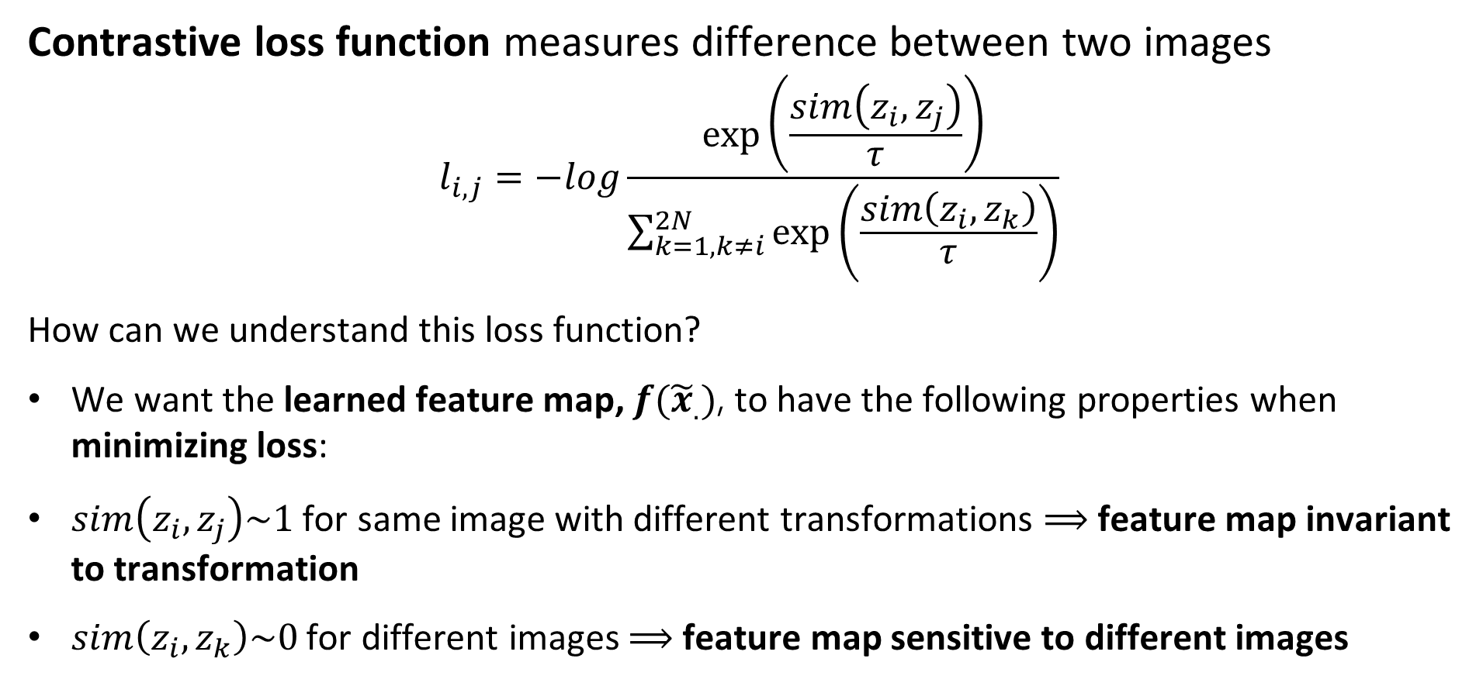
Contrastive Self-Supervised Learning
Contrastive loss function measures difference between two images
$$l_{i,j}=−log\frac{\exp\left(\frac{sim\left(z_{i},z_{j}\right)}{τ}\right)}{\sum_{k=1,k≠i}^{2N}{\exp\left(\frac{sim\left(z_{i},z_{k}\right)}{τ}\right)}}$$
How can we understand this loss function?
We want the learned feature map, $f({\tilde{x}}_{.})$, to have the following properties when minimizing loss:
$sim\left(z_{i},z_{j}\right)\sim 1$ for same image with different transformations $⟹$ feature map invariant to transformation
$sim\left(z_{i},z_{k}\right)\sim 0$ for different images $⟹$ feature map sensitive to different images

Slide 57
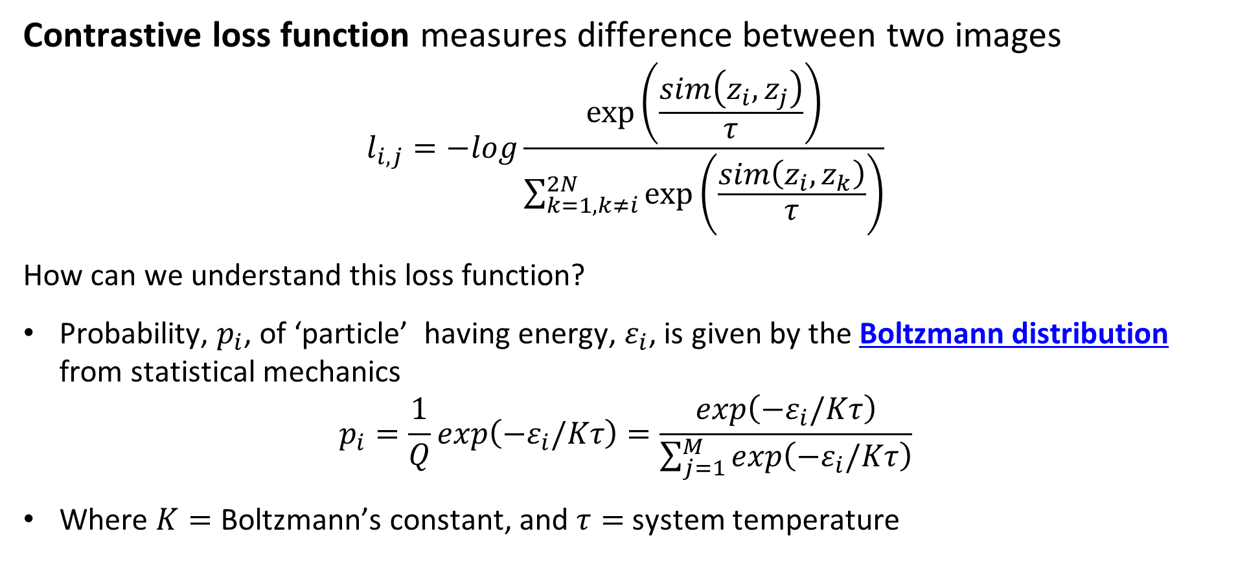
Contrastive Self-Supervised Learning
Contrastive loss function measures difference between two images
$$l_{i,j}=−log\frac{\exp\left(\frac{sim\left(z_{i},z_{j}\right)}{τ}\right)}{\sum_{k=1,k≠i}^{2N}{\exp\left(\frac{sim\left(z_{i},z_{k}\right)}{τ}\right)}}$$
How can we understand this loss function?
Probability, $p_{i}$, of ‘particle’ having energy, $ε_{i}$, is given by the Boltzmann distribution from statistical mechanics
$$p_{i}=\frac{1}{Q}exp\left(−ε_{i}/Kτ\right)=\frac{exp\left(−ε_{i}/Kτ\right)}{\sum_{j=1}^{M}{exp\left(−ε_{i}/Kτ\right)}}$$
Where $K=$ Boltzmann’s constant, and $τ=$ system temperature

Slide 58
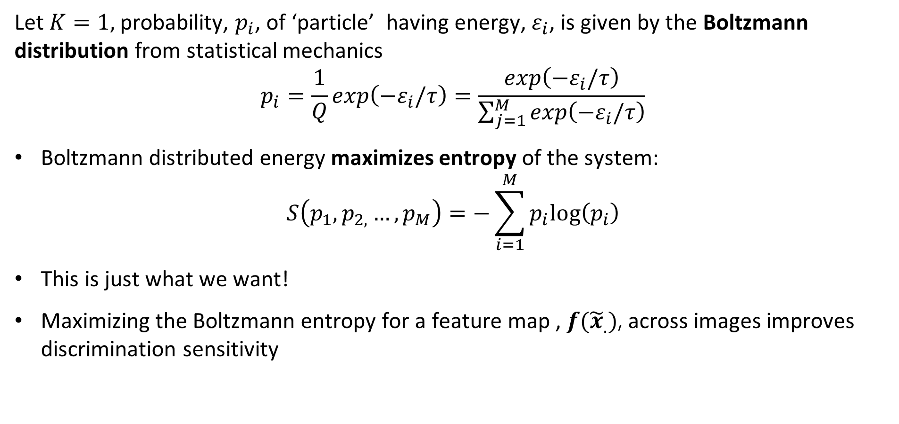
Contrastive Self-Supervised Learning
Let $K=1,$ probability, $p_{i}$, of ‘particle’ having energy, $ε_{i}$, is given by the Boltzmann distribution from statistical mechanics
$$p_{i}=\frac{1}{Q}exp\left(−ε_{i}/τ\right)=\frac{exp\left(−ε_{i}/τ\right)}{\sum_{j=1}^{M}{exp\left(−ε_{i}/τ\right)}}$$
Boltzmann distributed energy maximizes entropy of the system:
$$S\left(p_{1},p_{2,}…,p_{M}\right)=−\sum_{i=1}^{M}{p_{i}log⁡\left(p_{i}\right)}$$
This is just what we want!
Maximizing the Boltzmann entropy for a feature map , $f({\tilde{x}}_{.})$, across images improves discrimination sensitivity

Slide 59
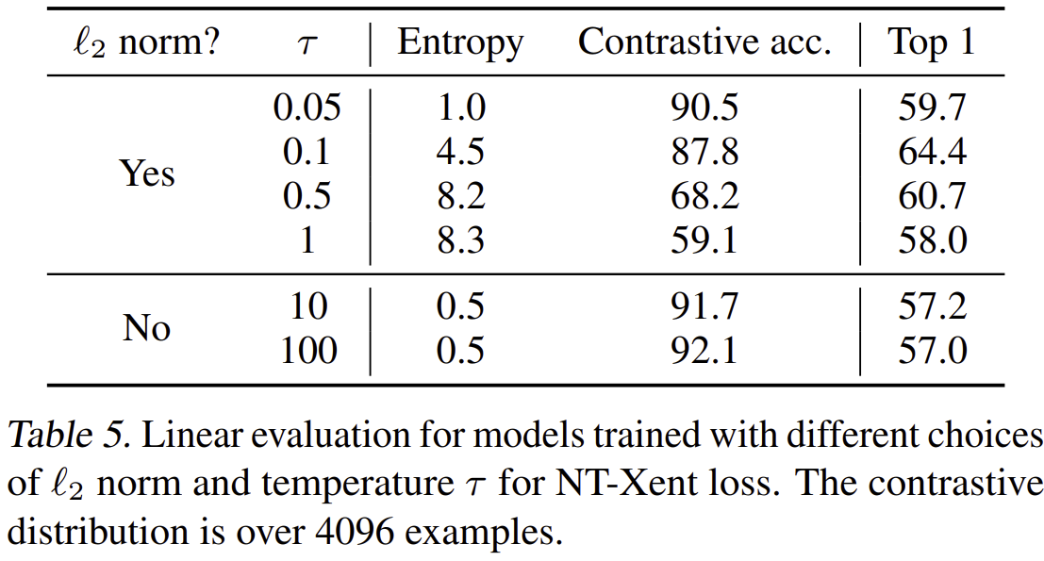

Contrastive Self-Supervised Learning
What value of $τ$ should we use?
Perform hyperparameter search
Trade-off between minimizing contrastive association loss and maximum entropy
From Chen, et.al., 2020

Slide 60

Contrastive Self-Supervised Learning
How well does contrastive pretext learning work?
From Chen, et.al., 2020

Slide 61
Scaling Vision Transformers

Slide 62


Scaling Vision Transformers
Zhai, et.al, 2022, investigated the relationship of model and training set size
Larger models and larger data sets $⇒$ lower error rate
But, all models show saturation

Slide 63
Scaling Vision Transformers
Zhai, et.al, 2022, investigated the relationship of model and training set size
Combination of larger model and training data required for optimal performance
Representation quality constrained by model size
Training dataset size beyond 1-3B images will improve massive models!

Slide 64

Scaling Vision Transformers
Zhai, et.al, 2022, investigated the relationship of model and training set size
Improved performance is achieved with massive training dataset and many fine-tuning epochs

Slide 65

Scaling Vision Transformers
Zhai, et.al, 2022, investigated the relationship of model and training set size
Using independent learning rates for head (top) and backbone improved performance

Slide 66
What Do Transformers See?

Slide 67

What Do Transformers See
Rahgu, et.al, 2022, investigated the feature maps of ResNets and Transformer
Vision transformer activations show great similarity between lower and higher layers
Whereas, ResNets show greater similarity between neighboring layers

Slide 68

What Do Transformers See
Rahgu, et.al, 2022, investigated the feature maps of ResNets and Transformer
Lower attention heads have great range of attention distance from local to global
Deeper attention heads have long range attention distance, focusing on scene semantics

Slide 69

What Do Transformers See
Rahgu, et.al, 2022, investigated the feature maps of ResNets and Transformer
Vision transformer activations remain local for localized input
Whereas, ResNets activations become diffuse with depth

Slide 70
Shifting Window (SWIN) Transformer Making Transformers Efficient 1

Slide 71
Toward Efficient Transformer Models
Efficient deep neural network architectures trade-off three performance metrics
Complexity and model parameters: more complex models have higher capacity but harder to train, need larger datasets
Error rate for task: measure of model effectiveness for task
Throughput: how fast can the NN perform inference, inverse of inference time
Complexity and model parameters
Throughput
Error rate for task

Slide 72
SWIN Transformer
Shifted Window (SWIN) transformer introduces more efferent transformer architecture
ViT architectures have quadratic complexity with increasing resolution
High inference time
Limited resolution limits possible tasks
Successful with classification, uses low resolution
Poor fit to tasks requiring high resolution, e.g. segmentation
SWIN architecture using shifting windows to reduce complexity

Slide 73

SWIN Transformer
Shifted Window (SWIN) transformer introduces architecture for features at multiple scales
SWIN Transformer uses hierarchy of scales
SWIN Transformer employs overlapping sliding windows to accommodate different scales
From Lui, et.al., 2021

Slide 74

SWIN Transformer
Shifted Window (SWIN) transformer introduces architecture for features at multiple scales
SWIN Transformer employs overlapping windows to accommodate different scales
Shifting windows may improve global attention
The shifting method reduces computation
From Lui, et.al., 2021

Slide 75

SWIN Transformer
Why is the SWIN Transformer efficient?
Computational complexity of the ViT architecture using $M×M$ patches, with a complexity parameter $C$, is quadratic in patch size, $h×w$:
$$Ω\left(MSA\right)=4hwC^{2}+2{\left(hw\right)}^{2}C$$
Computation complexity of SWIN transformer is linear in patch size , $h×w$ for $M×M$ windows:
$$Ω\left(MSA\right)=4hwC^{2}+2M^{2}hwC$$

Slide 76

SWIN Transformer
Shifted Window (SWIN) transformer uses cyclic shift for efficiency
SWIN uses efficient cyclic shifts generated with key update
Masking prevents leakage across non-adjacent tokens (patches)

Slide 77

SWIN Transformer
Shifted Window (SWIN) transformer uses different attention block
SWIN Transformer block uses Window-Multi-Headed Self-Attention (W-MSA)
Uses linear activation
Shifted window MSA, SW-MSA, updates from shifted window mask, from key update
See paper for details
From Lui, et.al., 2021

Slide 78


SWIN Transformer
SWIN architecture employs patch merging to achieve multi-scale attention
Linear embedding transforms $4×4×3=48$ pixel values per patch to C values
Linearly scales by dividing patches and multiplying C by 2
Patch resolutions $\frac{1}{4},\frac{1}{8},\frac{1}{16},\frac{1}{32}$
From Lui, et.al., 2021

Slide 79

SWIN Transformer
SWIN achieves near state-of-the-art performance
From Lui, et.al., 2021

Slide 80
Hybrid CNN +Transformer Models Making Transformers Efficient 2

Slide 81

EfficientFormer V2
EfficientFormer V2 optimizes accuracy performance and maintains efficiency using hybrid CNN-transformer architecture
Optimize performance across 3 dimensions
Complexity and model parameters
Inference time and throughput
Accuracy
Key updates for SWIN shifting windows hard to manage on mobile devices
From Li, et.al., 2023

Slide 82




EfficientFormer V2
EfficientFormer improves on previous hybrid transformer architectures
Token mixer layers replaced with feed forward network (FFN) layers with pure CNNs
FFN layer uses $1×1$ CONV layers for up-down sampling
GeLU activation maintained
Single residual loop
From Li, et.al., 2023

Slide 83


EfficientFormer V2
Gaussian error linear units, GeLU, activation
GeLU is a nonlinear activation based on Gaussian error function
$$GeLU\left(x\right)=x P\left(X≤x\right)$$
GeLU has smooth transition at 0
No vanishing gradient around 0
From Papers With Code

Slide 84


EfficientFormer V2
EfficientFormer improves on previous hybrid transformer architectures
From Li, et.al., 2023
Modified MHSA block boosts performance by 0.3% with no increase in complexity or latency
$3×3$ DW CONV adds local information to values, V
MLP add communications between heads, a.k.a. a talking head

Slide 85


EfficientFormer V2
EfficientFormer improves on previous hybrid transformer architectures
4-Layer model found to provide optimal trade-off of complexity, latency, and accuracy
Layer scales of $\frac{1}{4},\frac{1}{8},\frac{1}{16},\frac{1}{32}$
2 local FFN layers provide inductive bias from CNN
2 local-global attention layers
From Li, et.al., 2023

Slide 86


EfficientFormer V2
EfficientFormer improves on previous hybrid transformer architectures
First local-global attention layer uses fairly standard architecture
Down sample fixed $\frac{1}{32}$ scale to reduce quadratic complexity
Mix channels/heads
Compute stride dot product attention
Up sample to $\frac{1}{16}$ scale
From Li, et.al., 2023

Slide 87


EfficientFormer V2
EfficientFormer improves on previous hybrid transformer architectures
Second local-global modified attention layer
Mix channels/heads
Dual-path down sample uses max pooling and DWCONV past to reduce query, , by half
${Out}_{[B,H,\frac{N}{2},c]}=\left(Q_{[B,H,\frac{N}{2},c]}∙{K^{T}}_{[B,H, c,N]}\right)∙V_{[B,H, c,N]}$
CONV layer in residual loop
Compute self attention
Mix channels/heads
From Li, et.al., 2023

Slide 88

EfficientFormer V2
The architectural details of EfficientFormer V2 are optimized through a series of ablation studies
At each step the accuracy, latency and complexity are evaluated
From Li, et.al., 2023

Slide 89
Optimization For Vision Transformers

Slide 90
Optimization for Transformers
Vision Transformers have proved difficult to train and generalize
CNNs have proved easy to train
Inductive biases work in CNNs favor
Localization
Translation invariance
ViTs trained on massive data sets using augmentation and self-supervised learning
ViT generalization can be poor.
What can be done to improve ViT training?

Slide 91

Optimization for Transformers
Vision Transformers have proved difficult to train and generalize
Chen, et.al., 2022, investigate this problem
Compare cross entropy loss surface of ResNet 152 and ViT B/16
Gradients loss function for ViT are localized and extreme compared to ResNet!
Localized and extreme gradients explain difficult training and poor generalization

Slide 92
Optimization for Transformers
Vision Transformers have proved difficult to train and generalize
What can be done to improve ViT training?
Chen, et.al., 2022 proposed using sharpness-aware minimizer (SAM) proposed by Forest, et.al., 2021
Now implemented as tf.keras.models.experimental.SharpnessAwareMininization
SGD optimizers only minimize gradient
SGD optimizers incorporate no smoothness constraint into the loss function
Poor smoothness of loss function surface makes training and generalization difficult
Rough loss services change rapidly with small changes in data values

Slide 93

Optimization for Transformers
Sharpness-aware minimization (SAM)
SAM proposed by Forest, et.al., 2021 uses loss function with smoothness term
$$\min_{W}{\max_{\left\|ε\right\|≤ρ}{ℒ_{train}\left(W+ ℇ\right)}}$$
Loss is minimized over some neighborhood, $\left\|ε\right\|≤ρ$, rather than just locally
$$\hat{ε}\left(W\right)=\frac{ρ∇_{W}ℒ_{train}\left(W\right)}{\left\|∇_{W}ℒ_{train}\left(W\right)\right\|}$$
With neighborhood size hyperparameter $ρ$

Slide 94


Optimization for Transformers
Sharpness-aware minimization (SAM)
Using SAM smooths the ViT loss function
Eliminates extreme gradients
Larger ‘flat’ area around minimum improves generalization
From Chen, et.al., 2022

Slide 95

Optimization for Transformers
Sharpness-aware minimization (SAM)
SAM reduces the largest eigenvalue of the Hessian
Loss increases
Error rate decreases
From Chen, et.al., 2022

Slide 96

Optimization for Transformers
Sharpness-aware minimization (SAM)
Both SAM and data augmentation improve model performance
Combination of SAM and data augmentation is best
ResNet-152 gives better performance for smaller training dataset
From Chen, et.al., 2022

Slide 97


Optimization for Transformers
Sharpness-aware minimization (SAM)
SAM creates better defined global attention map
Smoother loss function $⇒$ less localized attention
From Chen, et.al., 2022

Slide 98
Summary
Vision transformers are seen as an alternative to CNNs
Vision transformers build globally sensitive feature maps
Vision transformers (ViTs) comprise several components
Sequence of image patches
Multi-headed self-attention
Self-supervised training on massive datasets
Vision transformers are computationally complex for training and inference
Generally, state-of-the-art ViT performance requires greater computation compared to CNN architectures

Slide 99
Summary
Vision transformers are seen as an alternative to CNNs
Contrastive self-supervised learning for transformation-invariant pre-training
Sharpness-aware minimization (SAM) improves ViT training and generalization
Error rate declines with combination of larger (complex) model and larger training dataset

