Slide 1

CSCI E-25 Computer Vision
Segmentation
Steve Elston
Copyright 2022, 2023, 2024, 2025, Stephen F Elston. All rights reserved.

Slide 2
Segmentation of Images
Segmentation methods attempt to divide images into similar regions
Segmentation is a classic CV task with a long history
Classical segmentation methods attempted to group pixels in like classes
Work started in early days of CV – 1970s
Primarily based on clustering models, but many other algorithms
Since 2015, deep neural network architectures have come to dominate image segmentation
Our focus for this lesson

Slide 3
Segmentation of Images
Three classes of segmentation algorithms, with different objectives
Semantic segmentation attempts to classify each pixel in an image
Most commonly applied type of segmentation
Goal is scene understanding
Often referred to as stuff segmentation
Instance segmentation attempts to identify and classify the pixels representing specific objects in the image
Harder task than semantic segmentation
Often referred to as things segmentation
Closely related to object detection task
Panoptic segmentation attempts to perform both of the foregoing tasks simultaneously
Identify pixels associated with the things in the foreground
Stuff is the background

Slide 4
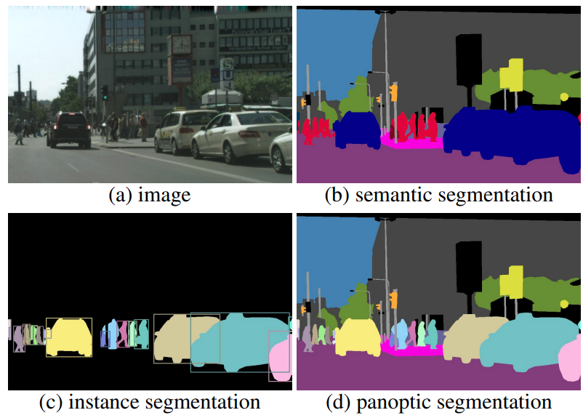
Segmentation of images
Example, semantic, instance and panoptic segmentation tasks
From: Kirillov, et. al, 2019

Slide 5
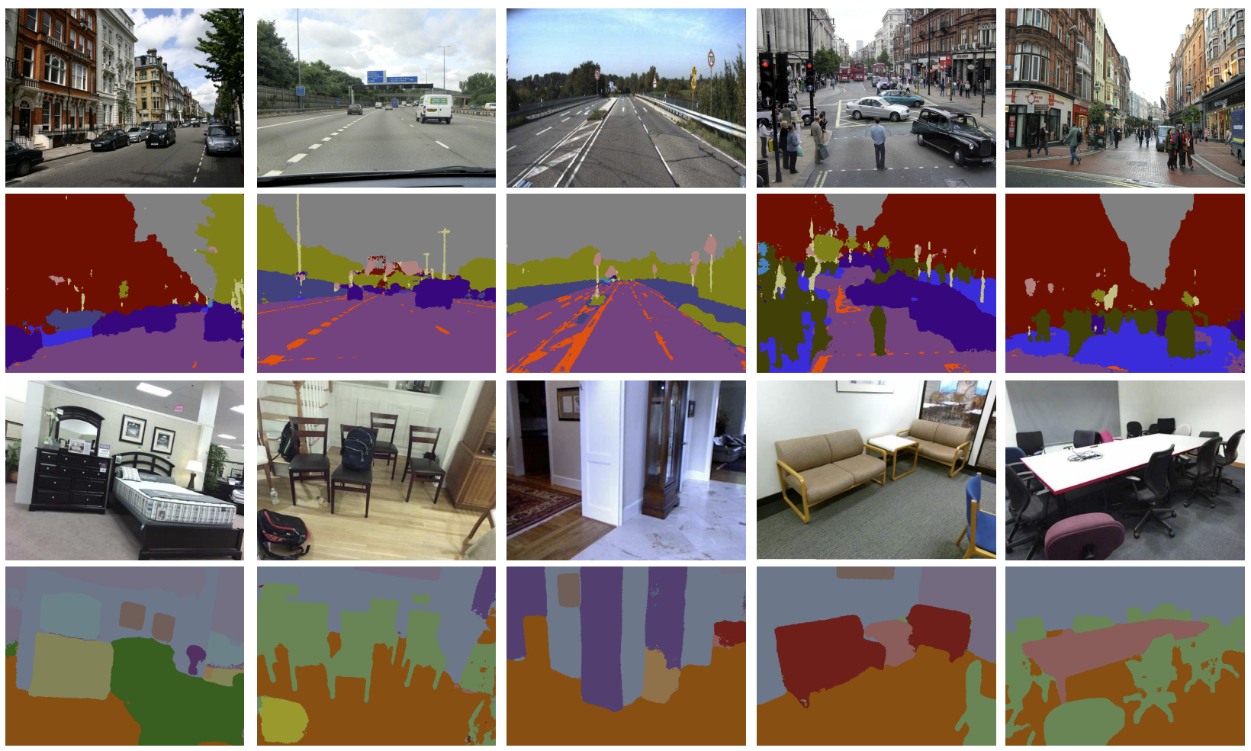
Segmentation of Images
Example: Semantic segmentation of stuff classes in image
From: Badrinarayanan, et. al., 2016

Slide 6
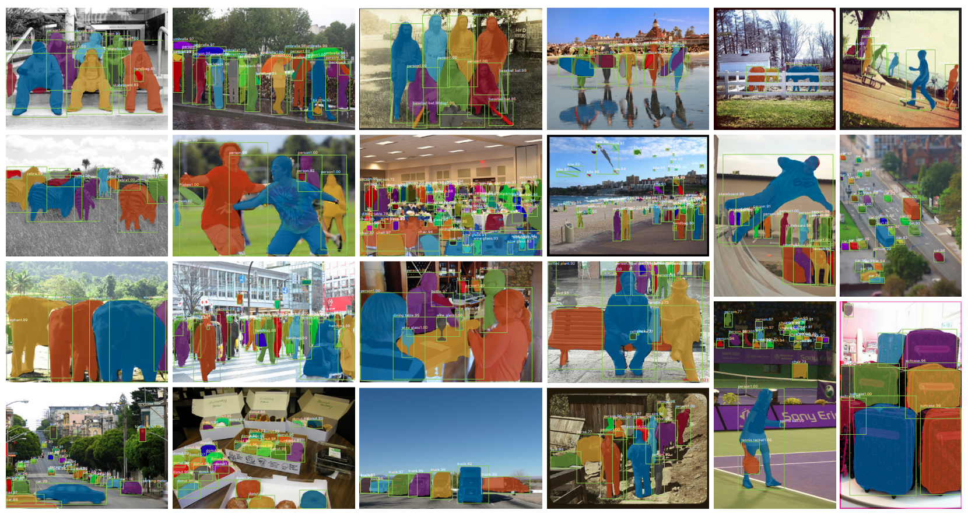
Segmentation of Images
Example: Instance segmentation of individual things in image
From: He, et. al., 2018

Slide 7
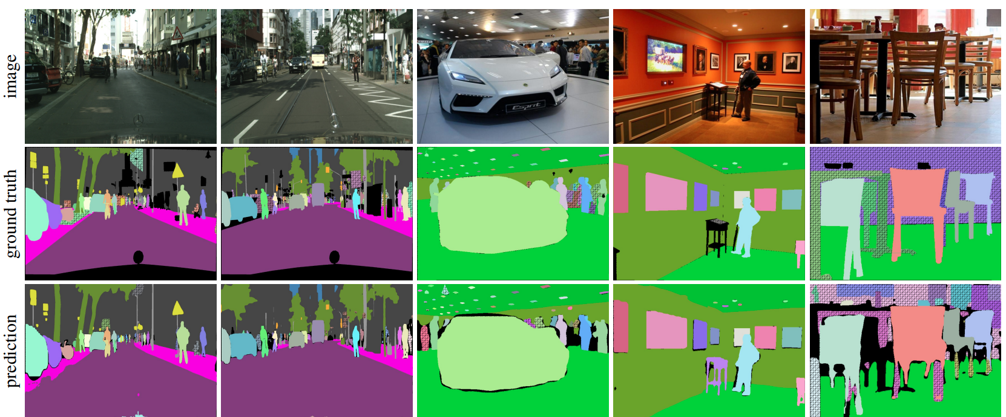
Segmentation of Images
Example: Panoptic segmentation of things and stuff in image
From: Kirillov, et. al., 2019

Slide 8
Segmentation of Images
You can find many architectures that have been proposed as well as benchmark datasets in Papers With Code
Semantic segmentation
Instance segmentation
Panoptic segmentation
Some algorithms can be applied to several of these problems

Slide 9
Evaluation of Segmentation Algorithms

Slide 10
Evaluation of Image Segmentation Algorithms
Need evaluation methods appropriate for different segmentation tasks
Semantic segmentation algorithms evaluated pixel-wise
Instance segmentation evaluated on instance classification
Panoptic segmentation must evaluate both stuff and thing classification

Slide 11
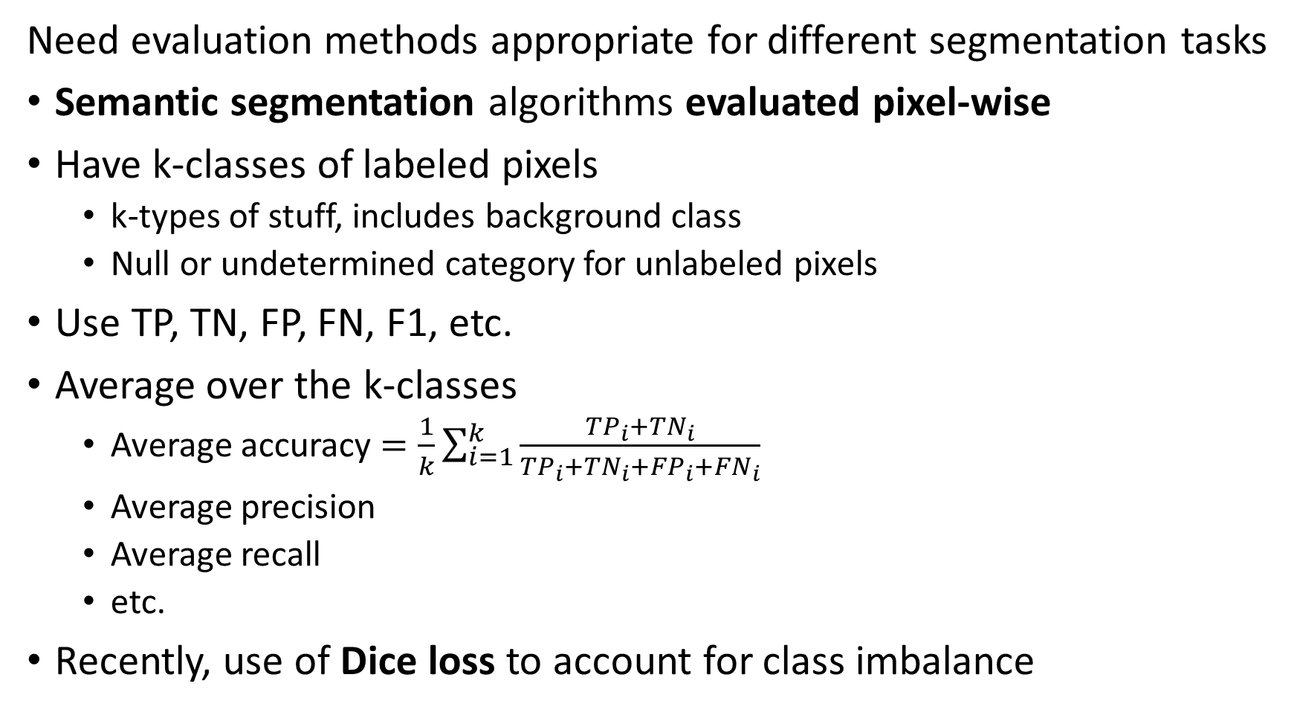
Evaluation of Image Segmentation Algorithms
Need evaluation methods appropriate for different segmentation tasks
Semantic segmentation algorithms evaluated pixel-wise
Have k-classes of labeled pixels
k-types of stuff, includes background class
Null or undetermined category for unlabeled pixels
Use TP, TN, FP, FN, F1, etc.
Average over the k-classes
Average accuracy $=\frac{1}{k}\sum_{i=1}^{k}{\frac{{TP}_{i}+{TN}_{i}}{{TP}_{i}+{TN}_{i}+{FP}_{i}+{FN}_{i}}}$
Average precision
Average recall
etc.
Recently, use of Dice loss to account for class imbalance

Slide 12
Loss Function for Object Detection
Dice-Sørensen coefficient, or Dice loss, is considered more robust to class imbalance
For two sets, $A$, $B$, the Dice-Sørensen coefficient is defined:
$$DC=\frac{2\left|A⋂B\right|}{\left|A\right|+\left|B\right|}, where \left| \right|=size of set$$
For the simple case of binary classification, we write Dice loss:
$$DL\left(y,\hat{p}\right)=1−\frac{2y\hat{p}+1}{y+\hat{p}+1}$$
Where:
$y=$ label
$\hat{p}=$ Binary category prediction
Dice loss is equivalent to F1 loss
Full details on loss functions for training semantic segmentation models can be found in Jadon, 2020, or Jeremy Jordan’s blog post

Slide 13
Evaluation of Image Segmentation Algorithms
Need evaluation methods appropriate for different segmentation tasks
Instance segmentation evaluated on instance classification
Same methods as object detection
Mean intersection over Union, mIoU
Mean average precision, mAP
Pixel-level accuracy

Slide 14
Evaluation of Image Segmentation Algorithms
Need evaluation methods appropriate for different segmentation tasks
Panoptic segmentation must evaluate both stuff and thing classification
Objects (things) should be correctly classified
Pixels in background (stuff) should be correctly classified
Possible approaches
Evaluate use weighted sum of stuff and thing metrics
Create integrated panoptic metric, Panoptic Quotient

Slide 15
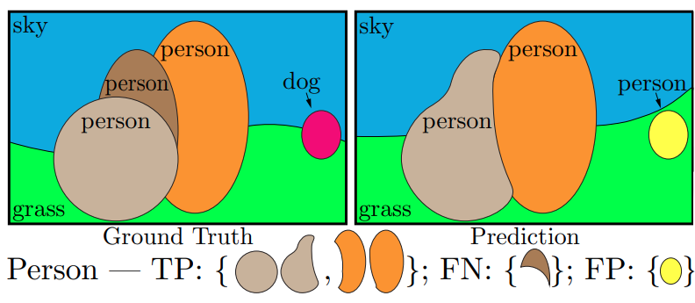
Evaluation of Image Segmentation Algorithms
Need evaluation methods appropriate for segmentation task
How do we define TP, FN and FP for panoptic segmentation?
From: Kirillov, et. al, 2019

Slide 16
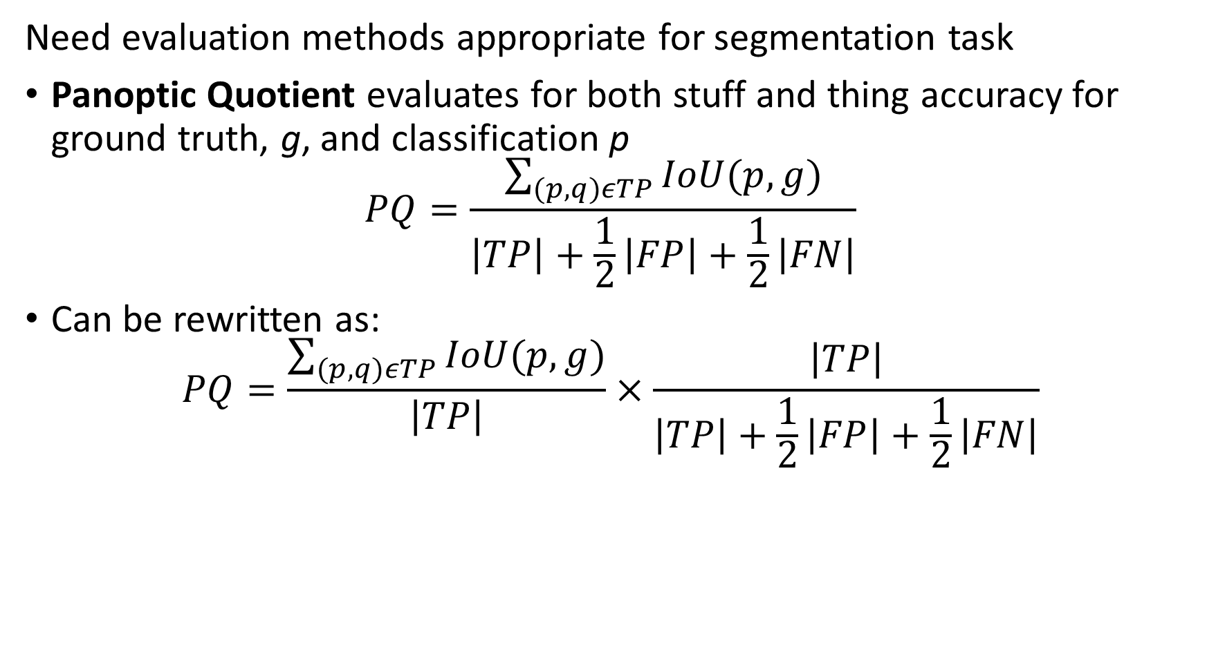
Evaluation of Image Segmentation Algorithms
Need evaluation methods appropriate for segmentation task
Panoptic Quotient evaluates for both stuff and thing accuracy for ground truth, g, and classification p
$$PQ=\frac{\sum_{(p,q)εTP}{IoU(p,g)}}{\left|TP\right|+\frac{1}{2}\left|FP\right|+\frac{1}{2}\left|FN\right|}$$
Can be rewritten as:
$$PQ=\frac{\sum_{(p,q)εTP}{IoU(p,g)}}{\left|TP\right|}×\frac{\left|TP\right|}{\left|TP\right|+\frac{1}{2}\left|FP\right|+\frac{1}{2}\left|FN\right|}$$

Slide 17
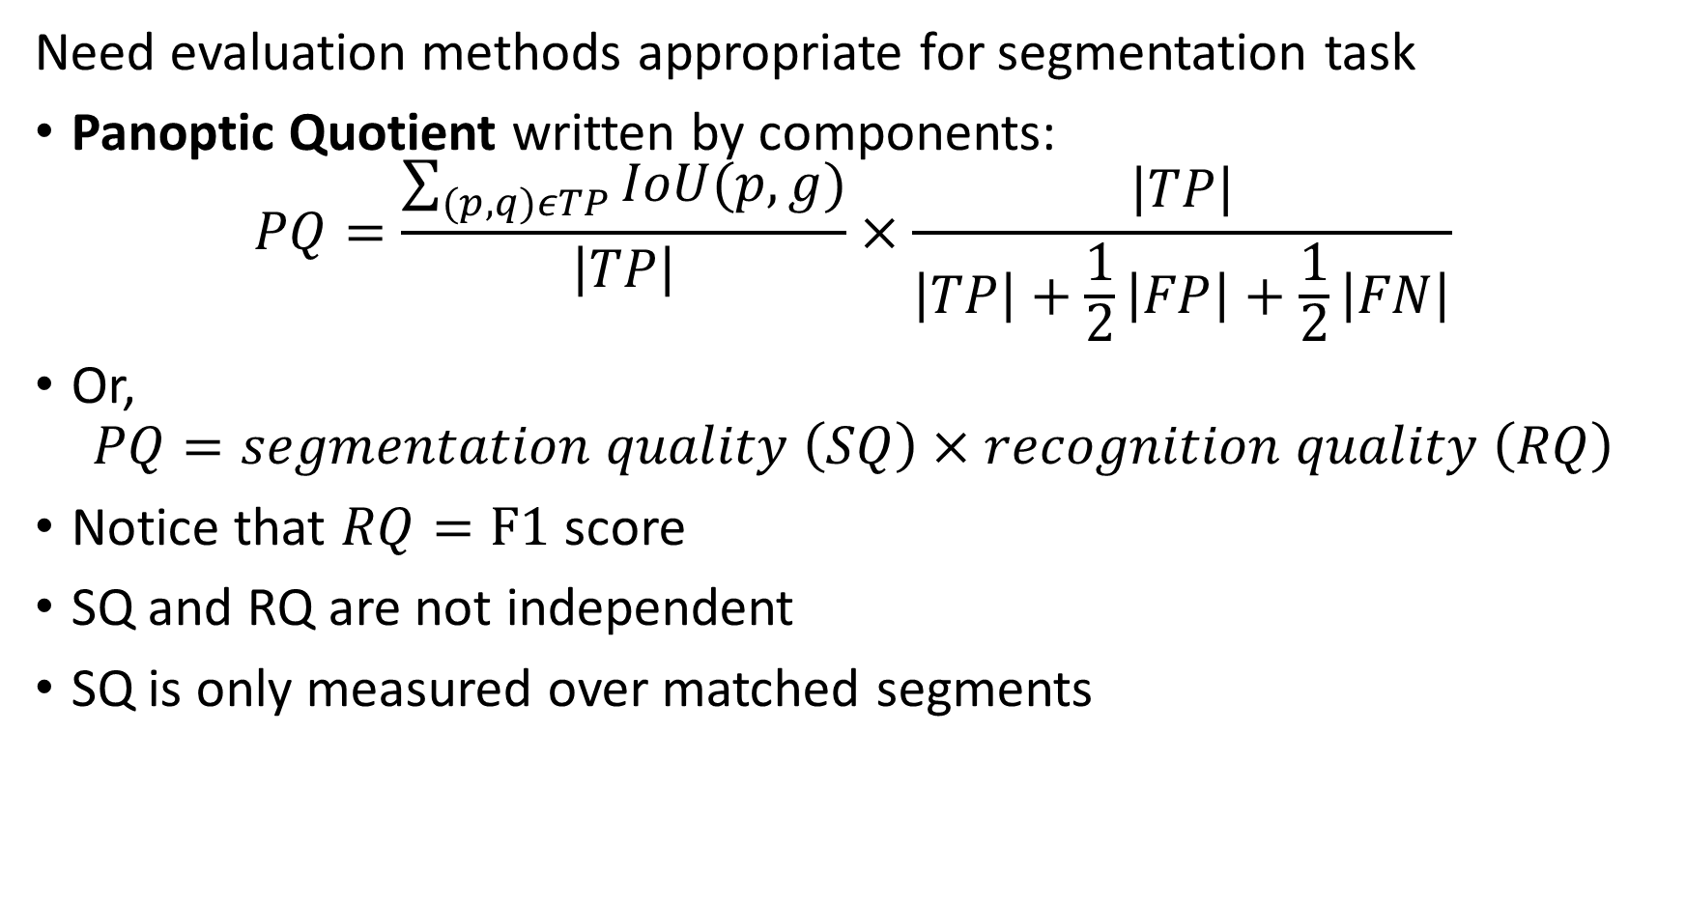
Evaluation of Image Segmentation Algorithms
Need evaluation methods appropriate for segmentation task
Panoptic Quotient written by components:
$$PQ=\frac{\sum_{(p,q)εTP}{IoU(p,g)}}{\left|TP\right|}×\frac{\left|TP\right|}{\left|TP\right|+\frac{1}{2}\left|FP\right|+\frac{1}{2}\left|FN\right|}$$
Or,
$$PQ=segmentation quality \left(SQ\right)×recognition quality \left(RQ\right)$$
Notice that $RQ=F1$ score
SQ and RQ are not independent
SQ is only measured over matched segments

Slide 18
Semantic Segmentation Algorithms

Slide 19
Deep Semantic Segmentation Algorithms
Semantic segmentation attempts to classify each pixel in an image
Each type of stuff (background) is classified under a single label category
Grass
Automobiles
People
Buildings
…
Classification does not differentiate between instances
Context is important in terms of semantic classification
Cars are on roads
Arms, legs, heads have specific relationships
…

Slide 20
Deep Semantic Segmentation Algorithms
Early attempts at deep semantic segmentation algorithms
Early attempts used convolutional layers followed by other layers
Fully connected layers – e.g. a VGG 16 architecture
Recurrent layers to capture spatial context
Results had limited accuracy at high computational cost
The Fully Convolutional Network (FCN), Long, et.al., 2014, was reasonably accurate
Based on VGG-16, but replace FC layers with softmax layer
Achieved context sensitivity by multiple down-samples with 2x2 max-pooling layers
Could not adapt to different scales
Produced blocky output – not pixel accurate

Slide 21
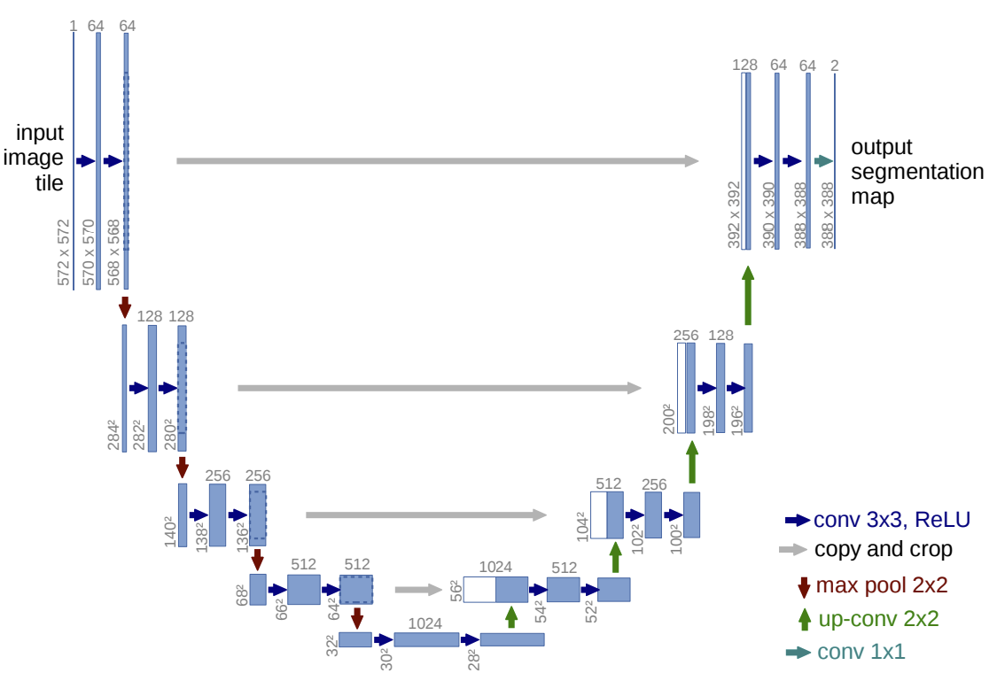
Deep Semantic Segmentation Algorithms
U-Net, Ronneberger, et. al, 2015, is a fully convolutional architecture
U-Net use an encoder-decoder architecture
Convolutional encoder layers create feature map
Encoder layers down-sample to 5 decreasing scales with 2x2 max-pooling – a feature pyramid
Decoder layers are up-sample with 2x2 convolution
Encoder Layers
Decoder Layers
1
2
3
4
5

Slide 22
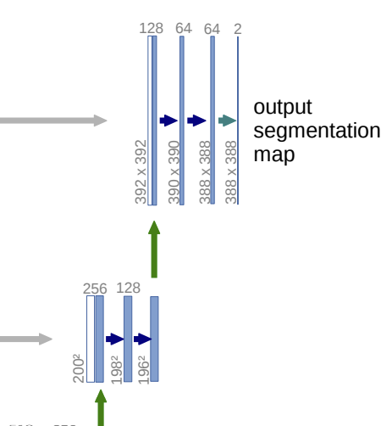
Deep Semantic Segmentation Algorithms
U-Net, Ronneberger, et. al, 2015, is a fully convolutional architecture
U-Net Decoder layers concatenate up-sampled and output from encoder Convolutional layers
Concatenation at all levels but largest scale
Concatenation maintains context information at all scales
Segmentation map output using softmax layer at full resolution

Slide 23
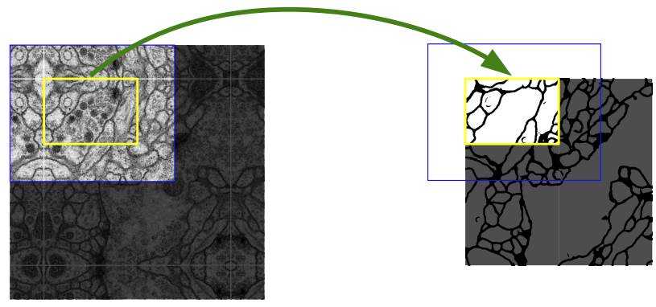
Deep Semantic Segmentation Algorithms
U-Net, Ronneberger, et. al, 2015, is a fully convolutional architecture
To maintain context and scale U-Net divides large images into overlapping tiles
Pixel-level segmentation performed on each tile and jointed by edge interpolation

Slide 24
Deep Semantic Segmentation Algorithms
Can perform up-sampling with transposed convolution
Can up-sample by using regular convolution with a fractional stride
But, inefficient in terms of computation and memory use
Transposed convolution originally proposed as Deconvolution Networks, Zeiler, et.al., 2010
Convolution down-samples image
Deconvolution is the inverse of forward convolution
Deconvolution up-samples image
Construct transpose convolution operator by using transpose of forward convolution kernel

Slide 25
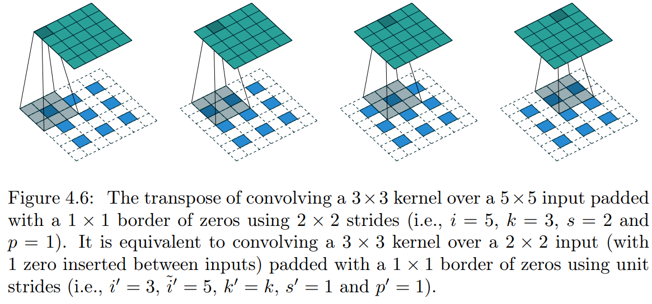
Deep Semantic Segmentation Algorithms
Can perform up-sampling with transposed convolution
Can up-sample by applying the transposed (inverse) convolution
Can apply to (conceptually) padded spare input tensor
Is memory and computationally more efficient than using fractional stride
From A guide to Convolution Arithmetic for Deep Learning, Dumoulin and Visin 2016

Slide 26
Deep Semantic Segmentation Algorithms
SegNet, Badrinarayanan, et. al., 2016, was created to overcome limitations of U-Net
U-Net is effective, but uses considerable memory
Concatenation operation doubles memory requirement
Slows execution
Despite these limitation, UNET is still widely applied
SegNet, also uses an encoder-decoder architecture
Reduces memory use
More efficient execution
Keras implementation of UNET architecture
See the Segmentation section of the computer vision section of Keras hub for additional implementations

Slide 27
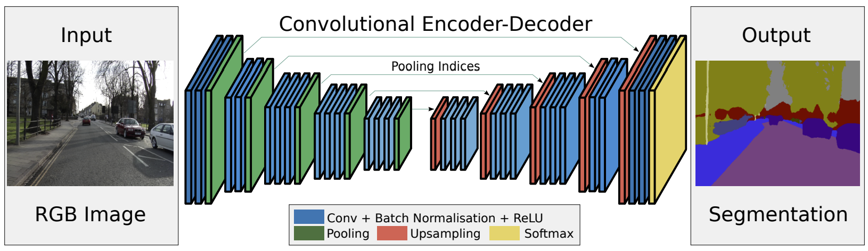
Deep Semantic Segmentation Algorithms
SegNet, Badrinarayanan, et. al., 2016, uses a fully convolutional encoder-decoder architecture
Encoder is based on VGG-16, less FC layers
Encoder down-samples with 2x2 max-pooling
Decoder is inverse convolutional layers of VGG-16
Decoder up-samples with 2x2 convolution
Encoder Layers
Decoder Layers

Slide 28
Deep Semantic Segmentation Algorithms
SegNet, Badrinarayanan, et. al., 2016, uses a fully convolutional encoder-decoder architecture
Encoder creates feature pyramid
Detail at fine scale
Context at coarse scale
Encoder Layers
Decoder Layers

Slide 29
Deep Semantic Segmentation Algorithms
SegNet, Badrinarayanan, et. al., 2016, uses a fully convolutional encoder-decoder architecture
Output layer is softmax layers – In yellow
Classifies each pixel
Dense classification
Network training with categorical cross-entropy loss
Encoder Layers
Decoder Layers

Slide 30
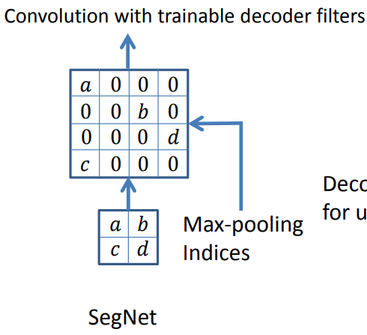
Deep Semantic Segmentation Algorithms
SegNet, Badrinarayanan, et. al., 2016, uses a fully convolutional encoder-decoder architecture
SegNet does not use concatenation with feature pyramid to save memory
Max-pooling indices created in feature pyramid
Max-pooling indices map value to up-sampled image
Convolution layer decodes the values to higher-resolution feature map
Max-pooling indices require less memory – similar to a hash table

Slide 31
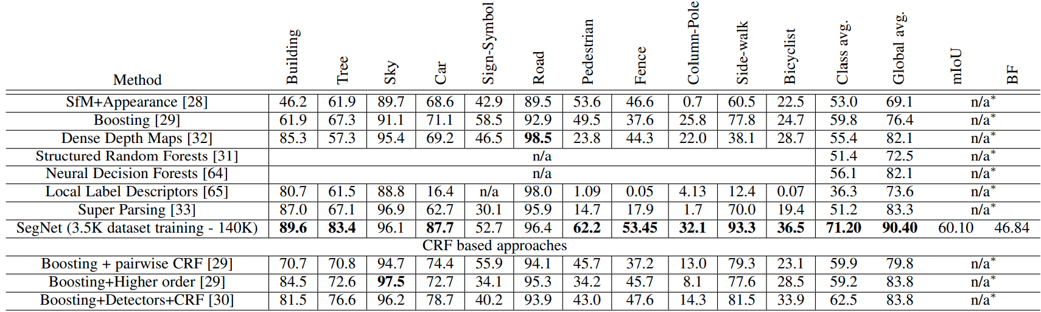
Deep Semantic Segmentation of Images
How well does SegNet, work?
Find many more details in Badrinarayanan, et. al., 2016

Slide 32
Deep Semantic Segmentation of Images
Example: Outdoor and indoor semantic segmentation with SegNet
From: Badrinarayanan, et. al., 2016

Slide 33
Instance Segmentation Algorithms

Slide 34
Deep Instance Segmentation Algorithms
Instance segmentation algorithms seek to label pixels for individual instances of objects, things
In contrast, Semantic segmentation attempts to label pixels of the same type of stuff
Instance segmentation is more challenging task
Is multi-task problem, object detection and segmentation of things in image
Background pixels are left unclassified
Instance segmentation is closely related to object detection

Slide 35
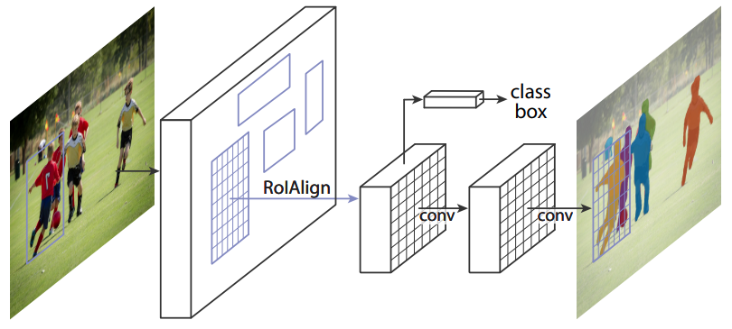
Deep Instance Segmentation Algorithms
Mask R-CNN, He, et. al, 2018, was a significant advance in instance segmentation
Earlier architectures required multiple steps:
Segment, then apply object detection for instances
Perform object detection for instances then segment
He, et.al. created an architecture that performs tasks in parallel

Slide 36
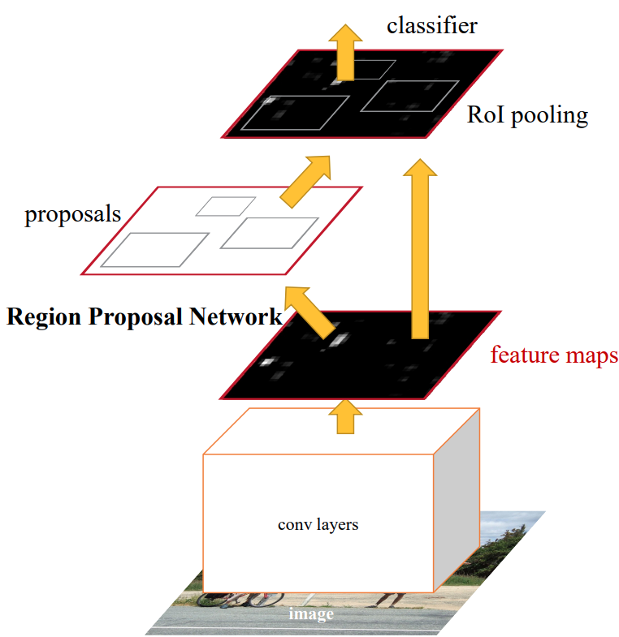
Deep Instance Segmentation Algorithms
Mask R-CNN is based on Faster R-CNN, Ren, et. al., 2016
Faster R-CNN can use any pre-trained convolutional model to create feature maps
A branch computes region proposals and different scales for objects
Region of interest (RoI) pooling combines features with proposals
Classifier identifies and classifies objects
Non-maximal suppression used to find best RoIs and object categories

Slide 37
Deep Instance Segmentation Algorithms
Mask R-CNN, He, et. al, 2018, was a significant advance in instance segmentation
Mask R-CNN is based on the Faster R-CNN architecture
Mask R-CNN adds a branch to create mask for each category in each RoI
Mask has pixel-level resolution
Binary classifier selects mask within each RoI

Slide 38
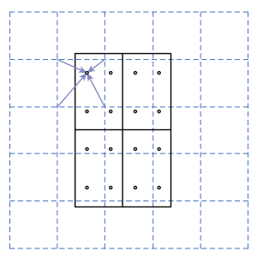
Deep Instance Segmentation Algorithms
Increasing resolution in Mask R-CNN
Faster R-CNN RoIPooling coarsely quantized onto coarse 7x7 feature map
RoIPooling does not allow accurate segmentation
Mask R-CNN uses RoIAlign to achieve pixel-level segmentation accuracy
RoIAlign uses bilinear interpolation to compute 4 values in each bin
Apply max or average pooling

Slide 39
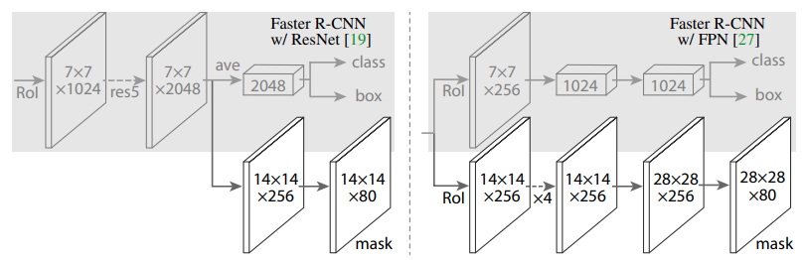
Deep Instance Segmentation Algorithms
Head architectures for Mask R-CNN
Head branches used to label object pixels, the mask
He, et. al., tried several backbones with corresponding head architectures
Different head architectures reflect how different scale are managed in backbone

Slide 40
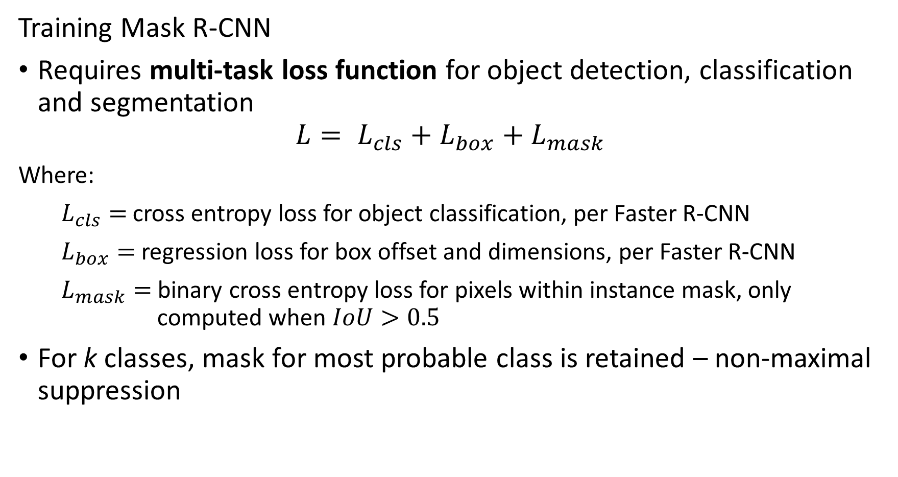
Deep Instance Segmentation Algorithms
Training Mask R-CNN
Requires multi-task loss function for object detection, classification and segmentation
$$L= L_{cls}+L_{box}+L_{mask}$$
Where:
$L_{cls}=$ cross entropy loss for object classification, per Faster R-CNN
$L_{box}=$ regression loss for box offset and dimensions, per Faster R-CNN
$L_{mask}=$ binary cross entropy loss for pixels within instance mask, only computed when $IoU>0.5$
For k classes, mask for most probable class is retained – non-maximal suppression

Slide 41
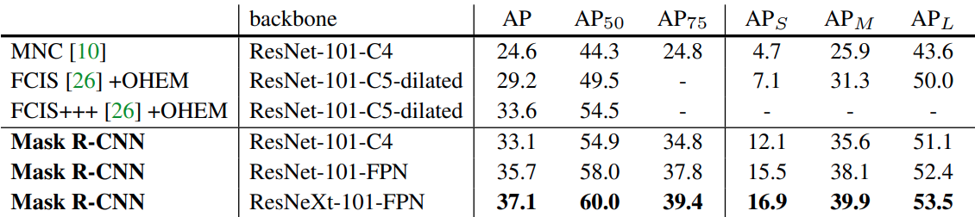
Deep Instance Segmentation of Images
How well does Mask R-CNN work?
He, et. al., compared Mask R-CNN to other models and to various choices of feature map generating backbones
Find many more details in He, et. al, 2018

Slide 42
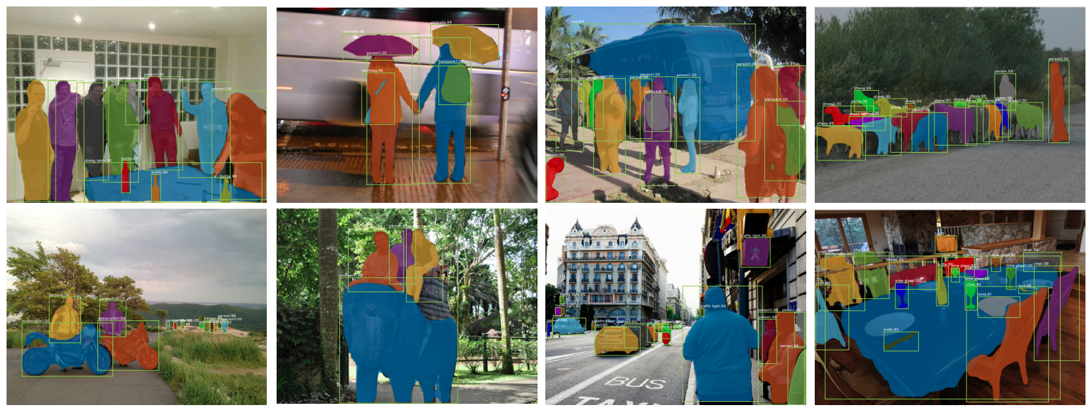
Deep Instance Segmentation of Images
Example: Indoor and outdoor Instance segmentation with Mask R-CNN
From: He, et. al, 2018

Slide 43
Panoptic Segmentation Algorithms

Slide 44
Deep Panoptic Segmentation Algorithms
Panoptic segmentation combines the instance segmentation and semantic segmentation tasks
Instance segmentation of foreground objects
Semantic segmentation of background pixels
Evaluate joint task with PQ
Or, independently evaluate:
mAP, mIoU, for instance segmentation
Average accuracy, AP, Dice loss, etc. for Semantic segmentation

Slide 45
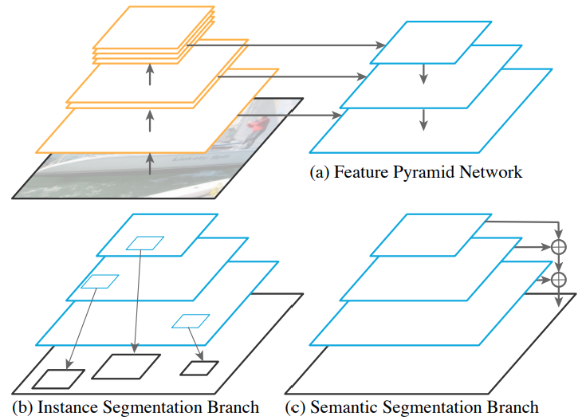
Deep Panoptic Segmentation Algorithms
Panoptic feature pyramid network, Kirillov, et. al., 2019, performs panoptic segmentation at multiple scales
Pyramid FPN uses a convolutional feature pyramid to create multi-scale feature map
Instance segmentation branch performs instance segmentation within bounding boxes
Semantic segmentation performed outside instance masks

Slide 46
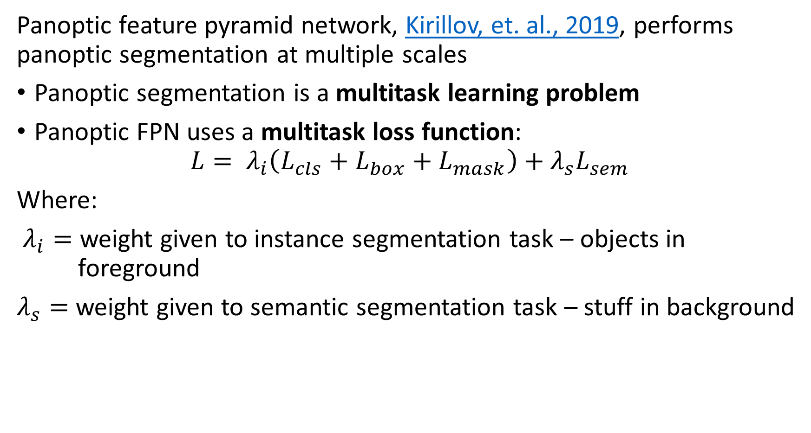
Deep Panoptic Segmentation Algorithms
Panoptic feature pyramid network, Kirillov, et. al., 2019, performs panoptic segmentation at multiple scales
Panoptic segmentation is a multitask learning problem
Panoptic FPN uses a multitask loss function:
$$L= λ_{i}\left(L_{cls}+L_{box}+L_{mask}\right)+λ_{s}L_{sem}$$
Where:
$λ_{i}=$ weight given to instance segmentation task – objects in foreground
$λ_{s}=$ weight given to semantic segmentation task – stuff in background

Slide 47
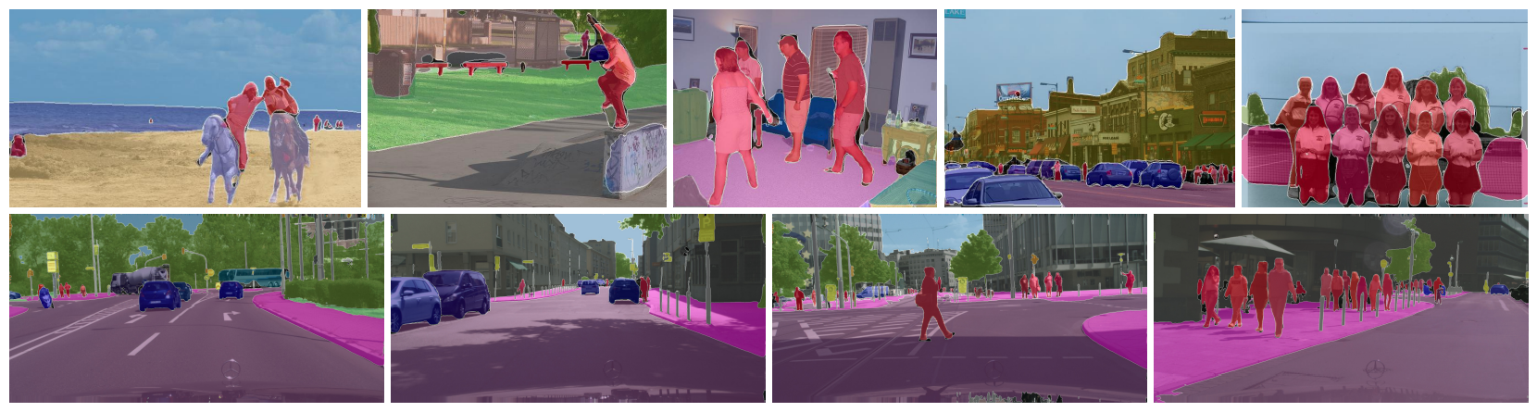
Deep Panoptic Segmentation of Images
Example: outdoor semantic segmentation with panoptic FCN
From: Kirillov, et. al., 2019

Slide 48
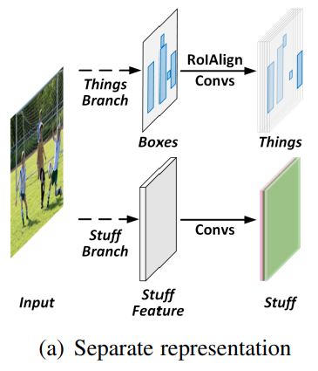
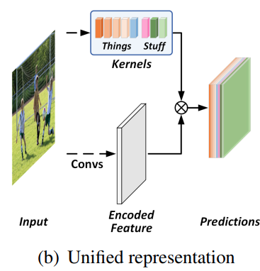
Deep Panoptic Segmentation Algorithms
Panoptic fully convolutional network, Li, et. al., 2021, was significant step forward
Pyramid FPN uses independent branches for instance and semantic segmentation tasks
To improve performance the panoptic FCN integrates both tasks by use of stuff and things kernels at several scales

Slide 49
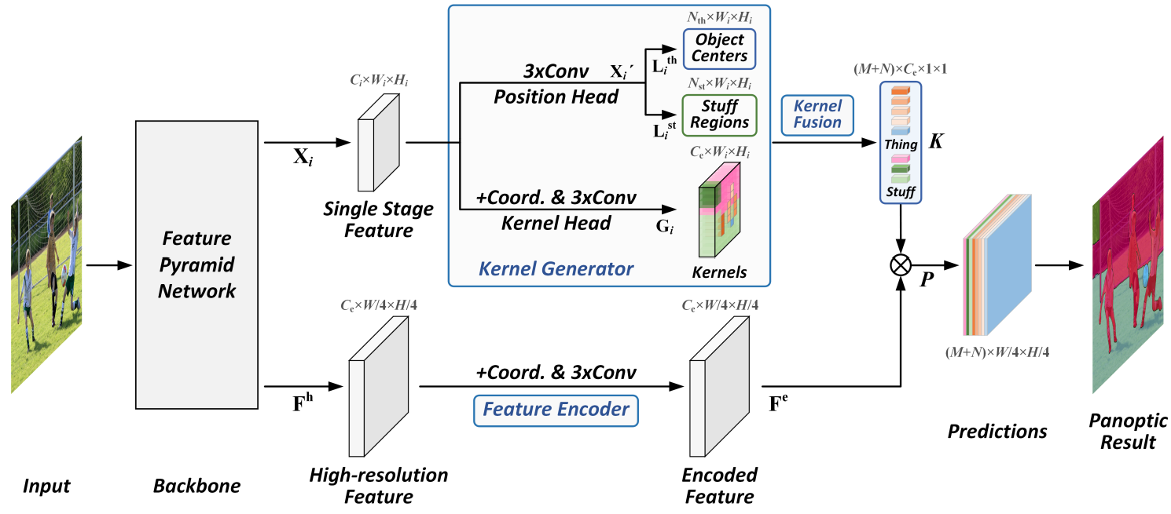
Deep Panoptic Segmentation Algorithms
Panoptic fully convolutional network, Li, et. al., 2021, was significant step forward
Feature pyramid network creates multiscale feature map
Encoded features have high resolution

Slide 50
Deep Panoptic Segmentation Algorithms
Panoptic fully convolutional network, Li, et. al., 2021, was significant step forward
Kernels are learned for instances (things) and semantics (stuff)
Kernel fusion creates multitask filters for stuff and things

Slide 51
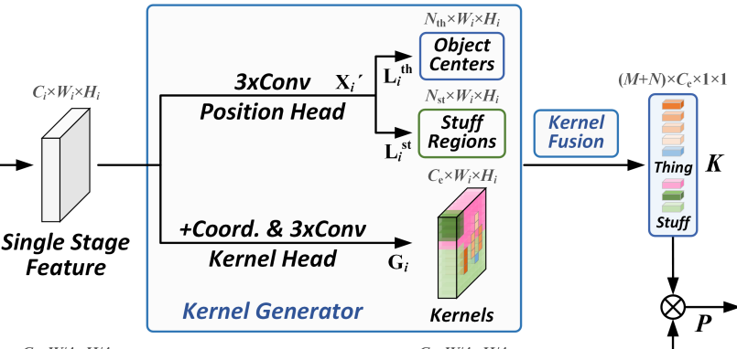
Deep Panoptic Segmentation Algorithms
Panoptic FCN uses two heads for position and kernel generation
Position head finds object centers for both stuff and things
Kernel head generates kernels at each scale for each class of stuff and things
Kernel fusion integrates kernels across scales and over stuff and things
Use cosine similarity over channels to determine context

Slide 52
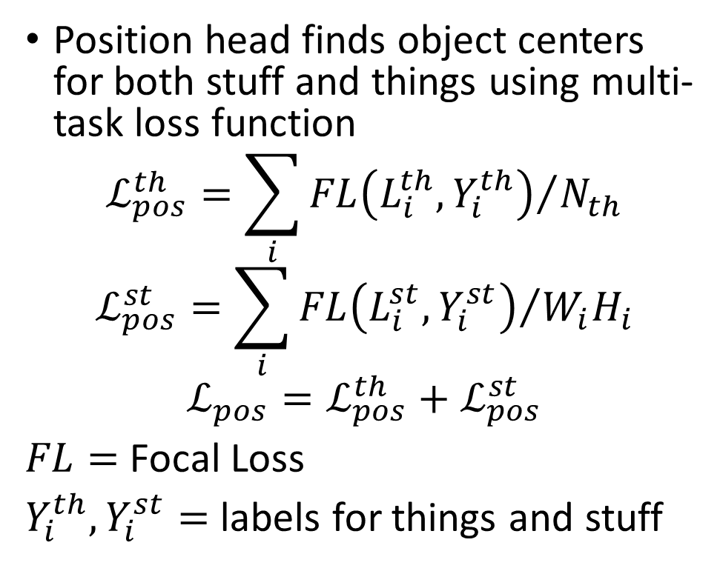
Deep Panoptic Segmentation Algorithms
Panoptic FCN uses two heads for position and kernel generation
Position head finds object centers for both stuff and things using multi-task loss function
$$ℒ_{pos}^{th}=\sum_{i}{{FL\left(L_{i}^{th},Y_{i}^{th}\right)}/{N_{th}}}$$
$$ℒ_{pos}^{st}=\sum_{i}{{FL\left(L_{i}^{st},Y_{i}^{st}\right)}/{W_{i}H_{i}}}$$
$$ℒ_{pos}^{ }=ℒ_{pos}^{th}+ℒ_{pos}^{st}$$
$FL=$ Focal Loss
$Y_{i}^{th},Y_{i}^{st}=$ labels for things and stuff

Slide 53
Deep Panoptic Segmentation Algorithms
Class imbalance with panoptic segmentation
Class imbalance is a significant problem when training panoptic segmentation models
Example: Foreground objects are generally only a small fraction of pixels
Example: Many types of small-area background categories – e.g. stripes on a road
To overcome class imbalance problems, Li, et. al., use two approaches:
Focal loss is applied in the position head
Training the end-to-end network uses Dice loss
Can use weighted combination

Slide 54
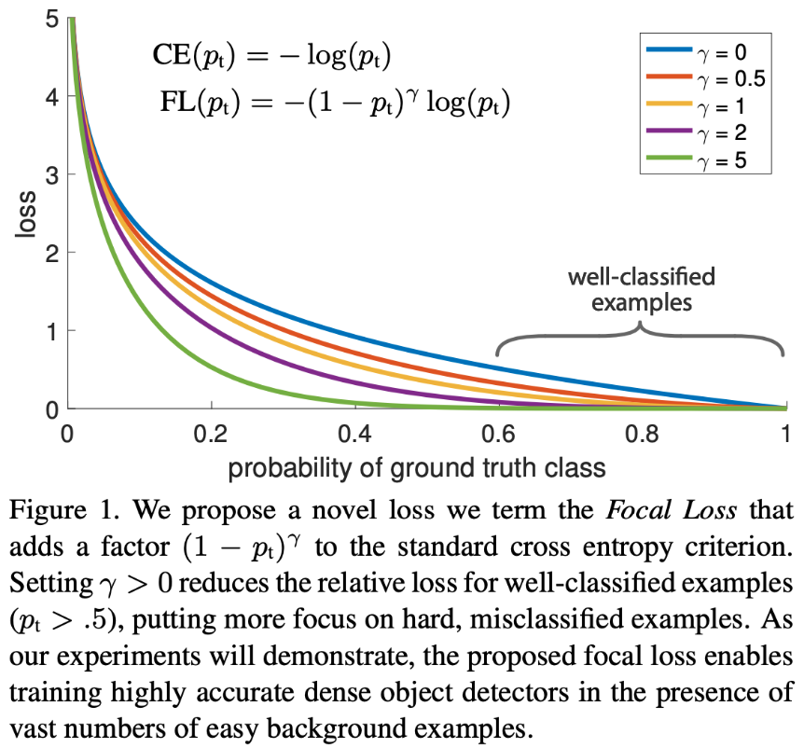
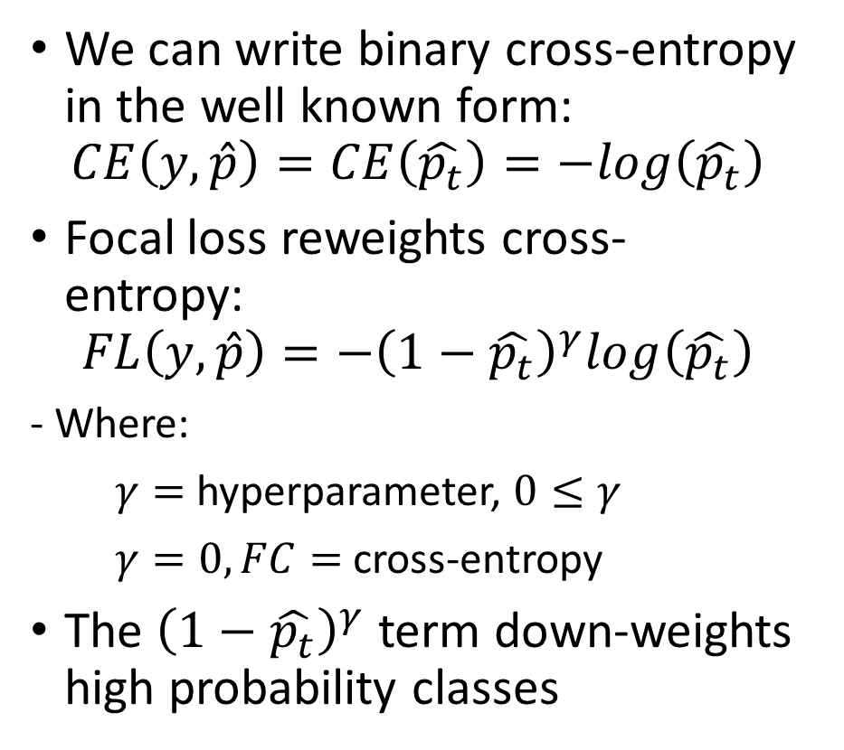
Deep Panoptic Segmentation Algorithms
Focal loss addresses class imbalance by reweighting cross-entropy
We can write binary cross-entropy in the well known form:
$$CE\left(y,\hat{p}\right)=CE\left(\hat{p_{t}}\right)=−log\left(\hat{p_{t}}\right)$$
Focal loss reweights cross-entropy:
$$FL\left(y,\hat{p}\right)={−\left(1−\hat{p_{t}}\right)}^{γ}log\left(\hat{p_{t}}\right)$$
- Where:
$γ=$ hyperparameter, $0≤γ$
$γ=0, FC=$ cross-entropy
The ${\left(1−\hat{p_{t}}\right)}^{γ}$ term down-weights high probability classes
Find many more details in Lin, et. al, 2018

Slide 55
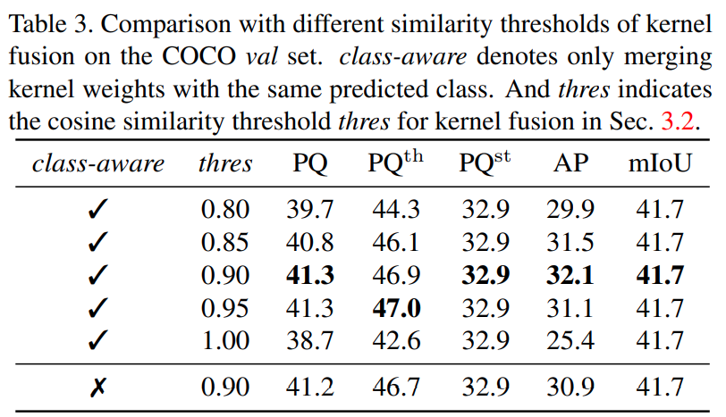
Deep Panoptic Segmentation Algorithms
Li, et. al., 2021, performed numerous experiments to optimize the panoptic FCN model
Paper includes 14 tables and 1 chart to summarize the results of these experiments
Example, Table 3 summarizes experiments on thresholds and use of class-awareness for merging kernel weights

Slide 56
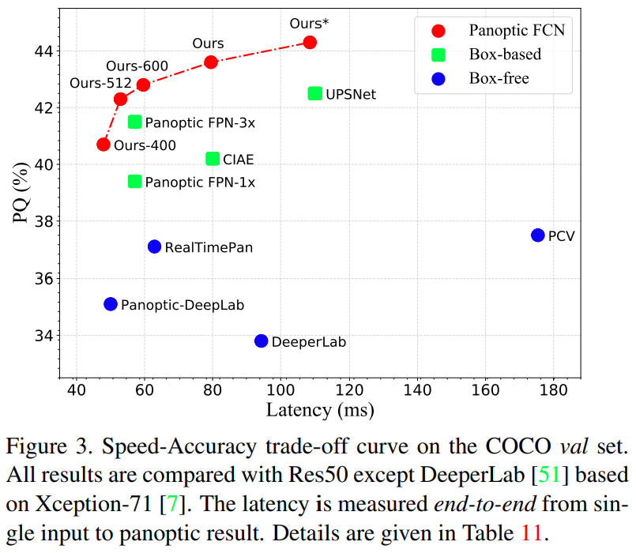
Deep Panoptic Segmentation Algorithms
How well does Panoptic FCN work?
Panoptic FCN out-performs on speed and accuracy
Integrated task architecture exhibits speed advantage
But none of these architectures achieves real-time speed

Slide 57
OneFormer: One Transformer to Rule Universal Image Segmentation

Slide 58
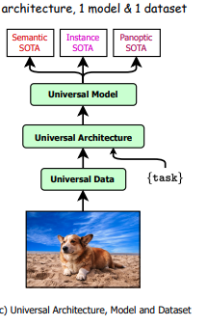
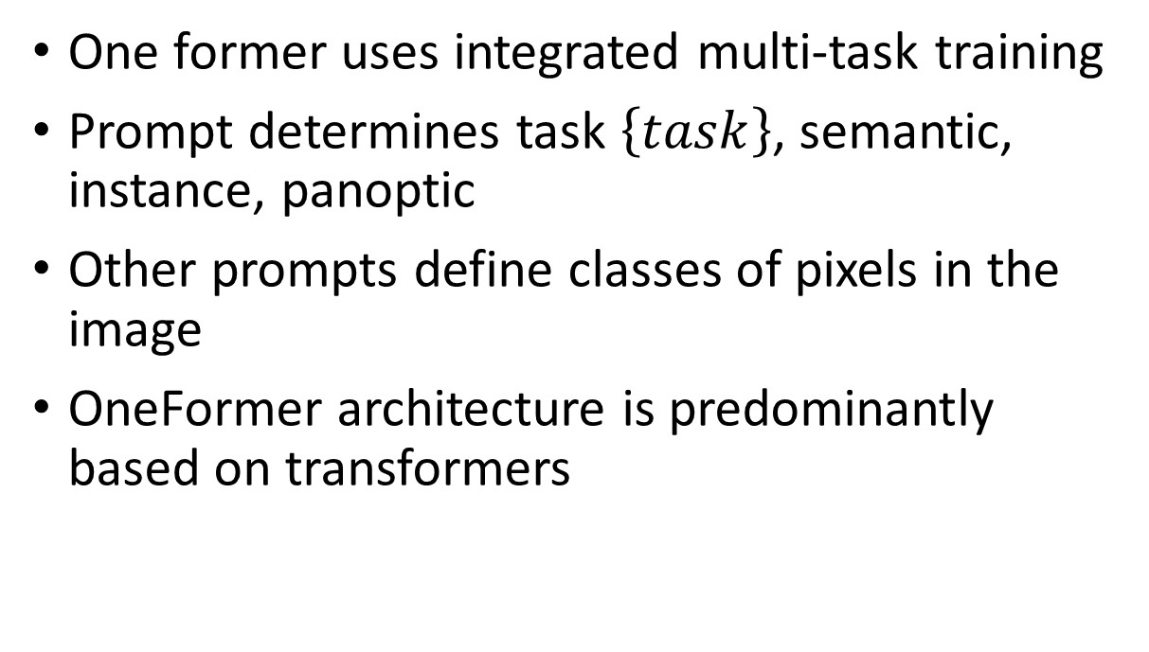
OneFormer
OneFormer, Jain, et. al., 2022, uses prompting to guide a generalized segmentation model
One former uses integrated multi-task training
Prompt determines task $\left\{task\right\}$, semantic, instance, panoptic
Other prompts define classes of pixels in the image
OneFormer architecture is predominantly based on transformers

Slide 59
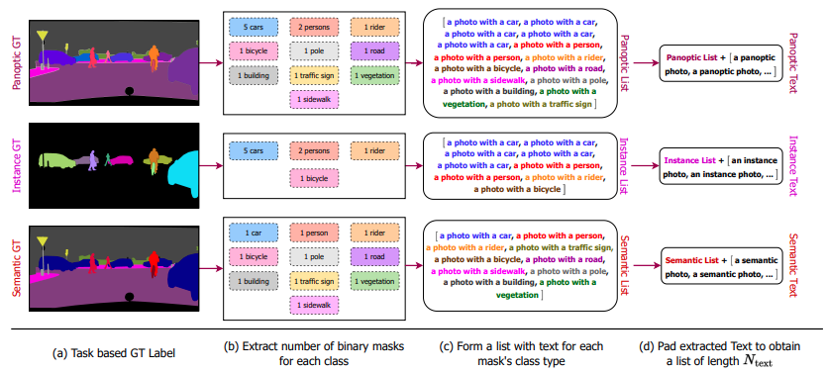
OneFormer
Prompts sets are specific to the segmentation task specified in the $\left\{task\right\}$ prompt

Slide 60
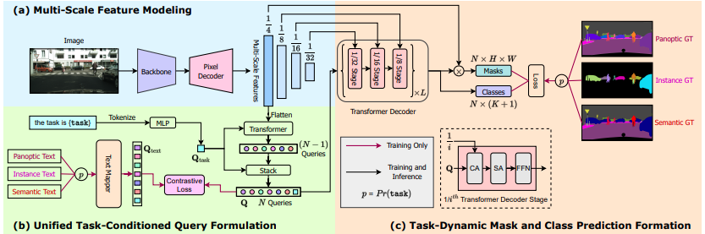
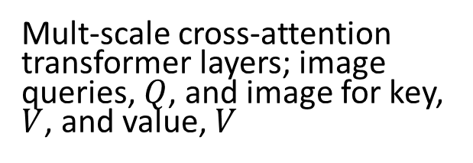
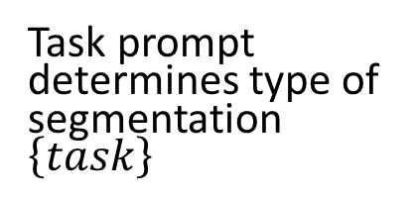
OneFormer
OneFormer, Jain, et. al., 2022, uses prompting to guide a generalized segmentation model
Mult-scale cross-attention transformer layers; image queries, $Q$, and image for key, $V$, and value, $V$
Transformer UNET encoder-decoder backbone
Inverted scale transformer pyramid
Task prompt determines type of segmentation $\left\{task\right\}$
Class specific prompts sets
Prompts are embedded into N text queries
N image queries

Slide 61
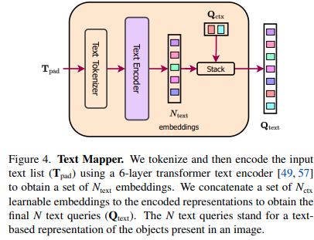
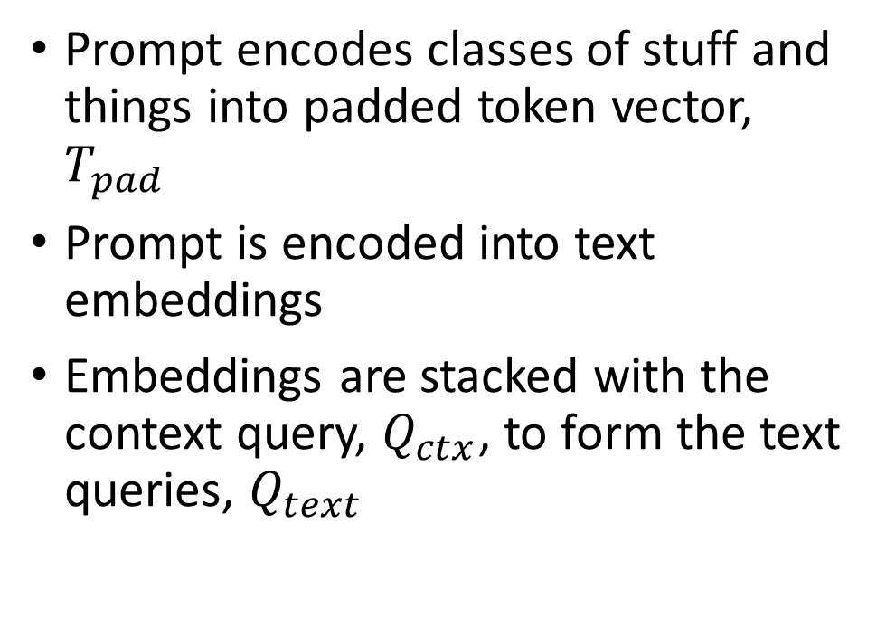
Deep Panoptic Segmentation Algorithms
Text queries are encoded from a context query, $Q_{ctx}$, and context specific prompts, $T_{pad}$
Prompt encodes classes of stuff and things into padded token vector, $T_{pad}$
Prompt is encoded into text embeddings
Embeddings are stacked with the context query, $Q_{ctx}$, to form the text queries, $Q_{text}$

Slide 62
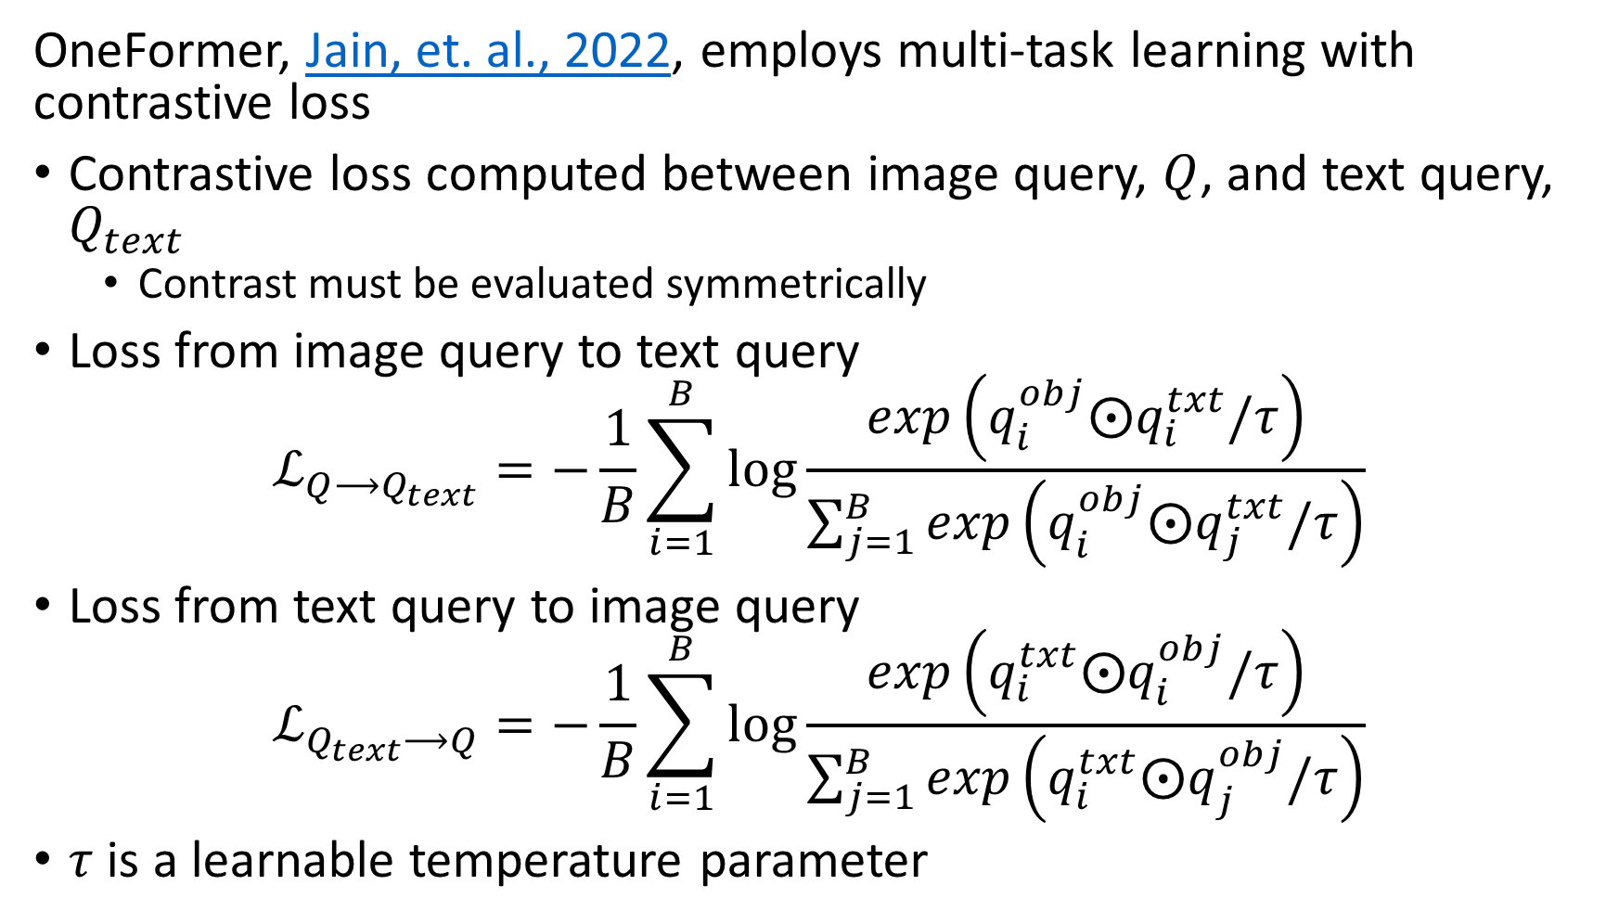
OneFormer
OneFormer, Jain, et. al., 2022, employs multi-task learning with contrastive loss
Contrastive loss computed between image query, $Q$, and text query, $Q_{text}$
Contrast must be evaluated symmetrically
Loss from image query to text query
$$ℒ_{Q⟶Q_{text}}=−\frac{1}{B}\sum_{i=1}^{B}{\log{\frac{exp\left(q_{i}^{obj}⨀q_{i}^{txt}/τ\right)}{\sum_{j=1}^{B}{exp\left(q_{i}^{obj}⨀q_{j}^{txt}/τ\right)}}}}$$
Loss from text query to image query
$$ℒ_{Q_{text}⟶Q}=−\frac{1}{B}\sum_{i=1}^{B}{\log{\frac{exp\left(q_{i}^{txt}⨀q_{i}^{obj}/τ\right)}{\sum_{j=1}^{B}{exp\left(q_{i}^{txt}⨀q_{j}^{obj}/τ\right)}}}}$$
$τ$ is a learnable temperature parameter

Slide 63
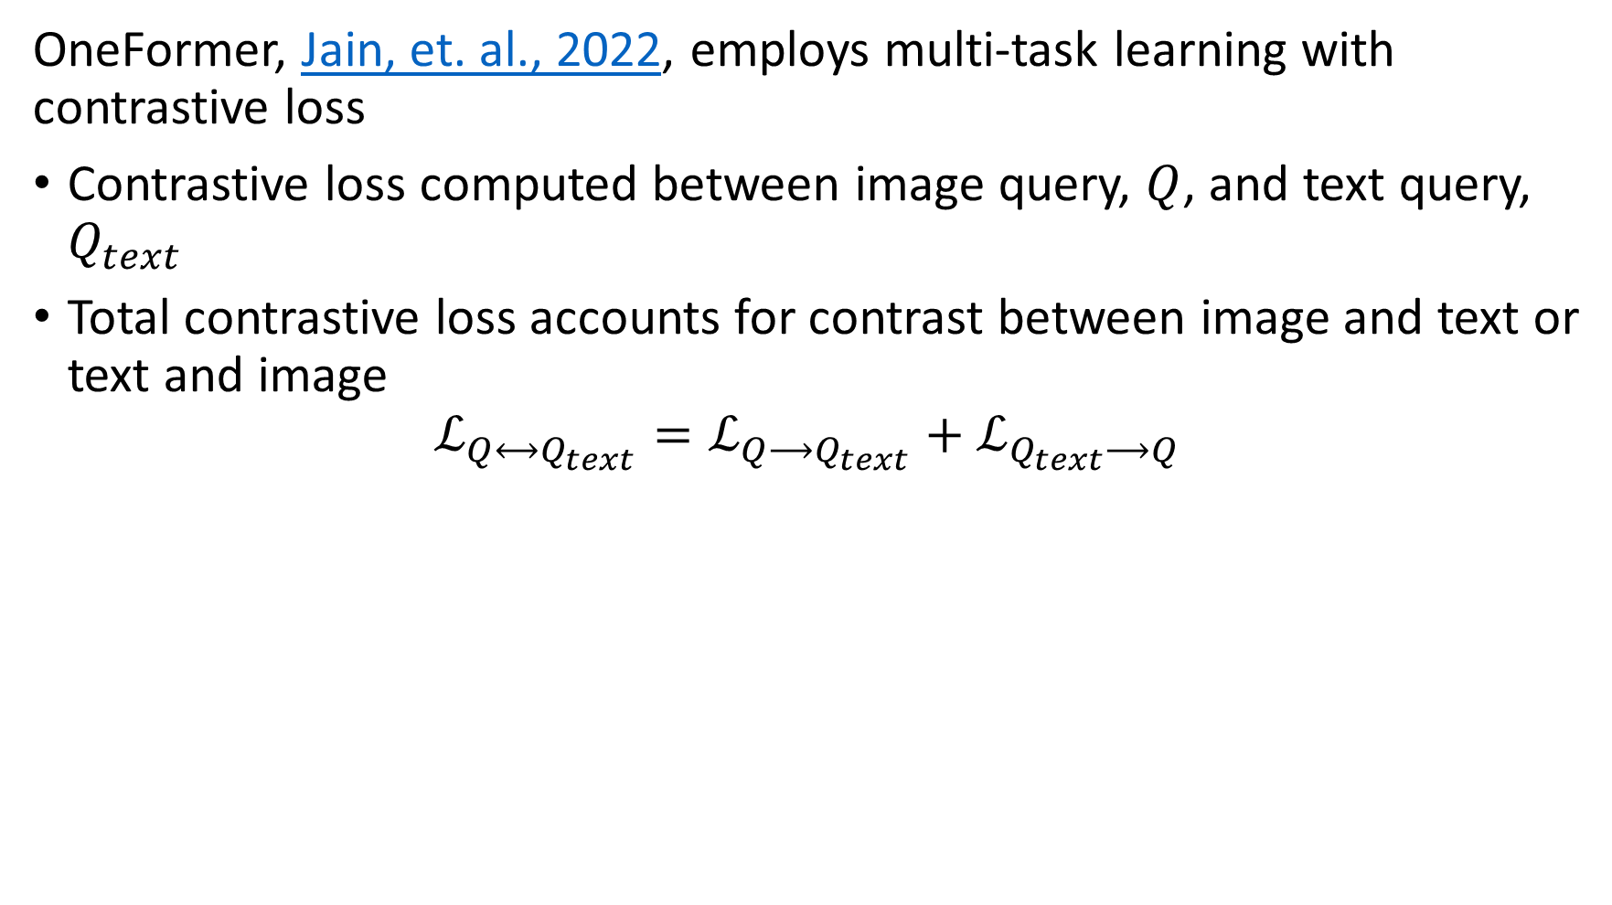
OneFormer
OneFormer, Jain, et. al., 2022, employs multi-task learning with contrastive loss
Contrastive loss computed between image query, $Q$, and text query, $Q_{text}$
Total contrastive loss accounts for contrast between image and text or text and image
$$ℒ_{Q⟷Q_{text}}={ℒ_{Q⟶Q_{text}}+ℒ}_{Q_{text}⟶Q}$$

Slide 64
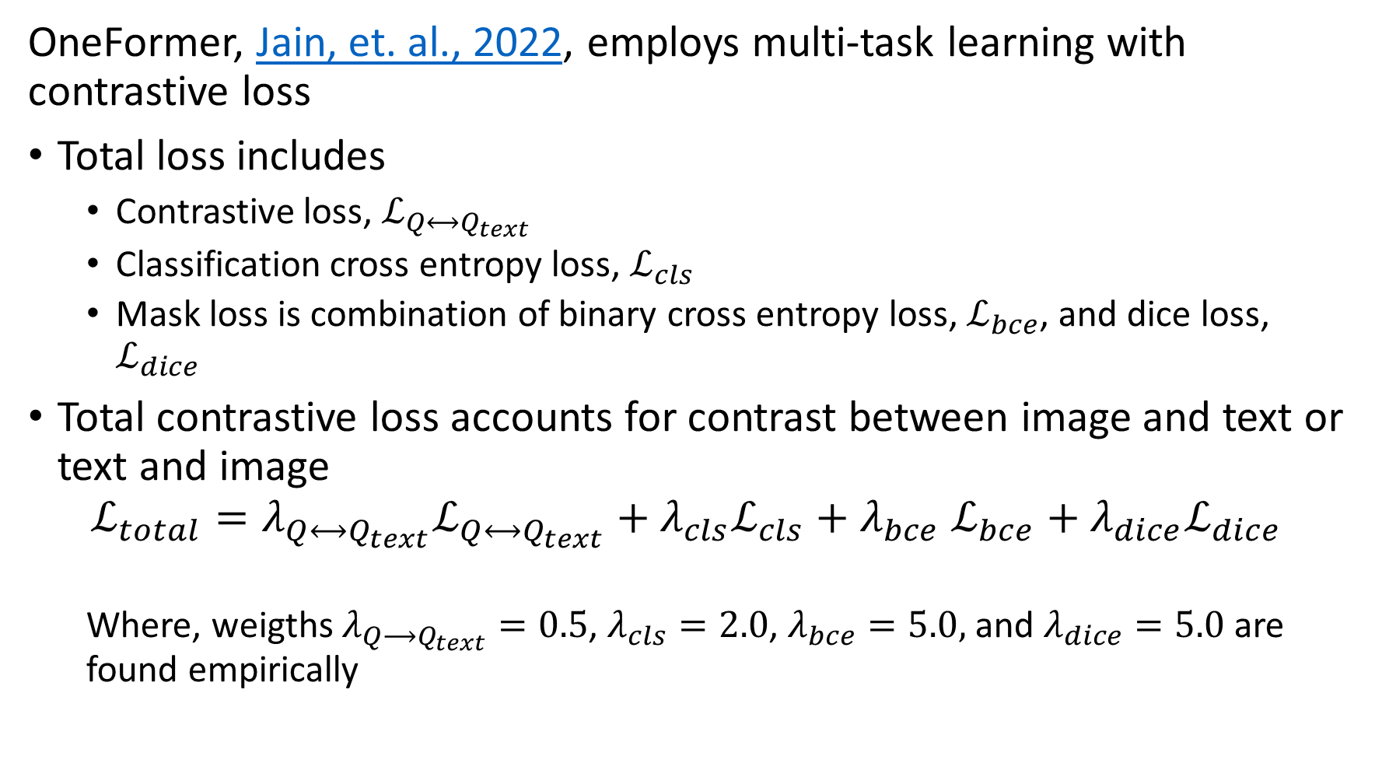
OneFormer
OneFormer, Jain, et. al., 2022, employs multi-task learning with contrastive loss
Total loss includes
Contrastive loss, $ℒ_{Q⟷Q_{text}}$
Classification cross entropy loss, $ℒ_{cls}$
Mask loss is combination of binary cross entropy loss, $ℒ_{bce}$, and dice loss, $ℒ_{dice}$
Total contrastive loss accounts for contrast between image and text or text and image
$$ℒ_{total}=λ_{Q⟷Q_{text}}{ℒ_{Q⟷Q_{text}}+λ_{cls}ℒ}_{cls}+λ_{bce} ℒ_{bce}+λ_{dice}ℒ_{dice}$$
Where, weigths $λ_{Q⟶Q_{text}}=0.5$, $λ_{cls}=2.0$, $λ_{bce}=5.0,$ and $λ_{dice}=5.0$ are found empirically

Slide 65
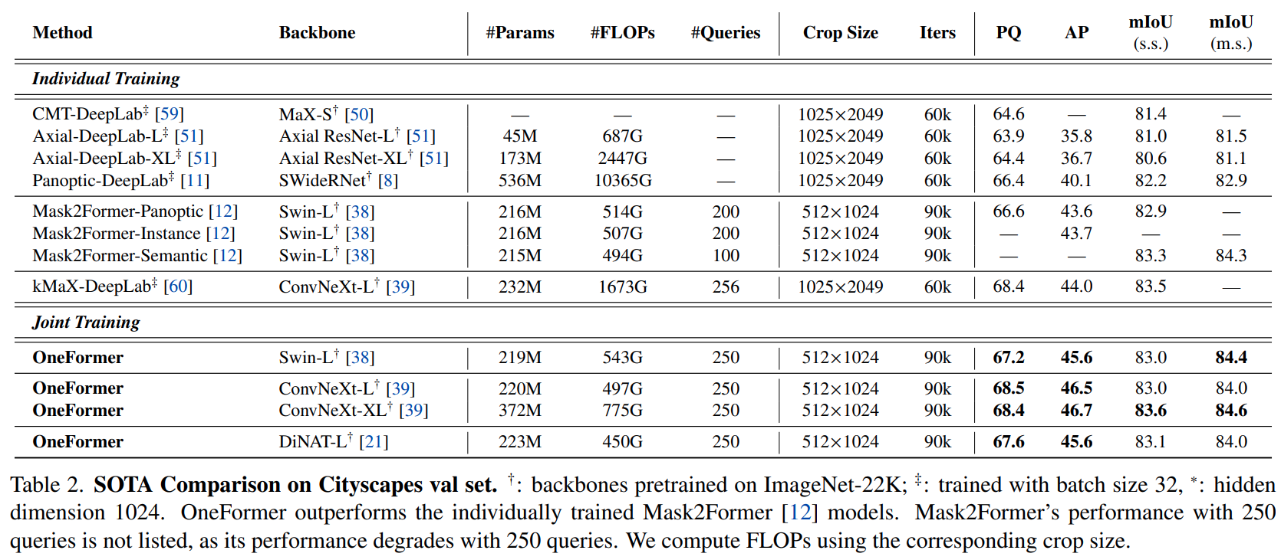
OneFormer
How well does OneFormer work?
Multi-task training of OneFormer achieves SOTA performance

Slide 66
SAM: A New Approach?

Slide 67
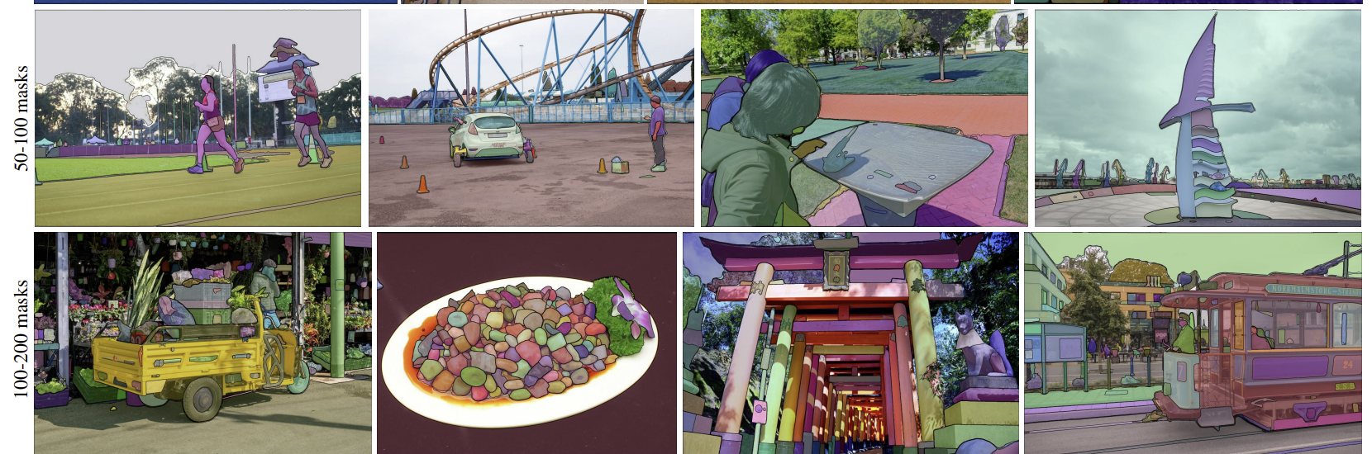
SAM is attempt at universal segmentation model
Segment Anything Model (SAM) is an ambitious attempt to unify segmentation tasks
SAM is a generalization of the SegFormer model by Xie, et.al., 2021
Keras example of Segformer
SAM is created by Kirillov, et.al., 2023
The SAM GitHub page includes pre-trained encoder and examples in PyTorch
Keras implementation example

Slide 68
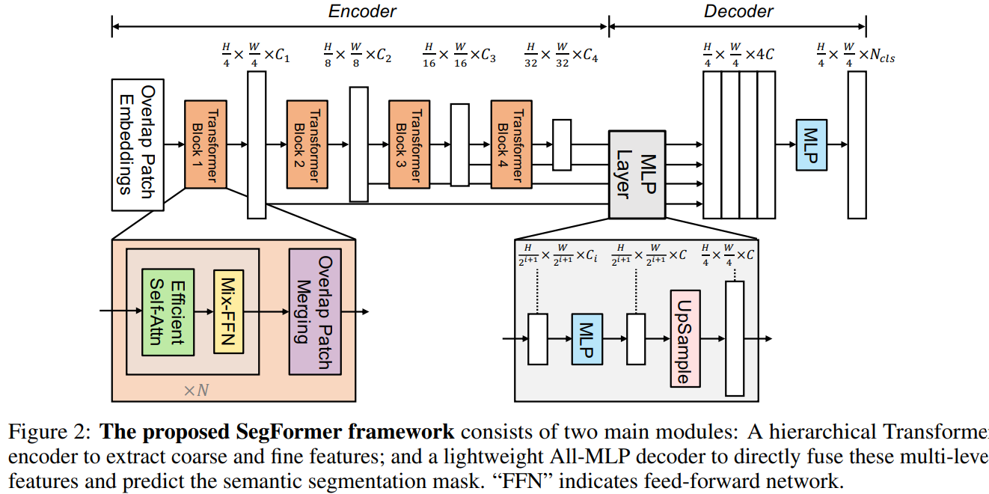

SegFormer Performs Semantic Segmentation
SegFormer has a novel encoder-decoder architecture
SegFomer encoder employs an hierarchical transformer architecture
Feature pyramid scales by octaves
Reduction factors of $C=\left[64,16,4,1\right]$ reduce computation of $O\left(n^{2}\right)$ self attention
Transformer layers are position-encoder free
Diagram from Xie, et.al., 2021

Slide 69
SegFormer Performs Semantic Segmentation
SegFormer has a novel encoder-decoder architecture
SegFomer decoder is uses only multi-layer preceptron (MLP) layers
MLP layers integrates all scales from encoder
MLP layer produces segmentation mask from decoded feature volume
Diagram from Xie, et.al., 2021

Slide 70
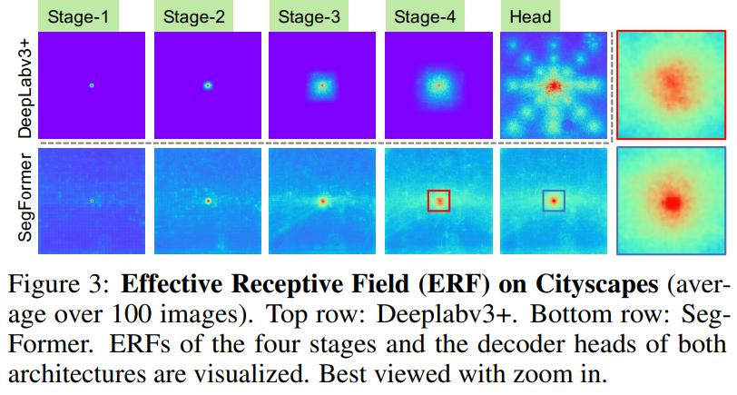
SegFormer Performs Semantic Segmentation
The transformer encoder in SegFormer produces features with greater context
Comparison of SegFomer layers with DeepLabv3+, Chen, et.al., 2018, a fully convolutional network (FCN)
Notice SegFomer activations are more global and location specific
Diagram from Xie, et.al., 2021

Slide 71
SAM is attempt at universal segmentation model
SAM is a system, not just a model, with properties:
Task: SAM attempts to generalize guided segmentation tasks
Create multiple responses to an ambiguous prompts
Response is guided, semantic, instance or panoptic
Prompts can be points, box or text
Model: Encoder-decoder architecture
Uses self-supervised leaning
Goal of zero-shot transfer learning
Data Engine: Manage collection and use of massive dataset for training
Dataset and Responsible AI: Training images drawn for many sources, regions and with wide range of content

Slide 72

SAM tries to deal with ambiguous prompts
SAM generates 3 levels of valid segmentation masks in response to ambiguous prompt
Example: Start with point prompt
Entire object mask
Subpart mask
Sub-subpart mask

Slide 73

SAM uses an encoder-decoder architecture
SAM uses MAE to map image to embedding space
Input image to segment
Embedded image tokens
Heavy-weight encoder with up to 12 multi-headed ViT blocks

Slide 74
SAM uses an encoder-decoder architecture
SAM produces 3 valid mask candidates for each ambiguous prompt
Mask with highest score (probability) output
Light weight mask decoder with 4 4-headed ViT units
Mask down-sampled with CNN
Prompts encoded by MLP

Slide 75


SAM uses an encoder-decoder architecture
The SAM encoder is based on Masked Autoencoder (MAE) by He, et.al., 2021
MAE uses self-supervised learning
Encoder and (disposable) decoder learn to replicate missing patches in training images
High probability of missing patch works best; $p>0.75$

Slide 76

SAM uses an encoder-decoder architecture
The SAM encoder is based on MAE by He, et.al., 2021
Positionally encoded unmasked patches
ViT encoder for sampled patches
ViT decoder for positionally sampled and masked patches
Masked image
positionally encoded patches
Reconstructed image
Dice and focal loss used for backpropagation

Slide 77
Training SAM
SAM is trained by combination of :
Training performed in steps:
Start with small number of human labeled images
Progress to larger number of automatically labeled, human evaluated cases
Finally, use vast number of self-supervised cases
Backpropagation with 10% dice loss and 90% focal loss

Slide 78
SAM may have some inherent pitfalls
SAM has impressive capabilities, but:
Speed: Computational burden per-image not documented
Segformer required considerable computing power
Several performance compromises to reduce computational burden
SAM2, Ravi, et. al., 2024, has significant speed improvements, up to 6x
Focus on zero-shot training: How can SAM be tuned for specific task?
Presently task-specific models outperform the generalized model
Ambiguity of masks: May not provide the desired result
Potential problem for tasks where specific accuracy is essential

Slide 79
Short Bibliography For Further Reading
UNET 3+: A Full-Scale Connected Unet for Medical Image Segmentation, Huang, et.al., 2020
EfficientPS: Efficient Panoptic Segmentation, Mohan and Valada, 2021
Masked-attention Mask Transformer for Universal Image Segmentation, Cheng, et. al., 2022
Neighborhood Attention Transformer, Sassani, et. al., 2022
SLiMe: Segment Like Me, Khani, et. al., 2023
3D-VisTA: Pre-trained Transformer for 3D Vision and Text Alignment, Zhu, et. al., 2023
SegGPT: Segmenting Everything In Context, Wang, et. al., 2023
U-Mamba: Enhancing Long-range Dependency for Biomedical Image Segmentation, Ma, Li, Wang, 2024

Slide 80
Summary
Three classes of segmentation algorithms, with different objectives
Semantic segmentation attempts to classify each pixel in an image
Most commonly applied type of segmentation
Goal is scene understanding
Often referred to as stuff segmentation
Instance segmentation attempts to identify and classify the pixels representing objects in the image
Harder task than semantic segmentation
Often referred to as things segmentation
Panoptic segmentation attempts to perform both tasks simultaneously
Identify pixels associated with the things in the foreground
Background is the stuff

