Slide 1

CSCI E-25 Computer Vision
Homography and Projections
Steve Elston
Copyright 2021, 2022, 2023, 2024, 2025 Stephen F Elston. All rights reserved.

Slide 2
Homography and Projections
How do we transform between light scattered off objects and projections on a camera image plane?
Use planar projective transformation to project the image of an object to an image plane
Use projection to transform one camera pose to another
Inverse transform from image planes to real-world object location
Planar transformations use projection matrix

Slide 3
Homography and Projections
Projections are used in many computer vision applications
Warping images to adjust for camera viewpoint, aka, camera pose
Tracking moving objects – a.k.a. optical flow
Small baseline object tracking
Video stabilization
Stitching images together
Create panoramas
Complex medical image construction
3D depth map construction
Robotics and autonomous vehicles
Engineering and design
Medical imaging
Integrating different imaging types, e.g. lidar and optical – beyond scope of our course
…

Slide 4
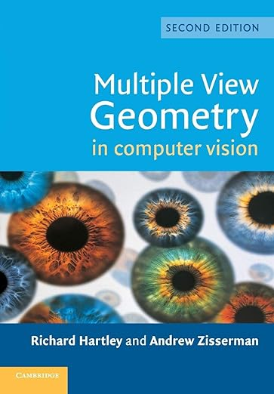
Planar transformations
Key reference on projective geometry and transformations

Slide 5
Projective Geometry

Slide 6
Projective Geometry
w
Projective transform changes view on image plane
See from above, top view, projections of 4 points on a line
Transformation projects one view to another on the image plane
Planar transformation have common Optical center
Image plane
Optical center
Projection 1
Projection 2

Slide 7
Projective Geometry
Location of points and lines in space is ambiguous in a single camera view
In top view, 4 points along a line on different world planes
All 3 sets of world plane points fall at the same points on the image plane
Planar transformation are ambiguous if more than one depth
World
Plane 3
Image plane
World
Plane 1
Optical center
World
Plane 2

Slide 8
Stereo Vision Problem
Stereo vision is a canonical problem in computer vision
Can locate a point in 3-D space from location on 2 or more image planes, seen in top view
Requires a model for the cameras
Intrinsic properties of cameras
Scene extrinsic from cameras
Solve system of camera equations to locate point in 3-D space
w
Image plane 1
Image plane 2
x₁
x₂
Optical center 1
Optical center 2

Slide 9




Image alignment
Example: How to align images from two views?
Locate interest points
For patches around the interest points extract statistics - descriptors
Matching points are identified by descriptors
Images can be warped to match – use image transformations
A₁
B₃
A₂
A₃
B₁
B₂

Slide 10
Pinhole Camera Model

Slide 11
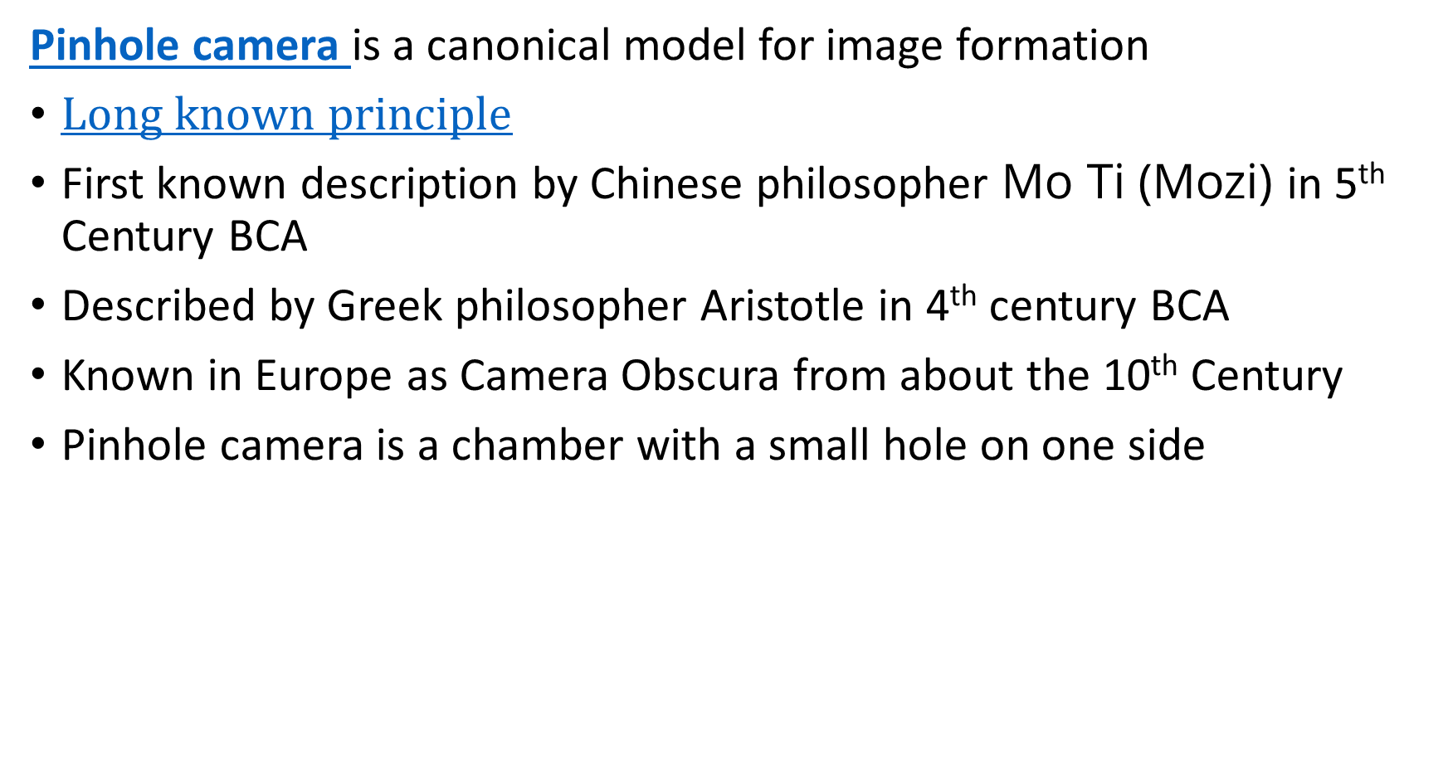
Pinhole Camera
Pinhole camera is a canonical model for image formation
$Long known principle$
First known description by Chinese philosopher Mo Ti (Mozi) in 5th Century BCA
Described by Greek philosopher Aristotle in 4th century BCA
Known in Europe as Camera Obscura from about the 10th Century
Pinhole camera is a chamber with a small hole on one side

Slide 12
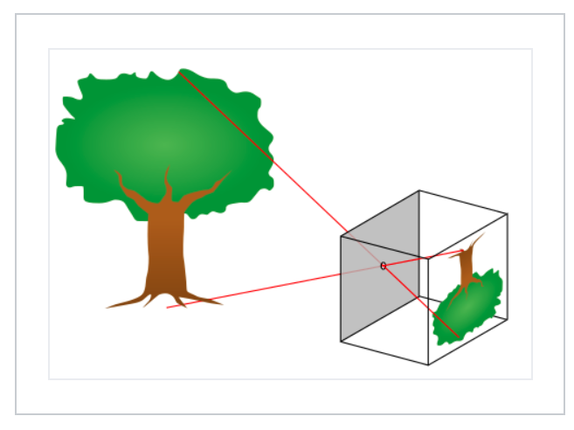
The Nature of Images
Basic image camera image formation
A camera forms an image from scattered light from an object
A pinhole camera or camera obscura forms an image by projecting light rays back to their source
Credit, Wikipedia commons

Slide 13
Pinhole Camera
Pinhole camera is a canonical model for image formation
Pinhole camera is a chamber with a small hole on one side
Image on side of chamber opposite hole
Use cartesian coordinates on the image plane
Pinhole is the origin of the coordinate system
Transform from real-world coordinates to image plane coordinates

Slide 14
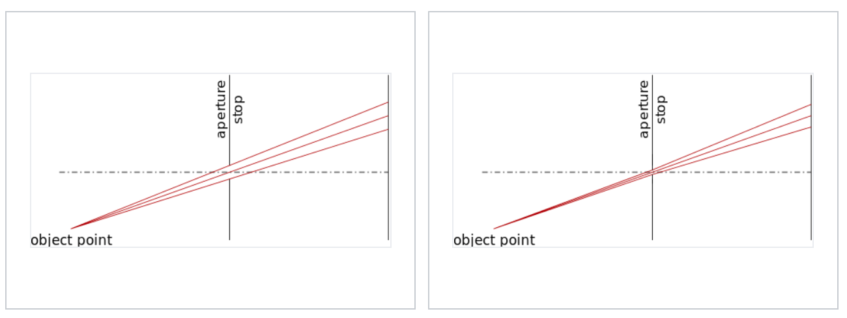
The Nature of Images
Basic image camera image formation
The smaller the aperture of the pinhole the light is focused to smaller area and the image is sharper, but less light passes
Aperture is parameterized by f-stops, f-ratio or f-number
Credit, Wikipedia commons

Slide 15
Camera Model in Cartesian Coordinates

Slide 16




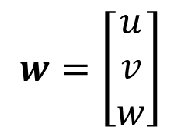



Cartesian Coordinates for Images
Pinhole camera model
Image plane, $z=1$
Object
$$w=\left[\begin{matrix}u \\ v \\ w\end{matrix}\right]$$
Pinhole at origin
Principal Point
O
$$z$$
Optic Axis, z
$$x$$
$$y$$
$$x=\left[\begin{matrix}x \\ y\end{matrix}\right]$$
Image
$$1$$
$$w$$

Slide 17
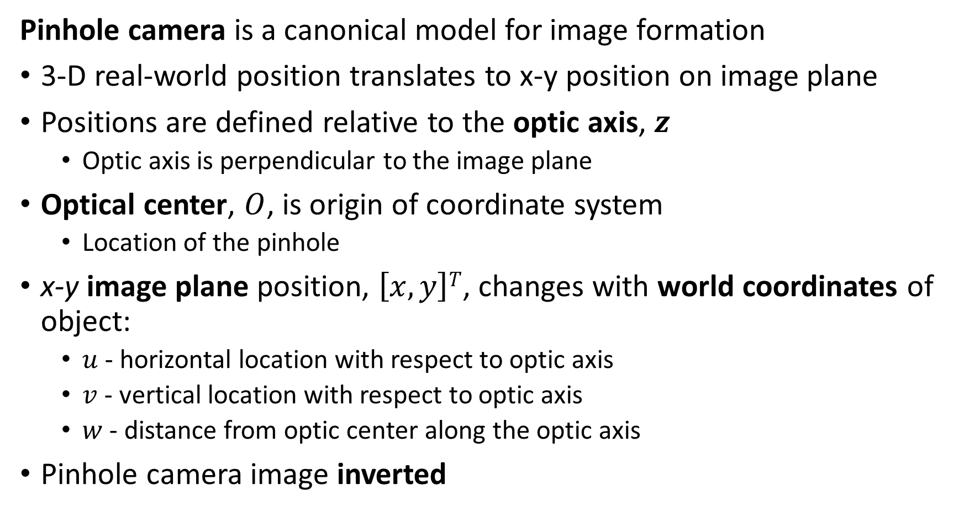
Pinhole Camera
Pinhole camera is a canonical model for image formation
3-D real-world position translates to x-y position on image plane
Positions are defined relative to the optic axis, $z$
Optic axis is perpendicular to the image plane
Optical center, $O$, is origin of coordinate system
Location of the pinhole
x-y image plane position, $\left[x,y\right]T$, changes with world coordinates of object:
$u$ - horizontal location with respect to optic axis
$v$ - vertical location with respect to optic axis
$w$ - distance from optic center along the optic axis
Pinhole camera image inverted

Slide 18
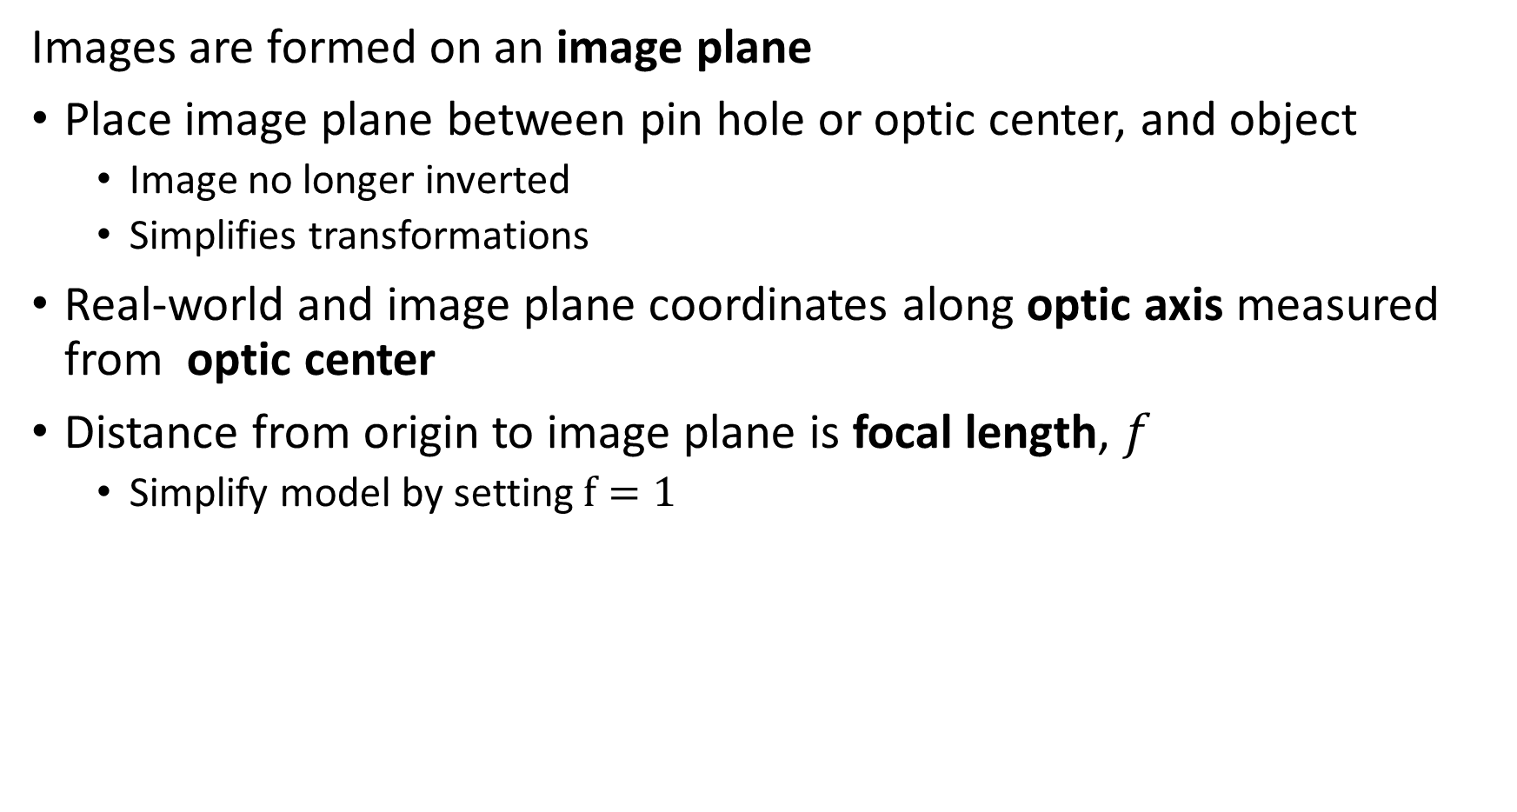
Coordinate System for Pinhole Camera
Images are formed on an image plane
Place image plane between pin hole or optic center, and object
Image no longer inverted
Simplifies transformations
Real-world and image plane coordinates along optic axis measured from optic center
Distance from origin to image plane is focal length, $f$
Simplify model by setting $f=1$

Slide 19

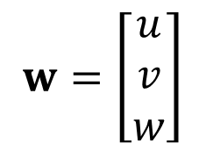





Pinhole Camera Model
Cartesian coordinates for a pinhole camera model
Image plane, $z=1$
$$w=\left[\begin{matrix}u \\ v \\ w\end{matrix}\right]$$
Pinhole at origin
$$x=\left[\begin{matrix}x \\ y\end{matrix}\right]$$
O
Right Hand Coordinate System
$$z$$
Principal Point
Optic Axis = z
$$x$$
$$y$$
$$f=1$$

Slide 20
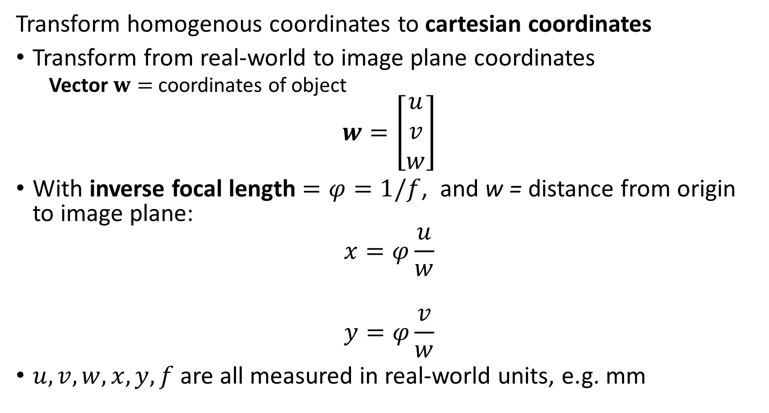
Cartesian Coordinates for Images
Transform homogenous coordinates to cartesian coordinates
Transform from real-world to image plane coordinates
Vector $w=$ coordinates of object
$$w=\left[\begin{matrix}u \\ v \\ w\end{matrix}\right]$$
With inverse focal length $=φ=1/f$, and w = distance from origin to image plane:
$$x=φ\frac{u}{w}$$
$$y=φ\frac{v}{w}$$
$u, v, w, x, y, f$ are all measured in real-world units, e.g. mm

Slide 21


Focal Length
Changing focal length changes field of view at a fixed distance
Image plane
Image plane
Field
of
view
Field
of
view
$$f_{ }$$
$${f′}_{ }$$
w
w
Short focal length
Long focal length

Slide 22
Planar Transformations in Homogeneous Coordinates

Slide 23
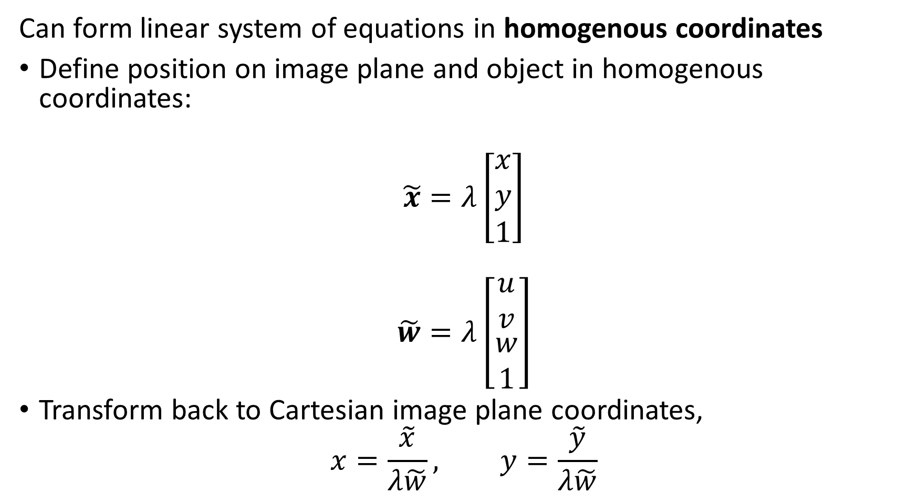
Homogenous Coordinates
Can form linear system of equations in homogenous coordinates
Define position on image plane and object in homogenous coordinates:
$$\tilde{x}=λ\left[\begin{matrix}x \\ y \\ 1\end{matrix}\right]$$
$$\tilde{w}=λ\left[\begin{matrix}u \\ v \\ \begin{matrix}w \\ 1\end{matrix}\end{matrix}\right]$$
Transform back to Cartesian image plane coordinates,
$$x=\frac{\tilde{x}}{λ\tilde{w}}, y=\frac{\tilde{y}}{λ\tilde{w}}$$

Slide 24



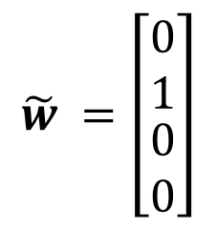
Pinhole Camera Model
Pinhole camera model in homogeneous coordinates
$$\tilde{w}=\left[\begin{matrix}\begin{matrix}λ_{2}x \\ λ_{2}y\end{matrix} \\ \begin{matrix}λ_{2}w \\ λ_{2}\end{matrix}\end{matrix}\right]$$
Image plane, $z=1$
Pinhole at origin
$$\tilde{x}=\left[\begin{matrix}λ_{1}x \\ λ_{1}y \\ λ_{1}\end{matrix}\right]$$
O
$$z$$
Principal Point
Optic Axis
$$x$$
$$y$$
$${\tilde{w}}_{ }=\left[\begin{matrix}\begin{matrix}0 \\ 1\end{matrix} \\ \begin{matrix}0 \\ 0\end{matrix}\end{matrix}\right]$$
$$φ=1$$

Slide 25
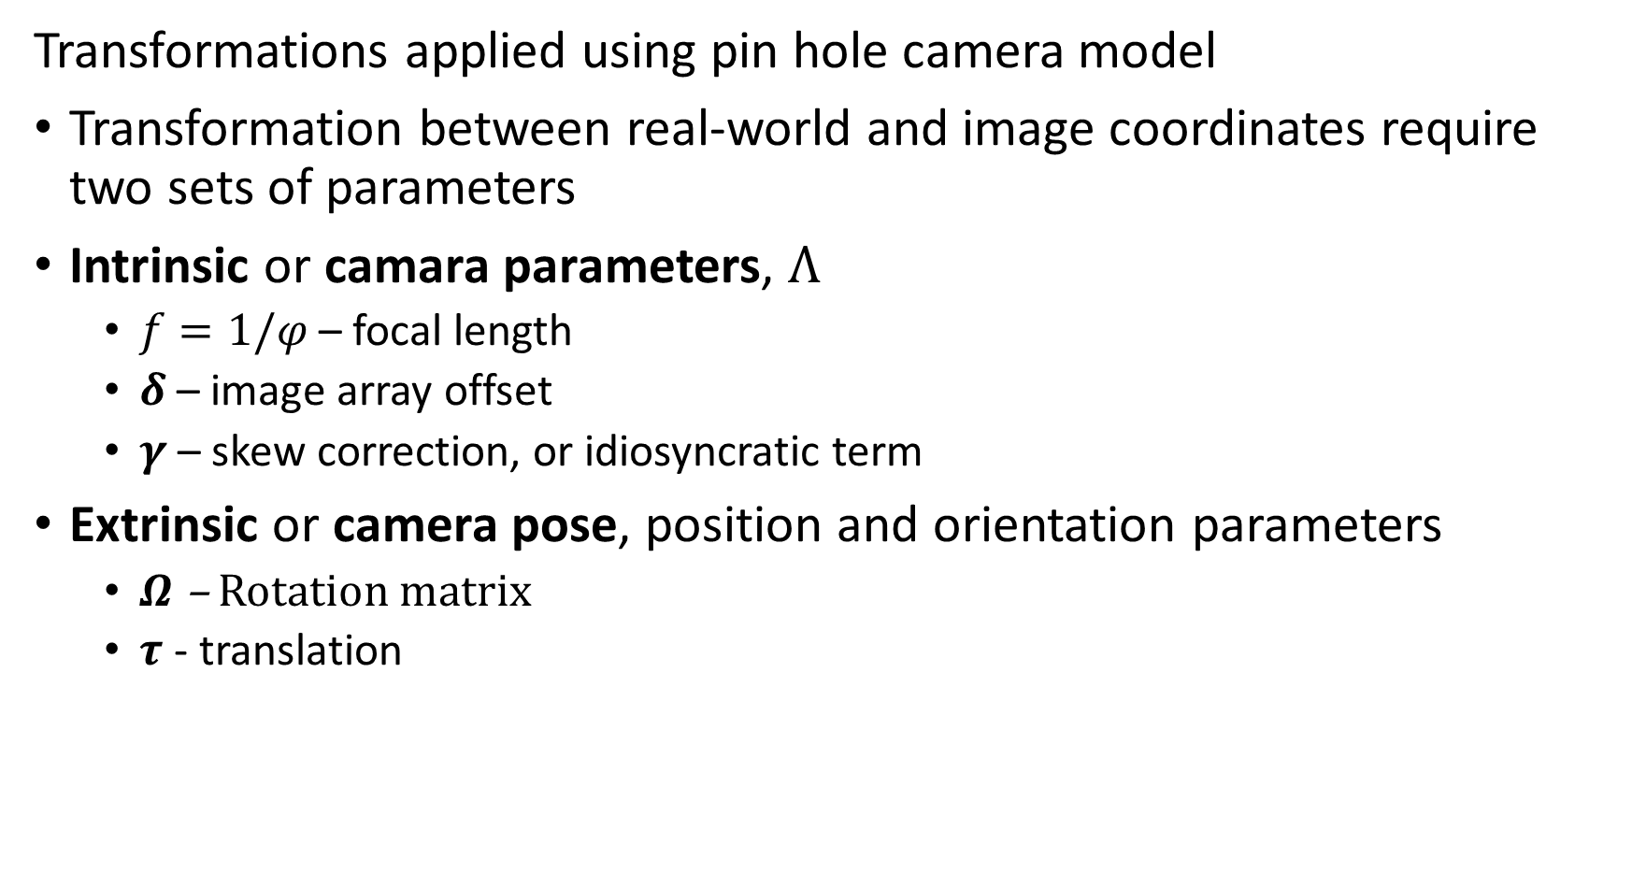
Transformations for Camera Model
Transformations applied using pin hole camera model
Transformation between real-world and image coordinates require two sets of parameters
Intrinsic or camara parameters, $Λ$
$f=1/φ$ – focal length
$δ$ – image array offset
$γ$ – skew correction, or idiosyncratic term
Extrinsic or camera pose, position and orientation parameters
$Ω$ – Rotation matrix
$τ$ - translation

Slide 26
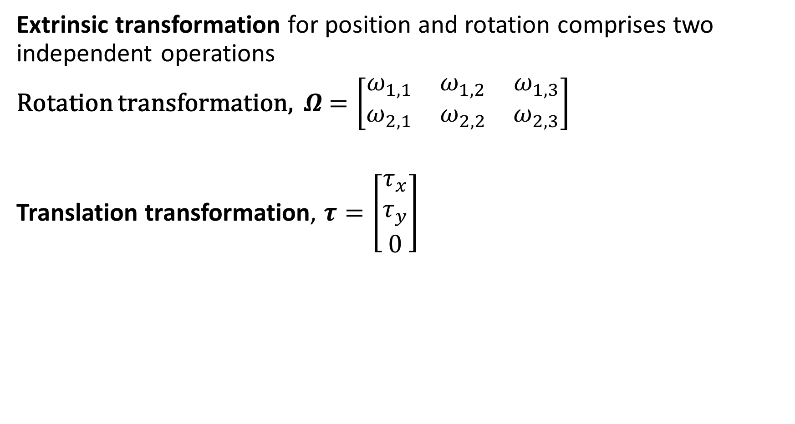
Transformations for Camera Model
Extrinsic transformation for position and rotation comprises two independent operations
Rotation transformation, $Ω$ $=\left[\begin{matrix}ω_{1,1} & ω_{1,2} & ω_{1,3} \\ ω_{2,1} & ω_{2,2} & ω_{2,3}\end{matrix}\right]$
Translation transformation, $τ=\left[\begin{matrix}τ_{x} \\ τ_{y} \\ 0\end{matrix}\right]$

Slide 27
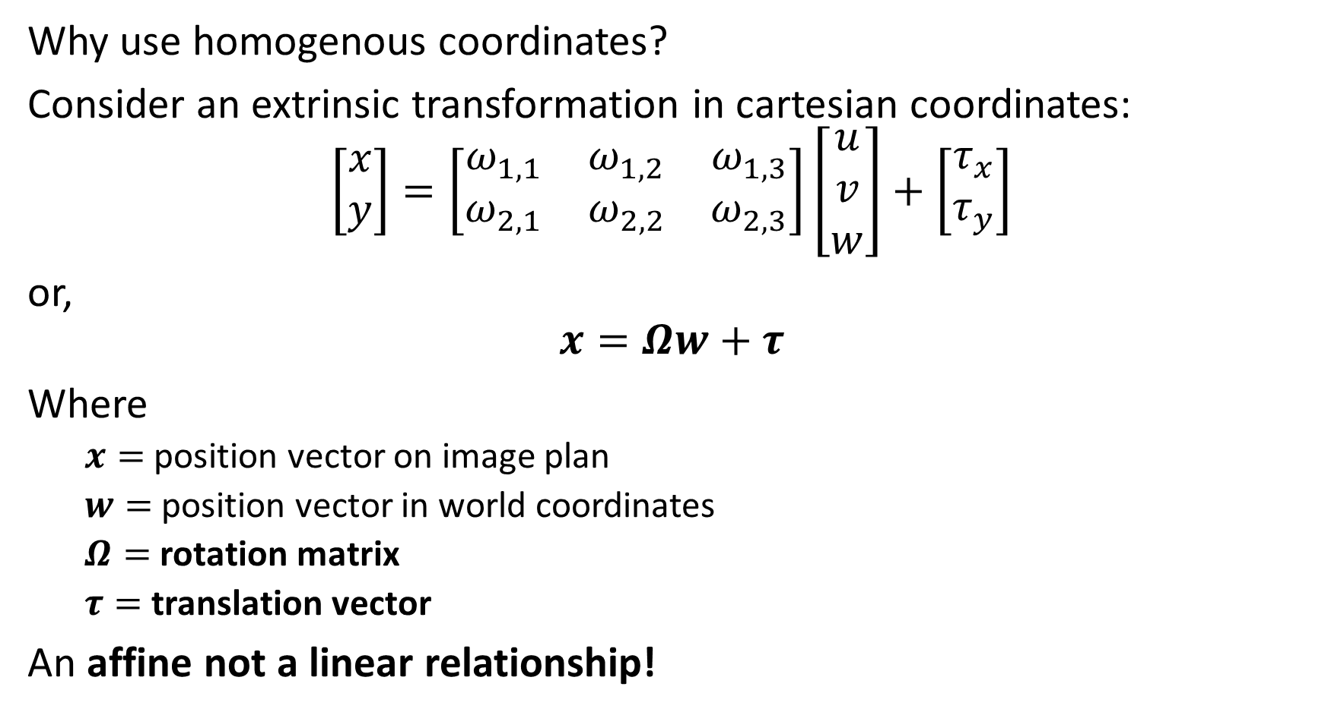
Pose Model in Cartesian Coordinates
Why use homogenous coordinates?
Consider an extrinsic transformation in cartesian coordinates:
$$\left[\begin{matrix}x \\ y\end{matrix}\right]=\left[\begin{matrix}ω_{1,1} & ω_{1,2} & ω_{1,3} \\ ω_{2,1} & ω_{2,2} & ω_{2,3}\end{matrix}\right]\left[\begin{matrix}u \\ v \\ w\end{matrix}\right]+\left[\begin{matrix}τ_{x} \\ τ_{y}\end{matrix}\right]$$
or,
$$x=Ωw+τ$$
Where
$x=$ position vector on image plan
$w=$ position vector in world coordinates
$Ω=$ rotation matrix
$τ=$ translation vector
An affine not a linear relationship!

Slide 28
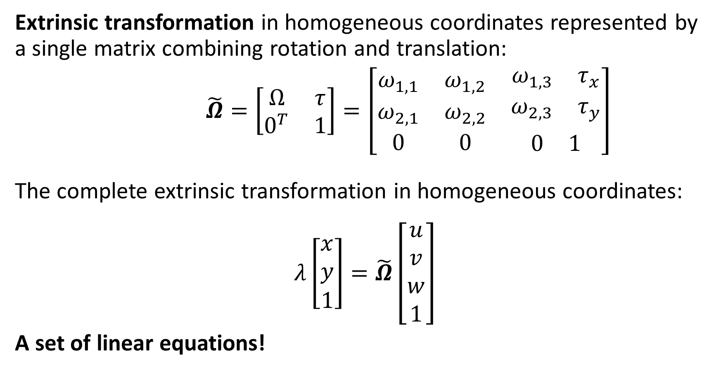
Pose Model in Homogenous Coordinates
Extrinsic transformation in homogeneous coordinates represented by a single matrix combining rotation and translation:
$\tilde{Ω}=\left[\begin{matrix}Ω & τ \\ 0^{T} & 1\end{matrix}\right]=\left[\begin{matrix}ω_{1,1} & ω_{1,2} & \begin{matrix}ω_{1,3} & τ_{x}\end{matrix} \\ ω_{2,1} & ω_{2,2} & \begin{matrix}ω_{2,3} & τ_{y}\end{matrix} \\ 0 & 0 & \begin{matrix}0 & 1\end{matrix}\end{matrix}\right]$
The complete extrinsic transformation in homogeneous coordinates:
$$λ\left[\begin{matrix}x \\ y \\ 1\end{matrix}\right]=\tilde{Ω}\left[\begin{matrix}u \\ v \\ w \\ 1\end{matrix}\right]$$
A set of linear equations!

Slide 29
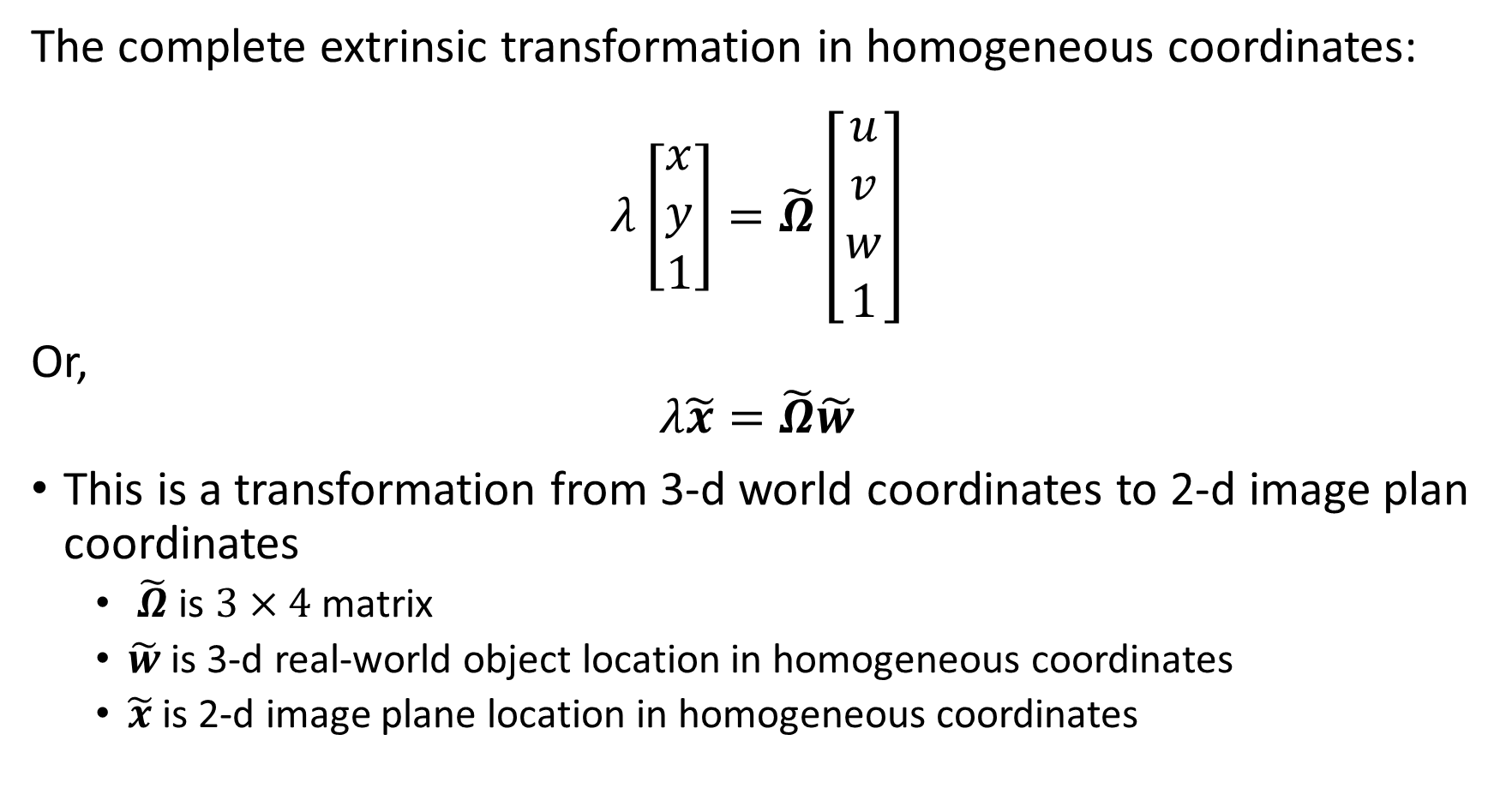
Pose Model in Homogenous Coordinates
The complete extrinsic transformation in homogeneous coordinates:
$$λ\left[\begin{matrix}x \\ y \\ 1\end{matrix}\right]=\tilde{Ω}\left[\begin{matrix}u \\ v \\ w \\ 1\end{matrix}\right]$$
Or,
$$λ\tilde{x}=\tilde{Ω}\tilde{w}$$
This is a transformation from 3-d world coordinates to 2-d image plan coordinates
$\tilde{Ω}$ is $3×4$ matrix
$\tilde{w}$ is 3-d real-world object location in homogeneous coordinates
$\tilde{x}$ is 2-d image plane location in homogeneous coordinates

Slide 30
Camera Models in Homogeneous Coordinates

Slide 31









Pinhole Camera Model in Homogeneous Coordinates
We can project location of another plane onto an image plane in homogeneous coordinates for the pinhole camera model with common optical center
plane, $z=w$
Image plane, $z=1$
$$\tilde{w}=\left[\begin{matrix}u \\ v \\ w\end{matrix}\right]$$
Pinhole at origin
$$\tilde{x}=\left[\begin{matrix}x \\ y \\ 1\end{matrix}\right]$$
O
$$z$$
Optic Axis
Principal Point
$$x$$
$$y$$
$$φ=1$$
$$w$$

Slide 32
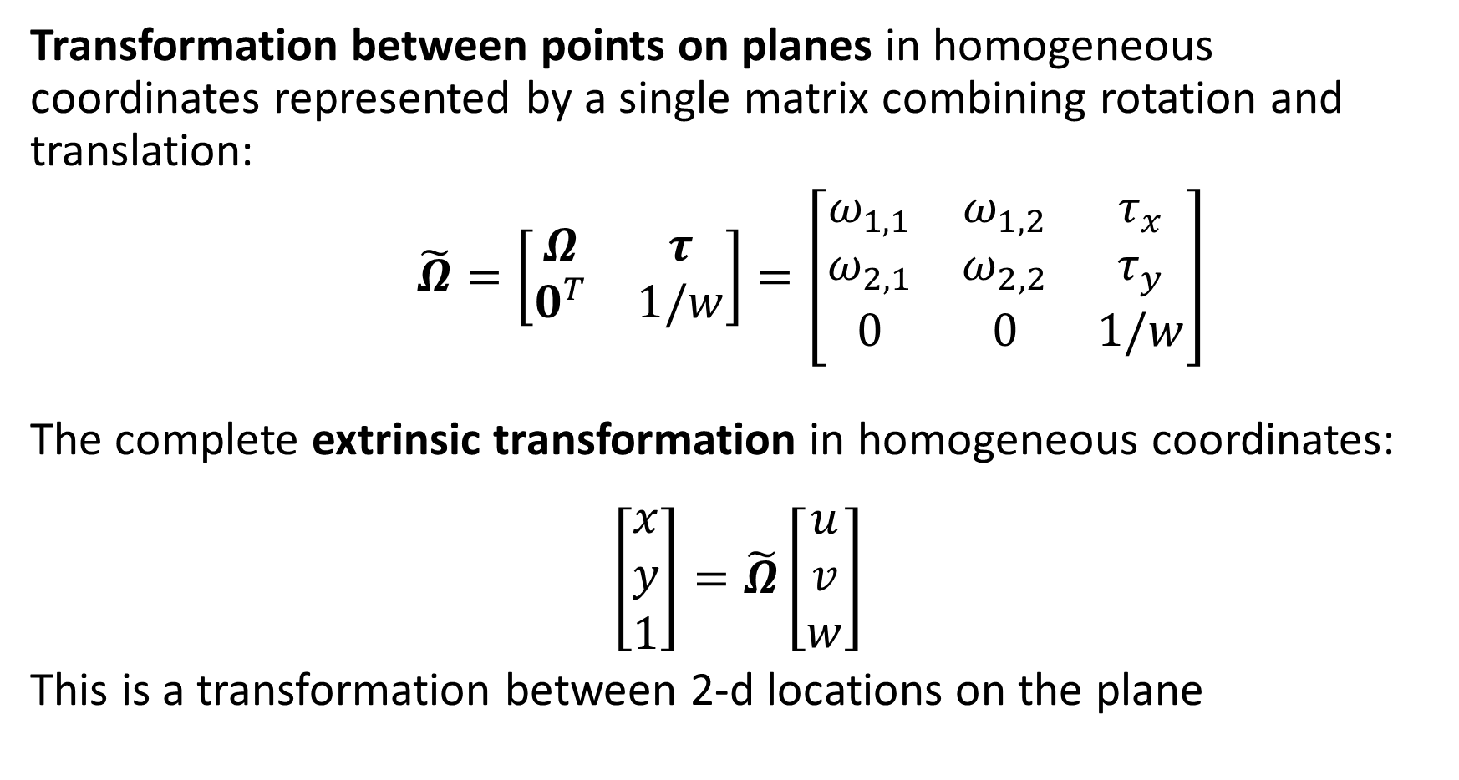
Homogenous Coordinates
Transformation between points on planes in homogeneous coordinates represented by a single matrix combining rotation and translation:
$\tilde{Ω}=\left[\begin{matrix}Ω & τ \\ 0^{T} & 1/w\end{matrix}\right]=\left[\begin{matrix}ω_{1,1} & ω_{1,2} & τ_{x} \\ ω_{2,1} & ω_{2,2} & τ_{y} \\ 0 & 0 & 1/w\end{matrix}\right]$
The complete extrinsic transformation in homogeneous coordinates:
$$\left[\begin{matrix}x \\ y \\ 1\end{matrix}\right]=\tilde{Ω}\left[\begin{matrix}u \\ v \\ w\end{matrix}\right]$$
This is a transformation between 2-d locations on the plane

Slide 33
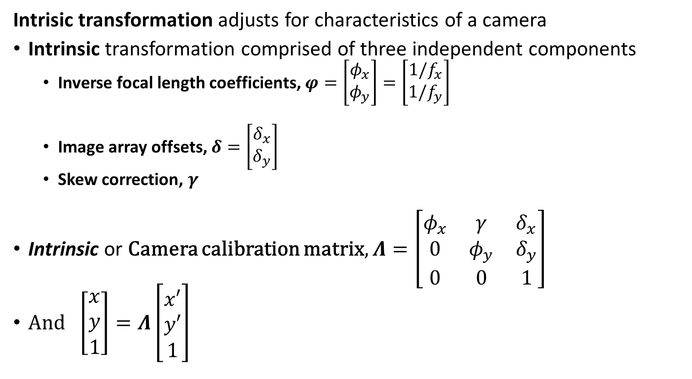
Transformations for Camera Model
Intrisic transformation adjusts for characteristics of a camera
Intrinsic transformation comprised of three independent components
Inverse focal length coefficients, $φ=\left[\begin{matrix}φ_{x} \\ φ_{y}\end{matrix}\right]=\left[\begin{matrix}{1/f}_{x} \\ {1/f}_{y}\end{matrix}\right]$
Image array offsets, $δ=\left[\begin{matrix}δ_{x} \\ δ_{y}\end{matrix}\right]$
Skew correction, $γ$
Intrinsic or Camera calibration matrix, $Λ=\left[\begin{matrix}φ_{x} & γ & δ_{x} \\ 0 & φ_{y} & δ_{y} \\ 0 & 0 & 1\end{matrix}\right]$
And $\left[\begin{matrix}x \\ y \\ 1\end{matrix}\right]=Λ\left[\begin{matrix}x′ \\ y′ \\ 1\end{matrix}\right]$

Slide 34

Transformations for Camera Model
How do we find the Intrinsic parameters of a camera?
Learn from multiple camera views of scene – more on this later
Use multiple views of a known target
Wide variety of calibration targets available commercially
Other suppliers

Slide 35
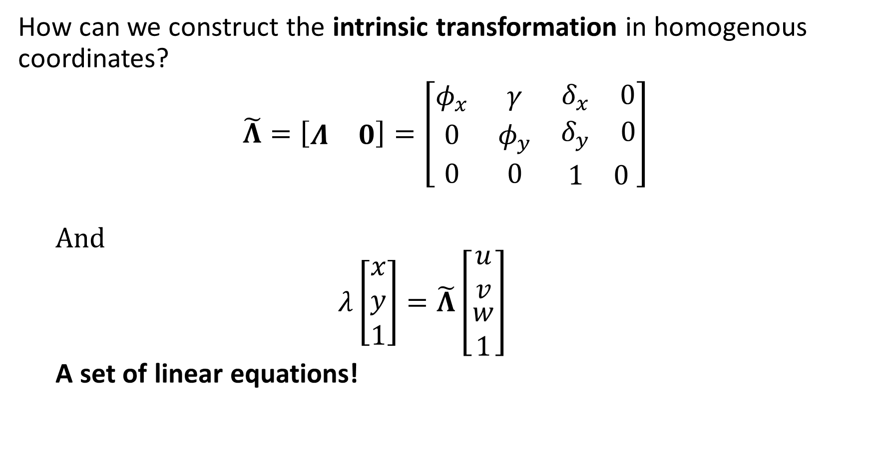
Camera Model in Homogenous Coordinates
How can we construct the intrinsic transformation in homogenous coordinates?
$\tilde{Λ}=\left[\begin{matrix}Λ & 0\end{matrix}\right]=\left[\begin{matrix}φ_{x} & γ & \begin{matrix}δ_{x} & 0\end{matrix} \\ 0 & φ_{y} & \begin{matrix}δ_{y} & 0\end{matrix} \\ 0 & 0 & \begin{matrix}1 & 0\end{matrix}\end{matrix}\right]$
And
$$λ\left[\begin{matrix}x \\ y \\ 1\end{matrix}\right]=\tilde{Λ}\left[\begin{matrix}u \\ v \\ \begin{matrix}w \\ 1\end{matrix}\end{matrix}\right]$$
A set of linear equations!

Slide 36
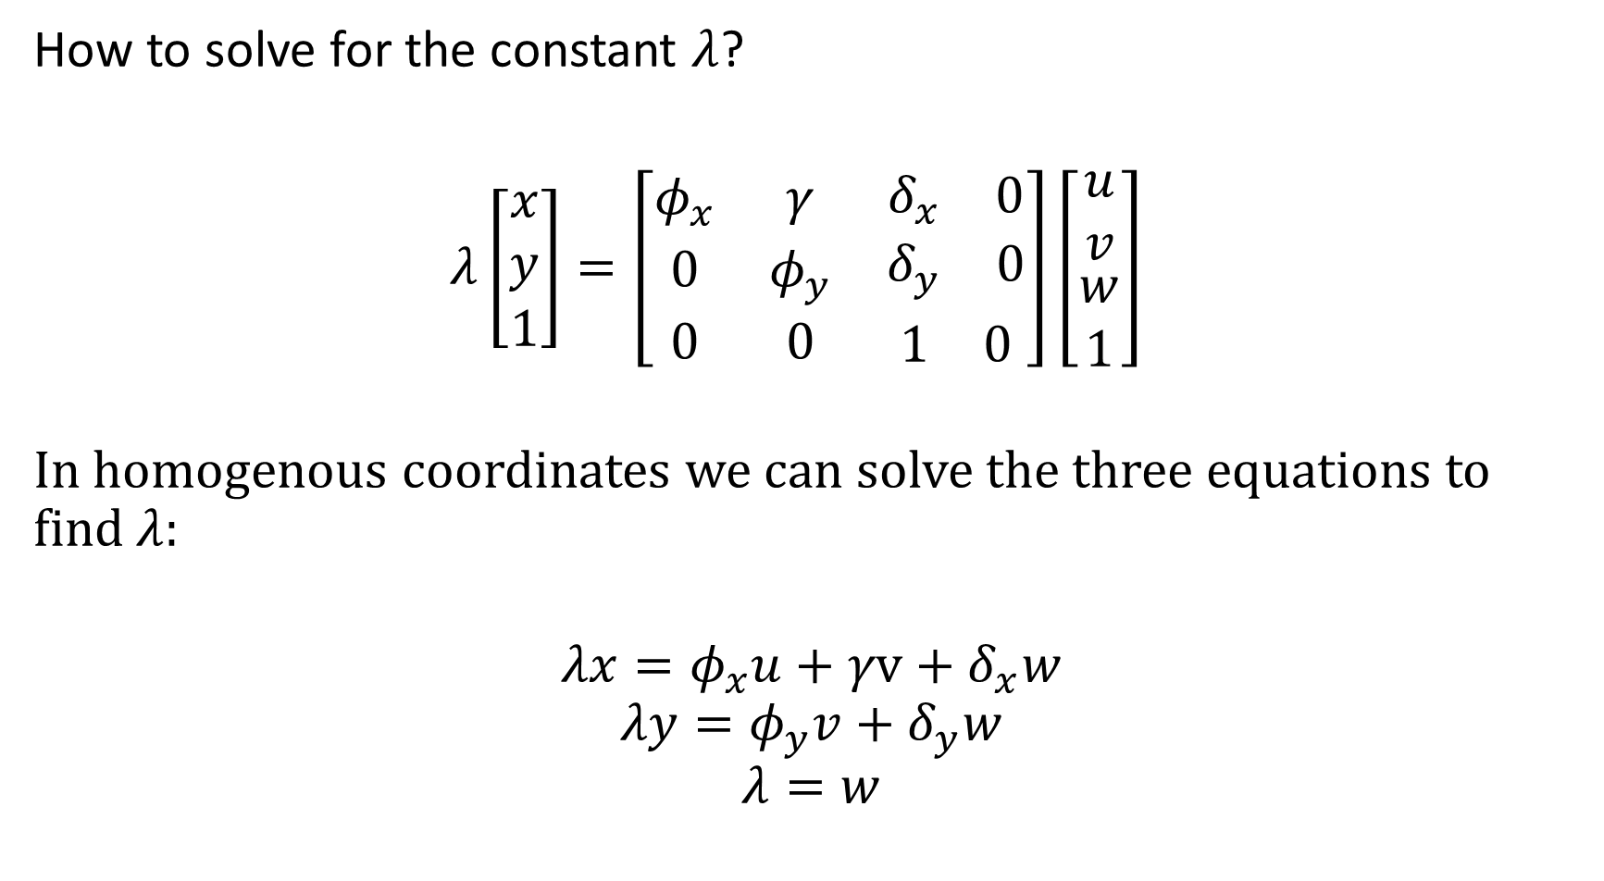
Homogenous Coordinates
How to solve for the constant $λ$?
$λ\left[\begin{matrix}x \\ y \\ 1\end{matrix}\right]=\left[\begin{matrix}φ_{x} & γ & \begin{matrix}δ_{x} & 0\end{matrix} \\ 0 & φ_{y} & \begin{matrix}δ_{y} & 0\end{matrix} \\ 0 & 0 & \begin{matrix}1 & 0\end{matrix}\end{matrix}\right]\left[\begin{matrix}u \\ v \\ \begin{matrix}w \\ 1\end{matrix}\end{matrix}\right]$
In homogenous coordinates we can solve the three equations to find $λ$:
$$λx=φ_{x}u+γv+δ_{x}w$$
$$λy=φ_{y}v+δ_{y}w$$
$$λ=w$$

Slide 37
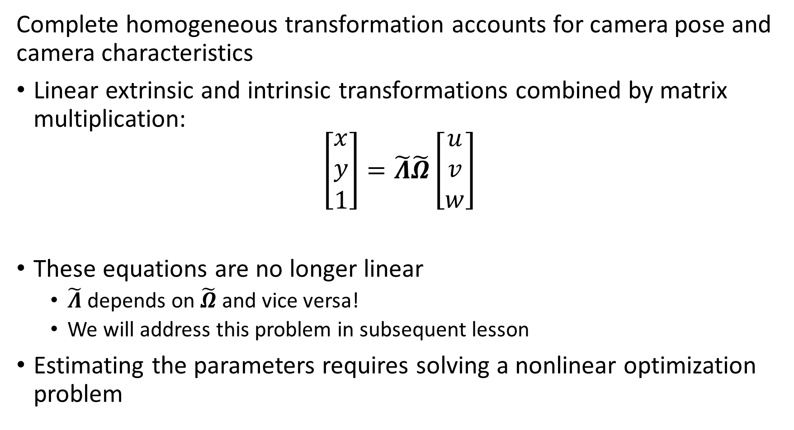
Transformations for Camera Model
Complete homogeneous transformation accounts for camera pose and camera characteristics
Linear extrinsic and intrinsic transformations combined by matrix multiplication:
$$\left[\begin{matrix}x \\ y \\ 1\end{matrix}\right]=\tilde{Λ}\tilde{Ω}\left[\begin{matrix}u \\ v \\ w\end{matrix}\right]$$
These equations are no longer linear
$\tilde{Λ}$ depends on $\tilde{Ω}$ and vice versa!
We will address this problem in subsequent lesson
Estimating the parameters requires solving a nonlinear optimization problem

Slide 38
Four Planar Transformation Problems

Slide 39
Four Planar Transform Problems
How can we understand these planar transformations?
There are four levels of complexity
2-D Euclidean – Rotation and translation
2-D Similarity – Rotation, translation, and scaling
Affine - Rotation, translation, scaling, and shearing
Projective – Perspective point transformation

Slide 40
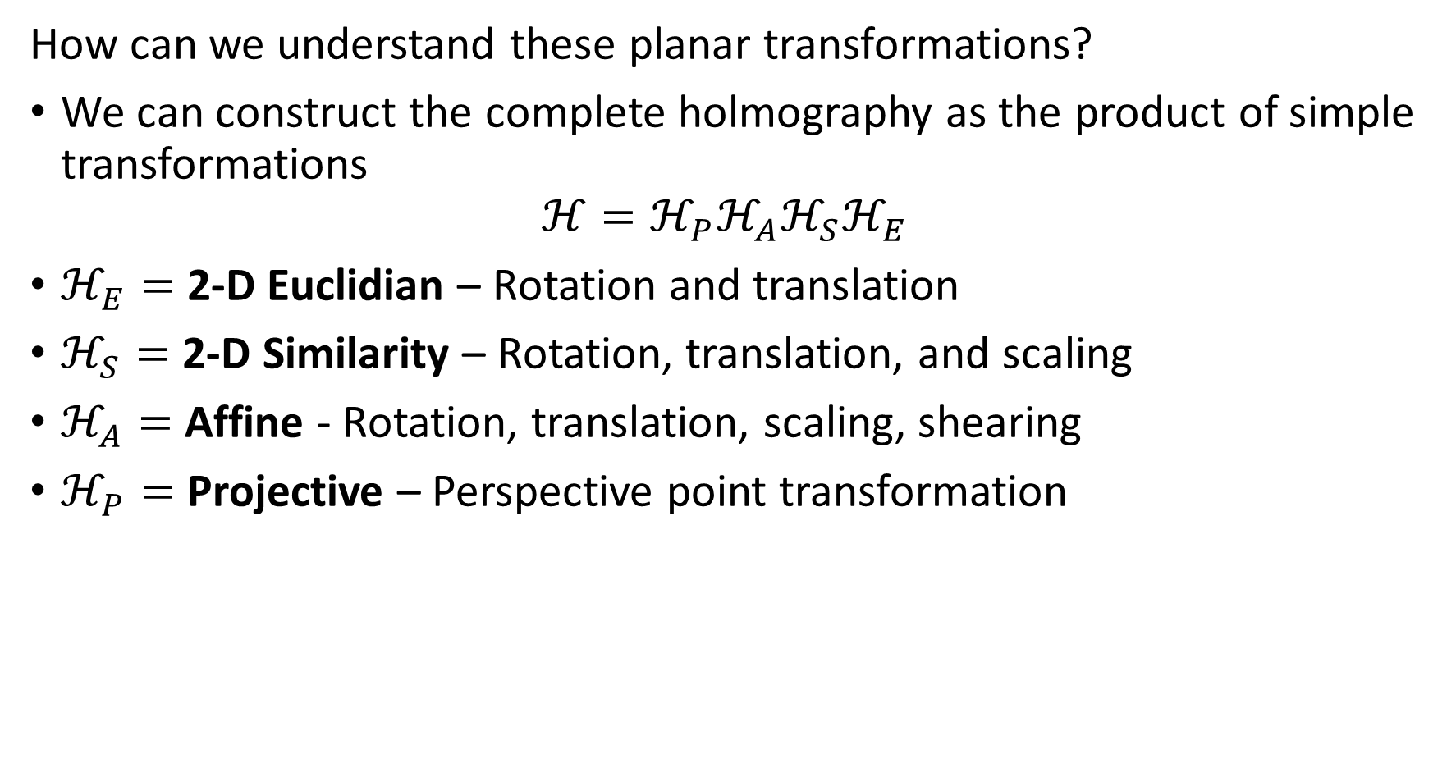
Four Planar Transform Problems
How can we understand these planar transformations?
We can construct the complete holmography as the product of simple transformations
$$ℋ=ℋ_{P}ℋ_{A}ℋ_{S}ℋ_{E}$$
$ℋ_{E}=$ 2-D Euclidian – Rotation and translation
$ℋ_{S}=$ 2-D Similarity – Rotation, translation, and scaling
$ℋ_{A}=$ Affine - Rotation, translation, scaling, shearing
$ℋ_{P}=$ Projective – Perspective point transformation

Slide 41
Four Planar Transform Problems
How can we understand these planar transformations?
Model is restricted to planar transformations
Transformation matrices are constant over image
Assumes all objects in image are at a constant distance from image plane
How to overcome the limitations of the model?
Can apply transformations over piecewise patches of the image, for example see implementation in Scikit Image
Or, use a polynomial representation of parameters, for example see implementation in Scikit Image

Slide 42
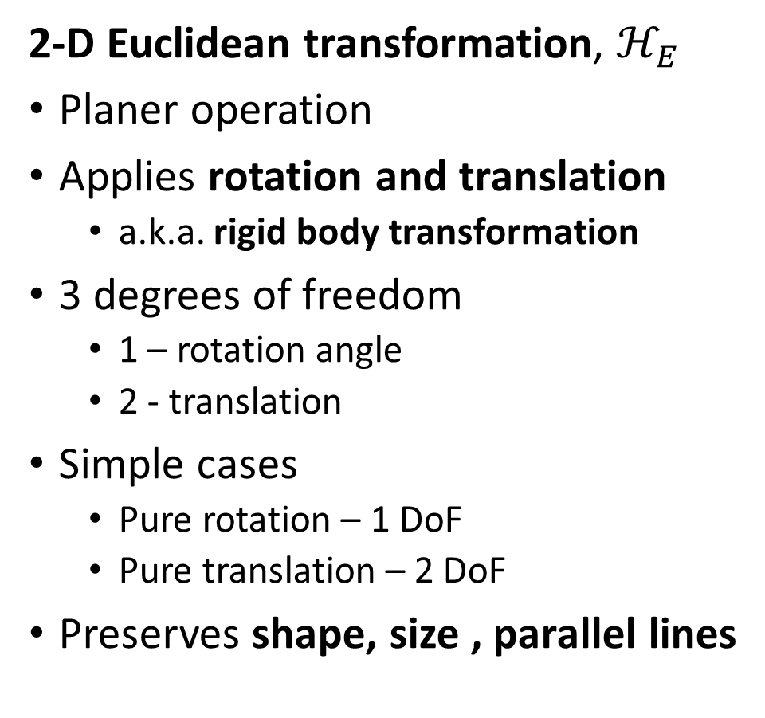
Four Planar Transformation Problems
2-D Euclidean transformation, $ℋ_{E}$
Planer operation
Applies rotation and translation
a.k.a. rigid body transformation
3 degrees of freedom
1 – rotation angle
2 - translation
Simple cases
Pure rotation – 1 DoF
Pure translation – 2 DoF
Preserves shape, size , parallel lines

Slide 43
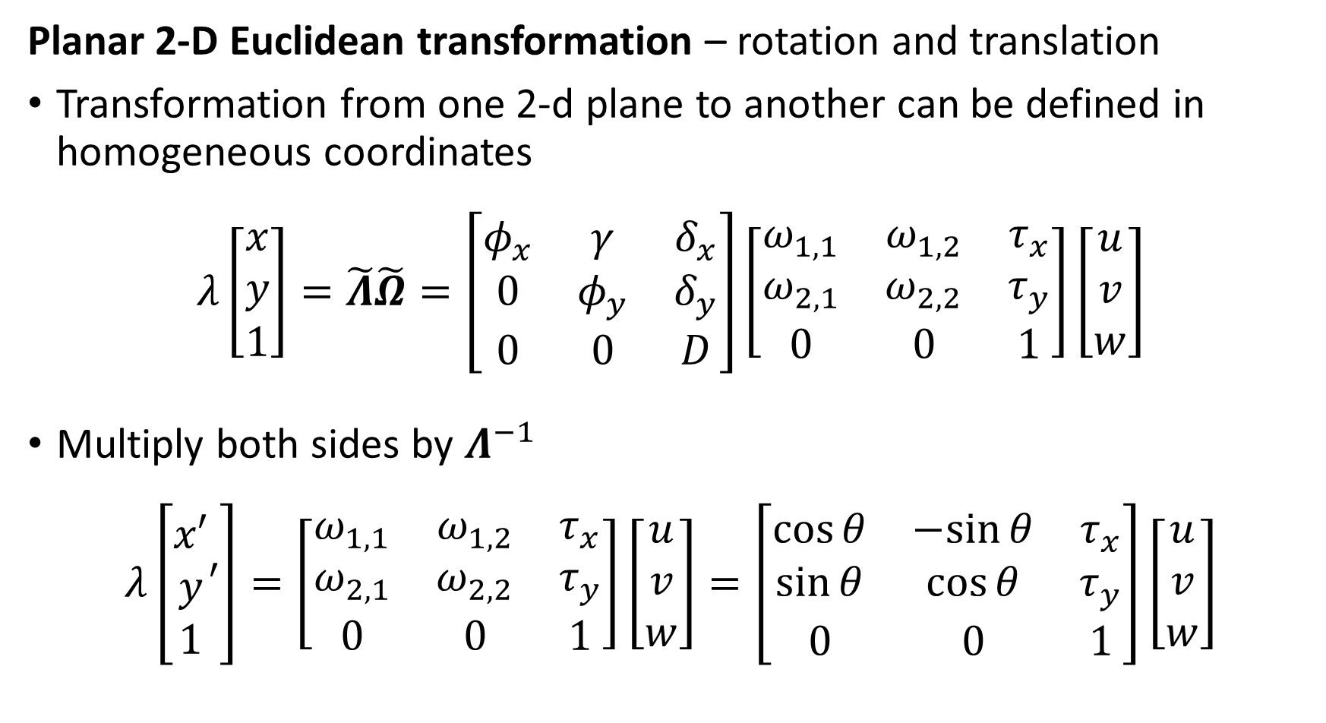
Four Planar Transform Problems
Planar 2-D Euclidean transformation – rotation and translation
Transformation from one 2-d plane to another can be defined in homogeneous coordinates
$$λ\left[\begin{matrix}x \\ y \\ 1\end{matrix}\right]=\tilde{Λ}\tilde{Ω}=\left[\begin{matrix}φ_{x} & γ & δ_{x} \\ 0 & φ_{y} & δ_{y} \\ 0 & 0 & D\end{matrix}\right]\left[\begin{matrix}ω_{1,1} & ω_{1,2} & τ_{x} \\ ω_{2,1} & ω_{2,2} & τ_{y} \\ 0 & 0 & 1\end{matrix}\right]\left[\begin{matrix}u \\ v \\ w\end{matrix}\right]$$
Multiply both sides by $Λ^{−1}$
$$λ\left[\begin{matrix}x′ \\ y \\ 1\end{matrix}′\right]=\left[\begin{matrix}ω_{1,1} & ω_{1,2} & τ_{x} \\ ω_{2,1} & ω_{2,2} & τ_{y} \\ 0 & 0 & 1\end{matrix}\right]\left[\begin{matrix}u \\ v \\ w\end{matrix}\right]=\left[\begin{matrix}\cos{θ} & −sin{θ} & τ_{x} \\ \sin{θ} & \cos{θ} & τ_{y} \\ 0 & 0 & 1\end{matrix}\right]\left[\begin{matrix}u \\ v \\ w\end{matrix}\right]$$

Slide 44
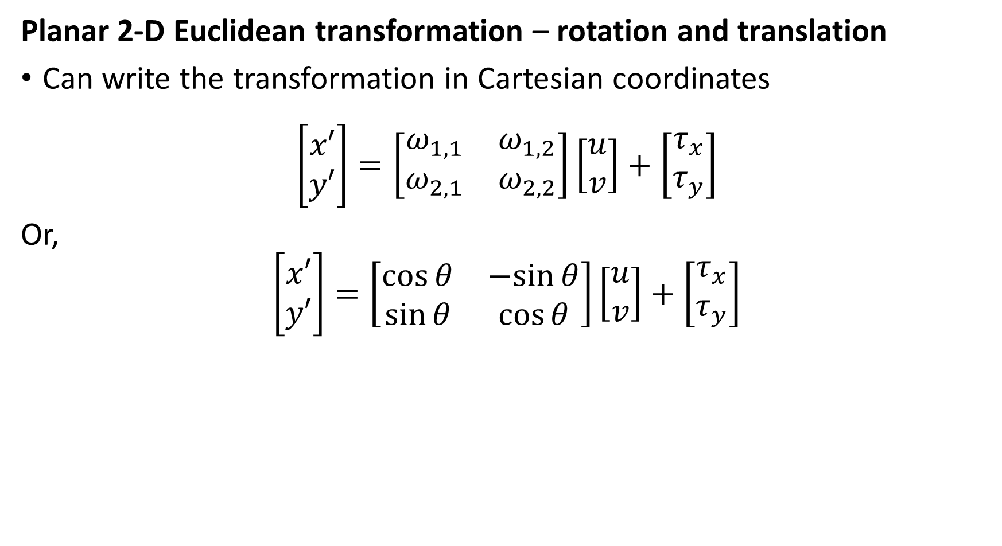
Four Planar Transform Problems
Planar 2-D Euclidean transformation – rotation and translation
Can write the transformation in Cartesian coordinates
$$\left[\begin{matrix}x′ \\ y′\end{matrix}\right]=\left[\begin{matrix}ω_{1,1} & ω_{1,2} \\ ω_{2,1} & ω_{2,2}\end{matrix}\right]\left[\begin{matrix}u \\ v\end{matrix}\right]+\left[\begin{matrix}τ_{x} \\ τ_{y}\end{matrix}\right]$$
Or,
$$\left[\begin{matrix}x′ \\ y′\end{matrix}\right]=\left[\begin{matrix}\cos{θ} & −sin{θ} \\ \sin{θ} & \cos{θ}\end{matrix}\right]\left[\begin{matrix}u \\ v\end{matrix}\right]+\left[\begin{matrix}τ_{x} \\ τ_{y}\end{matrix}\right]$$

Slide 45

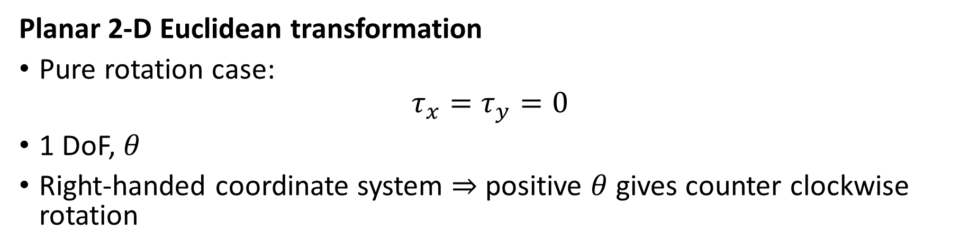
Four Planar Transformation Problems
Planar 2-D Euclidean transformation
Pure rotation case:
$$τ_{x}=τ_{y}=0$$
1 DoF, $θ$
Right-handed coordinate system $⇒$ positive $θ$ gives counter clockwise rotation
$$θ$$

Slide 46



Four Planar Transformation Problems
2-D Euclidean transformation
Pure translation case:
$$θ=0$$
2 DoF, $τ_{x},τ_{y}$
$$τ_{y}$$
$$τ_{x}$$

Slide 47




Four Planar Transformation Problems
Planar 2-D Euclidean transformation
Translation and rotation
3 DoF, $τ_{x},τ_{y},θ$
$$θ$$
$$τ_{y}$$
$$τ_{x}$$

Slide 48
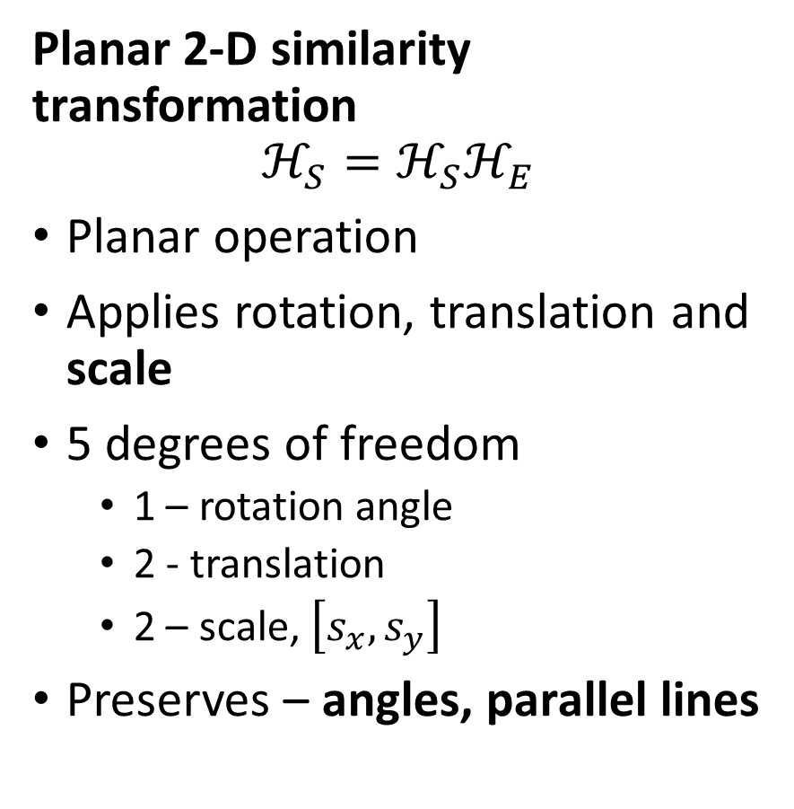
Four Planar Transformation Problems
Planar 2-D similarity transformation
$$ℋ_{S}=ℋ_{S}ℋ_{E}$$
Planar operation
Applies rotation, translation and scale
5 degrees of freedom
1 – rotation angle
2 - translation
2 – scale, $\left[s_{x},s_{y}\right]$
Preserves – angles, parallel lines

Slide 49
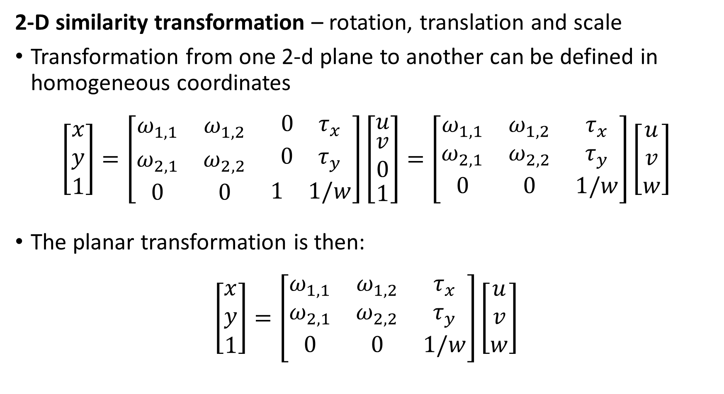
Four Planar Transformation Problems
2-D similarity transformation – rotation, translation and scale
Transformation from one 2-d plane to another can be defined in homogeneous coordinates
$$\left[\begin{matrix}x \\ y \\ 1\end{matrix}\right]=\left[\begin{matrix}ω_{1,1} & ω_{1,2} & \begin{matrix}0 & τ_{x}\end{matrix} \\ ω_{2,1} & ω_{2,2} & \begin{matrix}0 & τ_{y}\end{matrix} \\ 0 & 0 & \begin{matrix}1 & 1/w\end{matrix}\end{matrix}\right]\left[\begin{matrix}u \\ \begin{matrix}v \\ 0\end{matrix} \\ 1\end{matrix}\right]=\left[\begin{matrix}ω_{1,1} & ω_{1,2} & τ_{x} \\ ω_{2,1} & ω_{2,2} & τ_{y} \\ 0 & 0 & 1/w\end{matrix}\right]\left[\begin{matrix}u \\ v \\ w\end{matrix}\right]$$
The planar transformation is then:
$$\left[\begin{matrix}x \\ y \\ 1\end{matrix}\right]=\left[\begin{matrix}ω_{1,1} & ω_{1,2} & τ_{x} \\ ω_{2,1} & ω_{2,2} & τ_{y} \\ 0 & 0 & 1/w\end{matrix}\right]\left[\begin{matrix}u \\ v \\ w\end{matrix}\right]$$

Slide 50
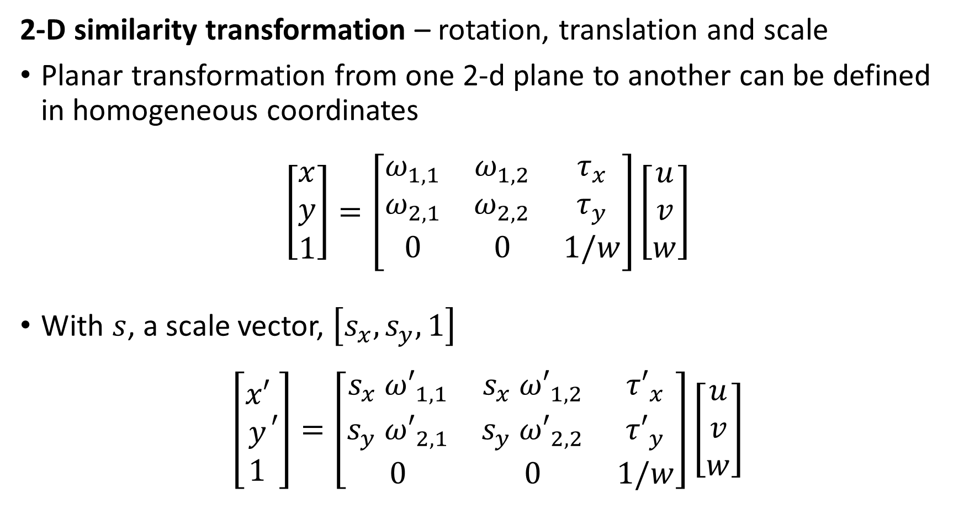
Four Planar Transformation Problems
2-D similarity transformation – rotation, translation and scale
Planar transformation from one 2-d plane to another can be defined in homogeneous coordinates
$$\left[\begin{matrix}x \\ y \\ 1\end{matrix}\right]=\left[\begin{matrix}ω_{1,1} & ω_{1,2} & τ_{x} \\ ω_{2,1} & ω_{2,2} & τ_{y} \\ 0 & 0 & 1/w\end{matrix}\right]\left[\begin{matrix}u \\ v \\ w\end{matrix}\right]$$
With $s$, a scale vector, $\left[s_{x},s_{y},1\right]$
$$\left[\begin{matrix}x′ \\ y \\ 1\end{matrix}′\right]=\left[\begin{matrix}{s_{x} ω′}_{1,1} & {s_{x} ω′}_{1,2} & {τ′}_{x} \\ {s_{y} ω′}_{2,1} & s_{y} {ω′}_{2,2} & {τ′}_{y} \\ 0 & 0 & 1/w\end{matrix}\right]\left[\begin{matrix}u \\ v \\ w\end{matrix}\right]$$

Slide 51
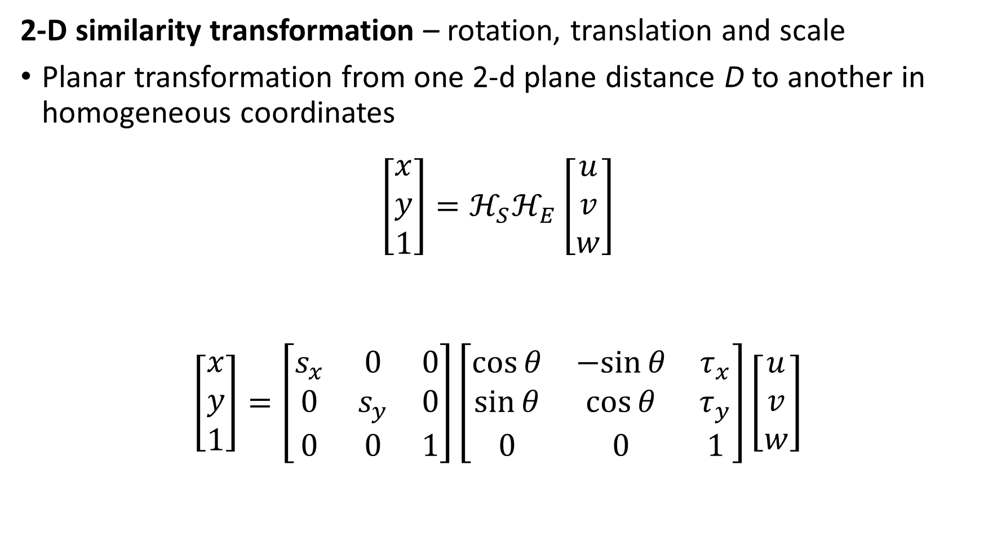
Four Transform Problems
2-D similarity transformation – rotation, translation and scale
Planar transformation from one 2-d plane distance D to another in homogeneous coordinates
$$\left[\begin{matrix}x \\ y \\ 1\end{matrix}\right]=ℋ_{S}ℋ_{E}\left[\begin{matrix}u \\ v \\ w\end{matrix}\right]$$
$$\left[\begin{matrix}x \\ y \\ 1\end{matrix}\right]=\left[\begin{matrix}s_{x} & 0 & 0 \\ 0 & s_{y} & 0 \\ 0 & 0 & 1\end{matrix}\right]\left[\begin{matrix}\cos{θ} & −sin{θ} & τ_{x} \\ \sin{θ} & \cos{θ} & τ_{y} \\ 0 & 0 & 1\end{matrix}\right]\left[\begin{matrix}u \\ v \\ w\end{matrix}\right]$$

Slide 52





Four Transformations
Planar 2-D similarity transformation
Translation, rotation and scale
5 DoF, $τ_{x},τ_{y},θ,s_{x},s_{y}$
$$s_{x}∗x$$
$$s_{y}∗y$$
$$θ$$
$$τ_{y}$$
$$y$$
$$x$$
$$τ_{x}$$

Slide 53
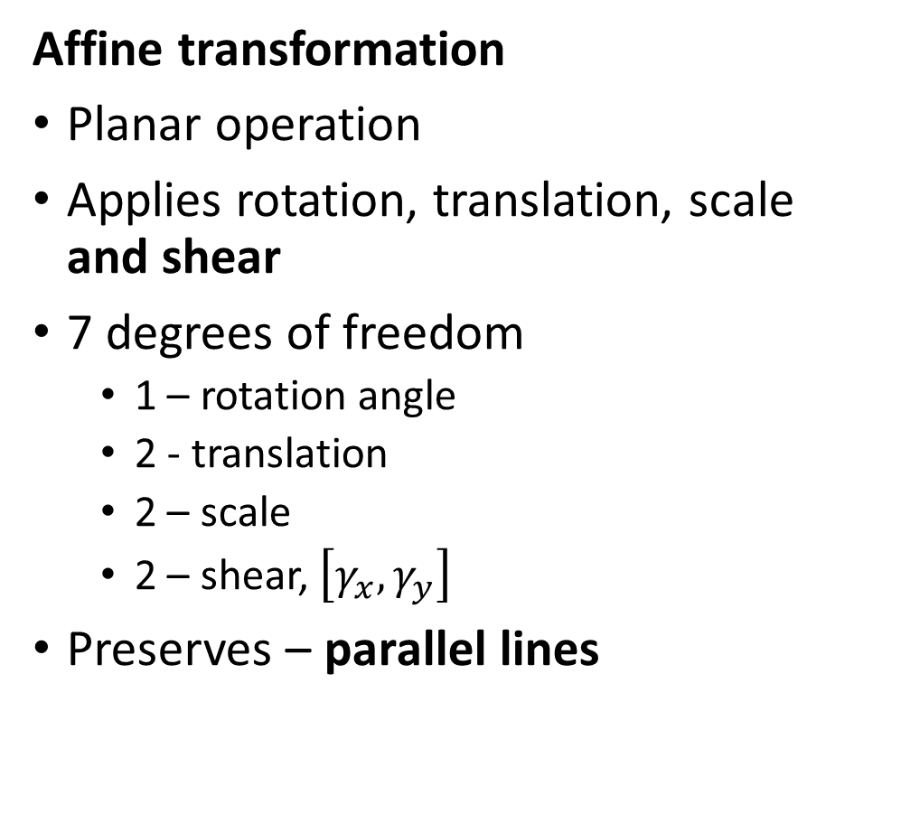
Four Transformations
Affine transformation
Planar operation
Applies rotation, translation, scale and shear
7 degrees of freedom
1 – rotation angle
2 - translation
2 – scale
2 – shear, $\left[γ_{x},γ_{y}\right]$
Preserves – parallel lines

Slide 54
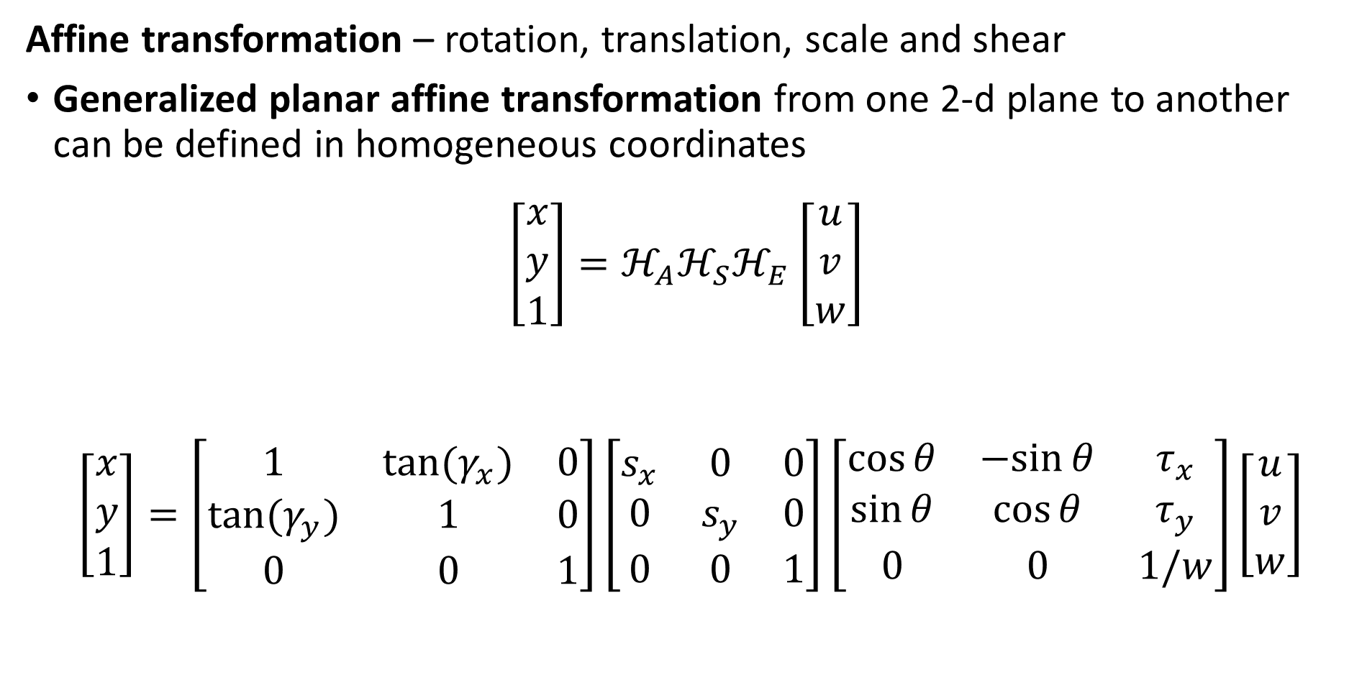
Four Planar Transformation Problems
Affine transformation – rotation, translation, scale and shear
Generalized planar affine transformation from one 2-d plane to another can be defined in homogeneous coordinates
$$\left[\begin{matrix}x \\ y \\ 1\end{matrix}\right]={ℋ_{A}ℋ}_{S}ℋ_{E}\left[\begin{matrix}u \\ v \\ w\end{matrix}\right]$$
$$\left[\begin{matrix}x \\ y \\ 1\end{matrix}\right]=\left[\begin{matrix}1 & tan⁡(γ_{x}) & 0 \\ tan⁡(γ_{y}) & 1 & 0 \\ 0 & 0 & 1\end{matrix}\right]\left[\begin{matrix}s_{x} & 0 & 0 \\ 0 & s_{y} & 0 \\ 0 & 0 & 1\end{matrix}\right]\left[\begin{matrix}\cos{θ} & −sin{θ} & τ_{x} \\ \sin{θ} & \cos{θ} & τ_{y} \\ 0 & 0 & 1/w\end{matrix}\right]\left[\begin{matrix}u \\ v \\ w\end{matrix}\right]$$

Slide 55



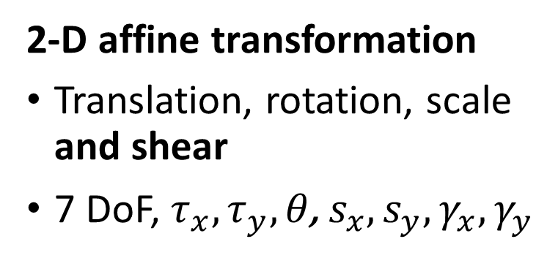




Four Planar Transformation Problems
2-D affine transformation
Translation, rotation, scale and shear
7 DoF, $τ_{x},τ_{y},{θ\text{,} s}_{x},s_{y},γ_{x},γ_{y}$
$$γ_{x}$$
$$s_{y}∗y$$
$$s_{x}∗x$$
$$τ_{y}$$
$$y$$
$$x$$
$$τ_{x}$$

Slide 56





Four Planar Transformation Problems
2-D affine transformation
Translation, rotation, scale and shear
7 DoF, $τ_{x},τ_{y},{θ\text{,} s}_{x},s_{y},γ_{x},γ_{y}$
$$s_{x}∗x$$
$$γ_{y}$$
$$s_{y}∗y$$
$$τ_{y}$$
$$y$$
$$x$$
$$τ_{x}$$

Slide 57


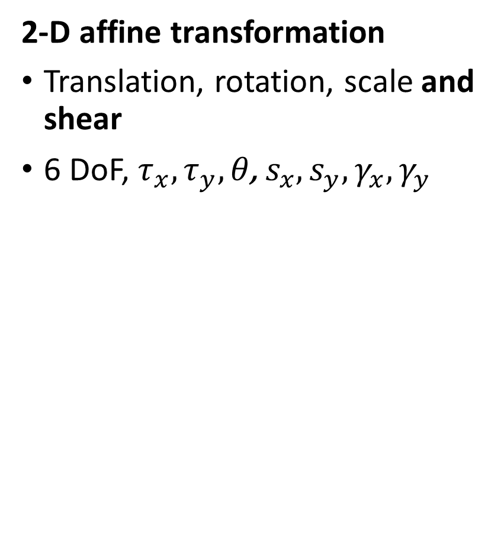



Four Planar Transformation Problems
2-D affine transformation
Translation, rotation, scale and shear
6 DoF, $τ_{x},τ_{y},{θ\text{,} s}_{x},s_{y},γ_{x},γ_{y}$
$$s_{y}∗y$$
$$γ_{x}$$
$$s_{x}∗x$$
$$θ$$
$$τ_{y}$$
$$y$$
$$x$$
$$τ_{x}$$

Slide 58
Perspective Transformations and Homography

Slide 59
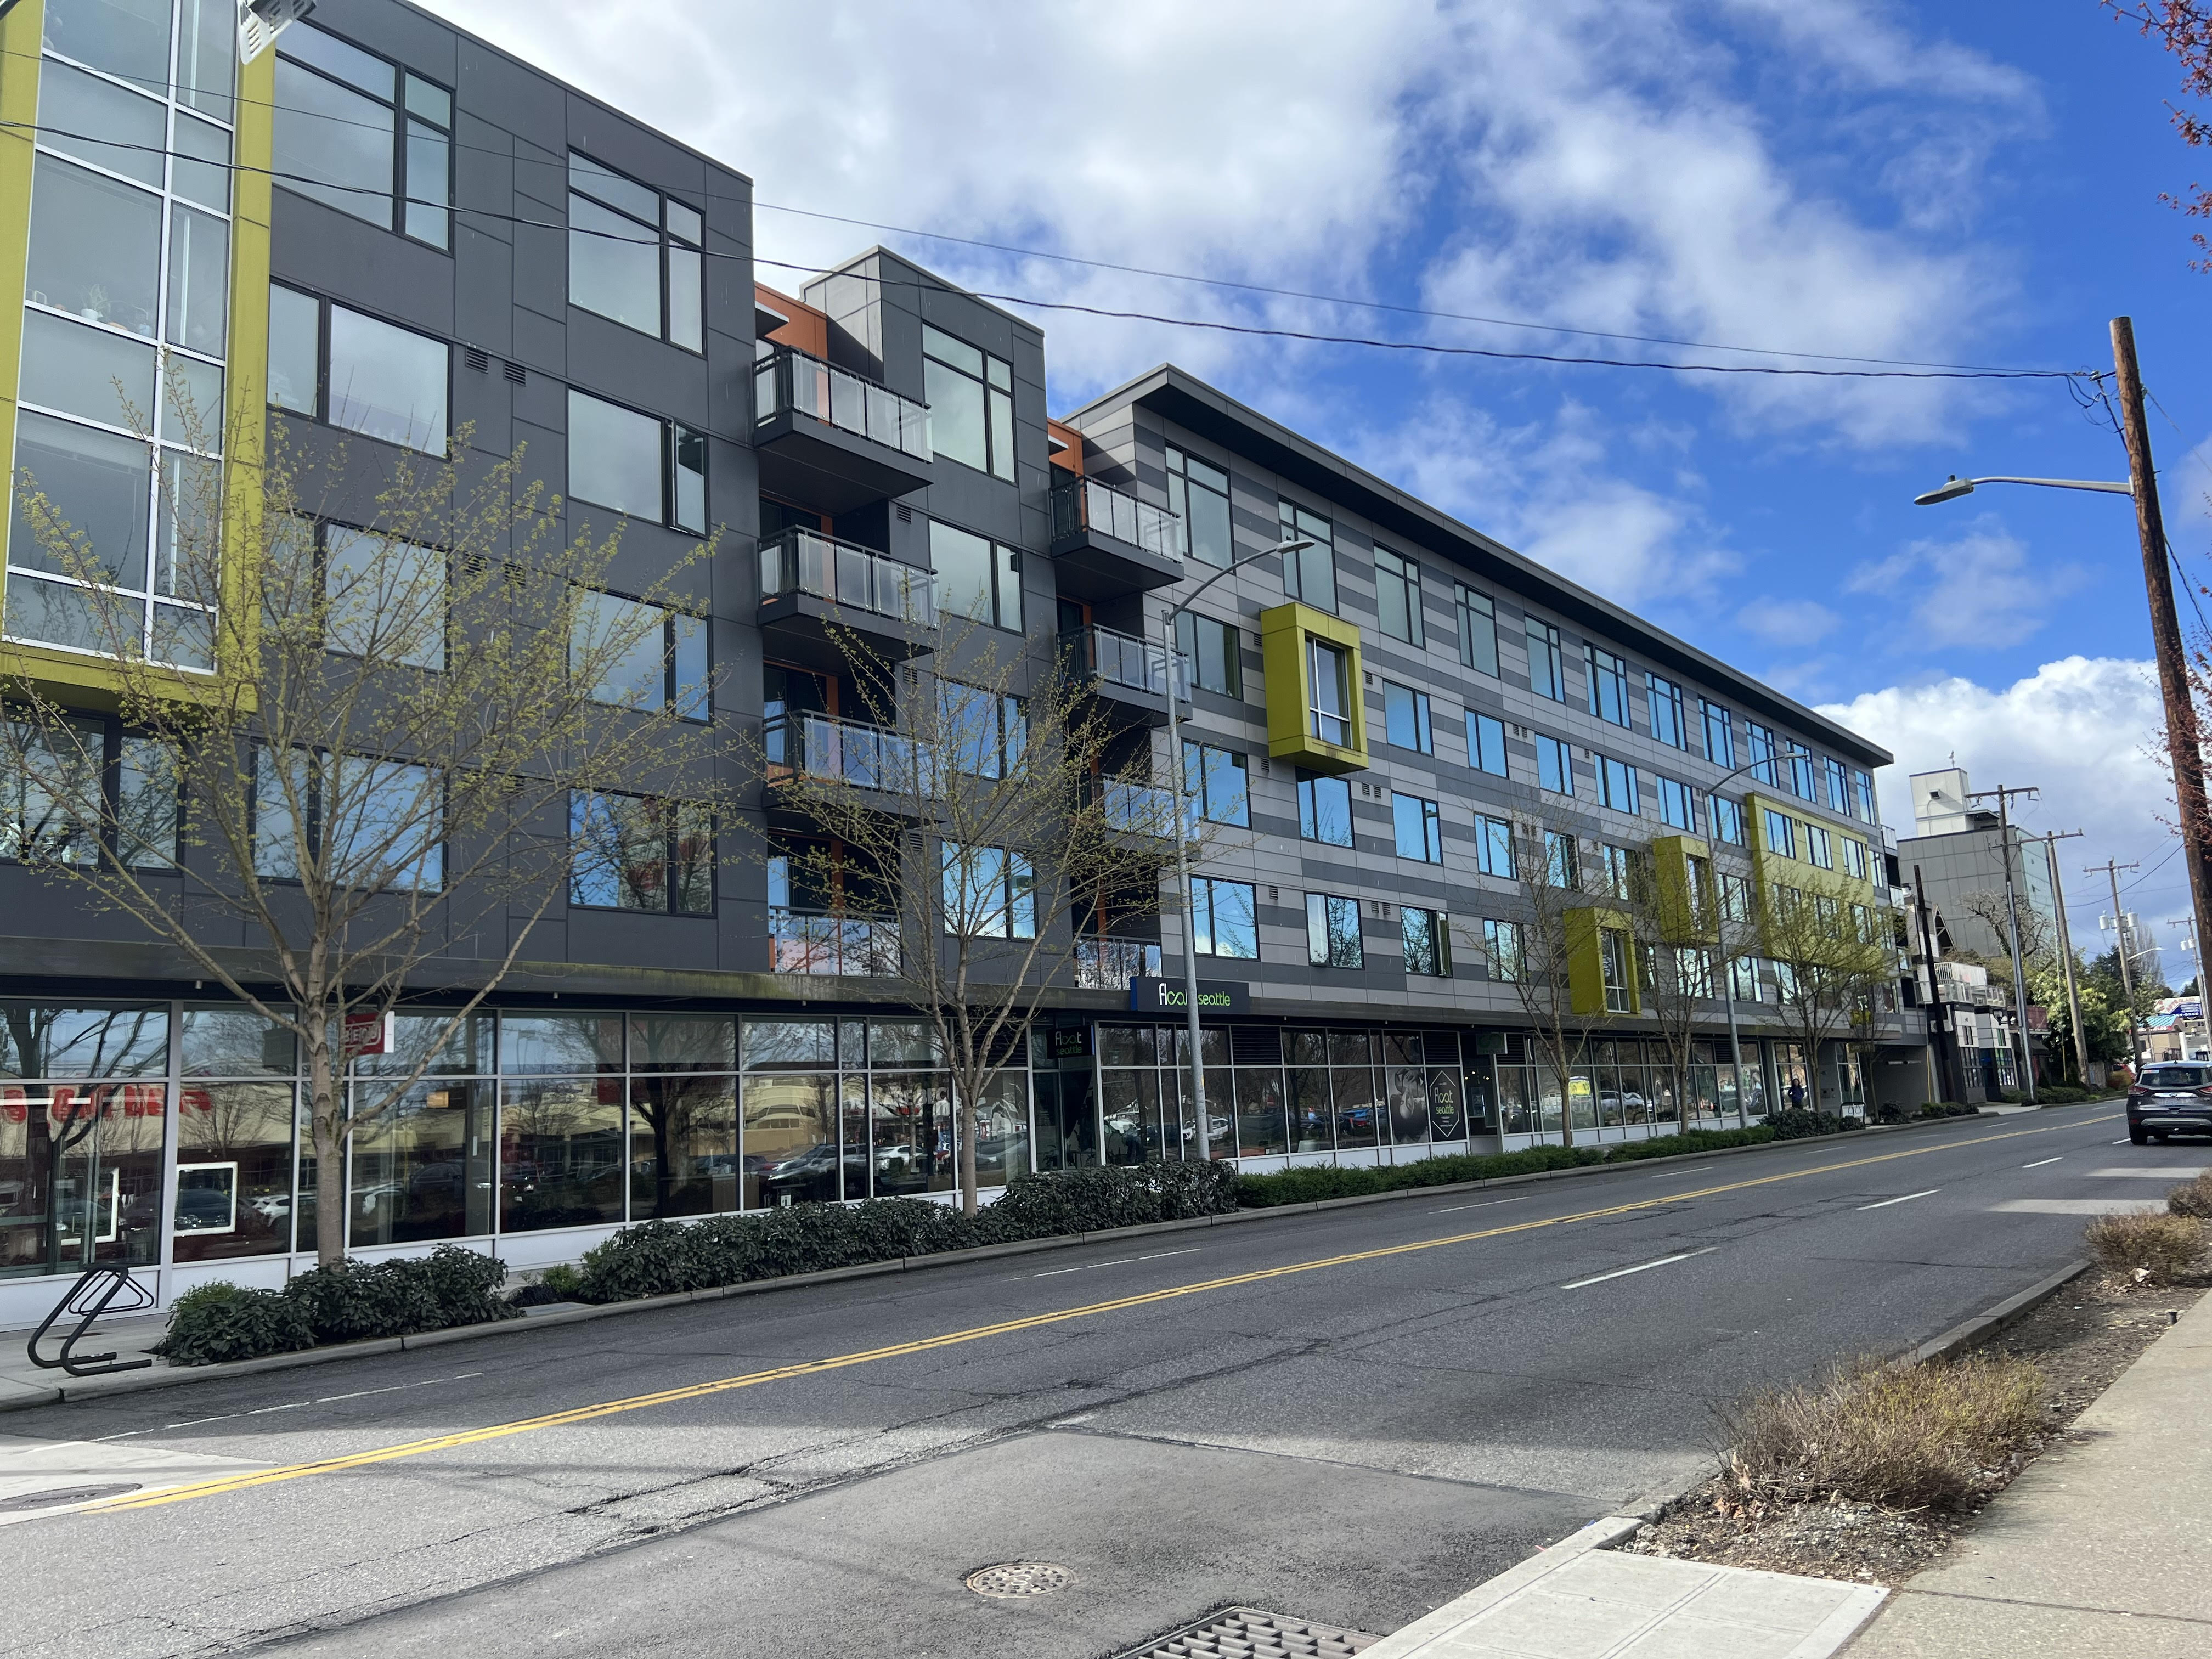
Projective Geometry
Projective transformation or homography
Perspective is determined by camera pose
Straight lines are not parallel in projective geometry
Straight lines meet at a vanishing point in a perspective view

Slide 60
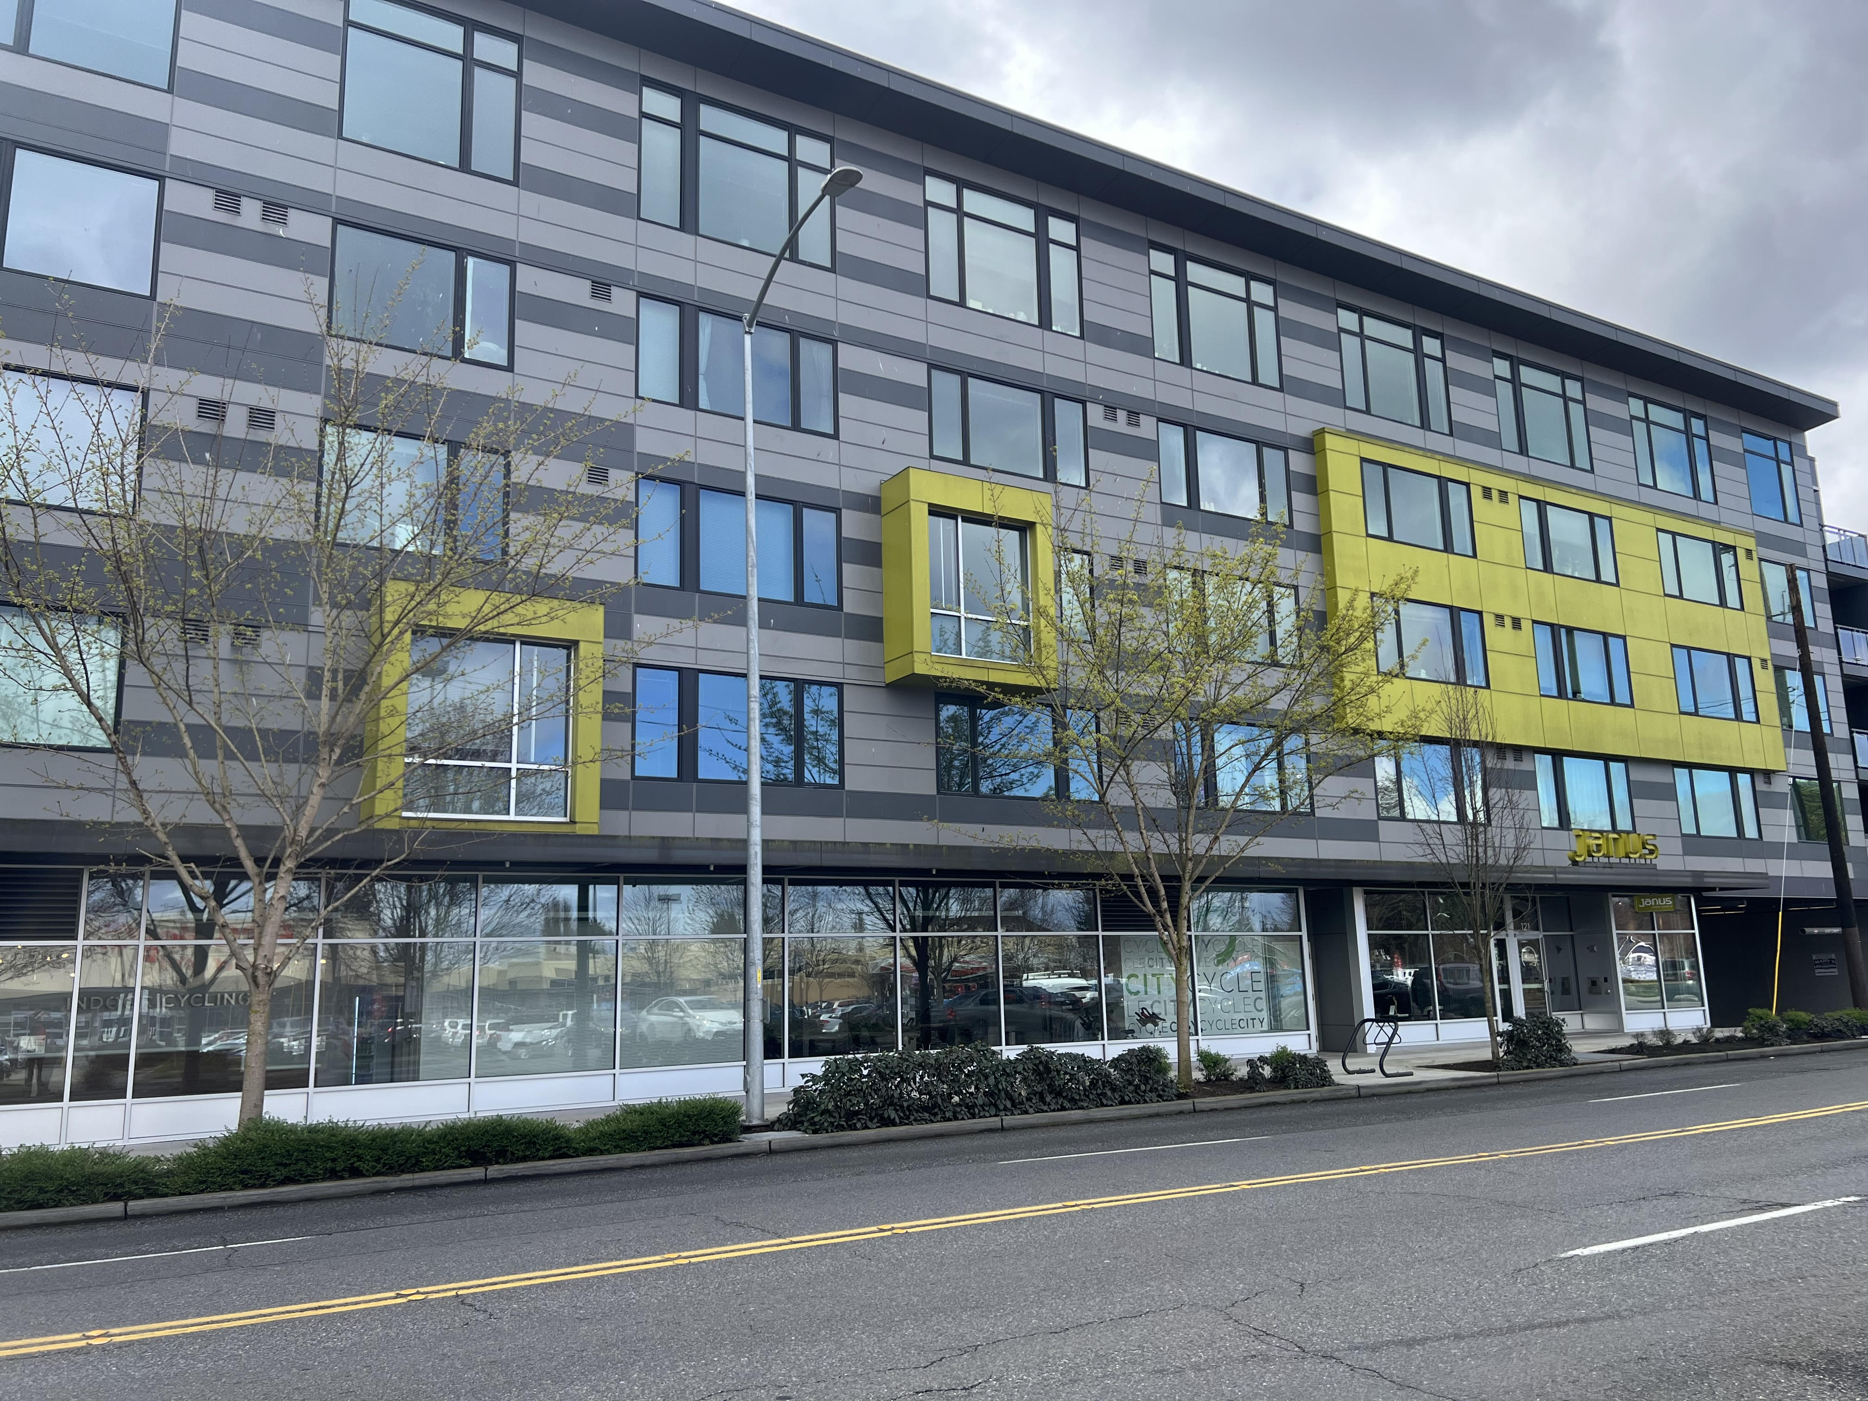
Projective Geometry
Projective transformation or homography
Perspective changes with camera pose
Vanishing point changes with perspective
Vanishing point is at infinity with orthogonal camera projection

Slide 61
Changing Camera Pose
Camera pose determines the perspective on a scene
Start with a point in space X
X projected, with projective matrix P, at point x on image plane of camera 1 with optical center o
X projected, with projective matrix P’, at point x’ on image plane of camera 2 with optic center o’
We will fully explore this 3-D problem in a subsequent lesson
$$X$$
$$P$$
$$P′$$
$$x$$
$$x′$$
$$o$$
$$o′$$

Slide 62



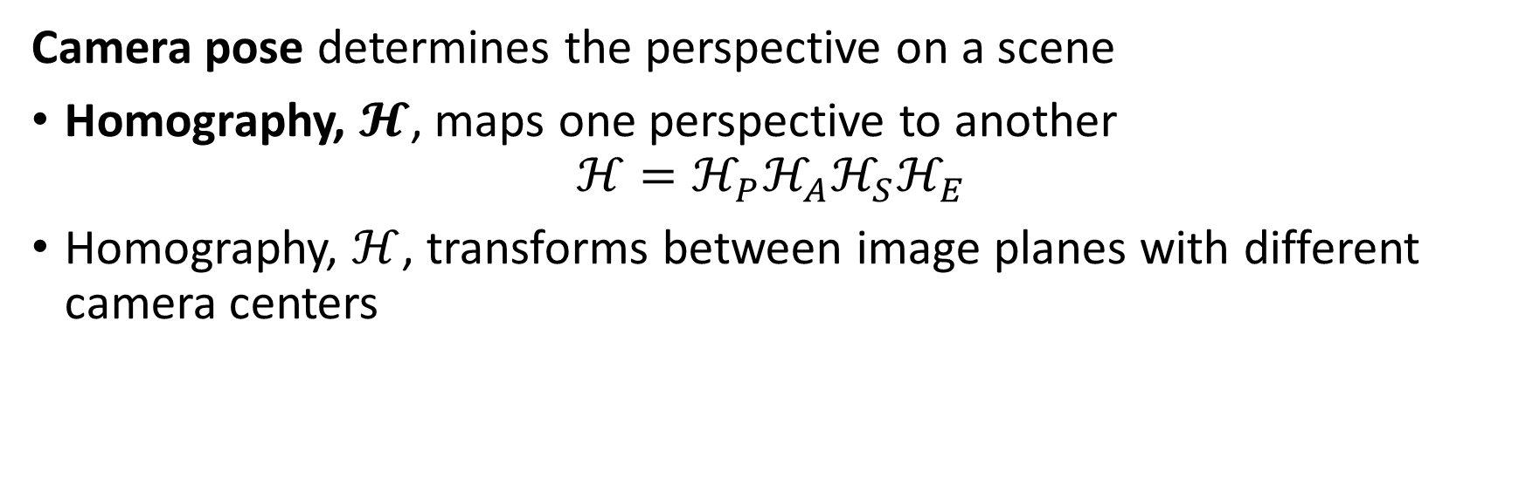





Changing Camera Pose
Camera pose determines the perspective on a scene
Homography, $𝓗$, maps one perspective to another
$$ℋ=ℋ_{P}ℋ_{A}ℋ_{S}ℋ_{E}$$
Homography, $ℋ$, transforms between image planes with different camera centers
$$X$$
$$P$$
$$P′$$
$$x$$
$$x′$$
$$ℋ=ℋ_{P}ℋ_{A}ℋ_{S}ℋ_{E}$$
$$o$$
$$o′$$

Slide 63
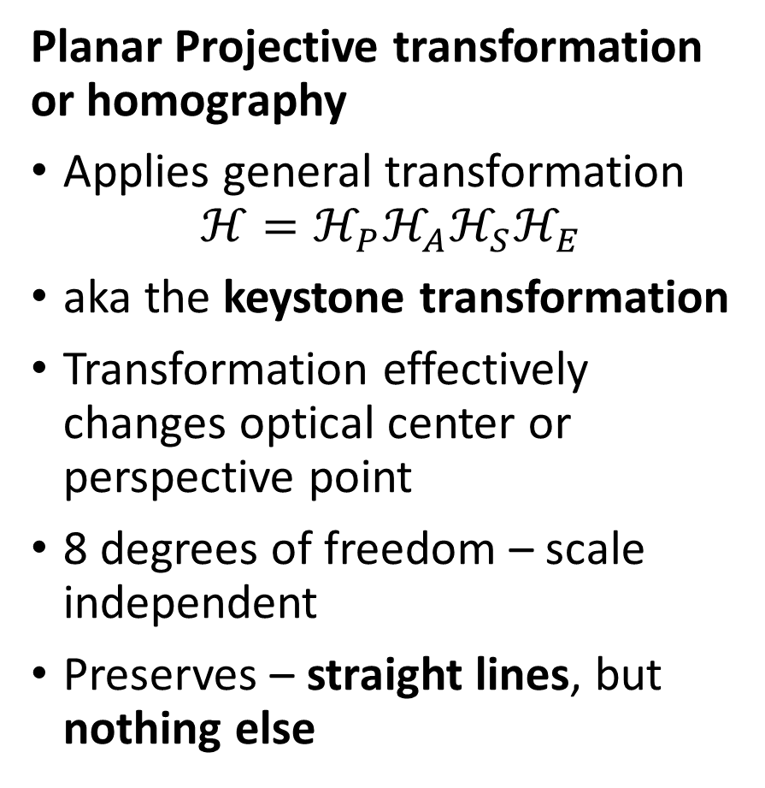
Projective Transformations or Homography
Planar Projective transformation or homography
Applies general transformation
$$ℋ=ℋ_{P}ℋ_{A}ℋ_{S}ℋ_{E}$$
aka the keystone transformation
Transformation effectively changes optical center or perspective point
8 degrees of freedom – scale independent
Preserves – straight lines, but nothing else

Slide 64
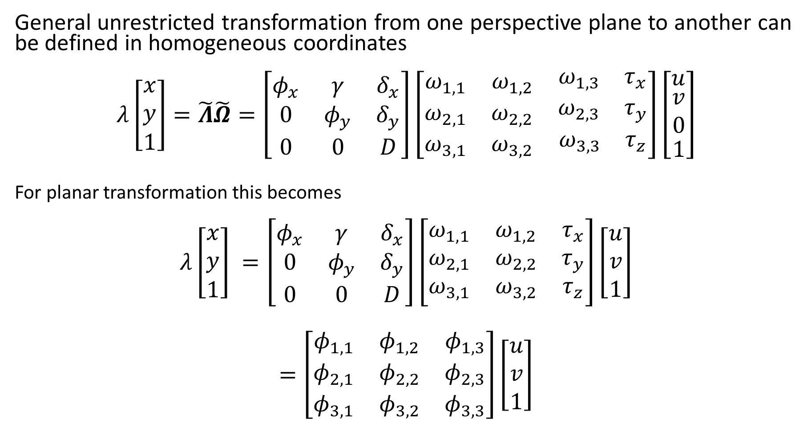
Projective Transformation or Homography
General unrestricted transformation from one perspective plane to another can be defined in homogeneous coordinates
$$λ\left[\begin{matrix}x \\ y \\ 1\end{matrix}\right]=\tilde{Λ}\tilde{Ω}=\left[\begin{matrix}φ_{x} & γ & δ_{x} \\ 0 & φ_{y} & δ_{y} \\ 0 & 0 & D\end{matrix}\right]\left[\begin{matrix}ω_{1,1} & ω_{1,2} & \begin{matrix}ω_{1,3} & τ_{x}\end{matrix} \\ ω_{2,1} & ω_{2,2} & \begin{matrix}ω_{2,3} & τ_{y}\end{matrix} \\ ω_{3,1} & ω_{3,2} & \begin{matrix}ω_{3,3} & τ_{z}\end{matrix}\end{matrix}\right]\left[\begin{matrix}u \\ \begin{matrix}v \\ 0\end{matrix} \\ 1\end{matrix}\right]$$
For planar transformation this becomes
$$λ\left[\begin{matrix}x \\ y \\ 1\end{matrix}\right] =\left[\begin{matrix}φ_{x} & γ & δ_{x} \\ 0 & φ_{y} & δ_{y} \\ 0 & 0 & D\end{matrix}\right]\left[\begin{matrix}ω_{1,1} & ω_{1,2} & τ_{x} \\ ω_{2,1} & ω_{2,2} & τ_{y} \\ ω_{3,1} & ω_{3,2} & τ_{z}\end{matrix}\right]\left[\begin{matrix}u \\ v \\ 1\end{matrix}\right]$$
$$=\left[\begin{matrix}φ_{1,1} & φ_{1,2} & φ_{1,3} \\ φ_{2,1} & φ_{2,2} & φ_{2,3} \\ φ_{3,1} & φ_{3,2} & φ_{3,3}\end{matrix}\right]\left[\begin{matrix}u \\ v \\ 1\end{matrix}\right]$$

Slide 65
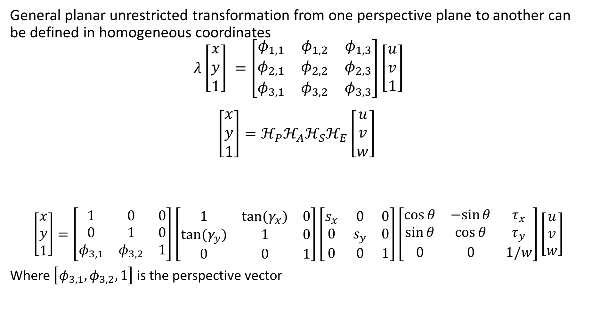
Projective Transformation or Homography
General planar unrestricted transformation from one perspective plane to another can be defined in homogeneous coordinates
$$λ\left[\begin{matrix}x \\ y \\ 1\end{matrix}\right] =\left[\begin{matrix}φ_{1,1} & φ_{1,2} & φ_{1,3} \\ φ_{2,1} & φ_{2,2} & φ_{2,3} \\ φ_{3,1} & φ_{3,2} & φ_{3,3}\end{matrix}\right]\left[\begin{matrix}u \\ v \\ 1\end{matrix}\right]$$
$$\left[\begin{matrix}x \\ y \\ 1\end{matrix}\right]={ℋ_{P}ℋ_{A}ℋ}_{S}ℋ_{E}\left[\begin{matrix}u \\ v \\ w\end{matrix}\right]$$
$$\left[\begin{matrix}x \\ y \\ 1\end{matrix}\right]=\left[\begin{matrix}1 & 0 & 0 \\ 0 & 1 & 0 \\ φ_{3,1} & φ_{3,2} & 1\end{matrix}\right]\left[\begin{matrix}1 & tan⁡(γ_{x}) & 0 \\ tan⁡(γ_{y}) & 1 & 0 \\ 0 & 0 & 1\end{matrix}\right]\left[\begin{matrix}s_{x} & 0 & 0 \\ 0 & s_{y} & 0 \\ 0 & 0 & 1\end{matrix}\right]\left[\begin{matrix}\cos{θ} & −sin{θ} & τ_{x} \\ \sin{θ} & \cos{θ} & τ_{y} \\ 0 & 0 & 1/w\end{matrix}\right]\left[\begin{matrix}u \\ v \\ w\end{matrix}\right]$$
Where $\left[φ_{3,1},φ_{3,2},1\right]$ is the perspective vector

Slide 66
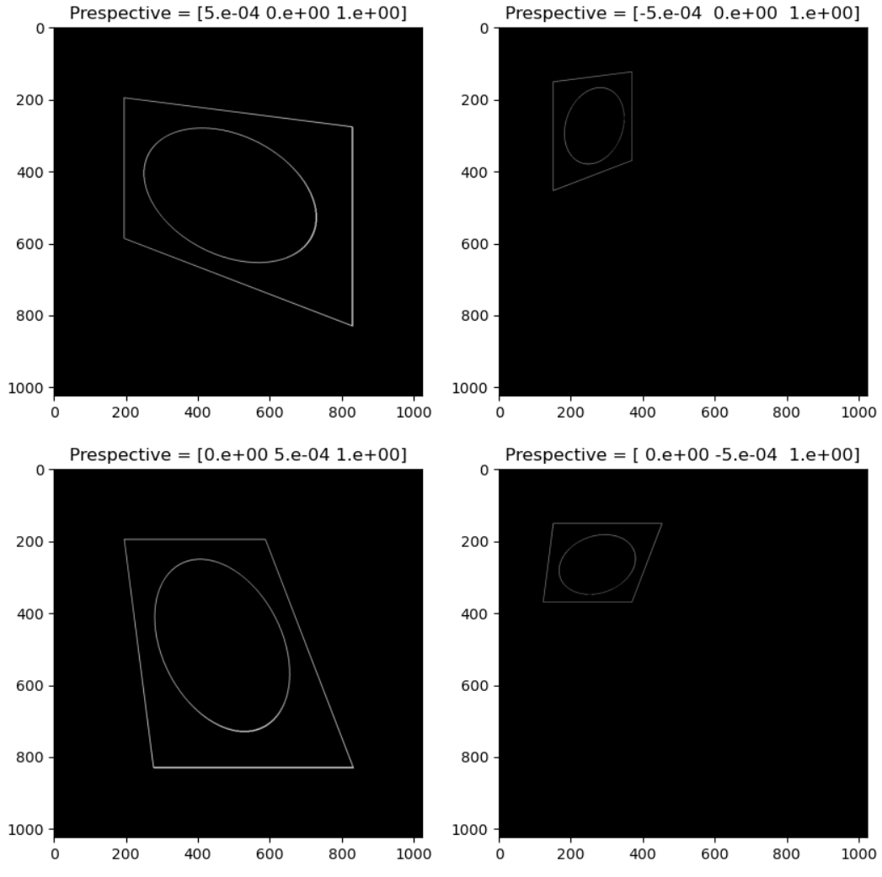

Projective Transformation or Homography
Example: Projective transform or homography
Effect of changing perspective vector
Only isotropic scale applied
Original image

Slide 67


Projective Transformation or Homography
Example: Projective transform or homography
Effect of changing perspective vector
Only isotropic scale applied
Original image

Slide 68

Summary
Planar transforms map between light scattered off objects and projections on a camera image plane
Planar projective transformation model based on pinhole camera
Planar transformations use projection matrix
2-D Euclidean – Rotation and translation
2-D Similarity – Rotation, translation, and scaling
Affine - Rotation, translation, scaling, shearing
Projective – General transformation, 8 DoF
Projective transform or homography maps one camera pose to another
$$ℋ=ℋ_{P}ℋ_{A}ℋ_{S}ℋ_{E}$$

