Slide 1
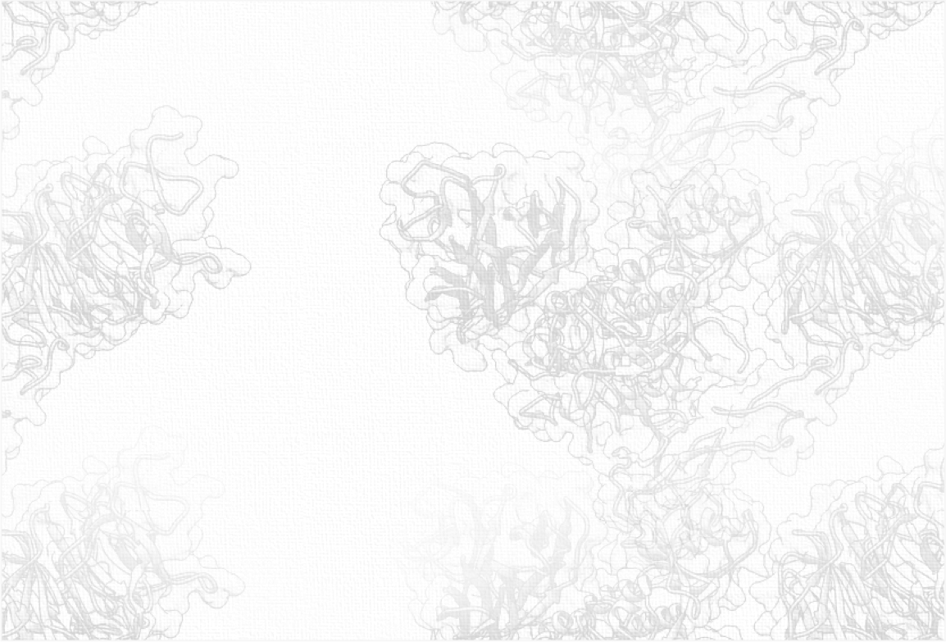
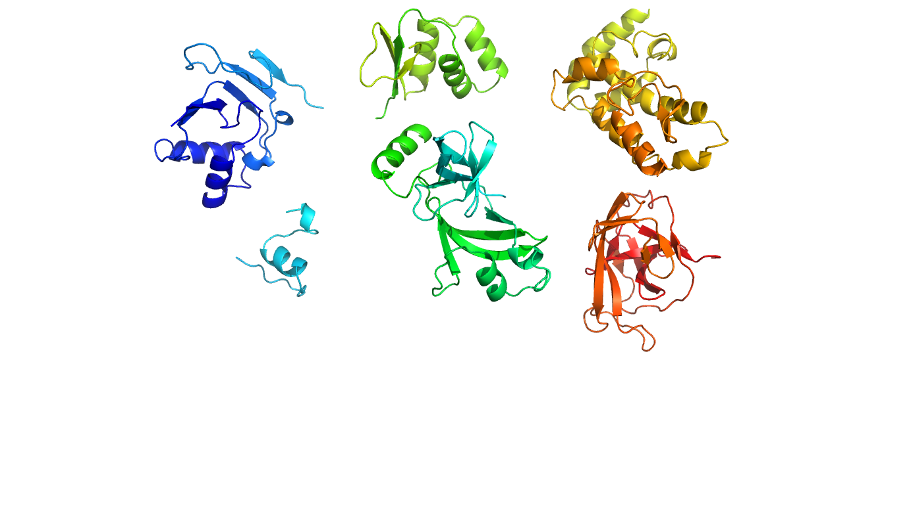
Clustering of 3D (or any) biological data

Slide 2
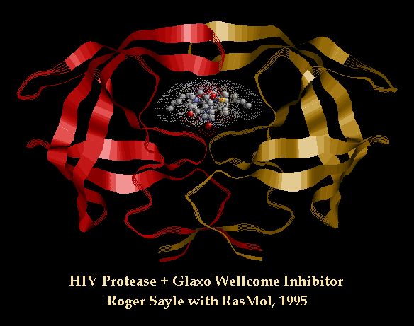
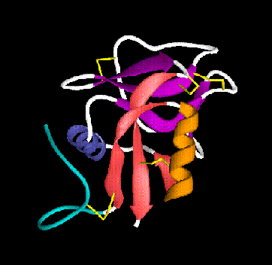
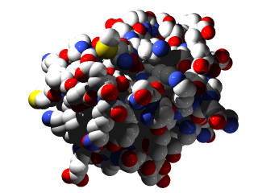
The Protein Fold Universe
How big is it?
500? 2000? 10000?
8
?
Human genome codes for ~20,000 proteins

Slide 3
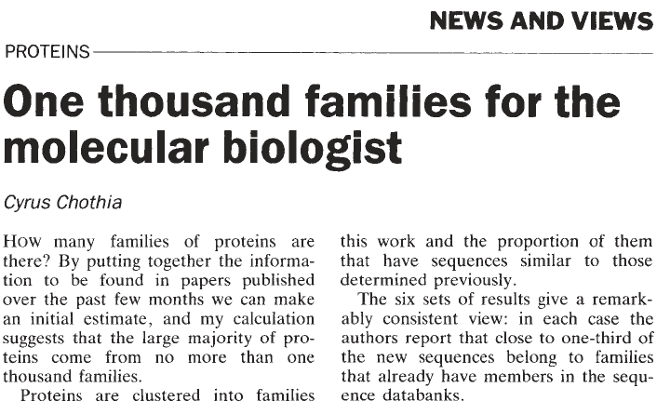

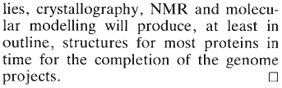
Only a few folds are found in nature

Slide 4
Estimates for the number of folds
ranges from 1,000 to 10,000, depending on the classification used
this number is sensitive to the parameters of the classification, i.e., how widely or narrowly fold is defined
different definitions result in dramatically different estimates
there is an inherent difficulty in estimating this number because of the vast amount of genomic data that we have not seen yet

Slide 5
Growth of unique SCOP folds per year

Slide 6
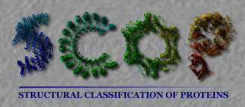
SCOP Structural Classification of Proteins
SCOP database is a largely manual classification of protein structural domains.
Published in 1995 and updated at least once yearly by Alexei G. Murzin and his colleagues, upon whose expertise the classification rests.

Slide 7
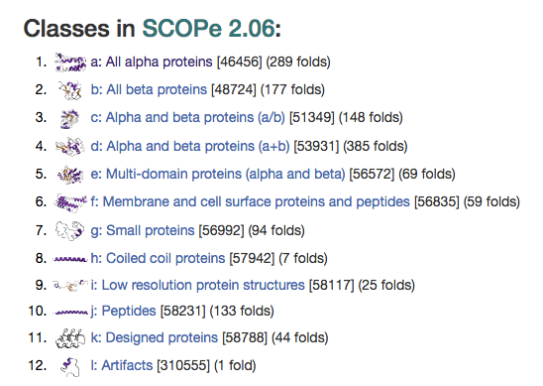
2016

Slide 8
Why and How should we automate fold classification?
Function prediction
Homology modeling
Model selection
ab initio modeling

Slide 9
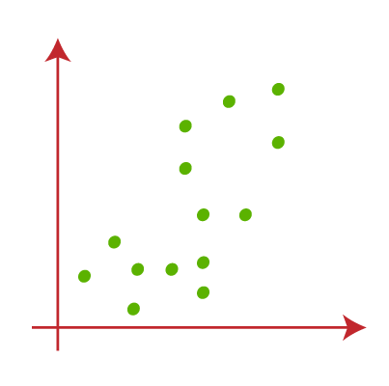
Clustering – a geometric/AI perspective
What is the correct way? Is there only one answer?

Slide 10
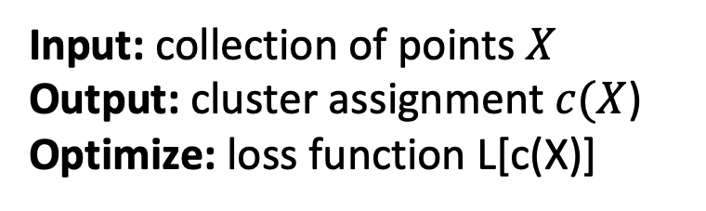
Clustering as an optimization problem
What is an appropriate loss function (objective function, score)
Input: collection of points $X$
Output: cluster assignment $c(X$)
Optimize: loss function L[c(X)]

Slide 11
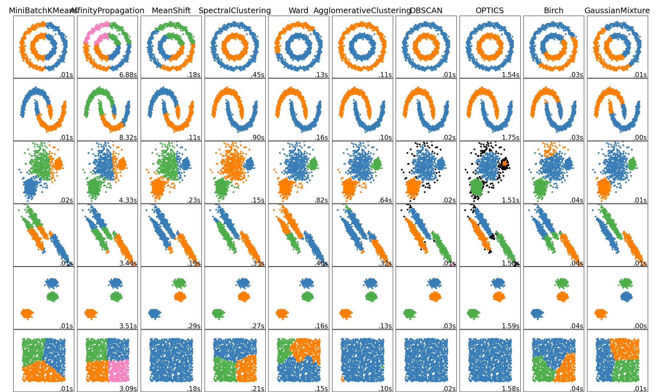
Approaches
k-means
Linkage
average
Short
complete
Spectral clustering
You-name-it clustering
https://scikit-learn.org/stable/modules/clustering.html

Slide 12
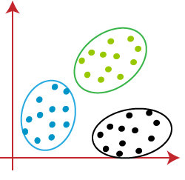
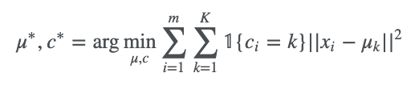
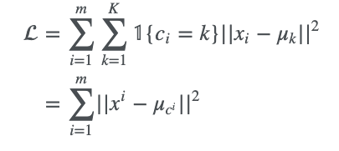

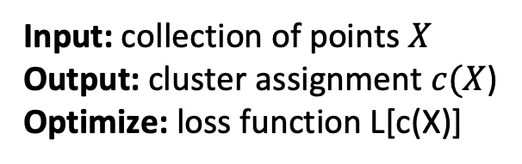


k-means: minimize distance of points from centers of their clusters f
What is an appropriate loss function (objective function, score)
Input: collection of points $X$
Output: cluster assignment $c(X$)
Optimize: loss function L[c(X)]
$$μ_{1}$$
$$μ_{2}$$
$$μ_{3}$$

Slide 13
Average linkage (hierarchical clustering)
What is an appropriate loss function (objective function, score)

Slide 14
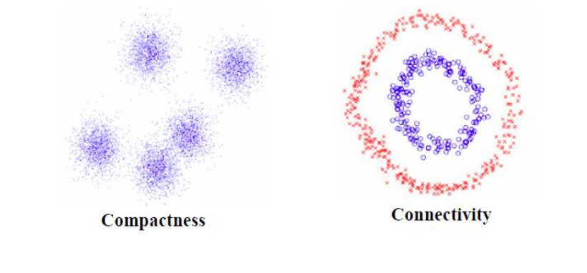
K-means and average clustering favor compactness over coonectivity
https://www.cs.cmu.edu/~aarti/Class/10701/slides/Lecture21_2.pdf

Slide 15
Spectral clustering
What is an appropriate loss function (objective function, score)
https://www.cs.cmu.edu/~aarti/Class/10701/slides/Lecture21_2.pdf

