Slide 1
Praktikum NLP
Raphael Baumann
Advisor: Benedikt Ebing
24.11.2023

Slide 2
Beispieltitel
Recap Dataloader Model First Run Next Steps
Kick-Off Meeting

Slide 3
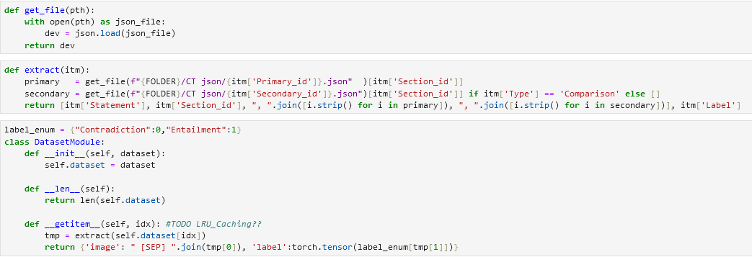
Beispieltitel
Recap Dataloader Model First Run Next Steps
“<Statement> [SEP] <Section> [SEP] <Primary> [SEP] <Secondary>“, <Label>

Slide 4
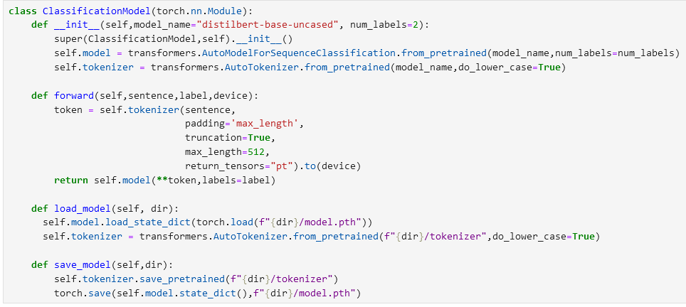
Beispieltitel
Recap Dataloader Model First Run Next Steps

Slide 5
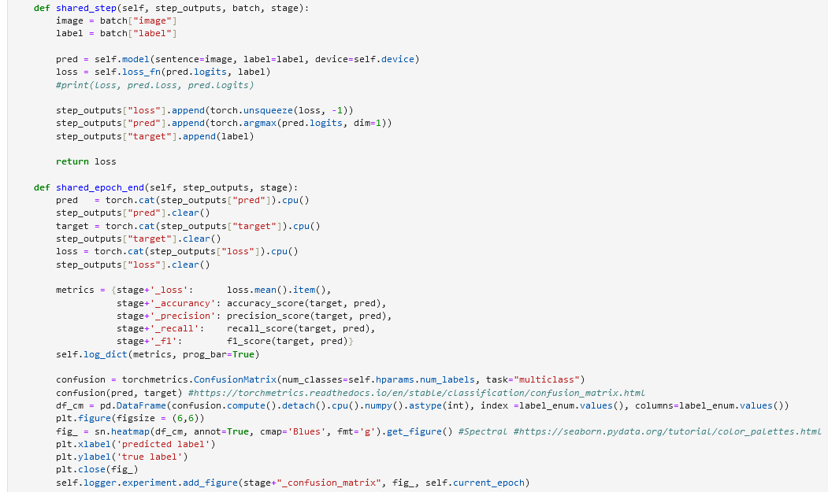
Beispieltitel
Recap Dataloader Model First Run Next Steps
Step for each Batch (Train/Val/Test)
Prediction/Loss Calculation
Save values
Step for each Epoch (Train/Val/Test)
Concatenate all values from all batches
Metric Calculation
Confusion Matrix
Notes:
Lightning functions

Slide 6
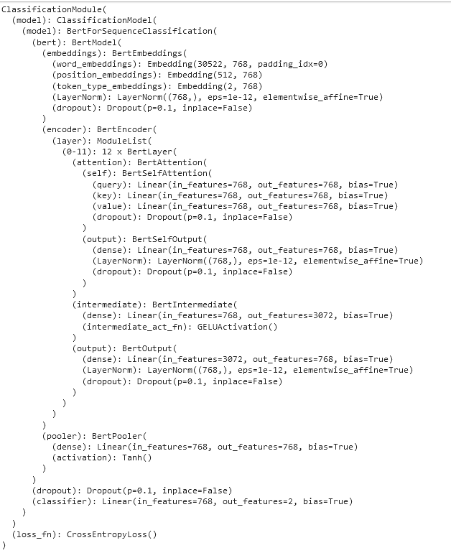
Beispieltitel
Recap Dataloader Model First Run Next Steps
Model=bert-base-uncased
Epochs=75
Lr= 5e^-6
Batch_Size=8
Optimizer=Adam
Seed_val = 42

Slide 7
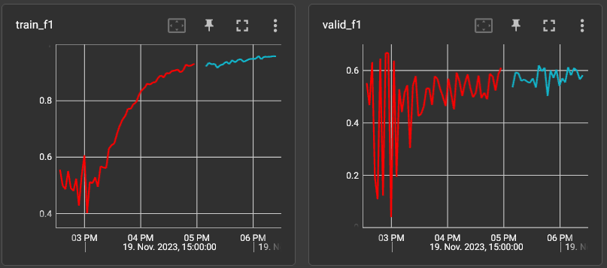

Beispieltitel
Recap Dataloader Model First Run Next Steps

Slide 8
Beispieltitel
Recap Dataloader Model First Run Next Steps
Test Other Models for better Results
Hyperparameter Search each on 3 Seeds
Epochs
Batch_Size
LR
Token Length
Dropout Percentage ???
Augmentierung/Randomization/Mixing/Permutate of
Primary
Secondary

