Slide 1
Praktikum NLP
Raphael Baumann
Advisor: Benedikt Ebing
05.12.2023

Slide 2
Recap
Recap Dataset Analysis Results Other Papers Next Steps
Implementierungsdetails
Lightning Framework
Dataloader
Model
Erster Durchlauf / Sanity Check der Implementierung

Slide 3
Dataset Analysis
Recap Dataset Analysis Results Other Papers Next Steps
{'Type': 'Single‘, 'Section_id': 'Results‘, 'Primary_id': 'NCT00593346‘, 'Statement‘: 'the primary trial does not report the PFS or objective response rate of its patient cohort‘, 'Label': 'Entailment'}
['Outcome Measurement: ' ,
' Local Control Using Ipsilateral Breast Tumor Recurrence Rates‘,
' [Not Specified]‘,
' Time frame: 2 years after treatment completion‘,
'Results 1: ',
' Arm/Group Title: Accelerated Partial Breast Brachytherapy‘,
' Arm/Group Description: Each patient will receive accelerated partial breast brachytherapy with multiple plane implant.‘,
' Patients will receive 3400 cGy delivered in 10 twice-daily fractions. Treatment is to be given over 5-7 days with a minimum of 6 hours separation between fractions.‘,
' Overall Number of Participants Analyzed: 151‘,
' Measure Type: Number‘,
' Unit of Measure: percentage of participants .7']
P1 … Pn
[CLS] <Statement> [SEP] <Section_id> [SEP] P1, P2, P3, … Pn [SEP]

Slide 4
Dataset Analysis
Recap Dataset Analysis Results Other Papers Next Steps
{'Type': 'Comparison', 'Section_id': 'Adverse Events', 'Primary_id': 'NCT02273973', 'Secondary_id': 'NCT00281697', 'Statement': 'a significant number of the participants in the secondary trial and the
primary trial suffered from Enterocolitis', 'Label': 'Contradiction'}
['Adverse Events 1:‘,
' Total: 20/167 (11.98%)‘,
' Cardiac failure acute 0/167 (0.00%)‘,
' Diarrhoea 5/167 (2.99%)‘,
' Colitis 2/167 (1.20%)‘,
' Enterocolitis 1/167 (0.60%)‘,
' Enterocolitis haemorrhagic 1/167 (0.60%)‘,
' Stomatitis 1/167 (0.60%)‘,
' Impaired healing 1/167 (0.60%)‘,
' Sudden death 1/167 (0.60%)‘,
' Postoperative wound infection 2/167 (1.20%)‘,
' Erysipelas 2/167 (1.20%)‘,
' Bacterial diarrhoea 1/167 (0.60%)‘,
'Adverse Events 2:‘,
' Total: 4/167 (2.40%)‘,
' Cardiac failure acute 1/167 (0.60%)‘,
' Diarrhoea 0/167 (0.00%)‘,
' Colitis 0/167 (0.00%)‘,
' Enterocolitis 0/167 (0.00%)‘,
' Enterocolitis haemorrhagic 0/167 (0.00%)‘,
' Stomatitis 0/167 (0.00%)‘,
' Impaired healing 0/167 (0.00%)‘,
' Sudden death 0/167 (0.00%)‘,
' Postoperative wound infection 1/167 (0.60%)‘,
' Erysipelas 0/167 (0.00%)‘,
' Bacterial diarrhoea 0/167 (0.00%)']
['Adverse Events 1:‘,
' Total: 112/458 (24.45%)‘,
' Febrile neutropenia 8/458 (1.75%)‘,
' Neutropenia 6/458 (1.31%)‘,
' Anaemia 3/458 (0.66%)‘,
' Thrombocytopenia 3/458 (0.66%)‘,
' Pancytopenia 2/458 (0.44%)‘,
' Myocardial infarction 0/458 (0.00%)‘,
' Pericardial effusion 0/458 (0.00%)‘,
' Tachycardia 0/458 (0.00%)‘,
' Acute myocardial infarction 1/458 (0.22%)‘,
' Atrial fibrillation 0/458 (0.00%)‘,
'Adverse Events 2:‘,
' Total: 39/221 (17.65%)‘,
' Febrile neutropenia 5/221 (2.26%)‘,
' Neutropenia 1/221 (0.45%)‘,
' Anaemia 2/221 (0.90%)‘,
' Thrombocytopenia 0/221 (0.00%)‘,
' Pancytopenia 0/221 (0.00%)‘,
' Myocardial infarction 2/221 (0.90%)‘,
' Pericardial effusion 2/221 (0.90%)‘,
' Tachycardia 2/221 (0.90%)‘,
' Acute myocardial infarction 0/221 (0.00%)‘,
' Atrial fibrillation 1/221 (0.45%)']
P1 … Pn
S1 … Sn
[CLS] <Statement> [SEP] <Section_id> [SEP] P1, P2, P3, … Pn [SEP] S1, S2, S3, … Sn [SEP]

Slide 5
Dataset Analysis
Recap Dataset Analysis Results Other Papers Next Steps
Labels sind in Train/Val gleichverteilt
Section Distribution
Sequence Length Distribution (len(string) / #-Words / #-token)
 | Contradiction | Entailment
Train | 850 | 850
Val | 100 | 100
 | Adverse Events | Eligibility | Intervention | Results
Train | 496 | 486 | 396 | 322
Val | 56 | 56 | 52 | 36
 | min | max | mean | median
Train | 154/21/29 | 11687/1740/2818 | 1766/254/460 | 1218/171/374
Val | 117/20/25 | 9266/1307/2201 | 1649/239/420 | 1092/157/360

Slide 6
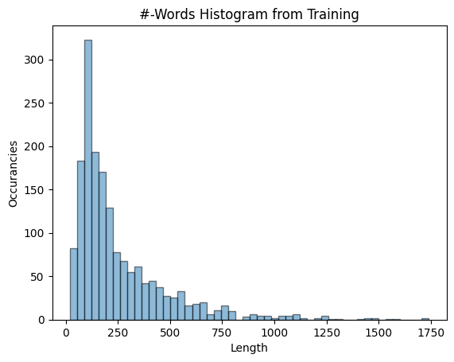
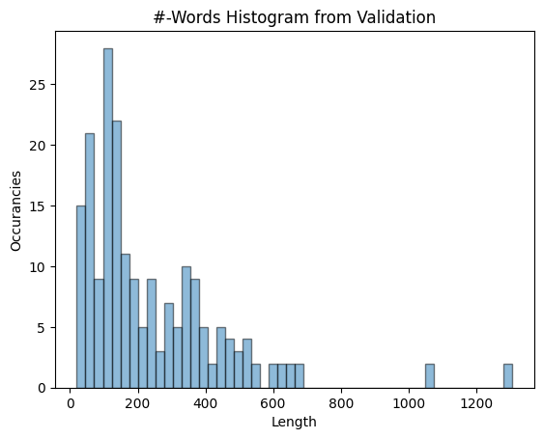
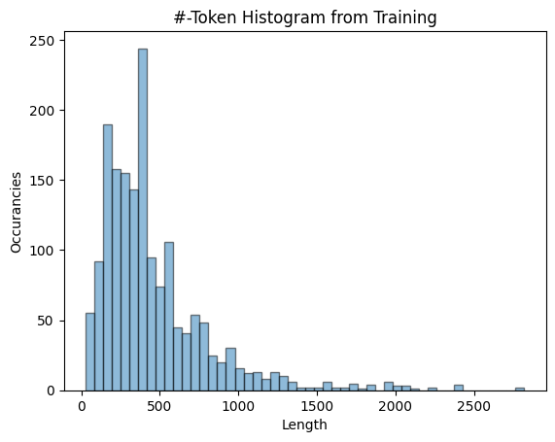
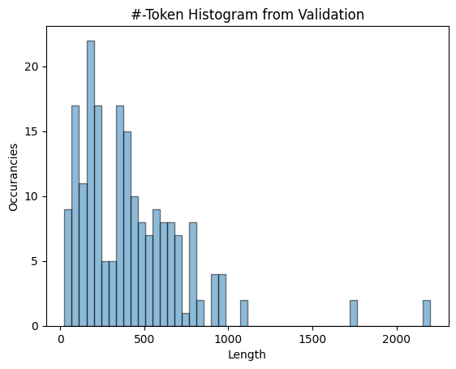

Dataset Analysis
Recap Dataset Analysis Results Other Papers Next Steps

Slide 7
Results
Recap Dataset Analysis Results Other Papers Next Steps
Permutation
P1, P2, …, Pn → P1‘, P2‘, …, Pn‘
S1, S2, …, Sn → S1‘, S2‘, …, Sn‘
Learning Rate
[3.e-06, 4.e-06, 5.e-06, 6.e-06, 7.e-06]
Token Test
[768, 1024]

Slide 8
Other Papers
Recap Dataset Analysis Results Other Papers Next Steps
[1] | F1 Validation
BERT-base | 69.2
BERT-large | 70.9
BioClinical-BERT-base | 65.3
ALBERT-v2-base | 67.1
ALBERT-v2-large | 67.1
ALBERT-v2-xlarge | 67.1
ALBERT-v2-xxlarge | 67.1
BART-base | 67.3
BART-large | 66.9
RoBERTa-base | 70.7
RoBERTa-large | 67.6
DeBERTa-v3-base | 75.8
DeBERTa-v3-large | 81.5
ELECTRA-base | 70.3
ELECTRA-large | 76.1
GPT2-base | 39.0
GPT2-medium | 44.2
GPT2-large | 61.5
[2] | F1 Validation
DistilBERT Base | 60.8
ELECTRA Small | 63.9
BioBERT v1.1 | 63.7
PubMedBERT | 66.0
Bio Discharge BERT | 59.2
Biomedical NER | 61.0
BioBERT Diseases NER | 65.5
MedBERT Breast Cancer | 31.4
[5] | F1 Validation
ClinicalBERT | 65.7
UmlsBERT | 67.0
StructBERT | 64.8
ERNIE | 66.2
[3] | F1 Validation
t5 | 62.2
[4] | F1 Validation
GatorTron-Base: Full Premise | 63.7
GatorTron-Base Relevant-Only | 69.6
GatorTron-Base: DA & Relevant-Only | 70.5
Notes:
[1] = https://aclanthology.org/2023.semeval-1.1.pdf
[2] = https://aclanthology.org/2023.semeval-1.245.pdf
[3] = https://aclanthology.org/2023.semeval-1.226.pdf
[4] = https://aclanthology.org/2023.semeval-1.220.pdf
[5] = https://arxiv.org/pdf/2304.13180.pdf

Slide 9
Next Steps
Recap Dataset Analysis Results Other Papers Next Steps
355M roberta-large-mnli
108M Charangan/MedBERT
108M michiyasunaga/BioLinkBERT-base
333M michiyasunaga/BioLinkBERT-large
42.5M bioformers/bioformer-8L-mnli
42.5M bioformers/bioformer-8L
41.5M bioformers/bioformer-16L
109M microsoft/BiomedNLP-BiomedBERT-base-uncased-abstract-fulltext
108M microsoft/BiomedNLP-BiomedBERT-base-uncased-abstract
333M microsoft/BiomedNLP-BiomedBERT-large-uncased-abstract
108M microsoft/BiomedNLP-BiomedELECTRA-base-uncased-abstract
333M microsoft/BiomedNLP-BiomedELECTRA-large-uncased-abstract
346M microsoft/biogpt
1.6B microsoft/BioGPT-Large
1.6B microsoft/BioGPT-Large-PubMedQA
301M google/byt5-small
583M google/byt5-base
1.2B google/byt5-large
3.7B google/byt5-xl
13B google/byt5-xxl
7B codellama/CodeLlama-7b-hf

