Slide 1
Praktikum NLP
Raphael Baumann
Advisor: Benedikt Ebing
09.01.2024

Slide 2
Recap: Dataset Mixing
Recap Permutation Learningrate Model Next Steps
Pretrainign -> Fine-Tune a BERT NLI Model
Equal Mix Batches
Random Mix Batches
Verdoppelt die Number der Batches anhand des kleinsten Datensatzes
Angewendet nur auf Train nicht auf Validation
len(a) + len(b)

Slide 3
Recap: Model Arcitecture
Recap Permutation Learningrate Model Next Steps
v3
v4
v5
v1
v2
Section
Primary
Secondary
Statement
Section
Primary
Secondary
Section
Primary
Secondary
Section
Primary
Secondary
Section
Secondary
Statement
Primary
Statement
Statement
Statement
BERT
BERT
BERT
BERT
BERT
BERT
BERT
BERT
BERT
BERT
BERT for CL
Pool
Pool
Pool
Pool
Pool
Pool
Pool
Pool
Pool
Pool
Cat(u, v, x, y)
Cat(u, v)
Cat(u, v, |u-v|)
cosineSim(u, v)
Dropout + Fully Connected Layer
Dropout + Fully Connected Layer
Dropout + Fully Connected Layer
Map(-1,1 -> 0, 1)
0 or 1
0 or 1
0 or 1
0 or 1
0 or 1

Slide 4

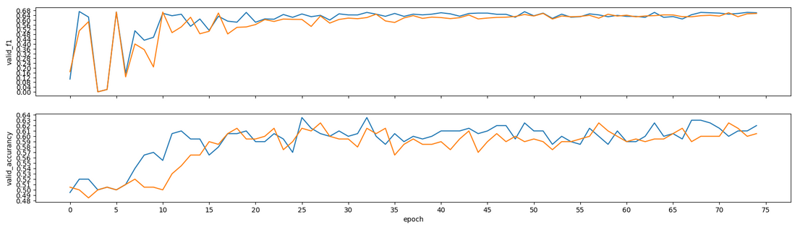
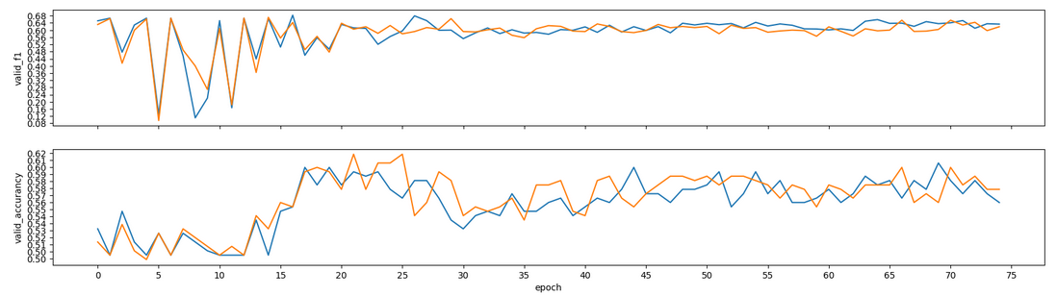
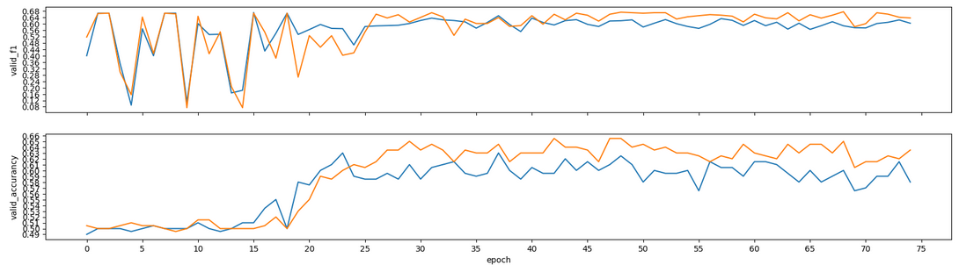
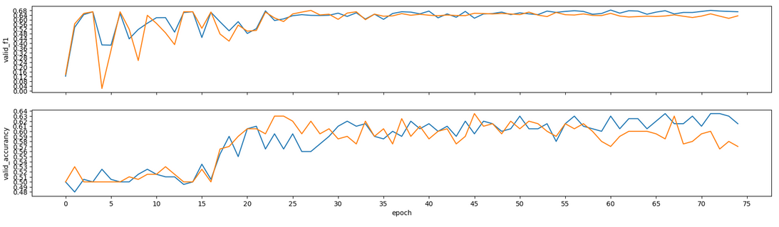
Permutation
Seed
Recap Permutation Learningrate Model Next Steps
0
1998
42
1M

Slide 5

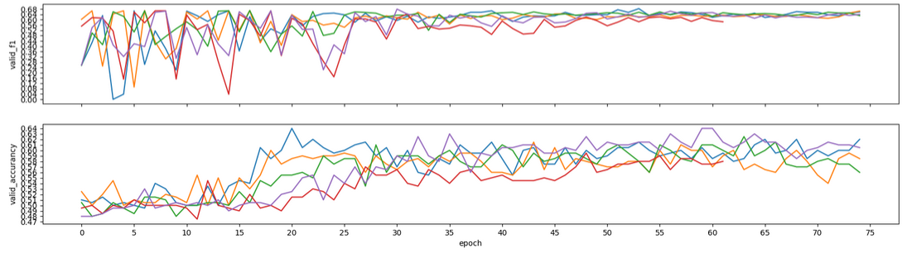
Learningrate 3e-6
Recap Permutation Learningrate Model Next Steps
Batch_size: 16

Slide 6

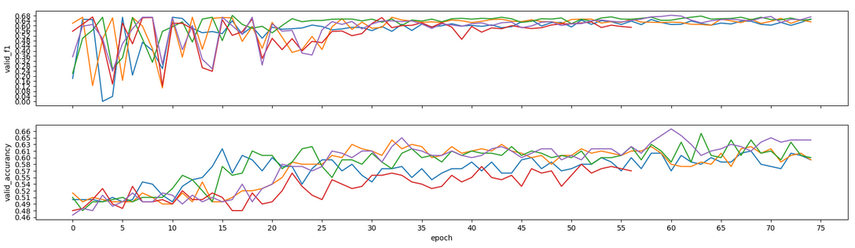
Learningrate 4e-6
Recap Permutation Learningrate Model Next Steps
Batch_size: 16

Slide 7

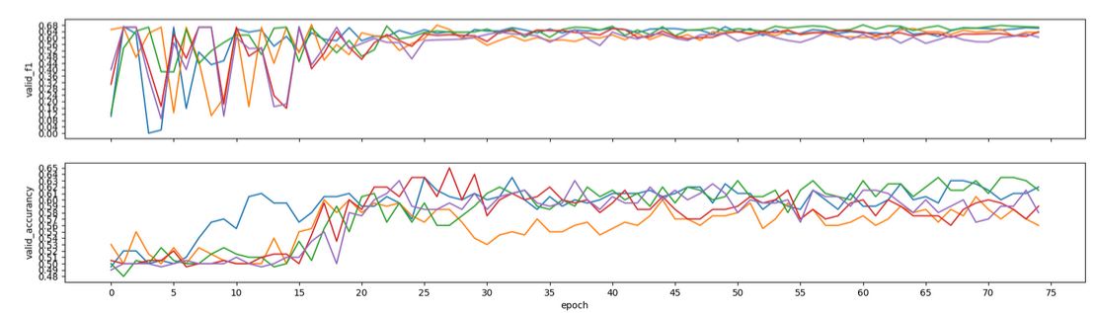
Learningrate 5e-6
Recap Permutation Learningrate Model Next Steps
Batch_size: 16

Slide 8

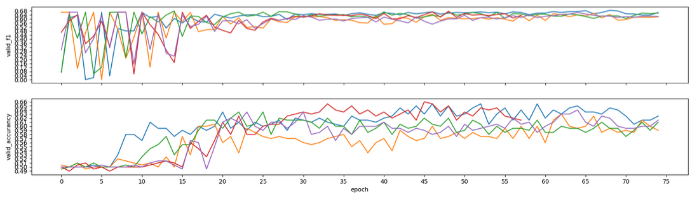
Learningrate 6e-6
Recap Permutation Learningrate Model Next Steps
Batch_size: 16

Slide 9

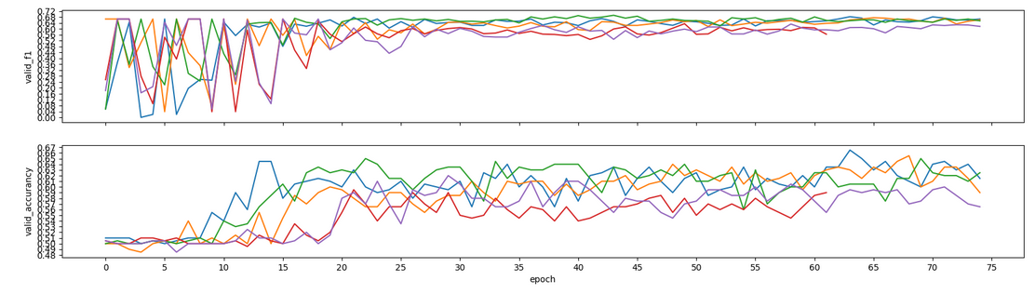

Learningrate 7e-6
Recap Permutation Learningrate Model Next Steps
Batch_size: 16

Slide 10
Models: more Loss
Recap Permutation Learningrate Model Next Steps
Section
Primary
Secondary
Statement
BERT
BERT
Pool
Pool
CosineEmbeddingLoss
v5
cosineSim(u, v)
MSELoss
v6
L1Loss
v7
Map(-1,1 -> 0, 1)
SoftMarginLoss
v8
0 or 1

Slide 11

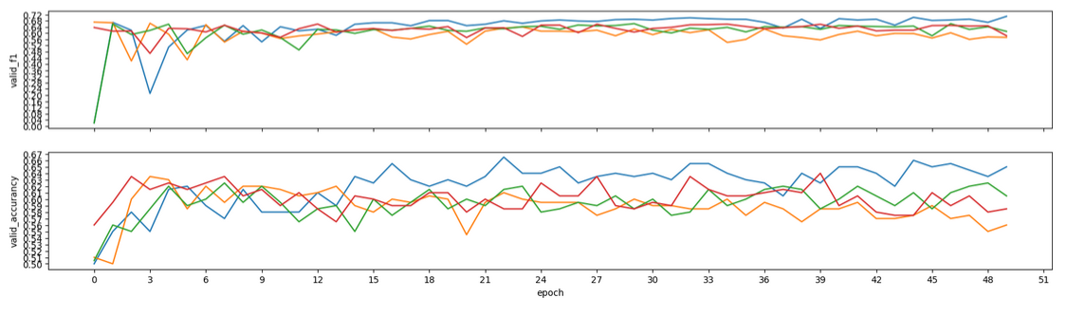
Models v3
Recap Permutation Learningrate Model Next Steps
Batch_size: 4

Slide 12
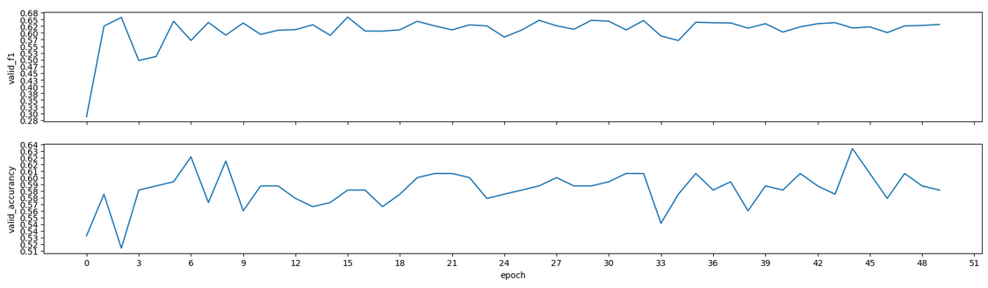
Models v4
Recap Permutation Learningrate Model Next Steps
Batch_size: 4

Slide 13

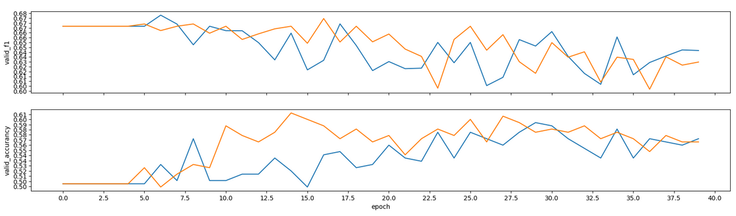
Models v5
Recap Permutation Learningrate Model Next Steps
Batch_size: 4

Slide 14

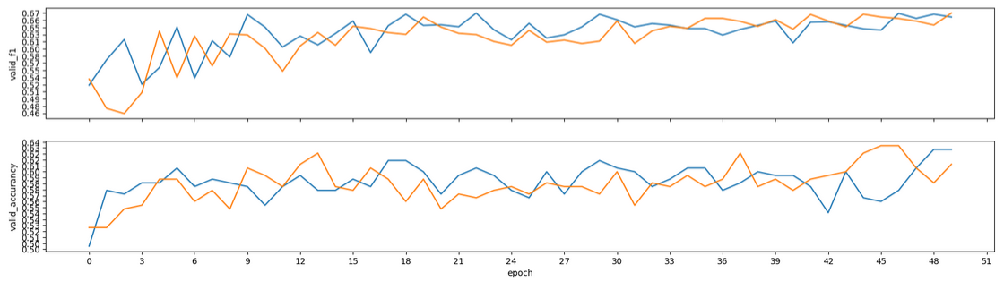
Models v6
Recap Permutation Learningrate Model Next Steps
Batch_size: 4

Slide 15

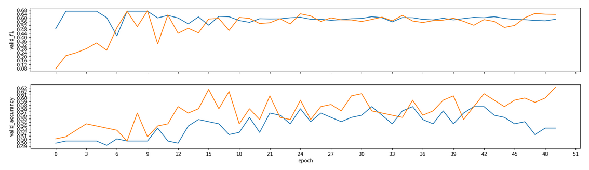
Models v7
Recap Permutation Learningrate Model Next Steps
Batch_size: 4

Slide 16

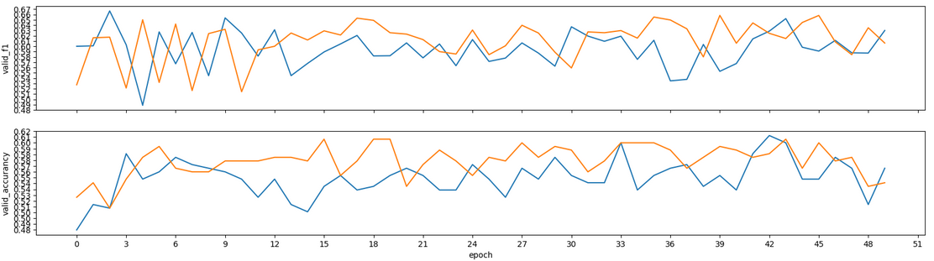
Models v8
Recap Permutation Learningrate Model Next Steps
Batch_size: 4

Slide 17
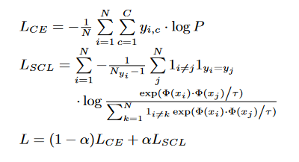

Next Steps
Recap Permutation Learningrate Model Next Steps
Für alle weiteren Seeds (0, 1998, 1M, 42)
SimCSE objective
Section
Primary
Secondary
Statement
BERT
BERT
Funktioniernede Implementierung auf SemEval
(supervised)
SimCSE
(unsipervised)
Pool
Pool
Classifyer
L_SCl
L_CE

Slide 18
Next Steps
Recap Permutation Learningrate Model Next Steps

