Slide 1
Praktikum NLP
Raphael Baumann
Advisor: Benedikt Ebing
05.02.2024

Slide 2
Task
Taks Dataset Disclaimer Baseline Permutation Dataset Mixing Architectures Adapter Conclusion
Natural Language Inference (NLI), also known as Recognizing Textual Entailment (RTE)
Based on Clinical Trial Reports (CTR)
Classification Task (Entailment or Contradiction)
Test the capability to reason over all sections CTRs
Learn complex decision boundaries between the classes
Shift from general to biomedical domain
Notes:
This is a short text that makes an objectively true claim about the contents of the premise. Annotators could choose to write a statement about one, or both premises. Non-trivial statements typically involve summarization, comparison, negation, relation, inclusion, superlatives, aggregation, or rephrasing, and require understanding multiple rows of the premise. Then the annotators select a subset of facts from the premise(s) that support the claims in the statement.
Then a negative rewriting technique was applied, modifying the previously produced entailment statement to contain objectively false claims while retaining the original sentence structure and length. This technique is used to reduce the likelihood of stylistic or linguistic patterns pertaining to either entailment or contradictory statements. Annotators then extract a subset of facts from the premise that contradict the claims in the false statement

Slide 3
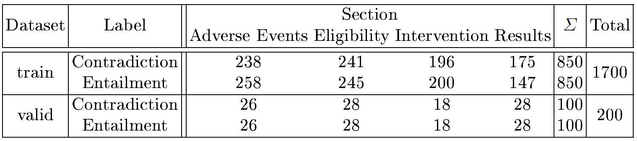
Dataset
Taks Dataset Disclaimer Baseline Permutation Dataset Mixing Architectures Adapter Conclusion
Generated by clinical domain experts, organisers and oncologists from the Cancer Research UK Manchester Institute and the Digital Experimental Cancer Medicine Team.
Eligibility: A set of conditions for patients to be allowed to take part in the clinical trial
Intervention: The type, dosage, frequency, and duration of treatments being studied
Results: Number of participants in the trial, outcome measures, units, and the results
Adverse Events: These are signs and symptoms observed in patients during the clinical trial

Slide 4
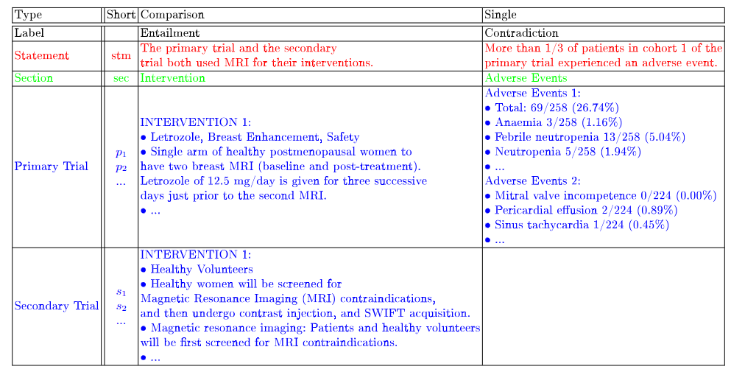
Dataset
Taks Dataset Disclaimer Baseline Permutation Dataset Mixing Architectures Adapter Conclusion
Notes:
Statement and the correlated Clinical Trial Reports
60% are Single and 40% are Comparison CTRs of the hole Dataset

Slide 5
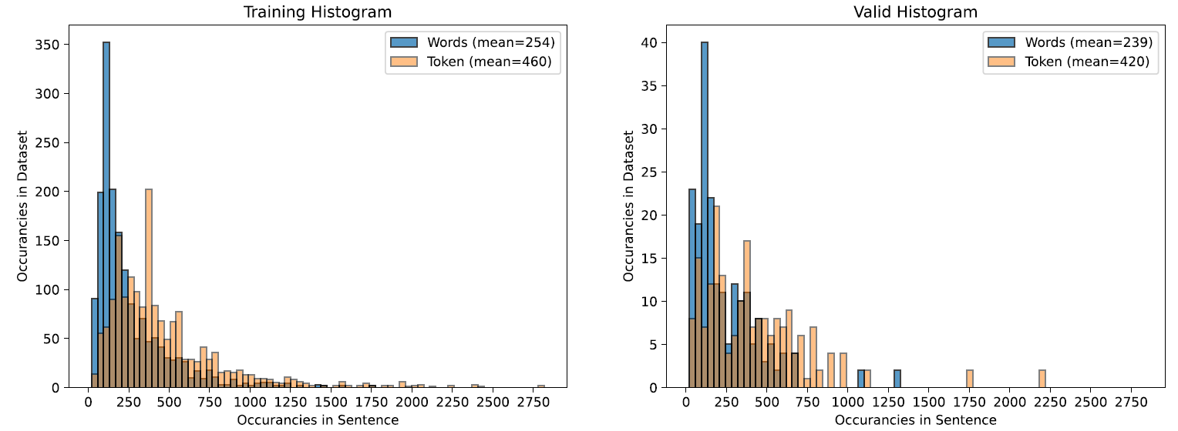
Dataset
Taks Dataset Disclaimer Baseline Permutation Dataset Mixing Architectures Adapter Conclusion
Notes:
30% der Sentences are outside of the 512 Token boundary

Slide 6
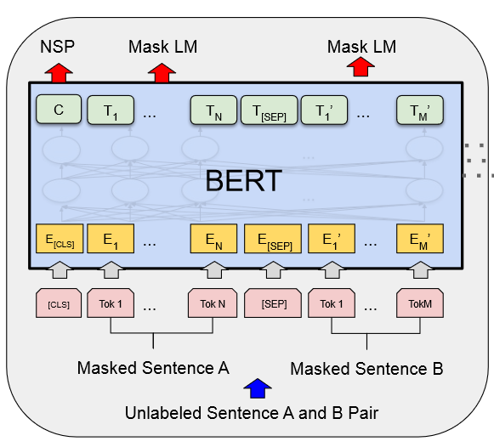
Disclaimer
Taks Dataset Disclaimer Baseline Permutation Dataset Mixing Architectures Adapter Conclusion
Experiments based on Kaggle and Colab Environment
Bottlenecks being either:
GPU RAM
Total Runtime
Parallel Loading of the Batch
Limits of experiments due to exceeding the weekly time maximum
BERT-base as the way-to-go Model with approx. 110M Parameters

Slide 7
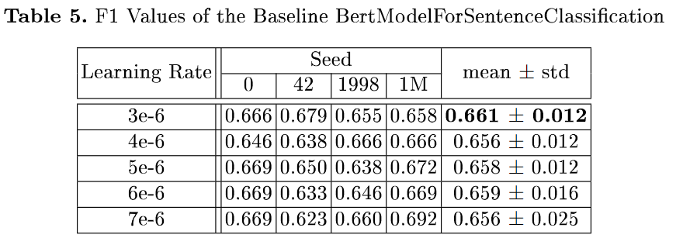
Baseline
Taks Dataset Disclaimer Baseline Permutation Dataset Mixing Architectures Adapter Conclusion
Bert Model with attached Classifier
CrossEntropyLoss
Weights of the Classifier are newly initialized
Hyperparameter Search:
more/less Tokens → not practicable
Learning Rate
Sentence
BertModel
For
Sentence
Classification
0 or 1

Slide 8
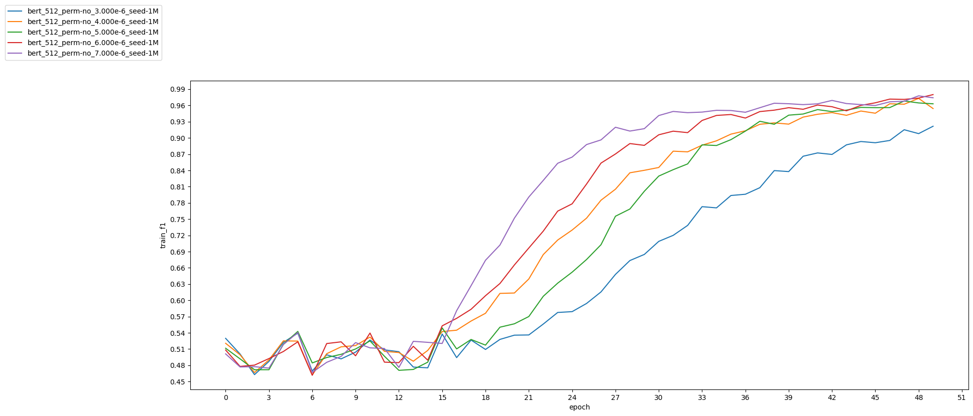
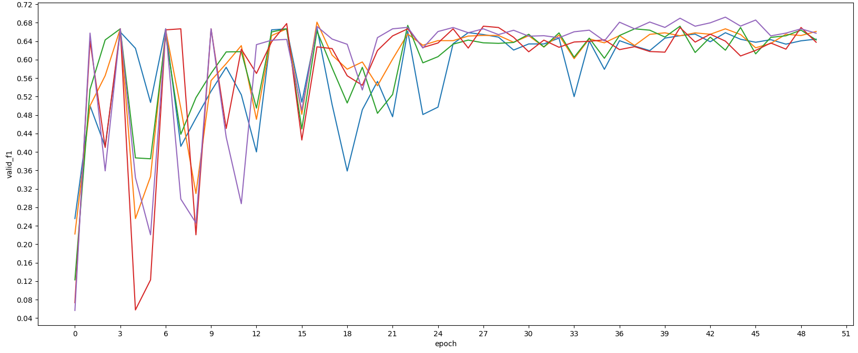
Baseline
Taks Dataset Disclaimer Baseline Permutation Dataset Mixing Architectures Adapter Conclusion
During Training
During Validation

Slide 9
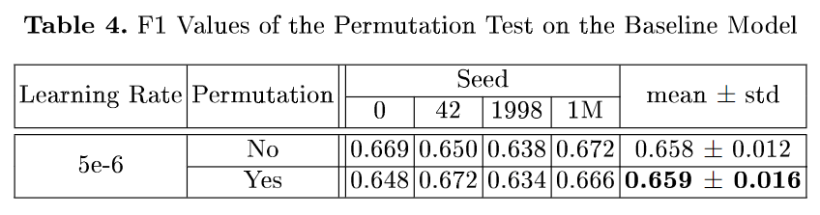
Permutation
Taks Dataset Disclaimer Baseline Permutation Dataset Mixing Architectures Adapter Conclusion
Countermeasure truncation trough Augmentation
Check if the order Important and to include/encode all information in BERT
Notes:
The learning kicks in time shifted about 2-3 epochs

Slide 10
Dataset Mixing
Taks Dataset Disclaimer Baseline Permutation Dataset Mixing Architectures Adapter Conclusion
Pre-Training -> Fine-Tune a BERT NLI Model
Equal Mix Batches (CombDL)
Random Mix Batches (CombDS)
doubles the number of batches
Mixing only appers on Train not on Validation
len(a) + len(b)

Slide 11
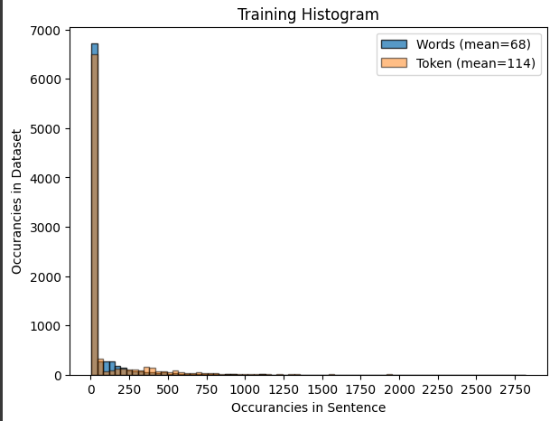
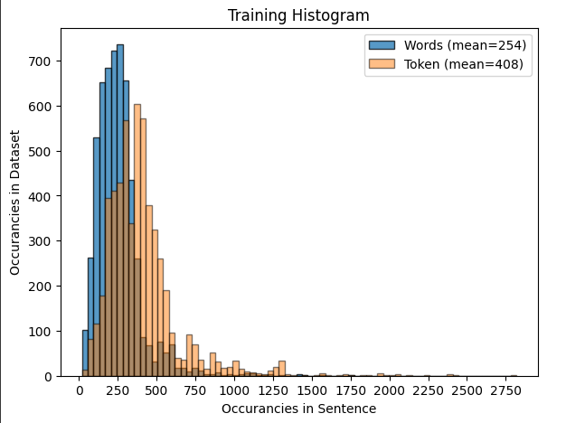
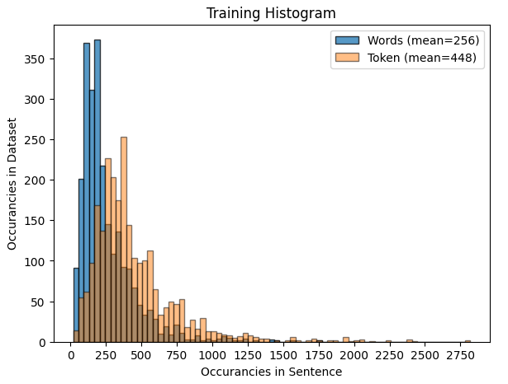
Dataset Mixing
Taks Dataset Disclaimer Baseline Permutation Dataset Mixing Architectures Adapter Conclusion
Objective: How Mixing of Datasets influences the Validation of SemEval in case of a multi-purpose Model
w/o netural class →only contradiction vs entailment
SNLI:
short pair of sentences for NLI
6765 datapoints from validation only
HEALTHVER:
public health claims, verified against scientific research articles
3848 datapoints in a combined train and validation set
SCIFACT:
scientific claims paired with evidence containing abstracts
773 datapoints in a combined train and validation set

Slide 12
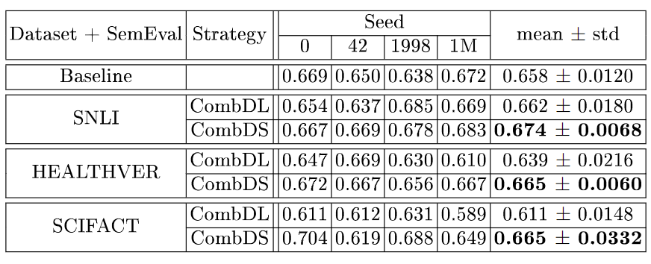
Dataset Mixing
Taks Dataset Disclaimer Baseline Permutation Dataset Mixing Architectures Adapter Conclusion

Slide 13
Architectures
Taks Dataset Disclaimer Baseline Permutation Dataset Mixing Architectures Adapter Conclusion
Sentence Embeddings using Siamese BERT or SimCSE
Tokens of Premise and Hypothesis are separated
Derive semantically meaningful sentence embeddings
Inspired by that, building own Architecture for SemEval NLI task

Slide 14
Architectures
Taks Dataset Disclaimer Baseline Permutation Dataset Mixing Architectures Adapter Conclusion
v2
v3
v4
v5/v6
Section
Primary
Secondary
Section
Primary
Secondary
Section
Primary
Secondary
Section
Secondary
Statement
Primary
Statement
Statement
Statement
BERT
BERT
BERT
BERT
BERT
BERT
BERT
BERT
BERT
BERT
Cat(u, v, x, y)
Cat(u, v)
Cat(u, v, |u-v|)
CosSim(u, v)
Classifier
Classifier
Classifier
Map(-1,1 -> 0, 1)
0 or 1
0 or 1
0 or 1
0 or 1

Slide 15
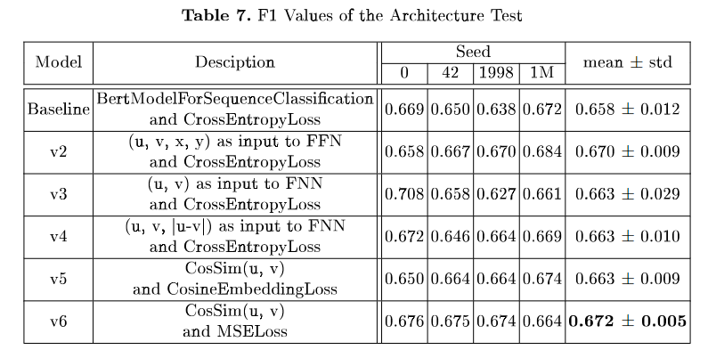
Architectures
Taks Dataset Disclaimer Baseline Permutation Dataset Mixing Architectures Adapter Conclusion
Notes:
SBERT STS benchmark dataset.
(u, v) has 66 compared to (u, v, |u-v|) 80.78

Slide 16
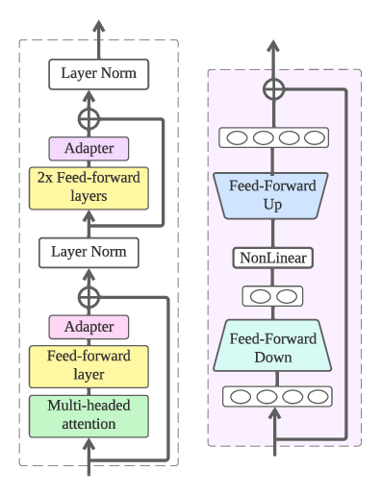
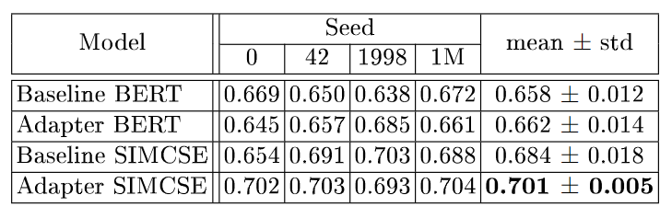
Adapter
Taks Dataset Disclaimer Baseline Permutation Dataset Mixing Architectures Adapter Conclusion
Classifier
Only Adapter and Classifcation Weights and Bias are Trainable
Approx 10M new Parameters
Keep the trained Embeddings
Faster Gradient Calculations
Can Overfit
512 → 768
GELU
768 → 512
INPUT
Notes:
sup-simcse-bert-base-uncased as Pretrained Model on SNLI Dataset

Slide 17
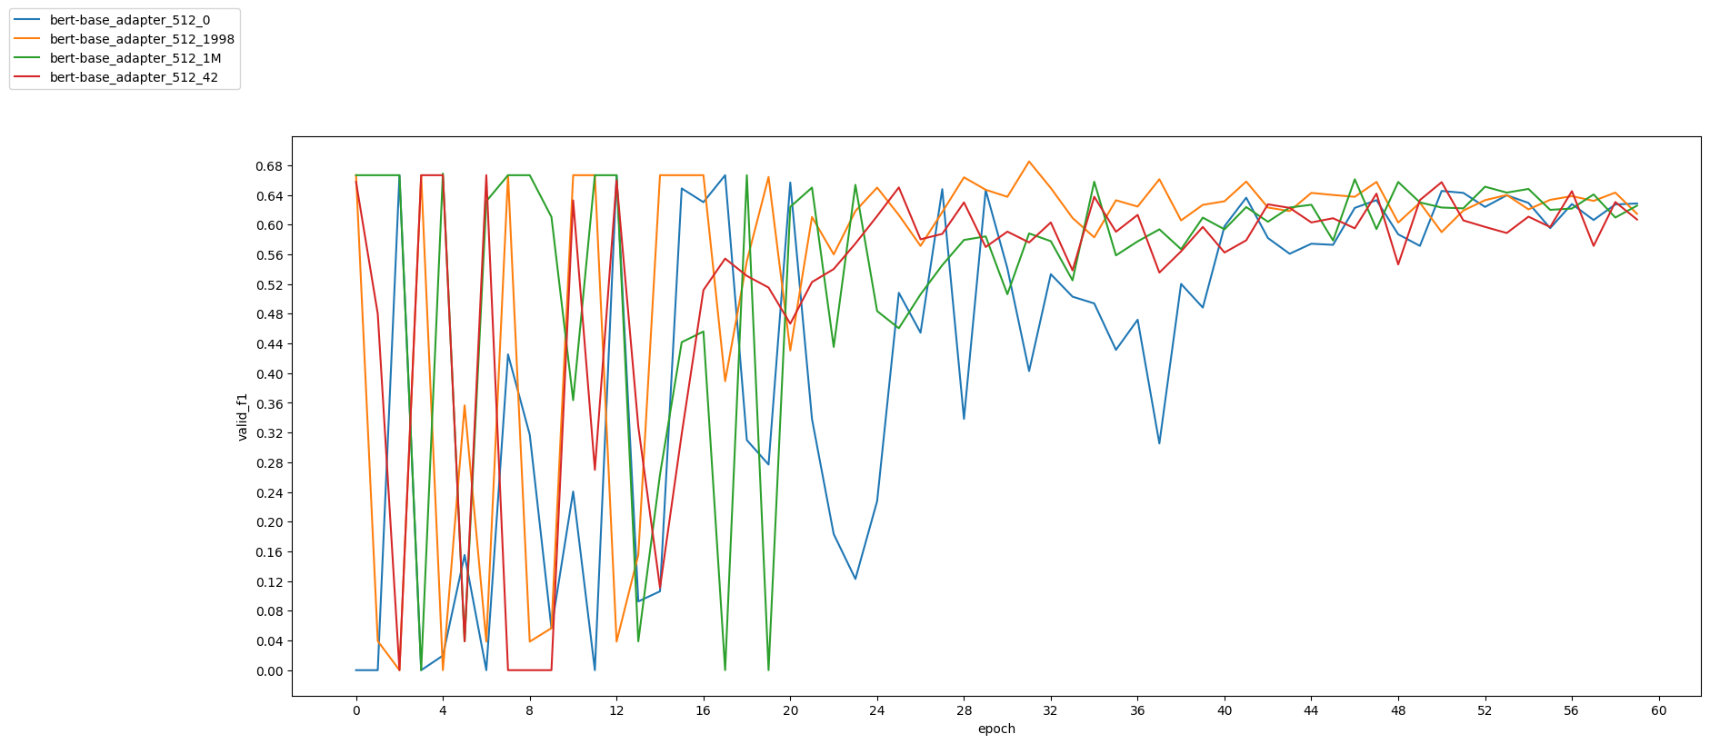
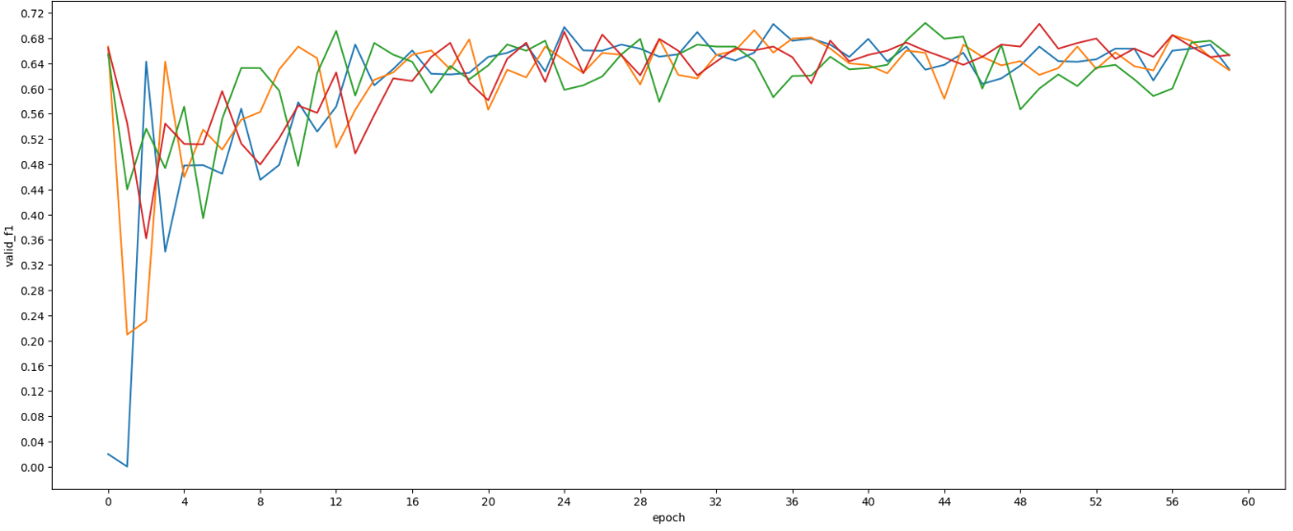

Adapter
Taks Dataset Disclaimer Baseline Permutation Dataset Mixing Architectures Adapter Conclusion
Notes:
sup-simcse-bert-base-uncased as Pretrained Model on SNLI Dataset

Slide 18
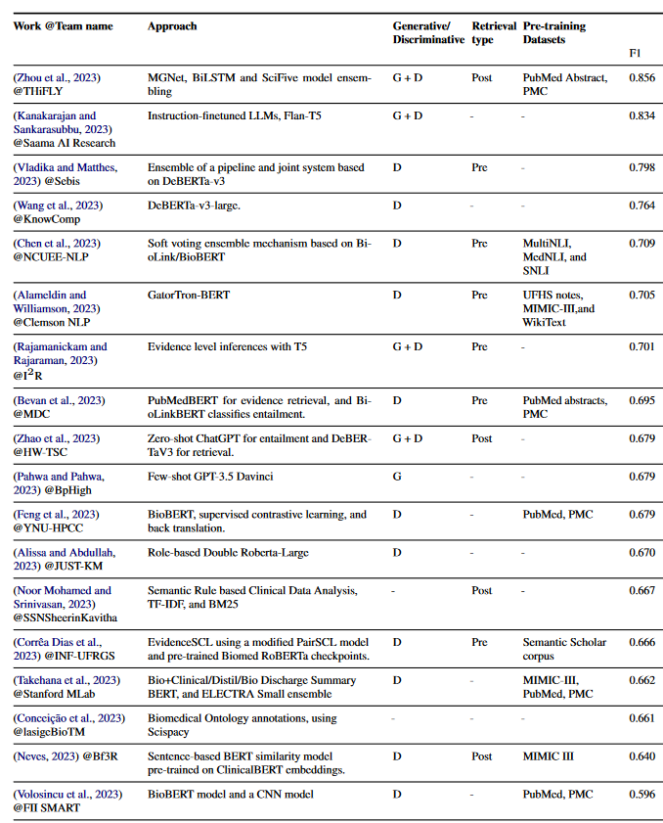
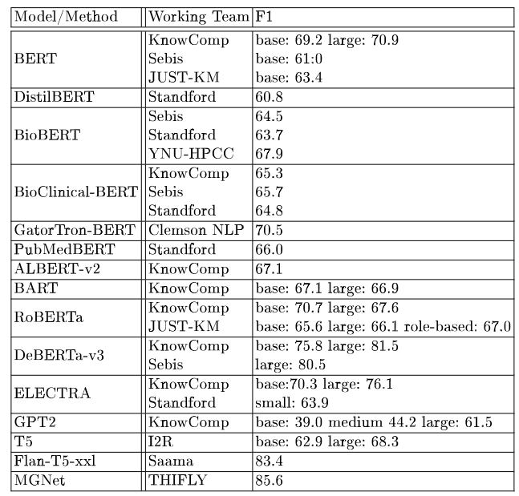
Some SemEval 2023 Results
Struggle to beat the 0.667 F1 mark
Adapter-SIMCSE being 7th place with 0.701
Notes:
50 percept precision and perfect recall, and that the F1-score results in a value of about 0.667
Precision = TP/(TP+FP)
Recall = TP/(TP+FN)
DEBERTA DECODING-ENHANCED BERT WITH DISENTANGLED ATTENTION
disentangled attention mechanism, where each word is represented using two vectors that encode its content and position, respectively, and the attention weights among words are computed using disentangled matrices on their contents and relative positions, respectively. Second, an enhanced mask decoder is used to incorporate absolute positions in the decoding layer to predict the masked tokens in model pre-training
F1 = harmonic mean of precision and recall
TP, FN
FP, TN

Slide 19
Conclusion
Taks Dataset Disclaimer Baseline Permutation Dataset Mixing Architectures Adapter Conclusion
Permutation → No results
Dataset Mixing → CombinedDataset better than CombinedLoader
Siamese Architectures → CosineSimmilarity + MSELoss
Adapter → Best Performance boost on BERTs Architecture

