Slide 1
R Microbiome Package
Tutorial 1b
Waleed Iqbal
Blas Rodriguez

Slide 2
Outline
Background
Microbiome
Microbiome Relation to Diseases (ex. Cancer)
Diversity / Diversity Analysis methods
Microbiome Analysis using R
Microbiome R Package
Importance of Microbiome R package
Tutorial Overview

Slide 3
Background

Slide 4
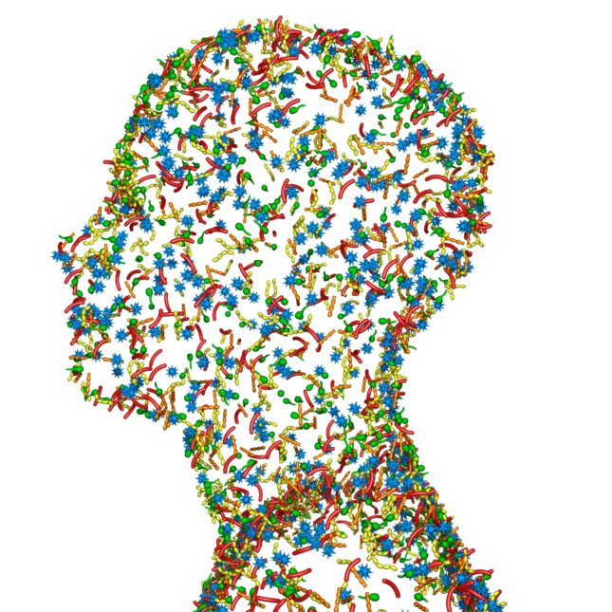
Microbiome
A community of micro-organisms living together in a particular habitat.
The combined genetic material of organisms in a particular environment
The human microbiome can be considered the counter part of the human genome in which the genes in our microbiome outnumber the genes in our genome by about 100 to 1.

Slide 5
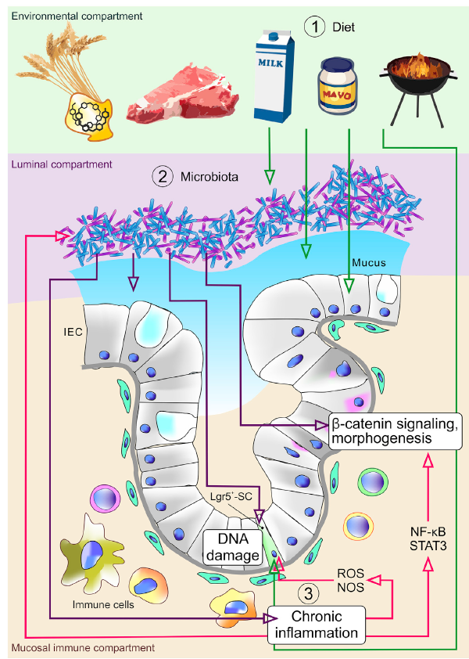
Intestinal microbiota promotes cancer development
Diet affects metabolism of microbiota & interfere with gut barrier (blue) function
Fusobacterium nucleatum cause DNA damage, secrete bacterial chemokines
Bacterial chemokines + cellular receptors
Inflammation + immune response

Slide 6
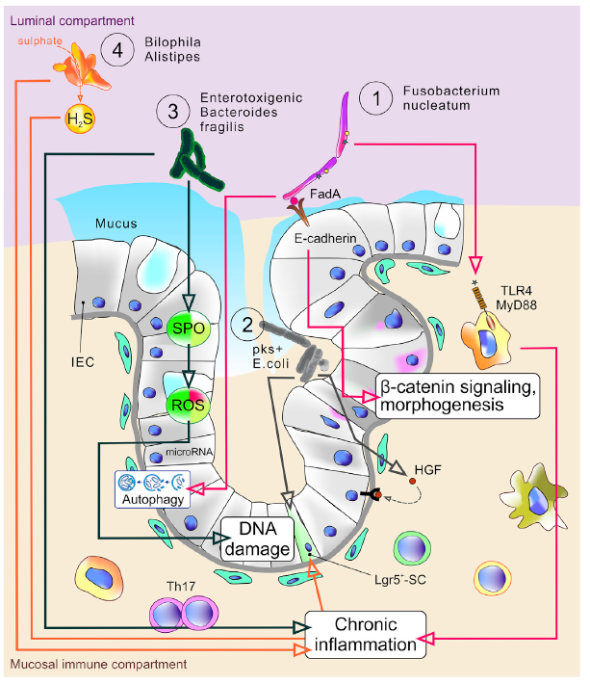
Microbial mechanisms influencing cancer development
Fusobacterium nucleatum antigens binds receptors on epithelial cells
B-catenin signaling, cell growth, and autophagy
E. coli strains produce genotoxin colibactin
Senescence in infected cells
Bacteroides fragilis induces reactive oxygen species
DNA damage + Th17 immune response
Bilophila wadsworthia/Alistipes spp. produce hydrogen sulfide (H2S)
DNA damage + inflammation

Slide 7
Bacterial diversity in 9 TCGA studies
TCGA studies: AML, GBM, LUAD, OV, BRCA, KIRC, KIRP, LUSC, STADBWA ALN
align refseq. TCGA data + bacterial genomes
Bacterial reads ranged from 11% (LUSC) – 100% (STAD)
Contamination in some samples:
Mycobacterium tuberculosis: ovarian(OV) + glioblastoma (GBM)

Slide 8
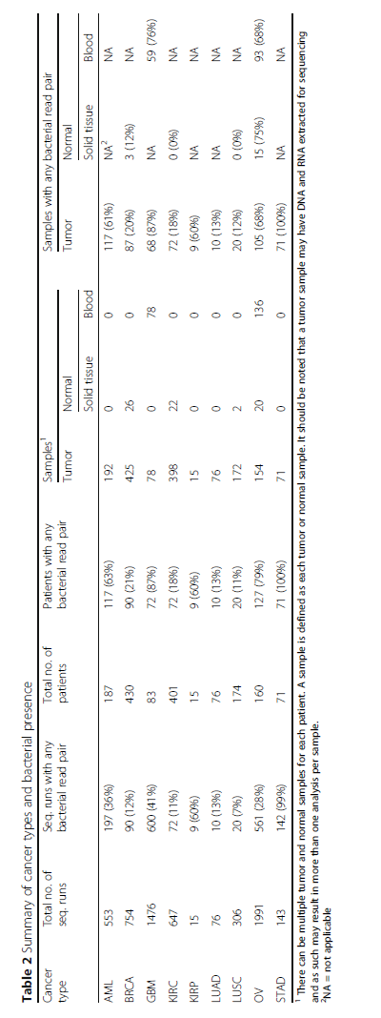
Bacterial reads in 9 TCGA tumor types
S.H Wong et al. “Clinical applications of gut microbiota in cancer biology”.
Seminars in Cancer biology (2018)

Slide 9
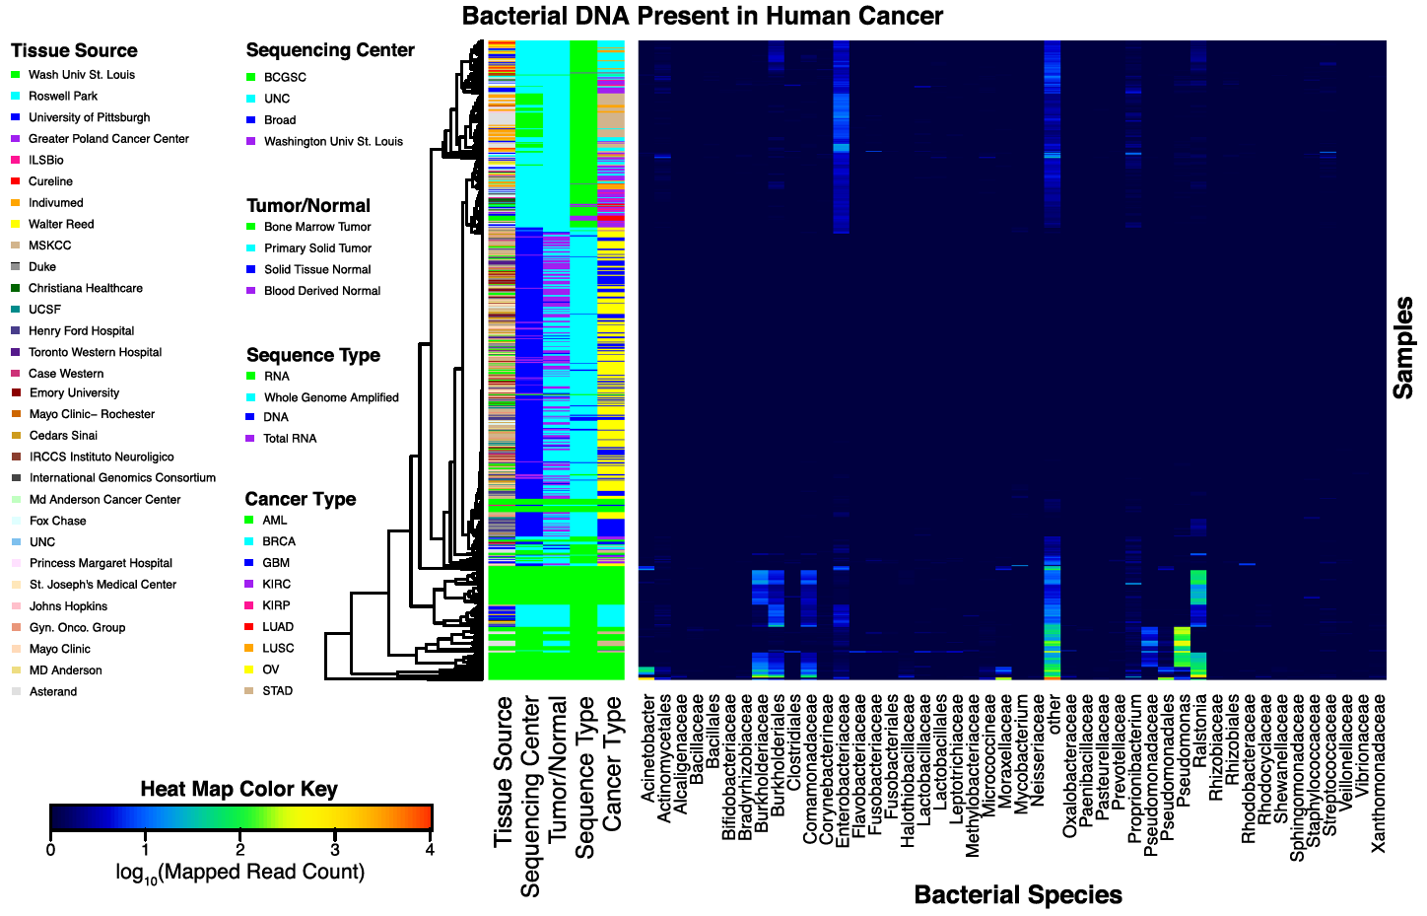
Bacterial diversity in 9 TCGA cancer types
Enterobacteriaceae & “other”
dominant taxa in most cancer types
GBM & OV
lowest bacterial diversity + more Mycobacterium (contamination)
Ralstonia spp.
dominant in GBM and AML respectively

Slide 10
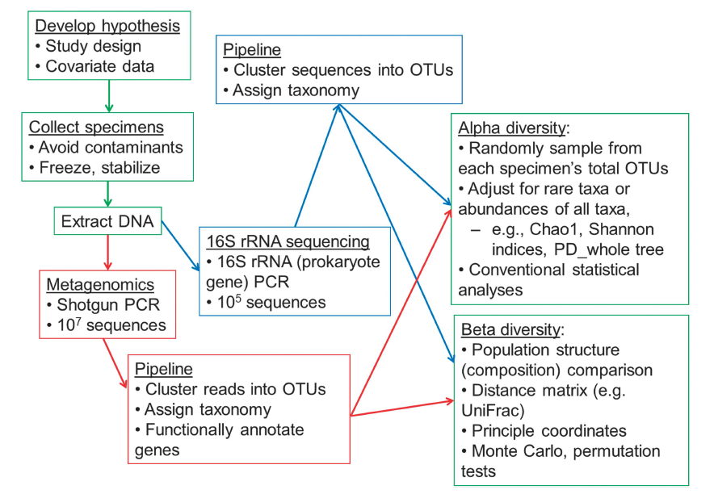
Schema for a human microbiome study
Collect samples (oral/ fecal tissue) & extract DNA
Sequencing methods:
16S ribosomal-RNA gene sequencing (blue)
Shotgun meta-genomic sequencing (red)
Data processing:
16S: public databases
Shotgun meta-genomic sequencing
Alpha (within participant) and Beta diversity (between participants):
Operational Taxonomic Units (OTUs) compared using statistics

Slide 11
Diversity Analysis Tools
Richness
Mean species diversity in the site or habitat
Dominance
Represents the abundance of the most abundant specie
Rarity / Low Abudance
Quantify the concentration of rare taxa.
Coverage
Number of groups needed to have a given proportion of the ecosystem occupied
Core abundance
Refers to the relative proportion of the core species
Gini Index
Common measure for inequality in economical income
Evenness
Refers to how close each specie is in an environment

Slide 12
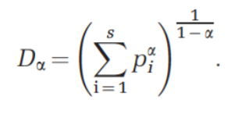
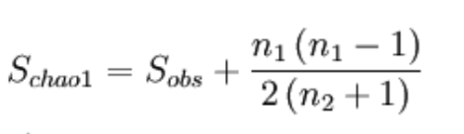
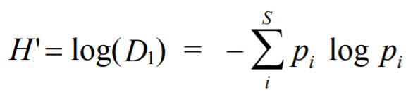
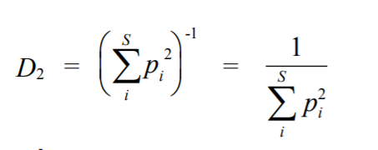
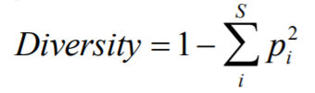
Diversity
Alpha Diversity
Species richness (and evenness) within a single sample
Beta Diversity
Change in species composition across a collection of samples
Chao Diversity
Estimates the diversity richness
Shannon-Wiener Index
Measures the information content of a sample unit
Simpson Index
Measure of Dominance, which is compliment is the diversity

Slide 13
Microbiome Analysis using R

Slide 14
Microbiome R Package – Why using R?
Open source (free) statistical programming language that includes tools for analysis of statistical, ecological diversity and community data
Easy to install and not too hard to make.
Packages are updated frequently.
Strong graphing and statistical capabilities.
Repositories such as the Comprehensive R Archive Network (CRAN) and Bioconductor provide some quality control of packages and make them easy to install.

Slide 15
Microbiome R Package – Characteristics
Facilitates exploration and analysis of microbiome profiling data, in particular 16S taxonomic profiling.
Tools are provided for the manipulation, statistical analysis, and visualization of taxonomic profiling data.
Supports the independent phyloseq data format and expands the available toolkit

Slide 16
Importance of Microbiome R Package
A framework for human microbiome research
The data represents the largest resource describing the abundance and variety of the human microbiome. https://www.nature.com/articles/nature11209
Defining the core Arabidopsis thalianaroot microbiome
Describe different bacterial communities in two geochemically distinct bulk soils and in rhizosphere and endophytic compartments prepared from roots grown in these soils using R https://www.nature.com/articles/nature11237
Reproducible research workflow in R for the analysis of personalized human microbiome data
Several examples in which the researchers leverage existing packages for analysis which allows easy sharing and modification by others.
https://www.worldscientific.com/doi/abs/10.1142/9789814749411_0018

Slide 17
Tutorial Overview
Download and installation of R, Rstudio
Download and update of library packages
Download and import of Data examples
Data Analysis
Create Phylogenetic Trees
Diversity Calculations
Alpha Diversity
Beta Diversity
Linear Model Comparison with Random Effect Subject Term (Univariate / Multivariate)

Slide 18
Useful Link
Download R
https://cran.r-project.org/
Download R Studio
https://www.rstudio.com/products/rstudio/download/#download
Example Database Github Repository
http://joey711.github.io/phyloseq/
Alpha Diversity Tutorial
https://microbiome.github.io/microbiome/Diversity.html
Beta Diversity Tutorial
http://microbiome.github.io/microbiome/Betadiversity.html
Univariate Comparison Tutorial
http://microbiome.github.io/microbiome/Mixedmodels.html
Multivariate Community Tutorial
http://microbiome.github.io/microbiome/PERMANOVA.html
Intro to Microbioma Package
https://bioconductor.org/packages/release/bioc/vignettes/microbiome/inst/doc/vignette.html?fbclid=IwAR0PXr1JRrbtgCtbuiEqVrqdb6ThanxZhPUTCt32w9hmnFCyJUap_BWTUbQ

