Slide 1
Slide 1
Lihi Berg
312503964
Valeria Barabanova
342707049
TCBDA-28

Slide 2
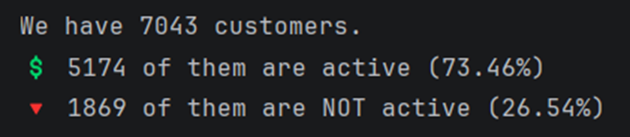
The problem
What we tried to predict
Our main goal was to predict customer churn:
Whether the customer will churn or not based on their characteristics. (binary classification problem)
Target Variable: churn
(0= stay, 1=leave)

Slide 3




The problem
The data available for that prediction
Time-Related features:
Tenure
Demographic features:
Gender
Senior citizen
Partner
Dependents
Service-Related features
Phone service
Multiple lines
Internet service
Online security
Online backup
Device protection
Tech support
Streaming tv
Streaming movies
Contract-related / Financial features:
Contract
Paperless billing
Payment method
Monthly charges
Total charges

Slide 4
The problem
Motivation & Applications
Why?
How?
The main motivation behind solving this problem is to understand and reduce customer churn, which directly impacts the company's revenue and long-term growth.
Acquiring new customers is typically more expensive than retaining existing ones, so identifying customers who are likely to leave allows the business to take proactive actions.
Additionally, analysing churn patterns helps uncover key factors influencing customer behaviour, enabling better strategic decision-making and improved customer satisfaction.
The solution can be applied by integrating the predictive model into business processes to identify high-risk customers in advance.
Companies can use these insights to implement targeted retention strategies such as personalized offers, improved customer support, or tailored marketing campaigns.
Furthermore, the findings can support data-driven decisions in areas like product development, pricing strategies, and customer experience optimization, ultimately leading to increased customer loyalty and profitability.

Slide 5
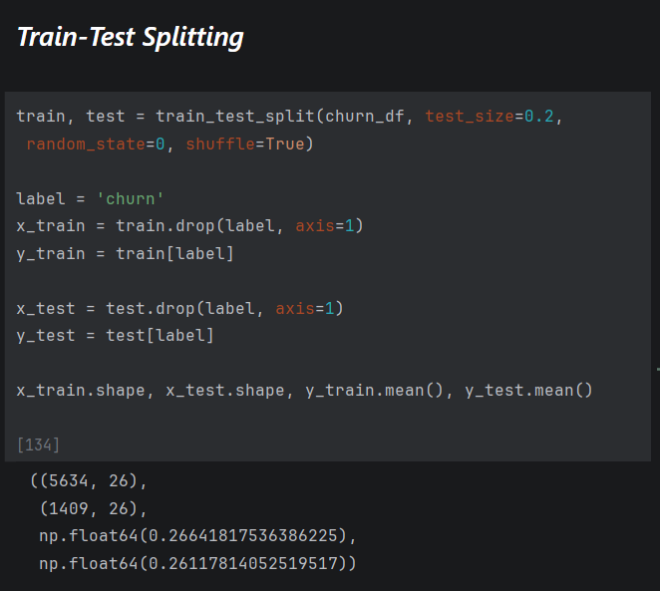
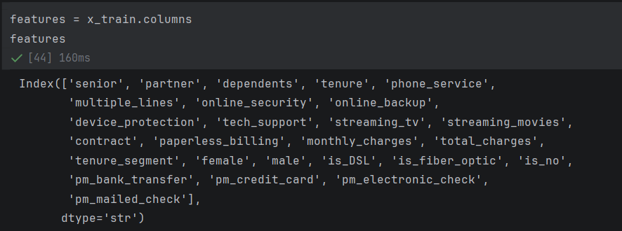
Data description
Dataset examples
Dataset features
The dataset contains a mix of 26 categorical and numerical features that describe customer behaviour and account characteristics.
The dataset contains 7,043 customers.
With an 80%-20% split.
We get 5,634 train and 1,409 test samples.

Slide 6
Data description
Label distribution
Missing Values
The target variable (Churn) is not evenly distributed, with more customers staying than leaving, indicating class imbalance.
Some columns contained missing or non-numeric values, the total_charges feature for example was found to be misclassified as a string. After conversion to numeric, missing values were found. We identified the missing values as new customers (tenure = 0) and imputed with 0 accordingly.

Slide 7
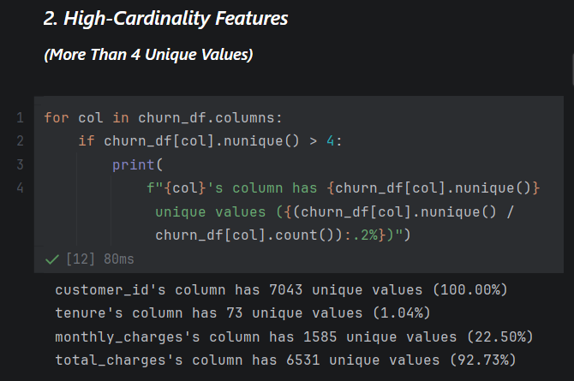
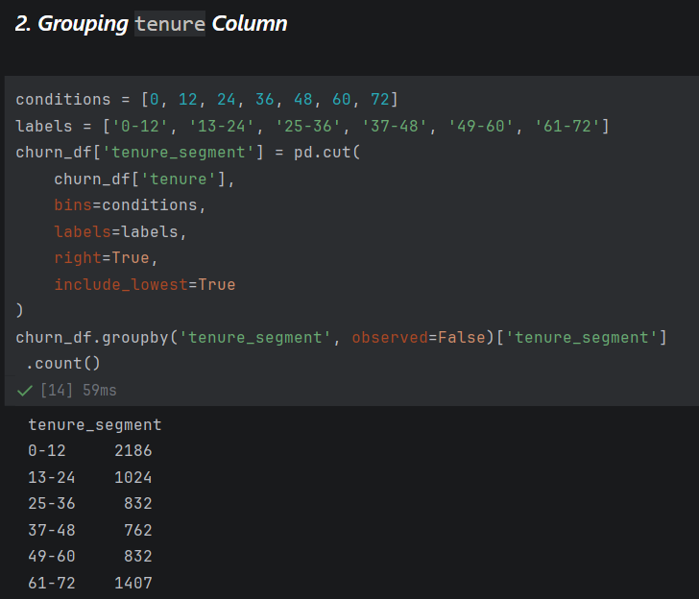
Data engineering
Feature removal
Feature creation
Non-informative features such as customer identifiers were removed, as they do not contribute to prediction.
Data transformations were applied, including categorization of numerical features and normalization of categorical values to ensure consistency

Slide 8
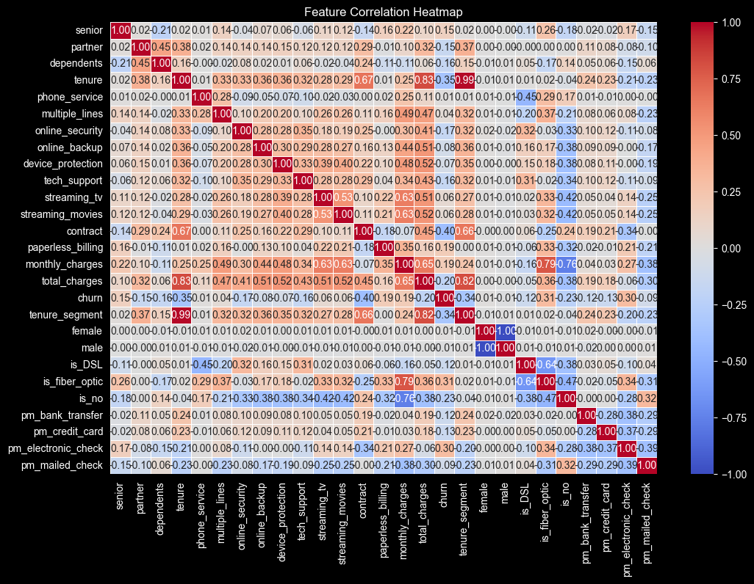
Data description
Strong correlations appear between related services and tenure, while churn shows moderate links mainly with contract type, monthly charges, and Fiber-optic usage.

Slide 9
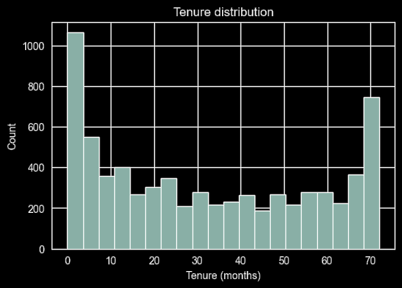
Data description
Tenure is concentrated at both low and high ends, reflecting new customer inflow and long-term loyalty, highlighting the importance of:
1. Improving early-stage retention strategies
2. Maintaining engagement with long-term customers

Slide 10
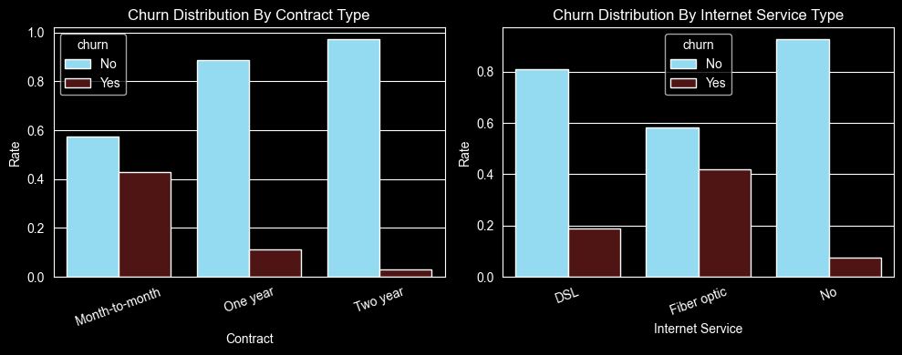
Data description
Contract Type
Internet Service Type
Churn is highest among month-to-month customers and decreases significantly with longer contract commitments.
Churn is highest among fiber optic users and lowest among customers with no internet service.
highlighting the importance of:
1. Encouraging customers to transition to longer-term contracts
2. Strengthening retention efforts for short-term subscribers
highlighting the importance of:
1. Investigating dissatisfaction among fiber optic services
2. Leveraging the high retention of customers without internet service, indicating an opportunity to strengthen and expand non-internet-based offerings

Slide 11
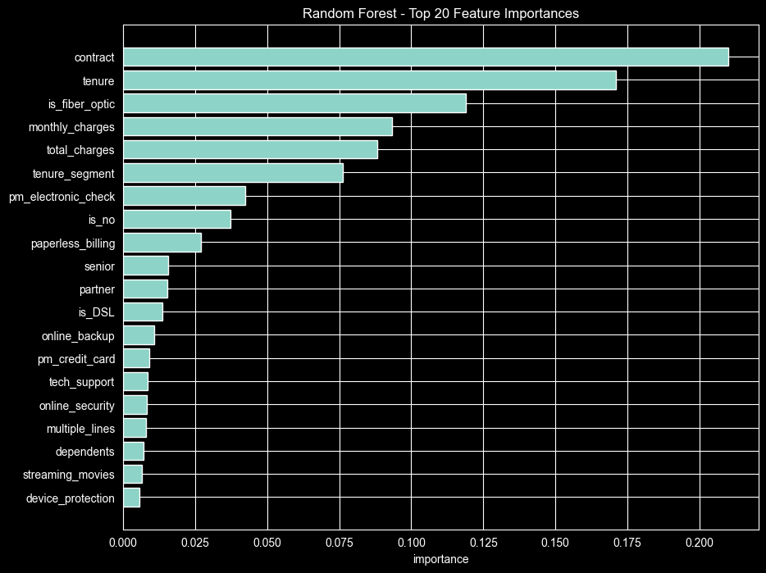
Data description
The Random Forest model identifies contract type and tenure as the most influential features in predicting churn, followed by Fiber optic usage and monthly charges.
This indicates that both customer commitment level and pricing/service experience play a central role in churn behaviour.
Lower-ranked features such as additional services have relatively minor impact, suggesting they are less critical in determining whether a customer will leave.

Slide 12
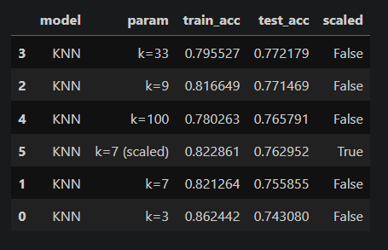
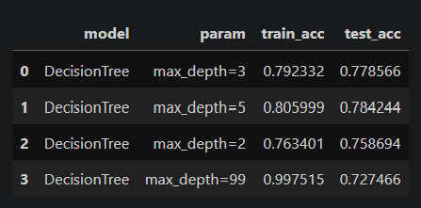
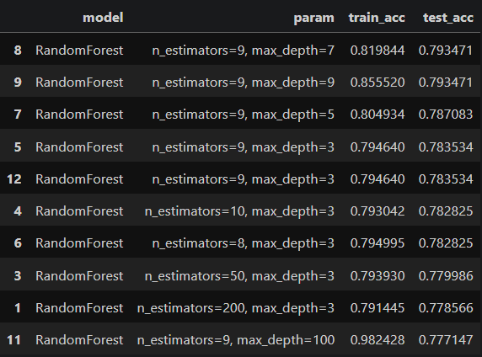
Machine Learning Algorithms
KNN (K Nearest Neighbours)
Decision Tree
Random Forest
Tested different max_depth values
(2, 3, 5, 99) and selected the best based on test accuracy.
Tested multiple k values
(3, 7, 9, 33, 100)
As well as a scaled version
(k=7 with StandardScaler).
Tested different n_estimators
(8, 9, 10, 50, 100, 150, 200)
as well as different max_depth values
(including 3, 5, 7, 9, 21, 100)
to find the best-performing configuration.

Slide 13
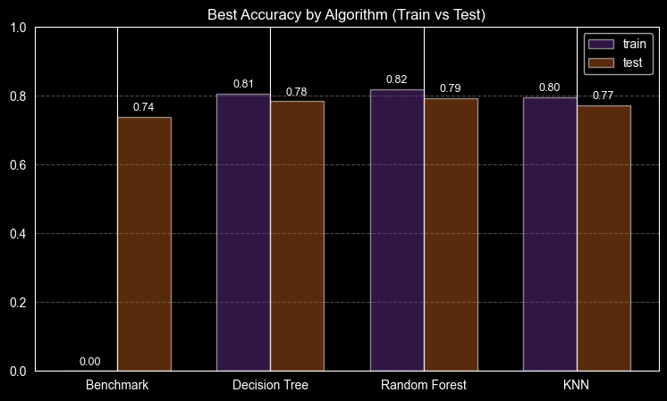
Algorithms Introspection
Best Accuracy by Algorithm (Train vs Test)- Final Conclusion
The comparison of model performance shows that Random Forest achieved the highest test accuracy (~0.79), closely followed by Decision Tree and KNN, all significantly outperforming the baseline model. While all models demonstrate relatively small gaps between training and test accuracy, Random Forest provides the best balance between performance and generalization, indicating strong predictive capability without significant overfitting.
Overall, the results confirm that churn prediction is a learnable problem with meaningful patterns in the data, primarily driven by customer tenure, contract type, and service characteristics.
These insights highlight clear business opportunities:
Encouraging long-term contracts
Improving high-risk services
Focusing on early customer retention
Final takeaway:
Machine learning models, especially ensemble methods like Random Forest can effectively support data-driven decision-making by identifying high-risk customers and enabling proactive retention strategies.

Slide 14

THANK YOU

