Slide 1
ANT: Another Nice Tool
Ali Beyad
October 1, 2003

Slide 2
What is Ant?
Java-based Build tool from Apache
De facto standard for building, packaging, and installing Java applications
Accomplishes same objectives that make does on Unix based systems
Files are written in XML

Slide 3
Why Ant?
Unlike makefiles, Ant files work cross platform
- No need for multiple, complex makefiles depending on the operating system.
- Tasks declared in platform independent way; Ant engine translates to OS specific commands.
Easy to create own Ant “tasks”, in addition to core tasks

Slide 4
Installing Ant
Download Ant binary distribution from:
http://ant.apache.org/bindownload.cgi
Set ANT_HOME to where you installed Ant
Include $ANT_HOME/bin in PATH
Make sure JAVA_HOME is set to point to JDK

Slide 5
Running Ant
Type “ant” at the command line
Automatically looks for build.xml file in current directory to run
Type “ant –buildfile buildfile.xml” to specify another build file to run.

Slide 6
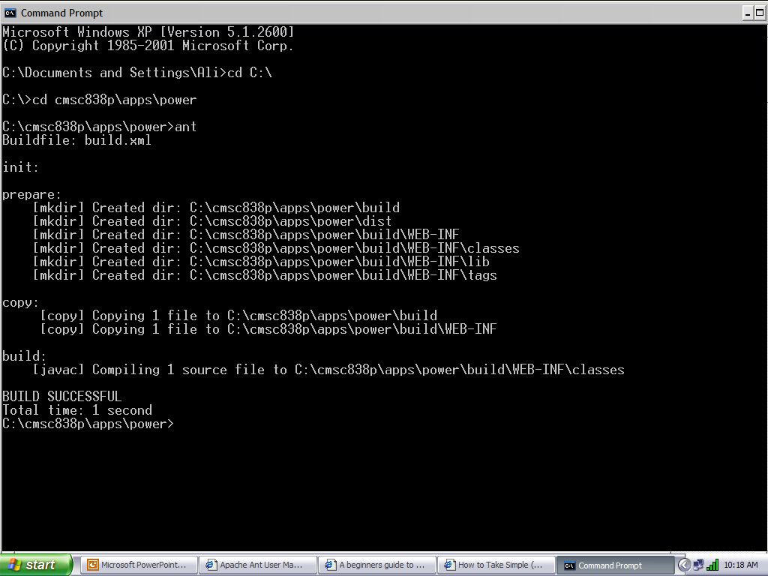
Ant Output

Slide 7
Sample build.xml
<project name="MyProject" default=“package" basedir=".">
<property name="src" location=“C:\Users\src"/>
<property name="build" location=“C:\Users\bin"/>
<property name="dist" location=“C:\Users\Document\destination"/>
<property name=“building” location =“${dist}\test”/>
<target name="init“ depends=“clean”>
<mkdir dir="${build}"/>
</target>
<target name="compile" depends="init" >
<javac srcdir="${src}" destdir="${build}"/>
</target>
<target name=“package" depends="compile" >
<mkdir dir="${dist}/lib"/>
<jar jarfile="${dist}/lib/MyProject-${JarName}.jar" basedir="${build}"/>
</target>
<target name="clean" >
<delete dir="${build}"/>
<delete dir="${dist}"/>
</target>
</project>

Slide 8
Ant Overview: Project
Each build file contains exactly one project and at least one target
Project tags specify the basic project attributes and have 3 properties:
- name
- default target
- basedir
Example: <project name=“MyProject” default=“build” basedir=“.”>

Slide 9
Ant Overview: Targets
Target is a build module in Ant
Each target contains task(s) for Ant to do
One must be a project default
Overall structure of targets:
<target name="A"/>
<target name="B" depends="A"/>
<target name="C" depends="B"/>
<target name="D" depends="C,B,A"/>

Slide 10
Ant Overview: Tasks
Each target comprises one or more tasks
Task is a piece of executable Java code (e.g. javac, jar, etc)
Tasks do the actual “build” work in Ant
Ant has core (built in) tasks and the ability to create own tasks

Slide 11
Ant Overview: Tasks
Example:
<target name="prepare" depends="init“ >
<mkdir dir="${build}" />
</target>
<target name="build" depends="copy" >
<javac srcdir="src" destdir="${build}">
<include name="**/*.java" />
</javac>
</target>

Slide 12
Ant Overview: Core Tasks
javac – Runs the Java Compiler
java – Runs the Java Virtual Machine
jar (and war) – Create JAR files
mkdir – Makes a directory
copy – Copies files to specified location
delete – Deletes specified files
cvs – Invokes CVS commands from Ant

Slide 13
Ant Overview: Writing Own Task
Create a Java class that extends org.apache.tools.ant.Task
For each attribute, write a setter method that is public void and takes a single argument
Write a public void execute() method, with no arguments, that throws a BuildException -- this method implements the task itself

Slide 14
Ant Overview: Properties
Special task for setting up build file properties:
Example:
<property name=“src” value=“/home/src”/>
Can use ${src} anywhere in build file to denote /home/src
Ant provides access to all system properties as if defined by the <property> task

Slide 15
Ant Overview: Path Structures
Ant provides means to set various environment variables like PATH and CLASSPATH.
Example of setting CLASSPATH:
<classpath>
<pathelement path="${classpath}"/>
<pathelement location="lib/helper.jar"/>
</classpath>

Slide 16
Command Line Arguments
-buildfile buildfile – specify build file to use
targetname – specify target to run (instead of running default)
-verbose, -quiet, -debug – Allows control over the logging information Ant outputs
-logger classname – Allows user to specify their own classes for logging Ant events

Slide 17
IDE Integration
Eclipse, NetBeans, JBuilder, VisualAge, and almost any other Java IDE has Ant integration built-in to the system
Refer to each IDE’s documentation for how to use Ant with that IDE

Slide 18
Web Development with Ant
Tomcat comes with special Ant tasks to ease Web application development and deployment
Copy $TOMCAT_HOME/server/lib/catalina-ant.jar to $ANT_HOME/lib
Ant tasks for Tomcat:
- install
- reload
- deploy
- remove

Slide 19
Documentation/References
Download: http://ant.apache.org/bindownload.cgi
User Manual: http://ant.apache.org/manual/index.html
Sun’s Web development tutorial (Ant and JSPs):
http://java.sun.com/webservices/docs/1.2/tutorial/doc/GettingStarted3.html
Java Development with Ant, by Erik Hatcher and Steve Loughran

