Slide 1
Software Development Life Cycle (SDLC)

Slide 2
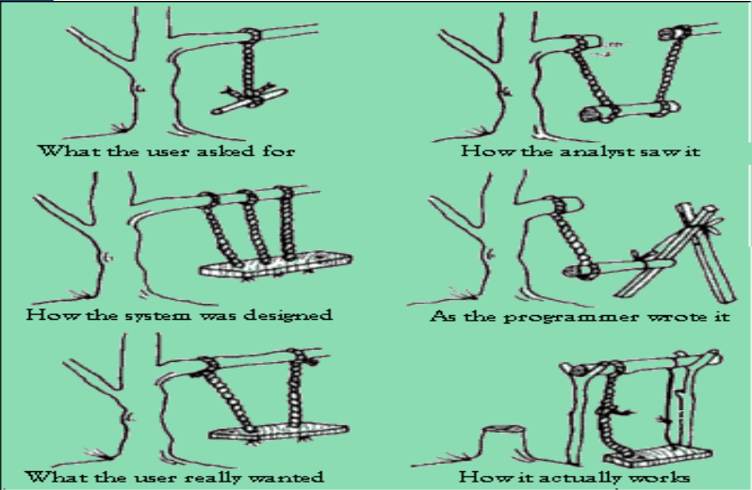

Slide 3
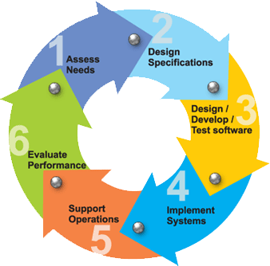
SDLC Model
A framework that describes the activities performed at each stage of a software development project.

Slide 4
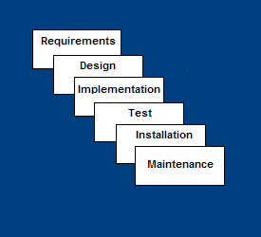
Waterfall Model
Requirements – defines needed information, function, behavior, performance and interfaces.
Design – data structures, software architecture, interface representations, algorithmic details.
Implementation – source code, database, user documentation, testing.

Slide 5
Waterfall Model
Requirements – defines needed information, function, behavior, performance and interfaces.
Design – data structures, software architecture, interface representations, algorithmic details.
Implementation – source code, database, user documentation, testing.

Slide 6
SCM
SCM "is a set of activities designed to control change by identifying the work products that are likely to change, controlling the changes imposed, and auditing and reporting on the changes made."

Slide 7
SCM
Process management - Ensuring adherence to the organization's development process.
Build management - Managing the process and tools used for builds.
Environment management - Managing the software and hardware that host the system.

