Slide 1




SQL in Azure - PaaS
Azure SQL Platform as a Service Architecture
ZORAN BARAC, Principal Data Architect @ CIN7
MCT, MCSE
zoran.barac.zof@gmail.com
blog.sqlserveronline.com
www.linkedin.com/in/zoran-barac/
www.meetup.com/Auckland-SQL-User-Group/

Slide 2
Agenda
Azure SQL PaaS Architecture
Basic, Standard, and General Purpose service tier locally redundant availability
General Purpose service tier zone redundant availability
Premium and Business Critical service tier locally redundant availability
Premium and Business Critical service tier zone redundant availability
Read-only replicas and read-only query workloads
Custom Architecture Azure SQL DB

Slide 3
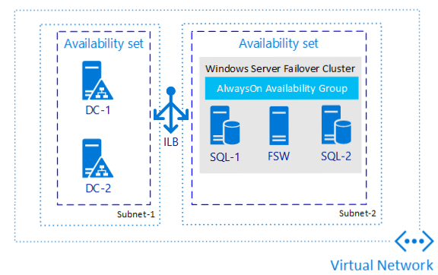
Always On AG architecture on Azure VM SQL Servers (IaaS)
Availability sets help protect against within datacenter downtime events by automatically deploying virtual machines across fault domains and update domains. Virtual machines must be added to an availability set when the VM is created.

Slide 4
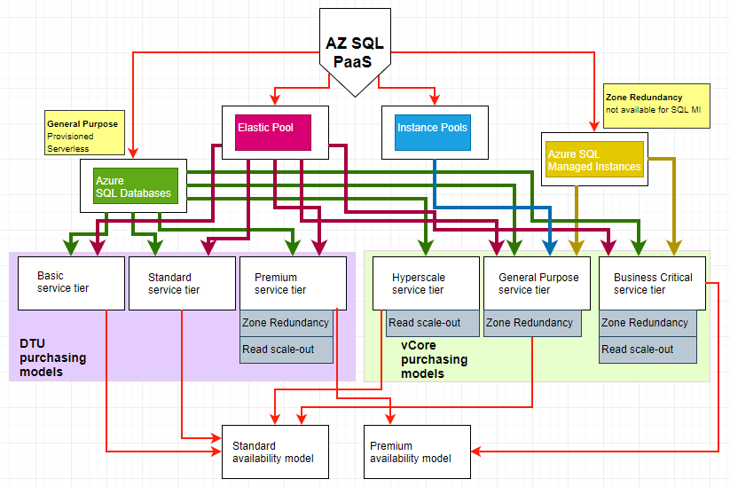

Slide 5
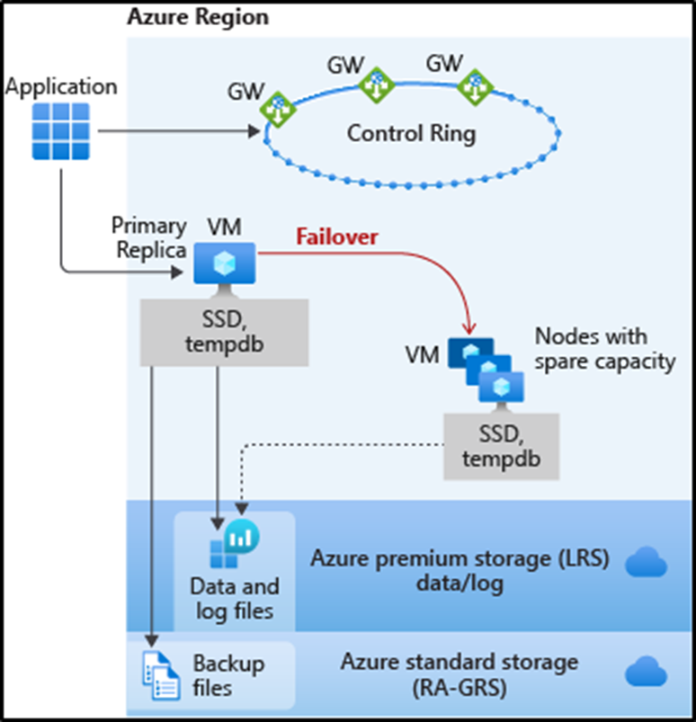
Basic, Standard, and General Purpose service tier locally redundant availability
The standard availability model includes two layers:
Compute layer that runs the sqlserver.exe process (contains only transient and cached data on the attached SSD, such as TempDB, model database, plan cache, buffer pool ).
Data layer with the database files (.mdf/.ldf) that are stored in Azure Blob storage. Azure blob storage has built-in data availability and redundancy feature.

Slide 6
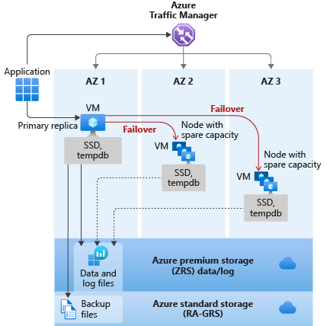
General Purpose service tier zone redundant availability
Notes:
For General Purpose tier, zone redundancy incurs an additional cost.
Zone redundant configuration for serverless and provisioned general purpose tier is only available in some regions.
Zone redundant for General Purpose is currently in Preview. The preview is not covered under Reserved Instance.
Zone redundant configuration is only available when the Gen5 compute hardware is selected.

Slide 7
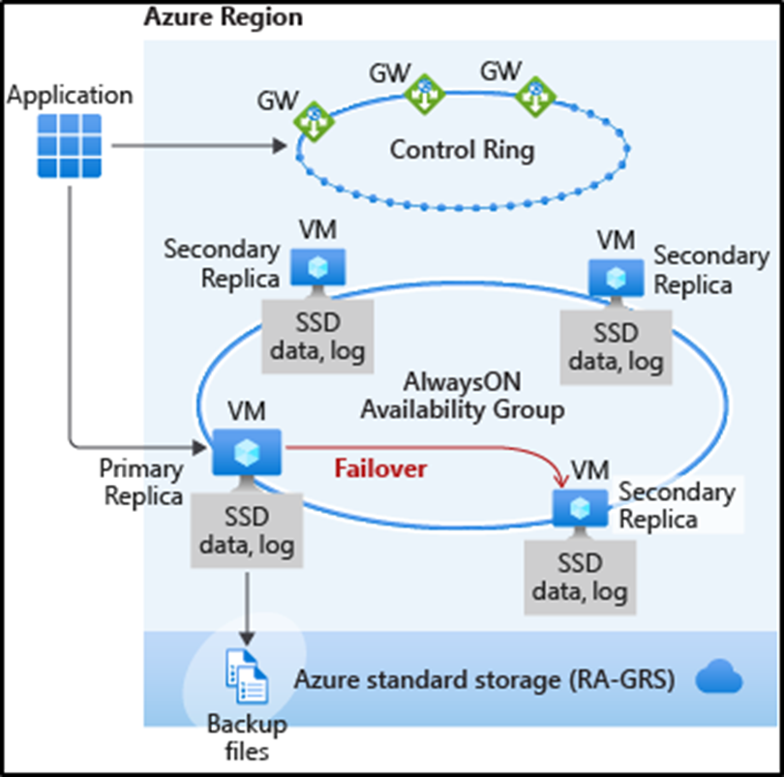
Premium and Business Critical service tier locally redundant availability
Business Critical service tiers leverage the Premium availability model, which integrates compute resources (SQL Server Database Engine process) and storage (locally attached SSD) on a single node.
High availability is achieved by replicating both compute and storage to additional nodes creating a three to four-node cluster.

Slide 8
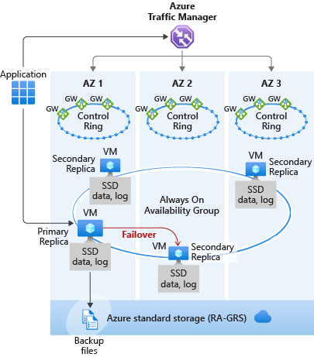
Premium and Business Critical service tier zone redundant availability
Performance impact - Zone redundant databases have replicas in different datacenters with some distance between them, the increased network latency may increase the commit time and affect the performance of some OLTP workloads.
Note
This feature is not available in SQL Managed Instance.

Slide 9
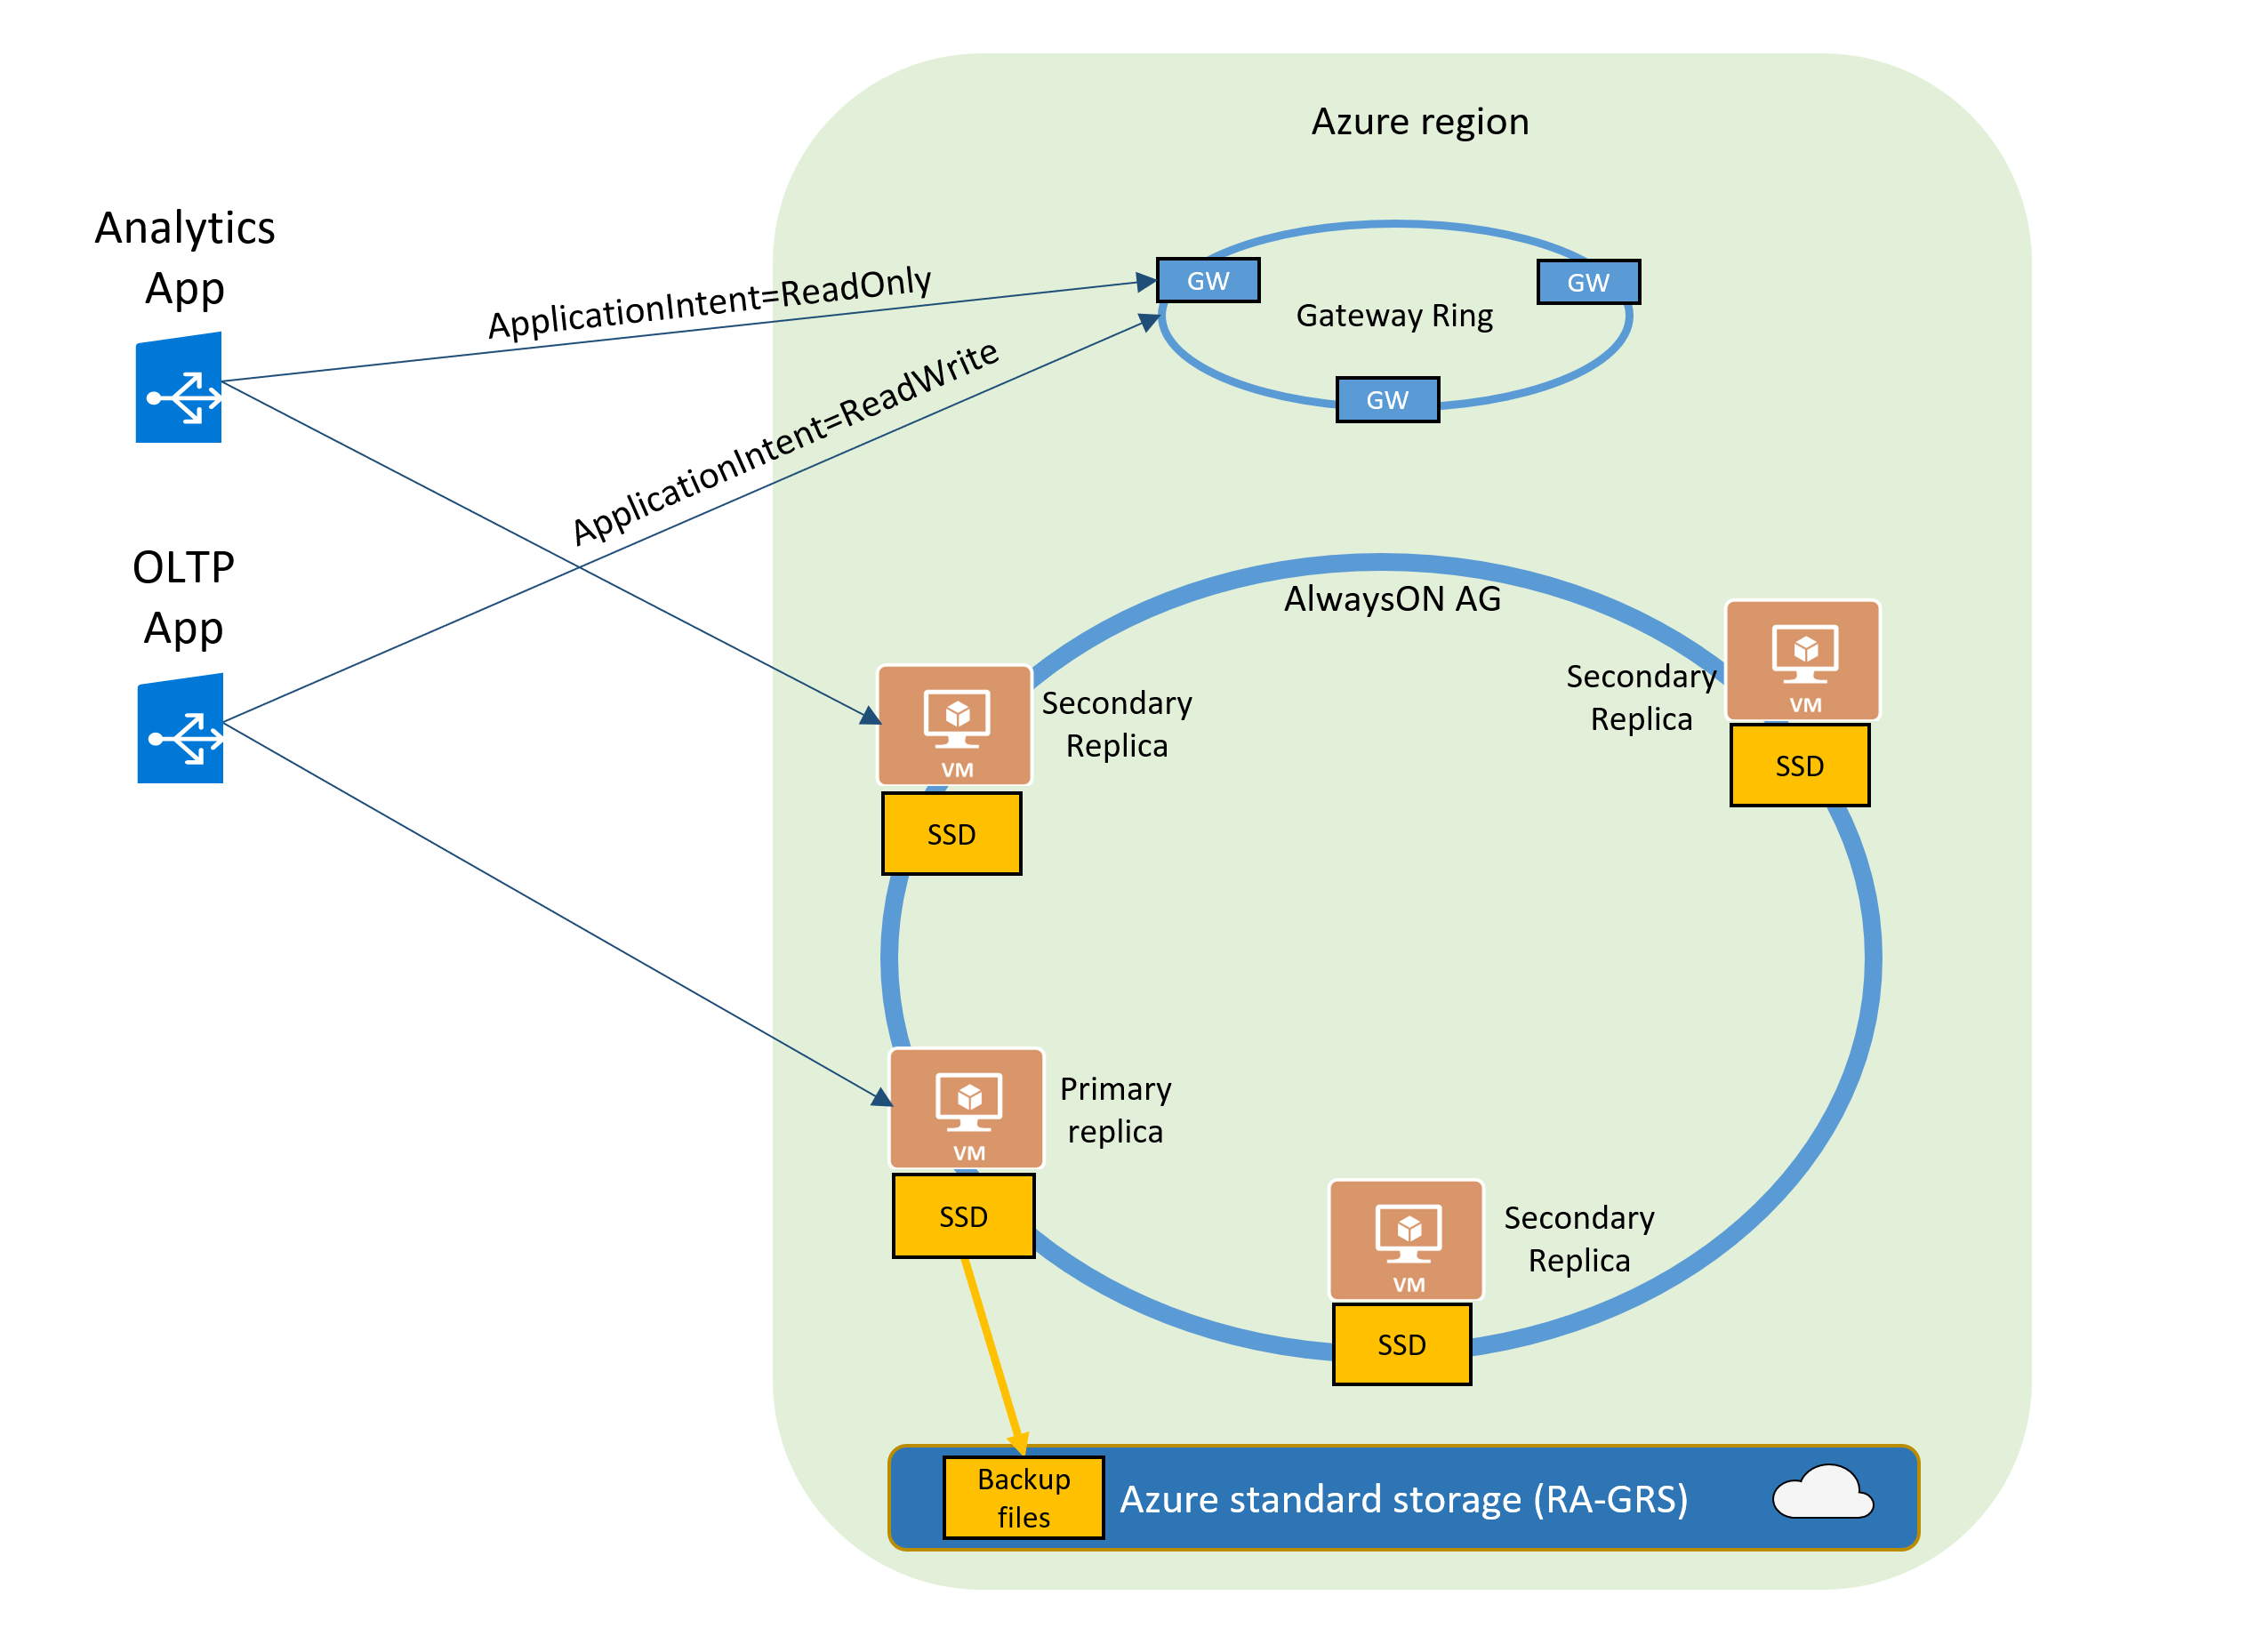
Read-only replicas and read-only query workloads
The Read Scale-Out feature is enabled by default on new Premium, Business Critical, and Hyperscale databases (if there is second instance).
In case of Azure SQL Managed Instance it will be Business Critical service tier. In case of Azure SQL Database it will be Premium or Business Critical service tier.
If your SQL connection string is configured with ApplicationIntent=ReadOnly, the application will be redirected by the gateway to a read-only replica of that database.

Slide 10
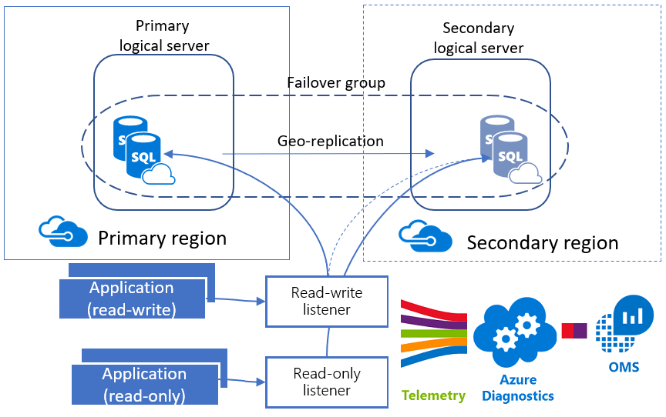
Custom Architecture Azure SQL DB
PowerShell (1 script)
Use existing or create new Resource Group;
Create primary Azure Logical SQL Server;
Set an admin login and password for your server;
Set Firewall Settings (IP address range);
Create Azure SQL Database;
Create a new login for the Azure SQL Server;
Create a new DB user for the existing login;
Create Failover Azure Logical SQL Server, including admin login, password and firewall rules;
Create Failover Group Name;
Add Database to the exiting Failover Group;
Create a new login for the Failover Azure SQL Server with matching SID;
Create a Workspace in the existing Resource Group;
Enable Azure SQL Analytics Intelligence Pack;
Enable Azure Diagnostics for Azure SQL database;
Configure Azure SQL Databases to stream diagnostics telemetry;

