Slide 1





Demystifying Azure Load Balancer role for a SQL Server Always On availability group on Azure VMs
zoran.barac.zof@gmail.com
blog.sqlserveronline.com
www.linkedin.com/in/zoran-barac/
www.meetup.com/Auckland-SQL-User-Group/

Slide 2
Agenda
01
Azure Load Balancer
02
Configuration
Type, differences between Public and Internal Load Balancers
Frontend IP configuration
Backend pools (Virtual machines)
Health probes (Protocol, Port)
Load balancing rules (Frontend IP address, Backend pool, Protocol, Port, Health Probe, Floating IP)
03
Monitoring
04
Troubleshooting
Insights

Slide 3
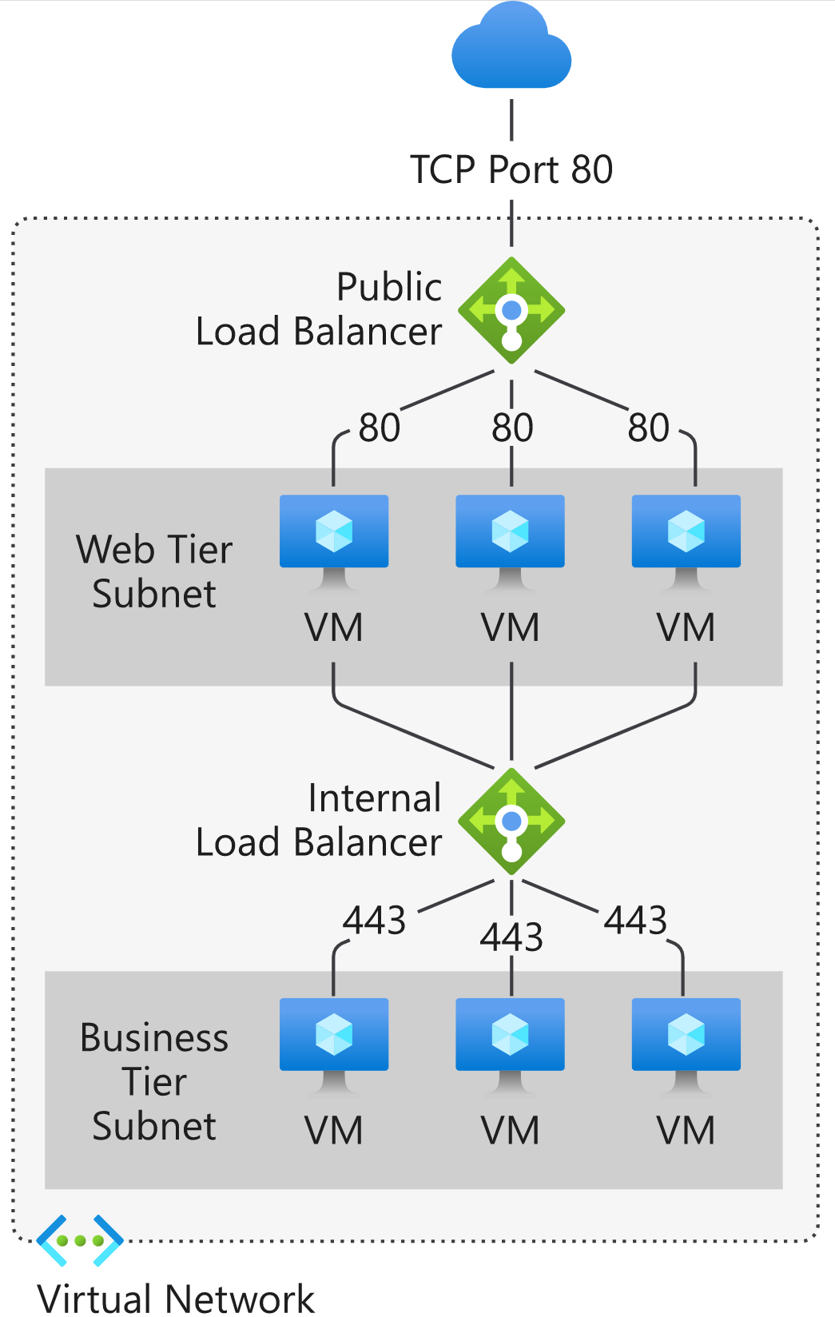
Azure Load Balancer
PUBLIC LOAD BALANCER
A public (Internet-facing) load balancer uses a public frontend IP address.
INTERNAL/PRIVATE LOAD BALANCER
Internal load balancer uses a private frontend IP address.
 | Standard Load Balancer | Basic Load Balancer
Backend type | IP based, NIC based | NIC based
Backend pool endpoints | Any virtual machines or virtual machine scale sets in a single virtual network | Virtual machines in a single availability set or virtual machine scale set
Health probes | TCP, HTTP, HTTPS | TCP, HTTP
Availability Zones | Zone-redundant and zonal frontends for inbound and outbound traffic | Not available
Multiple front ends | Inbound and outbound | Inbound only
Private Link Support | Standard ILB is supported via Private Link | Not supported
Global tier | Standard LB supports the Global tier for Public LBs enabling cross-region load balancing | Not supported

Slide 4
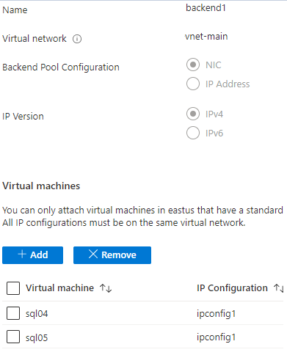
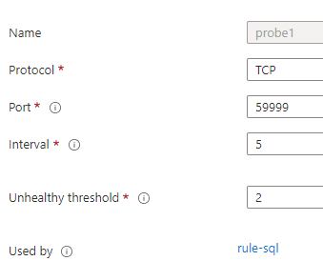
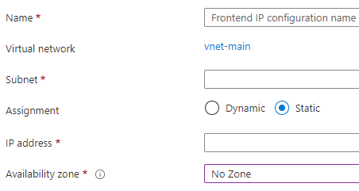
Azure Load Balancer Configuration
FRONTEND IP
BACKEND POOL
HEALTH PROBE
Front-end IP addresses and virtual networks are never directly exposed to an internet endpoint, meaning an internal load balancer cannot accept incoming traffic from the internet. Internal line-of-business applications run in Azure and are accessed from within Azure or from on-premises resources.
Azure calls the back-end address pool backend pool. In this case, the back-end pool is the addresses of the two SQL Server instances in our availability group
The probe defines how Azure verifies which of the SQL Server instances currently owns the availability group listener. This health probe will determine if an instance is healthy and can receive traffic.
Note
Load balancer holds the IP address for the listener. The load balancer routes traffic to the instance of SQL Server that is listening on the probe port.

Slide 5
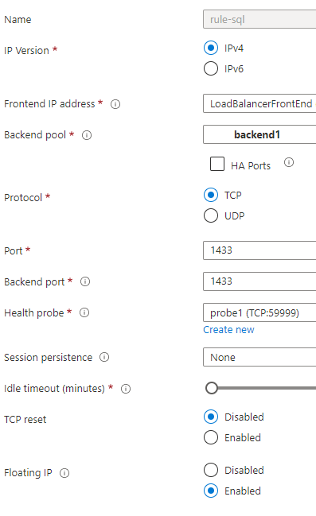
Load balancing rule
LOAD BALANCING RULE
A load balancing rule distributes incoming traffic that is sent to a selected IP address and port combination across a group of backend pool instances. Only backend instances that the health probe considers healthy receive new traffic.
SESSION PERSISTANCE
Session persistence specifies that traffic from a client should be handled by the same virtual machine in the backend pool for the duration of a session. "None" specifies that successive requests from the same client may be handled by any virtual machine.
FLOATING IP
Without Floating IP, Azure exposes a traditional load balancing IP address mapping scheme for ease of use (the VM instances' IP). Enabling Floating IP changes the IP address mapping to the Frontend IP of the load balancer to allow for additional flexibility.

Slide 6
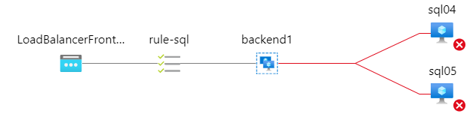
Azure Load Balancer Insights #1
Potential probe health port misconfiguration;
Firewall issues;
VMs not accessible;
VNET;
etc

Slide 7


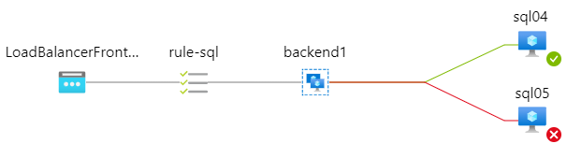
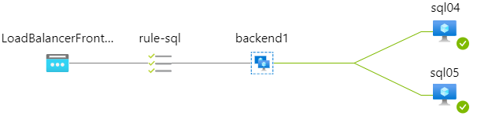
Azure Load Balancer Insights #2
We have two potential issues here:
Probe health port misconfiguration;
Probe health port misconfiguration;
Floating IP - Without Floating IP, Azure exposes a traditional load balancing IP address mapping scheme for ease of use (the VM instances' IP).
Floating IP - Without Floating IP, Azure exposes a traditional load balancing IP address mapping scheme for ease of use (the VM instances' IP).
Read-Only traffic potential error:
The target database ('dbname') is in an availability group and is currently accessible for connections when the application intent is set to read only.

Slide 8

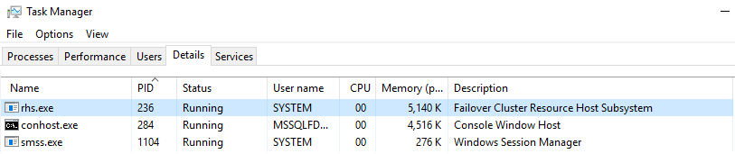
Azure Load Balancer Insights #3
On the server hosting the primary replica, RHS.EXE process should listening on the probe port you configured the internal load balancer with.
I you run command netstat -ano | find "59999" on primary SQL you will notice that ILB probe port is bound to a process called RHS.exe, at the same time if you run the same command on the secondary replica, RHS.exe is not bound to the ILB probe port.

Slide 9

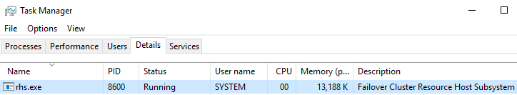
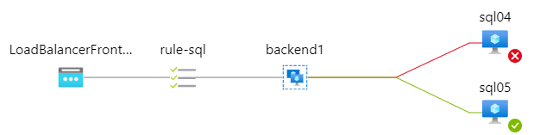
Azure Load Balancer Insights #4
On the server hosting the primary replica, RHS.EXE process should listening on the probe port you configured the internal load balancer with.
I you run command netstat -ano | find "59999" on primary SQL you will notice that ILB probe port is bound to a process called RHS.exe, at the same time if you run the same command on the secondary replica, RHS.exe is not bound to the ILB probe port.

Slide 10
https://github.com/baraczof/sessions/blob/main/DataWeekenderCU5/
THANK YOU

