Slide 1
Use PowerShell to deploy and configure Azure SQL Database (PaaS) with good resilience to outages and with integrated Azure SQL Analytics monitoring solution
ZORAN BARAC
DATA ARCHITECT at CIN7

Slide 2
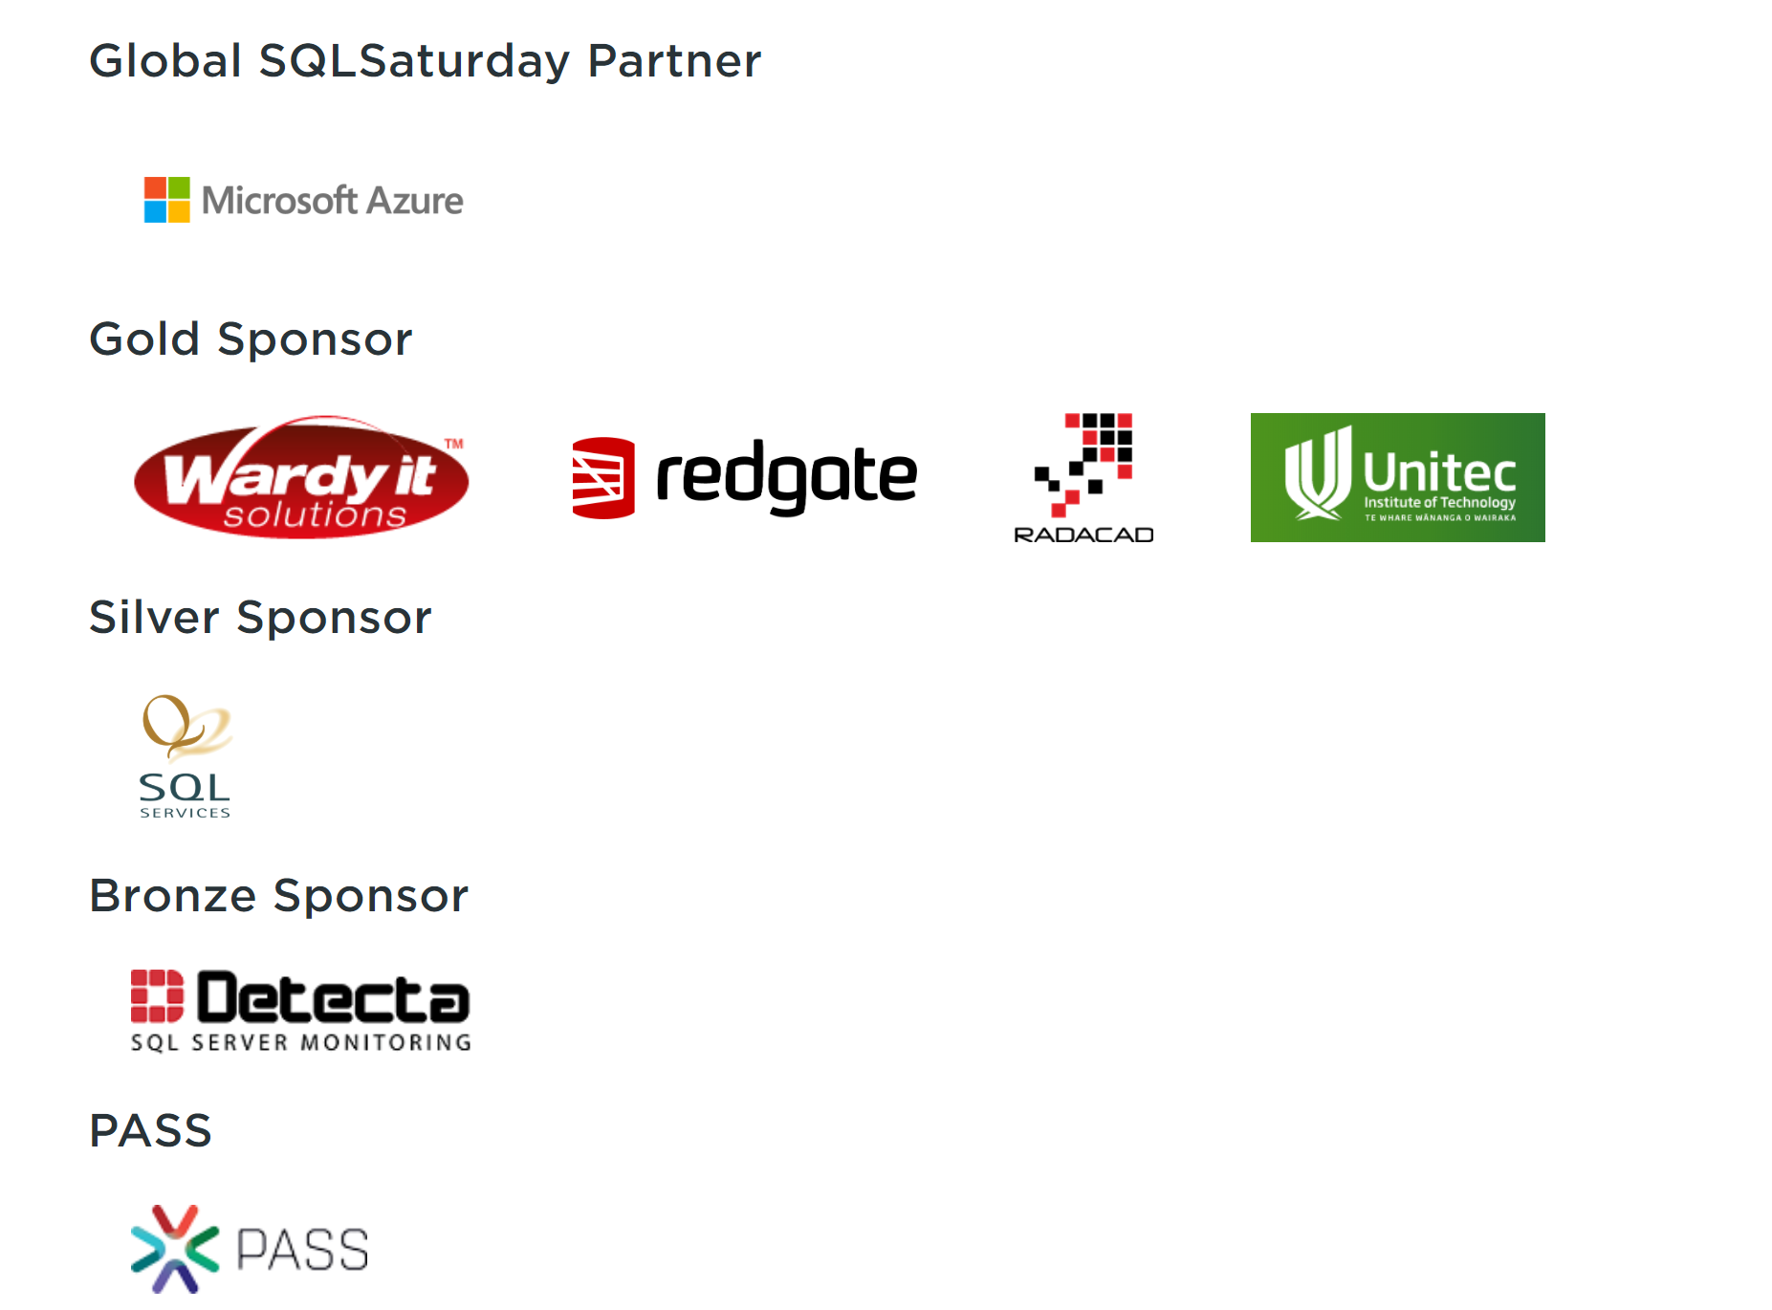
Thanks to our great Sponsors

Slide 3




About me
Zoran Barac
Data Architect @ CIN7
MCT, MCSE
zoran.barac.zof@gmail.com
blog.sqlserveronline.com
www.linkedin.com/in/zoran-barac/
www.meetup.com/Auckland-SQL-User-Group/

Slide 4
HA and Azure SQL Database - Standard availability model - Premium availability model

Slide 5
Two high-availability architectural models that are used in Azure SQL Database:
Standard availability model that is based on a separation of compute and storage. It relies on high availability and reliability of the remote storage tier. This architecture targets budget-oriented business applications that can tolerate some performance degradation during maintenance activities.
Premium availability model that is based on a cluster of database engine processes. It relies on the fact that there is always a quorum of available database engine nodes. This architecture targets mission critical applications with high IO performance, high transaction rate and guarantees minimal performance impact to your workload during maintenance activities.

Slide 6
Service Tiers and HA - General Purpose/Standard - Business Critical/Premium

Slide 7
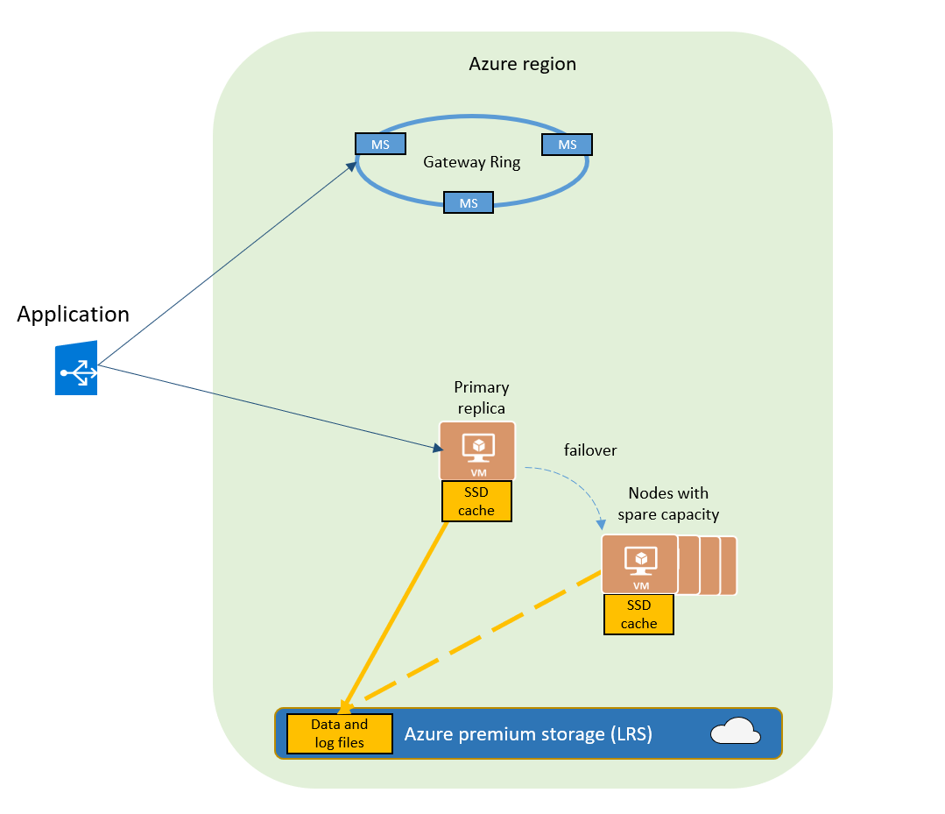
Basic, Standard, and General Purpose service tier availability
The standard availability model includes two layers:
Stateless compute layer that runs the sqlserver.exe process (contains only transient and cached data on the attached SSD, such as TempDB, model database, plan cache, buffer pool ).
A stateful data layer with the database files (.mdf/.ldf) that are stored in Azure Blob storage. Azure blob storage has built-in data availability and redundancy feature.

Slide 8
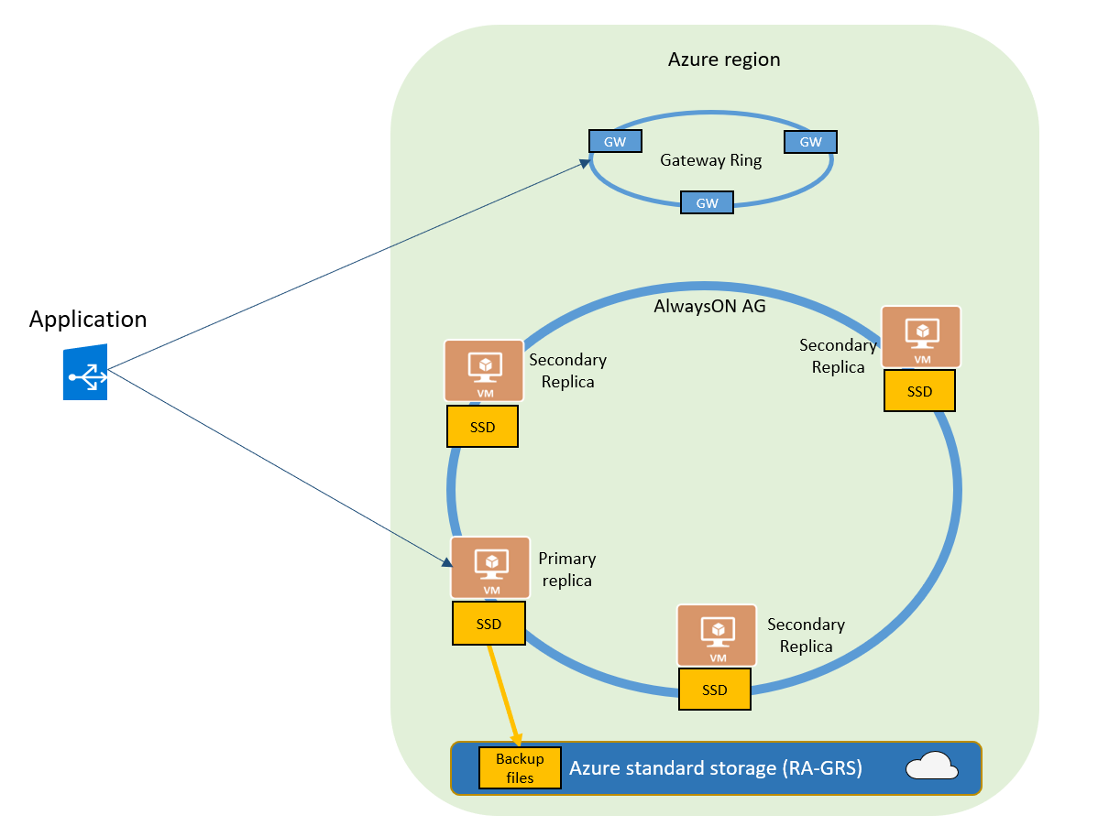
Premium and Business Critical service tier availability
Premium and Business Critical service tiers leverage the Premium availability model, which integrates compute resources (SQL Server Database Engine process) and storage (locally attached SSD) on a single node.
High availability is achieved by replicating both compute and storage to additional nodes creating a three to four-node cluster.
By default, the cluster of nodes for the premium availability model is created in the same datacenter. With the introduction of Azure Availability Zones, SQL Database can place different replicas in the cluster to different availability zones in the same region.

Slide 9
Azure SQL Database DR Architecture

Slide 10
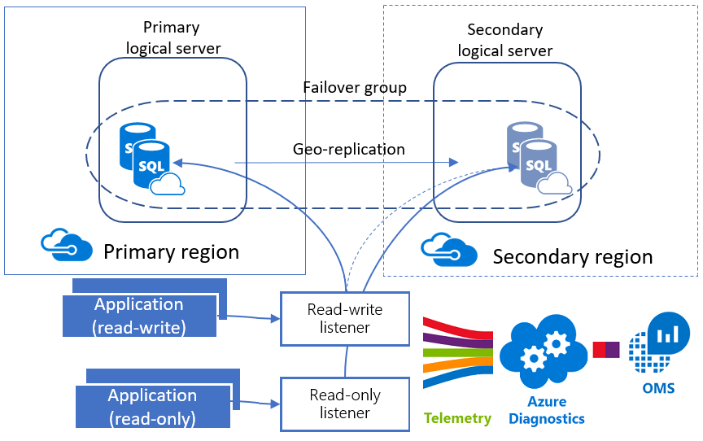

Slide 11
Powershell script

Slide 12
PowerShell Script
Connect to Azure Account,
Use existing or create new Resource Group,
Create primary Azure Logical SQL Server,
Set an admin login and password for your server,
Set Firewall Settings (IP address range),
Create Azure SQL Database,
Create a new login for the Azure SQL Server,
Create a new DB user for the created login,
Create failover Azure Logical SQL Server, including admin login, password and firewall rules (Optional),
Create Failover Group Name (Optional),
Add Database to the existing Failover Group (Optional),
Create a new login for the Failover Azure SQL Server with matching SID (Optional),
Create the workspace, enable diagnostics and configure data collection,
Add the Azure SQL Analytics (Preview) solution to Log Analytics workspace,
Send Email notification with connection string parameters.

Slide 13
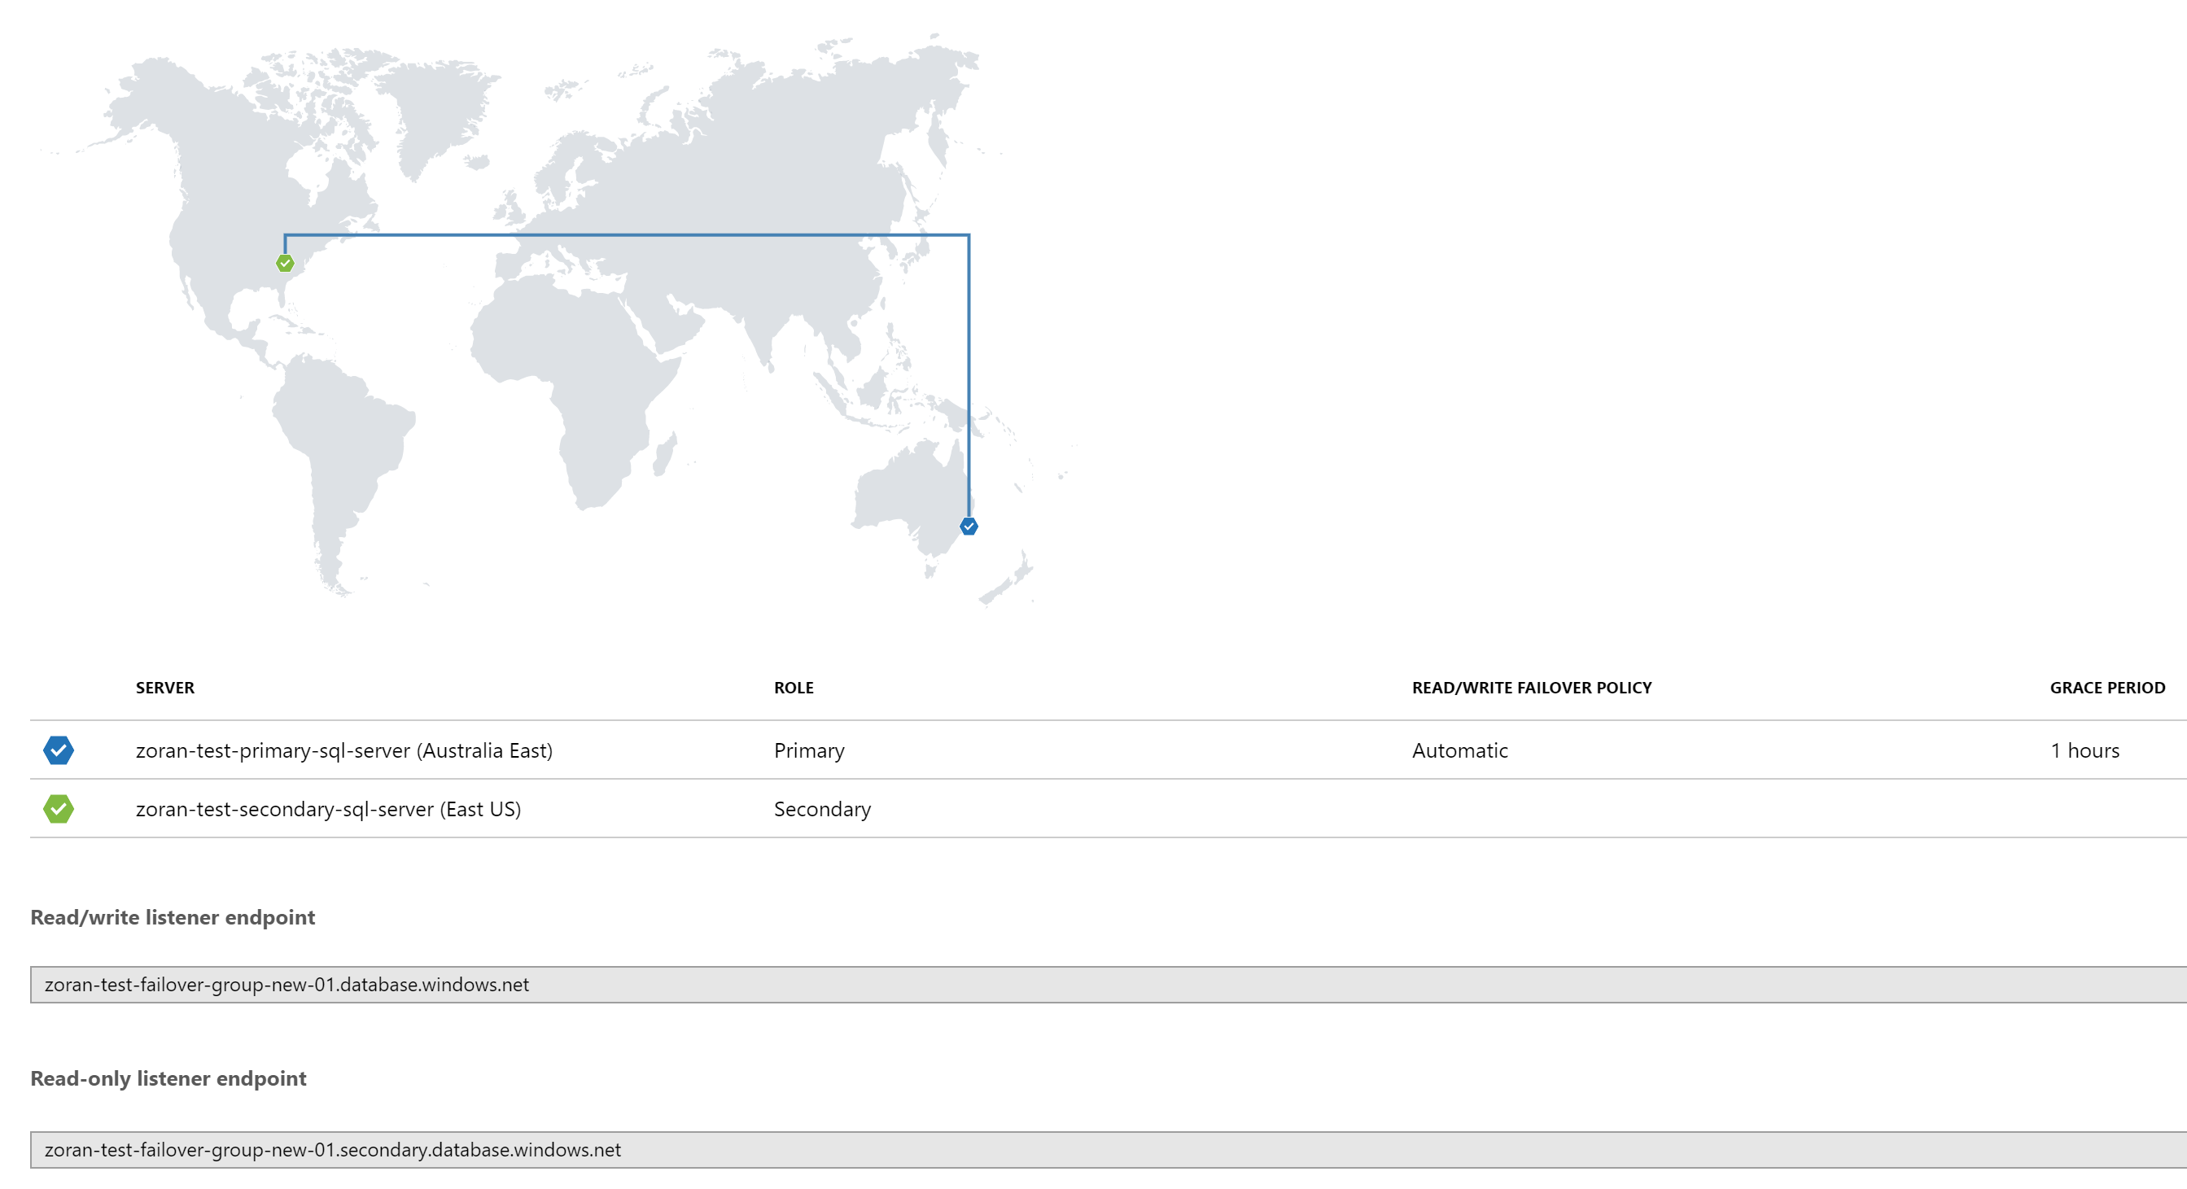
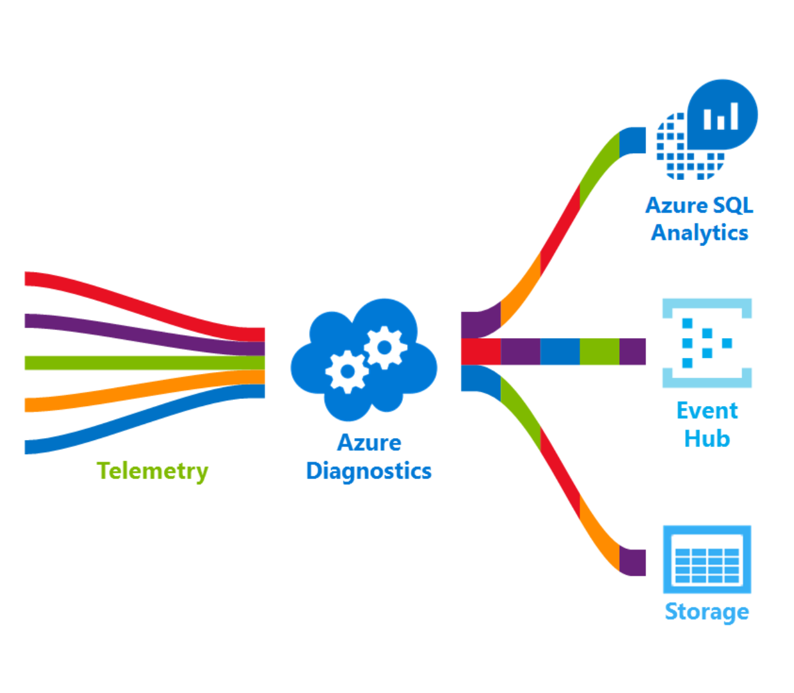

Slide 14
Manage Credentials
Connect-AzureRmAccount
Connect to Azure with an authenticated account for use with Azure Resource Manager cmdlet request
Get-AzureRmSubscription
Get subscriptions that the current account can access.
Select-AzureRmSubscription
Select a subscription and account to target in Azure PowerShell cmdlets
Get-AzureRmContext
The Get-AzureRmContext cmdlet gets the current metadata used to authenticate Azure Resource Manager requests. This cmdlet gets the Active Directory account, Active Directory tenant, Azure subscription, and the targeted Azure environment.

Slide 15
PowerShell Script – Resource Group
Script Parameters / Arguments
Comma separated list of variables, optionally prefixed with a [data type] and/or with = default values.
New-AzureRmResourceGroup
Azure resource group is a collection of Azure resources that are deployed as a unit. The New-AzureRmResourceGroup cmdlet creates an Azure resource group. You can create a resource group by using just a name and location.

Slide 16
PowerShell Script – Azure SQL
New-AzureRmSqlServer
The New-AzureRmSqlServer cmdlet creates an Azure SQL Database server
New-AzureRmSqldatabase
The New-AzureRmSqlDatabase cmdlet creates an Azure SQL database. You can also create an elastic database by setting the ElasticPoolName parameter to an existing elastic pool.
New-AzureRMSqlDatabaseFailoverGroup
Creates a new Azure SQL Database Failover Group for the specified servers. If the primary server is affected by an outage, automatic failover of the endpoints and databases will be triggered as dictated by the Failover Group's failover policy and grace period. Newly created Failover Groups do not contain any databases.
Add-AzureRmSqlDatabaseToFailoverGroup
Adds one or more databases on a Azure SQL Database Failover Group's primary server to to that Failover Group. The databases must not be secondary databases in existing replication relationships. The command will start geo-replication of any added databases to the Failover Group's secondary server.

Slide 17
PowerShell Script – Operational Insights
New-AzureRmOperationalInsightsWorkspace
The New-AzureRmOperationalInsightsWorkspace cmdlet creates a workspace in the specified resource group and location.
Set-AzureRmOperationalInsightsIntelligencePack
The Set-AzureRmOperationalInsightsIntelligencePack cmdlet enables the specified Intelligence Pack. In this case AzureSQLAnalytics’
Set-AzureRmDiagnosticSetting
The Set-AzureRmDiagnosticSetting sets the logs and metrics settings for the resource.

Slide 18
Azure SQL Analytics - Cloud Monitoring Solution

Slide 19
Azure SQL Analytics
Azure SQL Analytics is an advanced cloud monitoring solution for monitoring performance of Azure SQL databases, elastic pools, and Managed Instances at scale and across multiple subscriptions through a single pane of glass.
It collects and visualizes important Azure SQL Database performance metrics with built-in intelligence for performance troubleshooting.
It uses Azure Diagnostic metrics along with Azure Monitor views to present data about all your Azure SQL databases, elastic pools, and databases in Managed Instances in a single Log Analytics workspace.

Slide 20
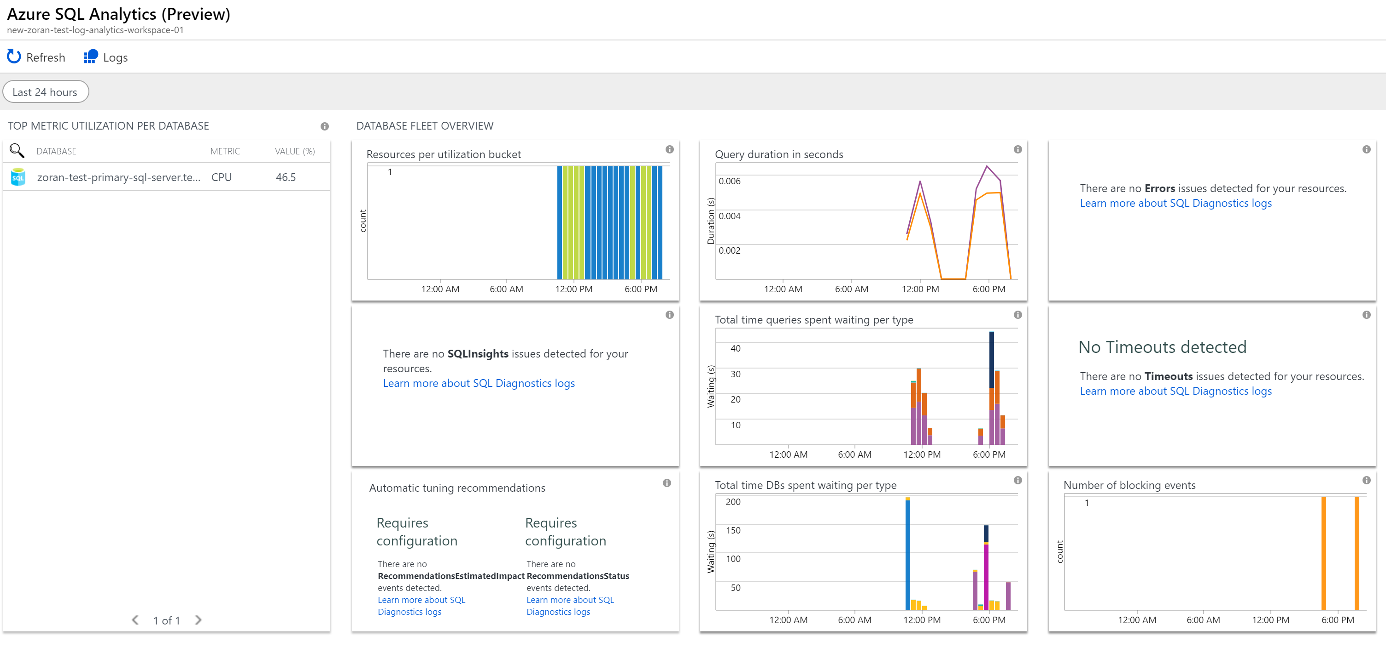

Slide 21
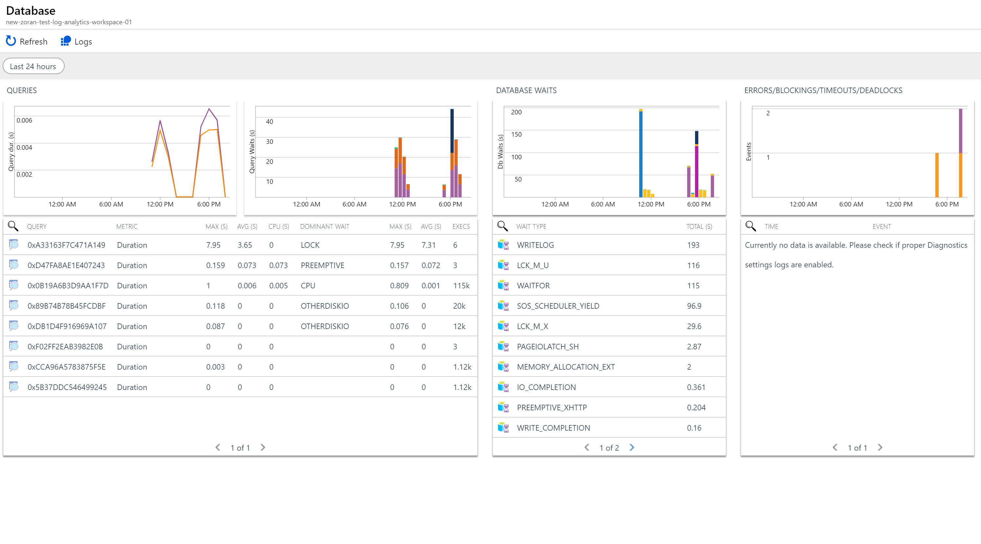

Slide 22
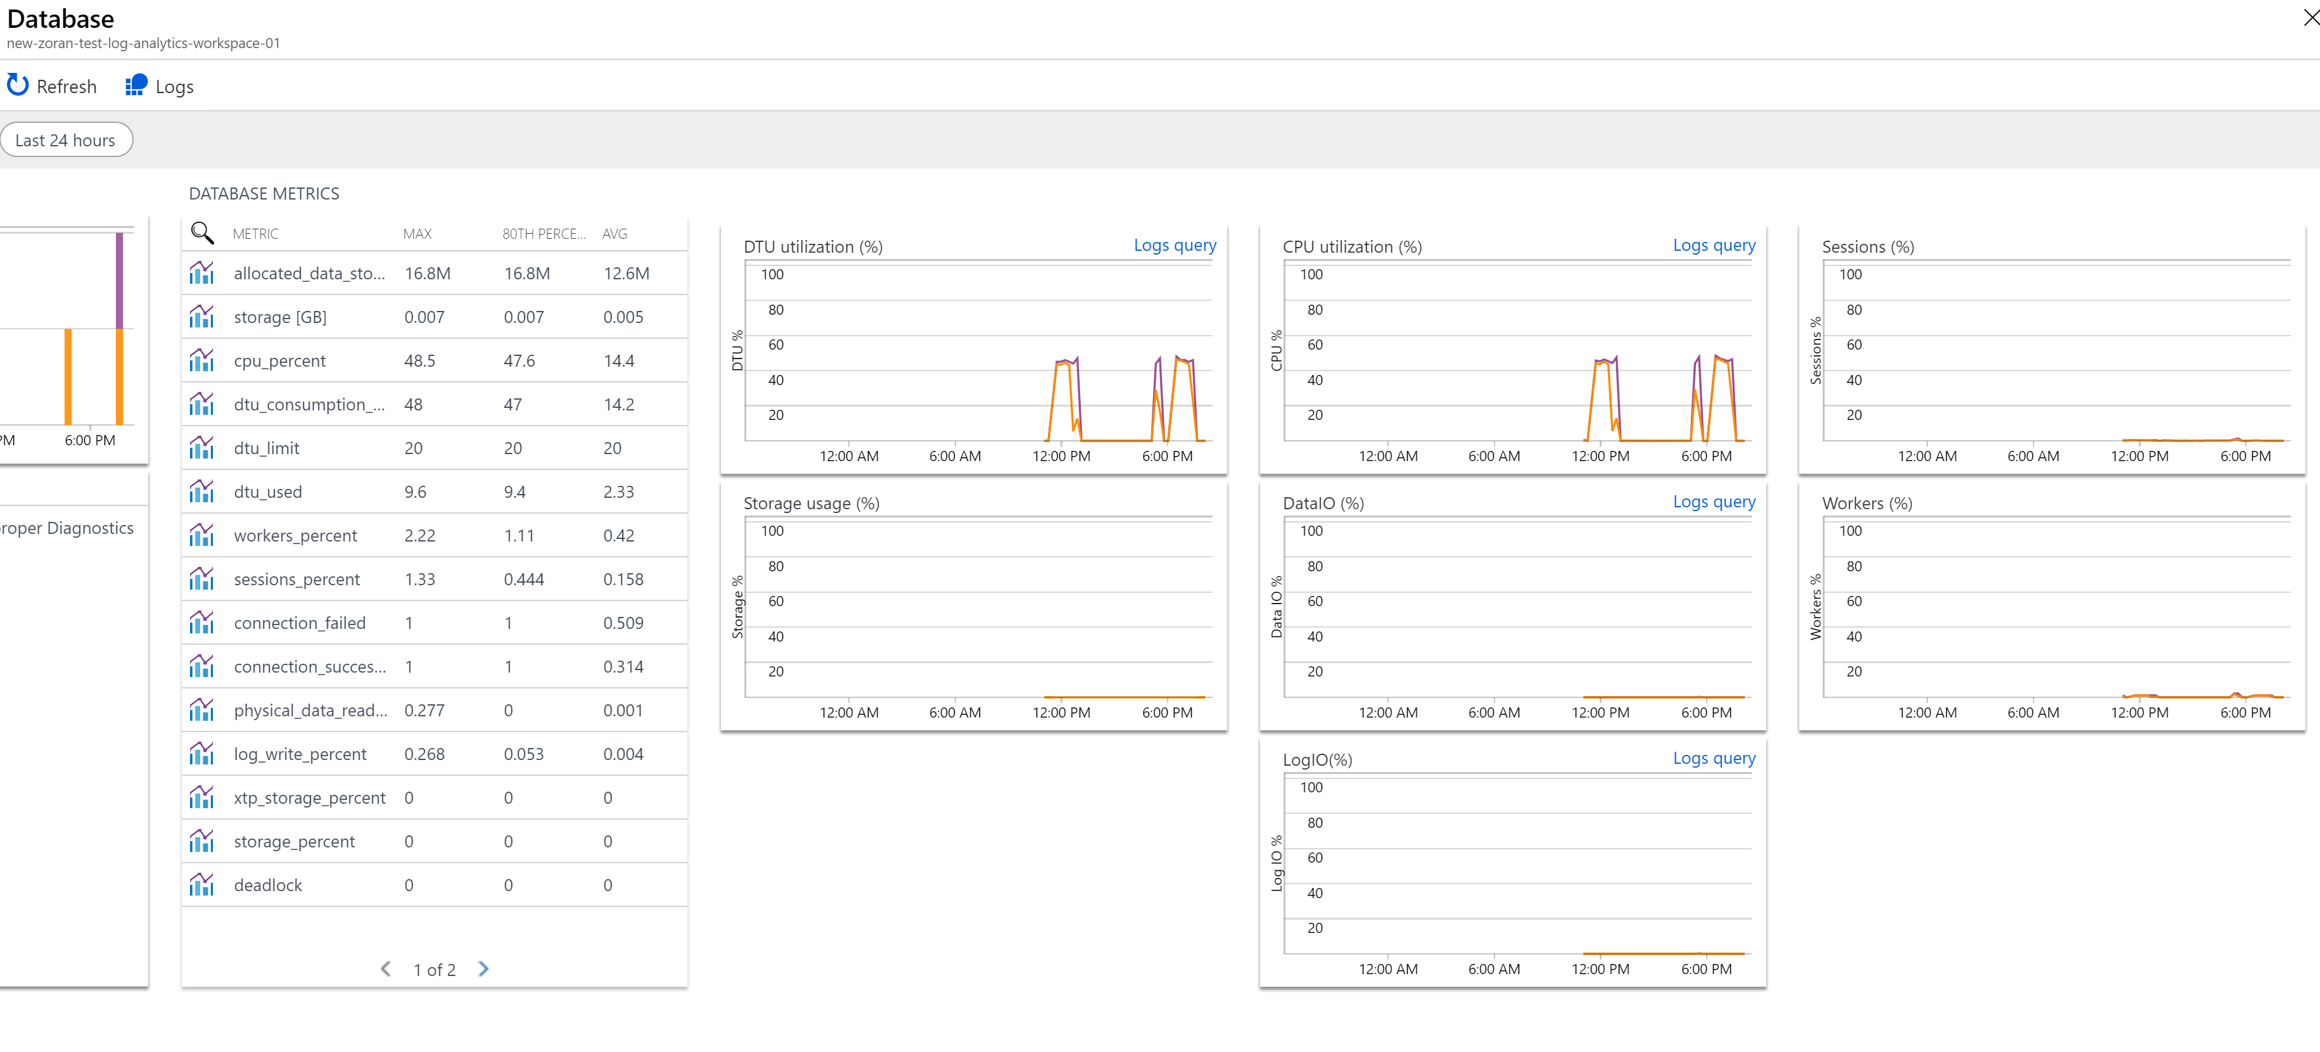

Slide 23
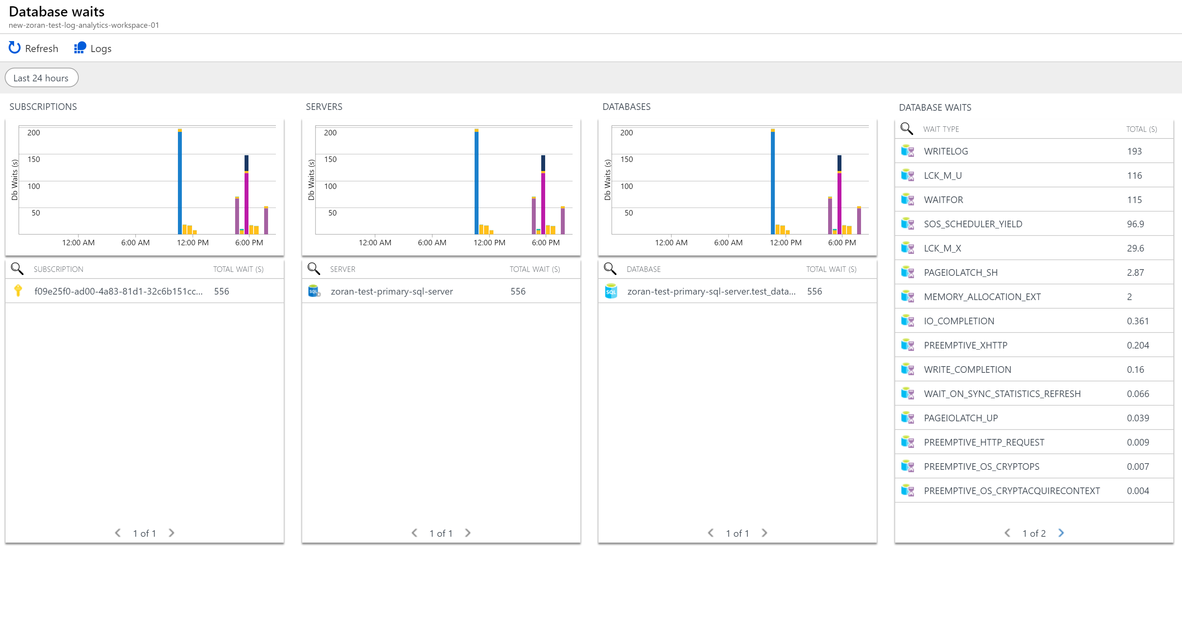

Slide 24
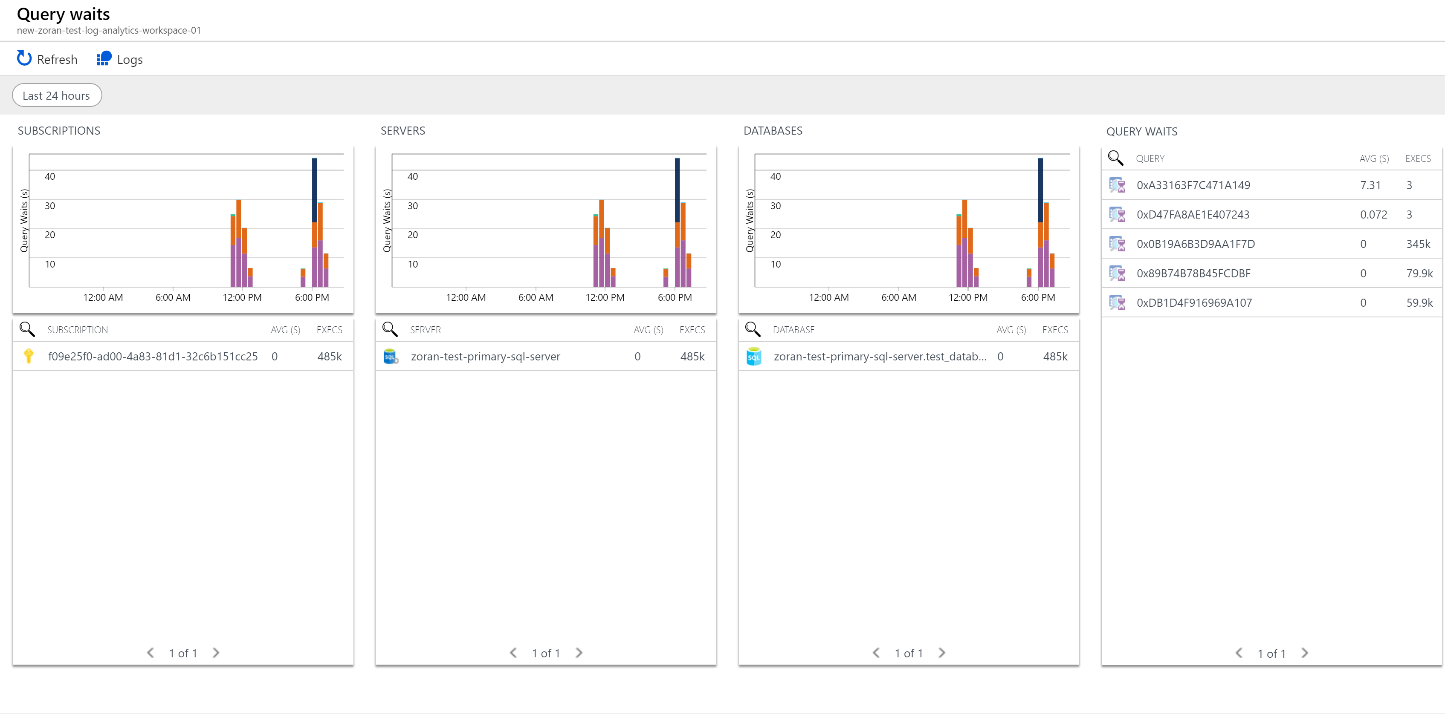

Slide 25
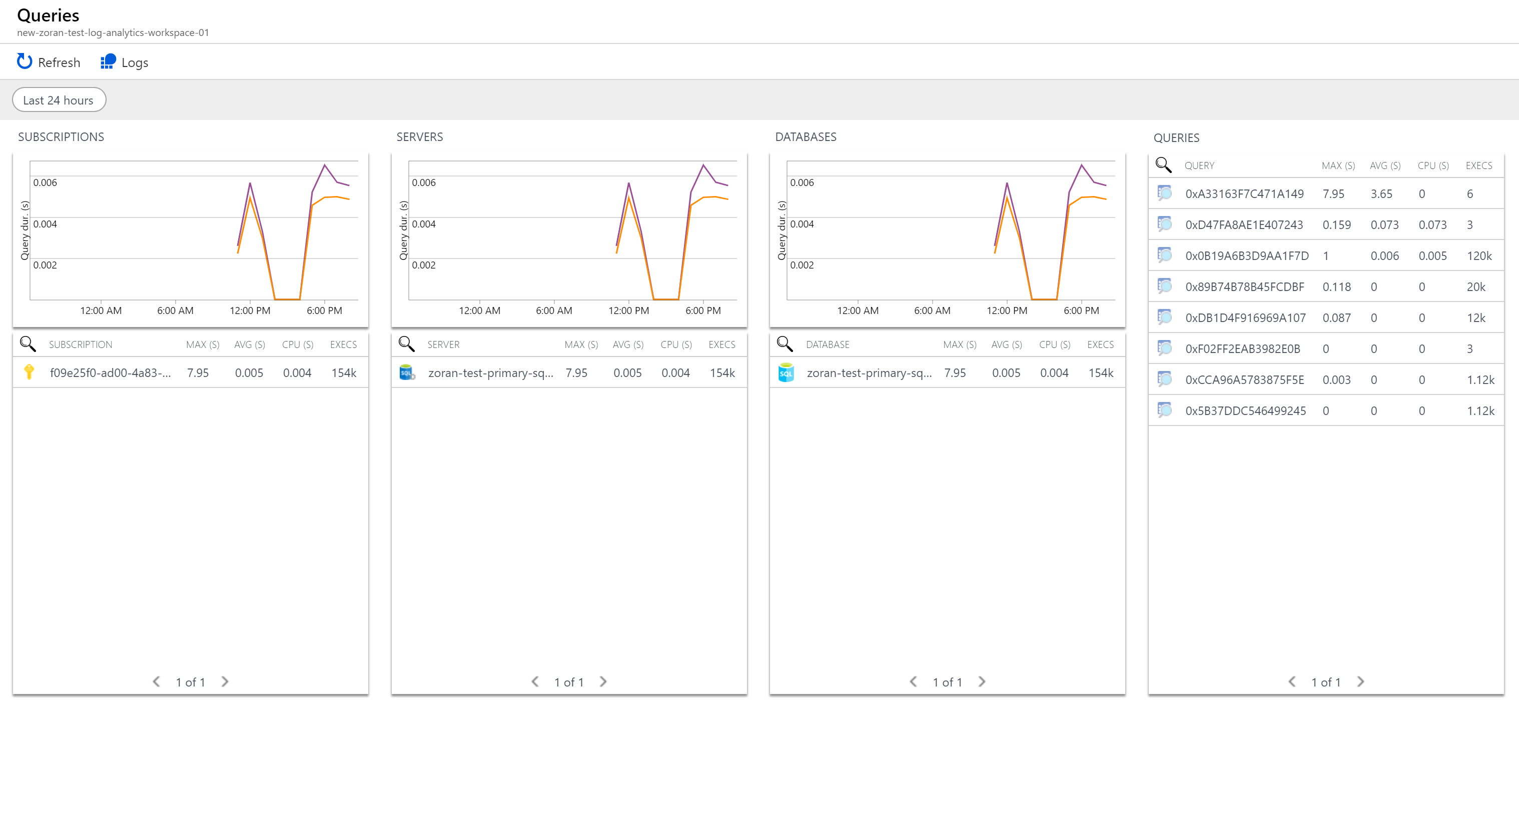

Slide 26
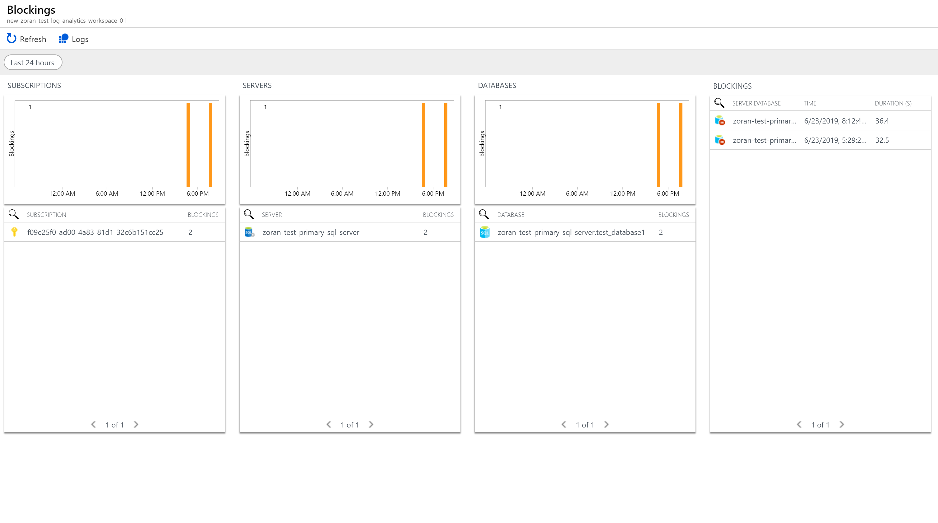

Slide 27
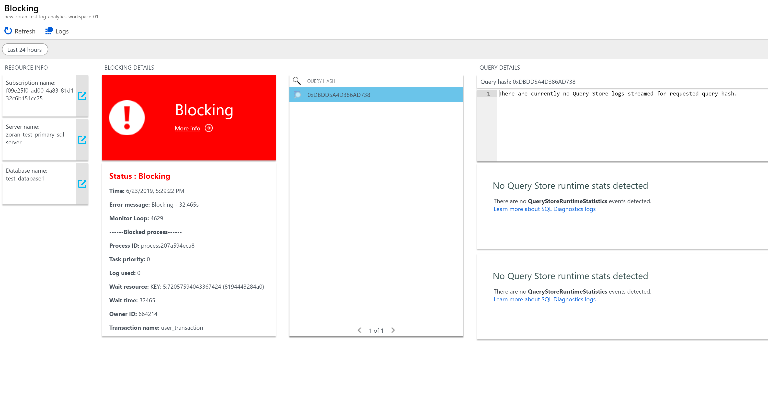

Slide 28
Thank you…

Slide 29
Resources
https://docs.microsoft.com/en-us/azure/sql-database/sql-database-high-availability
https://docs.microsoft.com/en-us/azure/azure-monitor/insights/azure-sql
https://docs.microsoft.com/en-us/powershell/module/azurerm.profile/?view=azurermps-6.13.0#profile
https://docs.microsoft.com/en-us/powershell/module/azurerm.resources/new-azurermresourcegroup?view=azurermps-6.13.0
https://docs.microsoft.com/en-us/powershell/module/azurerm.sql/new-azurermsqldatabase?view=azurermps-6.13.0
https://docs.microsoft.com/en-us/powershell/module/azurerm.sql/new-azurermsqlserver?view=azurermps-6.13.0
https://docs.microsoft.com/en-us/powershell/module/azurerm.sql/new-azurermsqldatabasefailovergroup?view=azurermps-6.13.0
https://docs.microsoft.com/en-us/powershell/module/azurerm.operationalinsights/set-azurermoperationalinsightsintelligencepack?view=azurermps-6.13.0

