Slide 1
Retrieval-Augmented Generation for Knowledge-Intensive NLP Tasks
2026.01.22
Ju hyung Lee

Slide 2
Contents
1
Introduction
2
Method
3
Experiment
4
Conclusion

Slide 3
Introduction
Problem: pre-trained language model is parametric – hard to update, interpret, avoid hallucination
Idea: Combine retrieval-based external memory + parametric seq2seq
Method: DPR(Dense Passage Retrieval) retrieves docs -> BART generates -> marginalized over top-K docs

Slide 4
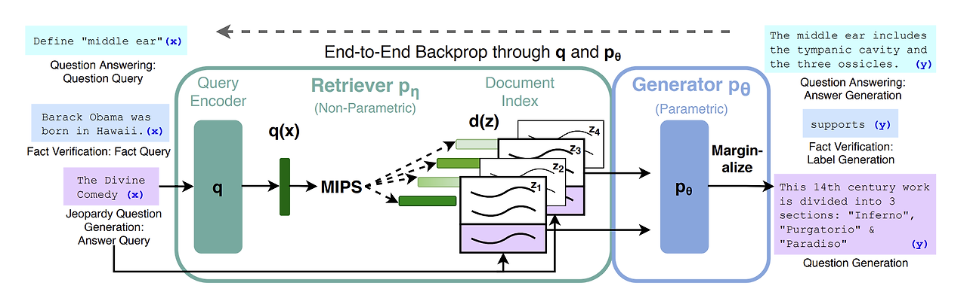
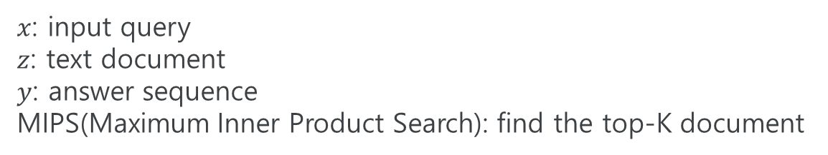
Introduction
$x$: input query
$z$: text document
$y$: answer sequence
MIPS(Maximum Inner Product Search): find the top-K document

Slide 5
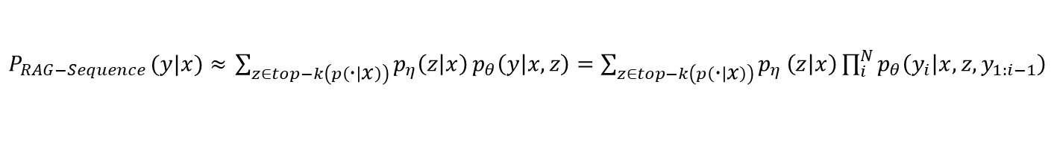
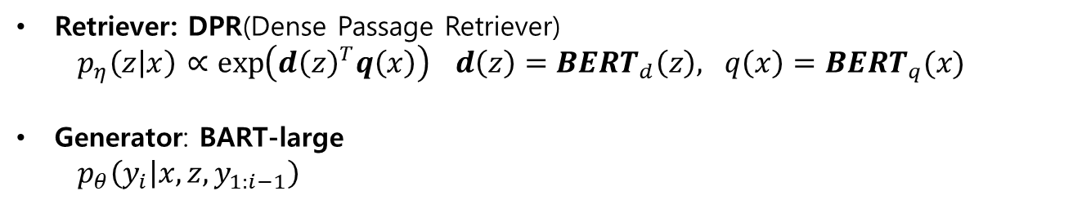
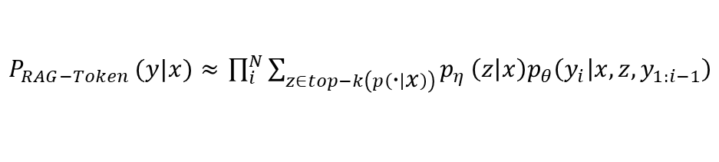
Models
retriever
generator
$P_{RAG−Sequence }(y|x)≈$ $\sum_{z∈top−k\left(p\left(∙ | x\right)\right)}{p_{η}\left(z | x\right)}p_{θ}\left(y | x,z\right)=\sum_{z∈top­−­­­­­k\left(p\left(∙ | x\right)\right)}{p_{η}}\left(z | x\right)\prod_{i}^{N}{p_{θ}\left(y_{i} | x,z,y_{1:i−1}\right)}$
$P_{RAG−Token }(y|x)≈$ $\prod_{i}^{N}{\sum_{z∈top­−­­­­­k\left(p\left(∙ | x\right)\right)}{p_{η}}\left(z | x\right)p_{θ}\left(y_{i} | x,z,y_{1:i−1}\right)}$
Retriever: DPR(Dense Passage Retriever)
  $p_{η}\left(z | x\right)$ $∝\exp\left({d\left(z\right)}^{T}q\left(x\right)\right) d\left(z\right)={BERT}_{d}\left(z\right), q\left(x\right)={BERT}_{q}(x)$
Generator: BART-large
  $$p_{θ}\left(y_{i} | x,z,y_{1:i−1}\right)$$
Notes:
RAG-Sequence Model
모델이 sequence내의 각 target token을 예측할 때 같은 문서를 참조하는 접근법
x가 주어졌을 때 y가 결과물으로 나올 확률은 x가 주어졌을 때 문서 z가 나오고, 그 z와 x가 주어졌을 때 다시 y가 나올 확률을 모든 z에 대해 더한 것과 같다 (marginalization)
그런데, k값을 적절히 세팅하면 top-k에 속하는 문서가 뽑힐 확률이 순위가 낮은 문서가 뽑힐 확률보다 훨씬 높으므로 후자를 무시할 수 있다. 즉, top-k에 속하는 문서에 대해서만 marginalize한다.
x, z가 주어졌을 때 시퀀스 y가 생성될 확률 = x, z가 주어지고 이전에 생성된 토큰이 주어졌을 때 다음 토큰이 생성될 확률을 전부 곱한 것
RAG-Token Model
모델이 각 토큰을 생성할 때 서로 다른 문서를 참조할 수 있다
먼저 retriever를 통해 Top K 개의 문서가 전달되고, generator는 각 document가 주어진 상황에서 다음 토큰을 예측
먼저, pθ(yi|x)는 marginalization을 이용하면 앞서와 같이, z가 주어질 확률*z가 주어졌을 때의 확률을 모든 z에 대해 더한 것과 같다 (summation 안쪽 수식)
다음 토큰을 생성할 때는 이전 토큰을 참조하므로, 이 확률을 곱해간다

Slide 6
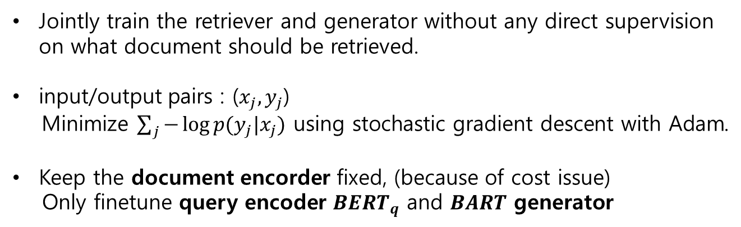
Training Method
Jointly train the retriever and generator without any direct supervision on what document should be retrieved.
input/output pairs : ($x_{j}, y_{j}$)
Minimize $\sum_{j}{−\log{p(y_{j}|x_{j})}}$ using stochastic gradient descent with Adam.
Keep the document encorder fixed, (because of cost issue)
Only finetune query encoder ${BERT}_{q}$ and $BART$ generator

Slide 7
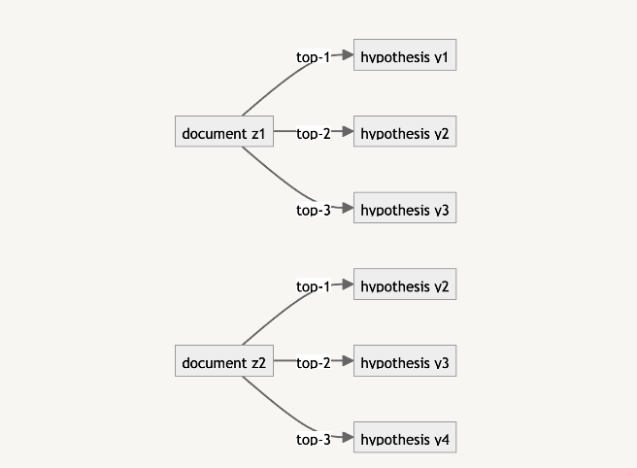
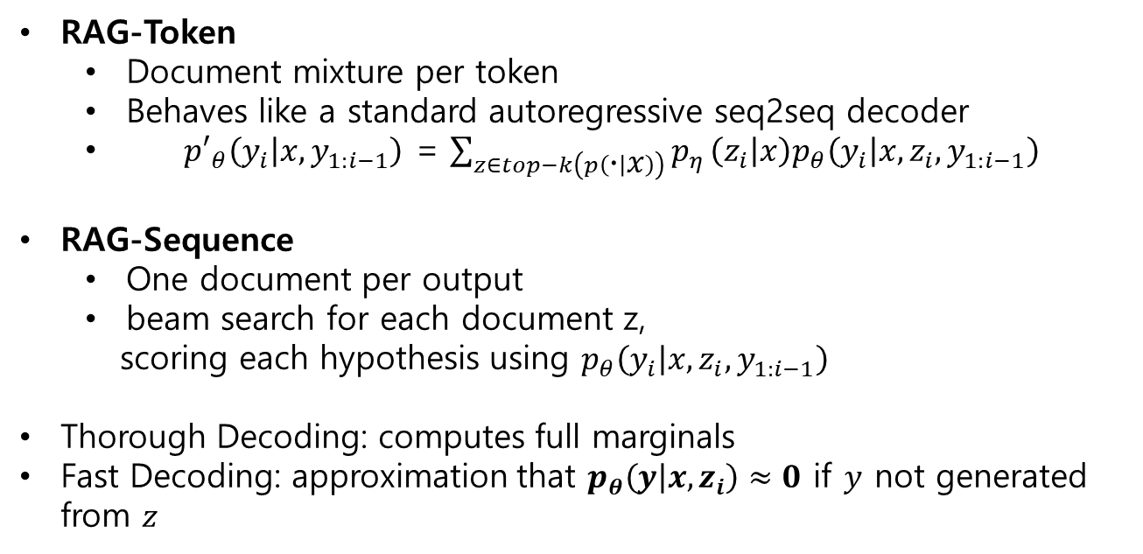
Decoding
RAG-Token
  Document mixture per token
  Behaves like a standard autoregressive seq2seq decoder
  ${p′}_{θ}\left(y_{i} | x,y_{1:i−1}\right)$ = $\sum_{z∈top­−­­­­­k\left(p\left(∙ | x\right)\right)}{p_{η}}\left(z_{i} | x\right)p_{θ}\left(y_{i} | x,z_{i},y_{1:i−1}\right)$
RAG-Sequence
  One document per output
  beam search for each document z,
  scoring each hypothesis using $p_{θ}\left(y_{i} | x,z_{i},y_{1:i−1}\right)$
Thorough Decoding: computes full marginals
Fast Decoding: approximation that $p_{θ}\left(y | x, z_{i}\right)≈0$ if $y$ not generated from $z$

Slide 8
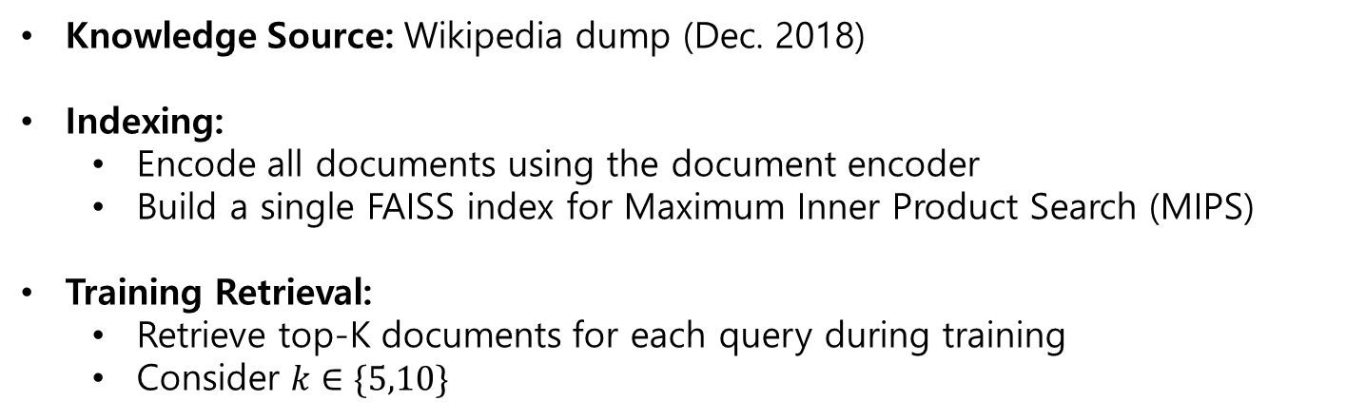
Experiments
Knowledge Source: Wikipedia dump (Dec. 2018)
Indexing:
  Encode all documents using the document encoder
  Build a single FAISS index for Maximum Inner Product Search (MIPS)
Training Retrieval:
  Retrieve top-K documents for each query during training
  Consider $k∈\{5,10\}$

Slide 9
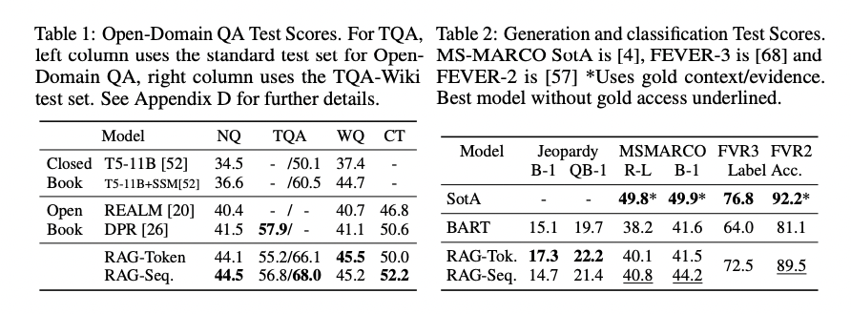
Result

Slide 10
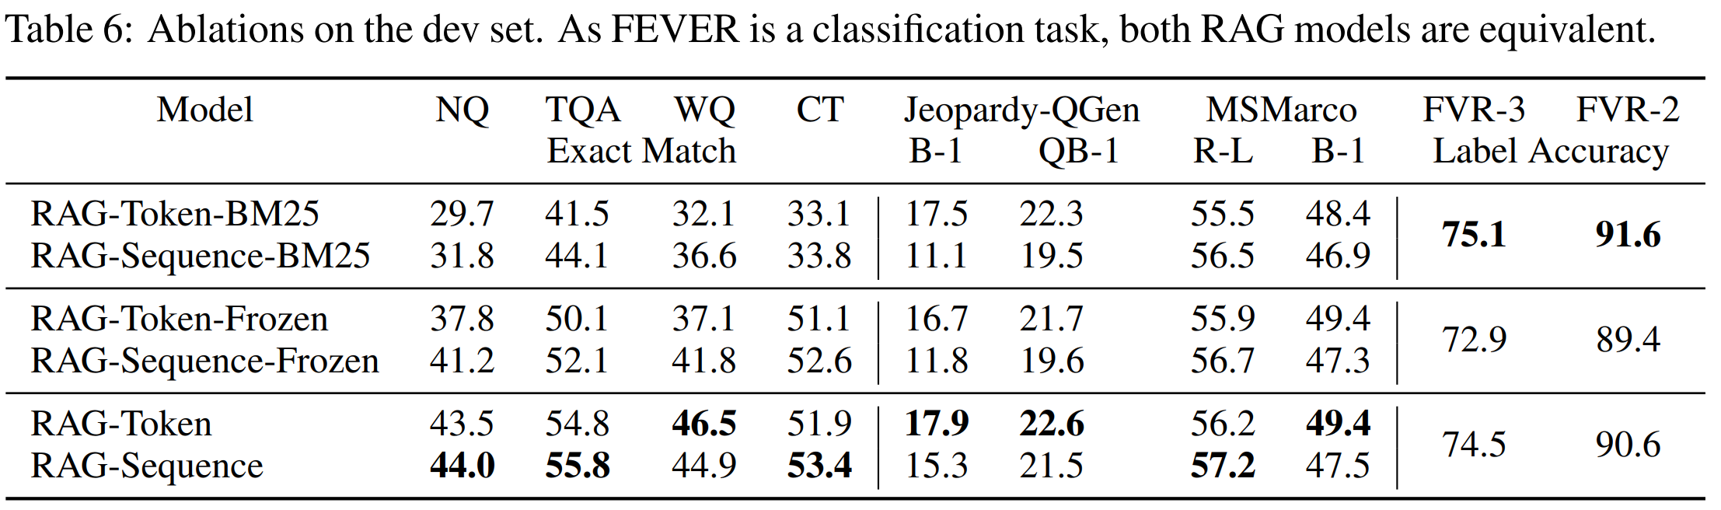
Result

Slide 11
Discussion
Introduced hybrid generation models combining parametric and non-parametric memory
RAG achieves state-of-the-art performance on open-domain QA
Future direction: joint pre-training of retriever + generator

Slide 12
Conclusion
RAG reduces hallucinations by grounding generation in factual external knowledge. (e.g., Wikipedia)
Risks remain, as external knowledge sources can contain biases or inaccuracies.
As a language model, RAG may still be misused for misleading content, impersonation, or spam/phishing.
In order to mitigate these risks, AI systems could be employed to fight against misleading content and automated spam/phishing.

Slide 13
Thank you
Insert the title of
your subtitle Here

