Slide 1
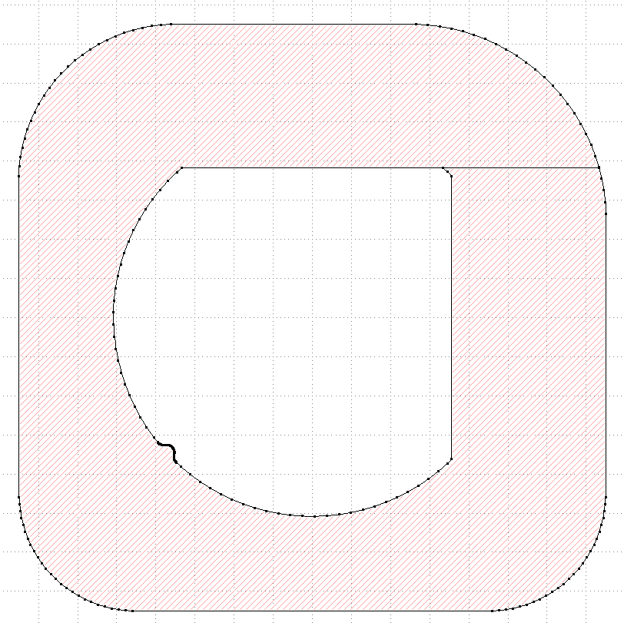
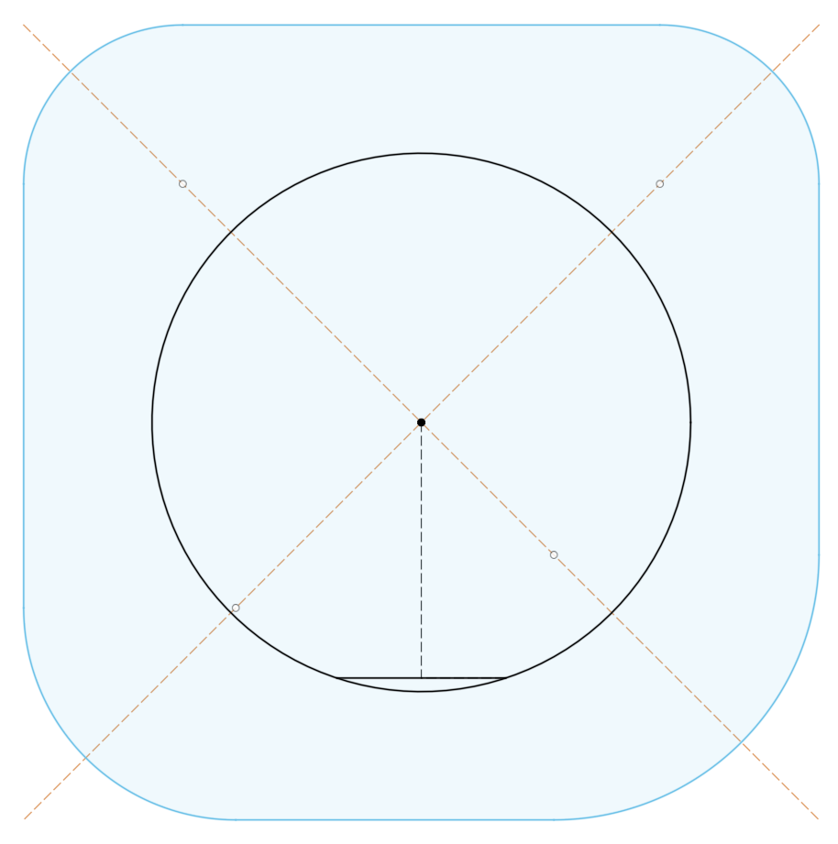
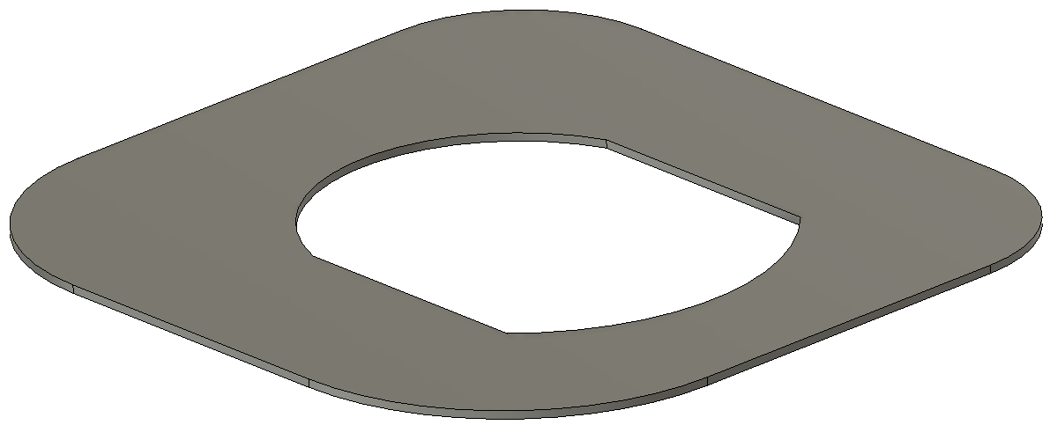

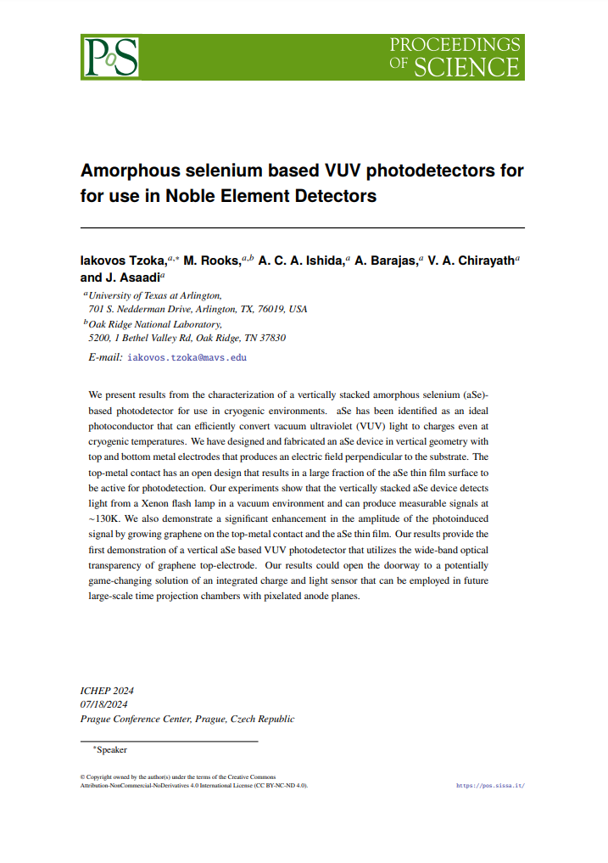
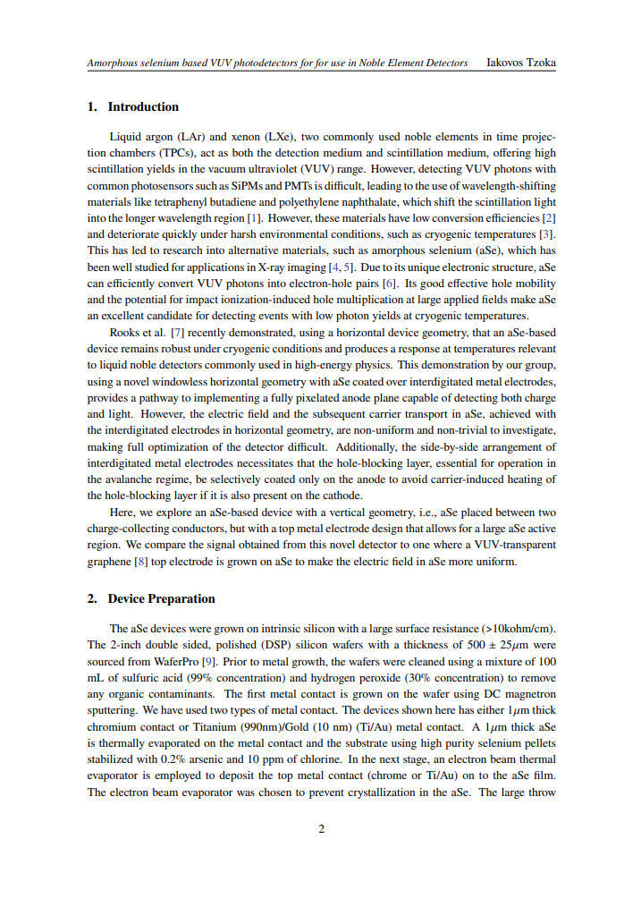
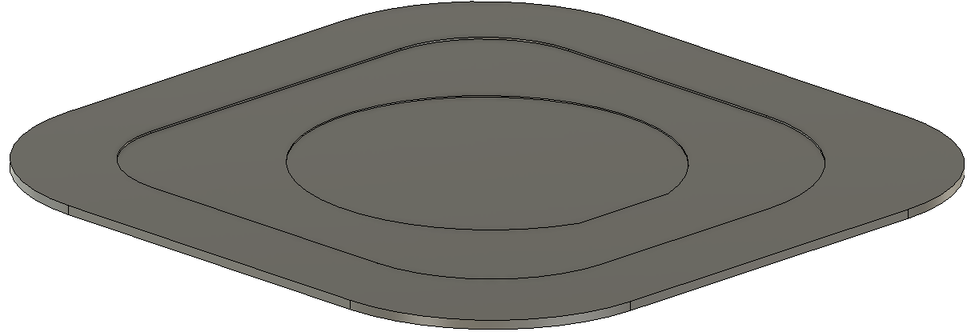
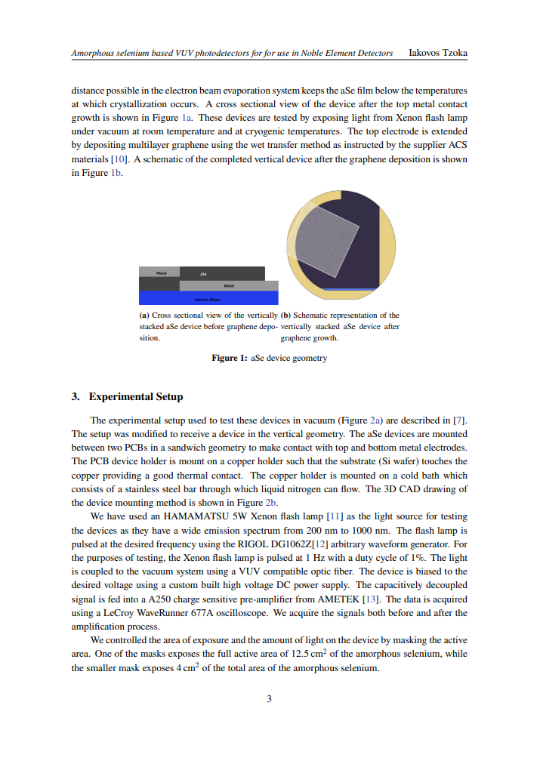
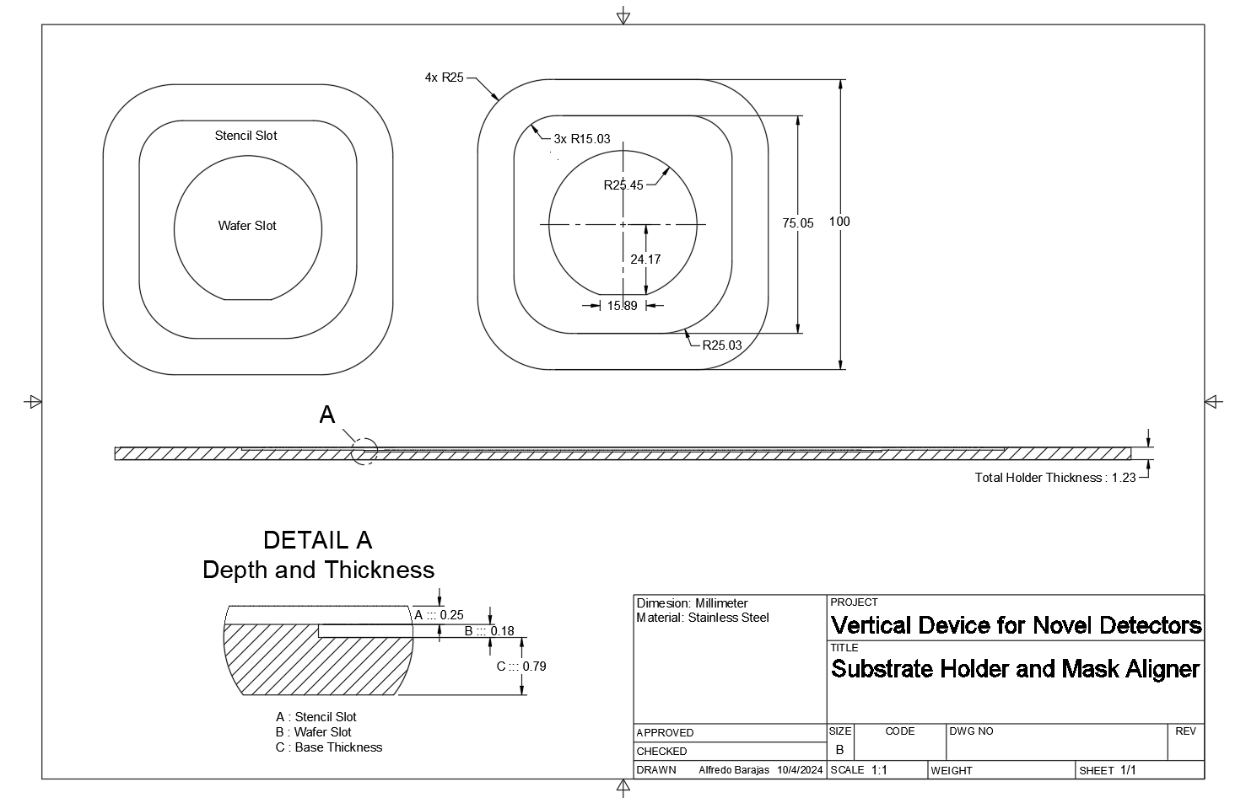
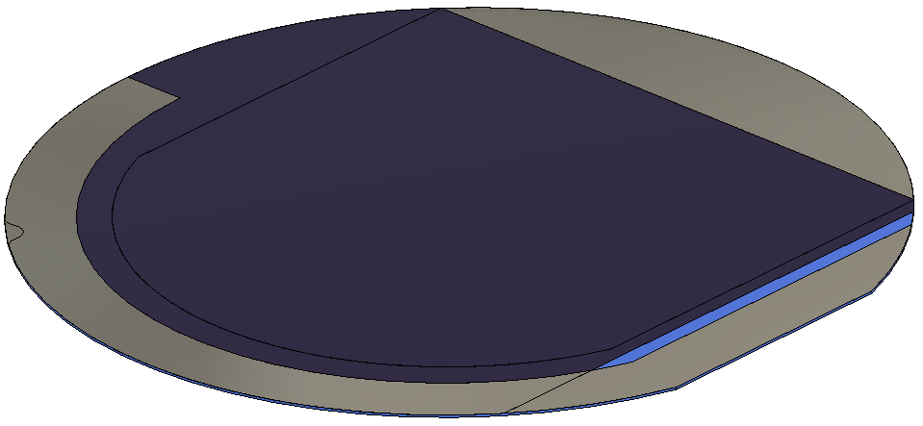
Files Available
3D CAD [ .step ]
2D CAD [ .dxf ]
Academic Paper [ .pdf ]
./Models/Masks/Name.step
./DXF/Name.dxf
./Academic Paper/Amorph…
4x Shadow Masks
./Models/Masks Aligner/Mask Aligner.step
Drawings [ .pdf ]
./DXF/Name.dxf
Mask Aligner
./Models/Wafer Model/Wafer Model.step
Wafer Model

Slide 2
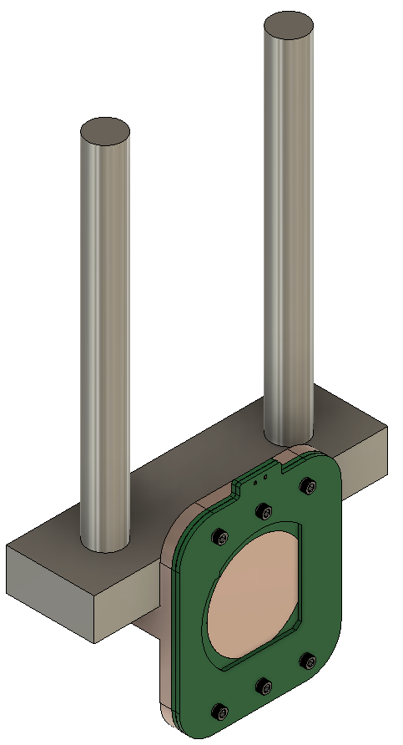
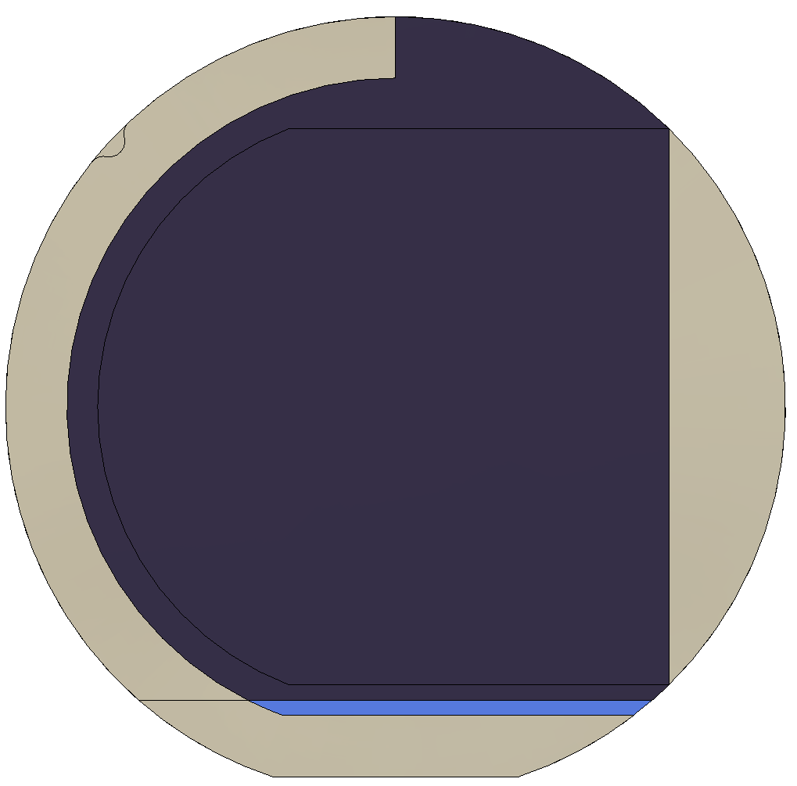
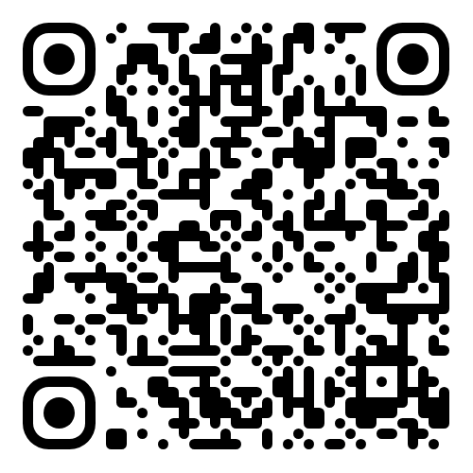
Design for Amorphous Selenium shadow masks used in experimental work for VUV photodectectors
Temperature Testing Stand
https://github.com/barajasalfredo13/ModuTherm-Wafer-Test-System

Slide 3
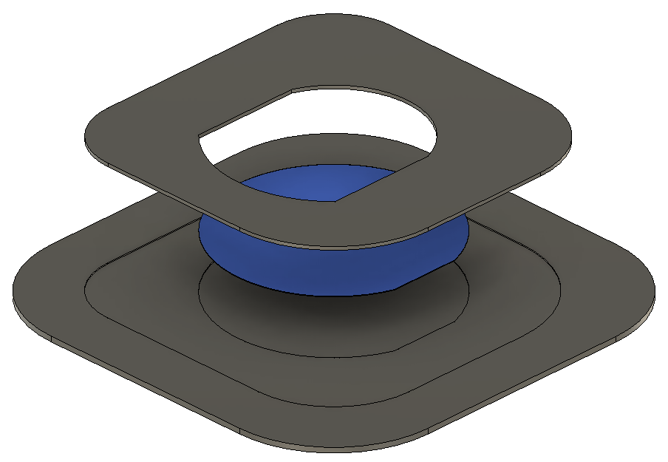
Mask and Holder
Mask
Silica Wafer
Mask Holder

Slide 4
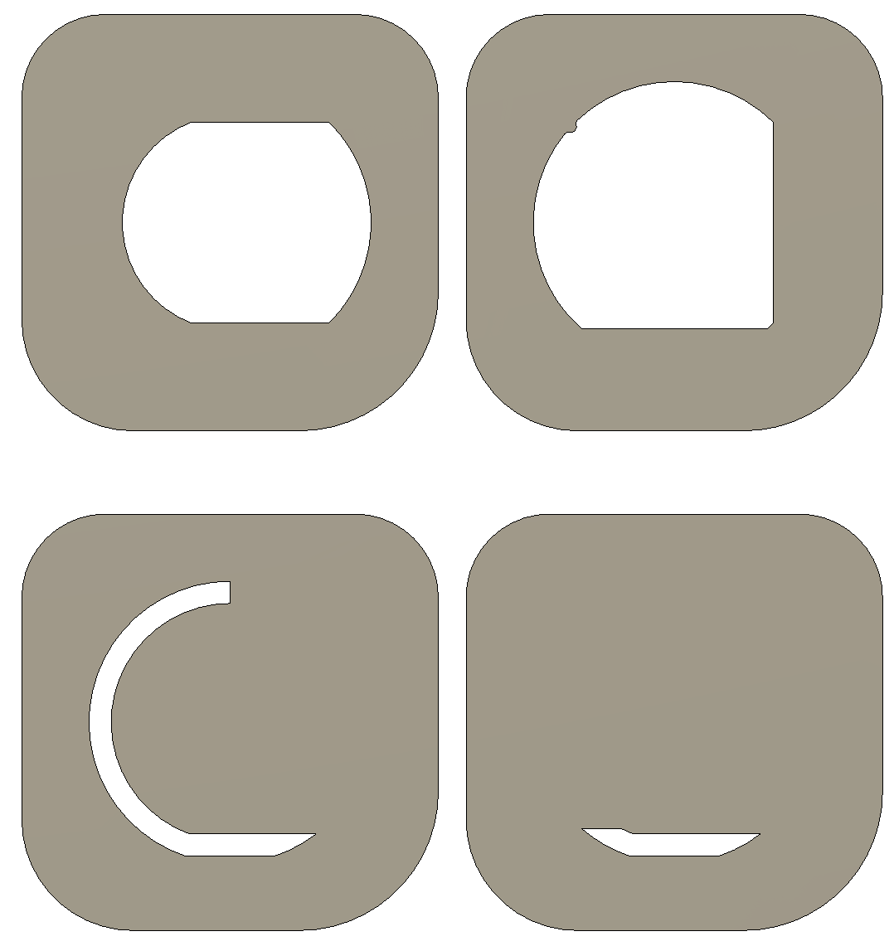

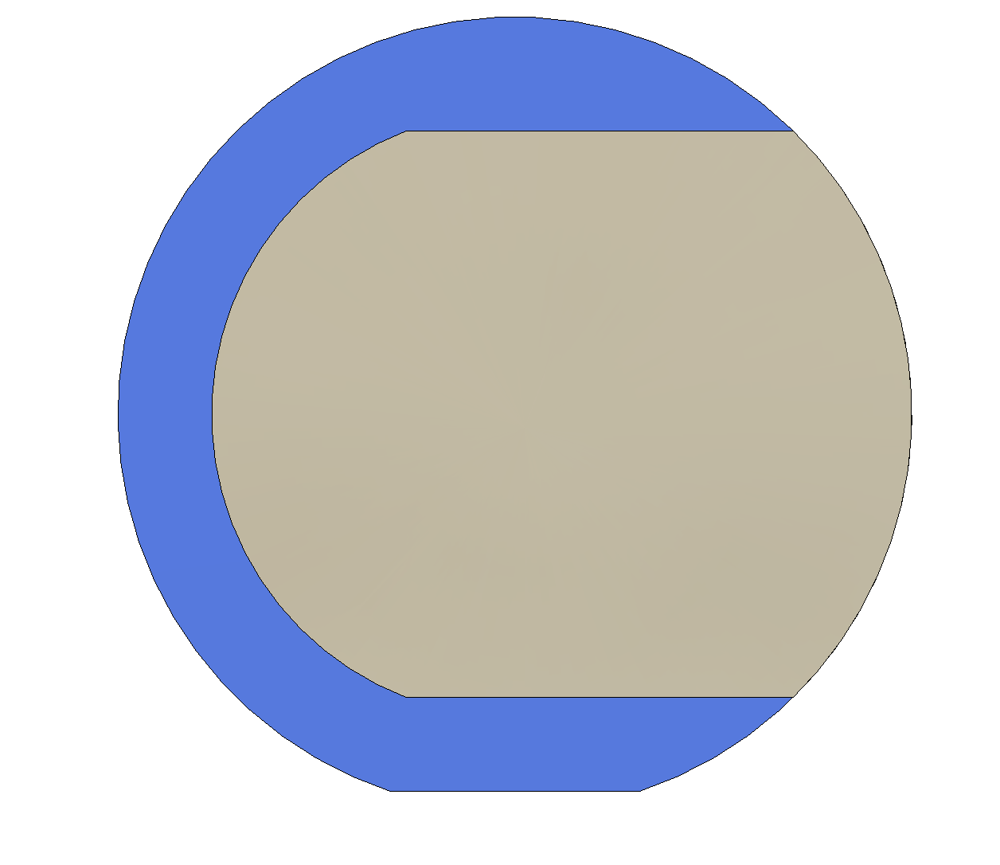
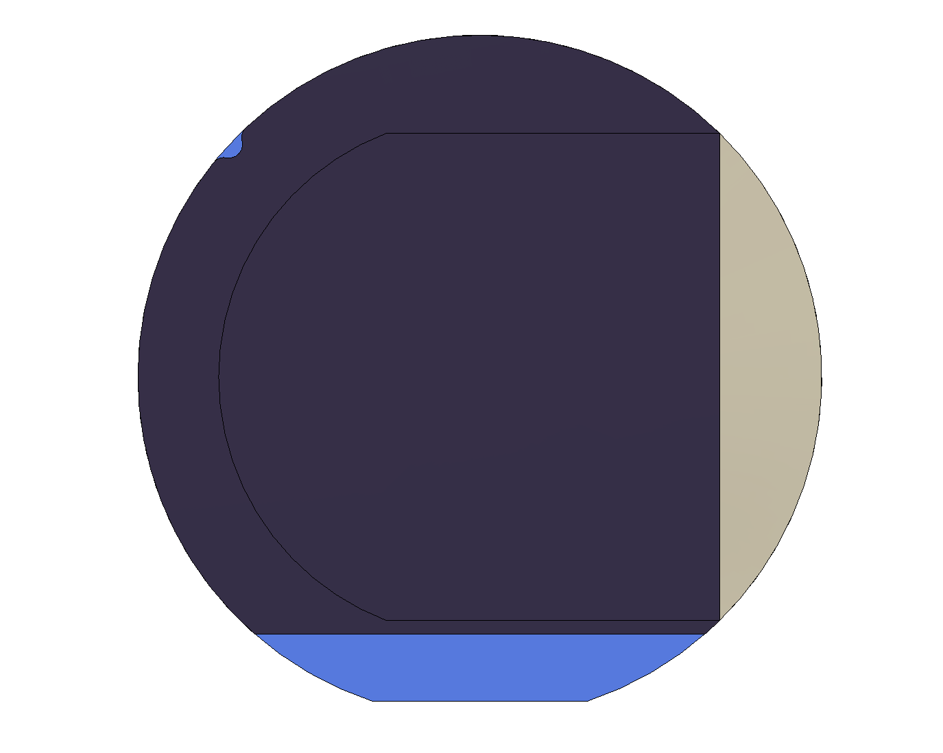
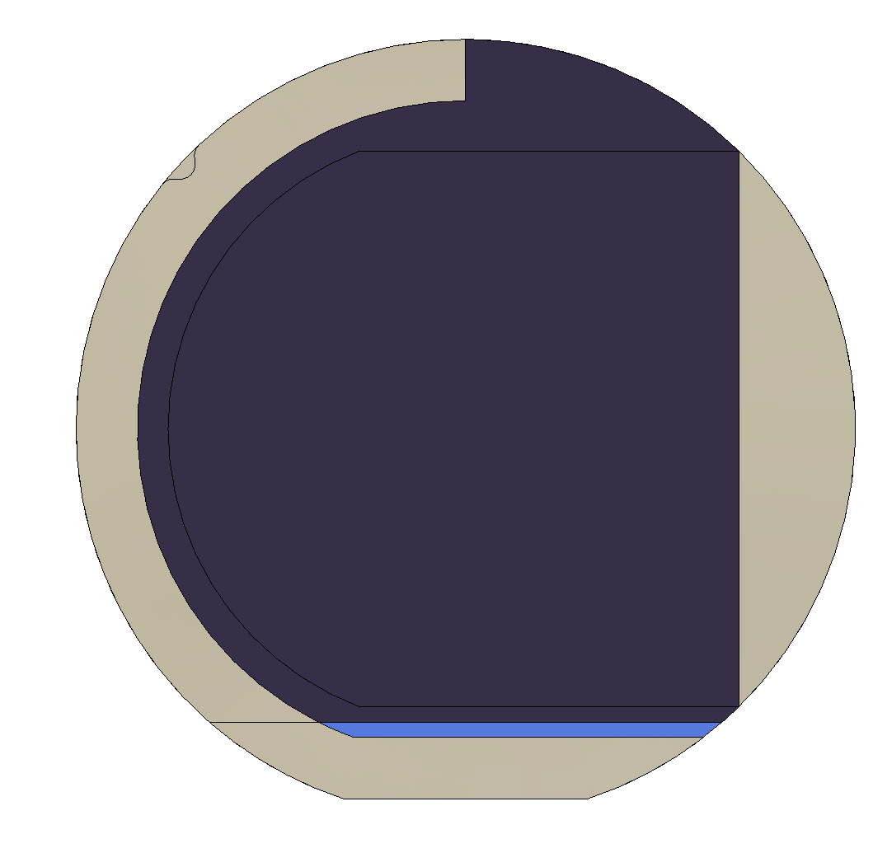
Base Conductor Mask
Base Conductor Mask
Test Material
Test Material Mask

Slide 5
Top Conductor 1
Top Conductor 1 Mask
Top Conductor 2
Top Conductor 2 Mask

