Slide 1
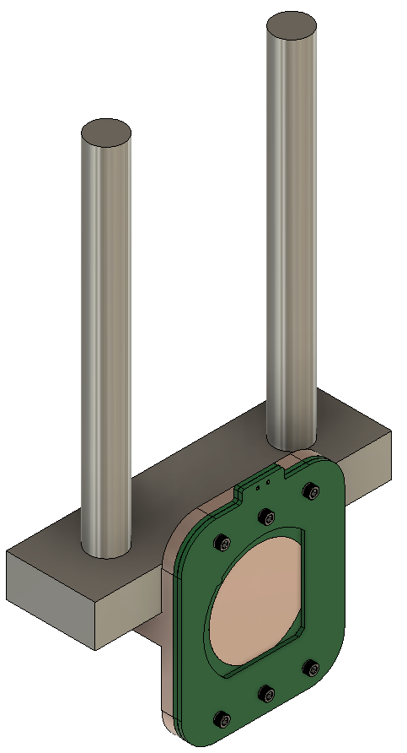
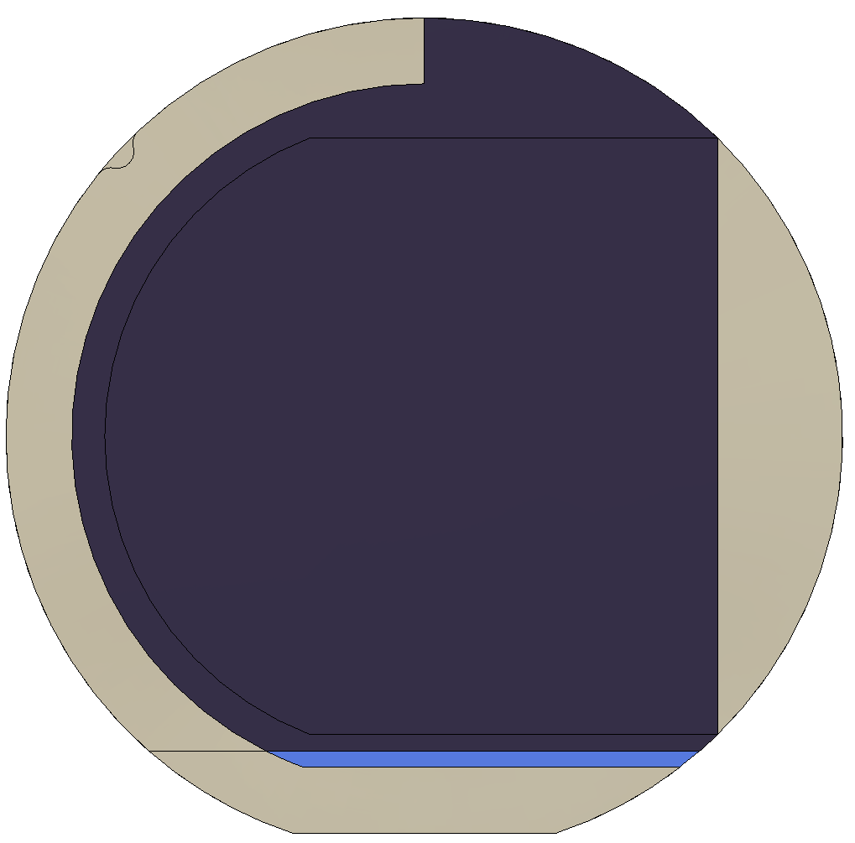
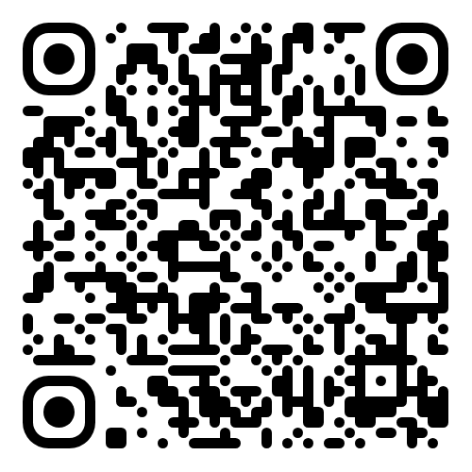
Design for Amorphous Selenium shadow masks used in experimental work for VUV photodectectors
Testing Stand
https://github.com/barajasalfredo13/ModuTherm-Wafer-Test-System

Slide 2
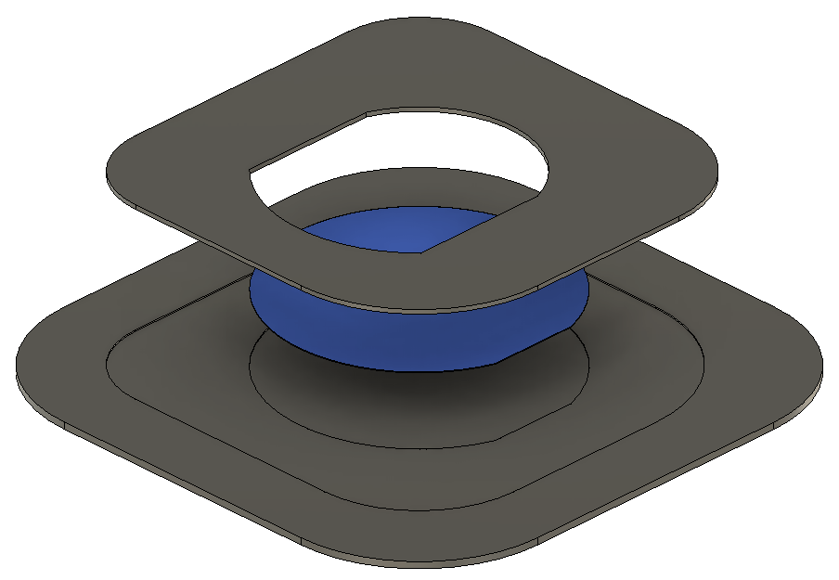
Mask and Holder
Mask
Silica Wafer
Mask Holder

Slide 3
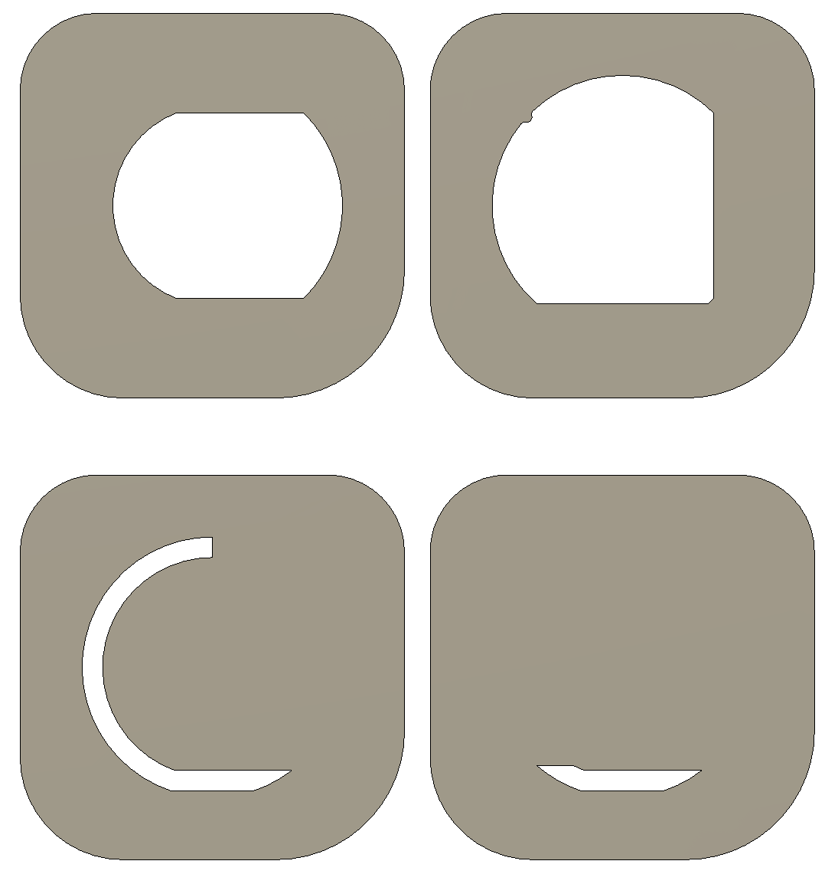
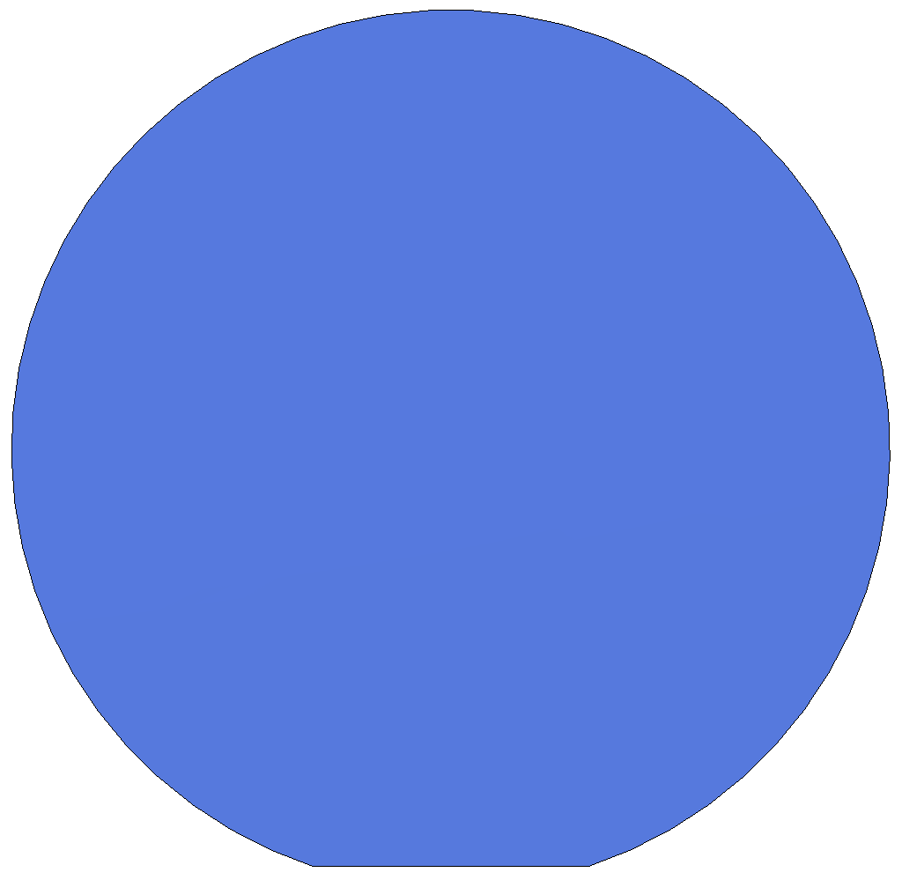
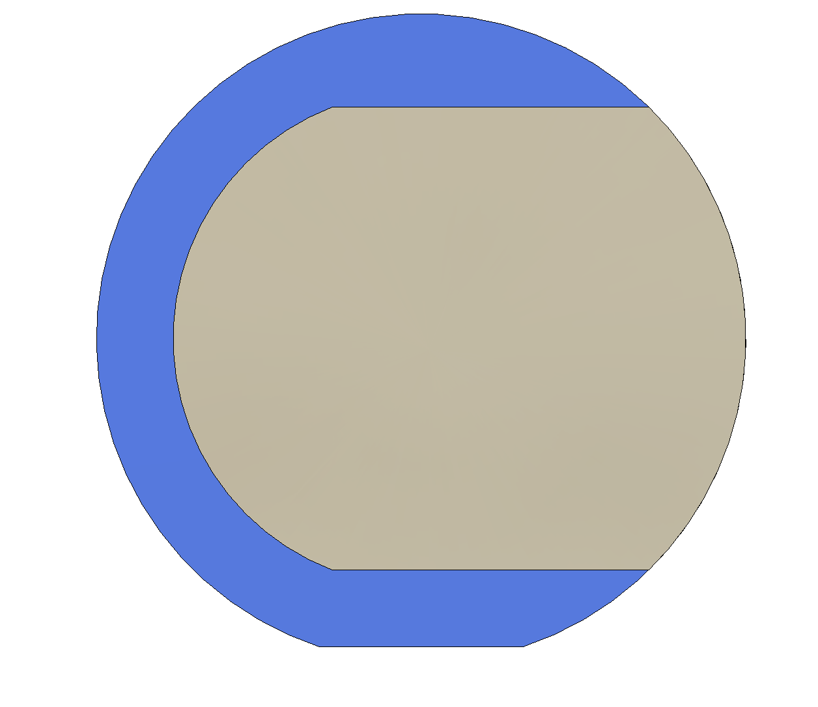
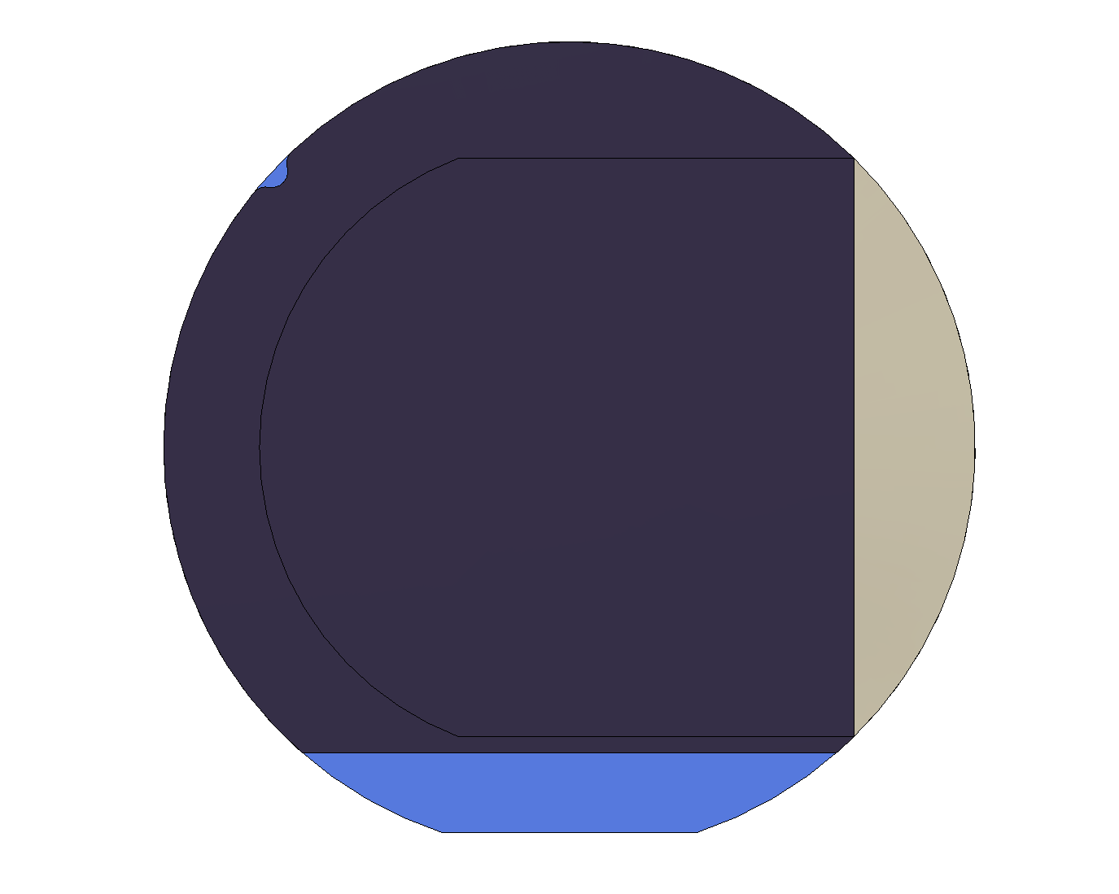
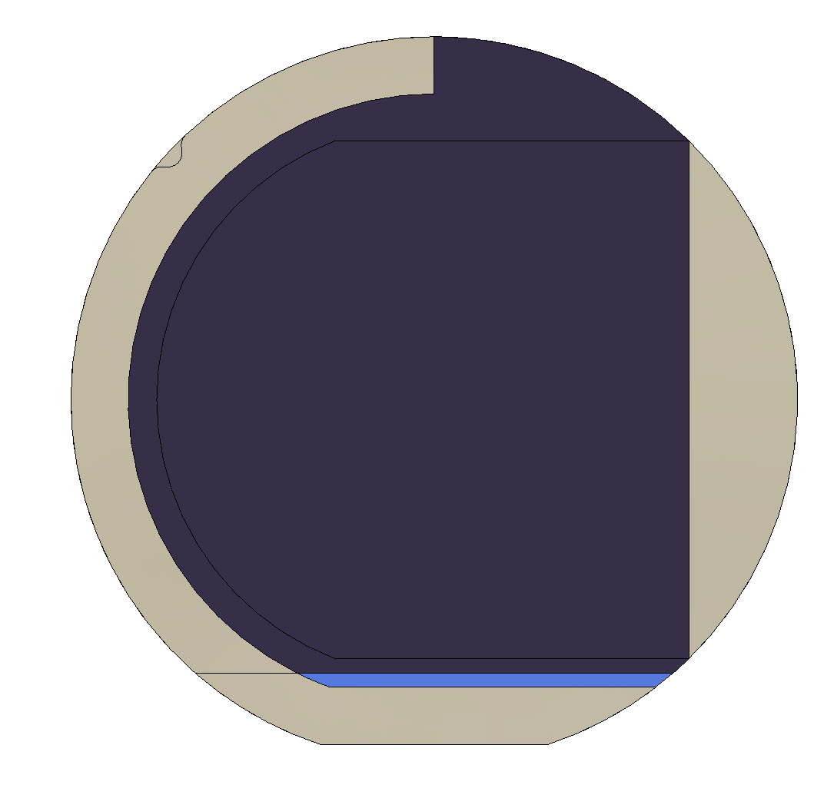
Metal Contact 1
Base Conductor Mask
Test Material
Test Material Mask

Slide 4
Metal Contact 2
Top Conductor 1 Mask
Metal Contact
Thickener
Top Conductor 2 Mask

Slide 5
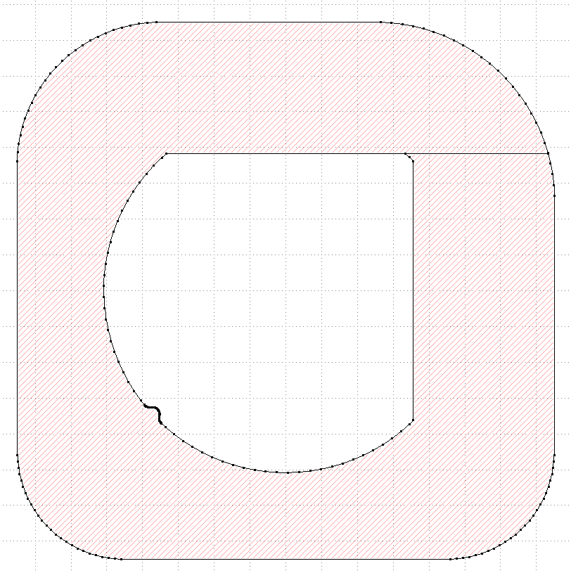
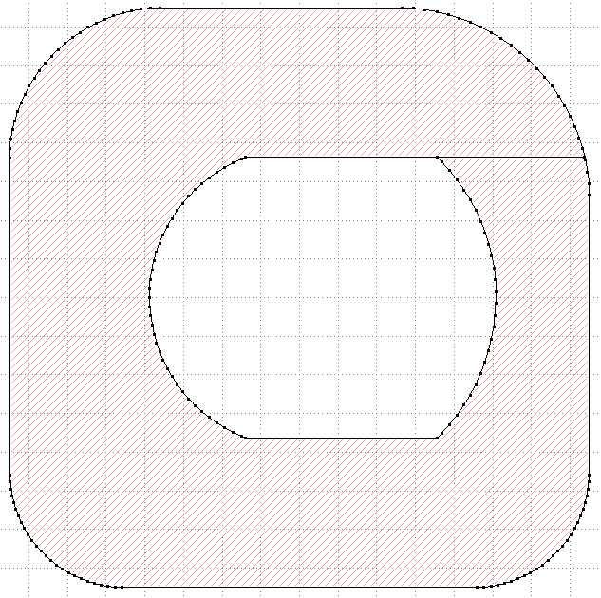
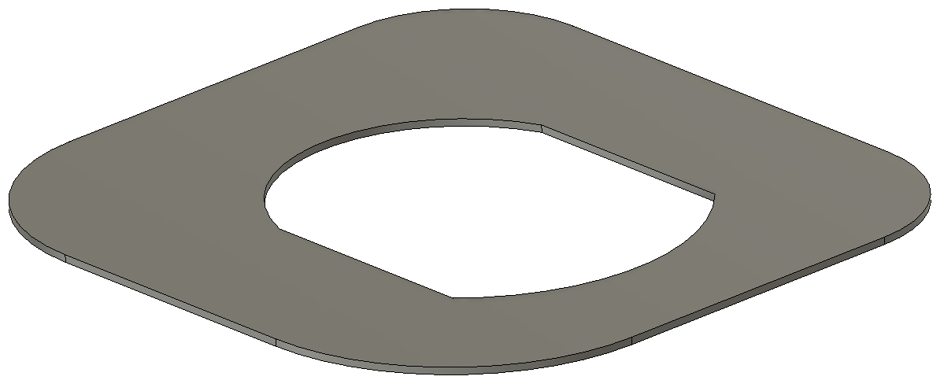

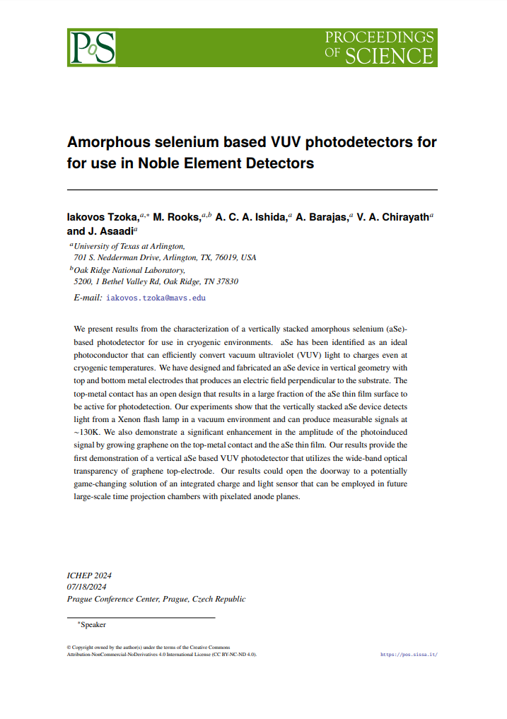
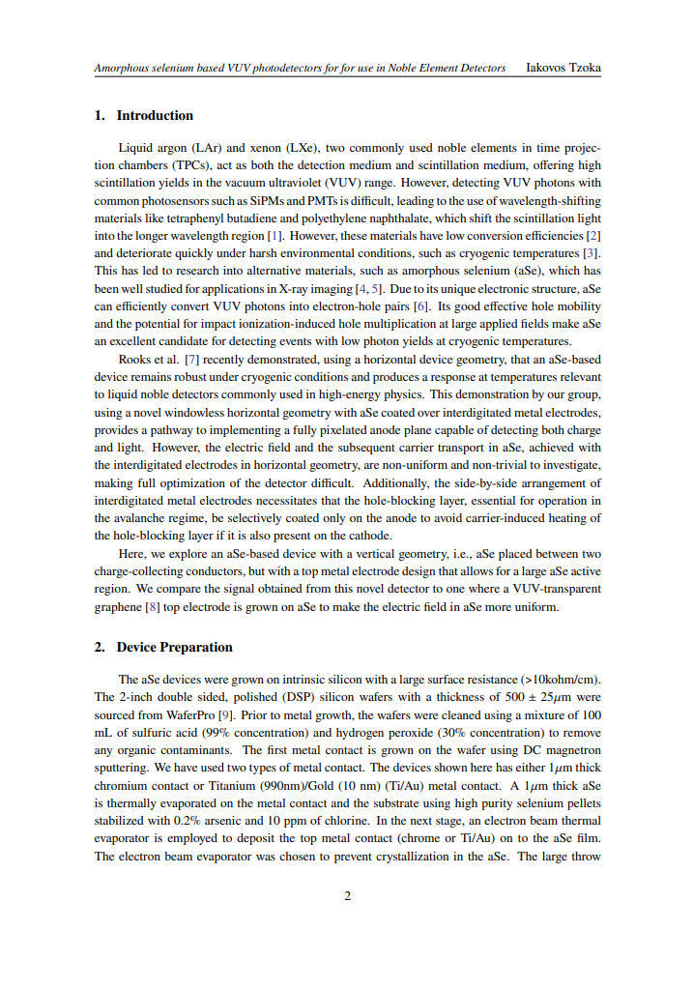
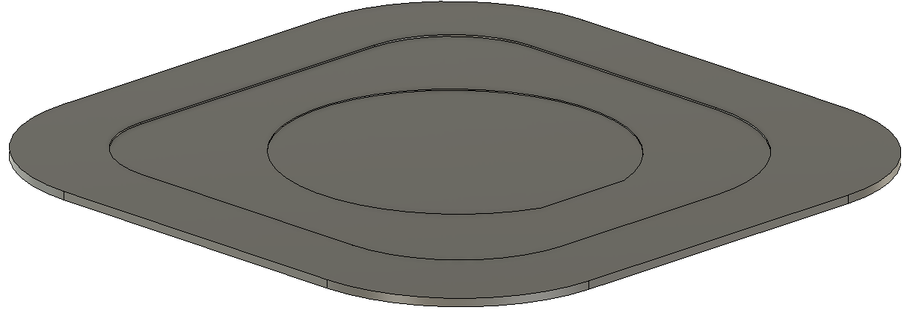
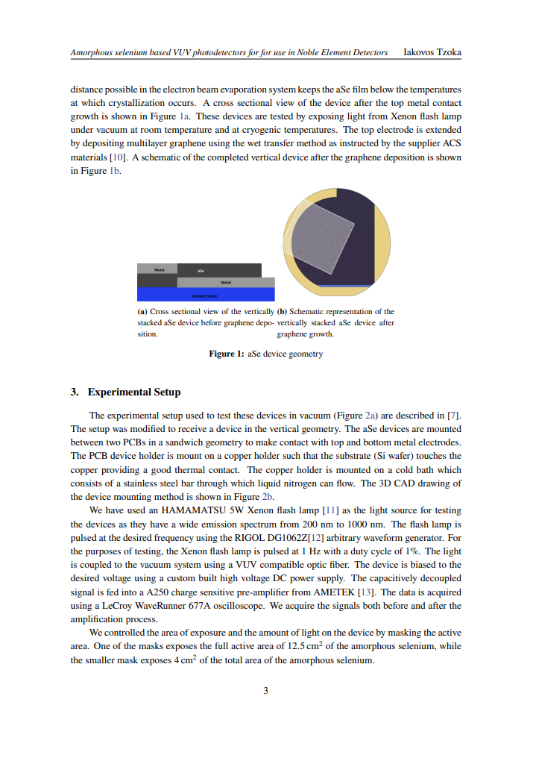
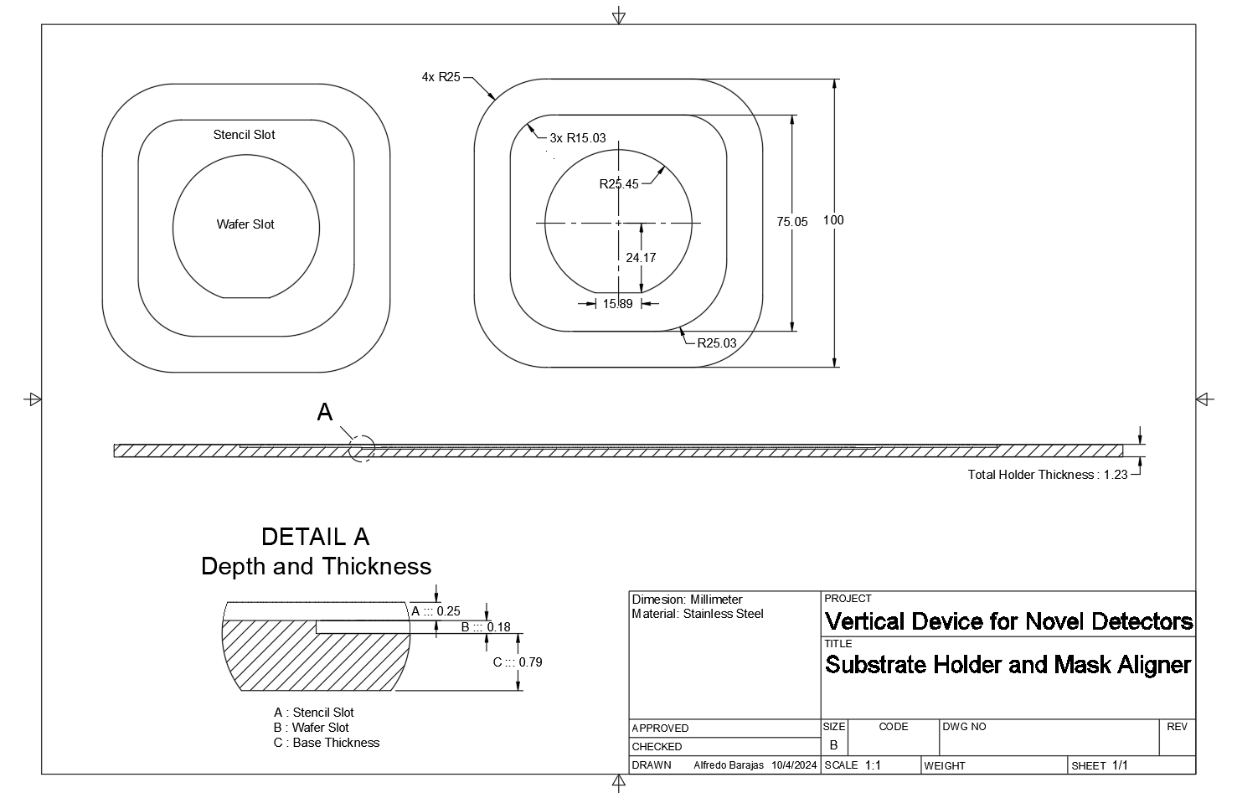
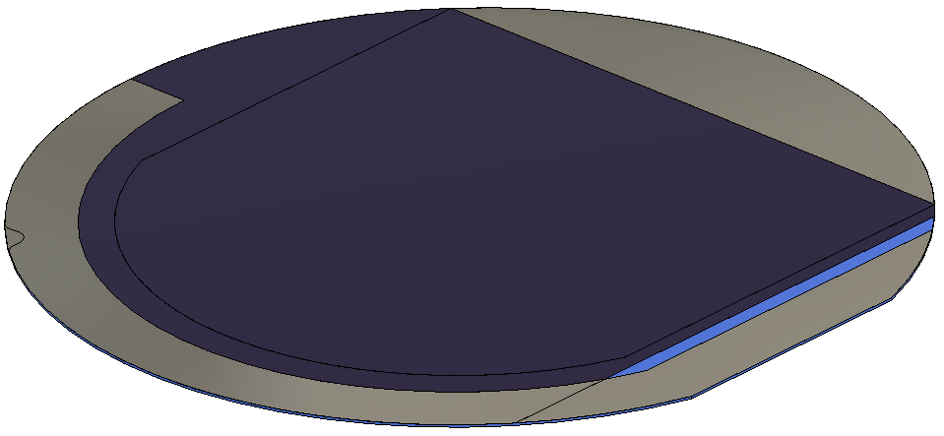
Files Available
3D CAD [ .step ]
2D CAD [ .dxf ]
Academic Paper [ .pdf ]
4x Shadow Masks
Drawings [ .pdf ]
Mask Aligner
Wafer Model

