Slide 1
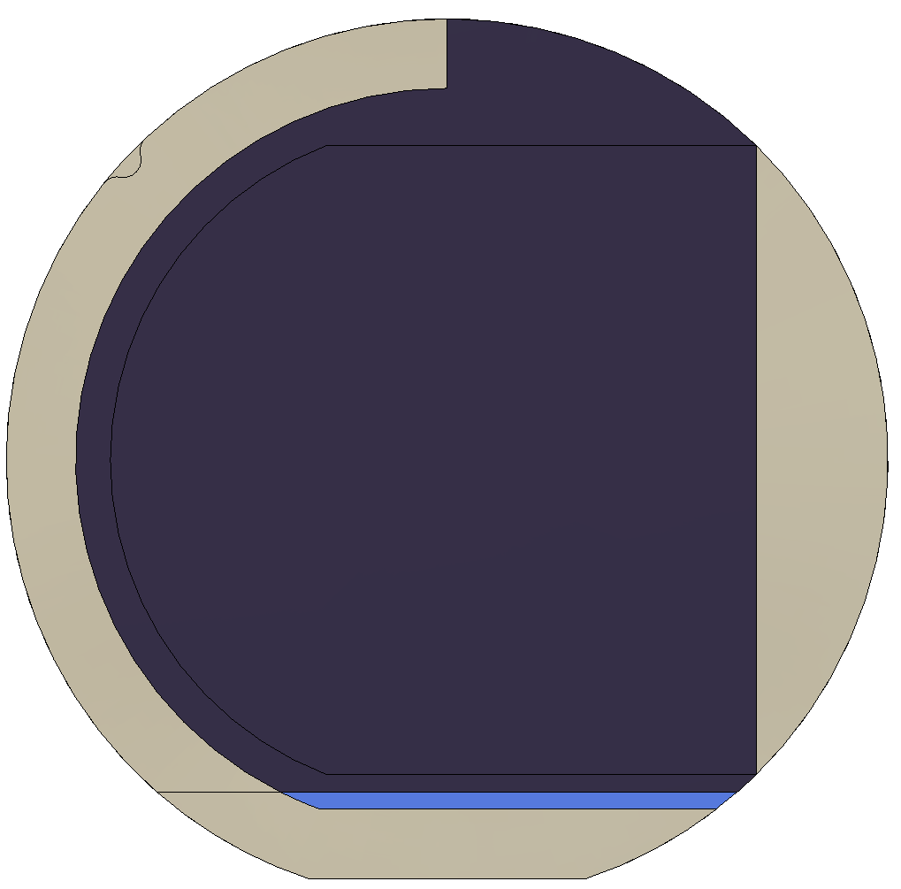
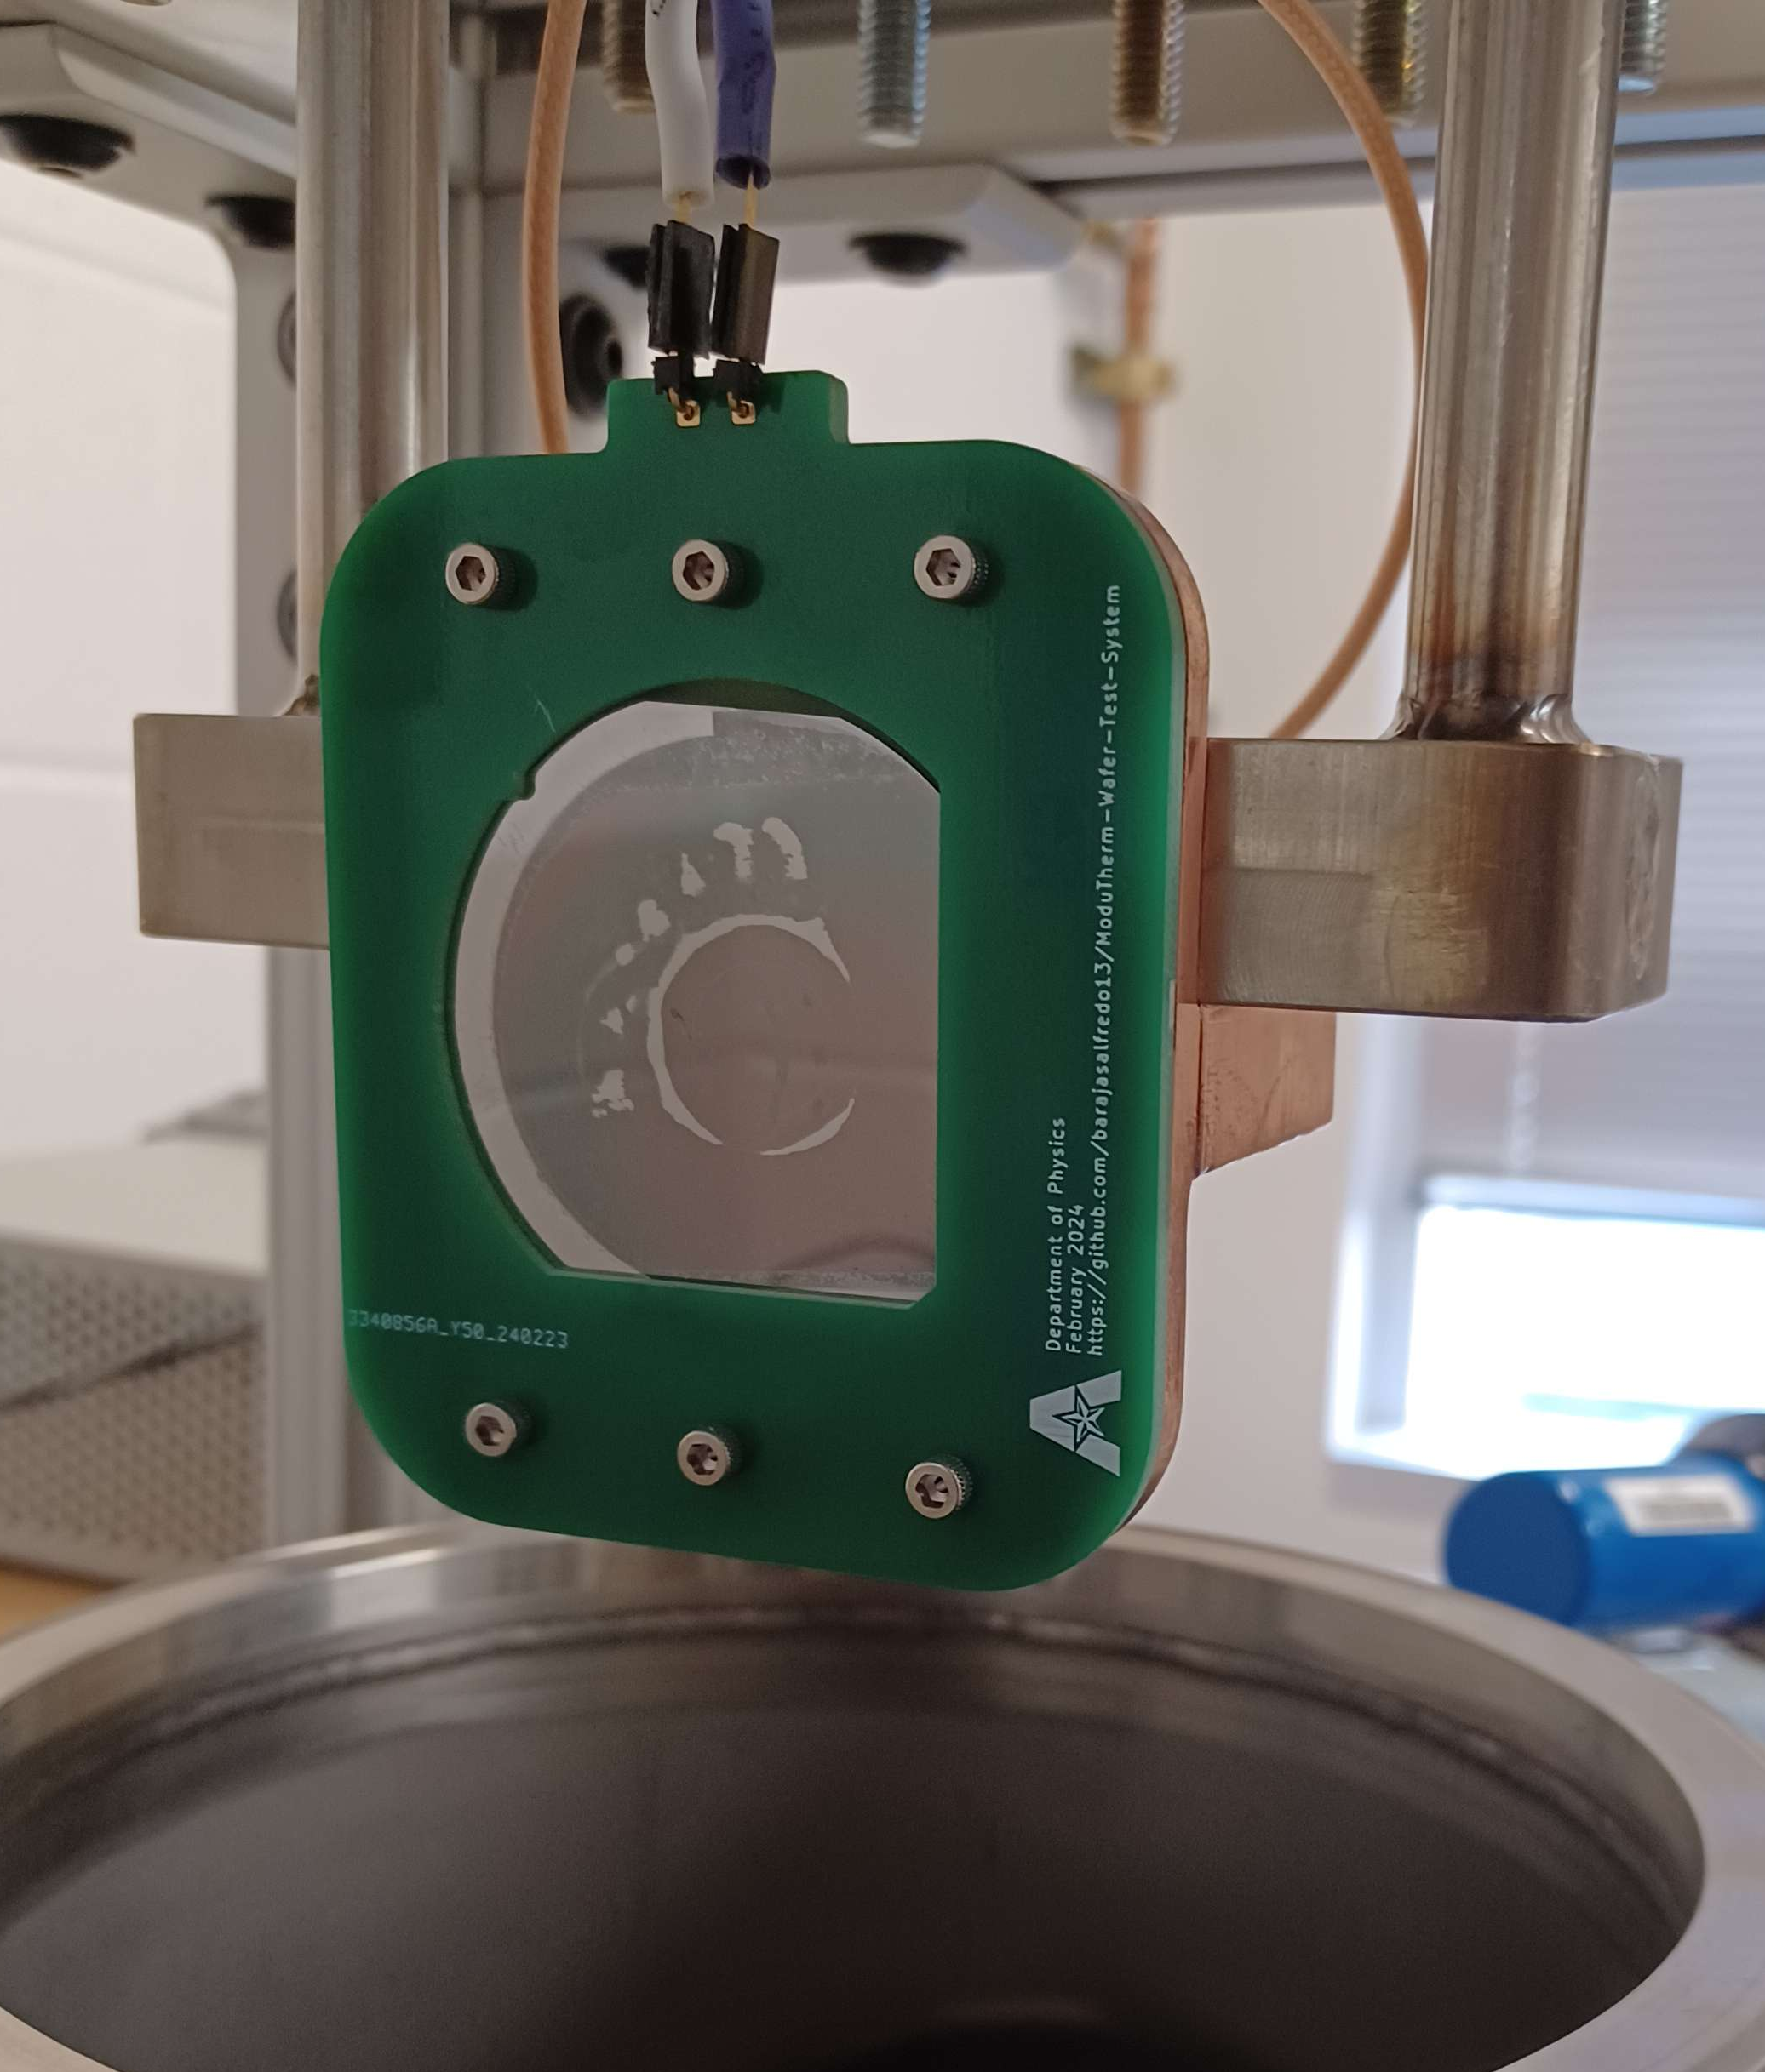
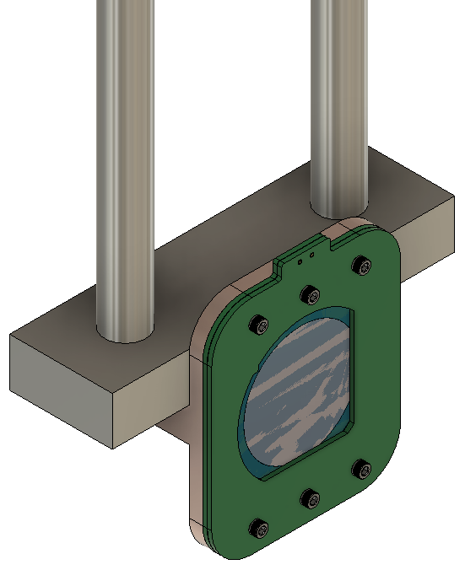
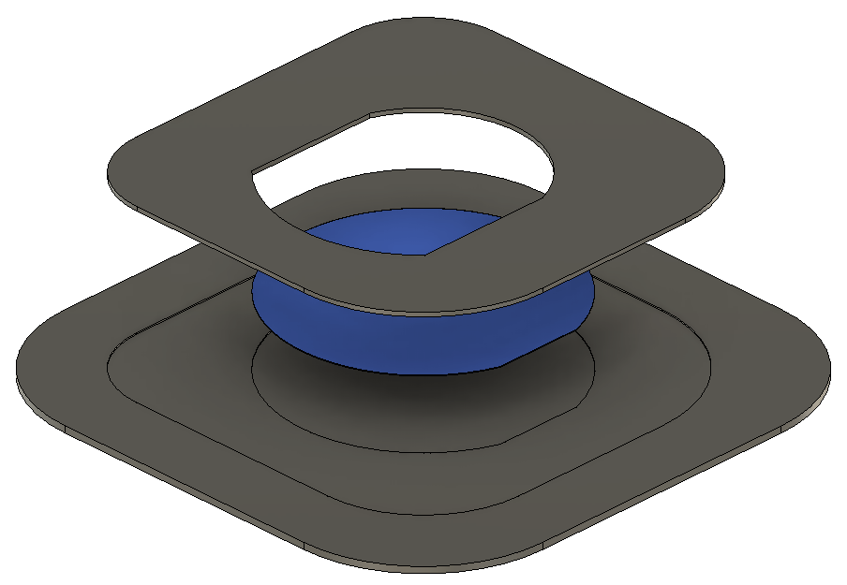

Temperature Testing Stand for 2-inch Silicon Wafers used in Experimental Research in VUV Photodetectors
Shadow Mask and Templates for 2-inch Silicon Wafers
https://github.com/barajasalfredo13/Amorphous-Selenium-Vertical-Design

Slide 2
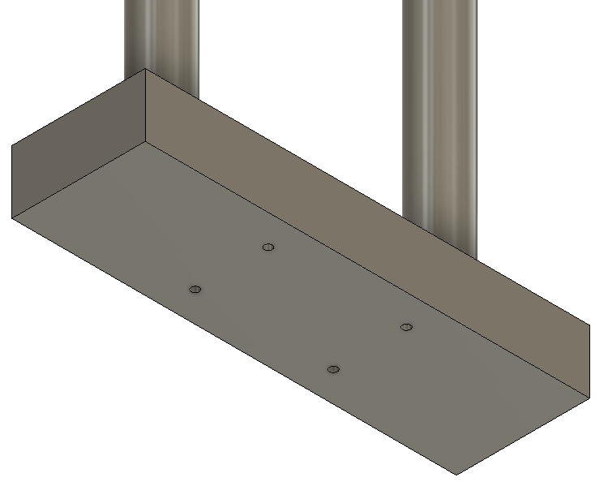
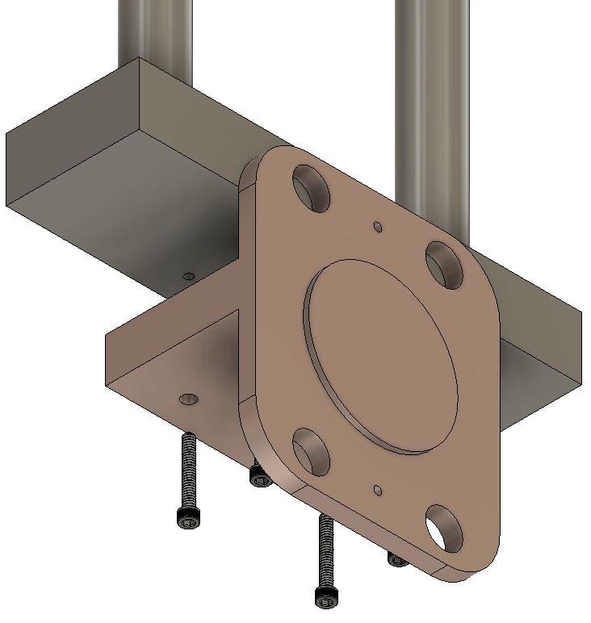
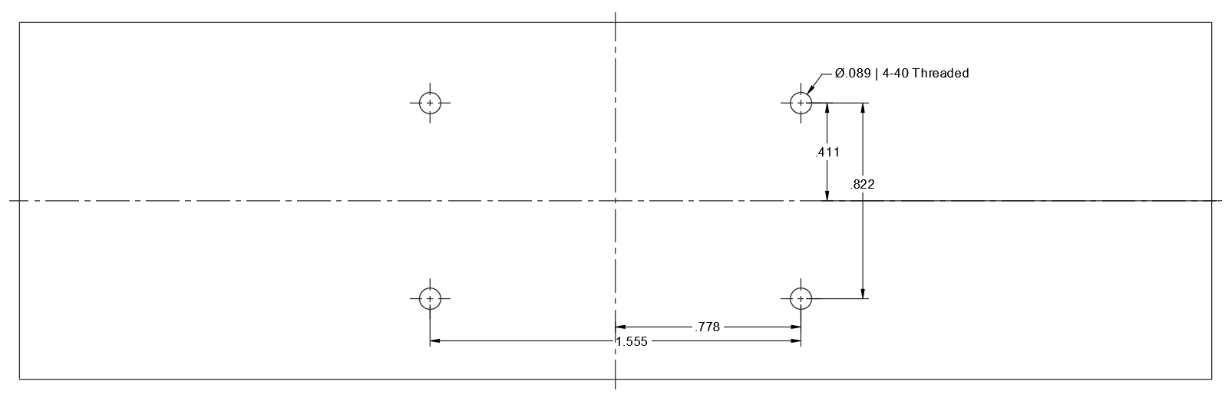
Mounting the Copper Temperature Block
Hole Dimensions and Locations of Stainless-Steel Block

Slide 3
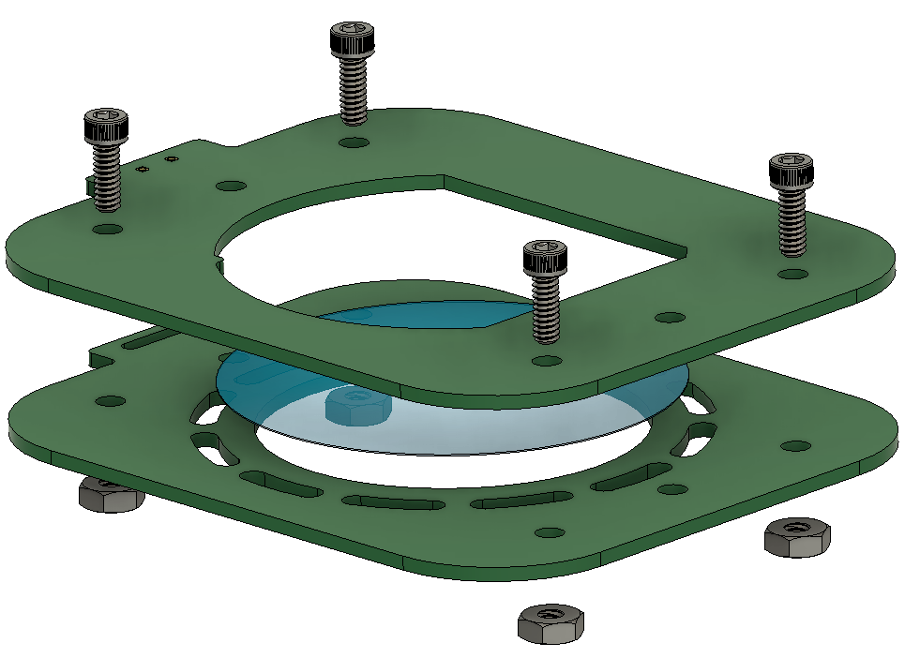
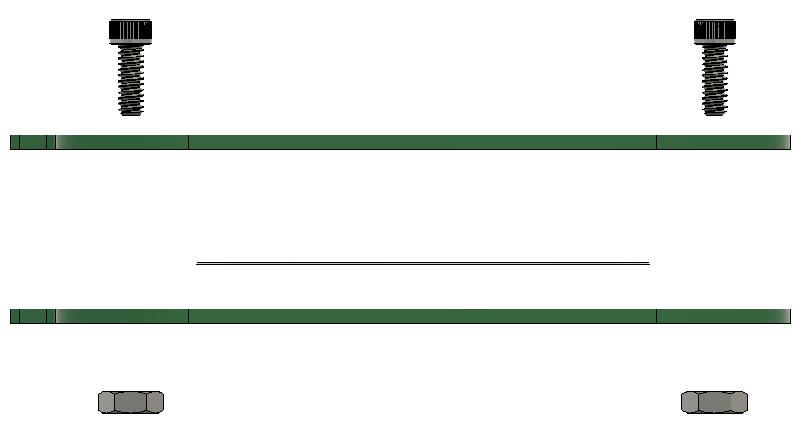
Mounting Samples onto the PCB Card
A
B
C
D
E
A – Vented Socket Head Screw B – Top Probe Card C – 2 Inch Substrate
D – Bottom Probe Card
E – Mil. Spec. 18-8 SS Hex Nut

Slide 4
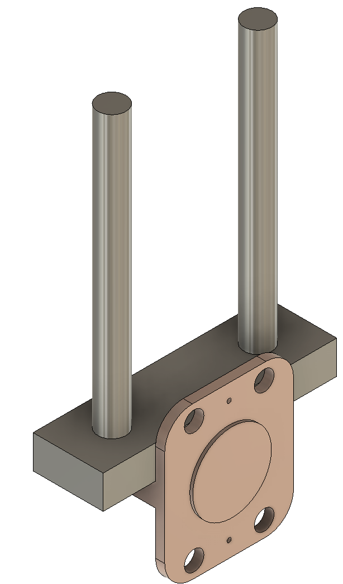
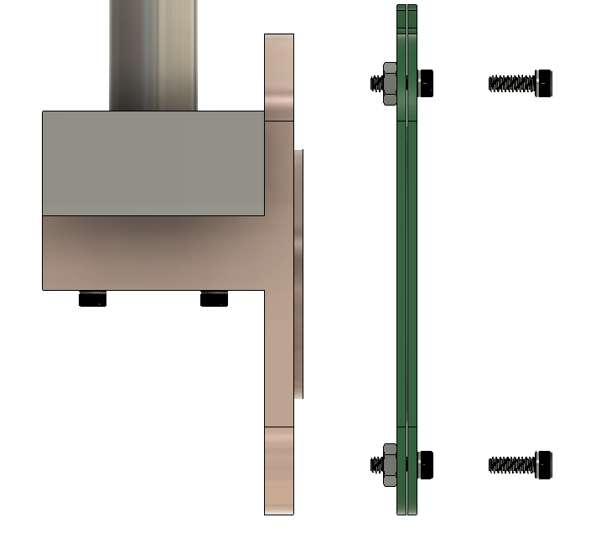
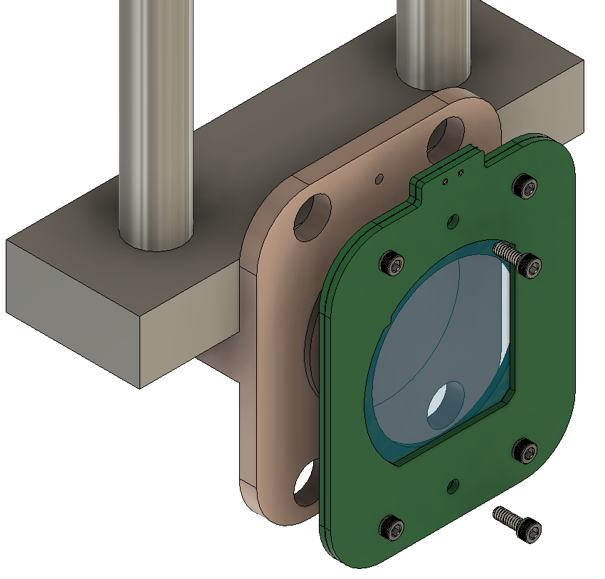
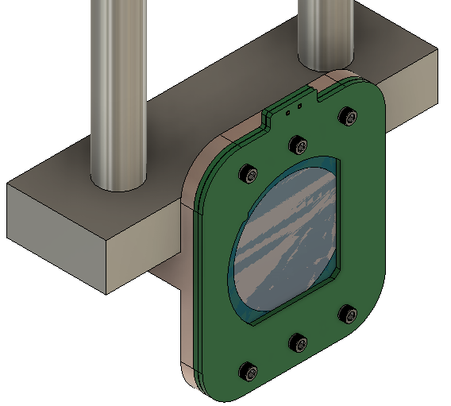
Mounting the Copper Temperature Block
B
A – Temperature Node B – Vented Socket Head Screw C – PCB Card
A
C

Slide 5
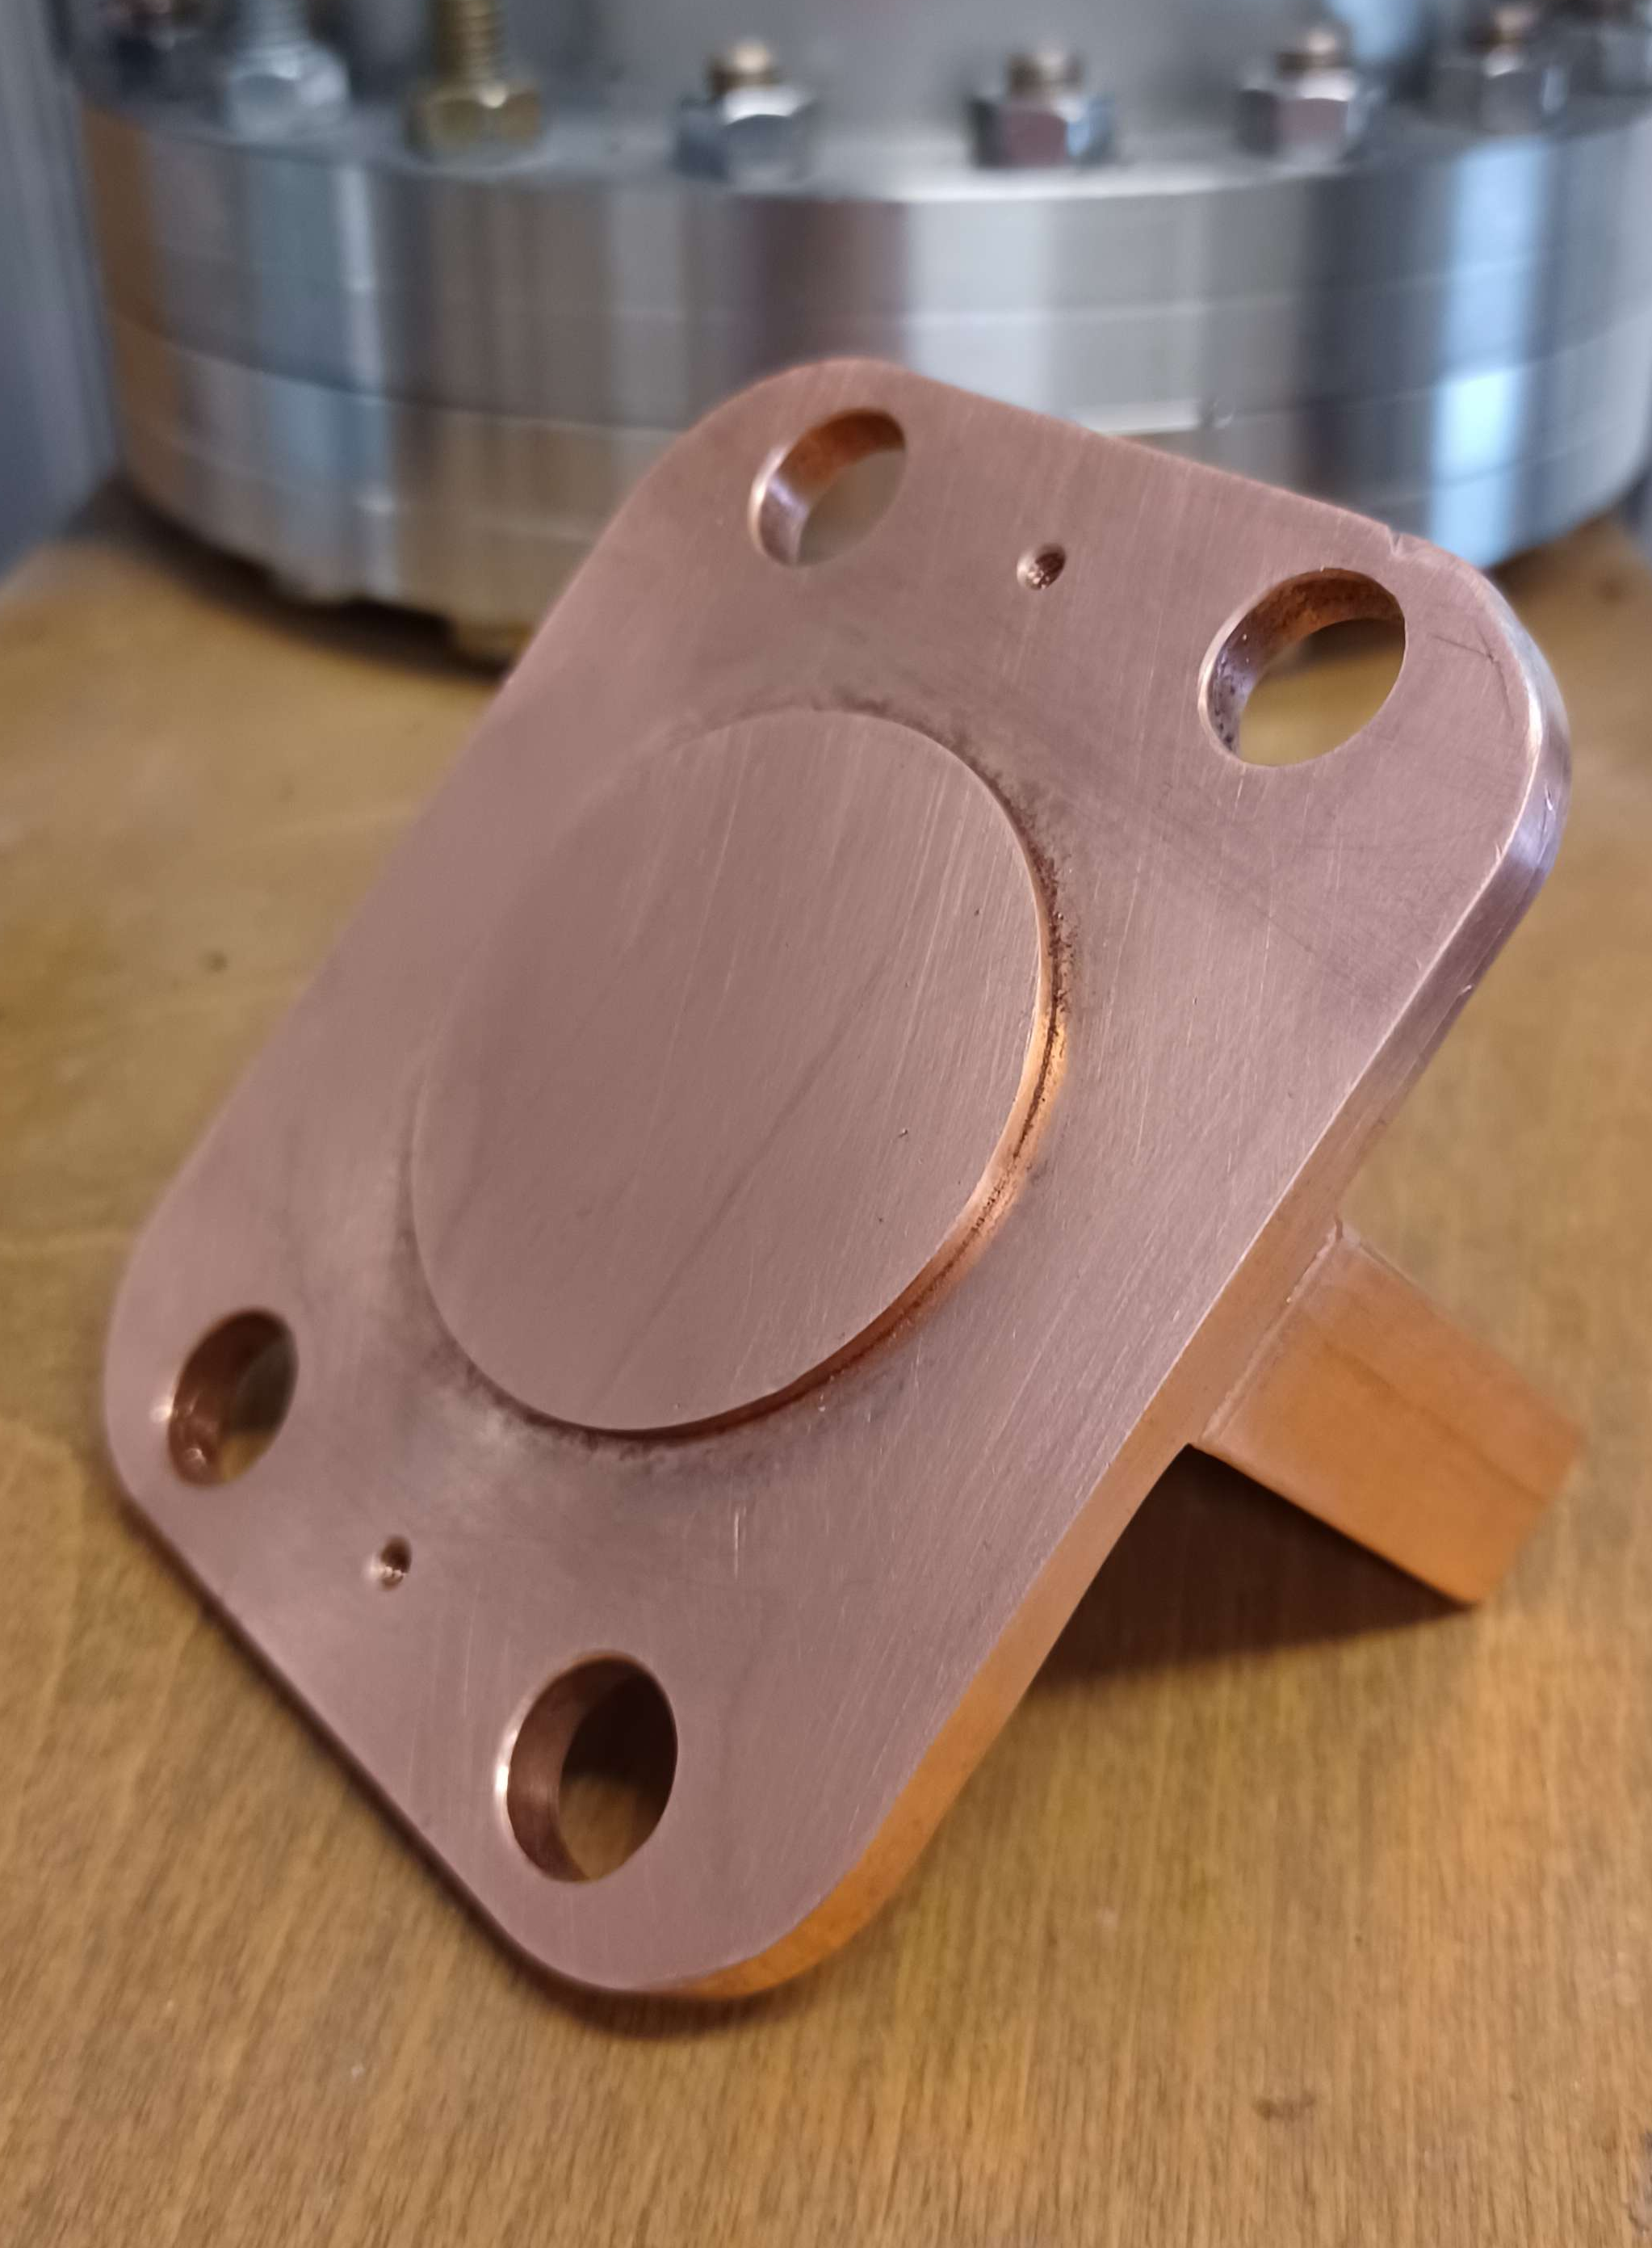
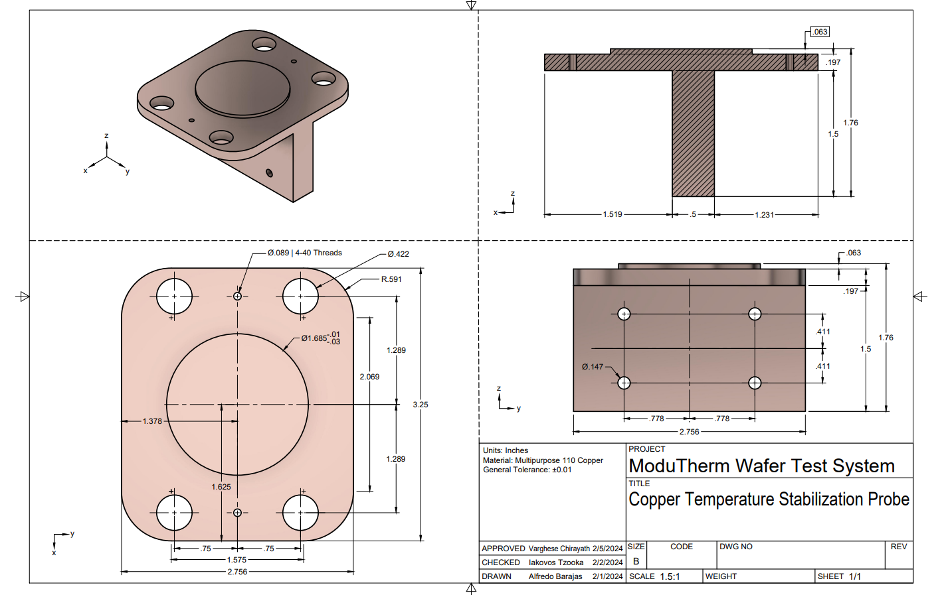
Copper Temperature Node
Drawings are included for reproducibility of the system

Slide 6
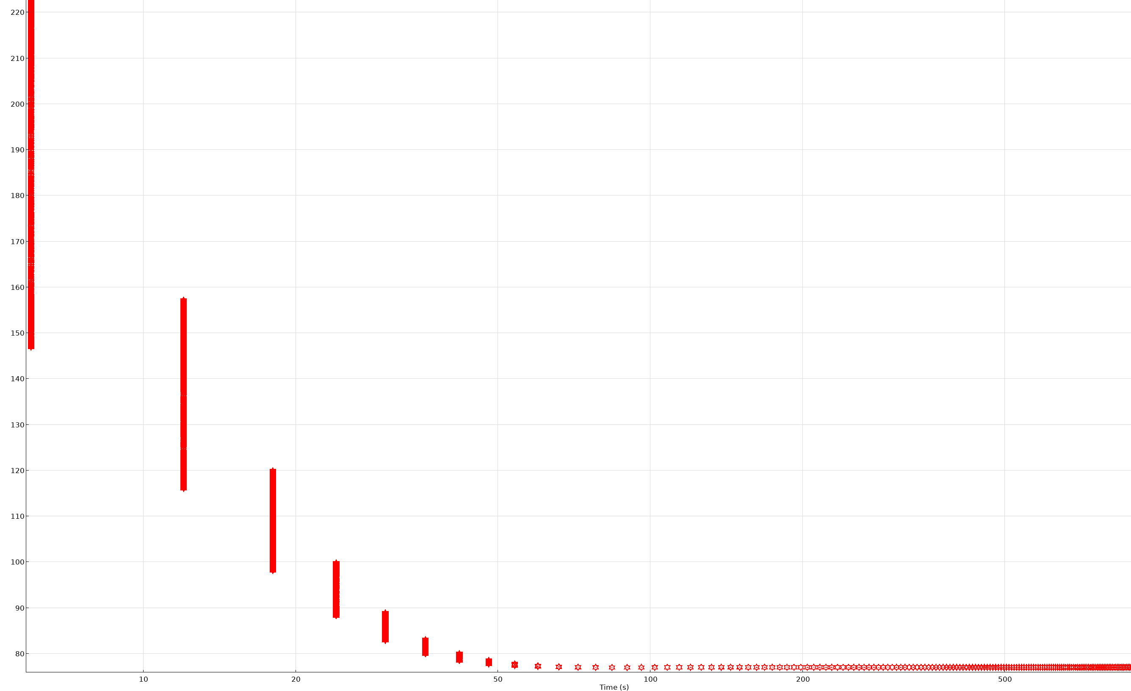
Boundary Analysis of Temperature for Copper Node
It is expected that after ~ 100 seconds under, liquid Nitrogen flow, that the Copper Node will converge onto 77 K

Slide 7
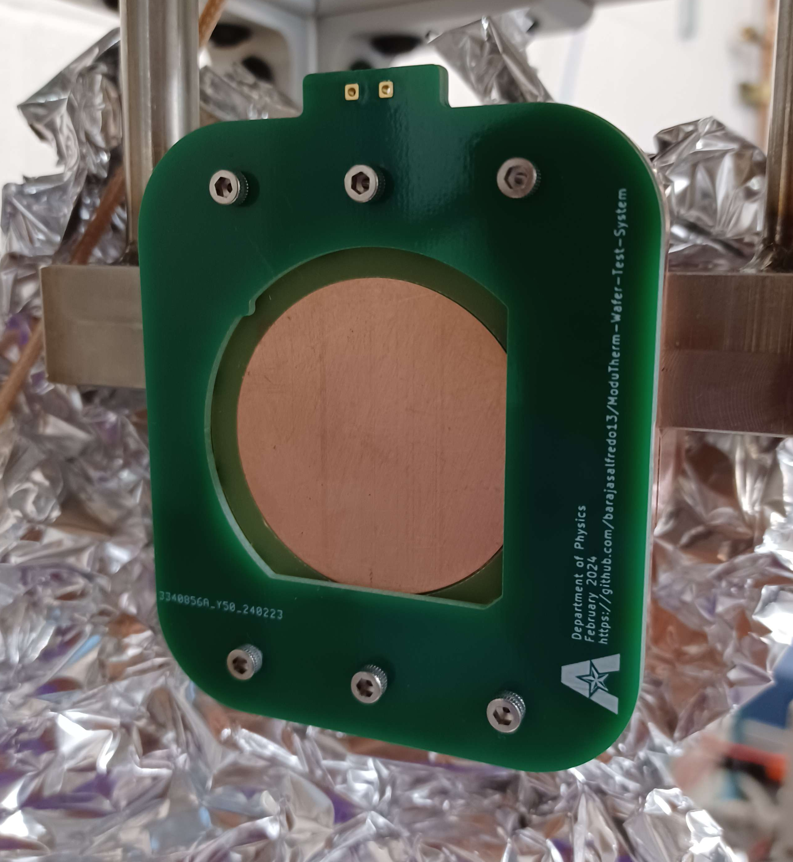
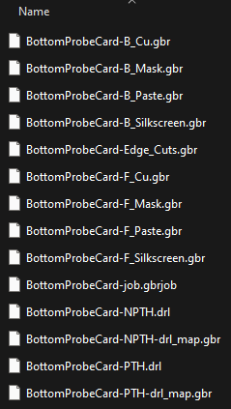
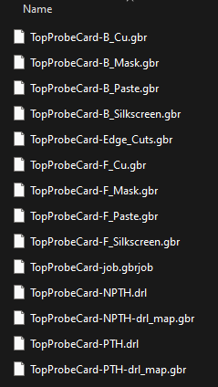
PCB Card
The Gerber Files generated are for the test of a vertical device, BUT the KiCAD Files contained have been made to accommodate modifications for new devices

Slide 8
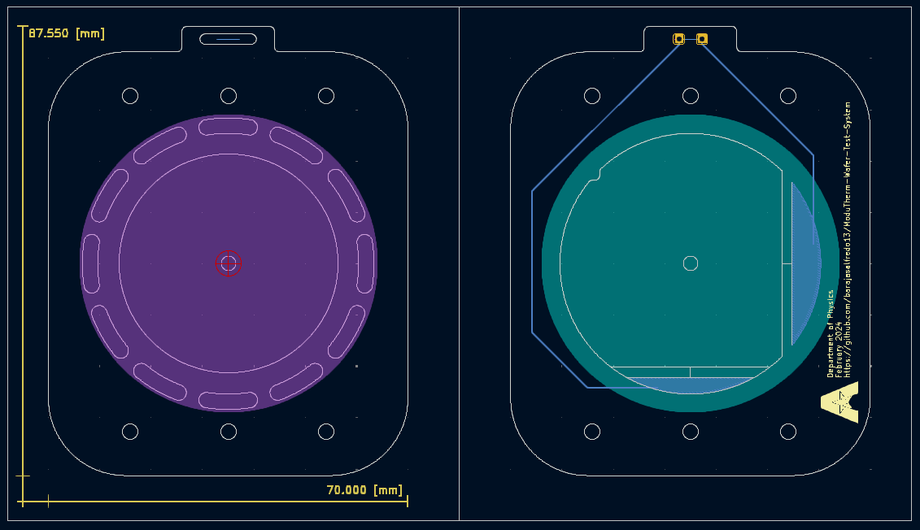
KiCAD Layer View

Slide 9
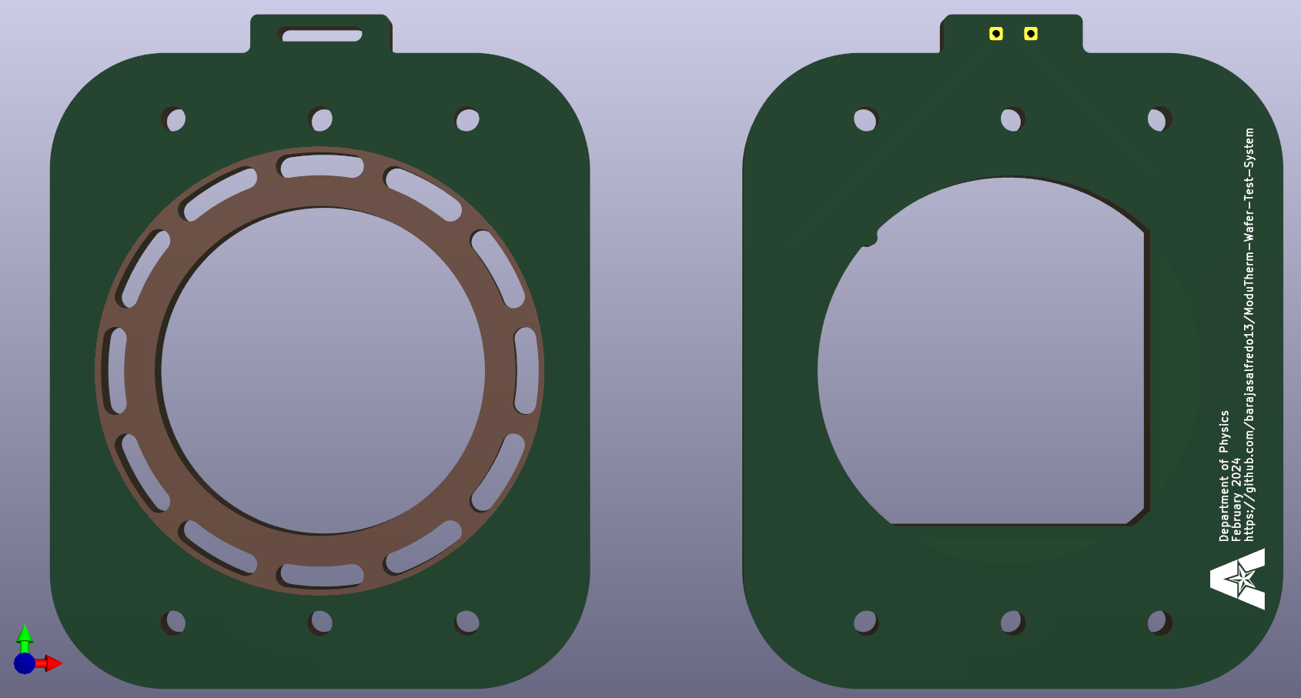
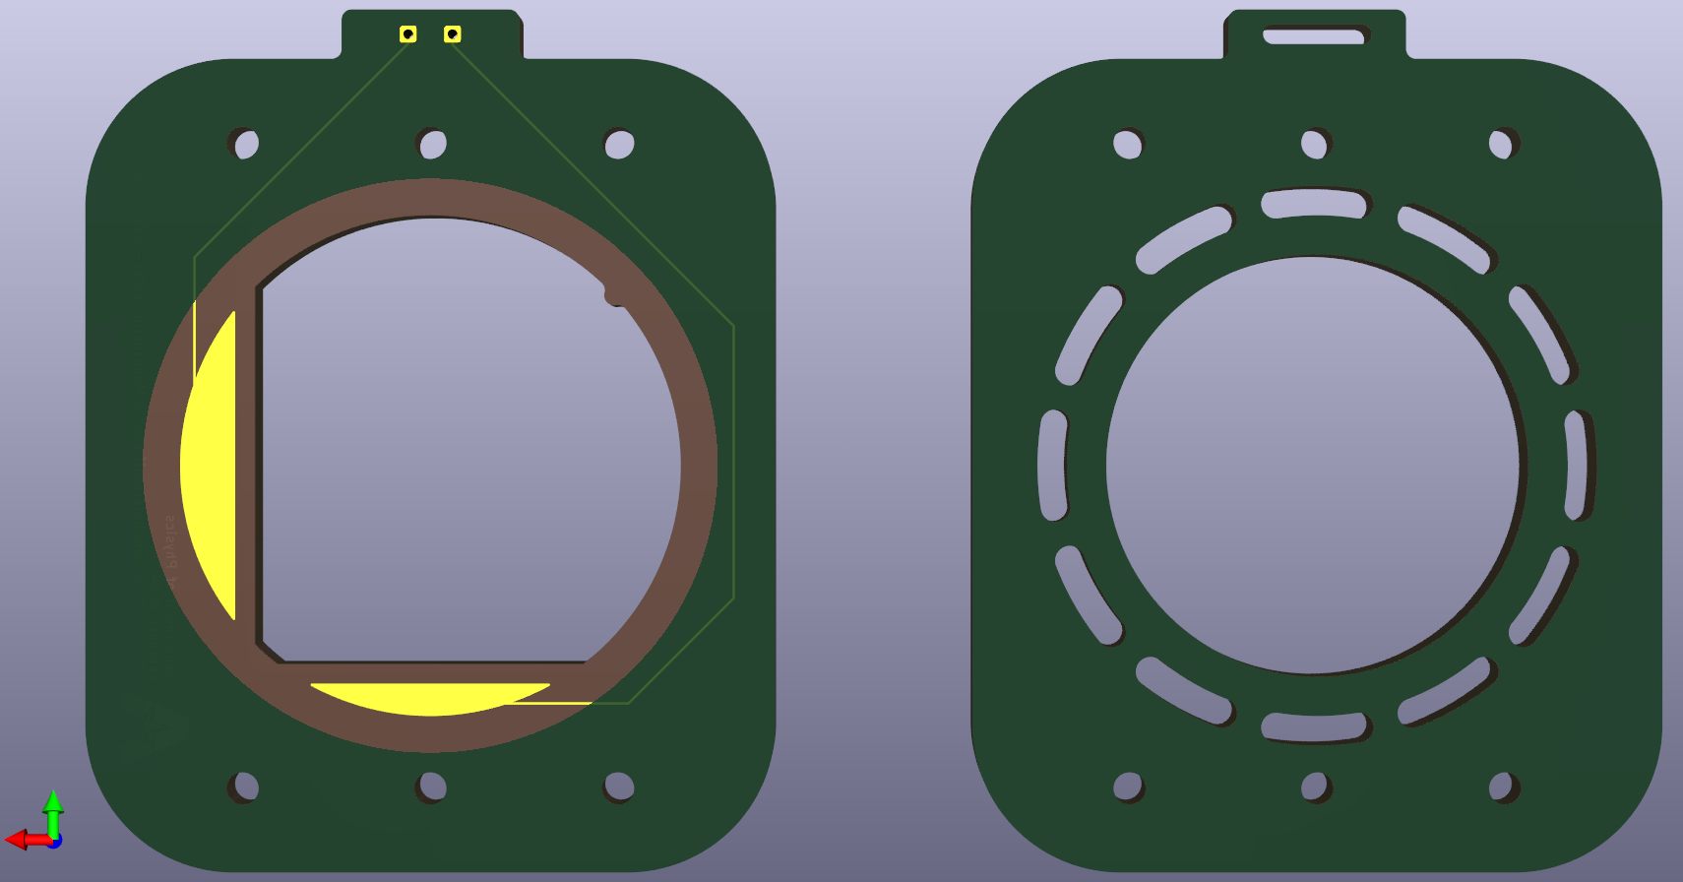
PCB Card Render

Slide 10

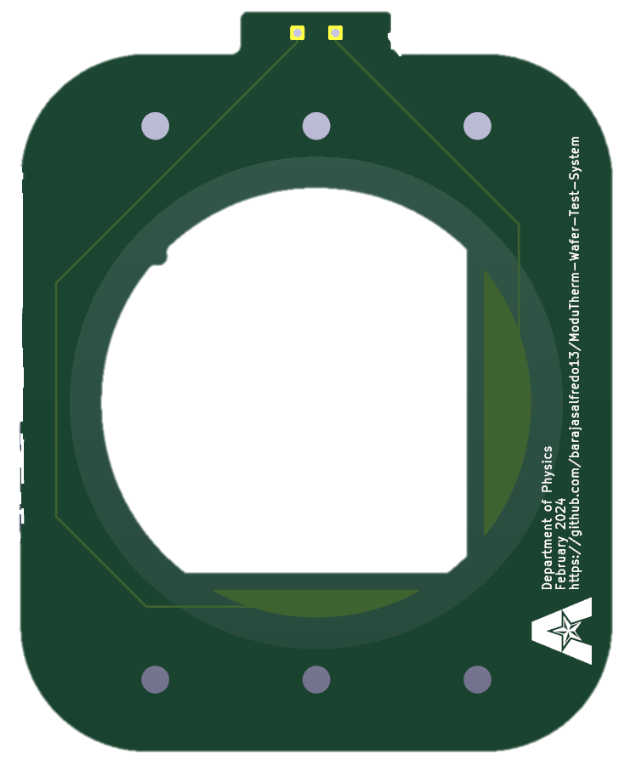
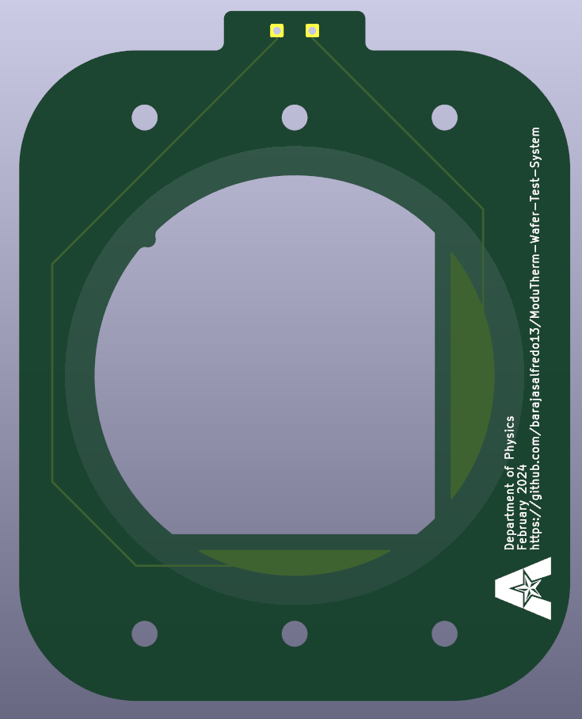
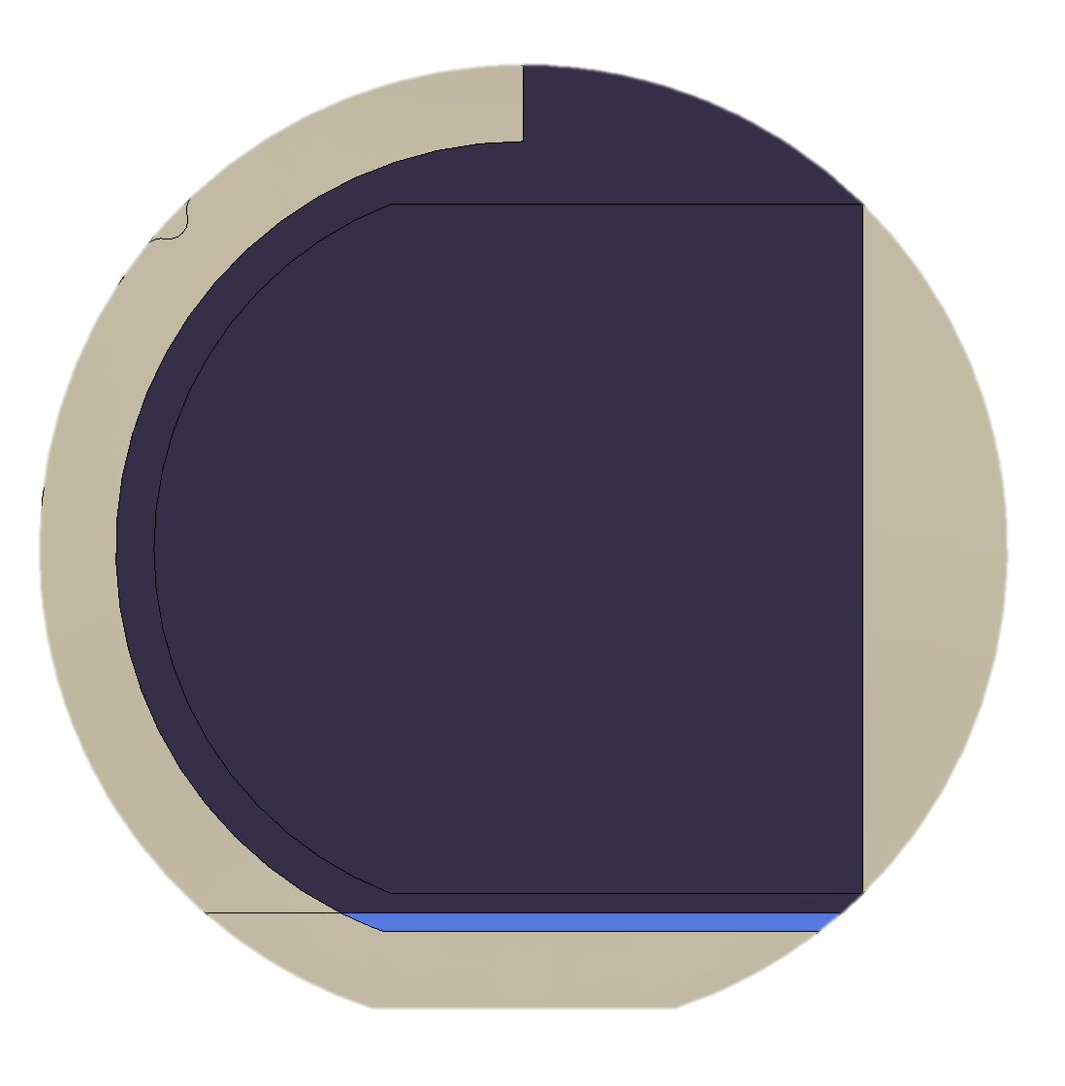
Sample Mount Render

