Slide 1
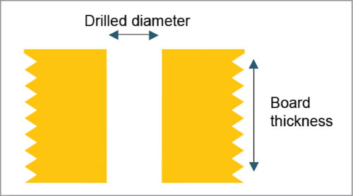
Looking at minimum specifications
PCBWay seems to have some “advanced” capabilities if we need small hole size and spacing
https://www.pcbway.com/advanced-pcb-capabilities.html
Relevant parameters
Min hole size: 0.15mm(CNC)｜0.1mm(Laser)
Max Aspect Ratio (Board Thickness to Hole Diameter): 13:1
This means for the smallest hole size our board has to be 1.3 mm or thinner
Min base copper thickness: 1/3 OZ (12um)
Min spacing between hole to outer layer conductor: 6mil (0.1524 mm)

