Slide 1

Similarity based on Shape and Appearance
Tel Aviv University
Barak Itkin
2017-12-07

Slide 2

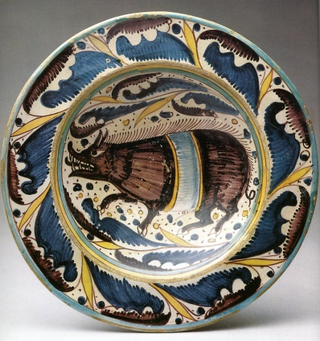
The Goal
Introducing the recognition types
A central goal of ArchAIDE is to simplify the task of classifying pottery
The work carried out at TAU aims to automate most* of the classification process
Our goal: Given a photograph of a sherd, identify the “pottery class” it belongs to
Class could be based on either decoration or profile

Slide 3
Deep Learning Intro
A very short introduction to Deep Learning
In order to build the recognition model, we use deep neural networks
In a nutshell, these are chains of mathematical functions with many parameters (can be millions and more)
With the right parameters, these functions can express complex logic that can solve many types of tasks
Using labeled samples, we slowly “train” the parameters to achieve the desired output (this is known as deep learning)
Once the models are trained, we can exploit their power to classify new samples

Slide 4
Deep Learning Needs
Why is this not as easy?
Deep learning involves many parameters to be “learned”
This means we need many labeled samples
Many as in hundreds, thousands, and usually more
However, we don’t have this much available labeled archaeological data (i.e. classified images of sherds)
Hence why this was not done earlier…

Slide 5
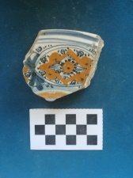
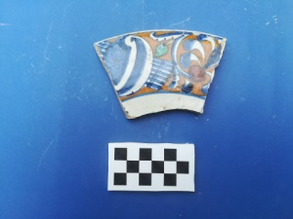
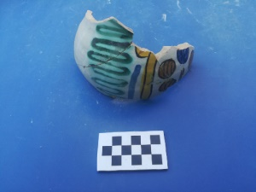
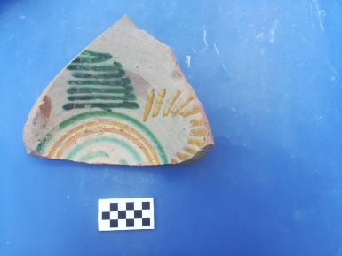
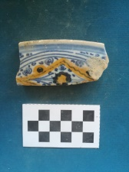
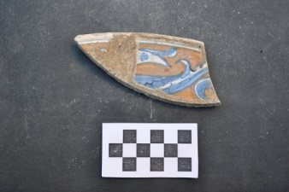
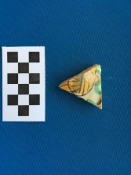
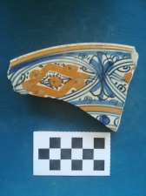
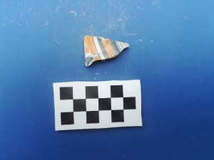
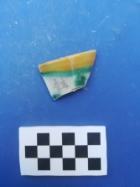
Decoration and Appearance
Recognizing sherds based on appearance
The first recognition type, is based on the appearance of the sherd
For example, classifying decorations on a sherd as belonging to a family of decorations

Slide 6
Appearance based recognition
Using transfer learning
Training neural networks to properly recognize image features, is hard
Requiring tons of samples and lots of computation time
Instead, we use a network that was already trained on real life images
A network trained on “ImageNet” – a dataset of many classes (animals, objects and many more)
Taking the “features” that were learnt there, we learn correspondence between features and appearance classes
Each feature has a weight per class
Learning this correspondence is still hard, yet feasible with the amount of images we have

Slide 7
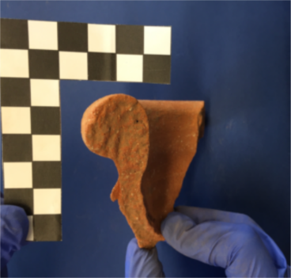
Shapes and profiles
Recognizing sherds based on fracture shapes
The second recognition type, is based on the fracture shape of the sherd
For example, classifying a sherd as belonging to a class with certain profile drawings

Slide 8
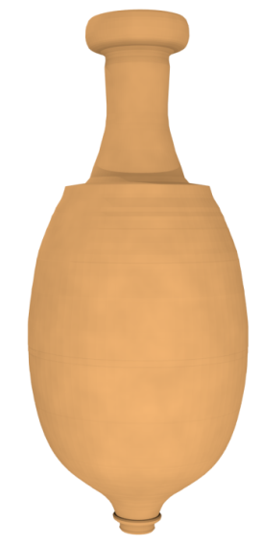
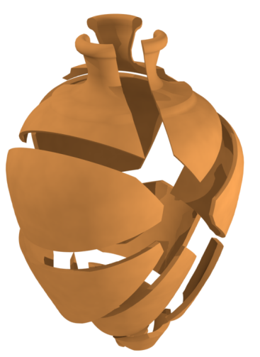
Shapes and profiles
Generating synthetic data
Here we can’t use a pre-trained network, and so we need lots of data
To overcome this limitation, we generate synthetic sherds by creating a 3D reconstruction of the model, and then breaking it (virtually)
CNR

Slide 9
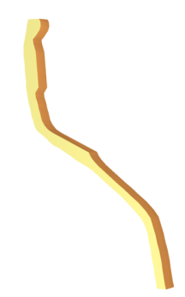
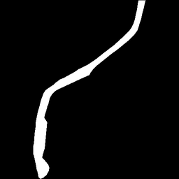
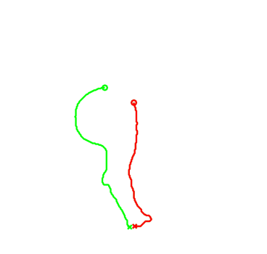
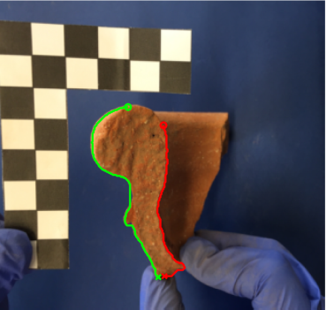
Shape input
Converting images and sherds to images
In the generation process, we pick “mostly vertical” fractures, and project these onto a black and white image
With pieces captured on the field, the user will have to annotate the fracture on the image (using software by CNR)
CNR
CNR

Slide 10
The final goal
Empowering archaeologists with computer tools
Our final goal is to create “groups” of sherds, representing “classes”
Based on either appearance or shape
The data will be collected via photographs (for appearance) or via generation (virtual synthetic sherds)
When a new sherd is captured, we compare it against all known classes of sherds
The result will be a ranking of classes by similarity
These will be inspected by archaeologists, to pick the final classification
Additional information (fabric, location, etc.) can be employed to further narrow down the list of classes

Slide 11
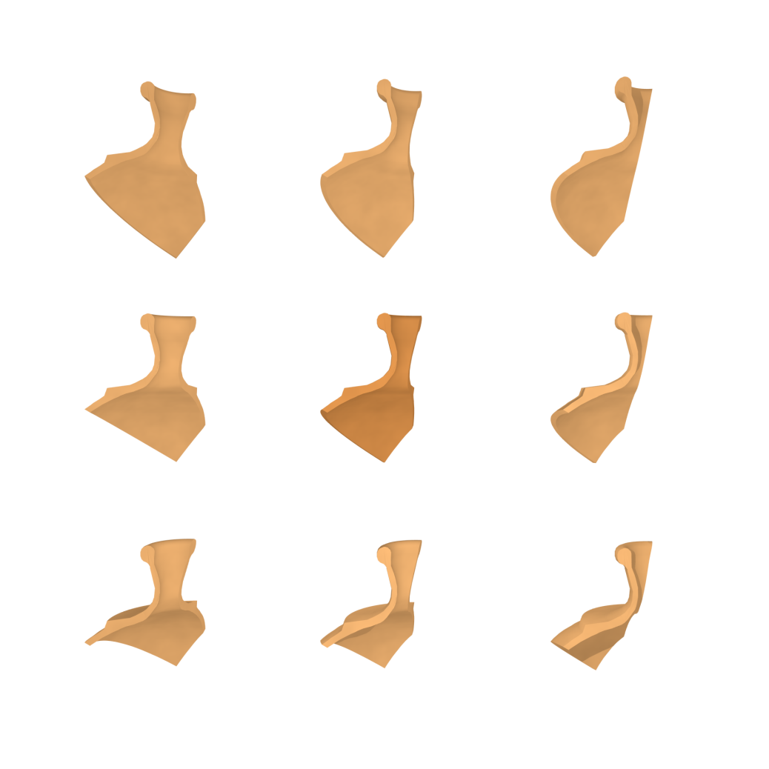
Summary
Questions? Feedback? Thoughts?
Questions?

