Slide 1

XpressKenya UBER FOR INDUSTRIAL GOODS
Student Name: Supervisor: Baraka Mshindi Mulumia Mr. Boniface Tum

Slide 2
Problem Statement
Due to megatrends such as digitalization, demographic change, urbanization, globalization and population growth, freight transports are anticipated to keep on increasing in the future. From a freight transport frame of reference, the number of people joining the middle social class in the society is increasing at an alarming rate. As a repercussion the demand for products and relocation will increase panoramically. In the current times, to be able to get freight transport services you would have to make a lot of calls, write some emails and even physically contact a product moving company

Slide 3
Proposed Solution
The major objective of this project to create a blended web application that will provide a platform for both freight clients and freight shippers alongside product distributors by making technological advancements to the logistic utility of the freight forwarding industry to make:
Freight services accessible via smartphones.
Freight clients able to move products and have real time updates on the whereabouts of their products.
Have commodities be where and when they are demanded by the clients.
Provide time utility and place utility from the point of product production to the point of consumption.

Slide 4
Related works
Amazon Relay
G4s / Ahadi movers
Various house/office moving companies in Kenya
It is indisputable that the current systems offering freight forwarding services have a number of drawbacks, this project aims to develop a web-based application. With this app, businesses of all sizes can manage their shipments fast and efficiently, receive transportation services at a fair price, and have constant access to a vast network of reliable carriers.

Slide 5
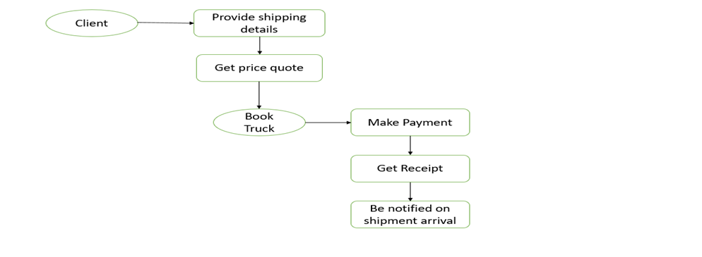
Project Overview

Slide 6
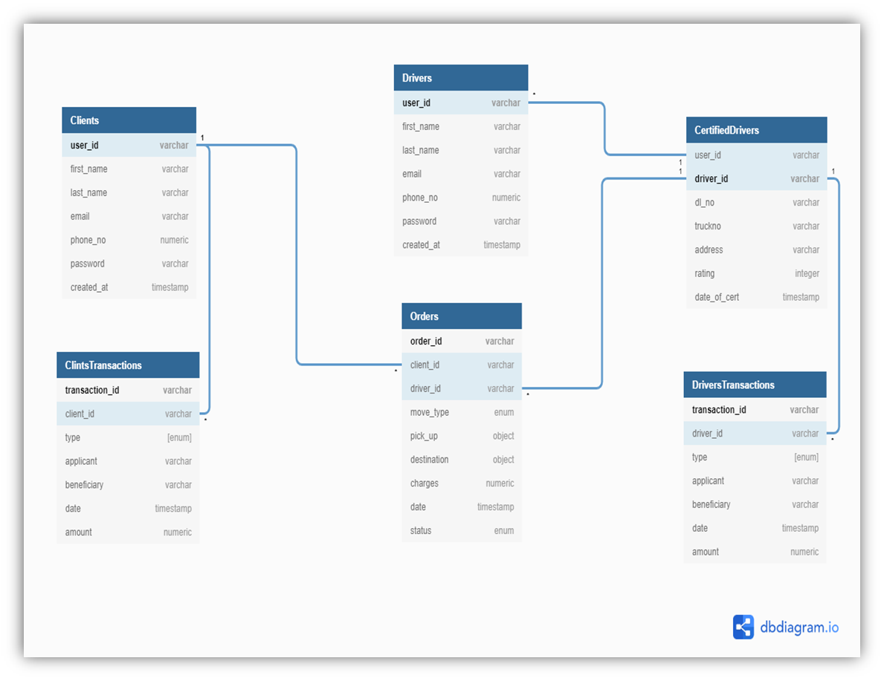
Project's database

Slide 7
Conclusion
Scope: The expanse of this project is limited to a number of areas:
The application is used only by shippers (freight clients) and truck drivers via their mobile phones and personal computers with an internet connectivity.
During the initial project deployment, the intended audience of the app are strictly residents of Kenya.
The app is restricted to one (Credit card) payment systems only.
Recommendations
Develop a native mobile application as most users will be using mobile devices
Integrate Mpesa payment system to improve ease of paying for services

