Slide 1

HOMIQUITY · MORTGAGE CORPORATION
A digital mortgage brokerage that
delivers lender-ready files.
Certainty and speed — a complete, standards-valid MISMO 3.4 package,
decision-ready on the first pass.
Wholesale-partner briefing · NMLS licensing in progress
Veteran-founded

Slide 2




THE PROBLEM
The file is a mess — so everyone pays for it
The borrower waits, blind
Days pass with no idea where they stand — anxiety, drop-off, and lost deals.
The lender gets a disorganized packet
Homiquity's fix
Incomplete, non-standard files get bounced back for what's missing — twice.
Turn a borrower's raw inputs into one organized, lender-ready package — fast, honest, and compliant — and deliver it straight to a wholesale lender.
Everyone re-keys the same data
The same numbers are re-entered by hand at every hand-off, adding errors and delay.
Homiquity Mortgage Corp. · Confidential — for prospective wholesale-lender partners
2

Slide 3



WHAT WE ARE
A mortgage broker — the loop is borrower ↔ lender
Borrower
Homiquity
Wholesale lender
Applies, uploads,
is coached
Organizes, validates,
packages, delivers
Underwrites, closes,
funds
One sentence: a borrower completes intake → gets an instant, deterministic pre-approval read → their file becomes a standards-valid MISMO package → we deliver it to a wholesale lender.
Agents, listings, and homeowner tools feed or extend the loop — they never sit on the critical path to a funded loan.
Homiquity Mortgage Corp. · Confidential — for prospective wholesale-lender partners
3

Slide 4







THE PIPELINE
From lead to a funded-ready package — end to end
1
2
3
4
5
6
Acquire
Intake
Decide
Package
Dual AUS
Deliver
Persona funnel
+ SEO
Consented URLA
+ TRID clock
Deterministic
pre-approval
MISMO 3.4 /
ULDD valid
DU + LPA
findings
To wholesale
lender
Gated + audited end to end. Submission is blocked until intake, AUS, and the lender package are clean — and every step is captured for the record.
Homiquity Mortgage Corp. · Confidential — for prospective wholesale-lender partners
4

Slide 5





STAGE 1 · ACQUIRE
We bring you qualified, consented borrowers
A purpose-built top-of-funnel — persona landing pages, an SEO/content engine, and free decision tools — captures buyers early and hands them into the loop with consent already in hand.
First-time buyer
VA loans
Persona landing pages
First-time buyer, VA, self-employed, refinance
SEO + education engine
Articles, glossary, buying-power tools that rank
Approval Strength + calculators
Nine calculators that turn browsers into applicants
Self-employed
Refinance
Homiquity Mortgage Corp. · Confidential — for prospective wholesale-lender partners
5

Slide 6



STAGE 2 · INTAKE
A complete, consented application — done right
Consented URLA (Form 1003)
The full application, captured cleanly — with the borrower's consent recorded before anything moves.
TRID clock starts at exactly six pieces
Not a moment sooner or later — the six application elements trigger the timing, correctly, every time.
E-disclosures + e-consent
ESIGN-compliant delivery and consent, tracked and auditable.
AI document coaching — extraction only
AI structures and completes the file. It never decides, and never implies approval or eligibility.
Homiquity Mortgage Corp. · Confidential — for prospective wholesale-lender partners
6

Slide 7




STAGE 3 · DECIDE
An instant pre-approval read you can trust
Instant read in one session
Deterministic.
AI-free.
Auditable.
Affordability, DTI, and credit-tier math resolve immediately — the borrower knows where they stand.
LLPA-aware pricing
Pricing adjustments computed against agency grids — cited, not guessed.
Ambiguity routes to a human
Edge cases are escalated to staff, never auto-decided by the machine.
Same inputs → same outcome. No black box, no model deciding who qualifies.
Adverse action handled
No adverse action without the required notice — FCRA/ECOA by construction.
Homiquity Mortgage Corp. · Confidential — for prospective wholesale-lender partners
7

Slide 8
STAGE 4 · PACKAGE
A package that's decision-ready on the first pass
MISMO 3.4 / ULDD
QM points-and-fees
Anti-steering disclosure
Standards-valid output (ULDD Phase 5) — the format your systems ingest.
Points-and-fees and APR-APOR spread pre-flighted against the note-date thresholds.
Reg Z §1026.36(e)(3) options presented before anything is locked.
Special Feature Codes
UCD / ULDD / EarlyCheck mirror
Complete + consistent
SFCs derived and validated as a set — not hand-typed.
We run your delivery edits as a lender's-eye pre-check before you ever see the file.
Outstanding-document gating means nothing critical is missing at submission.
Why you care: a clean, standards-valid file underwrites faster and bounces less — lowering your cost per loan.
Homiquity Mortgage Corp. · Confidential — for prospective wholesale-lender partners
8

Slide 9



STAGE 5 · DUAL AUS
DU and LPA — findings captured before delivery
Desktop Underwriter (DU)
Loan Product Advisor (LPA)
Fannie Mae
Freddie Mac
Casefile assembled from the verified file
Second agency leg run in parallel
DU-12.1-shaped findings captured
Findings reconciled against the DU read
Day-1-Certainty-style commitment output
Broadens the wholesale channels you can serve
The AUS legs run as deterministic simulations behind production adapters today; they switch to live DU/LPA the day Homiquity is credentialed — the integration seam is already built.
Homiquity Mortgage Corp. · Confidential — for prospective wholesale-lender partners
9

Slide 10

STAGE 6 · DELIVER
Submission-ready, into your TPO channel
A target shortlist of wholesale partners, a real submission state machine, and a readiness gate that won't let a file go until it's clean.
United Wholesale Mortgage
Rocket Pro TPO
Plaza Home Mortgage
Angel Oak
Newrez Wholesale
Target-5 shortlist · DU + LPA channels
SUBMISSION STATUS — TRACKED END TO END
Submitted
Acknowledged
In underwriting
Conditions
Clear to close
Funded
Readiness-gated. Every submission carries a snapshot of what we believed about the file at the moment we sent it — a built-in audit trail for both sides.
Lender shortlist is business-development data; the submission adapter is a deterministic simulation until a signed broker agreement exists.
Homiquity Mortgage Corp. · Confidential — for prospective wholesale-lender partners
10

Slide 11
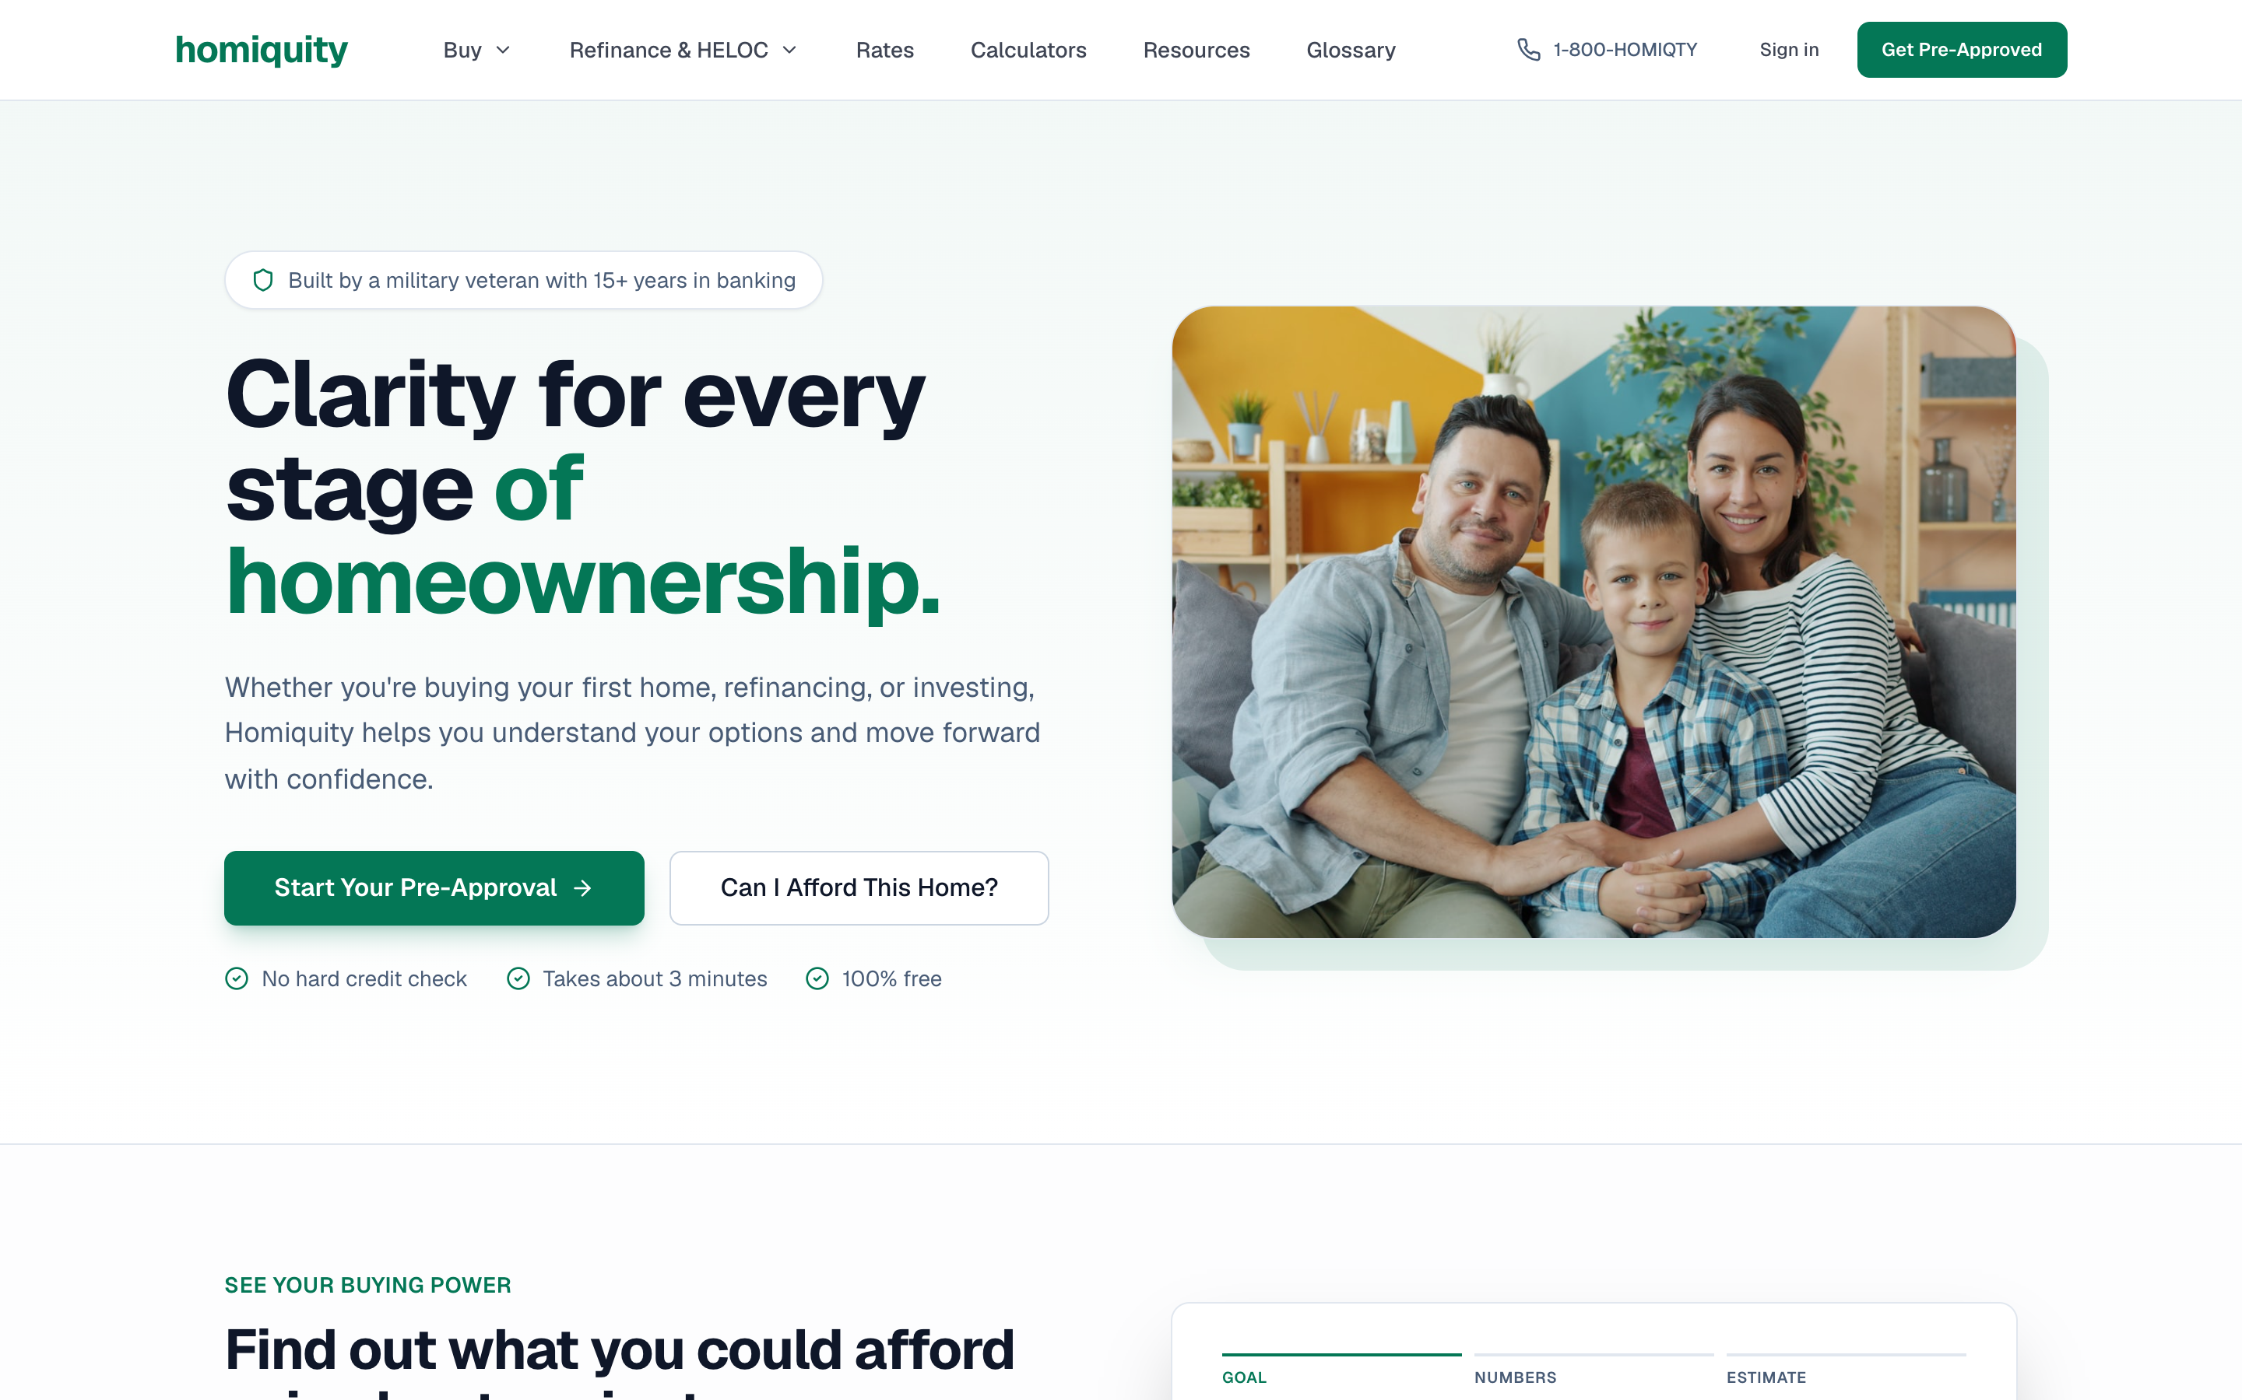
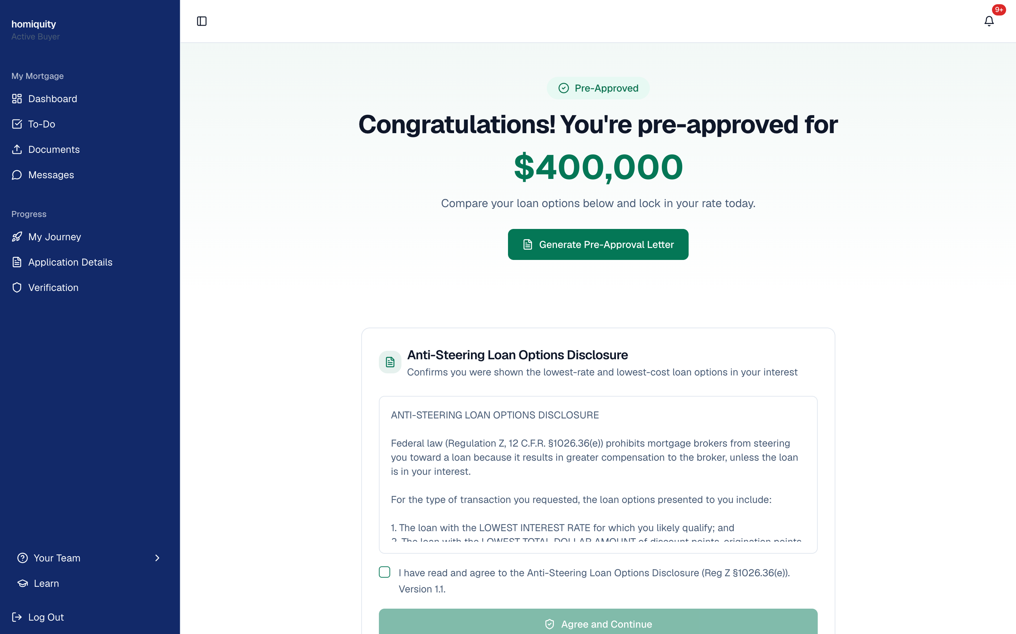
SEE IT LIVE — REAL PRODUCT
The borrower experience
Persona funnel + free decision tools — consented borrowers, captured early
Instant, deterministic pre-approval read — with the Reg Z anti-steering disclosure
Homiquity Mortgage Corp. · Confidential — for prospective wholesale-lender partners
11

Slide 12
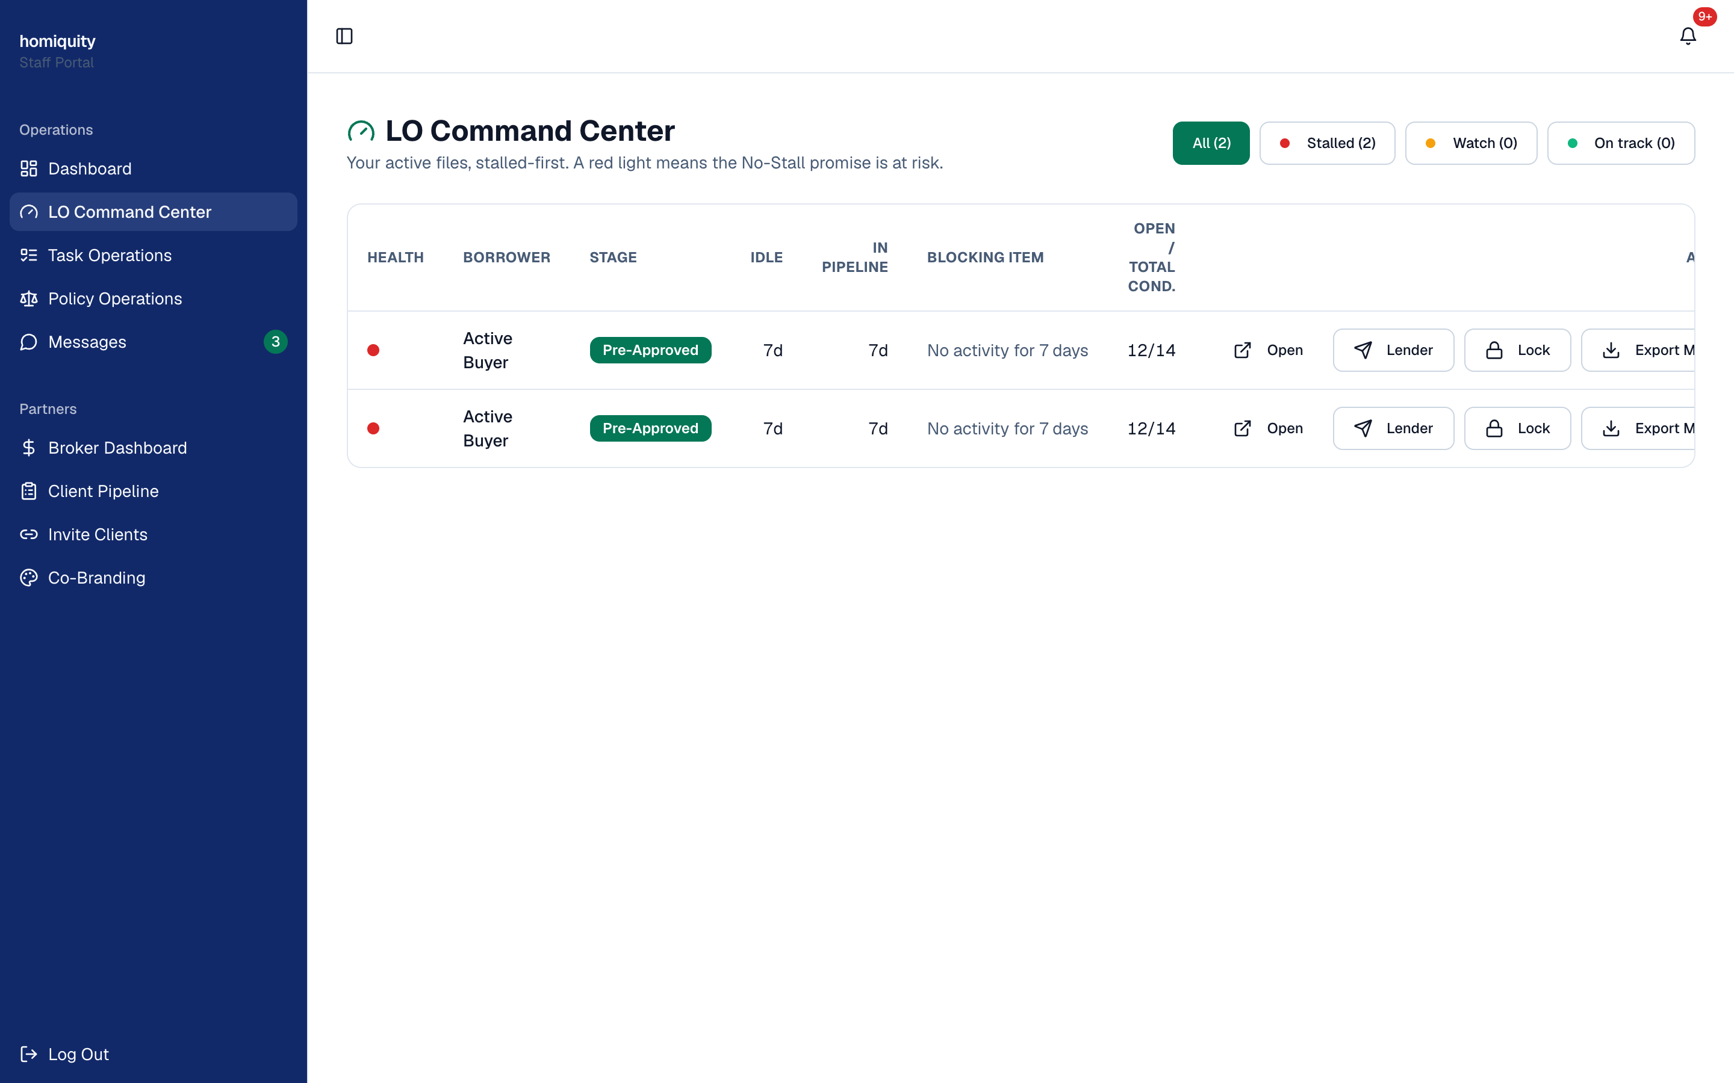
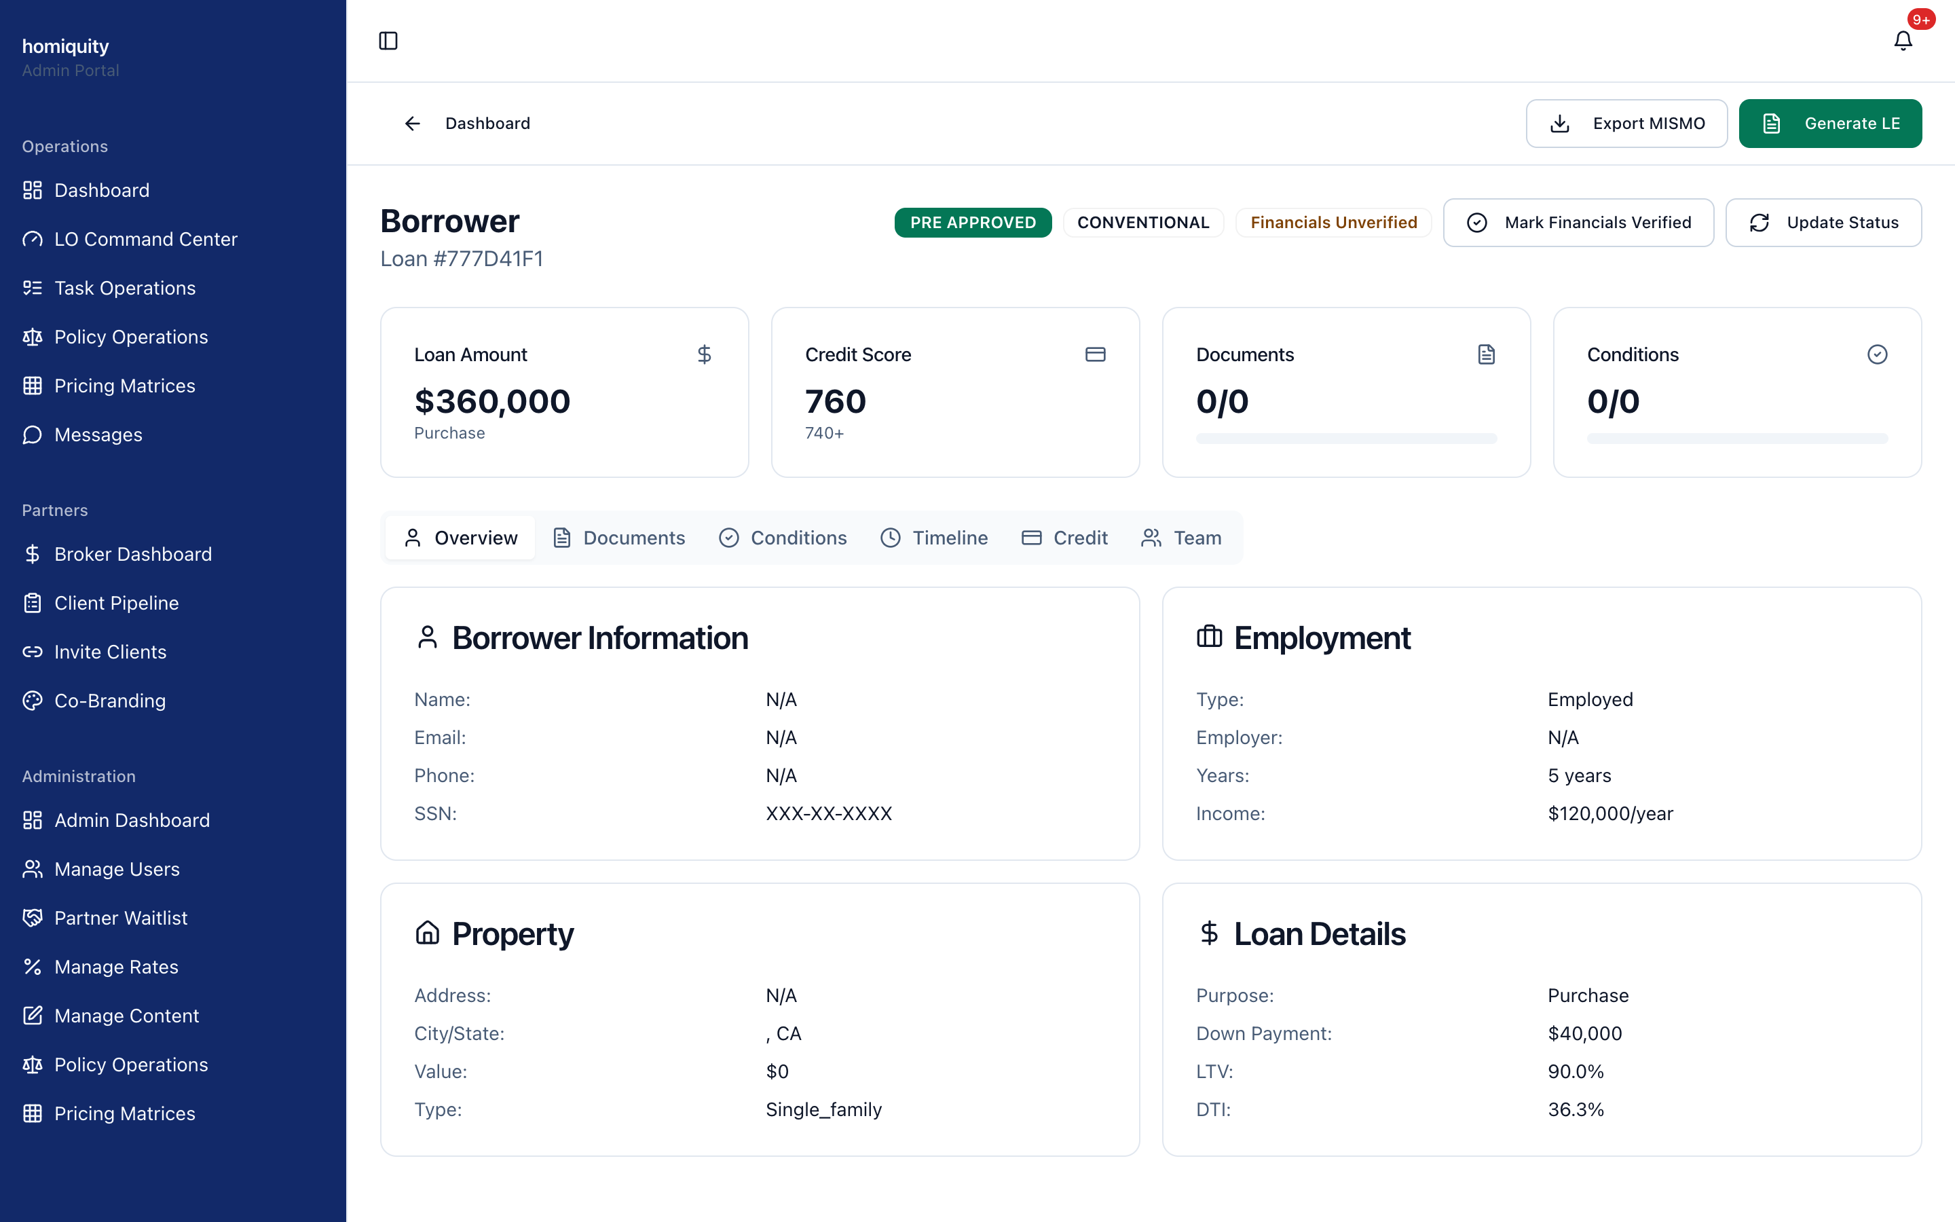
SEE IT LIVE — REAL PRODUCT
The broker's desk
No-Stall pipeline — one-click Export MISMO, submit to lender, lock the rate
The lender-ready file — MISMO 3.4 export, SSN vaulted (last-4), LTV/DTI
Homiquity Mortgage Corp. · Confidential — for prospective wholesale-lender partners
12

Slide 13
THE VALUE TO YOU
Three reasons a lender says yes
Clean files
Volume
Velocity
Standards-valid, pre-flighted packages underwrite faster and bounce less — lower cost per loan, higher pull-through.
A purpose-built funnel feeds you a steady flow of qualified, consented borrowers you didn't have to source.
Certainty and speed compress the path from intake to submission — less fallout, faster funding.
Homiquity Mortgage Corp. · Confidential — for prospective wholesale-lender partners
13

Slide 14

COMPLIANCE & TRUST
Built compliance-first, not bolted on
Deterministic engine
PII through a vault
Auditable decisions; no AI in the lending decision, ever.
SSNs stored as ciphertext + last-4, decrypted only at the delivery seam.
Audit log everywhere
Fannie-Mae-grounded
Every PII touch and file action is recorded for the record.
MISMO/ULDD terms verified against the official spec — never invented.
Correct NMLS identity
The package makes no promises
The company identifier prints on the package the day licensing lands.
Neutral validation language — no approval or eligibility claims.
Veteran-founded
Homiquity Mortgage Corp. · Confidential — for prospective wholesale-lender partners
14

Slide 15

STATUS
Built and validated today — live on credentialing
Working end to end now
What makes it live
Full intake → decision → package → delivery loop
NMLS licensing — in progress (the long-lead item)
MISMO 3.4 / ULDD-valid export
A signed broker agreement with your channel
Deterministic underwriting + dual-AUS legs
One adapter swap per vendor (credit, DU/LPA, AVM)
Compliance engines (QM, SFC, edit mirror)
Ops keys (email, storage) — a day of setup
Every vendor call runs behind a production adapter
Every integration seam is already in place — going live is configuration, not a rebuild.
Homiquity Mortgage Corp. · Confidential — for prospective wholesale-lender partners
15

Slide 16
THE ASK
Credential us on your
TPO channel.
The platform is built and validated. We're completing licensing now. Let's set up a live pilot the day it clears — and prove first-pass, standards-valid delivery on real files.
Homiquity Mortgage Corporation
Ammre Barakat, Founder
support@homiquity.com · (224) 400-0531 · homiquity.com
Veteran-founded
Confidential — for prospective wholesale-lender partners.
NMLS # prints here once issued.

Slide 17


APPENDIX
Under the hood — architecture & compliance base
Adapter architecture
Every external vendor (credit, DU/LPA, AVM, lender submission) sits behind one adapter function — a single, tested seam that flips from simulation to live per contract.
Deterministic core
The underwriting engine is pure and vendor-free: same inputs, same outcome, with typed error classification.
Fannie Mae reference base
MISMO 3.4 / ULDD Phase 5, UCD, Special Feature Codes and edit codes are grounded in the official spec set — terminology is verified, never invented.
NMLS reference base
Licensing logic is grounded in the NMLS Policy Guidebook and SAFE-Act mapping — state law controls, discrepancies escalate.
Homiquity Mortgage Corp. · Confidential — for prospective wholesale-lender partners
17

