Slide 1


















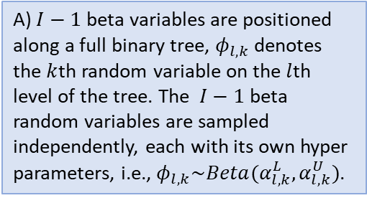


























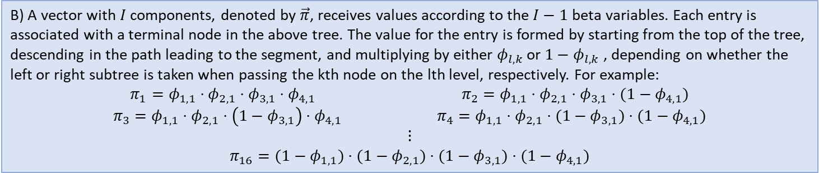






A) $I−1$ beta variables are positioned along a full binary tree, $φ_{l,k}$ denotes the $k$th random variable on the $l$th level of the tree. The $I−1$ beta random variables are sampled independently, each with its own hyper parameters, i.e., $φ_{l,k}\sim Beta(α_{l,k}^{L},α_{l,k}^{U})$.
$$φ_{1,1}$$
$$φ_{2,1}$$
$$φ_{2,2}$$
$$φ_{3,1}$$
$$φ_{3,1}$$
$$φ_{3,3}$$
$$φ_{3,4}$$
$$φ_{4,1}$$
$$φ_{4,2}$$
$$φ_{4,3}$$
$$φ_{4,4}$$
$$φ_{4,5}$$
$$φ_{4,6}$$
$$φ_{4,7}$$
$$φ_{4,8}$$
$$π_{1}$$
$$π_{2}$$
$$π_{3}$$
$$π_{4}$$
$$π_{5}$$
$$π_{6}$$
$$π_{7}$$
$$π_{8}$$
$$π_{9}$$
$$π_{10}$$
$$π_{11}$$
$$π_{12}$$
$$π_{13}$$
$$π_{14}$$
$$π_{15}$$
$$π_{16}$$
B) A vector with $I$ components, denoted by $\vec{π}$, receives values according to the $I−1$ beta variables. Each entry is associated with a terminal node in the above tree. The value for the entry is formed by starting from the top of the tree, descending in the path leading to the segment, and multiplying by either $φ_{l,k}$ or $1−φ_{l,k}$ , depending on whether the left or right subtree is taken when passing the kth node on the lth level, respectively. For example:
$$π_{1}=φ_{1,1}⋅φ_{2,1}⋅φ_{3,1}⋅φ_{4,1} π_{2}=φ_{1,1}⋅φ_{2,1}⋅φ_{3,1}⋅(1−φ_{4,1})$$
$$π_{3}=φ_{1,1}⋅φ_{2,1}⋅\left(1−φ_{3,1}\right)⋅φ_{4,1} π_{4}=φ_{1,1}⋅φ_{2,1}⋅(1−φ_{3,1})⋅(1−φ_{4,1})$$
$$⋮$$
$$π_{16}={(1−φ}_{1,1})⋅(1−φ_{2,1})⋅(1−φ_{3,1})⋅(1−φ_{4,1})$$
$$a_{0}$$
$$a_{1}$$
$$a_{2}$$
$$a_{3}$$
$$a_{4}$$
$$a_{5}$$
$$a_{6}$$
$$a_{7}$$
$$a_{8}$$
$$a_{9}$$
$$a_{10}$$
$$a_{11}$$
$$a_{12}$$
$$a_{13}$$
$$a_{14}$$
$$a_{15}$$
$$a_{16}$$
C) For each $i$, $i=1,…n:$a segment $A_{i}∈\left\{1,…,I\right\}$is sampled from the proportions given by the prior $\vec{π}.$
For each observation, $γ_{i}$ is sampled uniformly within the $A_{i}$th segment, i.e.:
$$γ_{i}|A_{i}\sim U\left(a_{A_{i}−1}, a_{A_{i}}\right)$$
$$γ_{1},γ_{2},…,γ_{n}$$
$$…$$

