Slide 1
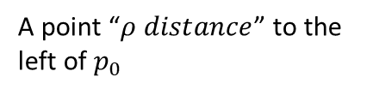

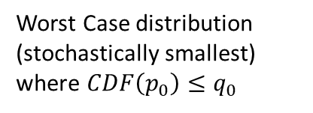




$$q$$
1
Legend:
Deconvolution estimate of the mixing distribution of P
Worst Case distribution (stochastically smallest) where $CDF\left(p_{0}\right)≤q_{0}$
$$q_{0}$$
Deconvolution estimates for data samples generated from Worst Case distribution
A point “$ρ distance$” to the left of $p_{0}$
0
0
$$p_{0}−ρ$$
$$p_{0}$$
1
$$P$$

