Slide 1

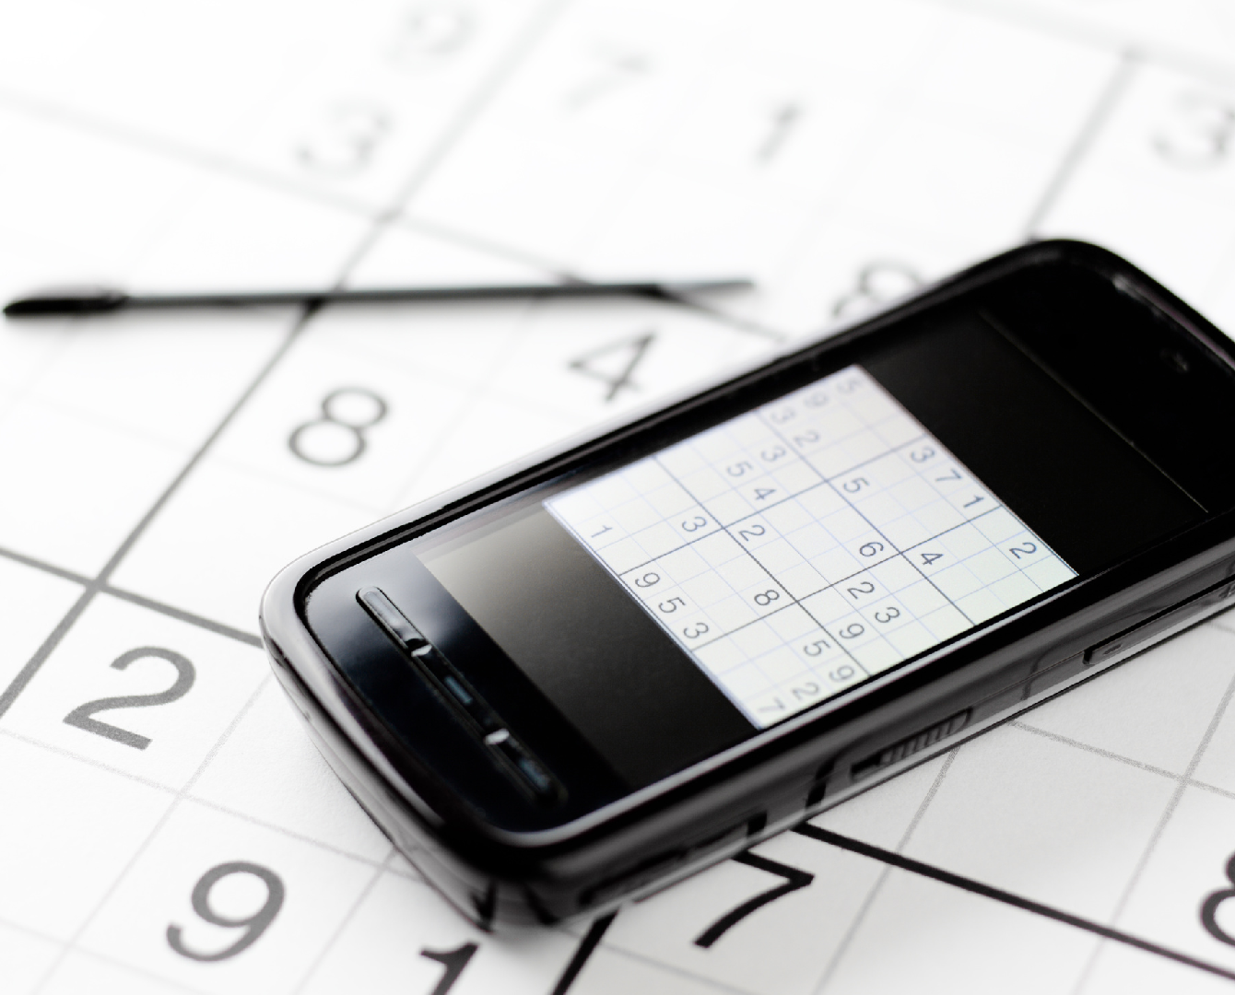

Sudoku Solver
BGU
ICBV 2023 - Final Project
Roey Lange Barak Daniel

Slide 2

Introduction
An image based Sudoku solver that uses CV techniques to identify and solve puzzles
Built using Python on Google Colab
Uses OpenCV, Pytesseract and an external OCR model and solver
Capable of detecting Sudoku puzzles from a variety of angles and rotations

Slide 3

The Problem
Sudoku is a logic based puzzle with a 9x9 grid of cells
Many sudoku puzzles are published without a solution, making it difficult to verify the solution
Our team set out to create an automated solver using CV techniques The goal of the project was to develop a program that could extract and solve a puzzle from an image

Slide 4

Detecting the sudoku grid in various orientations and tilts
The Challenges
Identifying and isolating individuals cells within the grid
Dealing with variations in lighting, contrast and colors of input images
Removing noise and artifacts to improve grid detections
Difficulty in identifying the correct orientations of the numbers within the grid ( 0, 90, 180 or 270 degree angle)

Slide 5
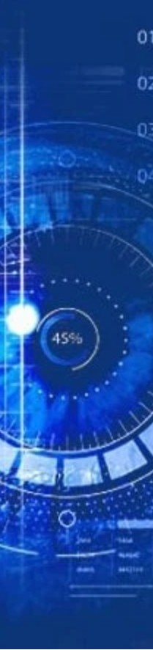
Approach
01
Image Processing: Conversion to Greyscale and Gaussian blurring - simplify the image and reduce the noise
Edge Detection: Find a group of points that represent a wide range of edges ( Canny's algorithm)
Contour Detection: Find the boundaries of all objects in the image grid of the puzzle using its geometrical features
External Frame Detection: Find the grid of the puzzle using its geometrical features (cv2.approxPolyDP)
05
Perspective Transformation: Transform the image to a 450x450 pixel frame
06
Image Rotation: Rotate the image so all numbers are aligned with the default axes
02
07
Digit inferring: Split the image into cells (50x50 each), predicting content using OCR model
03
04
08
Puzzle Solver: Use external code to solve the puzzle

Slide 6
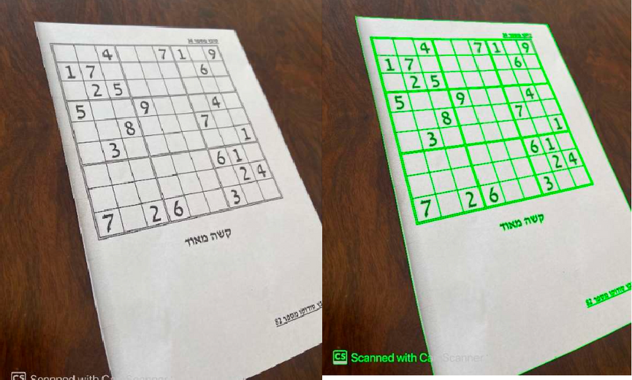
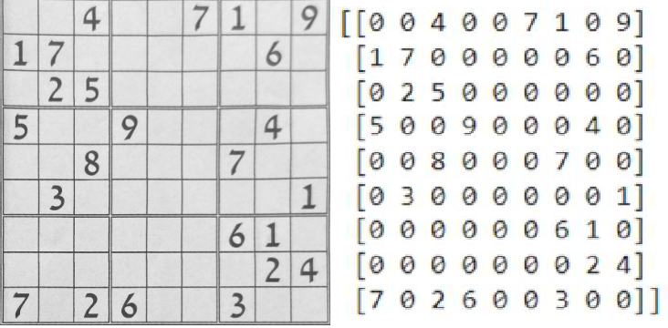
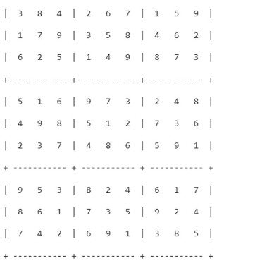
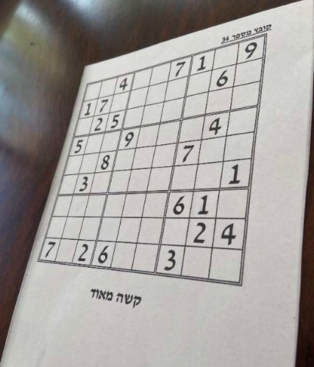
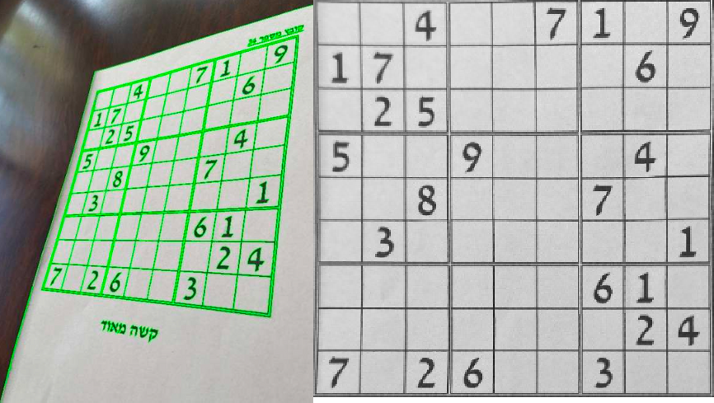
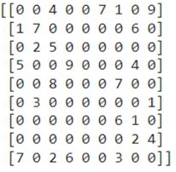
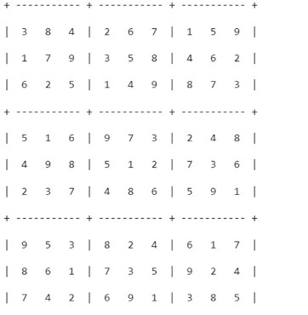
Examples

Slide 7
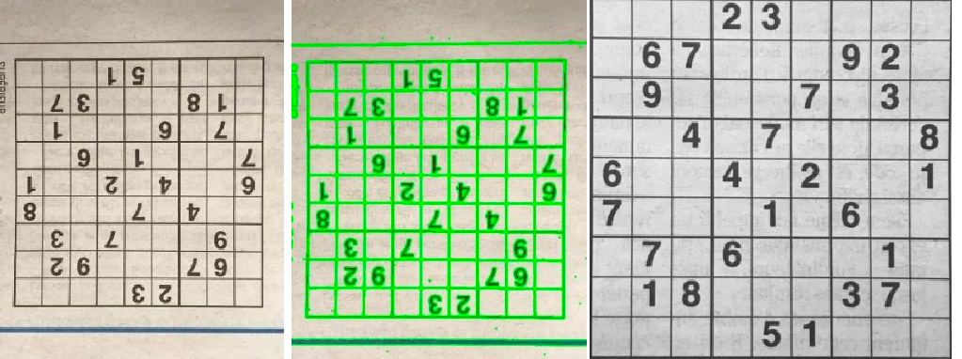
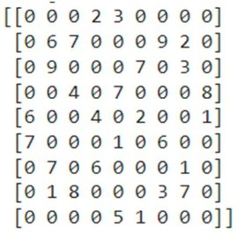
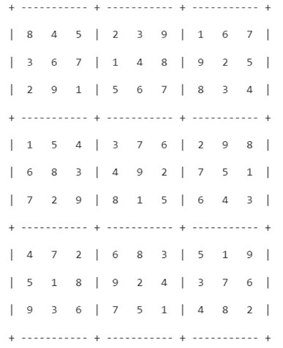
Examples

Slide 8

Questions

