Slide 1
Mini-Project #2 Application of Finite Element Analysis to a Simple Structural System
Moving analysis to the real world
Steps 1 & 2: Measurements and Wind Load

Slide 2
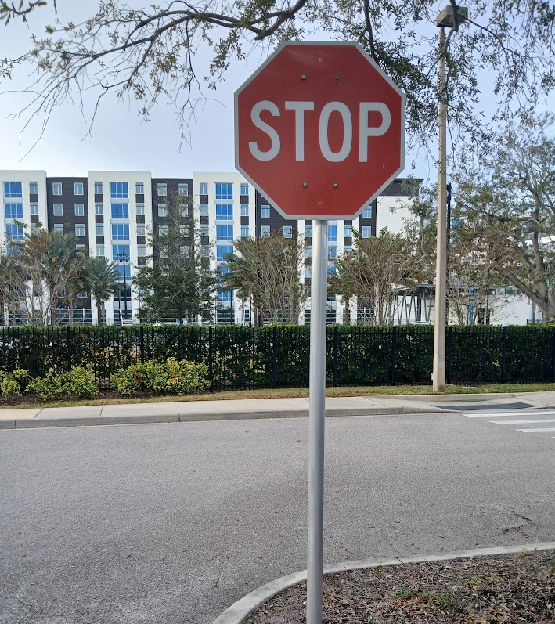
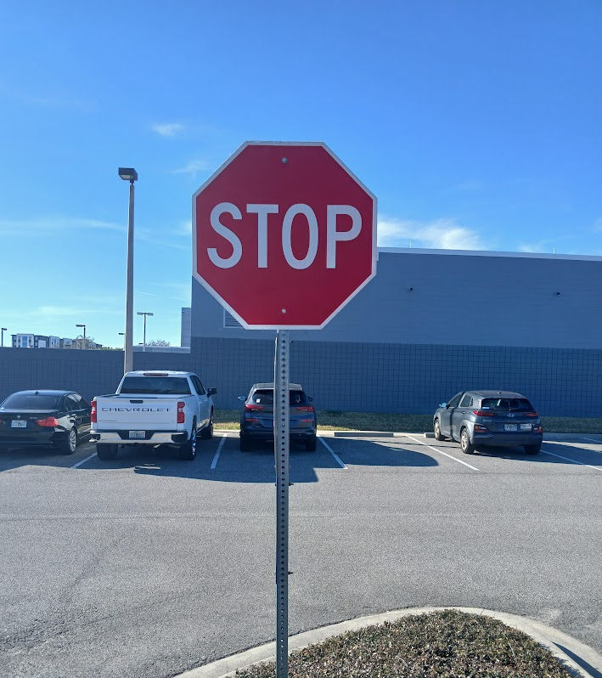
Context
We rely on them every day… the humble STOP sign.

Slide 3
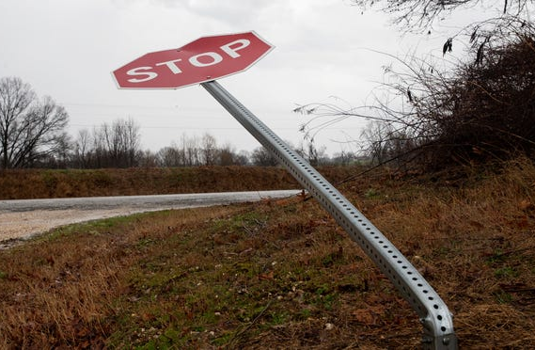
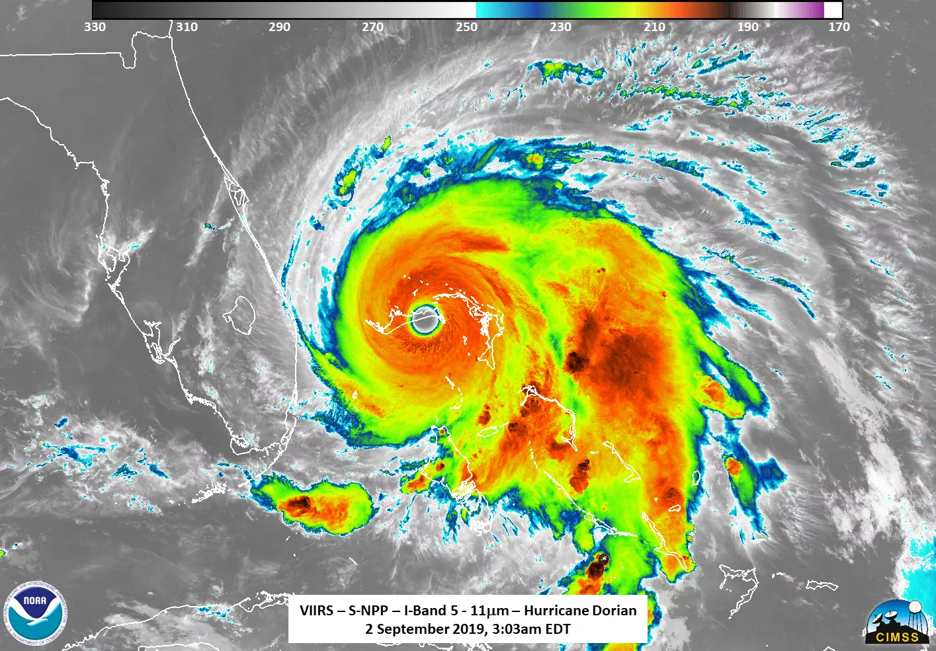

But, what if?
Could this happen here?

Slide 4
Steps to Completion
Step 1: Measure a STOP sign
Step 2: Estimate the wind load
Step 3: Design a 2-1/2” Diameter Pole Option
Step 4: Design a Galvanized Steel Rail Option

Slide 5
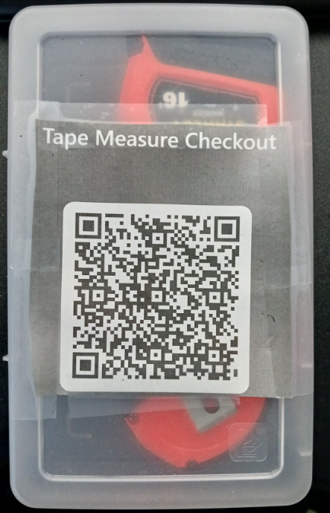
Step 1: Measure a Stop Sign
Pick a STOP sign on campus
NOTE: You must pick a STOP sign that can be safely accessed from a sidewalk or other safe location. You must not enter any roadway or parking surface to take your measurements
Two students must be present for any measurement activity – One student takes measurements while the other student ensures that no safety hazards are present
Develop a 3-D solid model of the sign system in SolidWorks (or other 3-D solid modelling software). Note the following:
You do need to model the connection between the sign and the pole
You do NOT need to model any features below the ground surface. Do NOT dig up the sign!!!!
Create a 2-D drawing that includes critical dimensions and a photo of your STOP sign.
Assess whether or not the sign meets the basic requirements for the City of Daytona Beach Engineering Standards (See next Slide). Provide explicit statements on your 2-D drawing regarding compliance for the following notes:
Note 2 – Access MUTCD Table 2B here: https://mutcd.fhwa.dot.gov/htm/2003r1/part2/part2b1.htm
Note 4
Note 6
Note 7 (This will require additional effort – completed in Steps 2-5)

Slide 6
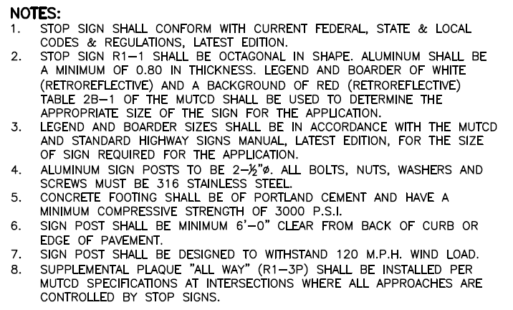
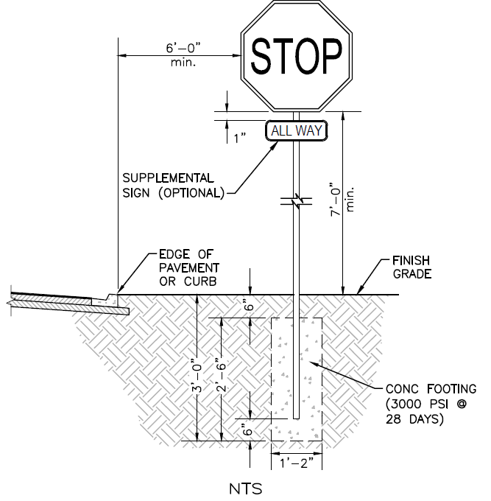


Slide 7
Does the sign meet Daytona Beach Standards
Yes, it does.
From note 2: The shape is octagonal and made of aluminum, it is also 0.080 inches thick. It is also 30 by 30.
From note 4: The diameter was measured to be 3 inches.
From note 6: The sign was more than 6 ft from the edge of the pavement. It was measured to be 8ft to the start of the pavement.
From note 7: Yes the sign can withstand 120mph of wind

Slide 8
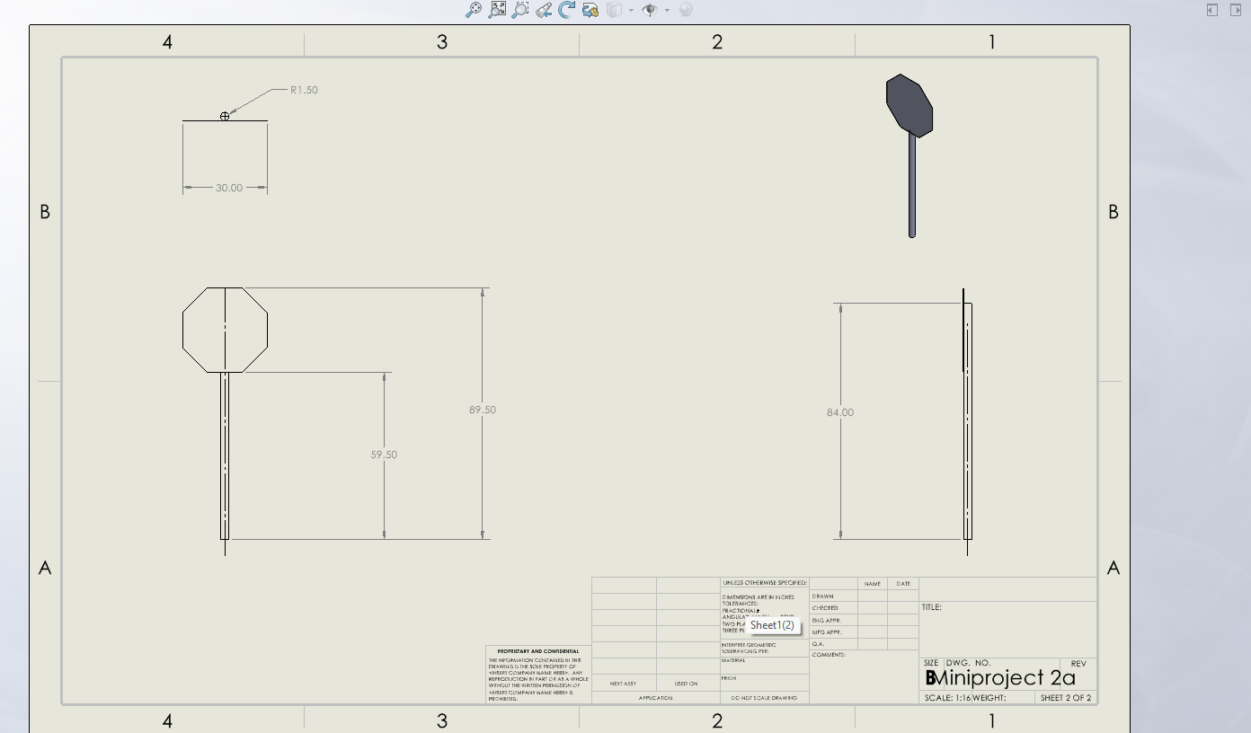

Slide 9
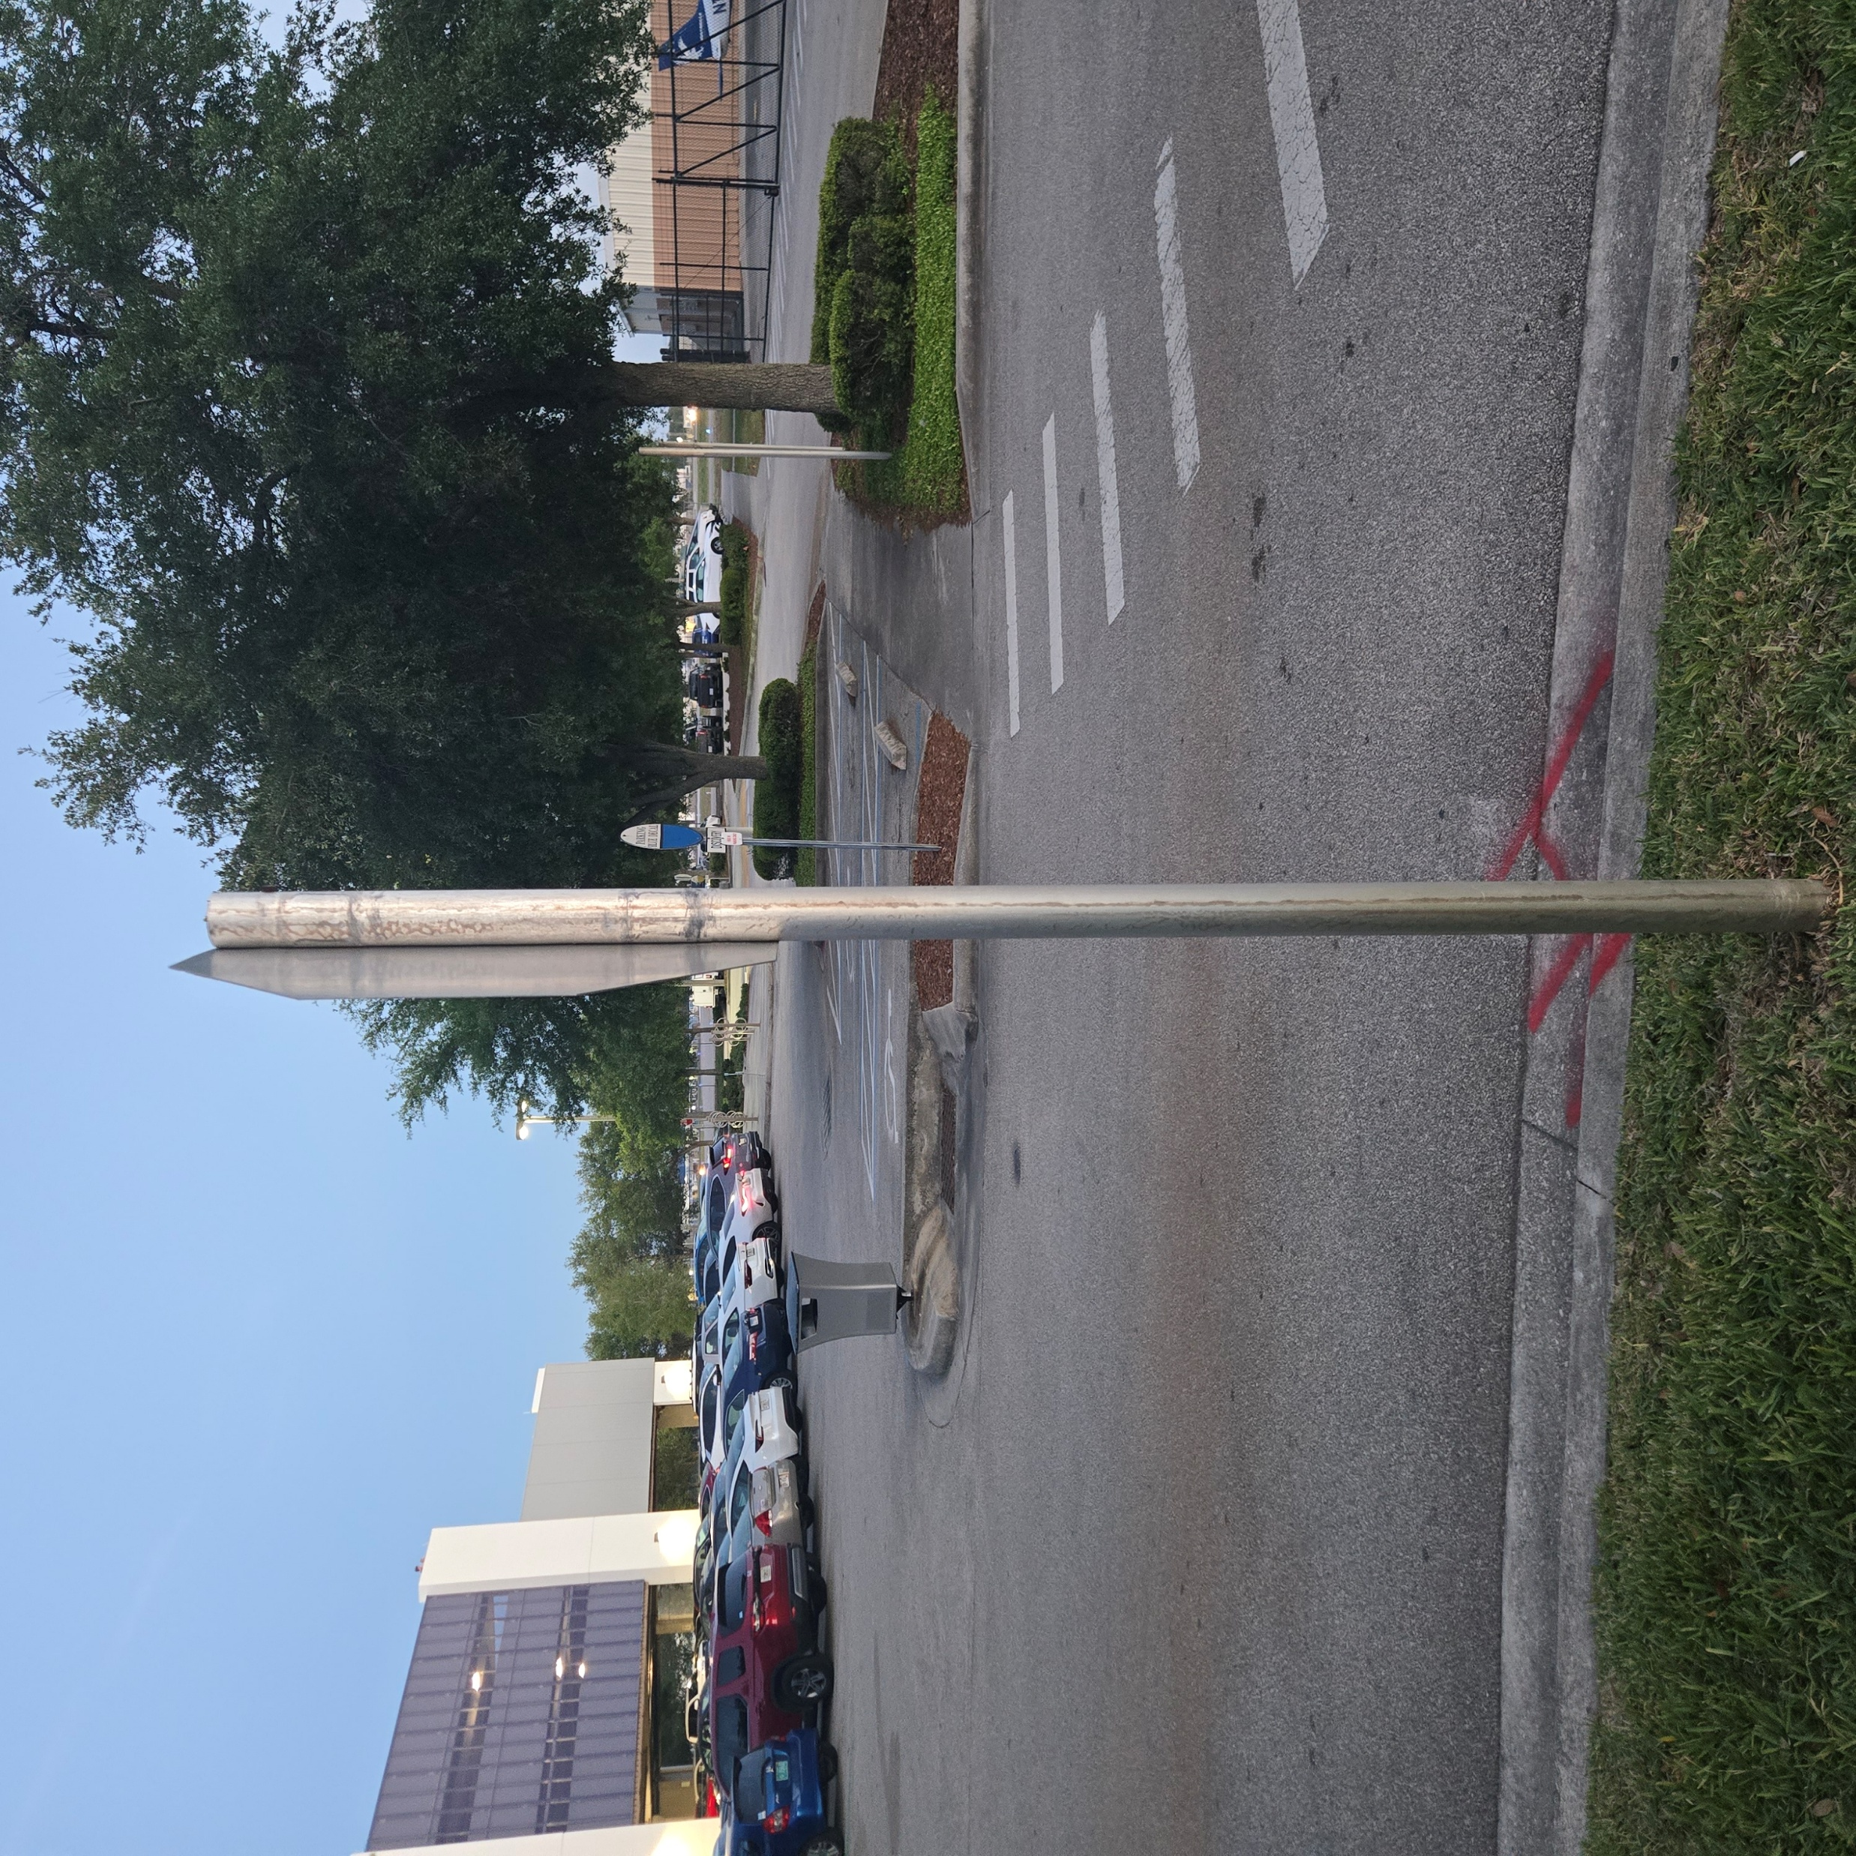
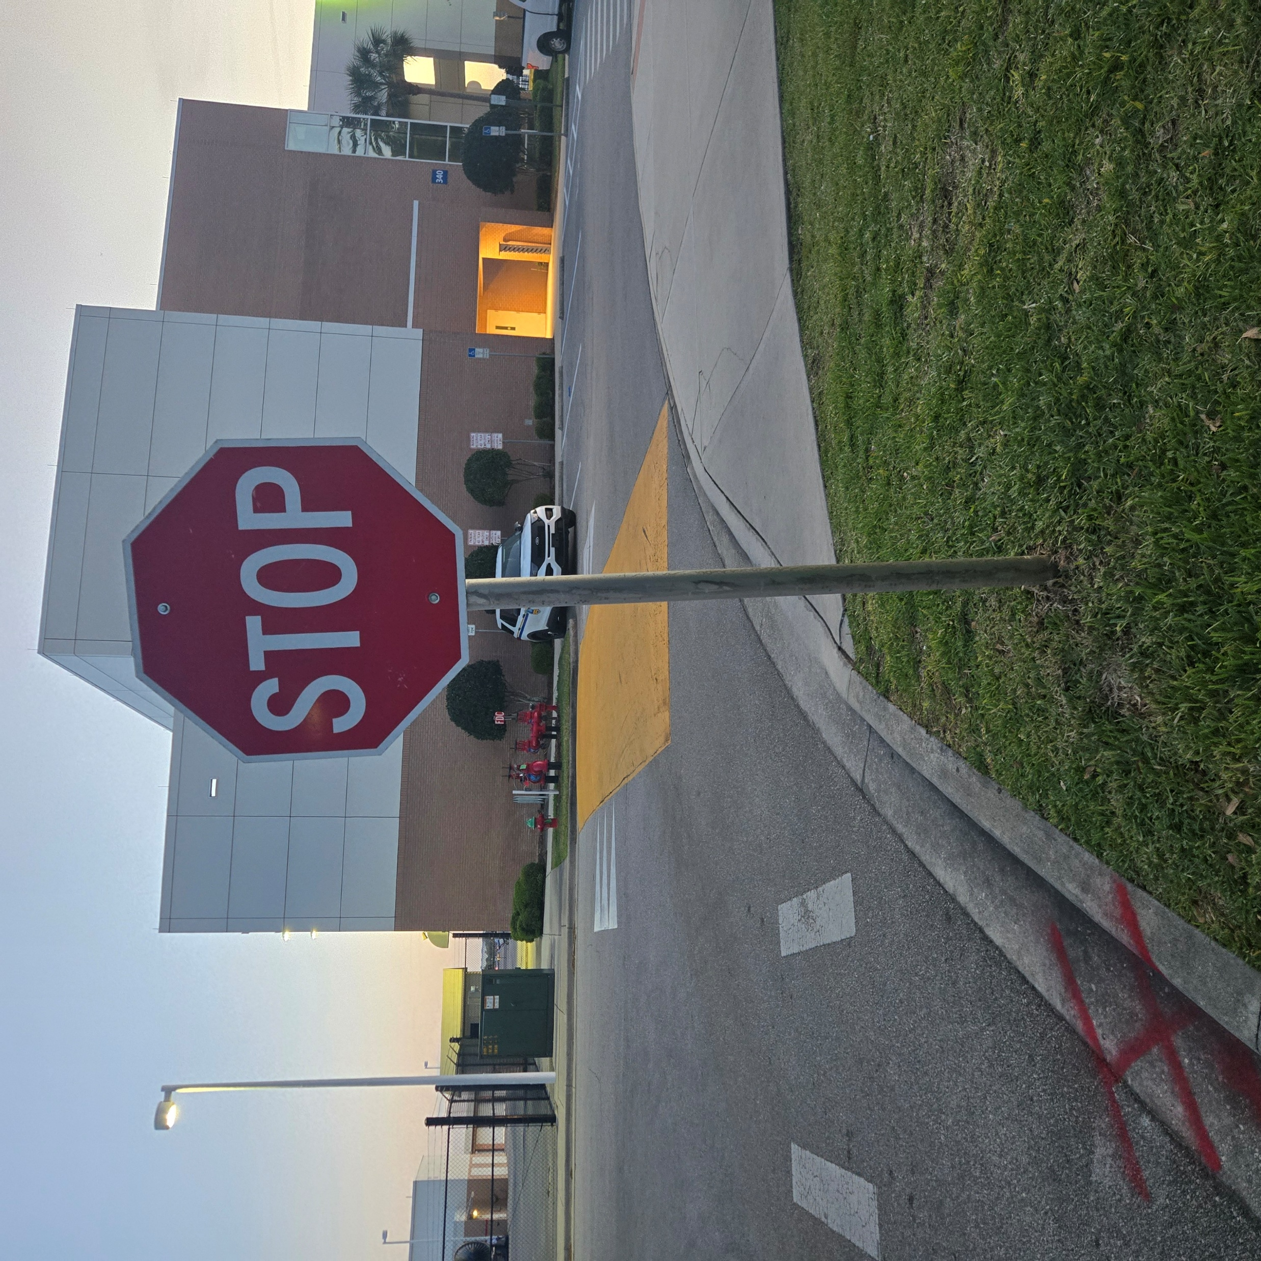

Slide 10
Step 2: Estimate Wind Load
Wind loads are described in terms of the pressure and/or the resulting force that develops on a surface exposed to a wind field.
Three methods to estimate the pressure/force that would be exerted on a STOP sign:
Bluff Body Drag Equations (from AE 201)
What would a physicist or aerospace engineer do?
Codified procedure from ASCE 7 (CIV 304)
What would a practicing professional do?
Computational Fluid Dynamics (AE 610)
What would a graduate student in engineering do?
For this step, you will pick two of these methods (I do NOT recommend CFD!) and then compare the results. You will also use a generic AI chat tool (e.g., ChatGPT or Gemini) to obtain a third estimate.

Slide 11
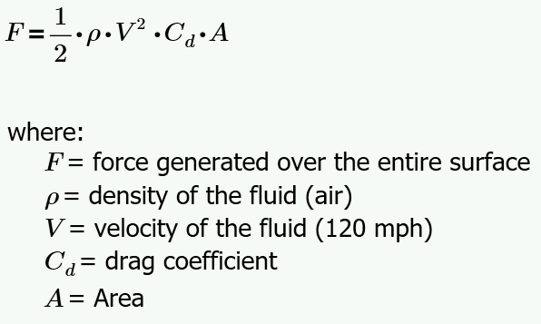
Step 2: Estimate Wind Load
Method 1: Bluff Body Drag Equation
Questions:
Do we need to consider the 2-1/2” pole?
What is an appropriate drag coefficient?
How important are the units for density, velocity, and area?

Slide 12
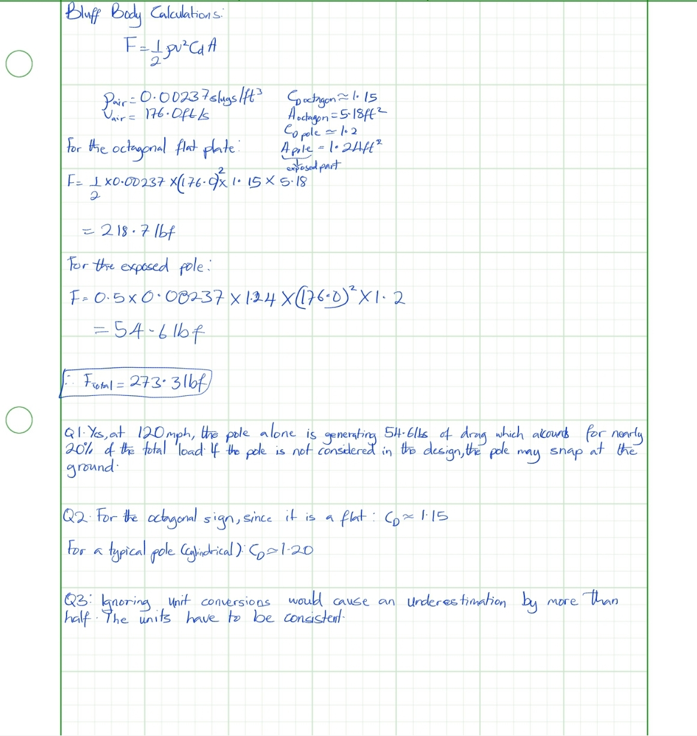

Slide 13
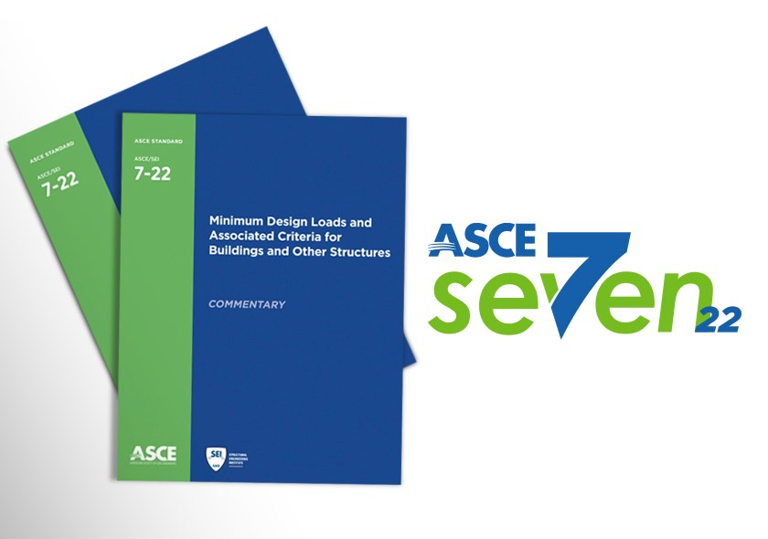
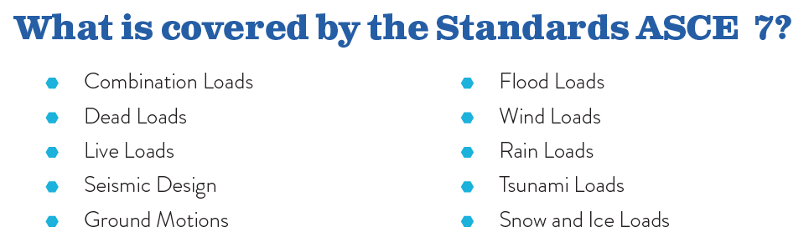
Step 2: Estimate Wind Load
Method 2: ASCE – 7 (The practicing professional approach)
Every six years, the American Society of Civil Engineers releases an updated version of the Minimum Design Loads and Associate Criteria for Buildings and Other Structures

Slide 14
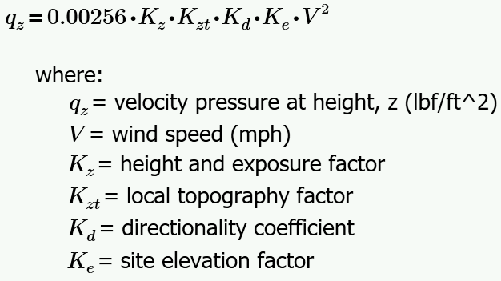
Step 2: Estimate Wind Load (ASCE 7)
Method 2: ASCE – 7 (The practicing professional approach)
Step 1 – Establish the Base Pressure
Essentially a two-step process:

Slide 15
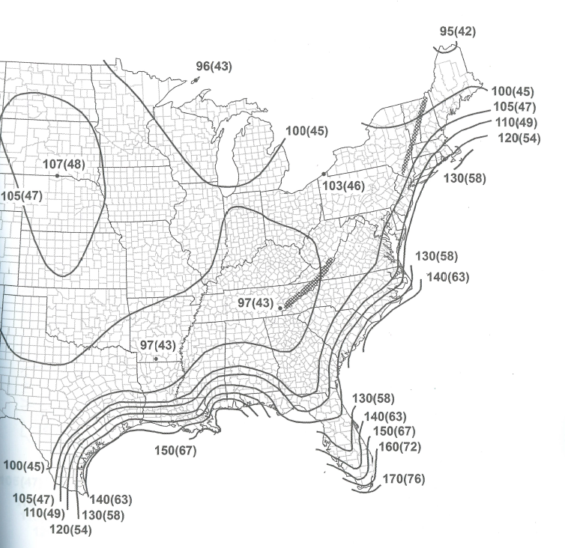
Establish the Base Pressure
City of Daytona Beach says: “Use 120 MPH for STOP signs.”

Slide 16
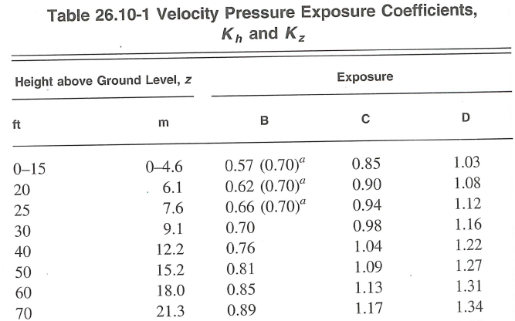
Establish the Base Pressure

Slide 17
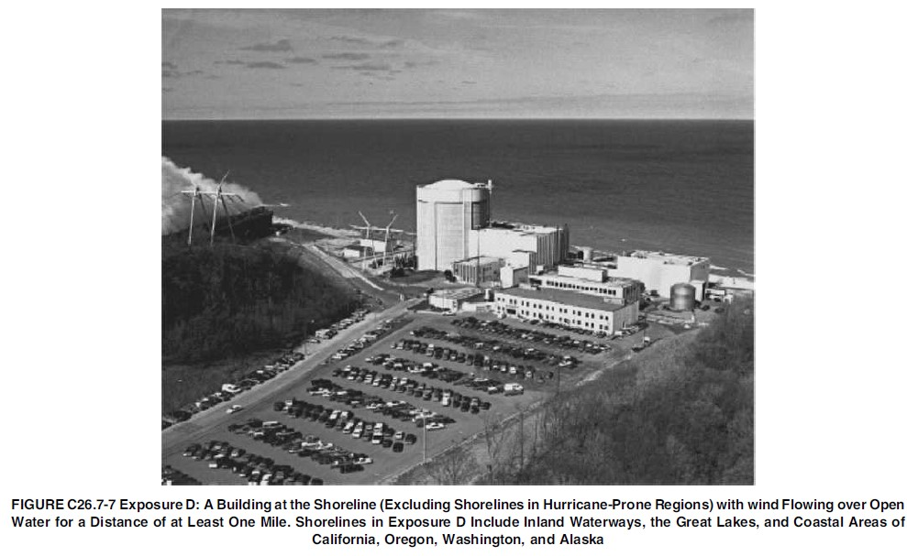

Slide 18
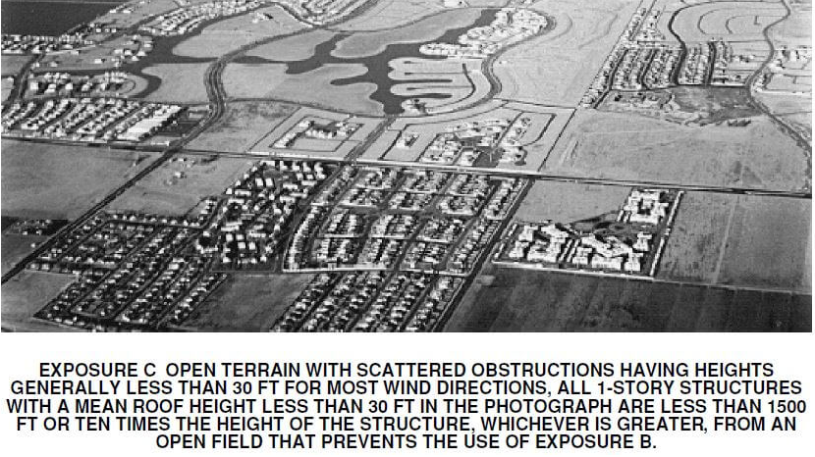

Slide 19
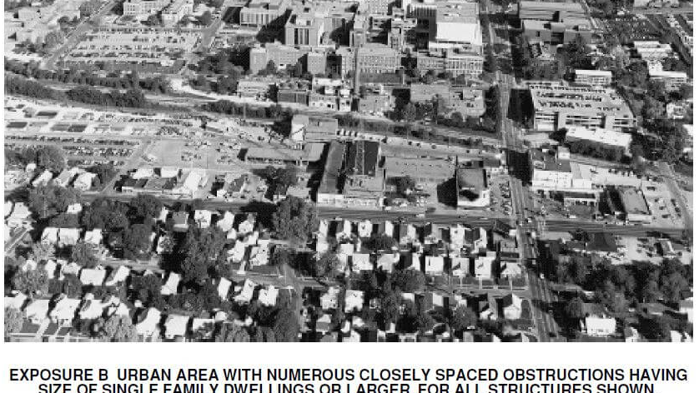

Slide 20
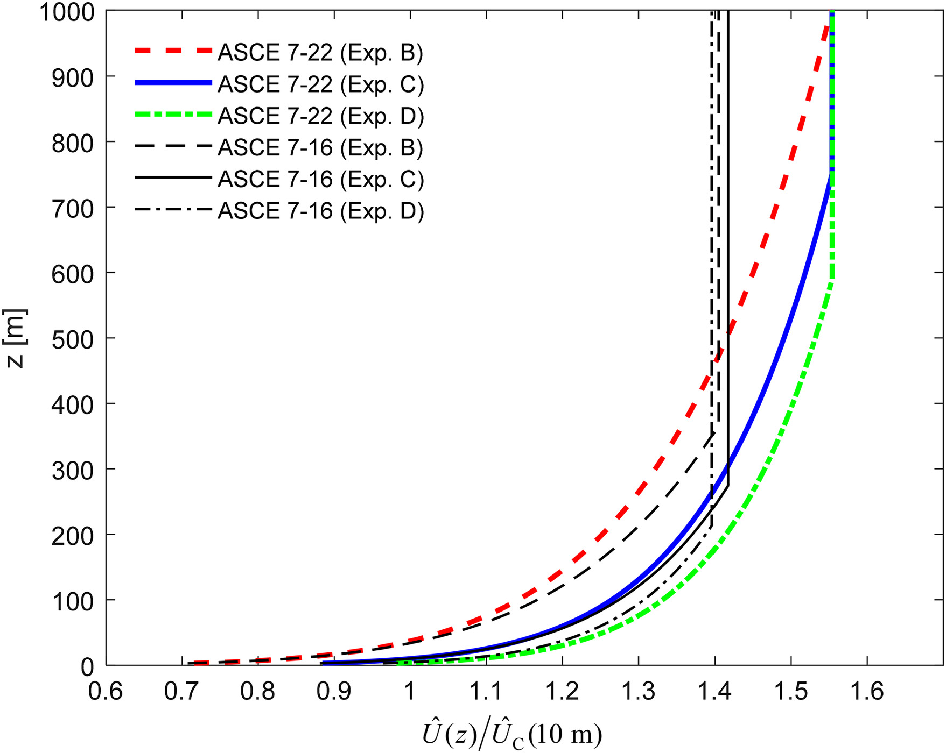
Boundary Layer Models
How tall is the Burj Khalifa?

Slide 21
Establish the Base Pressure
Exposure B for our STOP sign, use 0.57

Slide 22
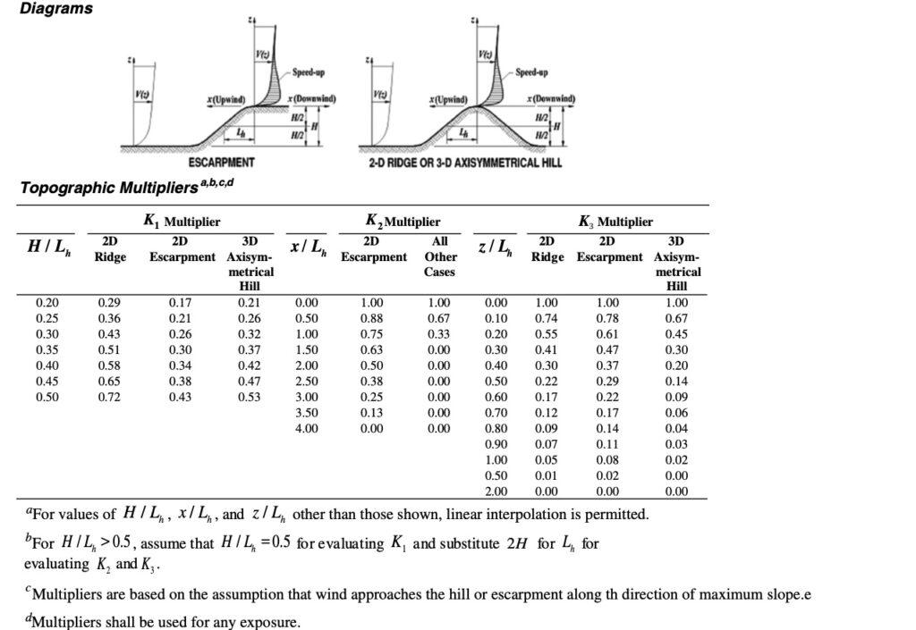
Use 1.0 for our STOP sign

Slide 23
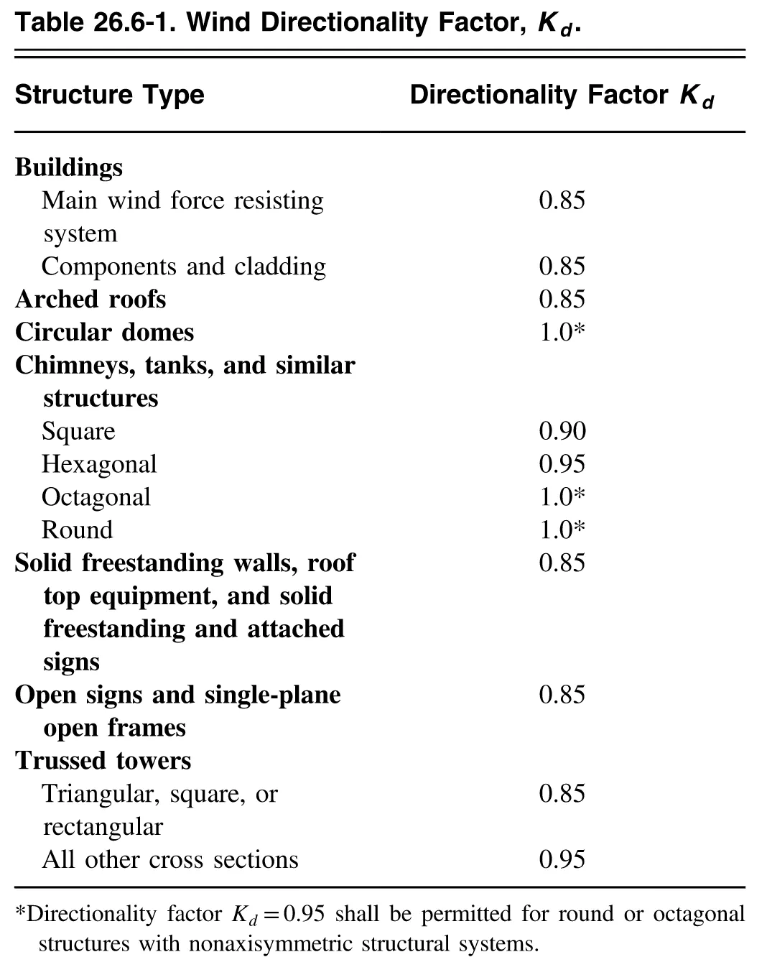
Kd is a “directionality coefficient”. They are essentially asking the question, “What is the likelihood that the maximum design windspeed will occur at the exact angle of incidence that maximize the load on the structure?”
For our stop sign, this means the wind direction would need to be perpendicular to the plane of the sign. In this case, ASCE 7 recommends 0.85.
Use 0.85 for our STOP sign

Slide 24
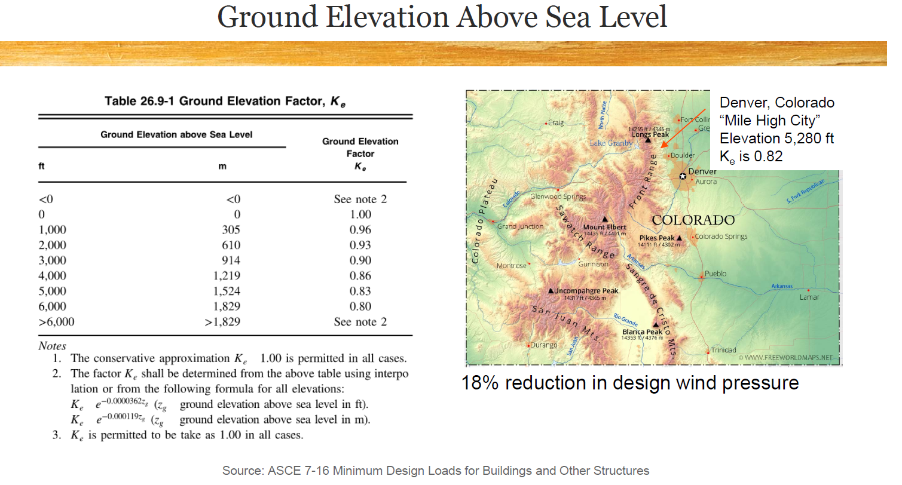

Slide 25
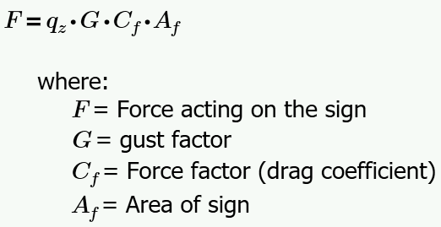
Step 2: Estimate Wind Load (ASCE 7)
Method 2: ASCE – 7 (The practicing professional approach)
Step 2 – Determine Force on the Sign
Essentially a two-step process:

Slide 26
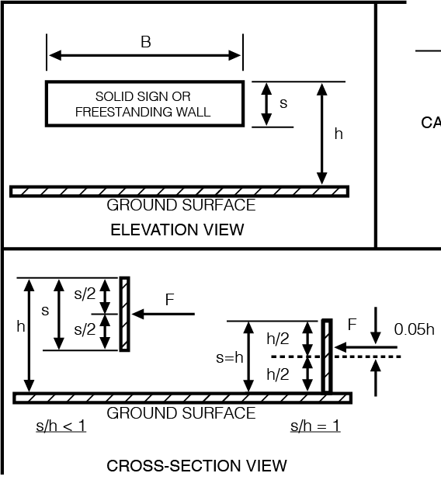
Step 2: Estimate Wind Load (ASCE 7)

Slide 27
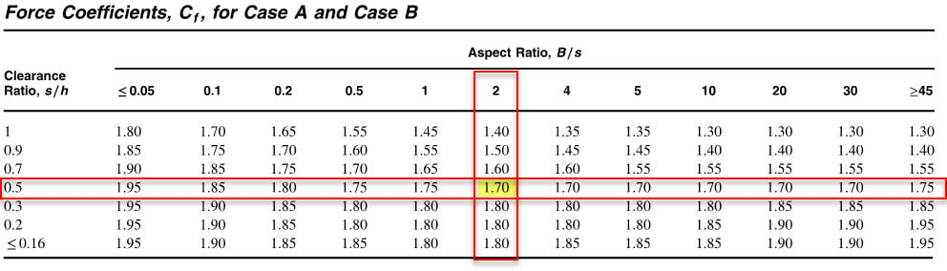
Step 2: Estimate Wind Load (ASCE 7)
Use appropriate values for s/h and B/s for our STOP sign

Slide 28
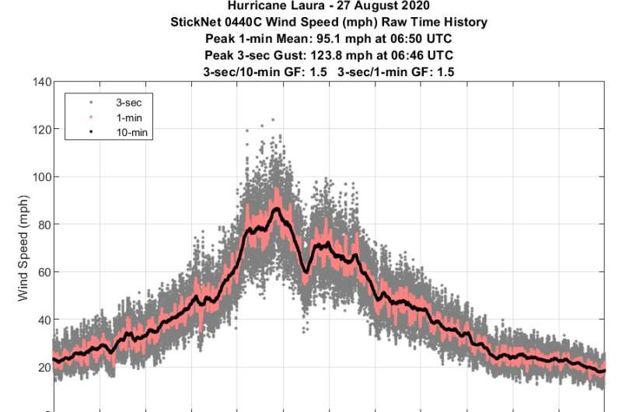
Step 2: Estimate Wind Load (ASCE 7)
For “Rigid” buildings or other structures, use G = 0.85
What is “Rigid”?
Fundamental frequency > 1 Hz
Use 0.85 for our STOP sign

Slide 29
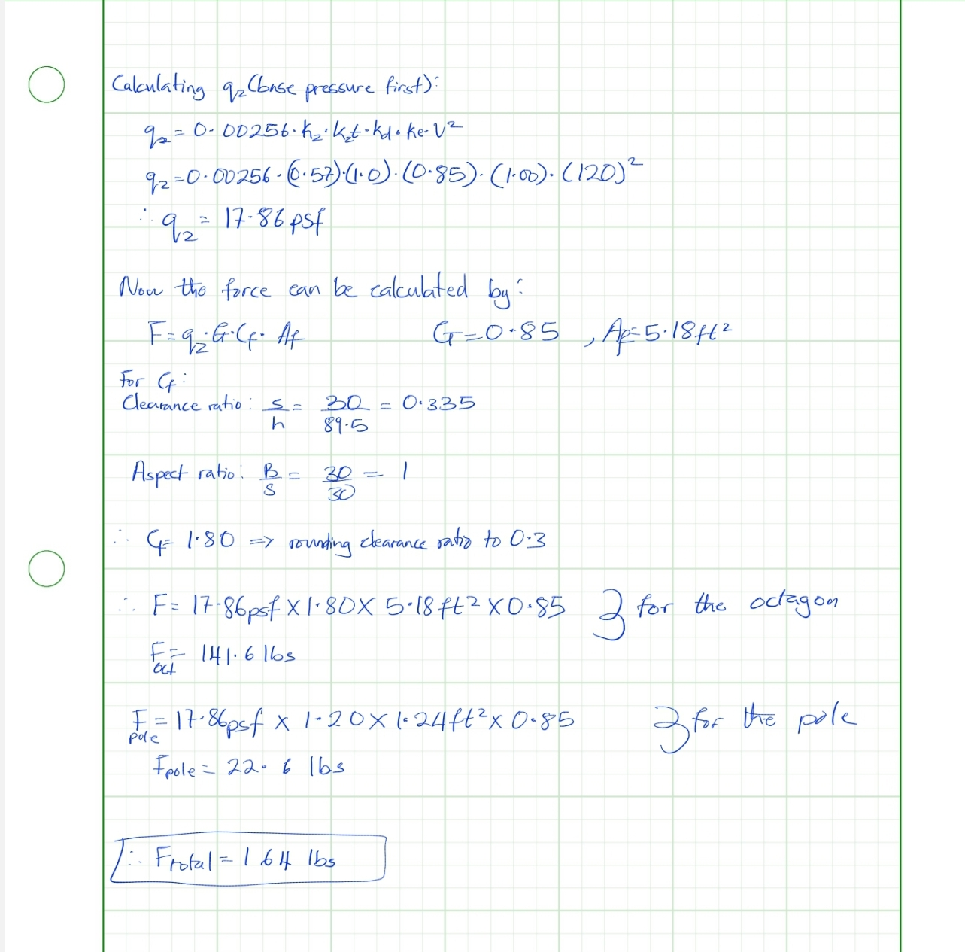

Slide 30
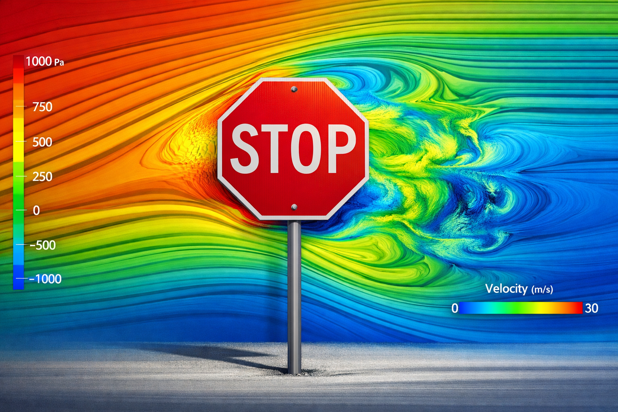
Step 2: Estimate Wind Load (CFD – if you dare!)

Slide 31
Step 2: Estimate Wind Load (AI)
Use your favorite AI tool to VALIDATE your hand calculations.

Slide 32
Step 2: Choose Final Wind Load
Choose your design wind load that you will use for the remainder of the project.
F = 164lbs (ASCE 7 Value)

Slide 33
Insert Your Wind Load Summary Here. For the bluff body calculation: the force was calculated to be 273.3 lbs and for the ASCE 7 method: the velocity was calculated to be 164.2 lbs. The two values have a percentage difference of approximately 50%. The Ai tool I used was Gemini, it also got a value of 164 lbs for the ASCE 7 method after plugging in the actual parameters specified, especially for the base pressure calculations. For the bluff body body method, it got a value of 273.9lbs. However, it did not that the calculations for the pole area may be wrong, but agreed that if I only accounted for the exposed part of the pole, my calculations are good. I will be proceeding with the ASCE 7 method because unlike the bluff body calculations, this method accounts for the boundary layer effect, meaning that this method accounts for the friction from the ground or trees or buildings that could interfere with the wind flow. Also, since the bluff body calculation overestimates the force the sign is to withstand, it can cost more to produce. In addition, the bluff body equation does not account for the vibration of the sign nor does it account for the stiffness of the sign.

