Slide 1



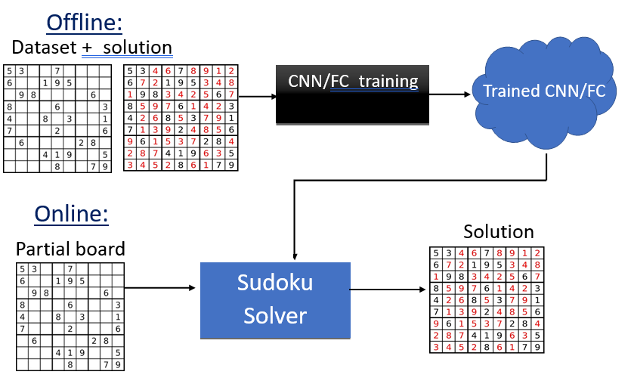
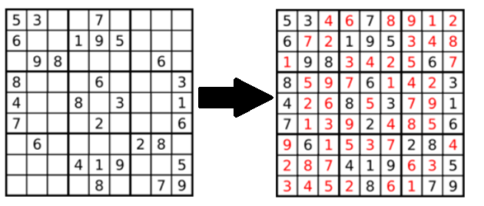
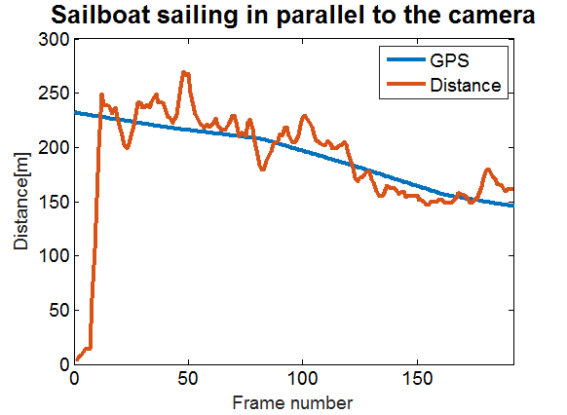
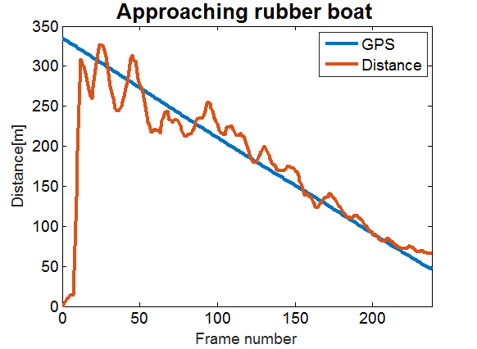
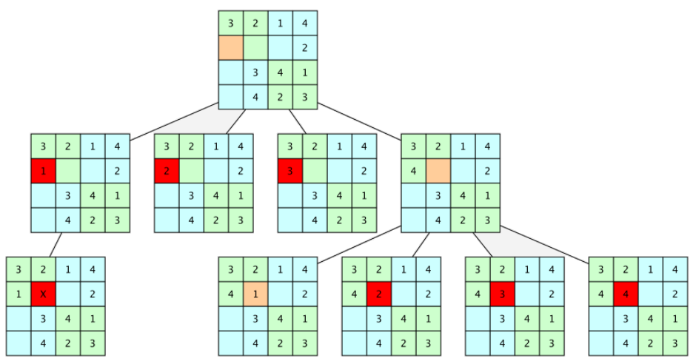
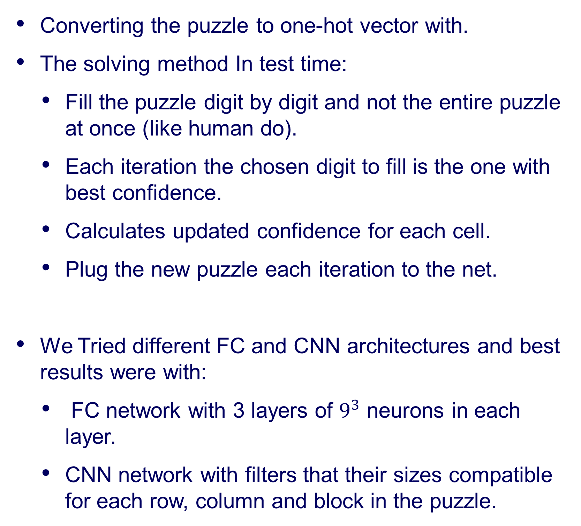
Solving Sudoku Using Machine Learning And AI Tools
Chen Dudai and Barak Mamistvalov, Supervised by Ron Dorfman and Tom Jurgenson
Introduction
Our Chosen Solution
Distance in Meters
The Sudoku game is a number placement puzzle that gained massive popularity in the last few years.
The objective is to fill a 9×9 grid with digits so that each column, row, and 3×3 blocks contain all the digits from 1 to 9.
Backtracking algorithm is a common method for solving Sudoku automatically.
Introduction
Offline: training a FC or CNN architecture to solve Sudoku puzzles using a dataset of one million Sudoku puzzles.
Online: a partial Sudoku puzzles is the input of the trained architecture and the output is the suggested solution of the network.
גרפים יפים של איבר ספציפי ברשת
A Sudoku puzzle and the solution
Converting the puzzle to one-hot vector with.
The solving method In test time:
Fill the puzzle digit by digit and not the entire puzzle at once (like human do).
Each iteration the chosen digit to fill is the one with best confidence.
Calculates updated confidence for each cell.
Plug the new puzzle each iteration to the net.
We Tried different FC and CNN architectures and best results were with:
FC network with 3 layers of $9^{3}$ neurons in each layer.
CNN network with filters that their sizes compatible for each row, column and block in the puzzle.
Goals
Solving Sudoku fast using deep learning methods
Comparing to brute-force method
ROI Detection
Challenges
Creating appropriate Deep Learning architectures
Improving solutions from the literature
??? Use an iterative solution???
Comparing the different Deep Learning methods we used
Comparing the Deep Learning solution to the Backtracking solution
Results
The best results is with 3 layers of FC...
לשים טבלה
An experiment with multiple marine vessels was conducted
For comparison to ground truth, videos were synchronized with GPS coordinate measurements for each vessel
Results show a mean absolute relative error of 7.1% with a standard deviation of 5.8%
Curriculum Learning
Backtracking Solution
Curriculum learning describes a type of learning in which you first start out with only easy examples of a task and then gradually increase the task difficulty.
In an article: Guy, H. (2019). “On the power of curriculum learning in training deep networks”, we saw that Curriculum learning in deep neural networks can improve the results of the network.
Training method in our project:
Increasing number of deleted digits in the puzzle to increase the level of difficulty.
Deleting elements properly from the original board to avoid more than one possible solution.
Distributed number of deleted elements so the net will “remember” how to solve easy puzzles.
גרף של השוואה בין התוצאות עם ובלי curriculum
The common automatically solution for Sudoku is using backtracking meaning:
recursive algorithm that attempts testing all possible paths towards a solution until a solution is found.
If the candidate for the solution cannot possibly be completed to a valid solution, the algorithm abandons the candidate ("backtracks").
Estimated distance vs. GPS measured distance
Conclusions
Successful estimation of distance with suitable accuracy for navigation applications
Accurate horizon detection
Robust selection of nearest point of tracked vehicle
Computationally efficient algorithm
Feasible to run in real-time on a USV
An example for backtracking solution for 4x4 Sudoku puzzle
September 2020

