Slide 1
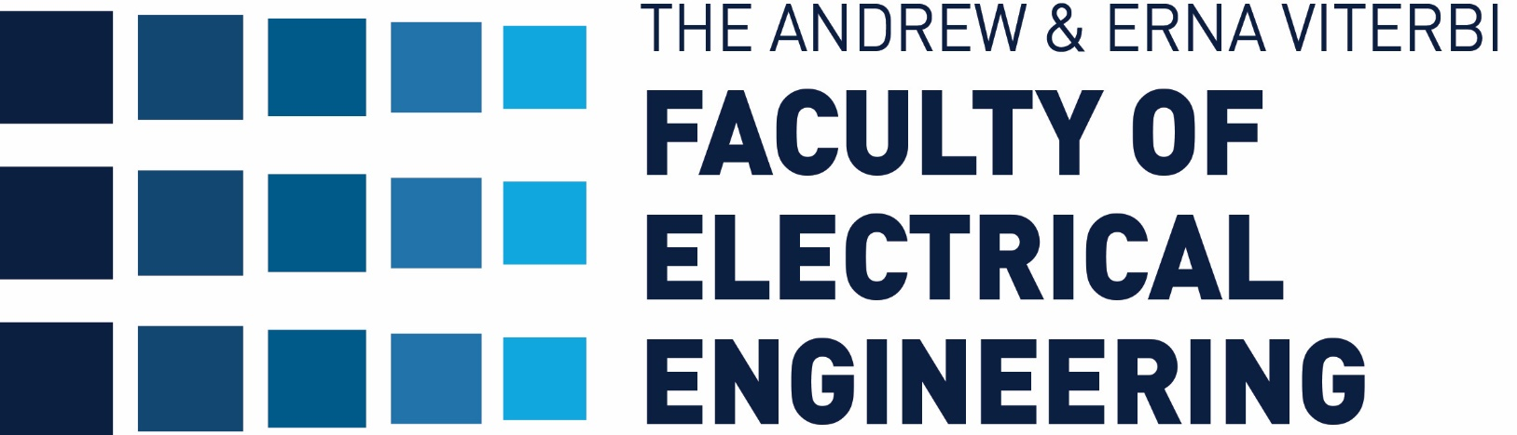
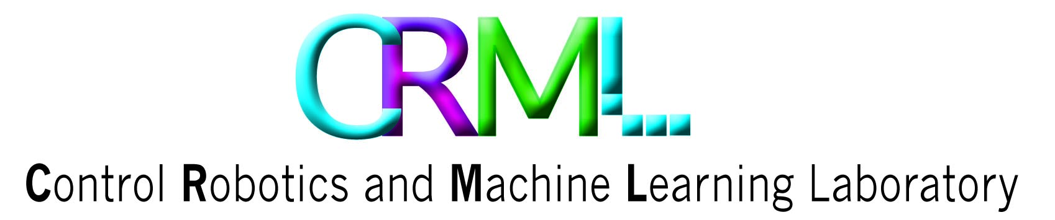

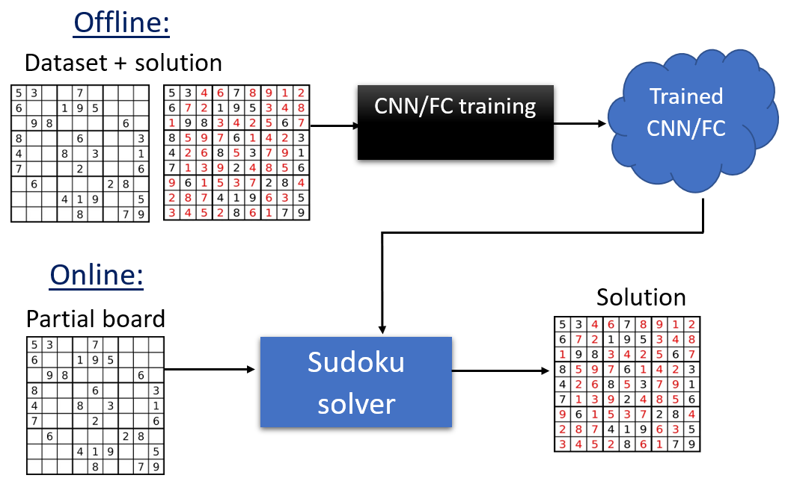
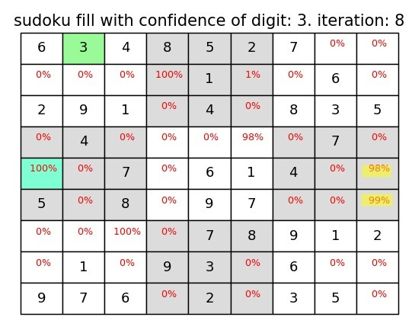
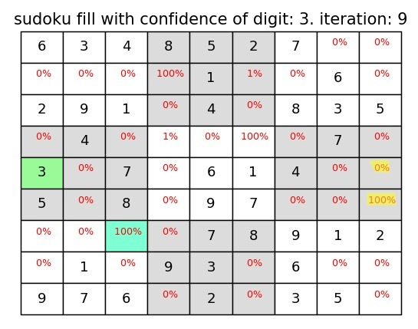
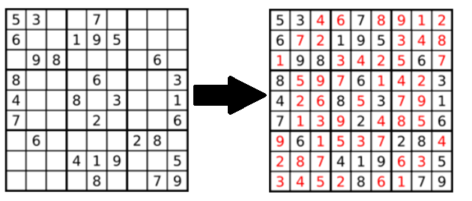
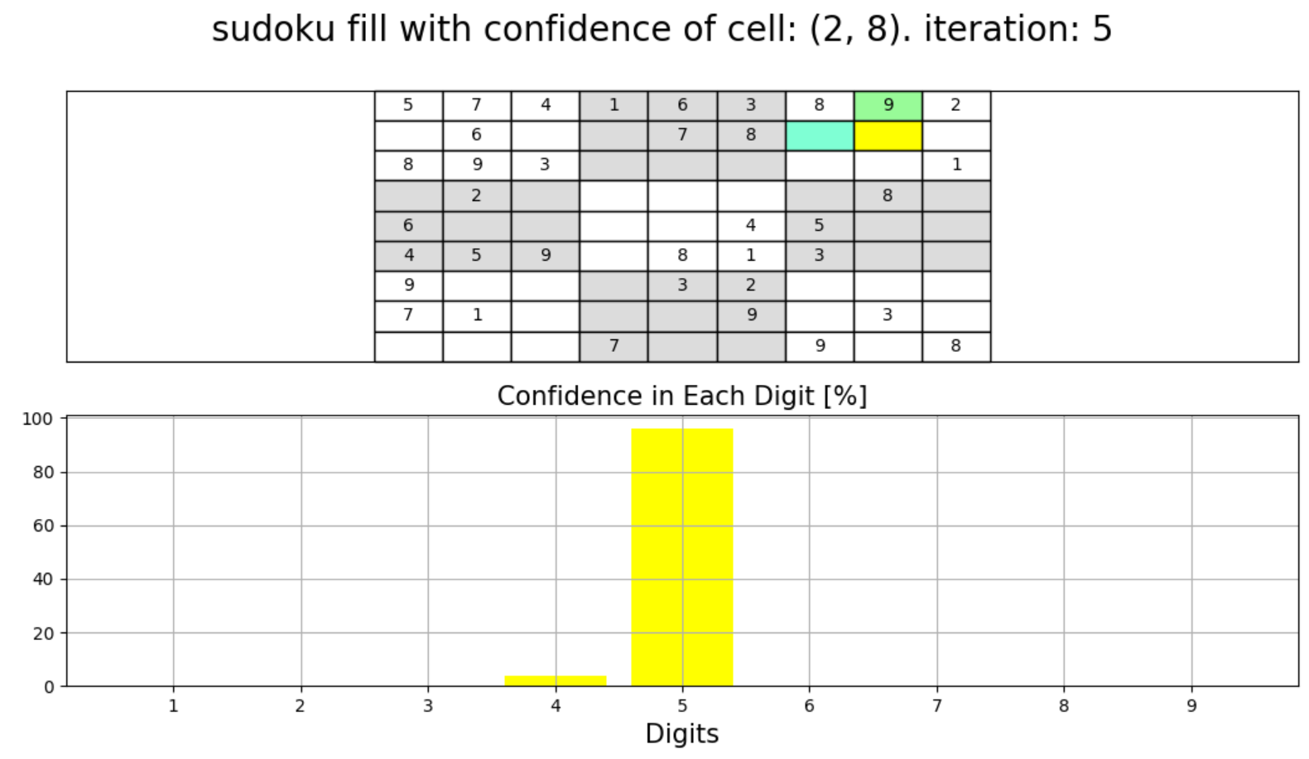
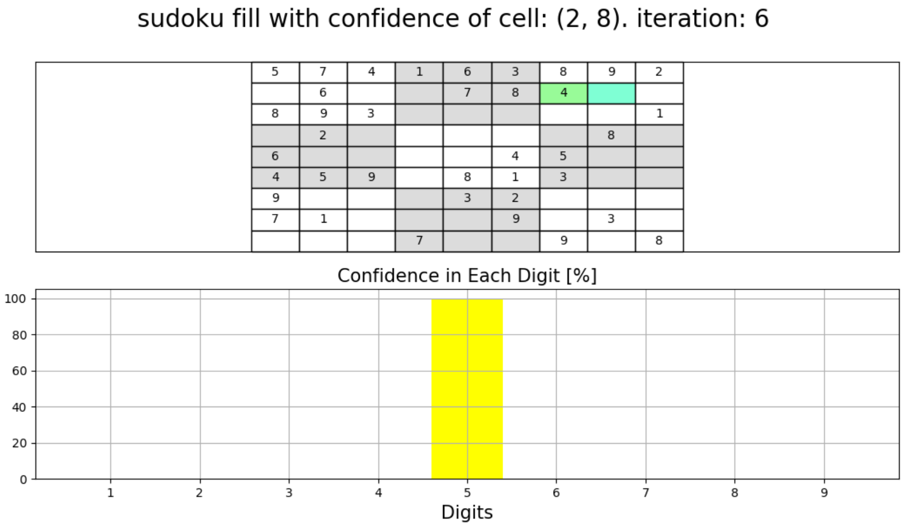
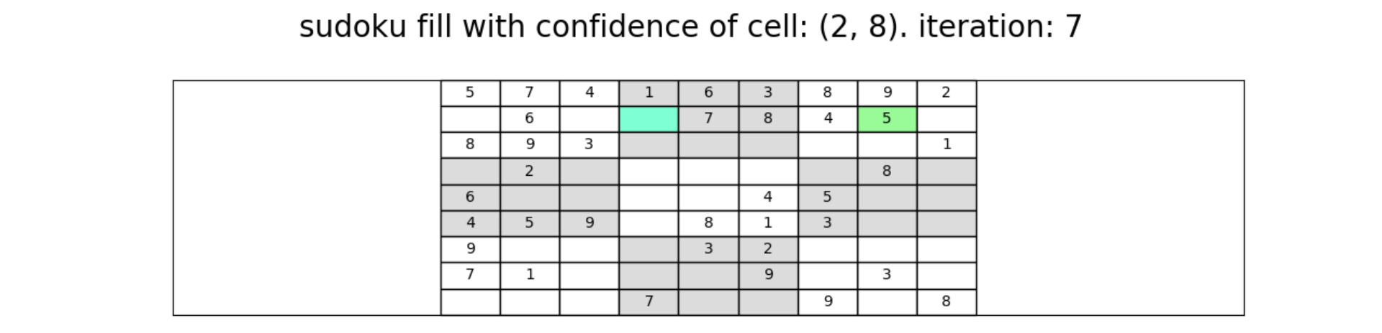
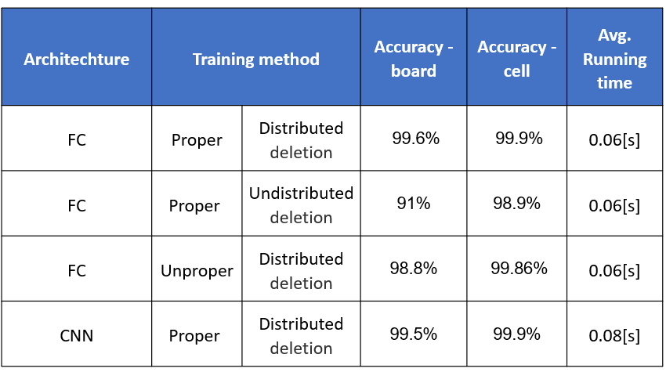
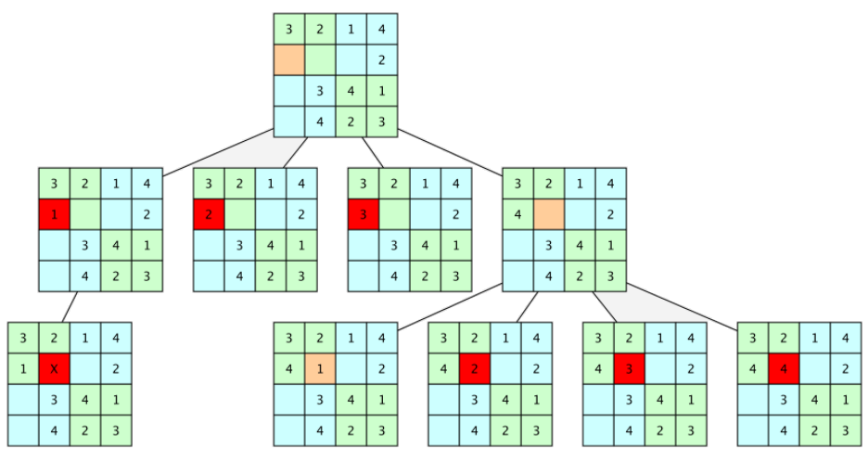
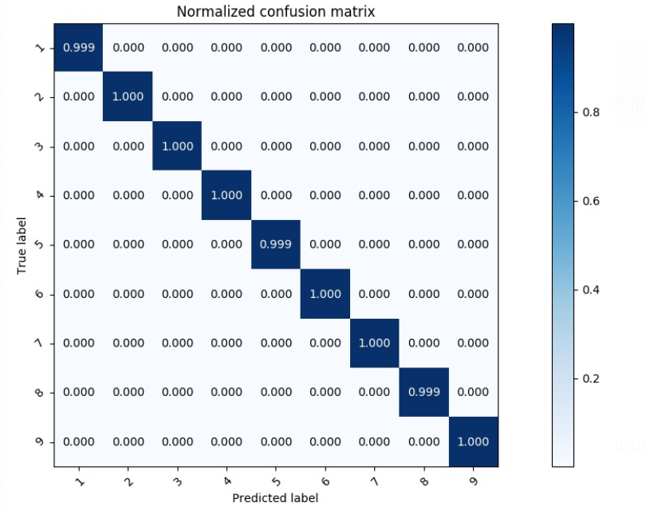
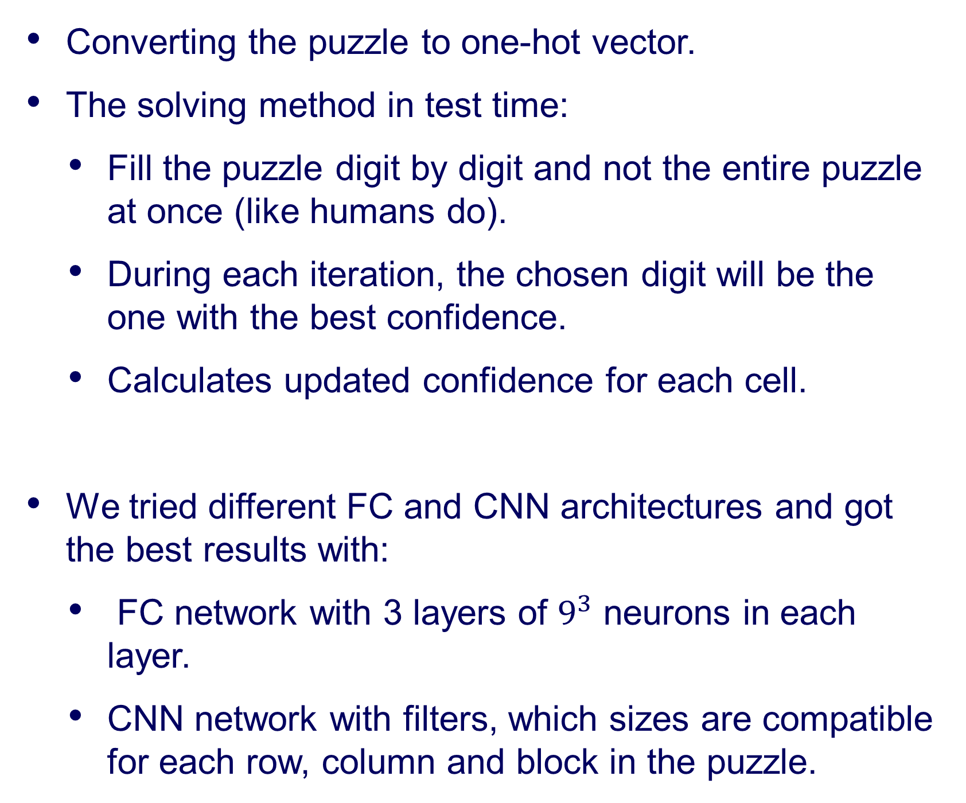
Solving Sudoku Using Machine Learning and AI Tools
Chen Dudai and Barak Mamistvalov
Supervised by Ron Dorfman and Tom Jurgenson
Distance in Meters
Introduction
Our Chosen Solution
Analyzing the Net
The Sudoku game is a number placement puzzle that gained massive popularity in the last few years.
The objective is to fill a 9×9 grid with digits so that each column, row, and 3×3 blocks contain all the digits from 1 to 9.
Backtracking algorithm is a common method for solving Sudoku automatically.
Offline: training a FC or CNN architecture to solve Sudoku puzzles using a dataset of one million Sudoku puzzles.
Online: partial Sudoku puzzles is the input of the trained architecture and the output is the suggested solution of the puzzle.
Analyzing the net performance on test puzzles:
That way we can evaluate what the net “thinks” before solving the puzzle.
A Sudoku puzzle and the solution
Converting the puzzle to one-hot vector.
The solving method in test time:
Fill the puzzle digit by digit and not the entire puzzle at once (like humans do).
During each iteration, the chosen digit will be the one with the best confidence.
Calculates updated confidence for each cell.
We tried different FC and CNN architectures and got the best results with:
FC network with 3 layers of $9^{3}$ neurons in each layer.
CNN network with filters, which sizes are compatible for each row, column and block in the puzzle.
Goals
Solving Sudoku fast using deep learning methods
Comparing to brute-force method
ROI Detection
Challenges
Creating appropriate Deep Learning architectures
Implementing Curriculum learning method
Finding the best training method to fit the problem
Overcome brute-force solution running time
Results
Curriculum Learning
Backtracking Solution
Curriculum learning describes a type of learning in which you first start out with only easy examples of a task and then gradually increase the task difficulty.
Training method in our project:
Increasing the number of deleted digits in the puzzle to increase the level of difficulty.
Deleting elements properly from the original board to avoid more than one possible solution.
Distributed number of deleted elements so the net will “remember” how to solve easy puzzles.
The common automatic solution for Sudoku is by using backtracking:
recursive algorithm that attempts to test all possible paths towards a solution, until one is found.
If the candidate for the solution cannot become a valid solution, the algorithm abandons the candidate ("backtracks").
Conclusions
Neural nets are capable to “learn” the Sudoku rules and play successfully
Faster than brute-force solution
Stable running time
Curriculum learning may perform better on suitable problems like Sudoku
The network “remembers” how to solve easy puzzles.
Iterative solution may perform better
Fill elements one by one
The best deletion method in training for this problem is: proper distributed deletion.
An example for backtracking solution for 4x4 Sudoku puzzle
Confusion matrix for each digit in the test set
September 2020

