Slide 1

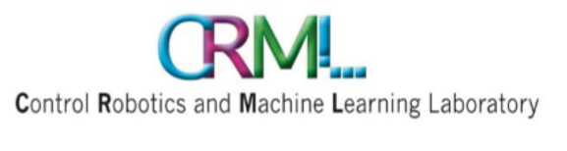
Final Presentation Solving Sudoku Using Machine Learning And AI Tools
Students: Chen Dudai, Barak Mamistvalov
Supervisors: Ron Dorfman, Tom Jurgenson
Semester: Winter, 2020
Date: 12/9/2020

Slide 2
Outline
Project Goal
Background
Literature Survey
Chosen Solution
Conclusions
Future Work
2

Slide 3
Project Goal
Solving Sudoku fast using deep learning methods
Comparing to brute-force method

Slide 4
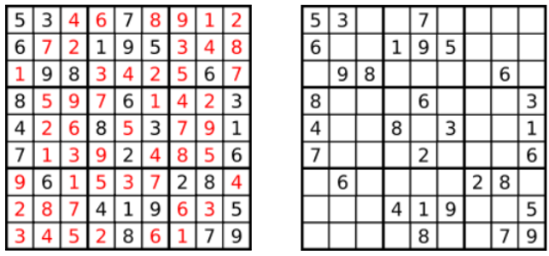
Background
Sudoku is a widespread game
Common size is 9x9
Fill board with numbers 1-9
Unique digits on every row, column, block
Backtracking is the common method of solving
Very time consuming (אולי להוסיף שקופית btacltracking או common solution)
Notes:
בבקטרקינג הזמן גדל אקספוננציאלית עם מספר האיברים המחוקים.

Slide 5
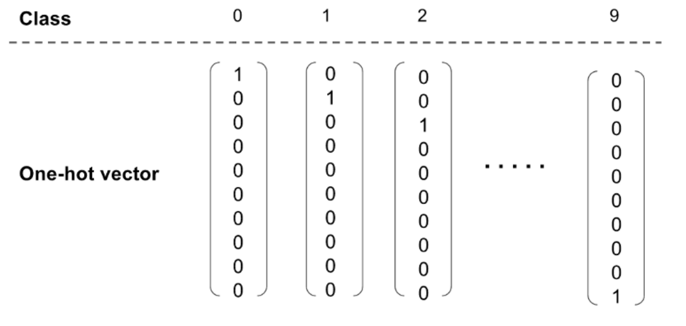
Dataset
One million puzzles from Kaggle.
Conversion to one-hot vector.
In training: create puzzles by deleting numbers from the full boards.
Notes:
One million puzzles from Kaggle. – יש מיליון לוחות של זוגות של פאזלים חלקיים ומלאים.

Slide 6
Architecture

