Slide 1

Integrating Wavelet Scattering into CNN
Gilad Navok
Barak Telem
Notes:
Hi everybody. Our project is about integrating wavelet scattering into CNN architecture

Slide 2
Outline
Introduction
Motivation
Background
Baseline
Our Models
Results
Future work (?)

Slide 3
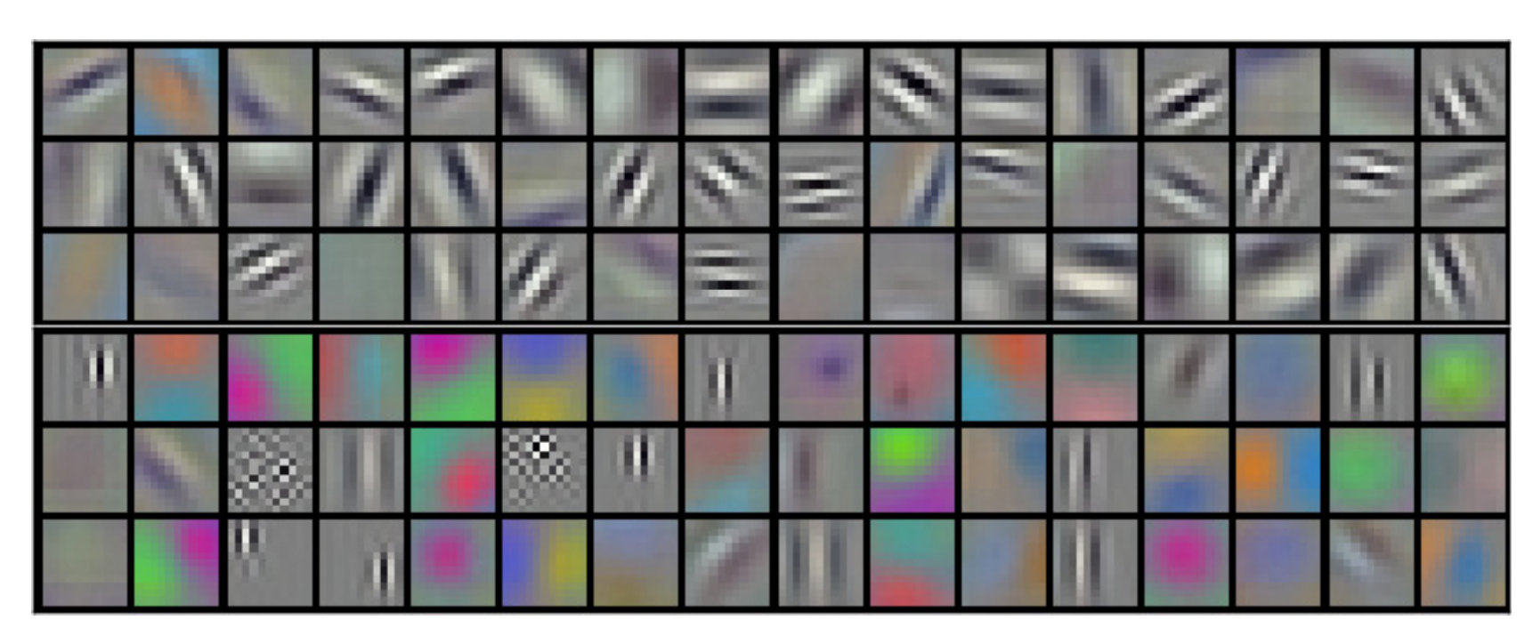
Motivation
CNNs kernels resembles wavelets
Small data training (prior)
Helping CNNs texture bias
Notes:
As we saw in class, at the end of training, the first layers of CNNs tend to get a shape resembling wavelets.
We wanted to examine if this property can be used to improve training on small data (like using prior)
In addition, we wanted to check if this integration can help CNN with texture bias. As scattering may leave CNN kernel to learn different features

Slide 4
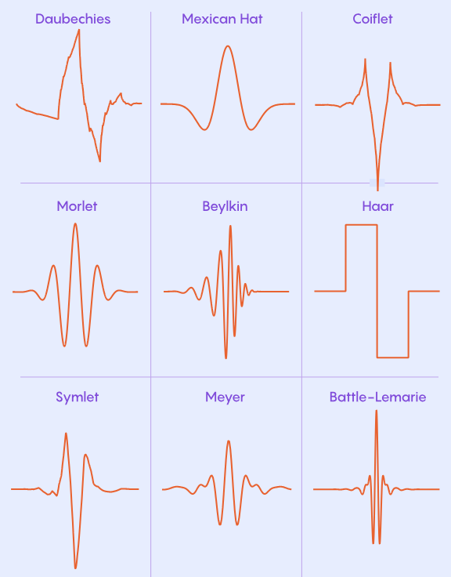
Background - Wavelets
Adjustable Scale
Directional Sensitivity
Versatile Design
Notes:
Adjustable Scale (Dilations):
Wavelets can be stretched or squeezed to detect features of any size—from fine edges to large structural shapes.
Connection to Scattering: This allows the network to separate signal components by frequency bands ($j$).
Directional Sensitivity (Rotations):
Unlike standard pixels, image wavelets are parameterized by orientation. They can specifically detect vertical, horizontal, or diagonal edges.
Connection to Scattering: Scattering networks average over these rotations to achieve rotational invariance.
Versatile Design (e.g., Morlet):
You can choose the wavelet shape that best fits your data (like Morlet or Mexican Hat).
Connection to Scattering: Scattering typically uses Complex Morlet wavelets because their "magnitude" (modulus) provides a smooth, stable envelope of the signal.

Slide 5
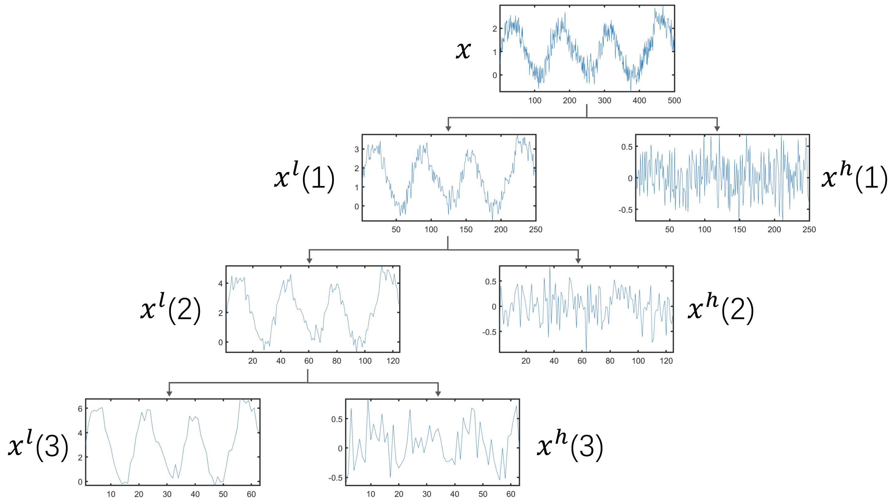
Wavelet Scattering Transform (WST)
Used for signal and image processing.
Applies convolution, nonlinearity and layer cascade on signals.
Notes:
Wavelet Scattering is a mathematical tool for processing signals and images.
Structurally, it resembles a CNN, using layers of convolution, and nonlinearity to extract features from signals.

Slide 6
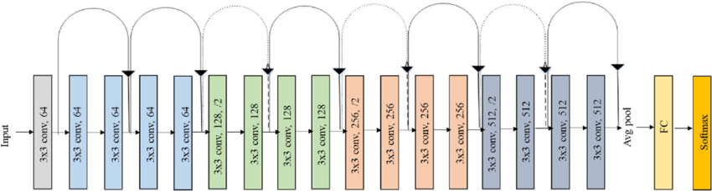
Baseline Model: ResNet18
A CNN model.
11M parameters.
17 conv layers with residual connections and 1 final FC layer.
Notes:
We selected ResNet18 for our baseline model. It is a 11M parameters CNN model with 17 convolutional layers with residual connections and 1 final fully connected layer.

Slide 7
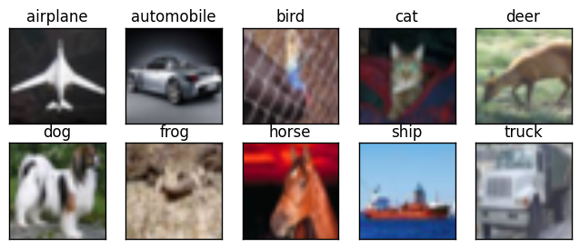
Dataset: CIFAR-10
60K 32x32 images.
10 distinct classes.
Notes:
For our dataset we use CIFAR-10. It is an image dataset that consists of 60K train and test 32x32 images and 10 distinct classes.

Slide 8
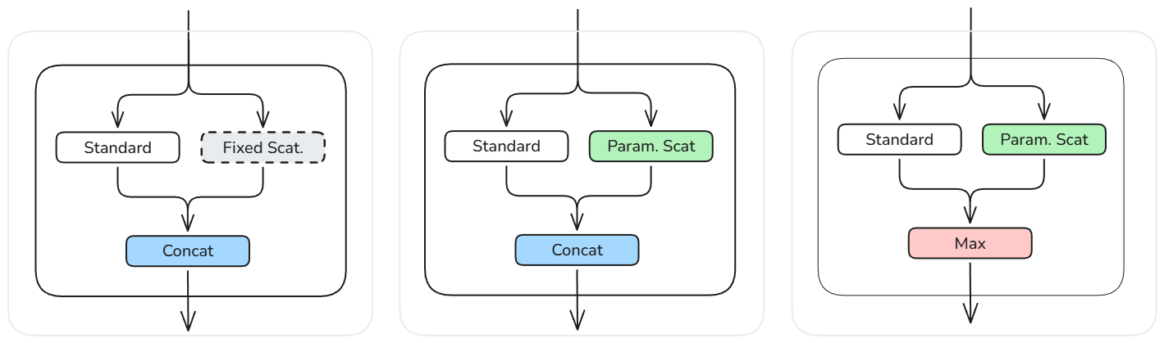
Proposed Hybrid Layers
Notes:
To integrate wavelet scattering to the baseline model, we proposed three variations of hybrid convolutional and wavelet scattering layers.
The first concatenates standard convolution features with fixed scattering transform coefficients.
The second one replaces the fixed scattering transform with a learnable, parametric one.
The last hybrid layer replaces channel wise concatenation with element-wise maximum.

Slide 9
Experiment 1: First Layer Replacement
Notes:
In our first experiment we replaced only the first convolutional layer in the baseline model with the hybrid layers, and evaluated the models test accuracy over the number of training samples.

Slide 10
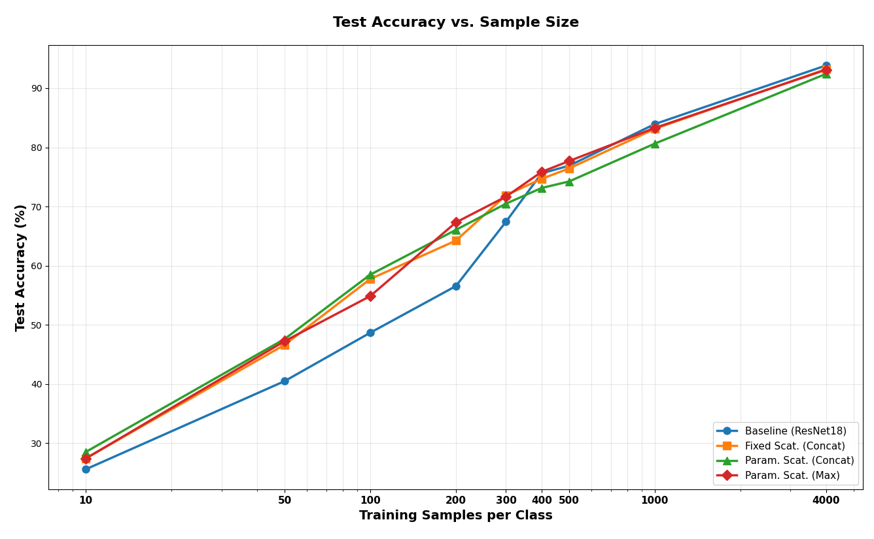
Results – Test Accuracy
Notes:
These are the results. As you can see, in the lower data regime the hybrid layers improve the test accuracy significantly. But at some point, around 400 samples per class, the baseline model catches up and performs slightly better than the hybrid model.

Slide 11
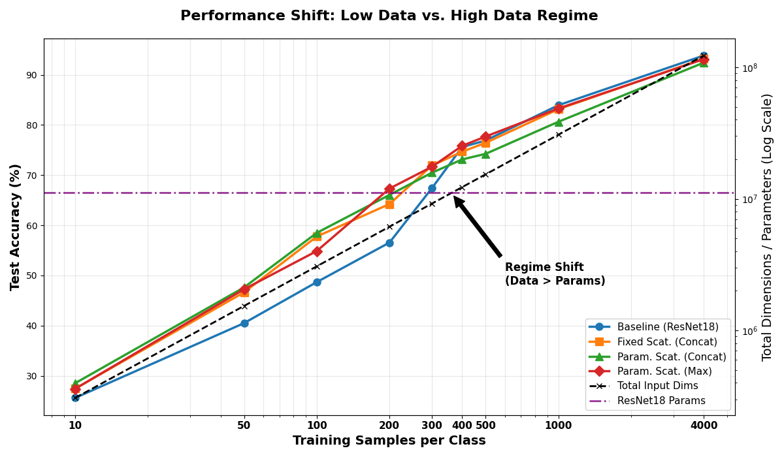
Results – Test Accuracy
Notes:
To explain this, we plot the training set size (the black dashed line), against the model’s parameter count (the purple horizontal dashed line). To the left of their intersection, the model has more parameters than data points. This allows the model to simply memorize the training data, leading to overfitting. Our hybrid models perform better in this region which suggests that the scattering layers act as an architectural regularizer – preventing the model from overfitting when data is scarce.

Slide 12
Experiment 2: Deeper Integration
Notes:
Next we experimented with replacing the first layers of the baseline model cumulatively, and evaluated the models as before.

Slide 13
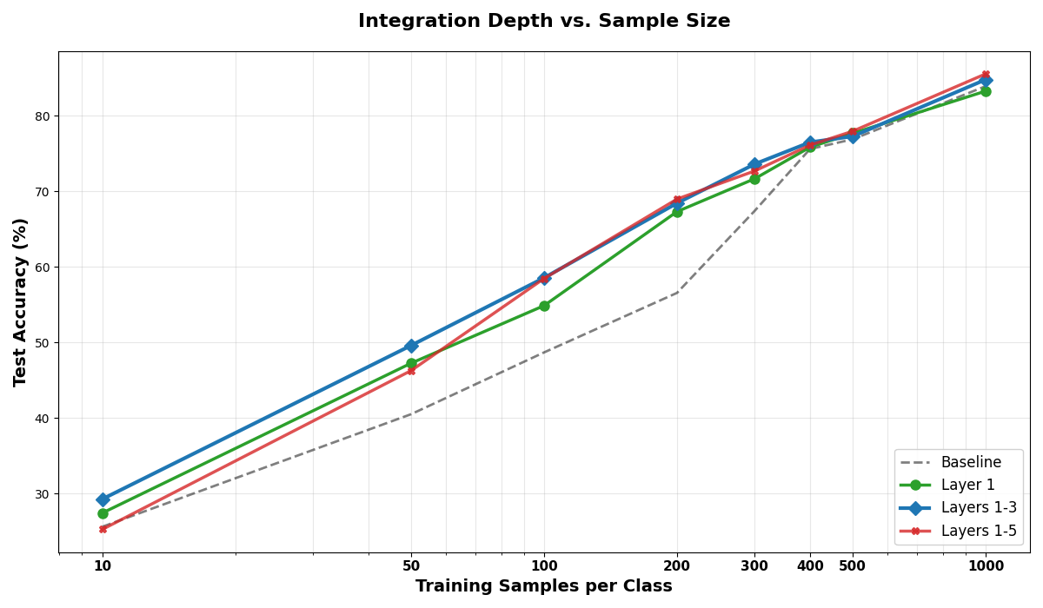
Results – Test Accuracy
Notes:
Once again, we evaluated the models test accuracy over the number of training samples.
"In this graph, the Gray dashed line is the Baseline. The Green line represents replacing just the first layer. The Blue line is Layers 1-through-3. And the Red line is Layers 1-through-5.“ As you can see, replacing Layers 1-through-3 consistently performs slightly better than just Layer 1. However, going deeper to Layer 5 (the Red line) does not yield further improvements in the low-data regime, but was slightly better at 1,000 samples.
Again, we evaluated the models test accuracy over the number of training samples. In green we see the test accuracy for replacing only the first layer, in blue layers 1-3 and in red layers 1-5, in gray we see the baseline model test accuracy. The effect here is pretty mild. We can see that replacing layers 1-3 is slightly better than replacing only the first layer, and replacing layers 1-5 performed worse on the lowest data regime, and very slightly better on the 1000 samples per class test.

Slide 14
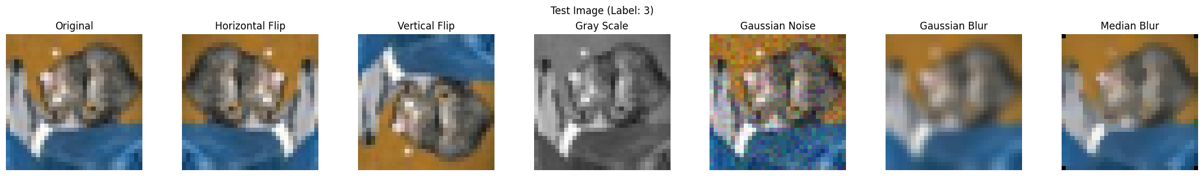
Results – Robustness
Augmentations that copy texture and positional changes (with Kornia)
Notes:
To check robustness to texture and positional changes of our models, we augmented our test set with 6 different augmentations.
Each pair will examine robustness in:
Positional changes
Color changes
Blur
Models were trained with the following augmentations:
Horizontal flip
Color jitter
Resize crop

Slide 15
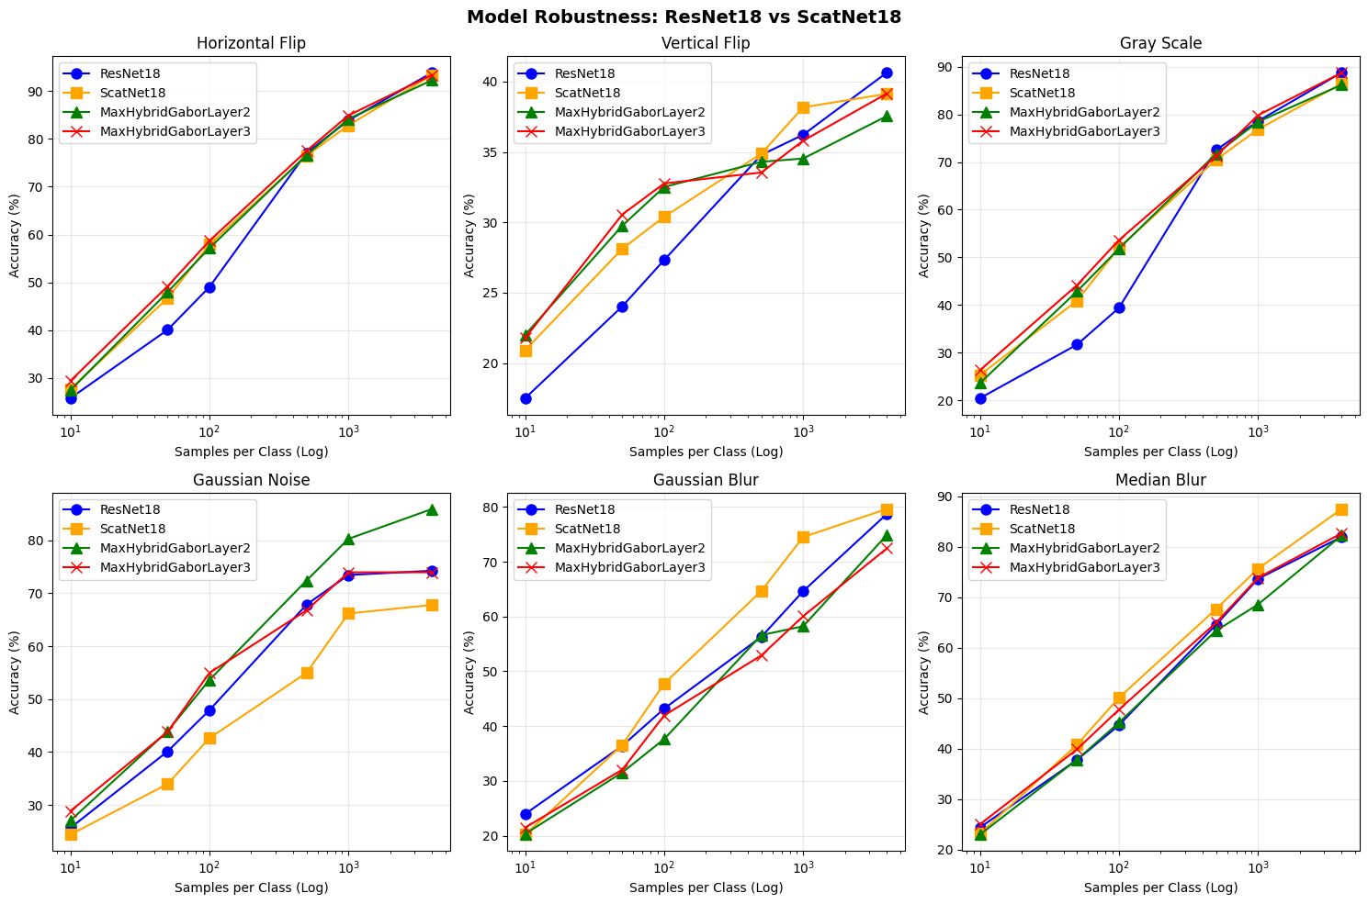
Results – Robustness
Accuracy on augmented test:
Resnet18 (Blue)
Parametric scattering (Yellow)
Learnable scattering (Green & Red)
Notes:
On these graphs, we can see how well each model performed as a function of data size.
Resnet (baseline) in blue
Parametric scattering in yellow
2 variations of learnable scattering in green and red

Slide 16
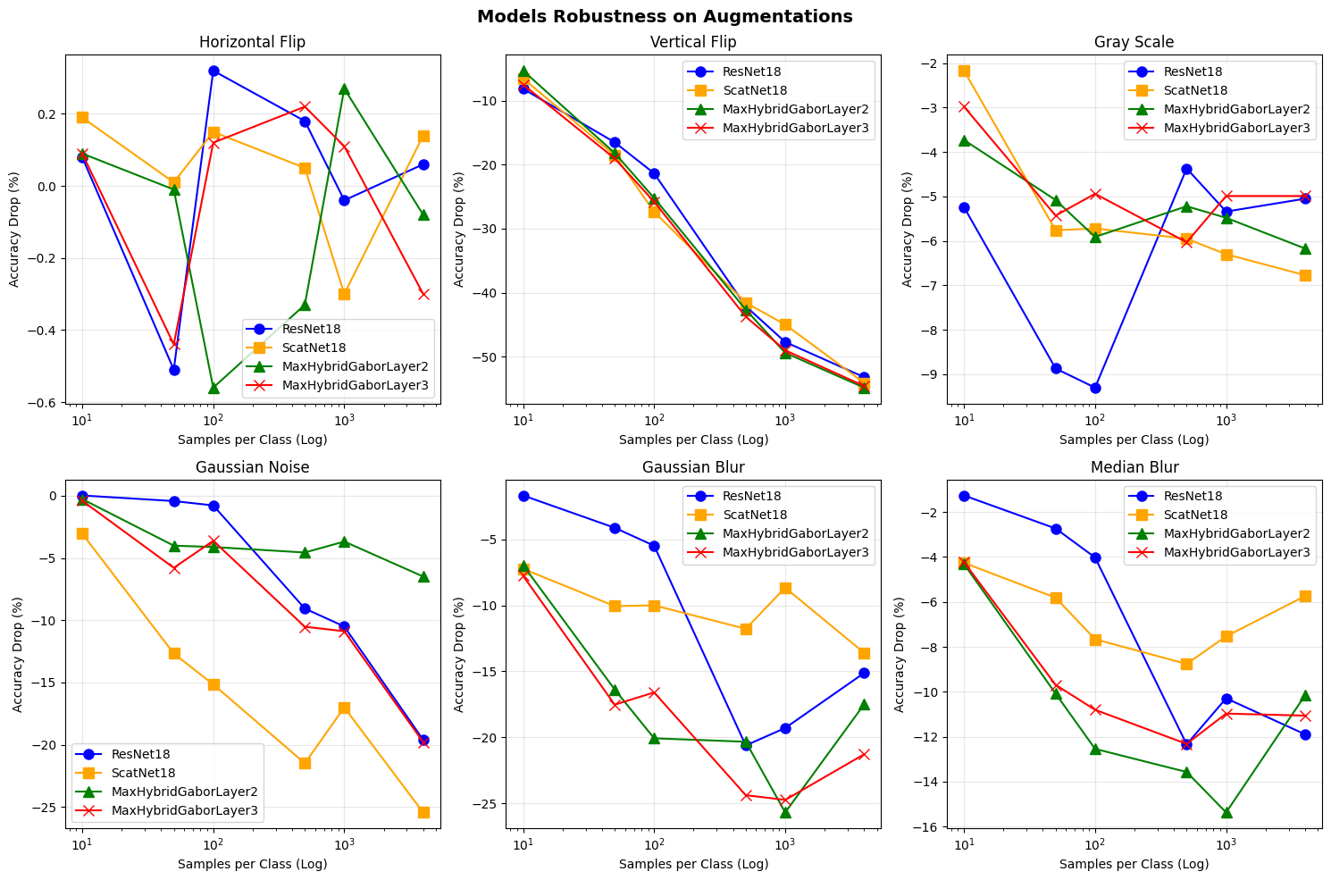
Results – Robustness
Accuracy drop (augmented – original)
Notes:
Here, we can see the accuracy drop for each model under different augmentations.
The results show a trade-off: After full training, parametric scattering performs worse than ResNet on Gaussian noise, but better on blurring.
We believe this is because scattering kernels activate strongly on high frequencies.
Noise, adds high frequencies, resulting in high scattering activation which confuses the network and reduces accuracy.
Conversely, blurring acts as a low-pass filter, resulting in low scattering activation, which allows the CNN kernels to become dominant and classify correctly.
This supports our theory that scattering handles texture detection. Freeing the CNN to learn other features.

Slide 17
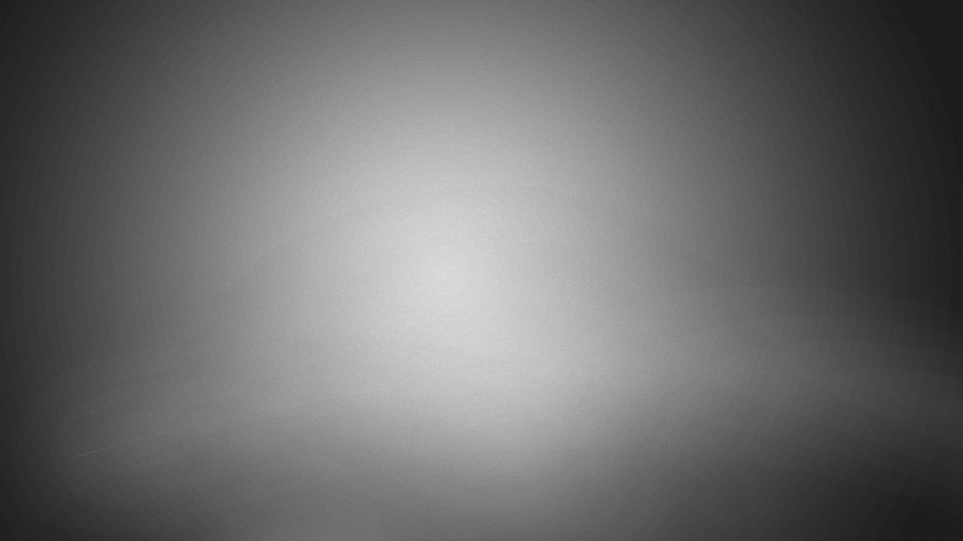
Thank You

