Slide 1
Integrating Wavelets to CNN
Gilad Navok
Barak Telem

Slide 2
Outline
Introduction
Motivation
Background
Baseline
Our Models
Results
Future work (?)

Slide 3
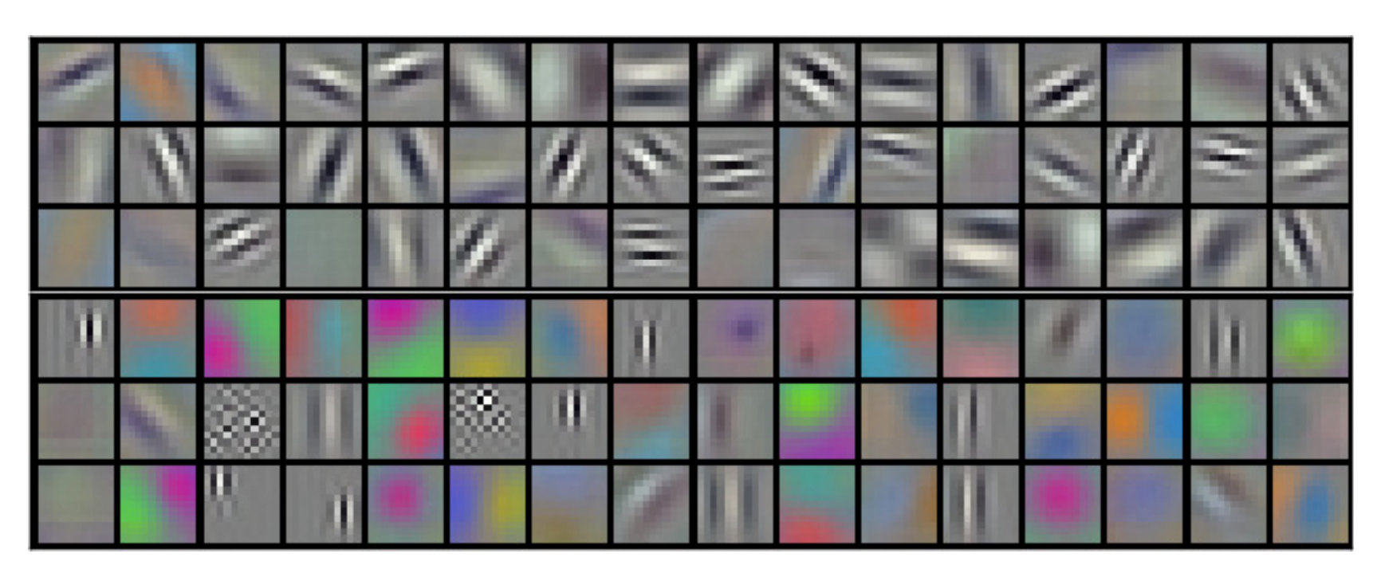
Motivation
CNN kernels resembles wavelets
Small data training (prior)
Helping CNN texture bias

Slide 4
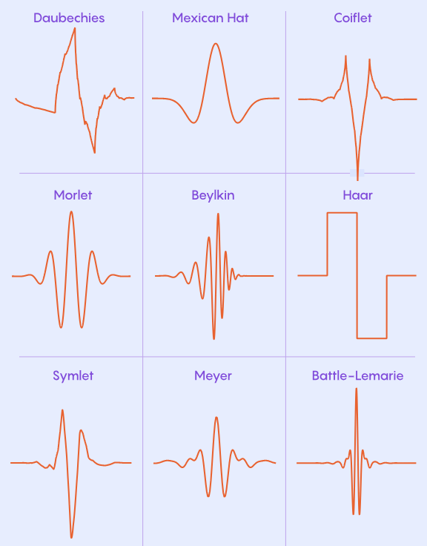
Background - Wavelets
Adjustable Scale
Directional Sensitivity
Versatile Design
Notes:
Adjustable Scale (Dilations):
Wavelets can be stretched or squeezed to detect features of any size—from fine edges to large structural shapes.
Connection to Scattering: This allows the network to separate signal components by frequency bands ($j$).
Directional Sensitivity (Rotations):
Unlike standard pixels, image wavelets are parameterized by orientation. They can specifically detect vertical, horizontal, or diagonal edges.
Connection to Scattering: Scattering networks average over these rotations to achieve rotational invariance.
Versatile Design (e.g., Morlet):
You can choose the wavelet shape that best fits your data (like Morlet or Mexican Hat).
Connection to Scattering: Scattering typically uses Complex Morlet wavelets because their "magnitude" (modulus) provides a smooth, stable envelope of the signal.

Slide 5
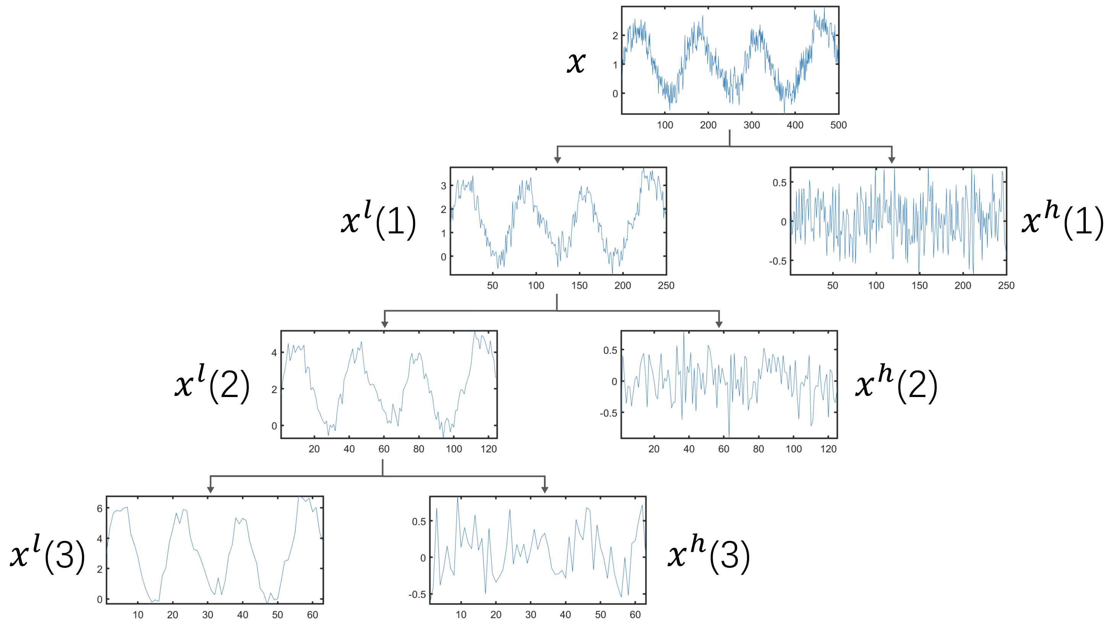
Background – Wavelet Scattering Transform (WST)
Similar concept to CNNs:
Convolve with fixed wavelets (kernels)
Apply modulus (non-linearity)
Average (pooling)
Cascade (layers)
Notes:
Convolve (Filter Bank): Apply a fixed bank of wavelets (dilated and rotated) to the image to separate features by scale and orientation.
Modulus (Non-Linearity): Take the complex absolute value $|x|$ of the filtered response. This removes high-frequency phase oscillations, ensuring stability.
Average (Pooling): Smooth the result with a low-pass filter (scaling function). This makes the representation invariant to small shifts (translation).
Cascade: Repeat these steps on the output to capture deeper, higher-order interactions (like "texture of texture").

Slide 6
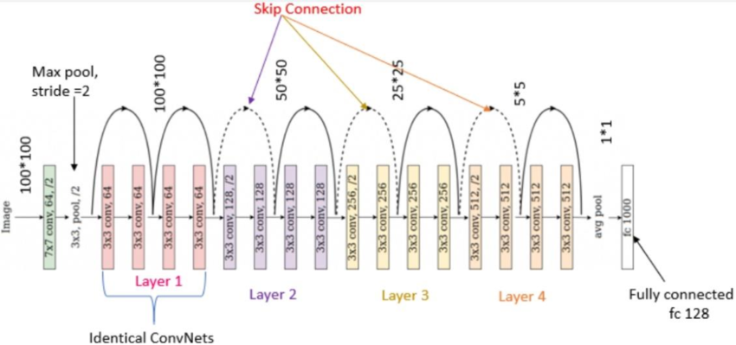
Baseline
ResNet18
CIFAR10

Slide 7
Models
ScatResNet18
Hybrid Gabor:
1
2
3

Slide 8
Results – Accuracy vs Data

Slide 9
Results – Accuracy vs Changed Layers

Slide 10
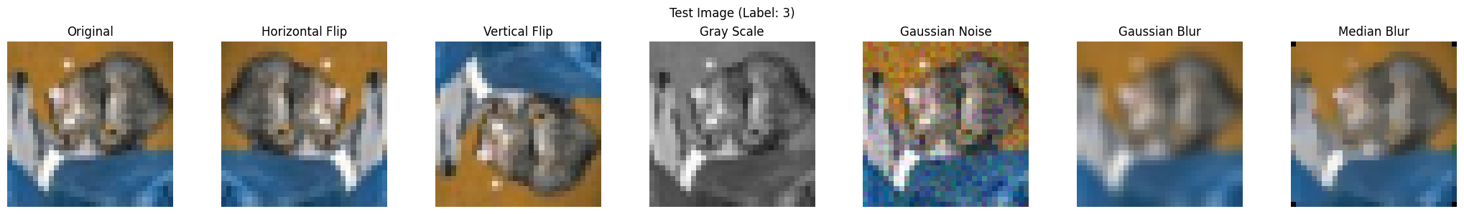
Results – Robustness
Augmentations that copy texture and positional changes
Notes:
Models were trained with the following augmentations:
Horizontal flip
Color jitter
Resize crop

Slide 11
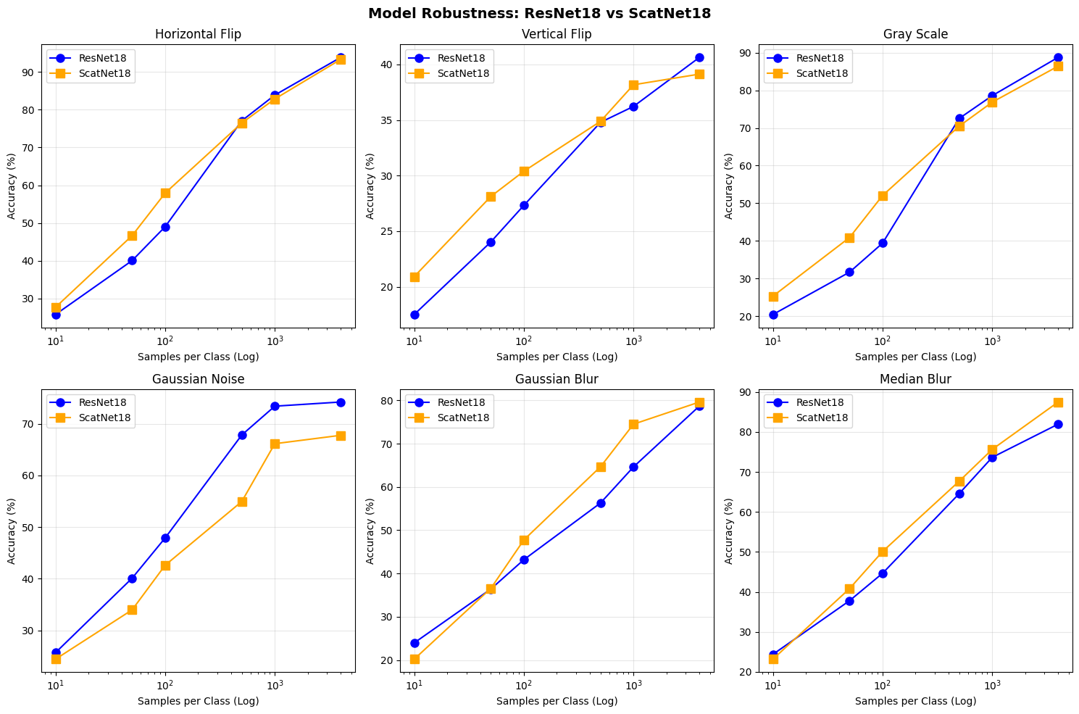
Results – Robustness
Overall performance:
In most cases scattering performs on par or better.
Exception: Color changes (gray scale, Gaussian noise) hurts scattering performance

Slide 12
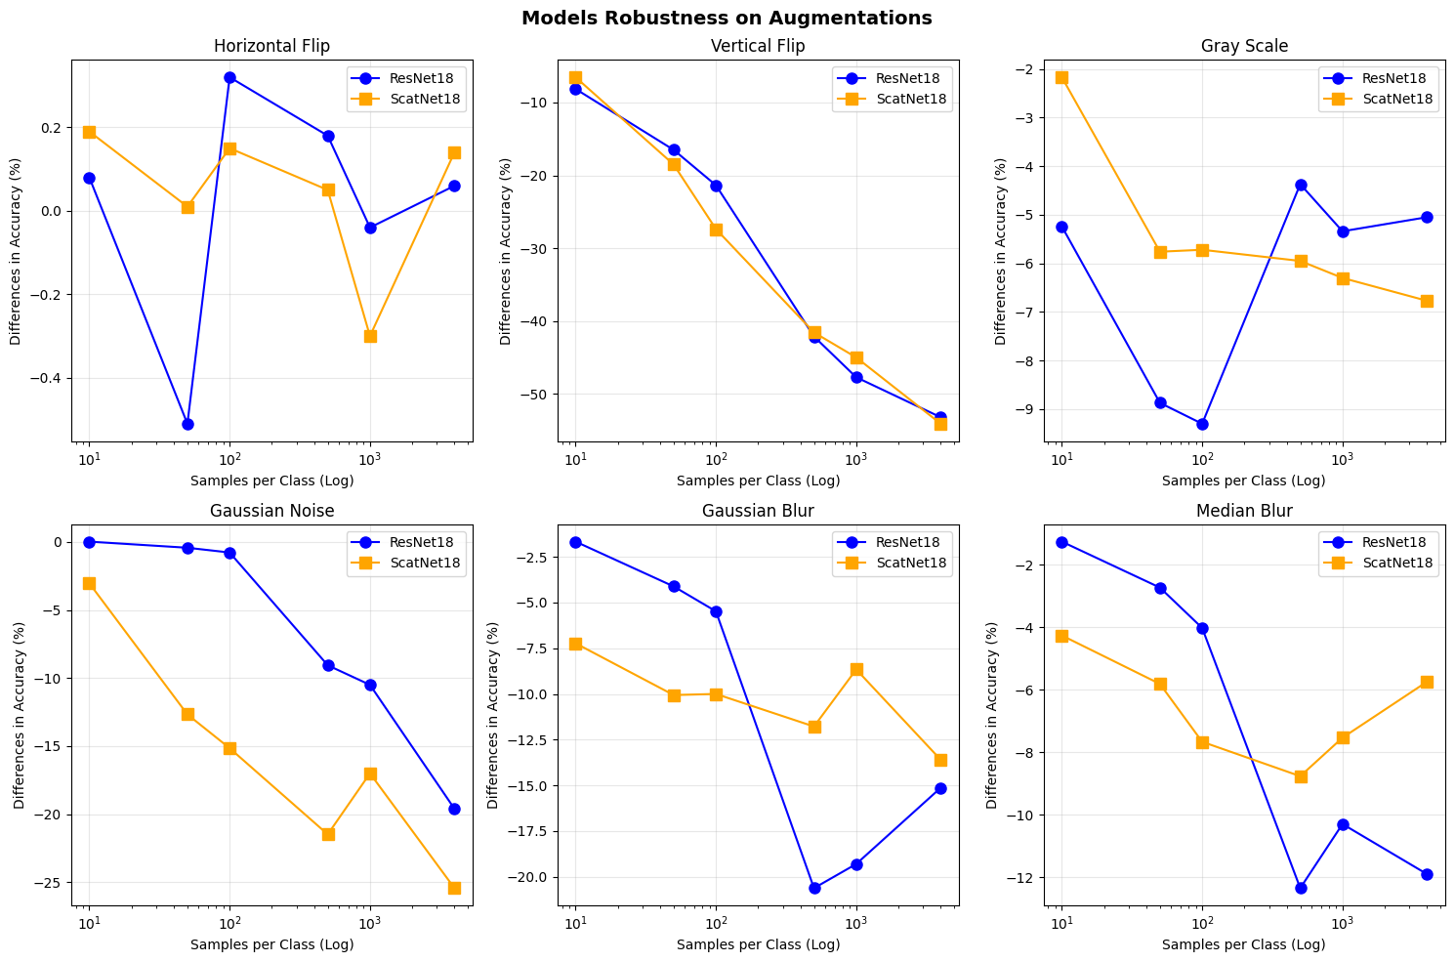
Results – Robustness
Accuracy drop
In big data regimes:
Positional change- Degrades the same
Color change- Scattering hurts
Blurring- Scattering helps

Slide 13
Future Work

