Slide 1
Analysis of Algorithms
Maximum Matching
Uri Zwick
April 2014 Modified: December 19, 2017 Minor modification: November 17, 2021
TexPoint fonts used in EMF.
Read the TexPoint manual before you delete this box.: AAAAA

Slide 2
Matching
A subset of edges no two of which touch each other
Maximal but not maximum matching

Slide 3
Matching
A subset of edges no two of which touch each other
An augmenting path

Slide 4
Matching
A subset of edges no two of which touch each other.
A maximum (even perfect) matching.

Slide 5

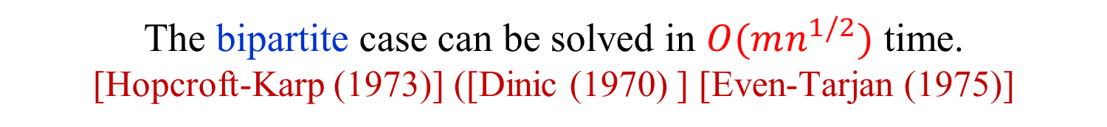

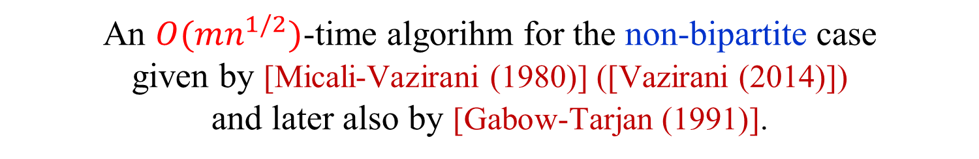
Maximum matching
The maximum matching problem in bipartite graphs can be easily reduced to a maximum network flow problem.
The problem in non-bipartite graphs is harder. First polynomial time algorithm given by [Edmonds (1965)].
The bipartite case can be solved in $O(mn^{1/2})$ time. [Hopcroft-Karp (1973)] ([Dinic (1970) ] [Even-Tarjan (1975)]
The bipartite case can be solved in $O(m^{10/7})$ time, using interior-point techniques [Madry (2013)].
An $O(mn α(m,n))$-time implementation of Edmonds’ algorithm was given by [Gabow (1976)].
An $O(mn^{1/2})$-time algorihm for the non-bipartite case given by [Micali-Vazirani (1980)] ([Vazirani (2014)]) and later also by [Gabow-Tarjan (1991)].

Slide 6




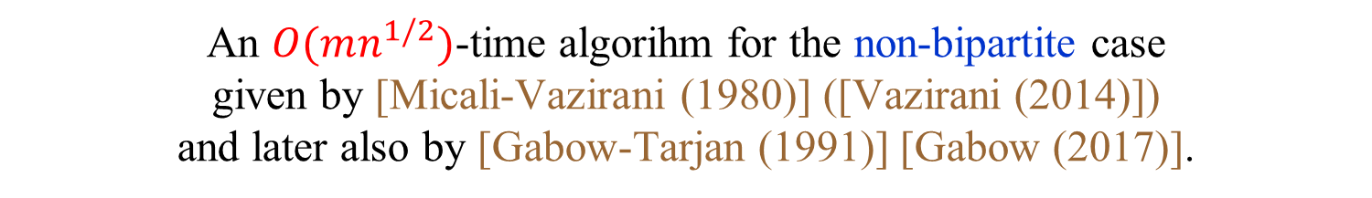
Maximum matching
The bipartite case can be reduced do maximum network flow.
The problem in non-bipartite graphs is harder. First polynomial time algorithm given by [Edmonds (1965)].
The bipartite case can be solved in $O(mn^{1/2})$ time. [Hopcroft-Karp (1973)] ([Dinic (1970) ] [Even-Tarjan (1975)]
The bipartite case can be solved in $O(m^{10/7})$ time, using interior-point techniques [Mądry (2013)].
An $O(mn α(m,n))$-time implementation of Edmonds’ algorithm was given by [Gabow (1976)].
An $O(mn^{1/2})$-time algorihm for the non-bipartite case given by [Micali-Vazirani (1980)] ([Vazirani (2014)]) and later also by [Gabow-Tarjan (1991)] [Gabow (2017)].
An $O(n^{ω})$-time algorithm using fast matrix multiplication. [Mucha-Sankowski (2004)] [Harvey (2006)]

Slide 7
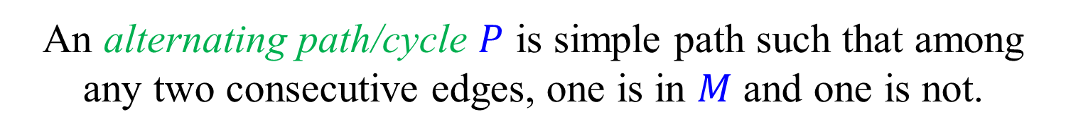
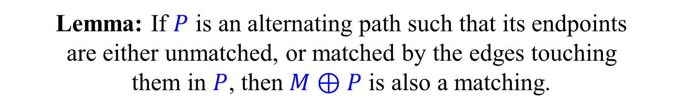
Alternating paths and cycles
with respect to a given matching $M$
An alternating path/cycle $P$ is simple path such that among any two consecutive edges, one is in $M$ and one is not.
Lemma: If $P$ is an alternating path such that its endpoints are either unmatched, or matched by the edges touching them in $P$, then $M⊕P$ is also a matching.
Symmetric difference: $A⊕B=\left(A∖B\right)∪(B∖A)$

Slide 8
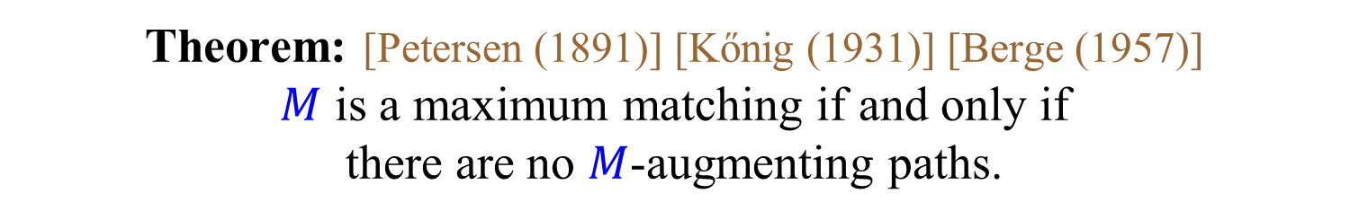
Augmenting paths
with respect to a given matching $M$
An alternating path that starts and ends in unmatched vertices.
Theorem: [Petersen (1891)] [Kőnig (1931)] [Berge (1957)] $M$ is a maximum matching if and only if there are no $M$-augmenting paths.
$M$-augmenting path = augmenting path w.r.t. $M$
How do we find augmenting paths?

Slide 9
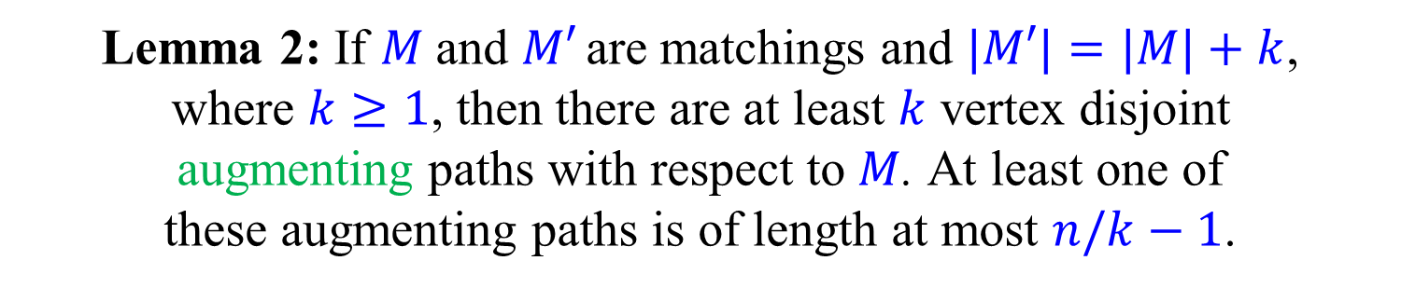
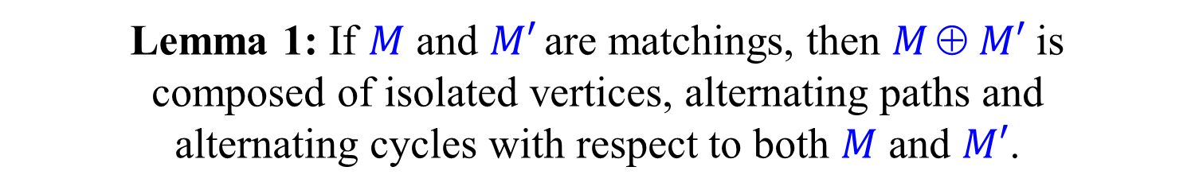
Proof of augmenting paths theorem
Lemma 1: If $M$ and $M′$ are matchings, then $M  M′$is composed of isolated vertices, alternating paths and alternating cycles with respect to both $M$ and $M′$.
Lemma 2: If $M$and $M′$ are matchings and $|M′|=|M|+k$, where $k≥1$, then there are at least $k$ vertex disjoint augmenting paths with respect to $M$. At least one of these augmenting paths is of length at most $n/k−1$.
The theorem follows easily.

Slide 10
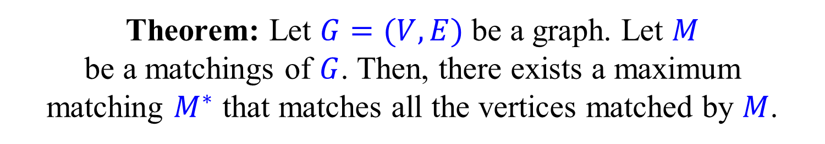
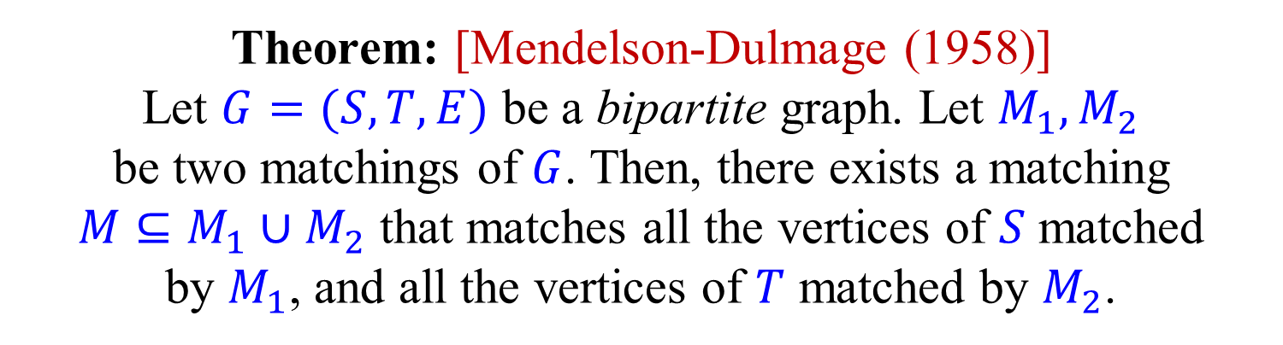
Mendelson-Dulmage Theorem
Theorem: Let $G=(V,E)$ be a graph. Let $M$ be a matchings of $G$. Then, there exists a maximum matching $M^{∗}$ that matches all the vertices matched by $M$.
Theorem: [Mendelson-Dulmage (1958)] Let $G=(S,T,E)$ be a bipartite graph. Let $M_{1},M_{2}$ be two matchings of $G$. Then, there exists a matching $M⊆M_{1}∪M_{2}$ that matches all the vertices of $S$ matched by $M_{1}$, and all the vertices of $T$ matched by $M_{2}$.
Exercise: Prove the theorems.

Slide 11
Alternating forests
even
Roots are unmatched.
odd
even
All root to leaf paths are alternating.
odd
Vertices in the forest are even or odd depending on the parity of their level.
even
odd
Scan unmatched edges of even vertices; Scan matched edges of odd vertices; Until an augmenting path (or a blossom) is found, or until all appropriate edges are scanned.

Slide 12

Scanning an unmatched edge from an even vertex
(1) Edge to a matched vertex not in the forest → Tree extended.
(2) Edge to an unmatched vertex → Augmenting path found.
4
(3) Edge to an even vertex in a different tree → Augmenting path found.
5
3
(4) Edge to an odd vertex → Ignore.
1
2
(5) Edge to an even vertex in a same tree → Blossom.

Slide 13
Scanning an matched edge from an odd vertex
(1) Edge to a vertex not in the forest → Tree extended.
(2) Edge to an odd vertex in a different tree → Augmenting path found.
2
(3) Edge to an odd vertex in a same tree → Blossom.
3
1
Cases (2) and (3) may be avoided if the forest is extended two edges at a time.

Slide 14
Scanning strategies
In the generic algorithms for bipartite and non-bipartite graphs, the order in which edges are scanned is arbitrary.
Fewer cases arise if when scanning an unmatched edge leading to a matched vertex not in the forest, we immediately scan the matched edge and add it to the forest.
We can build the trees of the forest one by one in DFS order (again fewer cases to consider).
We can build all trees simultaneously, level by level, in BFS order, to find shortest augmenting paths.

Slide 15
Correctness
Theorem: If there is an augmenting path, then the scanning algorithm, with any scanning order, finds either an augmenting path or a blossom.
e
o
e
e
If the scanning algorithm terminates, all vertices on the augmenting path must be labeled even or odd.
If the labels alternate, then one of the endpoints is odd and an augmenting path must have been found.
Otherwise, there must be an unmatched edge between two even vertices, or a matched edge between two odd vertices → augmenting path or a blossom found.

Slide 16

Vertex cover (VC)
A set $C⊆V$ is a vertex cover if at least one endpoint of each edge belongs to $C$
A VC must contain at least one vertex of each edge of a matching.
Hence, for every matching $M$ and VC $C$: $\left|M\right|≤|C|$

Slide 17
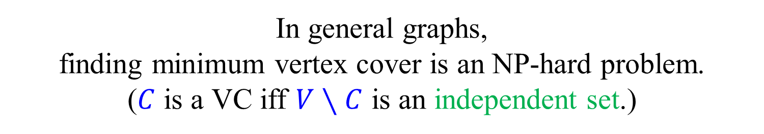
Minimum vertex cover
In general graphs, finding minimum vertex cover is an NP-hard problem. ($C$ is a VC iff $V∖C$ is an independent set.)
In bipartite graphs, a minimum vertex cover can be easily obtained from a maximum matching.
Theorem: [Kőnig (1931)] [Egerváry (1931)] In a bipartite graph, the size of a maximum matching is equal to the size of a minimum vertex cover.
Special case of the max-flow min-cut theorem, which in turn is a special case of LP-duality.

Slide 18

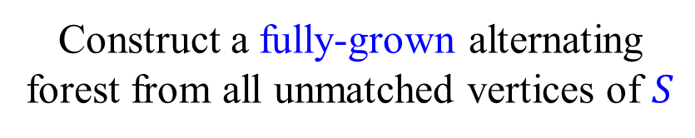

Maximum matching = Minimum vertex cover (in bipartite graphs)
$$G=(S,T,E)$$
Construct a fully-grown alternating forest from all unmatched vertices of $S$
Take the $T$ endpoints of the edges of $M$ in the forest, and the $S$ endpoints of the edges of $M$ not in the forest

Slide 19
Maximum matching ≠ Minimum vertex cover (in general graphs)
But, stay tuned…

Slide 20
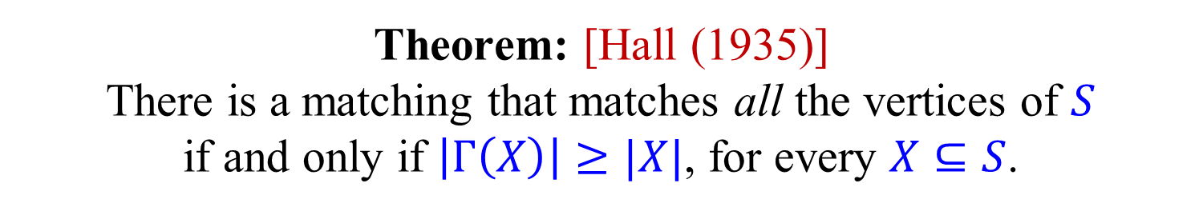
Hall’s Marriage Theorem
Let $G=(S,T,E)$ be a bipartite graph.
For $X⊆S$, let $Γ(X)$ be the neighbors of $X$ in $T$.
Theorem: [Hall (1935)] There is a matching that matches all the vertices of $S$ if and only if $\left|Γ\left(X\right)\right|≥|X|$, for every $X⊆S$.
Exercise: Prove Hall’s thereon. (There are many proofs. A simple proof follows by looking at minimum vertex covers.

Slide 21


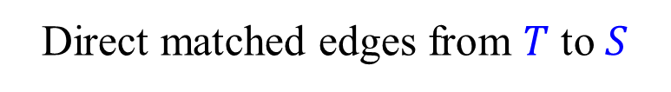
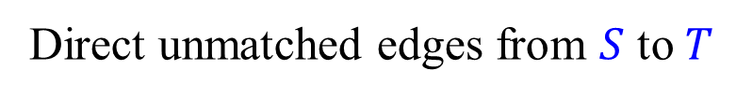
Equivalent formulation of the scanning algorithm for Bipartite graphs
Direct unmatched edges from $S$ to $T$
Direct matched edges from $T$ to $S$
$$S$$
$$T$$

Slide 22
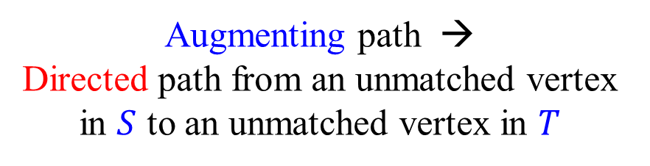
Equivalent formulation of the scanning algorithm for Bipartite graphs
Direct unmatched edges from $S$ to $T$
Direct matched edges from $T$ to $S$
Alternating path → Directed path
Augmenting path → Directed path from an unmatched vertex in $S$ to an unmatched vertex in $T$
$$S$$
$$T$$
Residual flow network

Slide 23
The algorithm of Hopcroft-Karp (1973) for bipartite graphs
Start with some (possibly empty) matching $M$.
In each phase, find a maximal collection of vertex disjoint shortest augmenting paths.
Number of phases is at most $2n^{1/2}$.
Each phase can be implemented in $O(m)$ time.
Total running time is $O(mn^{1/2})$.

Slide 24
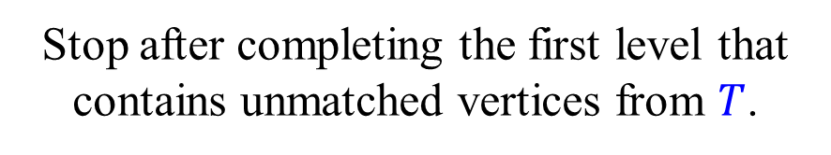
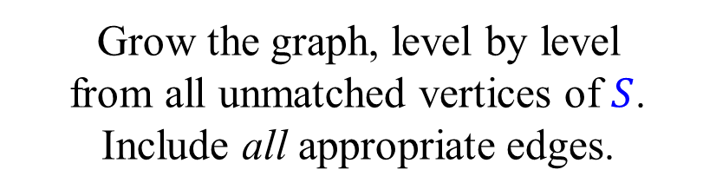
Forest → Layered graph
Grow the graph, level by level from all unmatched vertices of $S$. Include all appropriate edges.
Stop after completing the first level that contains unmatched vertices from $T$.
Find a maximal set of vertex disjoint shortest augmenting paths.

Slide 25

Forest → Layered graph
Grow the graph, level by level from all unmatched vertices of $S$. Include all appropriate edges.
Stop after completing the first level that contains unmatched vertices from $T$.
Find a maximal set of vertex disjoint shortest augmenting paths.

Slide 26
Forest → Layered graph
Grow the graph, level by level from all unmatched vertices of $S$. Include all appropriate edges.
Stop after completing the first level that contains unmatched vertices from $T$.
A maximal set is enough.
Find a maximal set of vertex disjoint shortest augmenting paths.

Slide 27
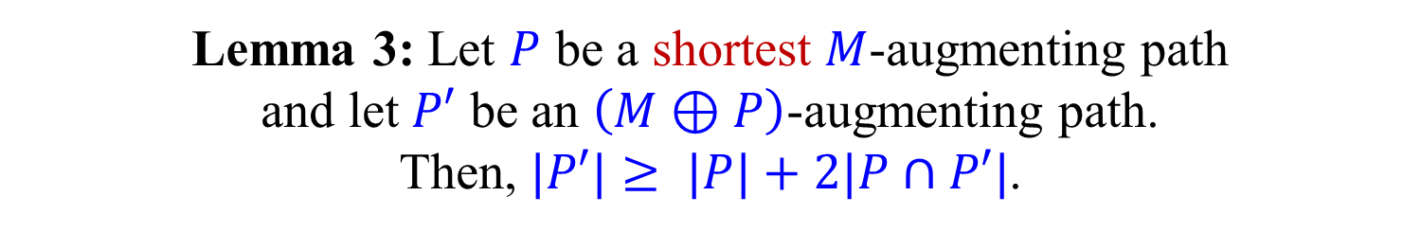

Number of phases
Lemma 3: Let $P$ be a shortest $M$-augmenting path and let $P′$ be an $\left(M⊕P\right)$-augmenting path. Then, $|P′|≥ |P|+2|P∩P′|$.
Proof:
$$N=\left(M⊕P\right)⊕P′$$
$$|N|=|M|+2$$
By Lemma 2, $M⊕N=P⊕P′$contains two disjoint $M$-augmenting path $P_{1}$ and $P_{2}$.
$$2\left|P\right|≤\left|P_{1}\right|+\left|P_{2}\right|≤\left|M⊕N\right|=\left|P⊕P′\right|=\left|P\right|+\left|P^{′}\right|−2\left|P∩P^{′}\right|$$

Slide 28
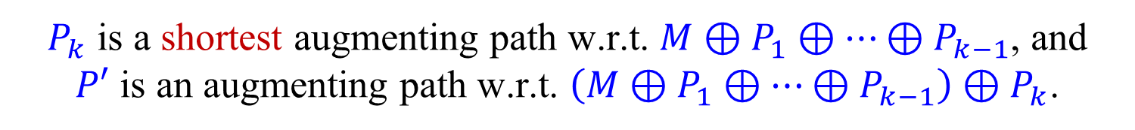
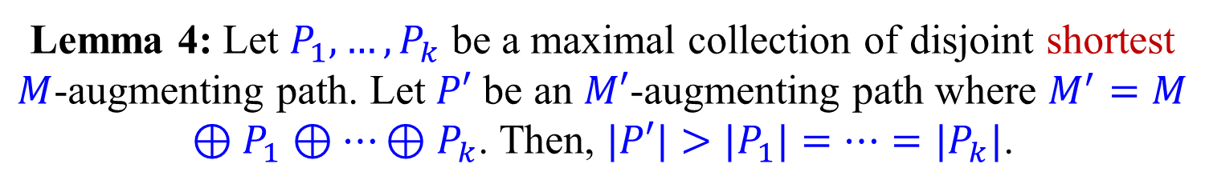
Number of phases
Lemma 4: Let $P_{1},…,P_{k}$ be a maximal collection of disjoint shortest $M$-augmenting path. Let $P′$ be an $M′$-augmenting path where $M^{′}=M⊕P_{1}⊕…⊕P_{k}$. Then, $|P′|>|P_{1}|=…=|P_{k}|$.
Proof:
If $P′$ is disjoint from $P_{1},…,P_{k}$ then $P′$ is also $M$-augmenting.
By the maximality of the collection, $\left|P^{′}\right|>\left|P_{1}\right|=…=|P_{k}|$.
Assume, w.l.o.g., that $P^{′}∩P_{k}≠∅$. (Otherwise, reorder.)
$P_{k}$ is a shortest augmenting path w.r.t. $M⊕P_{1}⊕…⊕P_{k−1}$, and $P′$ is an augmenting path w.r.t. $\left(M⊕P_{1}⊕…⊕P_{k−1}\right)⊕P_{k}$.
By Lemma 3, $|P′|≥|P_{k}|+2|P′∩P_{k}|>|P_{k}|$.

Slide 29
Number of phases
Theorem: The algorithm of Hopcroft and Karp finishes after at most 2n^{1/2} phases.
By Lemma 4, the augmenting paths found in each phase get longer and longer.
After n^{1/2} phases, if algorithm has not finished, the augmenting paths are of length at least n^{1/2}.
By Lemma 2 on slide 9, the number of edges missing in the current matching is at most n^{1/2}.
Thus, a maximum matching is found after at most n^{1/2} additional phases.
Note: We did not use bipartiteness in the proof.

Slide 30


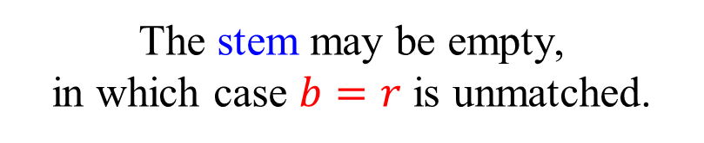
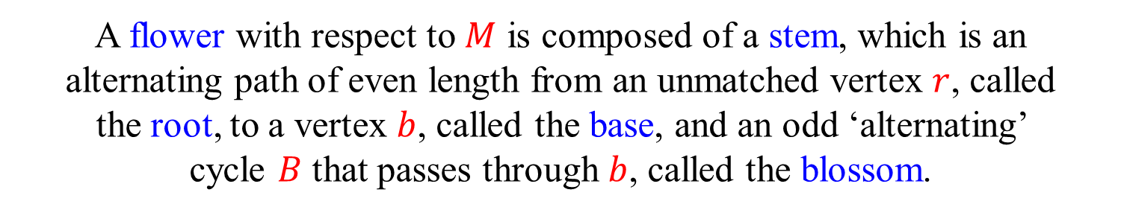


Flowers and blossoms
$$B$$
$$r$$
$$b$$
A flower with respect to $M$ is composed of a stem, which is an alternating path of even length from an unmatched vertex $r$, called the root, to a vertex $b$, called the base, and an odd ‘alternating’ cycle $B$ that passes through $b$, called the blossom.
The stem may be empty, in which case $b=r$ is unmatched.
For the time being, an odd ‘alternating’ cycle is called a blossom only of it is a part of a flower.

Slide 31

The challenge of blossoms
o
e
e
o
e
o
e
e
o
e
e
o
o
e
o
In this scanning order, augmenting path not found.
In this scanning order, augmenting path found.
But, a blossom is found.

Slide 32
The challenge of blossoms
Can we allow vertices to be both even and odd?
o
e
o
e
e
o
e
e
o
e
o
e
o
o
o
o
e
e
e
e
o
o
A bogus “augmenting path” is found.

Slide 33
Shrinking (contracting) blossoms
Contract the blossom and consider it to be a (super) even vertex.
Scan unmatched edges from all vertices of the blossom, including those that were originally odd.
Theorem: (Edmonds) The original graph contains an augmenting path if and only if the contracted graph does.

Slide 34
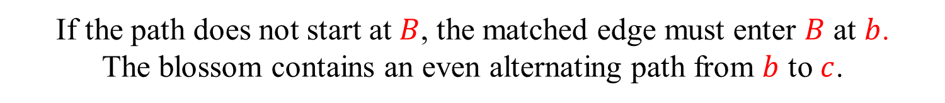




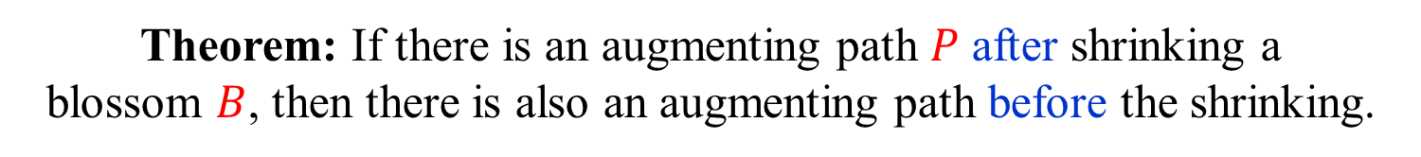
Augmenting path in contracted graph → Augmenting path in original graph
Theorem: If there is an augmenting path $P$ after shrinking a blossom $B$, then there is also an augmenting path before the shrinking.
$$B$$
$$b$$
$$B$$
$$c$$
If the path does not start at $B$, the matched edge must enter $B$ at $b$. The blossom contains an even alternating path from $b$ to $c$.

Slide 35

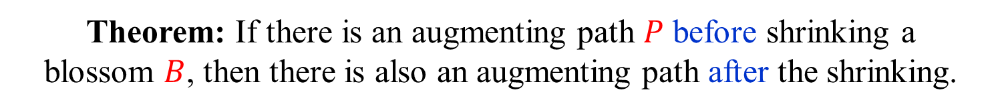

Augmenting path in original graph → Augmenting path in contracted graph
Theorem: If there is an augmenting path $P$ before shrinking a blossom $B$, then there is also an augmenting path after the shrinking.
If $P$ does not pass though $B$, then $P$ is also an augmenting path in the contracted graph.
What do we do if $P$ does pass through $B$?
Important to note that $B$ is part of a flower and thus has a (possibly empty) stem $Q$.

Slide 36




Is $P$ an augmenting path in the contracted graph?
$$b$$
$$B$$
$$P$$
$P$ is not necessarily a simple path in the contracted graph.
$P$ is not necessarily an alternating path in the contracted graph.

Slide 37


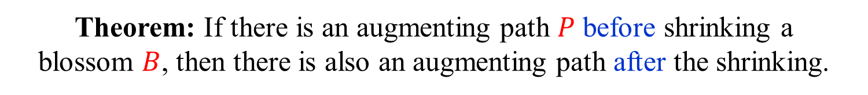





Augmenting path in original graph → Augmenting path in contracted graph
Theorem: If there is an augmenting path $P$ before shrinking a blossom $B$, then there is also an augmenting path after the shrinking.
Easy case: $B$ has an empty stem.
$$a$$
$$b$$
$$B$$
$$P′$$
Rest of $P$
$$c$$
B is unmatched in the contracted graph.
Let $P′$ be the subpath of $P$ that starts at an endpoint $a$ of $P$ that is not $b$ and continues until the first encounter with $B$.
$P′$ is an augmenting path from $a$ to $B$ in the contracted graph.

Slide 38
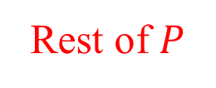





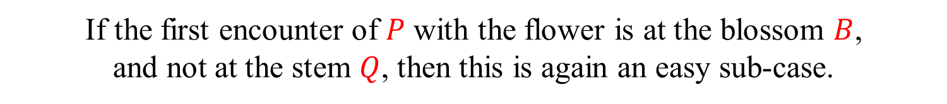

Hard(er) case: $B$ has a non-empty stem
$$r$$
$$b$$
$$a$$
$$B$$
Rest of $P$
$$P′$$
$$c$$
If the first encounter of $P$ with the flower is at the blossom $B$, and not at the stem $Q$, then this is again an easy sub-case.

Slide 39


Hard(er) case: $B$ has a non-empty stem
$$r$$
$$b$$
$$a$$
$$B$$
Rest of $P$
$$P′$$
$$c$$
If the first encounter of $P$ with the flower is at the blossom $B$, and not at the stem $Q$, then this is again an easy sub-case.
But, what if $P$, from both its sides, hits the stem before the blossom?
We can either face the problem head on, or bypass it.

Slide 40




Easy solution for hard(er) case
Hard(er) case: $B$ has a non-empty stem
$$r$$
$$b$$
$$B$$
$$Q$$
Let $GB$ be the contracted graph.
Let $MB= M∖B$be the matching in the contracted graph.
Let $Q$ be a stem of the flower with blossom $B$.
Let $M′=M⊕Q$.

Slide 41



Easy solution for hard(er) case
Hard(er) case: $B$ has a non-empty stem
$$r$$
$$b$$
$$M′$$
$$B$$
$$Q$$
Let $GB$ be the contracted graph.
Let $MB= M∖B$be the matching in the contracted graph.
Let $Q$ be a stem of the flower with blossom $B$.
Let $M′=M⊕Q$.
$|M′|=|M|$and $|M_{B}|=|M_{B}^{′}|$
$B$ is a blossom with an empty stem w.r.t. $M′$.
By the easy case, there is an augmenting path w.r.t. $M_{B}^{′}$, and hence also w.r.t. $M_{B}$.

Slide 42
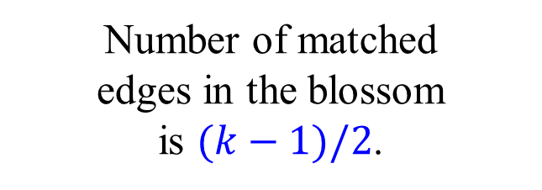
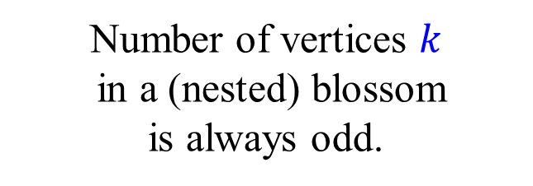
1
Nested blossoms
2
The only vertex unmatched inside a blossom is the base of the blossom.
3
4
6
14
5
7
10
28
8
18
15
20
9
There is an even alternating path from the base to any other vertex in the blossom.
11
12
19
21
16
13
Number of vertices $k$ in a (nested) blossom is always odd.
17
22
24
23
25
Number of matched edges in the blossom is $(k−1)/2$.
26
27

Slide 43
1
An augmenting path through nested blossoms
2
3
4
6
14
5
7
10
28
8
18
15
20
9
11
12
19
21
16
13
17
22
24
23
25
26
27

Slide 44
1
An augmenting path through nested blossoms
2
3
4
6
14
5
7
10
28
8
18
15
20
9
11
12
19
21
How do we find such a path?
16
13
17
22
24
23
25
26
27

Slide 45
1
Nested blossoms
2
3
4
6
14
5
7
10
8
18
15
20
9
11
12
19
21
16
13
17
22
24
23
25
26
27

Slide 46
1
Nested blossoms
2
3
4
6
14
5
7
10
8
18
15
20
9
11
12
19
21
16
13
17
22
24
23
25
26
27

Slide 47
1
Nested blossoms
2
3
4
6
14
5
7
10
8
18
15
20
9
11
12
19
21
16
13
17
22
24
23
25
26
27

Slide 48


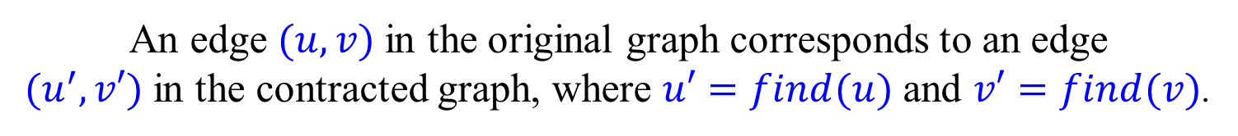
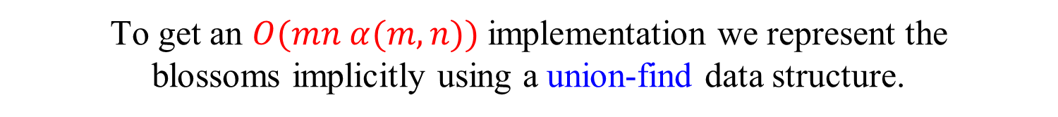
Implementing Edmonds’ algorithm
Using an explicit representation of the blossoms we can get an $O(n3)$ implementation.
To get an $O(mn α(m,n))$implementation we represent the blossoms implicitly using a union-find data structure.
If $v$ is in a (nested) blossom, then $find(v)$ returns its base. If $v$ is not in a blossom, then $find(v)=v$.
An edge $(u,v)$in the original graph corresponds to an edge $(u^{′},v′)$in the contracted graph, where $u′=find(u)$and $v′=find(v)$.
When a new blossom is found, we perform the appropriate union operations, making sure that the base is the representative item returned by find operations.

Slide 49
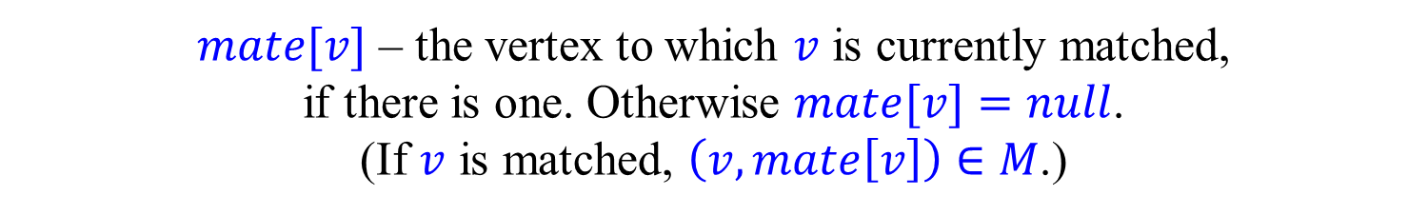

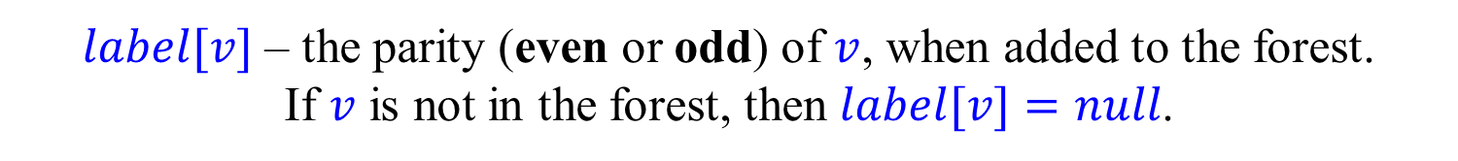
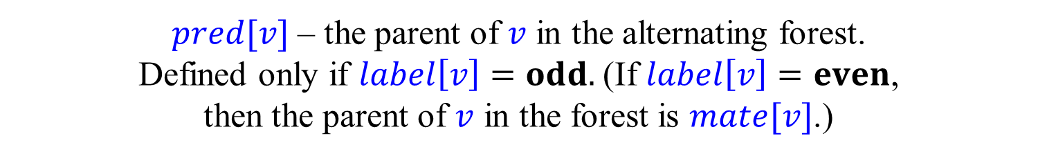
Implementing Edmonds’ algorithm
$mate[v]$ – the vertex to which $v$ is currently matched, if there is one. Otherwise $mate[v]=null$. (If $v$ is matched, $\left(v,mate\left[v\right]\right)∈M$.)
$label[v]$ – the parity (even or odd) of $v$, when added to the forest. If $v$ is not in the forest, then $label[v]=null$.
$pred[v]$ – the parent of $v$ in the alternating forest. Defined only if $label\left[v\right]=odd.$(If $label\left[v\right]=even$, then the parent of $v$ in the forest is $mate[v]$.)
$pred[v]$ and $label[v]$ are not changed when blossoms are formed.
$bridge[v]$ – the bridge (see below) that formed the first blossom containing the odd vertex $v$.
A vertex $v$ is said to be even if $label[find(v)]=even$.

Slide 50

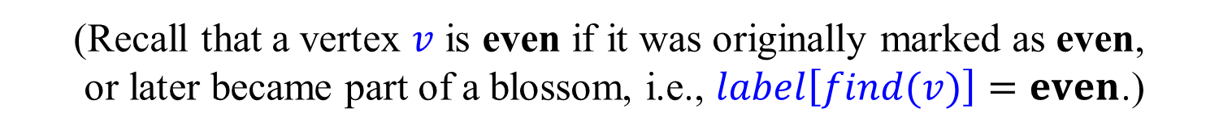

Implementing Edmonds’ algorithm
$Q$ – a list of even vertices yet to be scanned.
(Recall that a vertex $v$ is even if it was originally marked as even, or later became part of a blossom, i.e., $label\left[find(v)\right]=even$.)
Initially, either a single unmatched vertex, or all unmatched vertices are placed in $Q$.
By letting $Q$ be a queue or a stack, we can implement the BFS or DFS search strategies.

Slide 51
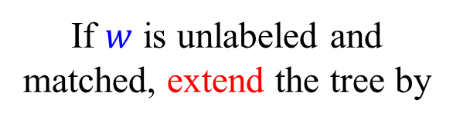

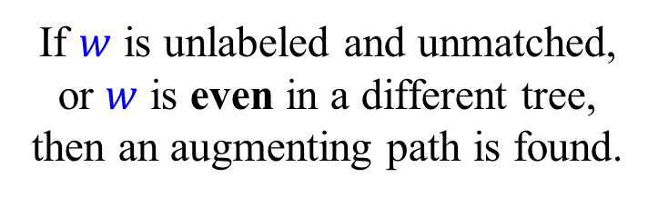
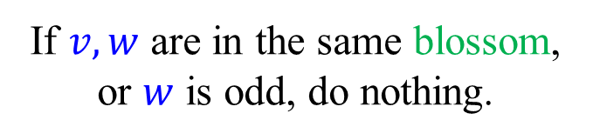
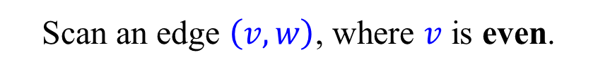
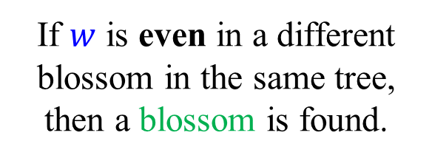



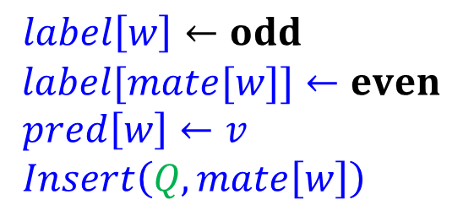
Scanning an edge and extending the tree
$$r$$
Scan an edge $\left(v,w\right)$, where $v$ is even.
If $w$ is unlabeled and unmatched, or $w$ is even in a different tree, then an augmenting path is found.
$$v$$
If $w$ is even in a different blossom in the same tree, then a blossom is found.
$$w$$
If $w$ is unlabeled and matched, extend the tree by
$$mate[w]$$
$label\left[w\right]←odd$ $label[mate[w]]←even$
$pred\left[w\right]←v$
$Insert\left(Q,mate\left[w\right]\right)$
If $v,w$ are in the same blossom, or $w$ is odd, do nothing.

Slide 52
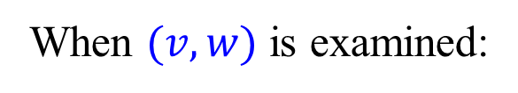




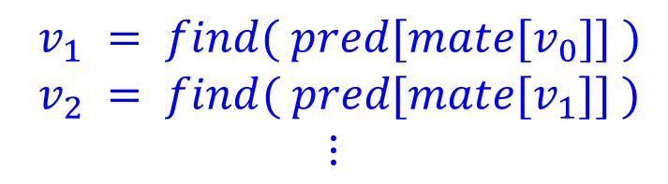

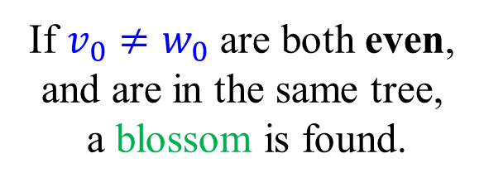

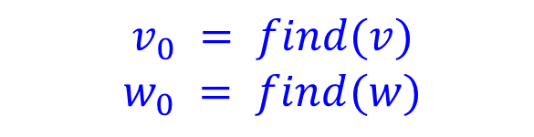
Shrinking a blossom
When $(v,w)$ is examined:
$$b=v_{2}=w_{1}$$
$v_{0} = find(v)$ $w_{0} = find(w)$
If $v_{0}≠w_{0}$ are both even, and are in the same tree, a blossom is found.
$$v_{1}$$
$$w_{0}$$
$$w$$
Find the base of the new blossom:
$$v_{0}$$
$v_{1} = find( pred[mate[v_{0}]] )$ $v_{2} = find( pred[mate[v_{1}]] )$ $$⋮$$
$$v$$

Slide 53



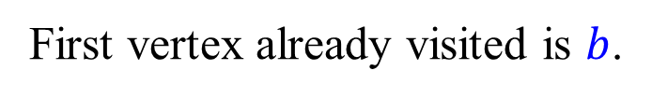


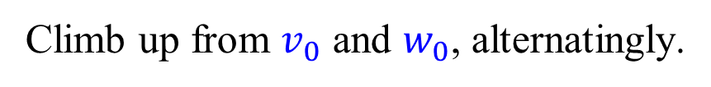
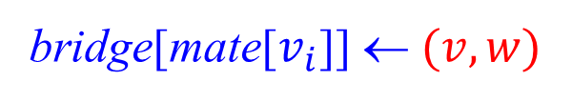





Shrinking a blossom
Climb up from $v_{0}$ and $w_{0}$, alternatingly.
First vertex already visited is $b$.
$$b=v_{2}=w_{1}$$
For every $i$ do:
insert(Q, mate[$v_{i}$])
union($b$, $v_{i}$)
$$v_{1}$$
$$w_{0}$$
union($b$, mate[$v_{i}$])
$$w$$
bridge[mate[$v_{i}$]] ← $(v,w)$
For every $j$ do:
insert(Q, mate[$w_{j}$])
$$v_{0}$$
union($b$, $w_{j}$)
$$v$$
union($b$, mate[$w_{j}$])
bridge[mate[$w_{j}$]] ← $(w,v)$

Slide 54

Shrinking a blossom
$$b=v_{2}=w_{1}$$
Time proportional to size of new blossom, i.e., the number of sub-blossoms, and does not depend on sizes of the sub-blossoms.
$$v_{1}$$
$$w_{0}$$
$$w$$
$$v_{0}$$
$$v$$

Slide 55




$$FindPath$$
To find augmenting paths, we use a function $FindPath$.
$FindPath(s,t)$ finds an even alternating path from $s$ to $t$, starting with a matched edge, if the following condition holds:
when $s$ became even, $t$ was the base of a (possibly trivial) blossom that was a (not necessarily strict) ancestor of the blossom of $s$.
($s$ becomes even either when it is labeled even, or when it is swallowed by a blossom.)
In particular, if $s$ is even and $r$ is the root of its tree, $FindPath(s,r)$ returns an even alternating path from $s$ to $r$.
$FindPath(s,t)$ is implemented recursively, as we shall see below.

Slide 56





Finding an augmenting path
$$r$$
$$v$$
$$w$$
If $(v,w)$connects an even vertex $v$ with an unmatched vertex w, and $r$ is the root, then
$$\left(w,v\right)+FindPath(v,r)$$ is an augmenting path.

Slide 57





Finding an augmenting path
$$r$$
$$r′$$
$$v$$
$$w$$
If $(v,w)$ connects even vertices in different trees, then $$Reverse\left(FindPath\left(v,r\right)\right) + \left(v,w\right)+FindPath(w,r′)$$ is an augmenting path.

Slide 58








Implementing $FindPath$
$$r$$
If $label\left[s\right]=even$,
$$t$$
go two steps up the tree using the edges $(s,mate[s])$and $(mate[s],pred[mate[s]])$. Then use $FindPath(pred[mate[s]],t)$.
$$pred[mate\left[s\right]]$$
$$mate[s]$$
$$s$$

Slide 59













Implementing $FindPath$
$$t$$
If $label\left[s\right]=odd$:
Let $bridge\left[s\right]=(v,w)$.
When the first blossom containing $s$ was formed, $mate[s]$ was the base of a blossom that was an ancestor of the blossom containing $v$.
$$s$$
$$Q$$
$$mate[s]$$
Also, $t$ was the base of a blossom that was an ancestor of the blossom containing $w$.
$$w$$
$$P$$
Thus, $P=FindPath(v,mate\left[s\right])$ and $Q=FindPath\left(w,t\right)$ are disjoint even alternating paths.
$$bridge[s]=vw$$
$$v$$
Return $\left(s,mate\left[s\right]\right)+Reverse\left(P\right)+\left(v,w\right)+Q$

Slide 60

$$FindPath$$
Find an even alternating path from $s$ to $t$. (Under some conditions.)
$FindPath(s,t)$:
if $s=t$:
return
else if $label\left[s\right]=$ even:
return $⟨ (s,mate[s]) , (mate[s],pred[mate[s]]) ⟩ +$
$FindPath(pred[mate[s]],t)$
else:
$\left(v,w\right)←bridge[s]$
return $\left\langle \left(s,mate\left[s\right]\right) \right\rangle +$
$Reverse\left(FindPath\left(v,mate\left[s\right]\right)\right)+$
$\left\langle \left(v,w\right) \right\rangle +FindPath(w,t)$
+ denotes catenation of lists.
$Reverse$ can be removed, as order of the edges is not important.

Slide 61



Odd Vertex Cover
A set $C⊆V$ and a collection of subsets $B_{1},…,B_{k}⊆V$ is an odd vertex cover if for every edge $e$ either $e∩C≠∅$ or $e ⊆B_{i}$ for some $i$.
The cost of the odd vertex cover is defined to be
$$\left|C\right|+\sum_{i=1}^{k}{\left\lfloor \frac{\left|B_{i}\right|}{2}\right\rfloor }$$
Without loss of generality, we may assume that all the sets $B_{i}$ are of odd size, hence the name, and that $C$ and $B_{1},…,B_{k}$ are disjoint.

Slide 62


Odd Vertex Cover
Theorem: In any graph, the size of the maximum matching is equal to the cost of the minimum odd vertex cover.
For every matching $M$ and every odd vertex cover $C$ and $B_{1},…,B_{k}$ we have
$$\left|M\right|≤ \left|C\right|+\sum_{i=1}^{k}{\left\lfloor \frac{\left|B_{i}\right|}{2}\right\rfloor }$$
To prove equality we look at the alternating forest constructed using the last (failed) iteration of Edmonds’ algorithm.

Slide 63



Maximum matching = Minimum odd vertex cover
Every even node in the forest is possibly a nested blossom.
The set $C$ is composed of the odd vertices in the forest, plus an arbitrary vertex not in the forest.
Each blossom becomes a set $B_{i}$. The vertices not in the forest, except one, become the last set $B_{k}$.
$|C|$ is equal to the number of edges of $M$ not contained in the $B_{i}$’s. The cost of each $B_{i}$ is equal to the number of edges of $M$ in it.

Slide 64




Tutte’s Theorem [Tutte (1947)]
Let $G=(V,E)$ be a graph.
For any $X⊆V$, let $odd(G∖X)$ be the number of connected components of $G∖X$ with an odd number of vertices.
Theorem: [Tutte (1947)]
A graph $G=(V,E)$ has a perfect matching iff $odd\left(G∖X\right)≤|X|$, for every $X⊆V$.
Exercise: Prove the theorem.
Hint 1: If $odd\left(G∖X\right)>|X|$, for some $X⊆V$, then $G$ clearly does not have a perfect matching, as in each odd connected component there is at least one vertex can be only be matched to a vertex of $X$.
Hint 2: If $G$ does not have a perfect matching, let $X$ be the set of odd vertices when Edmonds’ algorithm finishes.

Slide 65



Tutte-Berge Theorem [Tutte (1947)] [Berge (1958)]
Theorem: In any graph, the size of the maximum matching is equal to
where $odd(G−X)$ is the number of connected components in $G−X$ with an odd number of vertices.
Proof: Take $X$ to be the set of odd vertices in the final alternating tree.

Slide 66
Bonus material
Not covered in class this term
“Careful. We don’t want to learn from this.” (Bill Watterson, “Calvin and Hobbes”)

Slide 67








Direct solution for hard(er) case
Hard(er) case: $B$ has a non-empty stem
First encounters of $P$ with the flower are at the stem $Q$
$$r$$
$$Q$$
$$c$$
$$b$$
$$B$$
$$a$$
$$P′$$
Start with an endpoint $a$ of $P$ that is not $r$
$P′$ is the subpath of $P$ until first encounter with the stem
If $P′$ meets the stem at an even vertex $c$, that is again an easy sub-case

Slide 68







Direct solution for hard(er) case
Hard(er) case: $B$ has a non-empty stem
$P$ first encounters stem at odd vertices
$$r$$
$$c$$
$$b$$
$$B$$
$$a$$
$$P′$$
$$P′′$$
If $P$ does not enter $B$, then $P$ remains an augmenting path.
Let $P′$ be the subpath of $P$ until first encounter with the stem.
Let $P′′$ be the subpath of $P$ from the last time it leaves $B$.
Do we always get an augmenting path $P′$, ($c$ to $B$), $P′′$???
Unfortunately not. (Why?)

Slide 69







A challenging example
$$P′′$$
$$r$$
$$c$$
$$b$$
$$B$$
$$P′$$
$$a$$
Where is the augmenting path?

Slide 70








Direct solution for hard(er) case
Hard(er) case: B has a non-empty stem
$$r$$
$$c$$
$$b$$
$$B$$
$$a$$
$$P′$$
$$P′′$$
Let $P$ be an augmenting path and $Q$ a stem of $B$ such that $P$ first meets $Q$ as close as possible to $B$.
$P′′$be cannot intersect the path ($c$ to $B$).
We thus get an augmenting path $P′$, ($c$ to $B$) , $P′′$.

Slide 71

Correctness proofs
Theorem: If $M$ is not a maximum matching, then Edmonds algorithm finds an augmenting path.
We already saw two direct correctness proof, dealing with the shrinkage of a single blossom.
The correctness also follows from the maximum matching = minimum odd set cover theorem, as the algorithm produces a matching and a cover of the same size.
It also follows from the Tutte-Berge Theorem.
As we want to be absolutely sure, and want some practice, we sketch another proof taken from [Tarjan (1983)].

Slide 72



Basic observations
If $\left(u,v\right)∈M$ and $u$ is odd, then $v$ is immediately labeled even. (We assume this version of the algorithm.)
If $\left(u,v\right)∉M$, $u$ is even, and an augmenting path is not found, then $v$ is eventually labeled, either odd or even.
If $\left(u,v\right)∉M$ and $u,v$ are even, and an augmenting path is not found, then $u$ and $v$ eventually belong to the same blossom.
At most one vertex in any blossom is unmatched or matched to a vertex outside the blossom.
(Easy) Exercise: Prove these basic observations.

Slide 73

A useful lemma
Lemma: Let $G=(V,E)$ be a graph, let $M$ be a matching in $G$, and let $u_{0},u_{1},…,u_{2i}$ be an $M$-alternating path, where $u_{0}$ is unmatched. If Edmonds’ algorithm does not find an $M$-augmenting path, then $u_{2i}$ eventually becomes even.
Exercise: Does the lemma follow from the correctness of Edmonds’ algorithm?
We obtain below a direct proof of the lemma, leading to an alternative correctness proof of Edmonds’ algorithm.

Slide 74


Another correctness proof
Theorem: If $M$ is not a maximum matching, then Edmonds algorithm finds an augmenting path.
Suppose, for contradiction, that an augmenting path is not found.
Let $u_{0},u_{1},…,u_{2k−2},u_{2k−1}$ be an $M$-augmenting path.
By the lemma, $u_{0},u_{2},…,u_{2k−2}$ are eventually even.
Also by the lemma, $u_{1},u_{3},…,u_{2k−1}$ are eventually even.
(Looking at the path from the other side.)
Thus, all vertices on the path are eventfully even and eventually all belong to the same blossom.
This is a contradiction, as $u_{0},u_{2k−1}$ are both unmatched.

Slide 75

Proof of Lemma
Let $u_{0},u_{1},…,u_{2i}$ be an $M$-alternating path.
Suppose, by induction, that $u_{0},u_{2},…,u_{2i−2}$ are even.
Note that $\left(u_{2i−1},u_{2i}\right)∈M$.
If $u_{2i−1}$ is odd, then $u_{2i}$ is immediately even.
Suppose, for contradiction, that $u_{2i−1}$ is even but $u_{2i}$ is odd.
Let $j$ be the smallest index such that $u_{j},…,u_{2i−1}$ are all even.
As $u_{0},u_{2},…,u_{2i−2}$ are even, $j$ must be even.
Thus, $u_{j},…,u_{2i−1}$ eventually belong to the same blossom. As $u_{j−1}$ (if it exists) and $u_{2i}$ are odd, they do not belong to this blossom.
Contradiction, as both $u_{j}$ and $u_{2i−1}$ are not matched in the blossom.
Exercise: Check the proof and fill in missing details, if needed.

Slide 76


Factor-critical graphs
A matching is also called a 1-factor.
A graph $G=(V,E)$ is factor-critical if and only if $G∖\{v\}$ has a perfect matching for every $v∈V$.
Factor-critical graphs $⟺$ Nested blossoms
Lemma 1: Every (nested) blossom is factor-critical.
Lemma 2: Let $G=(V,E)$ be factor critical and let $M$ be a perfect matching of $G∖v$ for some $v∈V$. Then Edmonds’ algorithm, when run on $(G,M)$ shrinks $G$ into a single blossom.
Exercise: Prove the two lemmas.

Slide 77






Edmonds-Gallai decomposition
Let $D$ be the set of vertices not covered by at least one maximum matching of $G$.
Let $G=(V,E)$ be a graph.
Let $A$ be the set of vertices not in $D$ but adjacent to some vertex in $D$.
Let $C=V∖(A∪D)$.
Theorem:
(i) Every maximum matching of $G$ contains a perfect matching of each component of $G[C]$ and a near-perfect matching of each component of $G[D]$ and it matches each vertex of $A$ with a vertex from $D$.
(ii) Each component of $G\left[D\right]$ is factor critical.
(iii) The size of each maximum matching is $$\frac{1}{2}\left(\left|V\right|−c\left(G\left[D\right]\right)+\left|A\right|\right)$$

