Slide 1
Analysis of Algorithms
Minimum Directed Spanning Trees
Uri Zwick
Tel Aviv University
October 2015 Updated: November 21, 2017 Updated: November 10, 2021

Slide 2
Minimum Directed Spanning Trees
8
16
22
17
5
11
1
12
3
18
30
13
25
9
2
15

Slide 3
Minimum Directed Spanning Trees
8
16
22
17
5
11
1
12
3
18
30
13
25
9
2
15

Slide 4
Minimum Directed Spanning Trees
8
16
22
17
5
11
1
12
3
18
30
13
25
9
2
15

Slide 5
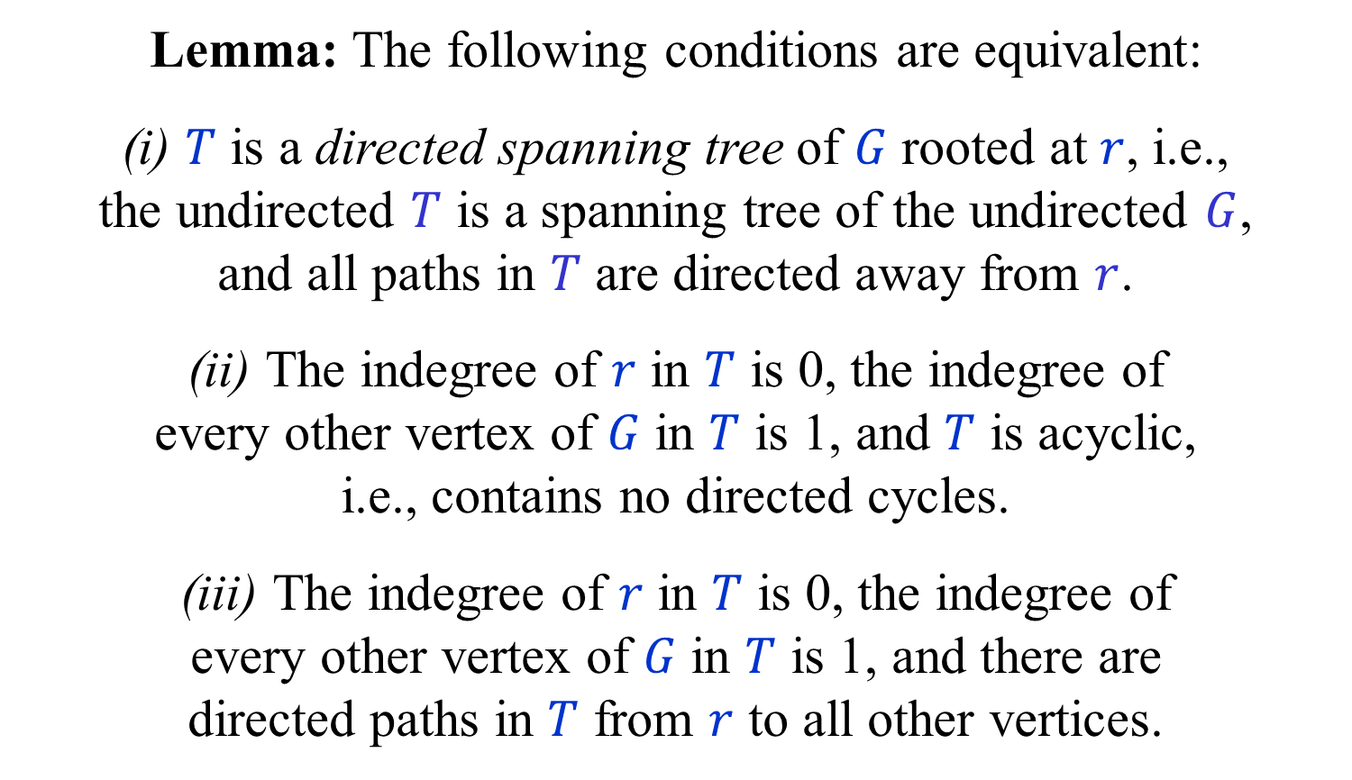
Directed Spanning Trees (DSTs) (Also known as arborescences)
Lemma: The following conditions are equivalent:
(i) $T$ is a directed spanning tree of $G$ rooted at $r$, i.e., the undirected $T$ is a spanning tree of the undirected $G$, and all paths in $T$ are directed away from $r$.
(ii) The indegree of $r$ in $T$ is 0, the indegree of every other vertex of $G$ in $T$ is 1, and $T$ is acyclic, i.e., contains no directed cycles.
(iii) The indegree of $r$ in $T$ is 0, the indegree of every other vertex of $G$ in $T$ is 1, and there are directed paths in $T$ from $r$ to all other vertices.

Slide 6
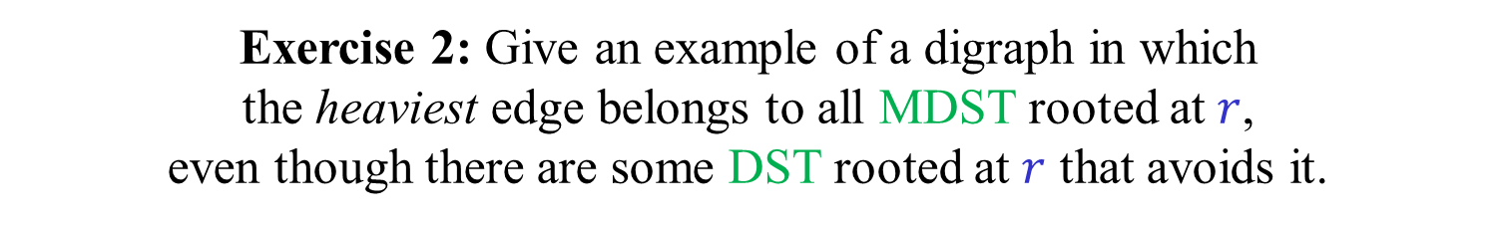
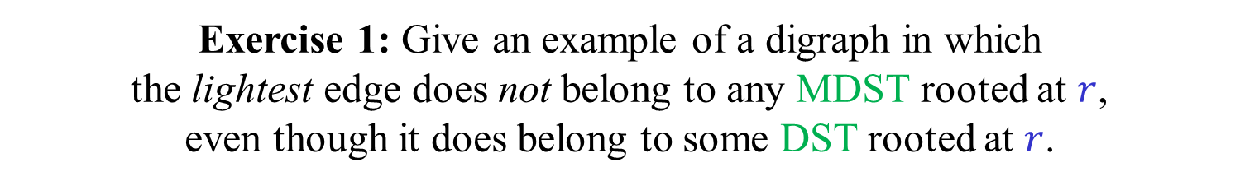
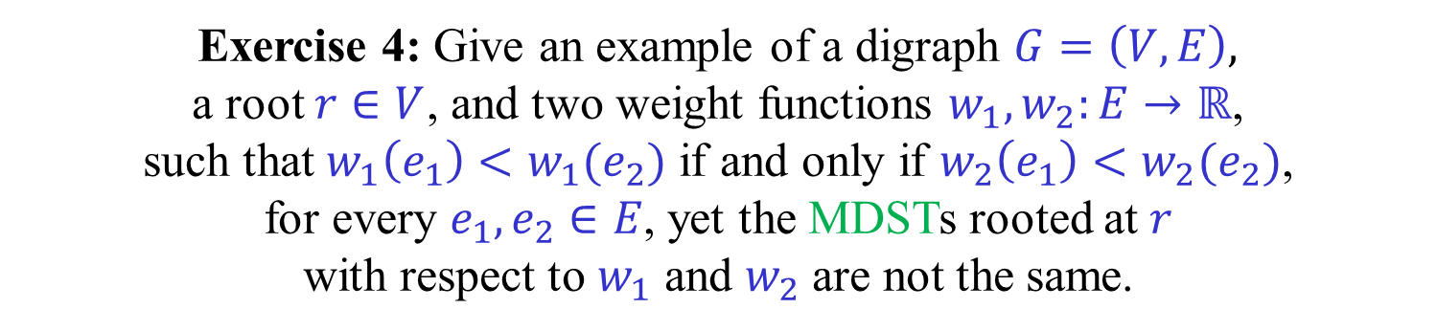
Directed cut/cycle rules?
Exercise 1: Give an example of a digraph in which the lightest edge does not belong to any MDST rooted at $r$, even though it does belong to some DST rooted at $r$.
Exercise 2: Give an example of a digraph in which the heaviest edge belongs to all MDST rooted at $r$, even though there are some DST rooted at $r$ that avoids it.
Exercise 3: Give an example of a digraph in which all edge weights are distinct but the MDST is not unique.
Exercise 4: Give an example of a digraph $G=\left(V,E\right),$ a root $r∈V$, and two weight functions $w_{1},w_{2}:E→ℝ$, such that $w_{1}\left(e_{1}\right)<w_{1}(e_{2})$ if and only if $w_{2}\left(e_{1}\right)<w_{2}(e_{2})$, for every $e_{1},e_{2}∈E$, yet the MDSTs rooted at $r$ with respect to $w_{1}$ and $w_{2}$ are not the same.

Slide 7
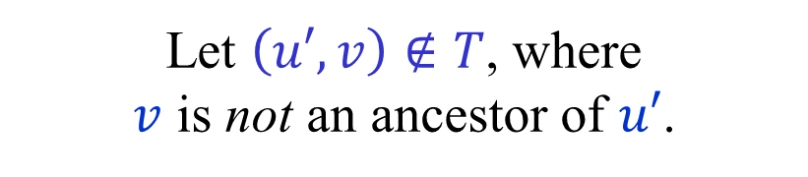







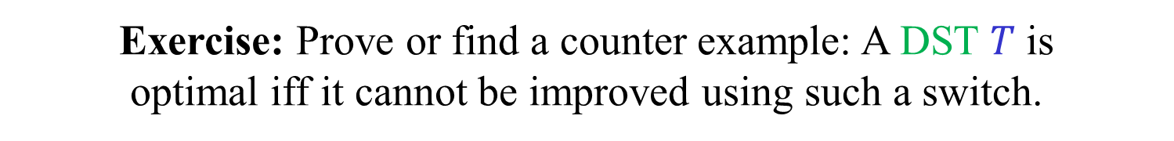

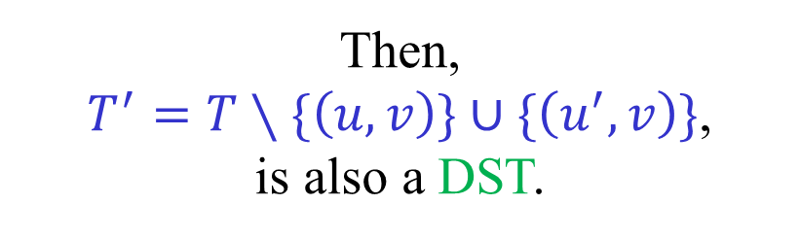
Modifying a DST
$$T$$
$$r$$
Lemma:
Let $T$ be a DST rooted at $r$.
Let $\left(u,v\right)∈T$.
$$u$$
Let $\left(u′,v\right)∉T$, where $v$ is not an ancestor of $u′$.
Then, $T^{′}=T∖\{\left(u,v\right)\}∪\{\left(u^{′},v\right)\}$, is also a DST.
$$v$$
$$u′$$
$$u′′$$
Exercise: Prove or find a counter example: A DST $T$ is optimal iff it cannot be improved using such a switch.

Slide 8
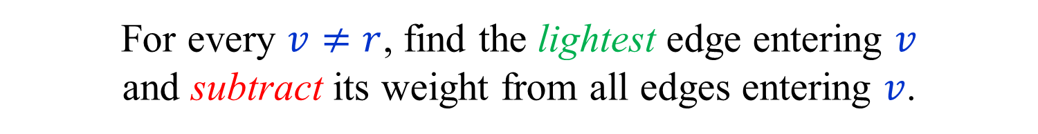
0-edges
Assume that all edge weights are non-negative.
(Otherwise, add a constant to all edge weights.)
For every $v≠r$, find the lightest edge entering $v$ and subtract its weight from all edges entering $v$.
(This does not change the MDST(s).)
Each vertex $v≠r$ now has a 0-edge entering it.
If there is a DST composed of 0-edges, then it is of course an MDST.
Otherwise, there must be a 0-cycle.

Slide 9

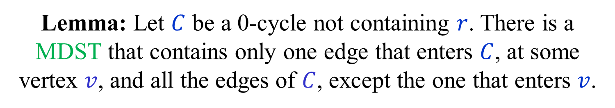


0-cycles
Lemma: Let $C$ be a 0-cycle not containing $r$. There is a MDST that contains only one edge that enters $C$, at some vertex $v$, and all the edges of $C$, except the one that enters $v$.
0
0
0
$$v$$
$$C$$
$$r$$
0
0
0

Slide 10










Let $T$ be an MDST that enters $C$ more than once.
Consider a path of $T$ from $r$ that first enters $C$ at $v_{0}$.
Let $v_{0},v_{1},…,v_{k−1},v_{k}=v_{0}$ be the vertices of $C$.
Let ${(v}_{i−1},v_{i})$be the first edge on $C$ not in $T$, where $i<k$.
Let $(u,v_{i})$be the edge of $T$ entering $v_{i}$.
$v_{i}$ is not an ancestor of $v_{i−1}$ in $T$.
Hence, $T^{′}=T∖\left\{\left(u,v_{i}\right)\right\}∪\{\left(v_{i−1},v_{i}\right)$} is a DST,
and ${w(T}^{′})≤w(T)$.
0
$$v_{i−1}$$
0
$$v_{1}$$
0
$$v_{i}$$
$$r$$
$$v_{0}$$
$$C$$
$$u$$
$$≥0$$
0
0
0
$$v_{k−1}$$

Slide 11

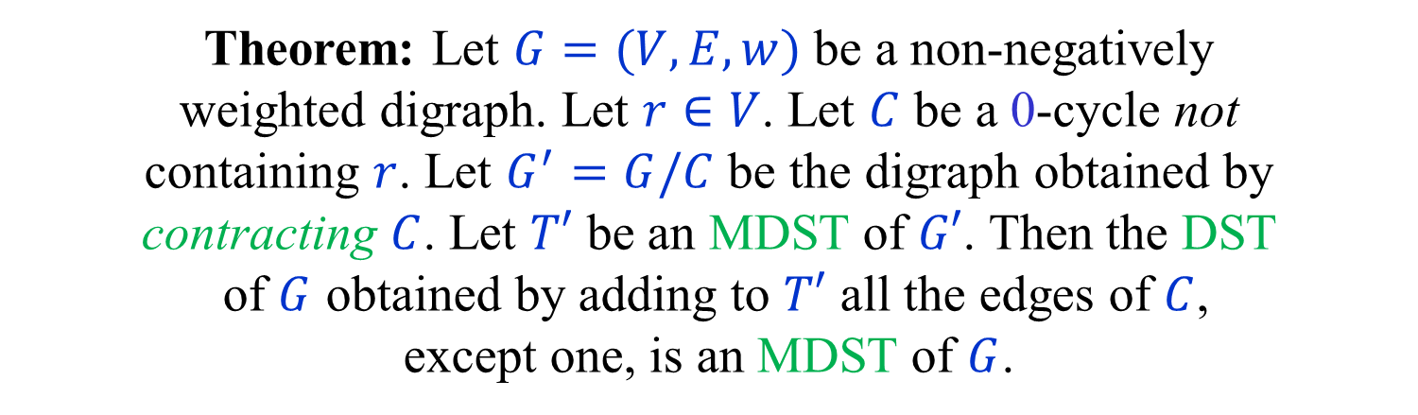

Contracting 0-cycles
Theorem: Let $G=(V,E,w)$ be a non-negatively weighted digraph. Let $r∈V$. Let $C$ be a 0-cycle not containing $r$. Let $G^{′}=G/C$ be the digraph obtained by contracting $C$. Let $T′$ be an MDST of $G′$. Then the DST of $G$ obtained by adding to $T′$ all the edges of $C$, except one, is an MDST of $G$.
0
0
0
$$C$$
$$r$$
0
0
0

Slide 12


Contracting 0-cycles
Proof:
There is a 1-1 correspondence between DSTs of $G$ that enter $C$ only once and all DSTs of $G^{′}.$
If $T$ and $T′$ correspond to each other, then $w\left(T\right)=w(T^{′})$.
Thus $T$ is a minimal DST of $G$ satisfying the restriction iff $T′$ is a DST of $G′$.
By the Lemma, a DST which is minimal among the DSTs satisfying the restriction is also an MDST.
0
0
0
$$C$$
$$r$$
0
0
0

Slide 13
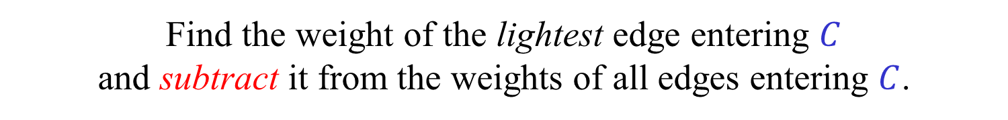
Edmonds’ algorithm [Chin and Liu (1965)] [Edmonds (1967)] [Bock (1971)]
Assume that all edge weights are non-negative, and that each vertex has an incoming 0-edge.
If there is a DST composed of 0-edges, we are done.
Otherwise, find a 0-cycle $C$ and contract it.
Find the weight of the lightest edge entering $C$ and subtract it from the weights of all edges entering $C$.
Recursively find an MDST in the contracted digraph and expand it into an MDST in the original digraph.
Number of recursive calls (iterations) is at most $n$.
Simple implementation in $O(mn)$ time.

Slide 14
Minimum Directed Spanning Trees
3
8
16
22
0
17
16
5
0
11
0
1
0
10
12
3
0
18
30
2
12
13
0
25
7
9
2
0
0
15
13

Slide 15
Minimum Directed Spanning Trees
3
8
16
22
0
17
16
5
0
11
0
1
0
10
12
3
0
18
30
2
12
13
0
25
7
9
2
0
0
15
13

Slide 16
Minimum Directed Spanning Trees
3
8
16
22
0
17
16
5
0
11
0
1
0
3
10
12
3
0
18
30
2
5
12
13
0
25
0
7
9
2
0
0
15
13
6

Slide 17
Minimum Directed Spanning Trees
3
8
16
22
0
17
16
5
0
11
0
1
0
3
10
12
3
0
18
30
2
5
12
13
0
25
0
7
9
2
0
0
15
13
6

Slide 18

Another small example
0
1
0
$$r$$
10
0
8
0
0
2
0
All edges end up with weight 0.
But, not every DST is an MDST.
A DST is an MDST iff it enters both cycles only once.

Slide 19
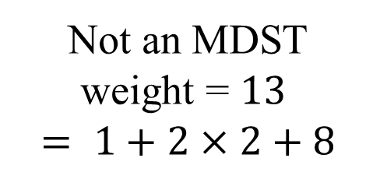
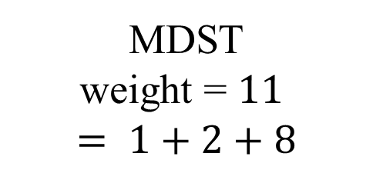


Another small example
0
1
0
MDST weight = $11$ $$= 1+2+8$$
$$r$$
10
0
8
0
0
2
0
0
1
0
Not an MDST weight = $13$ $$= 1+2×2+8$$
$$r$$
10
0
8
0
0
2
0

Slide 20
Expansion (undoing a contraction)
Invariant: Each contracted cycle, up to the current level, contains exactly one edge of the final DST entering it.

Slide 21
Expansion (undoing a contraction)
At the end, each contracted cycle, at each level, contains exactly one edge of the final DST entering it.

Slide 22
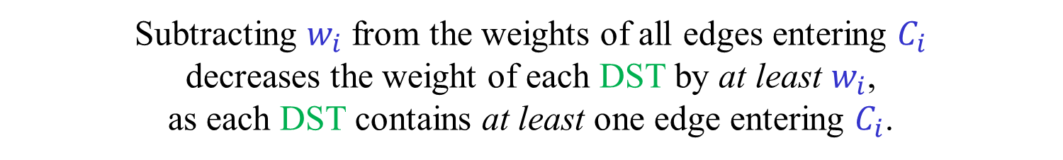
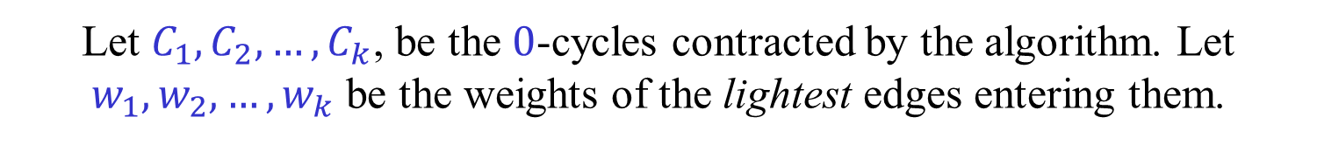
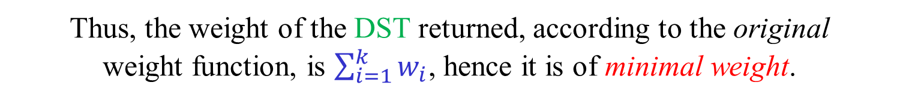

Alternative correctness proof
Let $C_{1},C_{2},…,C_{k}$, be the $0$-cycles contracted by the algorithm. Let $w_{1},w_{2},…,w_{k}$ be the weights of the lightest edges entering them.
Subtracting $w_{i}$ from the weights of all edges entering $C_{i}$ decreases the weight of each DST by at least $w_{i}$, as each DST contains at least one edge entering $C_{i}$.
The weight of each DST of the original graph is at least $\sum_{i=1}^{k}{w_{i}}$.
The weight of the DST returned by the algorithm, according to the final weight function, is 0.
By the invariant, for every $i$, the weight of exactly one edge of the DST returned was decreased by $w_{i}$.
Thus, the weight of the DST returned, according to the original weight function, is $\sum_{i=1}^{k}{w_{i}}$, hence it is of minimal weight.
(As we shall see, this is LP duality at work.)

Slide 23


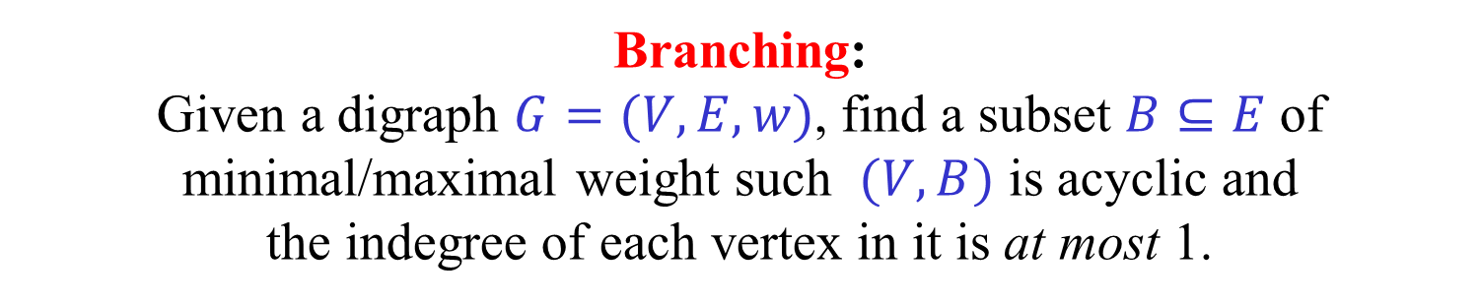
Variations
Specified root: Given a digraph $G=\left(V,E,w\right)$ and a root $r$, find a MDST rooted at $r$.
Unspecified root: Given a digraph $G=(V,E,w)$, find MDST rooted at any vertex.
Branching: Given a digraph $G=(V,E,w)$, find a subset $B⊆E$ of minimal/maximal weight such $(V,B)$ is acyclic and the indegree of each vertex in it is at most 1.
Exercise: Give simple reductions between the three problems.

Slide 24

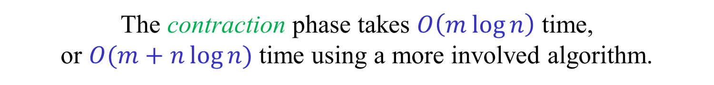

Efficient implementation [Tarjan (1977)] [Gabow-Galil-Spencer-Tarjan (1987)]
The algorithm is composed of a contraction phase, followed by an expansion phase.
We describe a version of the contraction phase that does not depend on the root $r$.
The same contraction phase can be used to find MDST with different roots.
The contraction phase takes $O\left(m\log{n}\right)$ time, or $O(m+n\log{n})$ time using a more involved algorithm.
The expansion phase, for a given root $r,$takes only $O\left(n\right)$ time.

Slide 25

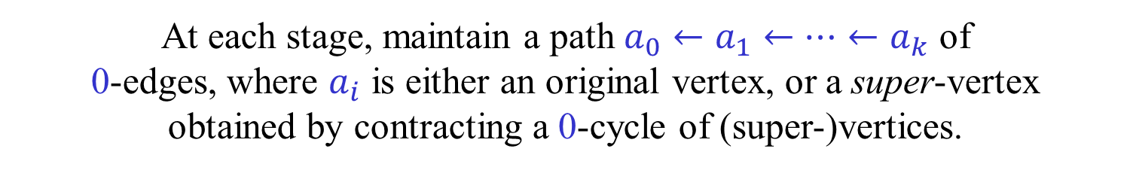
Contraction phase [Tarjan (1977)] [Gabow-Galil-Spencer-Tarjan (1987)]
Assume, for simplicity, that the digraph is strongly connected.
At each stage, maintain a path $a_{0}←a_{1}←…←a_{k}$ of 0-edges, where $a_{i}$ is either an original vertex, or a super-vertex obtained by contracting a 0-cycle of (super-)vertices.
Initially, the path is composed of an arbitrary vertex $a_{0}=a$.
The contraction phase ends when there is only one super-vertex.
For each (super-)vertex $a$ we maintain a meldable heap $P\left[a\right]$ containing all its incoming edges. The key of each edge is its current weight.
Contractions are done implicitly using a union-find data structure.
The heaps may contain self-loops and parallel edges.
We will also need a way to update weights.

Slide 26



Growing a path and contracting [Tarjan (1977)] [Gabow-Galil-Spencer-Tarjan (1987)]
Let $a_{0}←a_{1}←…←a_{k}=a$ be the current path.
Extract the lightest edge $\left(u,v\right)←ExtractMin(P\left[a\right])$ entering $a$.
If $find\left(a\right)=find(u)$, extract the next edge and repeat.
Subtract $w(u,v)$ from the weights of all edges entering $a$.
If ${u∉a}_{0},a_{1},…,a_{k}$, extend the path by letting ${a←a}_{k+1}←u$ and $k←k+1$.
If ${u∈a}_{i}$, create a new super-vertex $c$ by contracting the cycle $a_{i},a_{i+1},…,a_{k}$ and let ${a←a}_{i}←c$ , $k←i$.
The heap $P[c]$ is obtained by melding ${P[a}_{i}],{P[a}_{i+1}],…,{P[a}_{k}]$.
Update the union-find data structure so that $find(u)$ returns $c$for any vertex $u∈c$.

Slide 27












Growing a path and contracting
$$a$$
Self-loop:
$$u$$
$$v$$
$$a$$
Growth:
$$v$$
$$u$$
$$c$$
$$d$$
$$b$$
$$a$$
$$u$$
$$v$$
Contraction:

Slide 28








































Contraction phase – An example
$$n$$
$$c$$
$$g$$
$$l$$
$$m$$
$$a$$
$$b$$
$$d$$
$$e$$
$$f$$
$$i$$
$$j$$
$$k$$
$$h$$
Contraction tree
$$n$$
$$in\left[a\right]=(b,a)$$
$$in\left[h\right]=(i,b)$$
$$in\left[b\right]=(a,b)$$
$$in\left[i\right]=(j,i)$$
$$h$$
$$in\left[c\right]=(d,b)$$
$$in\left[j\right]=(k,j)$$
$$in\left[d\right]=(e,d)$$
$$in\left[k\right]=(i,k)$$
$$c$$
$$g$$
$$l$$
$$in\left[e\right]=(f,e)$$
$$in\left[l\right]=(m,j)$$
$$in\left[f\right]=(d,f)$$
$$in\left[m\right]=(f,m)$$
$$a$$
$$b$$
$$d$$
$$e$$
$$f$$
$$i$$
$$j$$
$$k$$
$$m$$
$$in\left[g\right]=(b,e)$$

Slide 29

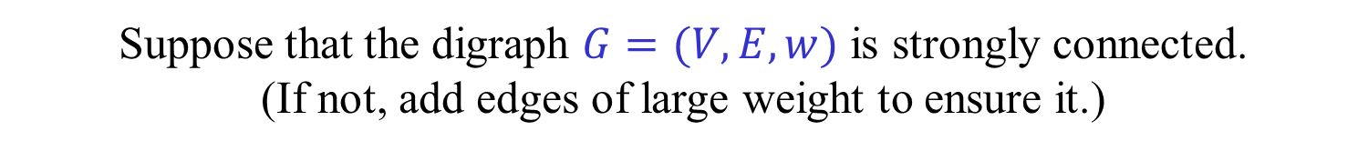


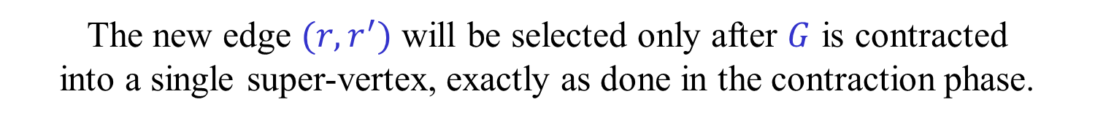

Contraction phase
Why can we ignore the root $r$ during the contraction phase?
Suppose that the digraph $G=(V,E,w)$ is strongly connected. (If not, add edges of large weight to ensure it.)
Add an auxiliary root $r′$ and an edge $\left(r,r^{′}\right)$ of huge weight $M$.
The MDST rooted at $r′$ is the MDST rooted at $r$ plus $(r^{′},r)$.
Run Edmonds’ algorithm on the new graph $G′$.
The new edge $(r,r^{′})$ will be selected only after $G$ is contracted into a single super-vertex, exactly as done in the contraction phase.
$$G$$
$$r′$$
$$r$$
$$M$$

Slide 30





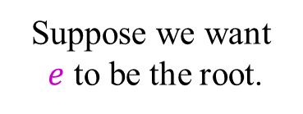


Expansion phase – An example
$$n$$
$$c$$
$$g$$
$$l$$
$$m$$
$$a$$
$$b$$
$$d$$
$$e$$
$$f$$
$$i$$
$$j$$
$$k$$
$$h$$
Suppose we want $e$ to be the root.
$$n$$
$$in\left[a\right]=(b,a)$$
$$in\left[h\right]=(i,b)$$
$$in\left[b\right]=(a,b)$$
$$in\left[i\right]=(j,i)$$
$$h$$
$$in\left[c\right]=(d,b)$$
$$in\left[j\right]=(k,j)$$
$$in\left[d\right]=(e,d)$$
$$in\left[k\right]=(i,k)$$
$$c$$
$$g$$
$$l$$
$$in\left[e\right]=(f,e)$$
$$in\left[l\right]=(m,j)$$
$$in\left[f\right]=(d,f)$$
$$in\left[m\right]=(f,m)$$
$$a$$
$$b$$
$$d$$
$$e$$
$$f$$
$$i$$
$$j$$
$$k$$
$$m$$
$$in\left[g\right]=(b,e)$$
$$in\left[n\right]=(−,e)$$

Slide 31

Expansion phase – An example
$$n$$
$$c$$
$$g$$
$$l$$
$$m$$
$$a$$
$$b$$
$$d$$
$$e$$
$$f$$
$$i$$
$$j$$
$$k$$
$$h$$
$$n$$
$$in\left[a\right]=(b,a)$$
$$in\left[h\right]=(−,e)$$
$$in\left[b\right]=(a,b)$$
$$in\left[i\right]=(j,i)$$
$$h$$
$$in\left[c\right]=(d,b)$$
$$in\left[j\right]=(k,j)$$
$$in\left[d\right]=(e,d)$$
$$in\left[k\right]=(i,k)$$
$$c$$
$$g$$
$$l$$
$$in\left[e\right]=(f,e)$$
$$in\left[l\right]=(m,j)$$
$$in\left[f\right]=(d,f)$$
$$in\left[m\right]=(f,m)$$
$$a$$
$$b$$
$$d$$
$$e$$
$$f$$
$$i$$
$$j$$
$$k$$
$$m$$
$$in\left[g\right]=(b,e)$$
$$in\left[n\right]=(−,e)$$

Slide 32

Expansion phase – An example
$$c$$
$$g$$
$$l$$
$$m$$
$$a$$
$$b$$
$$d$$
$$e$$
$$f$$
$$i$$
$$j$$
$$k$$
$$h$$
$$in\left[a\right]=(b,a)$$
$$in\left[h\right]=(−,e)$$
$$in\left[b\right]=(a,b)$$
$$in\left[i\right]=(j,i)$$
$$h$$
$$in\left[c\right]=(d,b)$$
$$in\left[j\right]=(k,j)$$
$$in\left[d\right]=(e,d)$$
$$in\left[k\right]=(i,k)$$
$$c$$
$$g$$
$$l$$
$$in\left[e\right]=(f,e)$$
$$in\left[l\right]=(m,j)$$
$$in\left[f\right]=(d,f)$$
$$in\left[m\right]=(f,m)$$
$$a$$
$$b$$
$$d$$
$$e$$
$$f$$
$$i$$
$$j$$
$$k$$
$$m$$
$$in\left[g\right]=(−,e)$$

Slide 33

Expansion phase – An example
$$c$$
$$g$$
$$l$$
$$m$$
$$a$$
$$b$$
$$d$$
$$e$$
$$f$$
$$i$$
$$j$$
$$k$$
$$in\left[a\right]=(b,a)$$
$$in\left[b\right]=(a,b)$$
$$in\left[i\right]=(j,i)$$
$$in\left[c\right]=(d,b)$$
$$in\left[j\right]=(k,j)$$
$$in\left[d\right]=(e,d)$$
$$in\left[k\right]=(i,k)$$
$$c$$
$$g$$
$$l$$
$$in\left[e\right]=(−,e)$$
$$in\left[l\right]=(m,j)$$
$$in\left[f\right]=(d,f)$$
$$in\left[m\right]=(f,m)$$
$$a$$
$$b$$
$$d$$
$$e$$
$$f$$
$$i$$
$$j$$
$$k$$
$$m$$
$$in\left[g\right]=(−,e)$$

Slide 34


Expansion phase – An example
$$c$$
$$l$$
$$m$$
$$a$$
$$b$$
$$d$$
$$e$$
$$f$$
$$i$$
$$j$$
$$k$$
$$in\left[a\right]=(b,a)$$
$$in\left[b\right]=(d,b)$$
$$in\left[i\right]=(j,i)$$
$$in\left[c\right]=(d,b)$$
$$in\left[j\right]=(k,j)$$
$$in\left[d\right]=(e,d)$$
$$in\left[k\right]=(i,k)$$
$$c$$
$$l$$
$$in\left[e\right]=(−,e)$$
$$in\left[l\right]=(m,j)$$
$$in\left[f\right]=(d,f)$$
$$in\left[m\right]=(f,m)$$
$$a$$
$$b$$
$$d$$
$$e$$
$$f$$
$$i$$
$$j$$
$$k$$
$$m$$

Slide 35


Expansion phase – An example
$$l$$
$$m$$
$$a$$
$$b$$
$$d$$
$$e$$
$$f$$
$$i$$
$$j$$
$$k$$
$$in\left[a\right]=(b,a)$$
$$in\left[b\right]=(d,b)$$
$$in\left[i\right]=(j,i)$$
$$in\left[j\right]=(m,j)$$
$$in\left[d\right]=(e,d)$$
$$in\left[k\right]=(i,k)$$
$$l$$
$$in\left[e\right]=(−,e)$$
$$in\left[l\right]=(m,j)$$
$$in\left[f\right]=(d,f)$$
$$in\left[m\right]=(f,m)$$
$$a$$
$$b$$
$$d$$
$$e$$
$$f$$
$$i$$
$$j$$
$$k$$
$$m$$

Slide 36













$$e$$
$$a$$
$$b$$
$$e$$
$$i$$
$$h$$
$$e_{3}$$
$$c$$
$$d$$
$$g$$
$$e_{2}$$
$$f$$
$$e_{1}$$
Edge $e$ eliminates $e_{1},e_{2},e_{3}$.

Slide 37
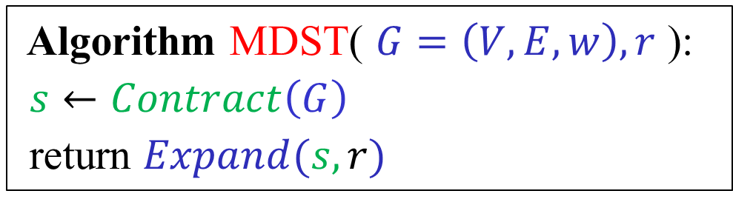
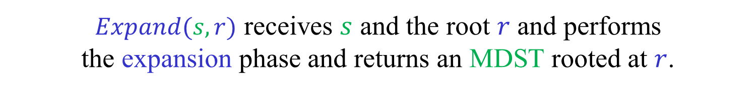

Algorithm MDST( $G=\left(V,E,w\right),r$ ):
$s←Contract\left(G\right)$
return $Expand(s,r)$
$s←Contract(G)$ performs the contraction phase, returning the resulting super-vertex $s$.
$Expand(s,r)$ receives $s$ and the root $r$ and performs the expansion phase and returns an MDST rooted at $r$.

Slide 38
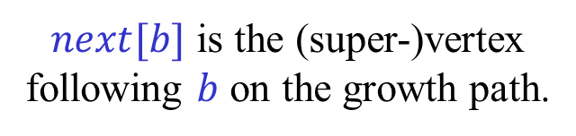
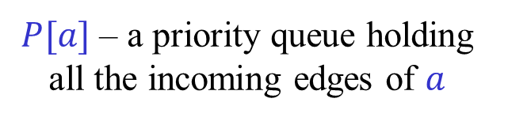
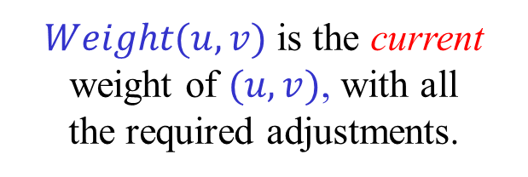
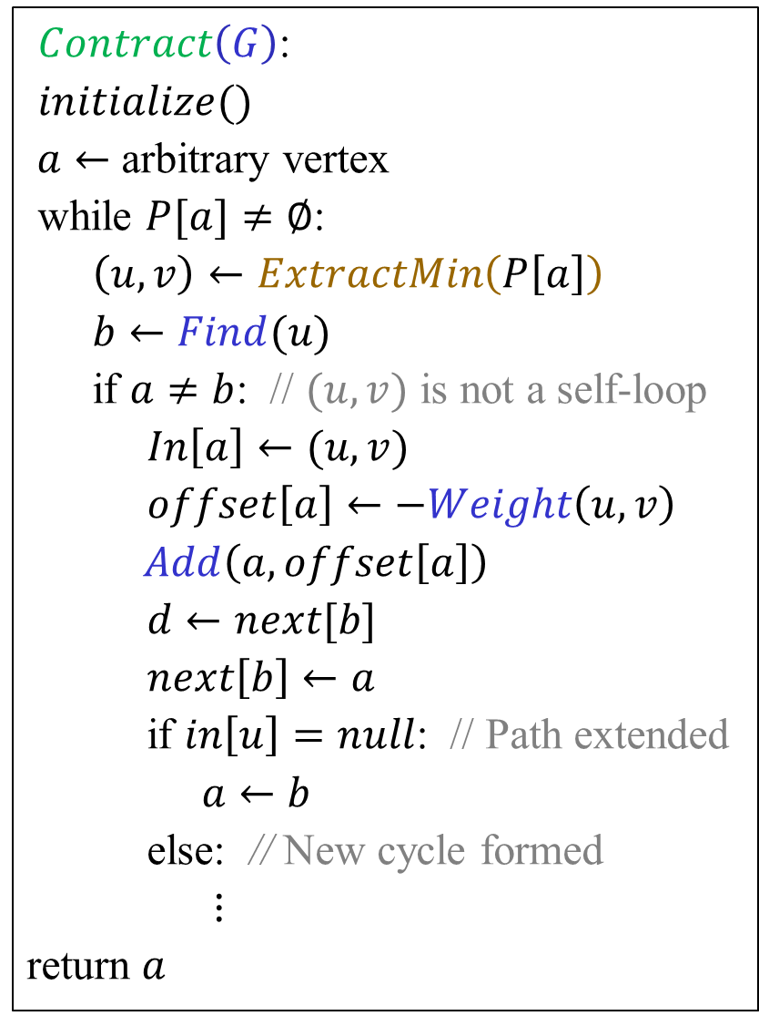
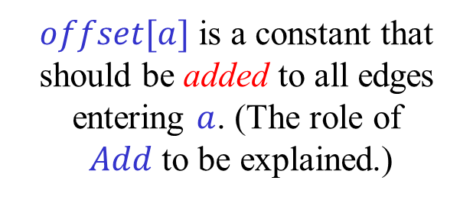

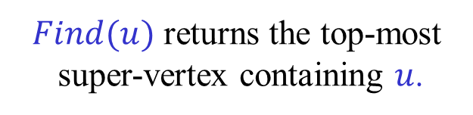
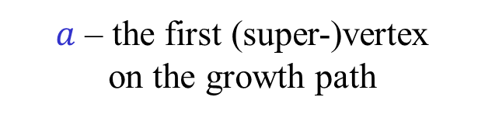
$Contract\left(G\right)$:
$initialize()$ $a←$ arbitrary vertex
while $P[a]≠∅$:
$\left(u,v\right)←ExtractMin\left(P\left[a\right]\right)$
$b←Find(u)$
if $a≠b$: // $(u,v)$ is not a self-loop
$In\left[a\right]←(u,v)$
$offset\left[a\right]←−Weight\left(u,v\right)$
$Add\left(a,offset\left[a\right]\right)$
$d←next[b]$
$next\left[b\right]←a$
if $in\left[u\right]=null$: // Path extended
$a←b$
else: // New cycle formed
$⋮$
return $a$
$a$ – the first (super-)vertex on the growth path
$P[a]$ – a priority queue holding all the incoming edges of $a$
$Find(u)$ returns the top-most super-vertex containing $u$.
$in[a]$ is a 0-edge entering $a$.
$offset[a]$ is a constant that should be added to all edges entering $a$. (The role of $Add$ to be explained.)
$Weight(u,v)$ is the current weight of $(u,v)$, with all the required adjustments.
$next[b]$ is the (super-)vertex following $b$ on the growth path.

Slide 39
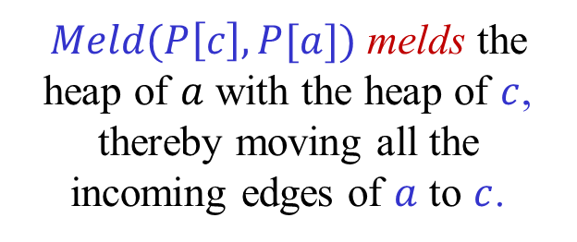
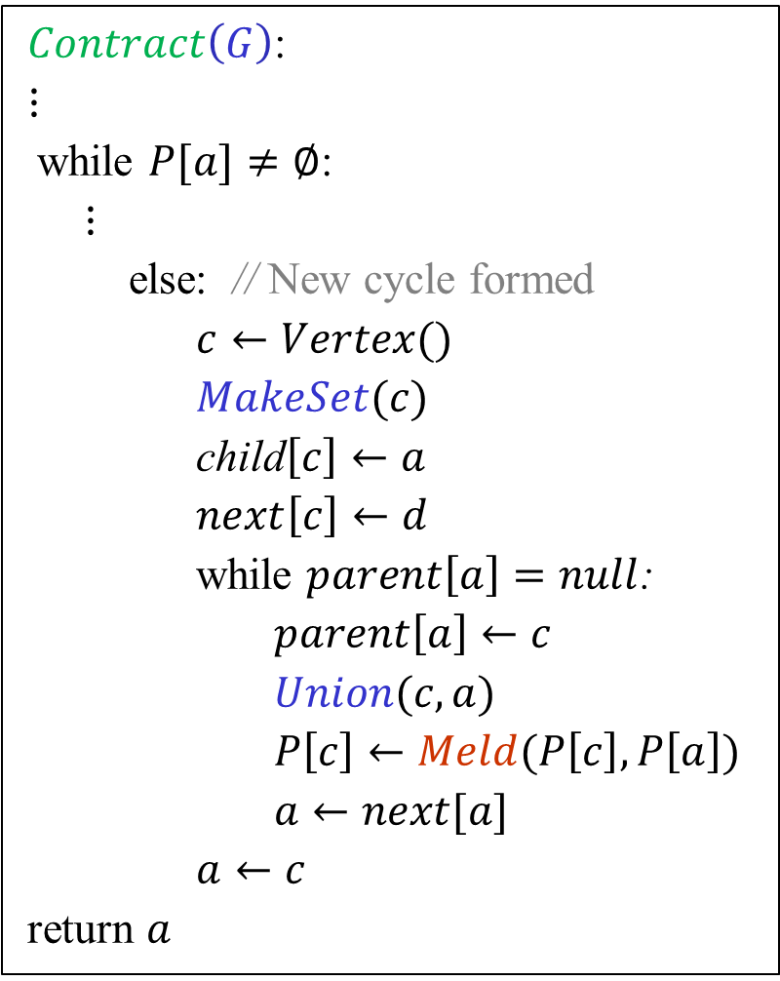
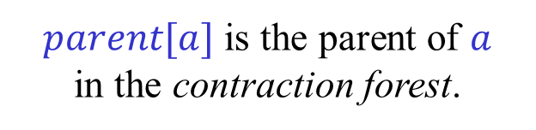
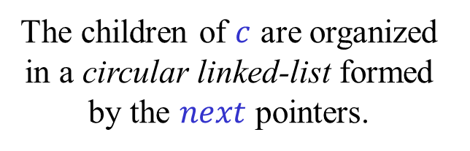
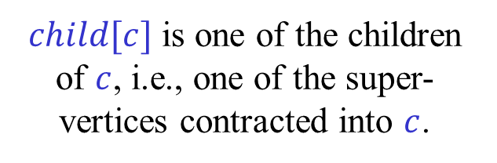
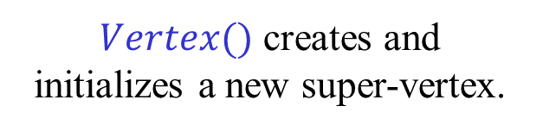
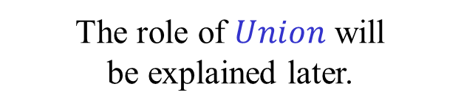
$Contract\left(G\right)$:
$⋮$ while $P[a]≠∅$:
$⋮$
else: // New cycle formed
$c←Vertex()$ $MakeSet(c)$
child$\left[c\right]←a$
$next\left[c\right]←d$
while $parent\left[a\right]=null$:
$parent\left[a\right]←c$
$Union(c,a)$
$P\left[c\right]←Meld(P\left[c\right],P\left[a\right])$
$a←next[a]$
$a←c$
return $a$
$Vertex()$ creates and initializes a new super-vertex.
$child[c]$ is one of the children of $c$, i.e., one of the super-vertices contracted into $c$.
The children of $c$ are organized in a circular linked-list formed by the $next$ pointers.
$parent[a]$ is the parent of $a$ in the contraction forest.
The role of $Union$ will be explained later.
$Meld(P\left[c\right],P[a])$ melds the heap of $a$ with the heap of $c$, thereby moving all the incoming edges of $a$ to $c$.
Tested and corrected by Orr Fischer.

Slide 40
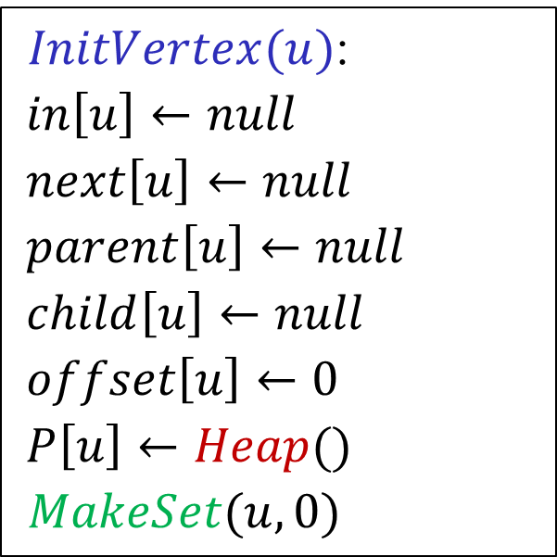
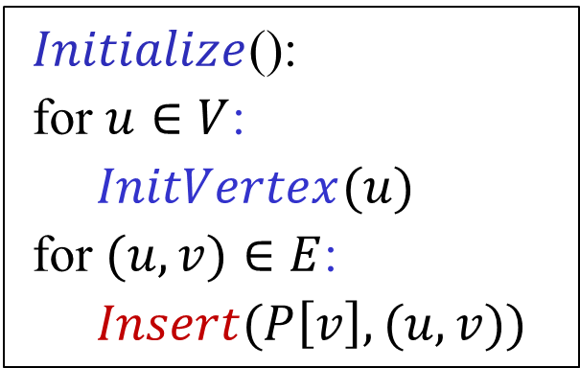
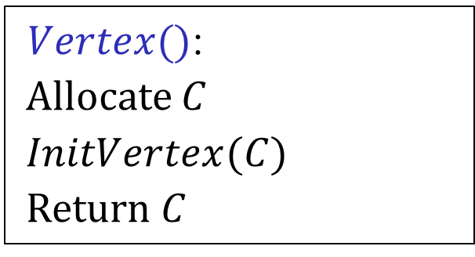
$Initialize$():
for $u∈V$:
$InitVertex(u)$
for $(u,v)∈E$:
$Insert(P\left[v\right],(u,v))$
$InitVertex(u)$:
$in\left[u\right]←null$
$next\left[u\right]←null$
$parent\left[u\right]←null$
$child\left[u\right]←null$
$offset\left[u\right]←0$
$P\left[u\right]←Heap()$ $MakeSet(u,0)$
$Vertex()$:
Allocate $C$
$InitVertex(C)$
Return $C$

Slide 41
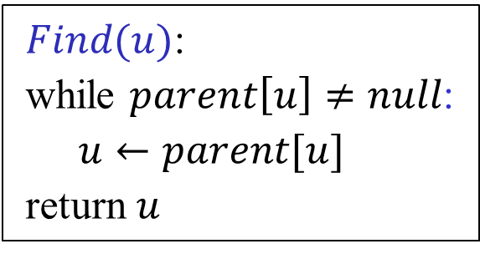
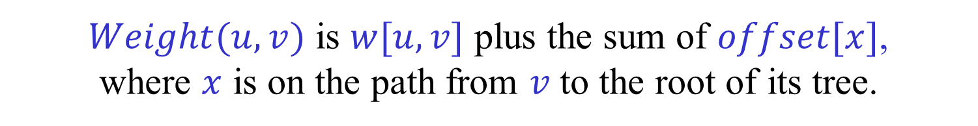

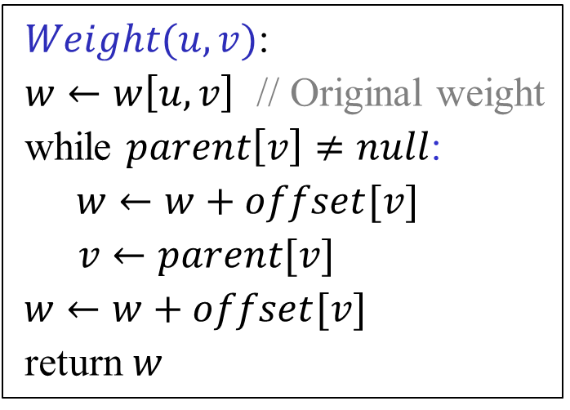
Naïve implementation of $Find$ and $Weight$
$Find(u)$:
while $parent\left[u\right]≠null$:
$u←parent[u]$
return $u$
$Weight(u,v)$:
$w←w\left[u,v\right]$ // Original weight
while $parent\left[v\right]≠null$:
$w←w+offset[v]$
$v←parent[v]$
$w←w+offset[v]$
return $w$
More efficient implementation to follow.
$Weight(u,v)$ is $w[u,v]$ plus the sum of $offset[x]$, where $x$ is on the path from $v$ to the root of its tree.
$$Weight\left(u,v\right)=w\left[u,v\right]+Value(v)$$

Slide 42
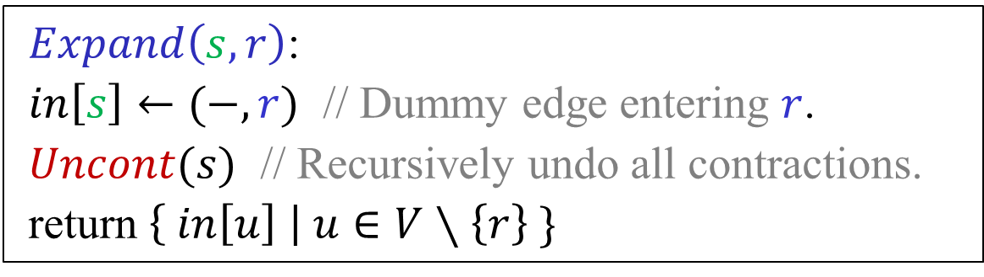
$Expand\left(s,r\right)$:
$in\left[s\right]←(−,r)$ // Dummy edge entering $r$.
$Uncont(s)$ // Recursively undo all contractions.
return $\left\{ in\left[u\right] \right| u∈V∖\left\{r\right\} \}$

Slide 43
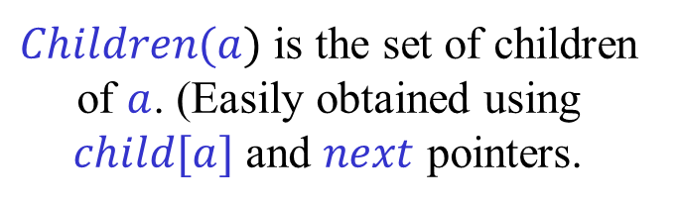

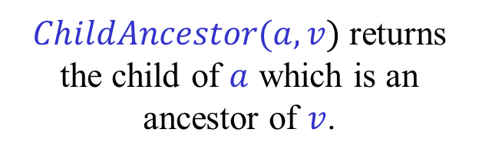
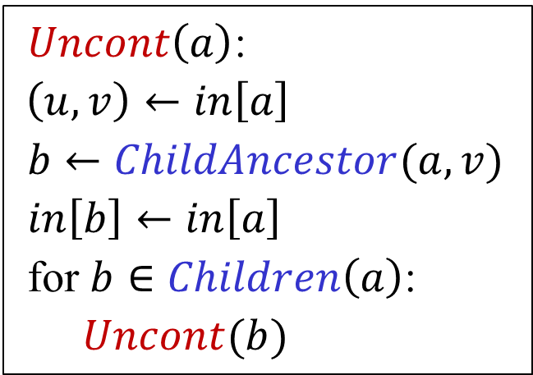

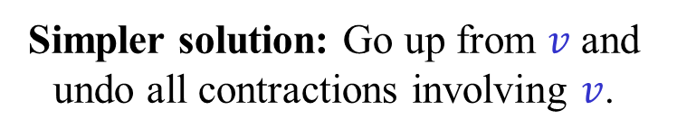

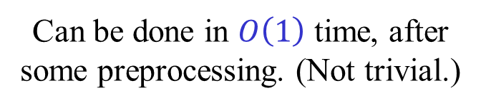


Undoing contractions (Version 1)
$v$ is a descendant of $a$.
$Uncont\left(a\right)$:
$\left(u,v\right)←in\left[a\right]$
$b←ChildAncestor(a,v)$
$in\left[b\right]←in\left[a\right]$
for $b∈Children\left(a\right)$:
$Uncont(b)$
$ChildAncestor(a,v)$ returns the child of $a$ which is an ancestor of $v$.
$Children(a)$ is the set of children of $a$. (Easily obtained using $child[a]$ and $next$ pointers.
$$a$$
How do we implement $ChildAncestor(a,v)$?
$$v$$
Can be done in $O\left(1\right)$ time, after some preprocessing. (Not trivial.)
$$b$$
Simpler solution: Go up from $v$ and undo all contractions involving $v$.

Slide 44




Undoing contractions (Version 2)
$Uncont\left(s\right)$:
$R←\{s\}$ // Roots of contraction forest
while $R≠∅$:
$c←Extract(R)$
$\left(u,v\right)←in[c]$
$in\left[v\right]←\left(u,v\right)$
$Dismantle(v)$
$$c$$
$$v$$
$Dismantle(v)$ dismantles the path from $v$ to the root of the contraction forest, adding new roots formed to $R$.
End result identical to the one obtained by the previous version.

Slide 45



$Dismentle\left(u\right)$:
while $parent\left[u\right]≠null$:
$v←next[u]$
while $v≠u$:
$parent\left[v\right]←null$
$Insert\left(R,v\right)$ $v←next[v]$
$u,parent\left[u\right]←parent\left[u\right],null$
The code above does not destroy the super-vertices containing $u$. Easy to add it, making sure that original vertices are not destroyed.
The code does not use $child$ pointers, so they are not really needed. If they are available, we can Insert $v$ to $R$ only if $child\left[v\right]≠null$.

Slide 46


Undoing contractions (Version 3)
$Uncont\left(L\right)$:
while $L≠∅$:
$c←L.DeleteLast()$
$\left(u,v\right)←in[c]$
$in\left[v\right]←\left(u,v\right)$
$v←parent\left[v\right]$
while $a≠c$:
$L.Delete(a)$
$a←parent[a]$
$$c$$
$$v$$
$L$ is the list of super-vertices created, in the order of creation.
Simpler implementation of Version 2.

Slide 47



Meldable Heaps with implicit keys
We need meldable heaps, i.e., heaps that support $Insert$, $Meld$ and $ExtractMin$.
$DecreaseKey$ operations are not needed (yet).
For the time being, we can use Binomial heaps. $Insert$, $Meld$ in $O\left(\log{n}\right)$ time ($O\left(1\right)$ amortized time). $ExtractMin$ in $O(\log{n})$ time.
But, we need to change the weights = keys of edges.
Can we still use standard data structures?
The keys of all edges in a heap change by the same amount. Hence, all order relations are preserved.
Thus, any comparison-based data structure that does not store keys explicitly, but calls $Weight$ to compute keys, when needed, still works correctly.

Slide 48

UNION-FIND with Names and Values
To obtain a faster implementation of $Find$ and $Weight$ use a an extension of the union-find data structure.
$MakeSet(u,x)$ – Make $u$ into a singleton set, called $u$, with value $x$.
$MakeSet(A)$ – Make $A$ into an empty set.
$Unite(A,B)$ – Unite $A$ and $B$. The new set is called $A$.
$Find(u)$ – Return the set currently containing $u$.
$Value(u)$ – Return the value of $u$.
$Add(A,Δ)$ – Add $Δ$ to the values of all items in $A$.
Sets now have names. Items are also treated as singleton sets.
Items have values. Values of all items in a set can be changed together.

Slide 49

UNION-FIND with Names and Values
Each set is represented as a tree.
The set and the root of the tree point to each other.
Values of items are in difference form.
Each item $u$ has an offset $offset[u]$.
The value of $u$ is the sum of the offsets on the path from $u$ to the root.
To add a constant $Δ$ to the values of all the items in a set $A$, simply add $Δ$ to the offset of the root of $A$.
$Find(u)$ and $Value\left(u\right)$ are implemented using path compression.
$Unite(A,B)$ is implemented using linking by rank.
The (non-trivial) analysis of union-find applies.
A sequence of $m$ operations on $n$ items takes $O(m α\left(m,n\right))$ time.
In our case, $m≥n\log{n}$, so the total time in $O(m)$.

Slide 50








Path Compression
offsets
$$y_{1}$$
$$y_{1}$$
$$y_{2}$$
$$y_{2}$$
$$y_{3}$$
$${y_{2}+y}_{3}$$
$$y_{4}$$
$${y_{2}+y}_{3}+y_{4}$$

Slide 51


















$Union(A,B)$ by rank
$$A$$
$$u$$
$$x$$
$$B$$
$$v$$
$$y$$
If $rank\left(u\right)≤rank(v)$:
If $rank\left(u\right)>rank(v)$:
$$A$$
$$v$$
$$y$$
$$A$$
$$u$$
$$x$$
$$u$$
$$x−y$$
$$v$$
$$y−x$$
$$rank\left(v\right)←\max\left\{rank\left(v\right),rank\left(u\right)+1\right\}$$

Slide 52






LP duality
min $c^{T}x$
max $b^{T}y$
(P)
(D)
s.t. $Ax≥b$
s.t. $A^{T}y≤c$
$x≥0$
$y≥0$
Weak duality:
If $x$ is a feasible solution of (P) and $y$ is a feasible solution of (D)
$$b^{T}y≤{\left(Ax\right)}^{T}y=x^{T}\left(A^{T}y\right)≤x^{T}c=c^{T}x$$
Thus, if $b^{T}y=c^{T}x$, then $x$ and $y$ are optimal.
Strong duality:
If $x$ and $y$ are optimal then $b^{T}y=c^{T}x$.

Slide 53


LP formulation of MDST
$\min{ \sum_{e∈E}{w\left(e\right)x_{e}}}$ s.t. $\sum_{e∈δ_{in}(S)}{x_{e}}≥1$ , $∅≠S⊆V∖\{r\}$
$x_{e}≥0$ , $e∈E$
(Primal)
$\max{ \sum_{∅≠S⊆V∖\{r\}}{y_{S}}}$ s.t. $\sum_{S : e∈δ_{in}(S)}{y_{S}}≤w(e)$ , $e∈E$
$y_{S}≥0$ , $∅≠S⊆V∖\{r\}$
(Dual)
Assuming $w\left(e\right)≥0$ for every $e∈E$.
$$δ_{in}\left(S\right)=E\left(\overline{S},S\right)=\left\{ \left(u,v\right)∈E \right| u∉S , v∈S \}$$
The LP is of exponential size! Is it useful?

Slide 54

LP formulation of MDST
$\min{ \sum_{e∈E}{w\left(e\right)x_{e}}}$ s.t. $\sum_{e∈δ_{in}(S)}{x_{e}}≥1$ , $∅≠S⊆V∖\{r\}$
$x_{e}≥0$ , $e∈E$
(Primal)
$\max{ \sum_{∅≠S⊆V∖\{r\}}{y_{S}}}$ s.t. $\sum_{S : e∈δ_{in}(S)}{y_{S}}≤w(e)$ , $e∈E$
$y_{S}≥0$ , $∅≠S⊆V∖\{r\}$
(Dual)
Weak duality:
$$\sum_{S}{y_{S}} ≤ \sum_{S}{y_{S}\sum_{e∈δ_{in}\left(S\right)}{x_{e}}} = \sum_{e∈E}{x_{e}\sum_{e∈δ_{in}\left(S\right)}{y_{S}}} ≤ \sum_{e∈E}{w\left(e\right)x_{e}}$$

Slide 55
LP formulation of MDST
How do we know that the primal LP has an optimal 0,1 solution that corresponds to an MDST?
All the constraints of the primal LP are clearly necessary. Thus, the value of the primal LP is a lower bound on the weight of an MDST.
Edmonds’ algorithm produces a feasible 0,1 solution of the primal and a feasible solution of the dual of equal objective values. By weak duality, they are both optimal.
Thus, this is indeed an LP formulation of the problem.
Furthermore, if all the weights are integral, there is an integral optimal dual solution.
The system is therefore Total Dual Integral (TDI).

Slide 56

Certificate of optimality
The optimal dual solution produced by Edmonds’ algorithm can be used as a certificate of optimality.
The certificate can be checked in $O(m+n)$ time, faster than the time needed to find an DMST.
The certificate is given in the form of a contraction forest, with the corresponding offset = dual value attached to each node.
To check the certificate we need to answer (off-line) LCA queries and compute sums along paths.
Can we hope to get a linear time verification algorithm?
Not likely, see below.

Slide 57



















Contraction forest as a certificate
The leaves are the original vertices of the graph.
The non-leaves are super-vertices = cuts.
The parent of a node is the node into which it was contracted.
(The cuts used in the dual form a laminar family.)
To each node we attach the offset added to edges entering it.
What is the final weight of an edge $(u,v)$?
The original weight of $(u,v)$ plus the sum of the offsets from $v$ to $LCA(u,v)$, not including the offset of $LCA(u,v)$.
$$n$$
$$h$$
Check that the modified weight of all tree edges is 0, and that all modified weights are non-negative.
$$c$$
$$g$$
$$l$$
$$q$$
$$a$$
$$b$$
$$d$$
$$e$$
$$f$$
$$i$$
$$j$$
$$k$$
$$m$$
$$o$$
$$p$$
$$r$$

Slide 58






Shortest Path → MDST
Let $G=(V,E,w)$ be a positively weighted directed graph.
Let $s,t∈V$. Want to find a shortest path from $s$ to $t$.
Add 0-edges from $t$ to all vertices of $G$.
An MDST is composed of a shortest path $P$ from $s$ to $t$, and 0-edge from $t$ to all vertices not on $P$.
$$G$$
$$0$$
$$s$$
$$t$$
$$0$$
((Re-)discovered by Shiri Chechik.)

Slide 59
Bonus material
Not covered in class this term
“Careful. We don’t want to learn from this.” (Bill Watterson, “Calvin and Hobbes”)

Slide 60
More efficient implementation [Gabow-Galil-Spencer-Tarjan (1987)]
The current algorithm runs in $O\left(m\log{n}\right)$ time.
In the worst case, each edge is inserted and deleted from a heap.
Can we reduce the number of insertions and deletions?
Remove self-loops and parallel edges as soon as they occur.
Heaps hold vertices rather than edges.
Each vertex is in at most one heap.
For each vertex maintain an exit list holding, in order, its edges to the growth path. (No parallel edges.)
The last edge on an exit list is active. All other edges in exit lists are passive.
The tail of an active edge is in a heap.
For each vertex on the growth path, maintain a passive set, holding the passive edges entering it.

Slide 61





Exit lists, active and passive edges [Gabow-Galil-Spencer-Tarjan (1987)]
$$a_{0}$$
$$a_{1}$$
$$a_{2}$$
$$a_{k−1}$$
The growth path
$$u$$
Each vertex $u$ has an exit list holding, in order, its edges to the path.
Only the lightest edge from $u$ to $a_{i}$, if any, is in the exit list.
The exit list of $a_{i}$ only holds edges to vertices preceding it on the path.
The last edge on an exit list is active. All other edges are passive.
If $\left(u,v\right)$ is active, and $v∈a_{i}$, then $u∈P[a_{i}]$ with key $Weight(u,v)$.
For each $a_{i}$, $Passive[a_{i}]$ is the set of passive edges entering $a_{i}$.

Slide 62






Extension
$${v=a}_{k}$$
$$a_{0}$$
$$a_{1}$$
$$a_{k−1}$$
$$b=u$$
Let $v←ExtractMin(P\left[a_{k−1}\right])$.
If $Find\left(v\right)=v$, the path is extended.
For each edge $(u,v)$ entering $v$:
Let $b←Find(u)$ be the component of $u$.
???
If $Exit[b]=∅$, add $(u,v)$ to $Exit[b]$, making it active, and insert $b$ to $P[v]$.
Otherwise, let $\left(u^{′′},v^{′′}\right)←Last(Exit\left[b\right])$ and let $a_{i}←Find(v^{′′})$. Make $(u^{′′},v^{′′})$ passive and add it to $Passive[a_{i}]$. Append $(u,v)$ to $Exit[b]$. Move $b$ from $P[a_{i}]$ to $P[a_{k}]$.

Slide 63







Contraction
$$c$$
$$a_{0}$$
$$a_{1}$$
$$a_{i}$$
$$a_{k−1}$$
$$b=u$$
Unite $a_{i},…,a_{k−1}$ to form $c$.
Meld $P[a_{i}],…,{P[a}_{k−1}]$ to form $P[c]$.
For each passive edge $(u^{′},v^{′})$ of $a_{i},…,a_{k−1}$:
If $(u^{′},v^{′})$ is lighter than the active edge of $b=Find(u^{′})$ then: remove the currently active edge and make $(u^{′},v^{′})$ active; Do a $DecreaseKey$ on $b$ in $P[c]$ to $Weight(u^{′},v^{′})$.
Otherwise, remove $(u^{′},v^{′})$ from the exit list of $b$.
Let $Passive\left[c\right]←∅$.

Slide 64












Complexity
Heap operations:
$Union$-$Find$-$Value$ operations:
$MakeHeap$– $2n$ operations
$Union$– $2n$ operations
$Insert$– $n$ operations
$Add$– $2n$ operations
$ExtractMin$– $2n$ operations
$Value$– $O\left(m+n\log{n}\right)$ operations
$DecreaseKey$– $m$ operations
(Two $Value$ operations for each comparison made.)
$Move$ – $m$ operations
($O(1)$ ops. for each vertex and edge.)
In general, $Move$ cannot be implemented in $O(1)$ (amortized) time without affecting the (amortized) times of the other operations.
In our case, $Move$ can be implemented in $O(1)$ (amortized) time.
Total cost of $Union$-$Find$-$Value$ operations is $O(m+n\log{n})$.
$α\left(O\left(m+n\log{n}\right),2n\right)=O(1)$.

Slide 65


Implementing $Move$ [Gabow-Galil-Spencer-Tarjan (1987)]
Modify Fibonacci heaps as follows.
$Move(u,P,Q)$ starts with $DecreaseKey(u,P,0)$.
The key of $u$ is unchanged and it is now a root.
Move $u$ and its subtree from $P$ to $Q$.
The descendants of $u$ are now misplaced.
When an $ExtractMin(P)$ operation returns $u$, return the misplaced children of $u$, and their subtrees, to the heap they should be in.
Works in our case!

Slide 66










Edmonds’ algorithm and sorting
r
$$M$$
$$w_{1}<w_{2}<w_{3}<w_{4}$$ $≪M$
u
0
0
0
0
$$w_{1}$$
$$w_{2}$$
$$w_{3}$$
$$w_{4}$$
$$v_{1}$$
$$v_{2}$$
$$v_{3}$$
$$v_{4}$$
Example by Orr Fischer (and possibly others).

Slide 67





Edmonds’ algorithm and sorting
r
$$M−w_{1}$$
$$w_{1}<w_{2}<w_{3}<w_{4}$$ $≪M$
u
0
0
0
0
$$0$$
$${ w}_{2} \\ −w_{1}$$
$$w_{3}−w_{1}$$
$$w_{4}−w_{1}$$
$$v_{1}$$
$$v_{2}$$
$$v_{3}$$
$$v_{4}$$
Example by Orr Fischer (and possibly others).

Slide 68


Edmonds’ algorithm and sorting
r
But, in this case there is a simpler optimal dual.
$$w_{1}<w_{2}<w_{3}<w_{4}$$ $≪M$
$$M$$
u
0
0
0
0
$$w_{1}$$
$$w_{2}$$
$$w_{3}$$
$$w_{4}$$
$$v_{1}$$
$$v_{2}$$
$$v_{3}$$
$$v_{4}$$

