Slide 1
Minimum Spanning Tree Verification
Uri Zwick
Tel Aviv University
October 2015 Updated: November 13, 2017 Updated: October 20, 2021

Slide 2
Is this an MST?
11
16
22
17
5
8
1
13
3
18
30
12
25
9
2
15

Slide 3
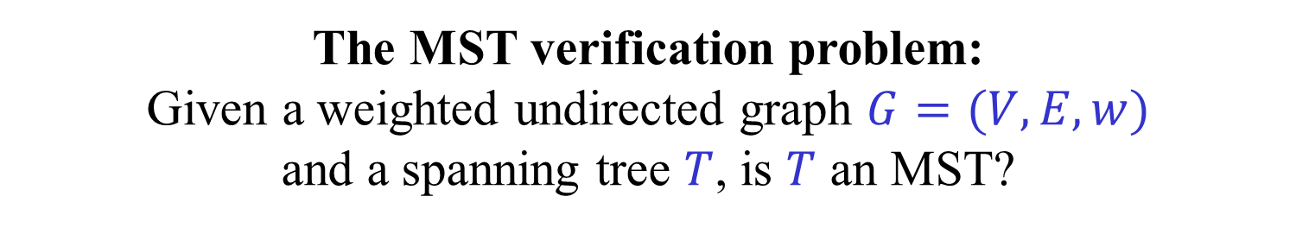
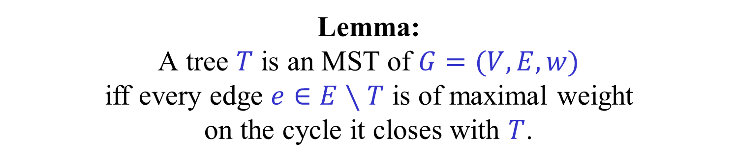
MST verification
The MST verification problem: Given a weighted undirected graph $G=(V,E,w)$ and a spanning tree $T$, is $T$ an MST?
Lemma: A tree $T$ is an MST of $G=(V,E,w)$ iff every edge $e∈E∖T$ is of maximal weight on the cycle it closes with $T$.

Slide 4
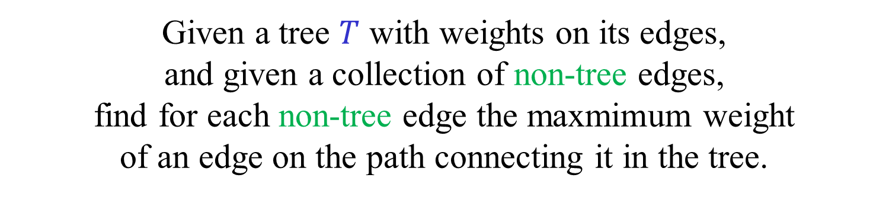
Tree-Path Maxima (TPM)
Given a tree $T$ with weights on its edges, and given a collection of non-tree edges, find for each non-tree edge the maxmimum weight of an edge on the path connecting it in the tree.
Notes:
Add weights?

Slide 5
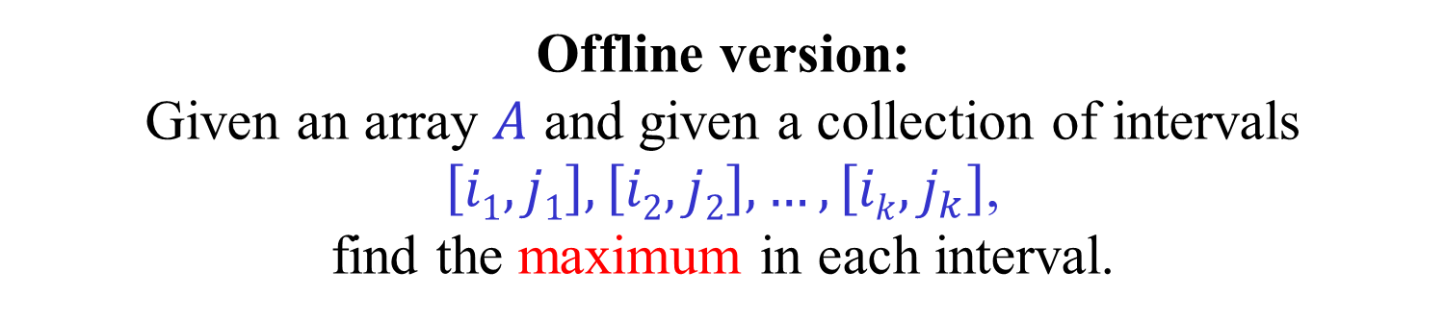




Special case: Range Maxima
Offline version: Given an array $A$ and given a collection of intervals $\left[i1,j1\right],\left[i2,j2\right],…,\left[ik, j_{k}\right]$, find the maximum in each interval.
Online version: Preprocess a given array $A$, such that the maximum in each interval $\left[i,j\right]$ can be found quickly.
Exercise: If we replace maximum by sum, the problem is trivial.
$$a_{1}$$
$$a_{2}$$
$$a_{n}$$
Notes:
Add numbers to the path?

Slide 6
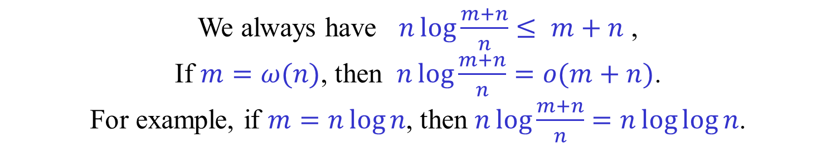
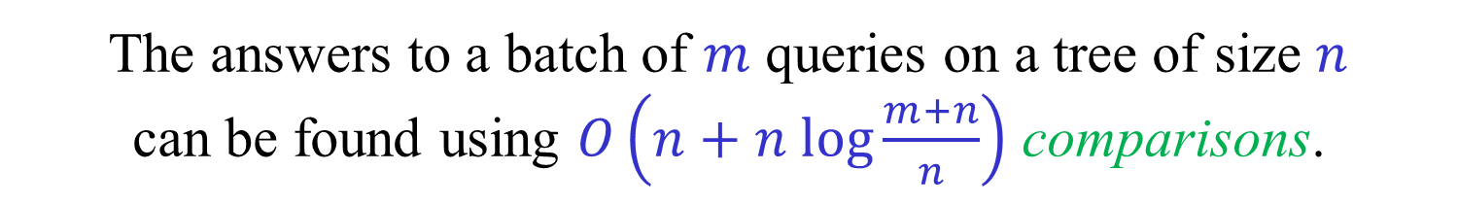
(Offline) Tree-Path Maxima
[Komlós (1985)]
The answers to a batch of $m$ queries on a tree of size $n$ can be found using $O\left(n+n log{\frac{m+n}{n}}\right)$ comparisons.
We always have $n\log{\frac{m+n}{n}}≤ m+n$ , If $m=ω(n)$, then $n\log{\frac{m+n}{n}}=o(m+n)$. For example, if $m=n\log{n}$, then $n\log{\frac{m+n}{n}}=n\log{\log{n}}$.
Number of comparisons may be sublinear!
Notes:
Add additional results

Slide 7


(Offline) Tree-Path Maxima
[Dixon-Rauch-Tarjan (1992)] [King (1997)]
[Buchsbaum-Kaplan-Rogers-Westbrook (1998)]
[Hagerup (2009)]
The answers to a batch of $m$ queries on a tree of size $n$can be found in $O\left(m+n\right)$ time.
We describe a version that uses “bit tricks”, but only on $\lg{n}$-bit words, not on weights.
Notes:
Add additional results

Slide 8
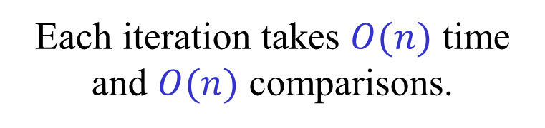
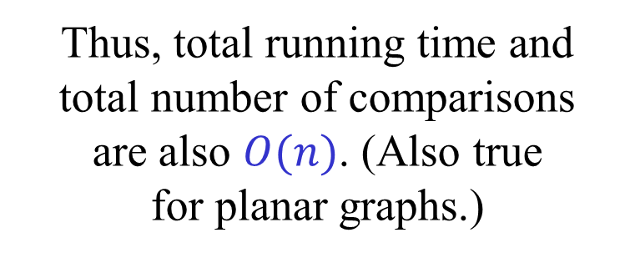
Running Borůvka on a tree [King (1997)]
Each iteration takes $O(n)$ time and $O(n)$ comparisons.
1
4
Each iteration reduces the number of vertices by a factor of at least 2.
10
6
11
2
Thus, total running time and total number of comparisons are also $O(n)$. (Also true for planar graphs.)
9
3
5
7
8
But, why is it useful?

Slide 9
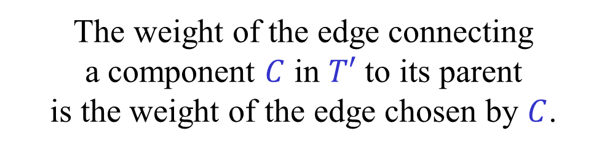




Running Borůvka on a tree [King (1997)]
$$T$$
$$T′$$
1
11
11
4
10
6
9
9
10
10
11
2
$$C$$
3
9
$$C$$
5
7
7
8
6
6
2
2
3
5
1
1
4
7
8
The weight of the edge connecting a component $C$ in $T′$ to its parent is the weight of the edge chosen by $C$.

Slide 10
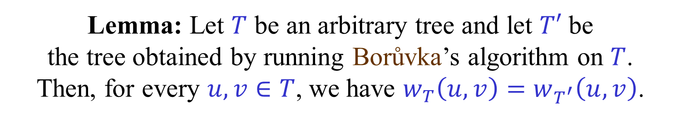
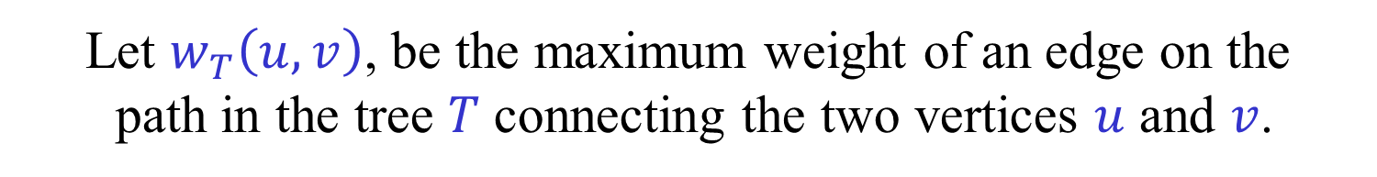
Running Borůvka on a tree [King (1997)]
Let $w_{T}\left(u,v\right)$, be the maximum weight of an edge on the path in the tree $T$ connecting the two vertices $u$ and $v$.
Lemma: Let $T$ be an arbitrary tree and let $T′$ be the tree obtained by running Borůvka’s algorithm on $T$. Then, for every $u,v∈T$, we have $w_{T}\left(u,v\right)=w_{T^{′}}\left(u,v\right)$.
(A proof will be given shortly.)

Slide 11
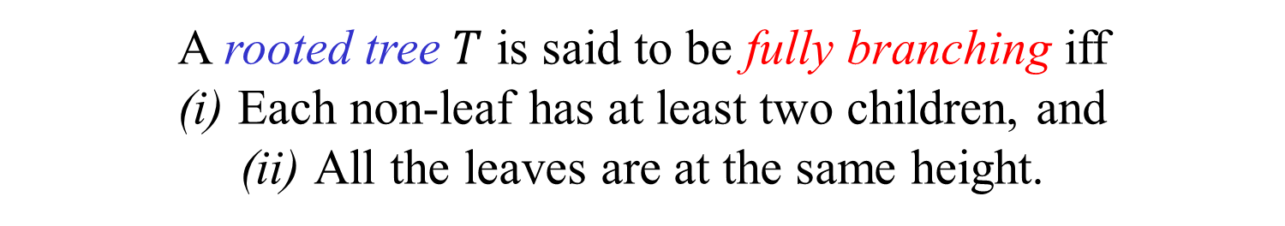
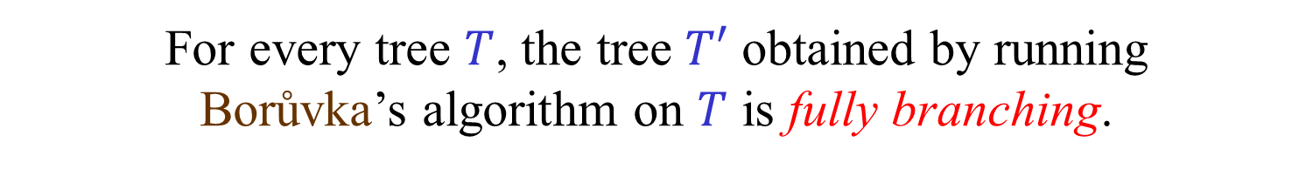
Fully branching trees
A rooted tree $T$ is said to be fully branching iff (i) Each non-leaf has at least two children, and (ii) All the leaves are at the same height.
For every tree $T$, the tree $T′$ obtained by running Borůvka’s algorithm on $T$ is fully branching.
Also, every vertex of $T$ is a leaf of $T′$.
We have thus reduced the TPM problem for general trees to the TPM problem for fully branching trees. Furthermore, we may assume that all queries are between two leaves.

Slide 12




Lowest Common Ancestors
If $u$ and $v$ are vertices of a rooted tree $T$, then $LCA(u,v)$ is the lowest vertex in $T$ which is an ancestor of both $u$ and $v$.
$$LCA(u,v)$$
$$u$$
$$v$$

Slide 13



Queries from leaves to ancestors
A query between two leaves can be replaced by two queries between leaves and their ancestors.
$$w_{T}\left(u,v\right)=max⁡\left\{{ w}_{T}\left(u,LCA\left(u,v\right)\right) , { w}_{T}\left(v,LCA\left(u,v\right)\right) \right\}$$
$$LCA(u,v)$$
$$u$$
$$v$$

Slide 14
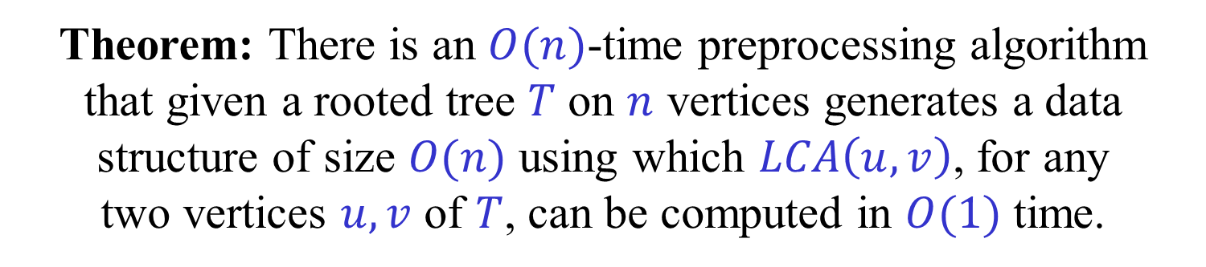


Lowest Common Ancestors
Theorem: There is an $O(n)$-time preprocessing algorithm that given a rooted tree $T$ on $n$ vertices generates a data structure of size $O(n)$ using which $LCA\left(u,v\right)$, for any two vertices $u,v$ of $T$, can be computed in $O(1)$ time.
$$u,v$$
Preprocessing algorithm
Query answering algorithm
$$LCA(u,v)$$

Slide 15


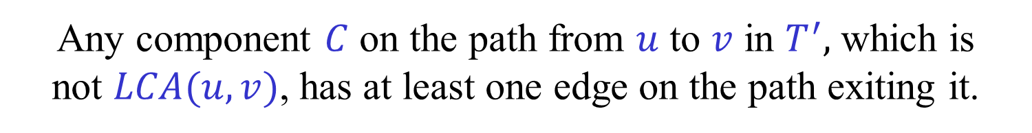

Running Borůvka on a tree [King (1997)]
$$LCA(u,v)$$
$$u$$
$$v$$
First direction: $w_{T^{′}}\left(u,v\right)≤w_{T}(u,v)$
Any component $C$ on the path from $u$ to $v$ in $T^{′},$ which is not $LCA(u,v)$, has at least one edge on the path exiting it.
Thus $w\left(C\right)≤w_{T}(u,v)$, and hence $w_{T^{′}}\left(u,v\right)≤w_{T}(u,v)$.

Slide 16


Running Borůvka on a tree [King (1997)]
$$LCA(u,v)$$
$$u$$
$$v$$
Second direction: $w_{T^{′}}\left(u,v\right)≥w_{T}(u,v)$
Consider the heaviest edge of the path from $u$ to $v$ in $T$.
Any component $D$ that contains vertices from the path, but not $u$ or $v$, has at least two edges on the path exiting it.
Thus, the heaviest edge much eventually be chosen by a component $C$ that contains either $u$ or $v$.

Slide 17
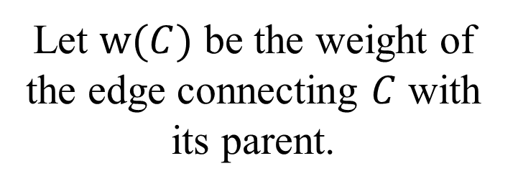
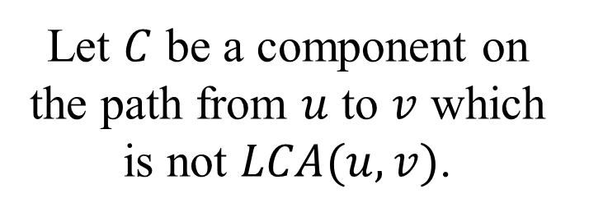


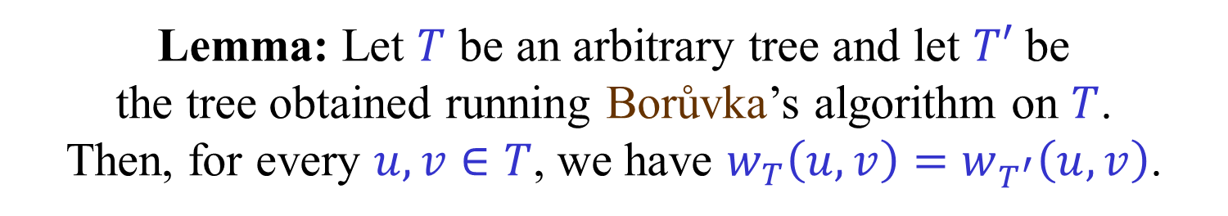


Running Borůvka on a tree [King (1997)]
Lemma: Let $T$ be an arbitrary tree and let $T′$ be the tree obtained running Borůvka’s algorithm on $T$. Then, for every $u,v∈T$, we have $w_{T}\left(u,v\right)=w_{T^{′}}\left(u,v\right)$.
Proof: (First direction)
$$w(C)$$
Let $C$ be a component on the path from $u$ to $v$ which is not $LCA(u,v)$.
$$C$$
Let $w(C)$ be the weight of the edge connecting $C$ with its parent.
$$u$$
$$v$$

Slide 18


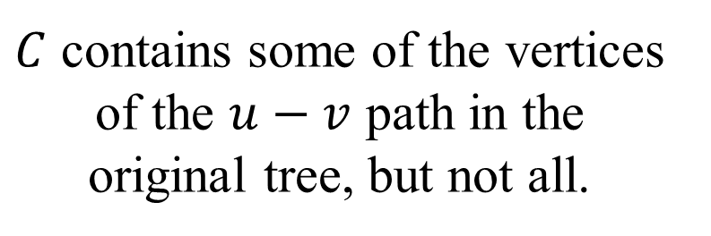
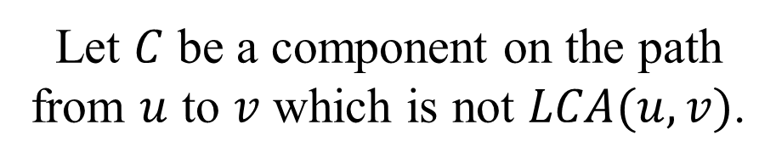
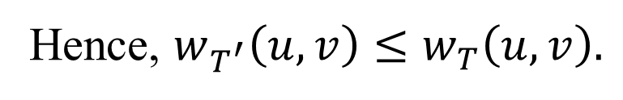

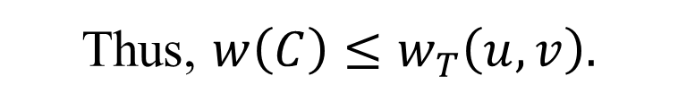

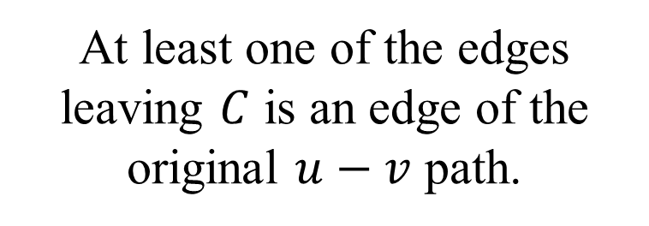
Running Borůvka on a tree [King (1997)]
Proof: (First direction)
Let $C$ be a component on the path from $u$ to $v$ which is not $LCA(u,v)$.
$C$ contains some of the vertices of the $u−v$ path in the original tree, but not all.
$$w(C)$$
$$C$$
At least one of the edges leaving $C$ is an edge of the original $u−v$ path.
Thus, $w\left(C\right)≤w_{T}\left(u,v\right).$
$$u$$
$$v$$
Hence, $w_{T^{′}}\left(u,v\right)≤w_{T}\left(u,v\right).$

Slide 19
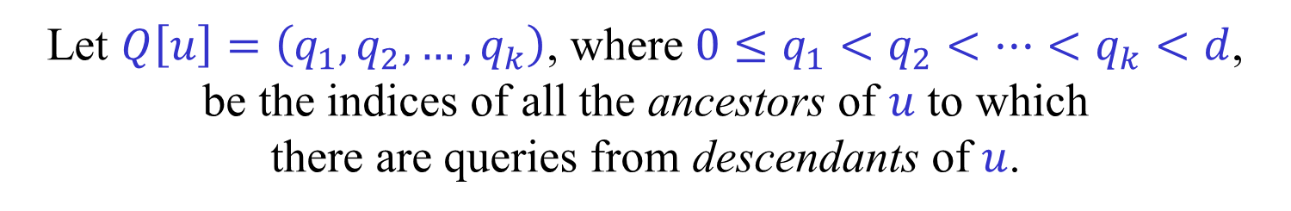

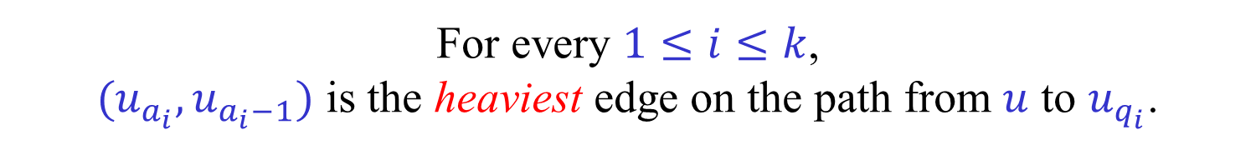
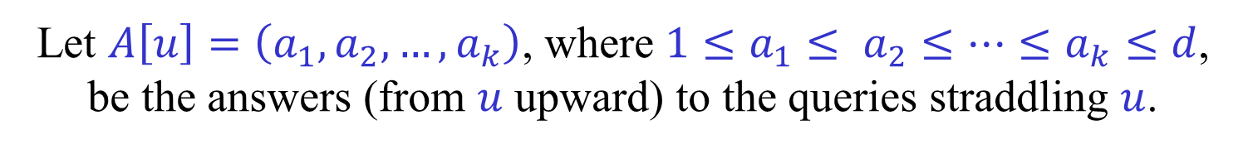
Komlós’ algorithm (1985)
For any node $u$ of depth $d$ in the tree, let ${r=u}_{0},u_{1},…,u_{d−1}$ be the ancestors of $u$ in $T$.
Let $Q\left[u\right]=\left(q_{1},q_{2},…,q_{k}\right)$, where ${0≤q}_{1}<q_{2}<…<q_{k}<d$, be the indices of all the ancestors of $u$ to which there are queries from descendants of $u$.
Let $A\left[u\right]=\left(a_{1},a_{2},…,a_{k}\right)$, where ${1≤a}_{1}≤ a_{2}≤…≤a_{k}≤d$, be the answers (from $u$ upward) to the queries straddling $u$.
For every $1≤i≤k$, $(u_{a_{i}},u_{a_{i}−1})$ is the heaviest edge on the path from $u$ to $u_{q_{i}}$.
We need to compute $A[u]$ for all the leaves.

Slide 20













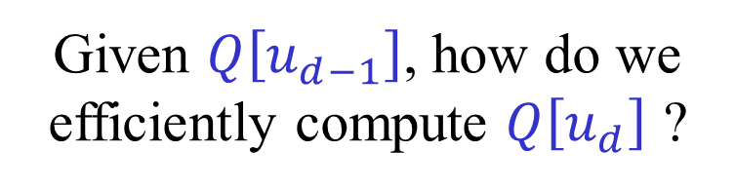



$$u_{0}$$
$$9$$
$$u_{1}$$
$$8$$
$$Q\left[u\right]=(1,2,5)$$
$$u_{2}$$
$$u_{3}$$
$$1$$
$$A\left[u\right]=(2,4,6)$$
$$u_{4}$$
$$7$$
$$4$$
$$Q\left[u_{d}\right]⊆Q\left[u_{d−1}\right]∪\{d−1\}$$
$$u_{5}$$
$${u=u}_{6}$$
$$2$$
Given $Q\left[u_{d−1}\right]$, how do we efficiently compute $Q\left[u_{d}\right]$ ?

Slide 21
















Komlós’ algorithm (1985)
$$u_{0}$$
$$5$$
$$Q\left[u\right]=(0,1,2,3)$$
$$u_{1}$$
$$2$$
$$A\left[u\right]=(3,3,3,4)$$
$$u_{2}$$
$$7$$
$$u_{3}$$
$$Q\left[v\right]=(1,3,4)$$
$$3$$
$$u=u_{4}$$
$$A′\left[v\right]=(3,4,−)$$
$$4$$
$$v=u_{5}$$
$$A\left[v\right]=(3,5,5)$$

Slide 22








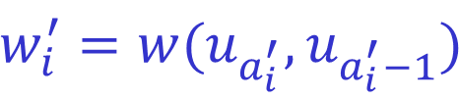
Komlós’ algorithm (1985)
Suppose that $v$ is of depth $d$ and that $u$ is the parent of $v$.
We know $A[u]$ and want to compute $A[v]$.
Let $A′\left[v\right]=\left(a_{1}^{′},a_{2}^{′},…,a_{k}^{′}\right)$ be the answers in $A[u]$ to the queries in $Q[v]$.
$$w_{i}^{′}{=w(u_{a_{i}^{′}},u_{a_{i}^{′}−1}})$$
$$\overline{w}$$
$$v$$
$$u$$
$$u_{a_{i}^{′}}$$
$$u_{q_{i}}$$
$$w_{i}{=\max\left\{\overline{w},w_{i}^{′}\right\}}$$
$w_{1}^{′}≥w_{2}^{′}≥…≥w_{k}^{′}$

Slide 23



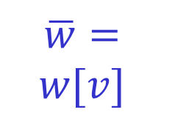
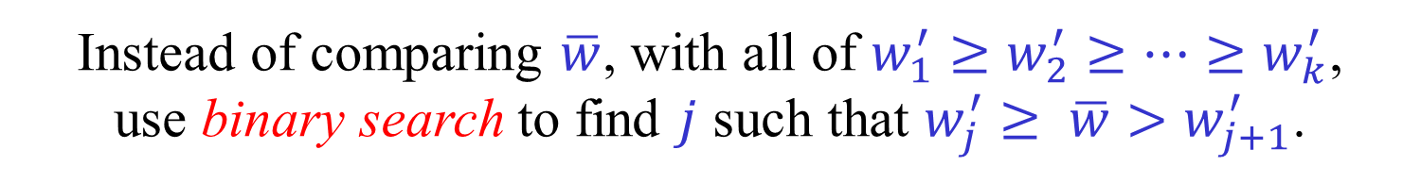



Komlós’ algorithm (1985)
$$w_{1}^{′}$$
$$\overline{w}= \\ w[v]$$
$$w_{2}^{′}$$
$$w_{k}^{′}$$
$$v$$
$$u$$
$$w_{i}{=\max\left\{\overline{w},w_{i}^{′}\right\}}$$
$w_{1}^{′}≥w_{2}^{′}≥…≥w_{k}^{′}$
Instead of comparing $\overline{w}$, with all of $w_{1}^{′}≥w_{2}^{′}≥…≥w_{k}^{′}$, use binary search to find $j$ such that $w_{j}^{′}≥ \overline{w}>w_{j+1}^{′}$.
$$a_{i} = \left\{\begin{aligned}a_{i}^{′} if \overline{w}≤w_{i}^{′} \\ d otherwise\end{aligned}\right.= \left\{\begin{aligned}a_{i}^{′} if i≤j \\ d otherwise\end{aligned}\right.$$

Slide 24
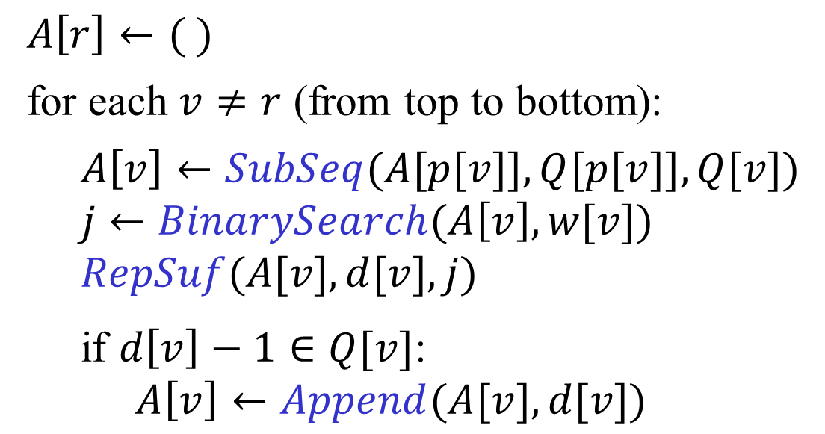
Komlós’ algorithm (1985)
$A\left[r\right]←( )$
for each $v≠r$ (from top to bottom):
$A\left[v\right]←SubSeq(A[p[v]],Q[p[v]],Q[v])$
$j←BinarySearch(A\left[v\right],w[v])$
$RepSuf(A[v],d[v],j)$
if $d\left[v\right]−1∈Q[v]$:
$A\left[v\right]←Append(A[v],d[v])$
Exercise: Understand the pseudo-code.

Slide 25
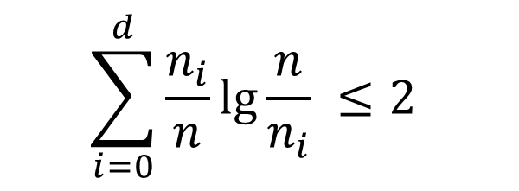
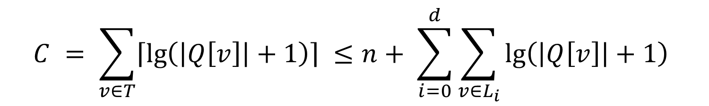
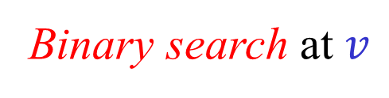



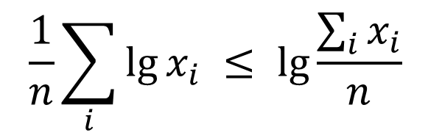
Analysis of Komlós’ algorithm
Counting comparisons
$$C = \sum_{v∈T}{\left\lceil \lg\left(\left|Q\left[v\right]\right|+1\right)\right\rceil ≤n+ \sum_{i=0}^{d}{\sum_{v∈L_{i}}{\lg\left(\left|Q\left[v\right]\right|+1\right)}}}$$
Binary search at $v$
${n_{i}=|L}_{i}|$ , $\sum_{i}{n_{i}}=n$
$L_{i}$ - nodes of depth $i$
$n_{0}=1$ , $n_{i}≥2n_{i−1}$
$$\frac{1}{n}\sum_{i}{\lg{x_{i}} ≤ \lg{\frac{\sum_{i}{x_{i}}}{n}}}$$
Lemma 1:
(Concavity)
$$\sum_{i=0}^{d}{\frac{n_{i}}{n}\lg{\frac{n}{n_{i}}}} ≤2$$
Lemma 2:
Notes:
Add additional results

Slide 26
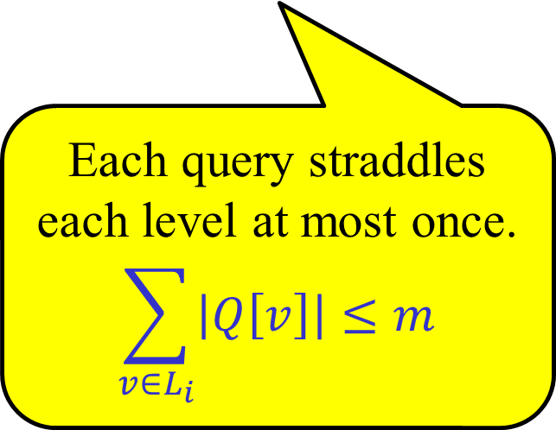
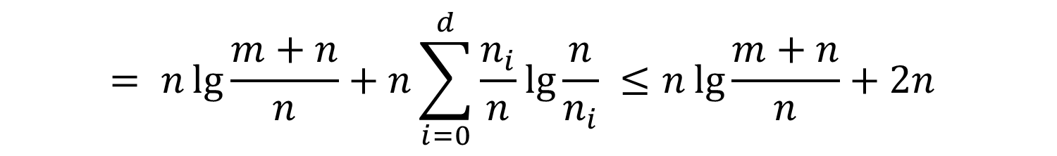

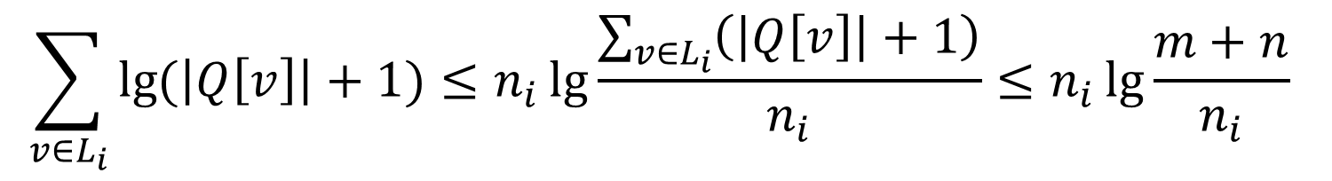
Analysis of Komlós’ algorithm
$$C = \sum_{v∈T}{\left\lceil \lg\left(\left|Q\left[v\right]\right|+1\right)\right\rceil ≤n+ \sum_{i=0}^{d}{\sum_{v∈L_{i}}{\lg\left(\left|Q\left[v\right]\right|+1\right)}}}$$
$$\sum_{v∈L_{i}}{\lg{(\left|Q\left[v\right]\right|+1)}≤n_{i}\lg{\frac{\sum_{v∈L_{i}}{\left(\left|Q\left[v\right]\right|+1\right)}}{n_{i}}≤n_{i}\lg{\frac{m+n}{n_{i}}}}}$$
$$\sum_{i=0}^{d}{n_{i}\lg{\frac{m+n}{n_{i}}}} = \sum_{i=0}^{d}{n_{i}\left(\lg{\frac{m+n}{n}}+\lg{\frac{n}{n_{i}}}\right)}$$
Lemma 1: Concavity
Each query straddles each level at most once.
$$\sum_{v∈L_{i}}{\left|Q\left[v\right]\right|}≤m$$
$$= n\lg{\frac{m+n}{n}}+n\sum_{i=0}^{d}{\frac{n_{i}}{n}\lg{\frac{n}{n_{i}}}} ≤n\lg{\frac{m+n}{n}}+2n$$
Notes:
Add additional results

Slide 27
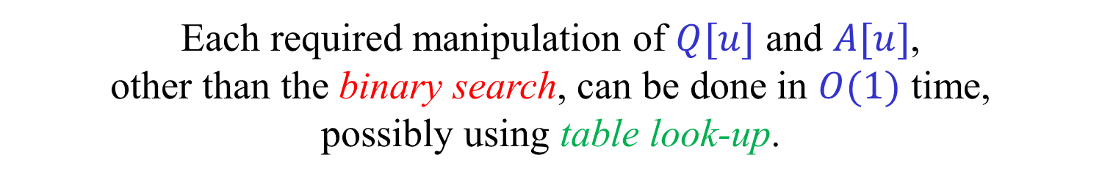

Implementation of Komlós’ algorithm
[Hagerup (2009)]
Assume that each machine word contains at least $\lg{n}$ bits.
Standard operations on two machine word take $O(1)$ time.
Memory access (indirect addressing) takes $O(1)$ time.
As the tree is fully branching, its depth is at most $\lg{n}.$
Each one of $Q[u]$ and $A[u]$ can be represented, as a bit vectors, in a single word!
Each required manipulation of $Q[u]$ and $A[u]$, other than the binary search, can be done in $O(1)$ time, possibly using table look-up.

Slide 28








Implementation of Komlós’ algorithm
[Hagerup (2009)]
$$u$$
$$3$$
$$4$$
$$2$$
$$1$$
$$9$$
$$5$$
$$8$$
7
6
5
4
3
2
1
0
$$76543210$$
$Q\left[u\right]=\left(0,2,5,6\right)=\left[01100101\right]$
$A\left[u\right]=\left(3,3,6,7\right)→\left[11001000\right]= \overline{A}[u]$
For concreteness, bit 0 is the least significant bit.
$A[u]$ may contain repeated numbers.
How do we recover $A[u]$ from the bit vector $\overline{A}[u]$ ?

Slide 29
Implementation of Komlós’ algorithm
[Hagerup (2009)]
$b↑A=\min\left\{a∈A | a>b\right\}$ (Successor)
$B↑A=\left\{b↑A | b∈B\right\}$
$$a_{i} = q_{i}↑\overline{A}[u]$$
$$SubSeq\left(A\left[u\right],Q\left[u\right],Q\left[v\right]\right) → Q\left[v\right]↑\overline{A}[u]$$
Exercise: Understand and prove these two relations.
How do we implement $b↑A$ and $B↑A$ ?
What other bit operations do we need?
How do we implement the binary search?

Slide 30
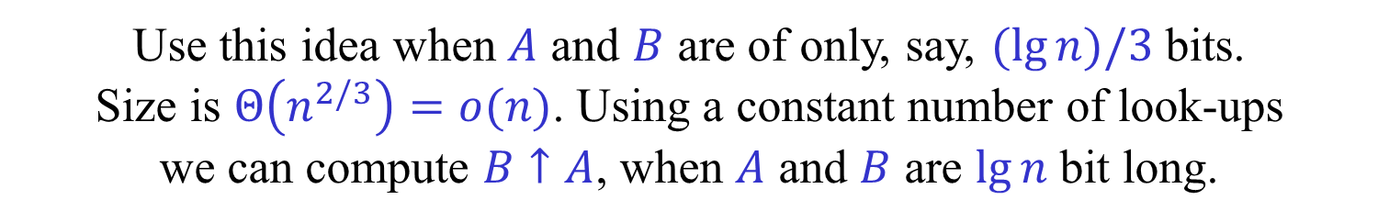



Operations on words
Suprisingly (?) $B↑A$ can be implemented using a constant number of standard word operations.
In C notation [Hagerup (2009)]:
$B↑A$ $→$ $A\&(\sim (A|B)^(\left(\sim A | B\right)+B))$
In any case, we can use table look-up to implement $B↑A$ and other operations that we may need.
As both $A$ and $B$ are only $\lg{n}$ bit long, we can use a precomputed $n×n$ table to look-up $B↑A$.
But this requires $Θ\left(n^{2}\right)$ space and initialization time.
Use this idea when $A$ and $B$ are of only, say, $(\lg{n})/3$ bits. Size is $Θ\left(n^{2/3}\right)=o(n)$. Using a constant number of look-ups we can compute $B↑A$, when $A$ and $B$ are $\lg{n}$ bit long.
Same applies to any decomposable operation.

Slide 31
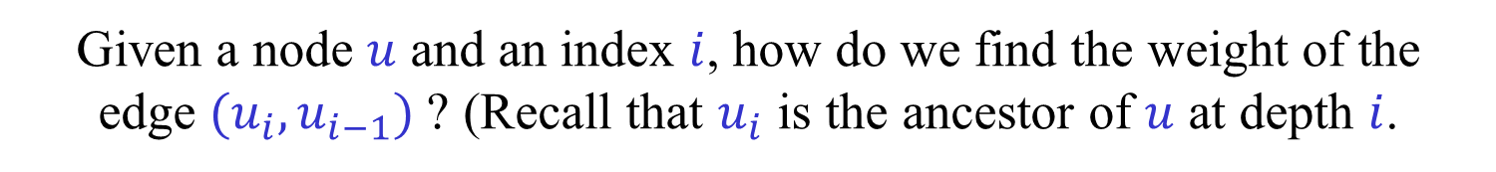
Implementation of Komlós’ algorithm
[King (1997)] [Hagerup (2009)]
More details are needed…
For the binary search, given $Q[u]$ and $i$, we need to extract $q_{i}$.
Given a word $Q$ and an index $i$, find the index of the $i$-th 1 in $Q$.
Use table look-up.
Given a node $u$ and an index $i$, how do we find the weight of the edge $(u_{i},u_{i−1})$ ? (Recall that $u_{i}$ is the ancestor of $u$ at depth $i$.
While descending to $u$, keep an array $[u_{0},u_{1},…,u_{d}]$.
More seriously: How do we find LCAs?

Slide 32

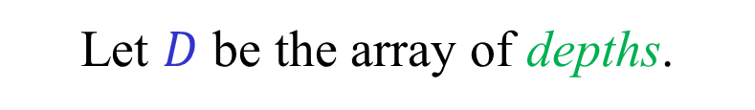

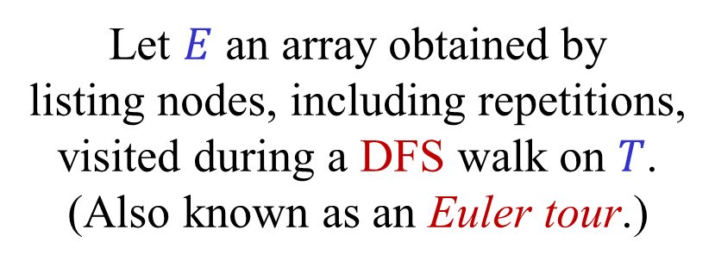
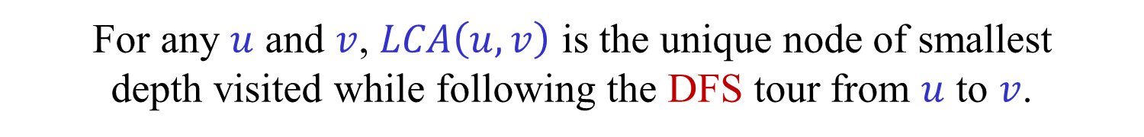
LCA → $(±1)$ Range Minima
a
Let $E$ an array obtained by listing nodes, including repetitions, visited during a DFS walk on $T$. (Also known as an Euler tour.)
$$T$$
b
h
Let $D$ be the array of depths.
c
d
g
E: a b c b d e d f d b g b a h a
e
f
D: 0 1 2 1 2 3 2 3 2 1 2 1 0 1 0
For any $u$ and $v$, $LCA\left(u,v\right)$ is the unique node of smallest depth visited while following the DFS tour from $u$ to $v$.
$ind(u)$ – index of first (or any) occurrence of $u$ in $E$.
$$LCA\left(u,v\right)= E\left[ argmin D\left[ind\left(u\right):ind\left(v\right)\right] \right]$$
(Assuming $ind\left(u\right)<ind(v)$.)
Notes:
Add numbers to the path?

Slide 33




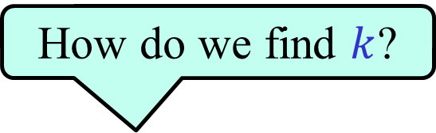

Range Minima
Naïve preprocessing algorithm:
For $1≤i<j≤n$, let $M\left[i,j\right]=argmin A[i:j]$
Preprocessing time and space = $Θ\left(n^{2}\right)$ , Query time = $O(1)$.
Simple preprocessing algorithm:
For $1≤i≤n$ and $1≤k≤\lg{n}$, let $M\left[i,k\right]=argmin A[i:i+2^{k}−1]$
Preprocessing time and space = $Θ\left(n\log{n}\right)$ , Query time = $O(1)$.
$$i$$
$$j$$
How do we find $k$?
$$2^{k}$$
$$2^{k}≤j−i+1<2^{k+1}$$
$$\min{A\left[i:j\right]=\min\left\{ M\left[i,k\right] , M\left[j−2^{k}+1,k\right] \right\}}$$

Slide 34




$(±1)$Range Minima
[Bender-Farach Colton (2000)]
A linear preprocessing algorithm:
Split the array of size $n$ into blocks of size $(\lg{n})/2$.
Compute the minimum in each block.
Generate an array of size $2n/\lg{n}$ containing the minima.
Use the $O\left(n\lg{n}\right)$ algorithm on this smaller array.
For each block, compute prefix and suffix minima.
A query $[i,j]$ not contained in a single block is easily answered in $O(1)$ time.
$$i$$
$$j$$

Slide 35



$(±1)$Range Minima
[Bender-Farach Colton (2000)]
A linear preprocessing algorithm:
How do we answer a query $[i,j]$ contained in a single block?
Each block is defined by its initial value and a sequence of $(\lg{n})/2−1$ of $±1$.
The initial value is irrelevant for the location of the minimum.
We can thus represent each block using $(\lg{n})/2$ bits.
To answer query $\left[i,j\right]$, extract relevant bits and use table look-up.
$$i$$
$$j$$

Slide 36
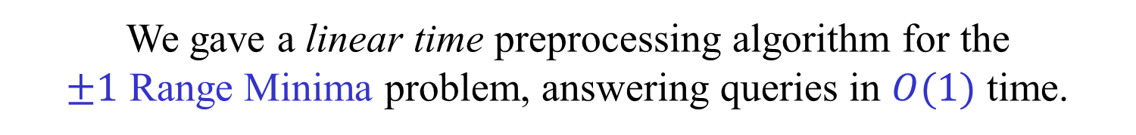

MST verification, LCA queries, Range Minima
Where do we stand?
To finish the description of the MST verification algorithm we need a way to answer (offline) LCA queries.
We reduced the problem of answering LCA queries to a special $±1$ case of the Range Minima problem.
We gave a linear time preprocessing algorithm for the $±1$ Range Minima problem, answering queries in $O(1)$ time.
We are thus done with the MST verification algorithm.
What about the general Range Minima problem?
We reduce the Range Minima problem to the problem of answering LCA queries, thus solving this problem as well.

Slide 37
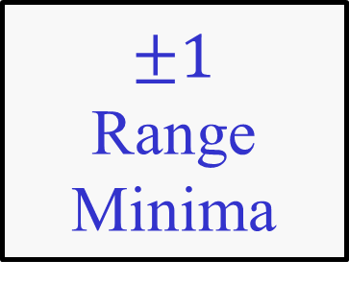
MST verification, LCA queries, Range Minima
MST verification
LCA queries
$±1$ Range Minima
Range Minima

Slide 38





Cartesian trees [Vuillemin (1980)]
A Cartesian tree $T_{A}$ of an array $A=[a_{1},a_{2},…,a_{n}]$ is the binary tree defined recursively as follows:
If $i$ is the (smallest) index of a maximal number in $A$ then,
the root of $T_{A}$ is $i$,
5
the left subtree is $T_{A\left[1:i−1\right]}$,
2
8
the right subtree is $T_{A\left[i+1:n\right]}$ (with indices increment by $i$).
1
4
6
1
2
3
4
5
6
7
8
3
7
10
37
22
28
52
5
1
48
Notes:
Add numbers to the path?

Slide 39
Range Maxima → LCA on Cartesian Trees [Gabow-Bentley-Tarjan (1984)]
Lemma: $\operatorname{argmax}{A[i:j]} = LCA_{T_{A}}\left(i,j\right)$
Proof: By induction. (Exercise.)
5
1
2
3
4
5
6
7
8
2
8
10
37
22
28
52
5
1
48
1
4
6
3
7
Notes:
Add numbers to the path?

Slide 40

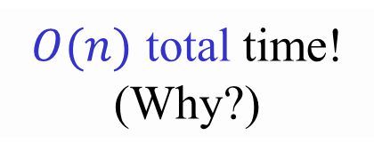









Computing Cartesian trees
$i_{1}$
$$T_{A\left[1:n−1\right]}$$
$i_{1}$
$$T_{A\left[1:n\right]}$$
$i_{2}$
$i_{2}$
$i_{j}$
$n$
$i_{k}$
$i_{j}$
Find the smallest $j$ for which $A\left[i_{j}\right]<A[n]$, by climbing up the right spine.
$O(n)$ total time! (Why?)
$i_{k}$
Notes:
Add numbers to the path?

Slide 41
Checking meldable priority queues
[Bright-Sullivan (1994)]
$H←MakeHeap(x)$ – create a heap containing item $x$.
$H←Meld(H_{1},H_{2})$ – meld $H_{1}$ and $H_{2}$. (Destroys $H_{1},H_{2}$.)
$x←FindMin(H)$ – return an item with the minimum key.
$Delete(H,x)$ – delete $x$ from $H$.
$Insert\left(H,x\right) → Meld(H,MakeHeap\left(x\right))$
$DeleteMin\left(H\right) → Delete(H,FindMin\left(H\right))$
$$DecreaseKey\left(H,x\right) → Insert\left(Delete\left(H,x\right)\right),x)$$
(Not efficient!)

Slide 42
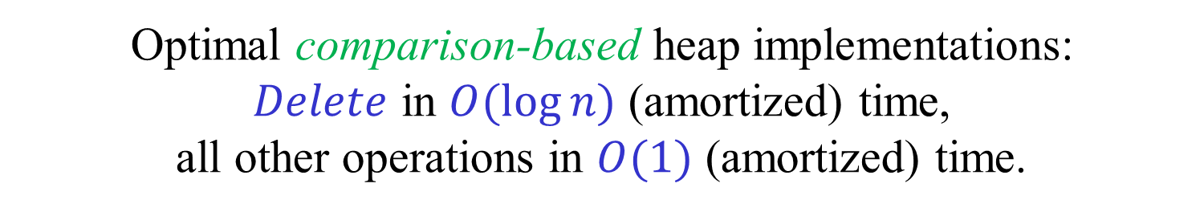

Checking meldable heaps
[Bright-Sullivan (1994)]
Optimal comparison-based heap implementations: $Delete$ in $O(\log{n)}$ (amortized) time, all other operations in $O(1)$ (amortized) time.
How quickly can we check whether a particular sequence of meldable heap operations was processed correctly?
We are only given the output of the $FindMin$ operations.
We know nothing about the actual implementation.
We only care about this particular sequence.
Can check in $O(m)$ time!
(Where $m$ is the number of operations.)

Slide 43





























Checking meldable heaps
[Bright-Sullivan (1994)]
$$H_{7}$$
$$MakeHeap\left(x_{1}\right)→ H_{1}$$
$$H_{7}$$
$$MakeHeap\left(x_{2}\right)→ H_{2}$$
$$k_{3}$$
$$k_{1}$$
$$H_{5}$$
$$MakeHeap\left(x_{3}\right)→ H_{3}$$
$$k_{3}$$
$$k_{2}$$
$$MakeHeap\left(x_{4}\right)→ H_{4}$$
$$k_{4}$$
$$H_{5}$$
$$k_{2}$$
$$H_{6}$$
$$Meld\left(H_{1},H_{2}\right)→ H_{5}$$
$$−∞$$
$$−∞$$
$$FindMin\left(H_{5}\right)→ x_{2}$$
$$H_{1}$$
$$H_{4}$$
$$Delete\left(H_{5},x_{2}\right)$$
$$x_{1}$$
$$x_{2}$$
$$x_{3}$$
$$x_{4}$$
$$Meld\left(H_{3}{,H}_{4}\right)→H_{6}$$
$$Meld\left(H_{5}{,H}_{6}\right)→H_{7}$$
Check that the tree is an MST!
$$FindMin\left(H_{7}\right)→ x_{3}$$

Slide 44



Checking meldable heaps
[Bright-Sullivan (1994)]
Construct a forest, and some non-forest edges, as follows.
The leaves are the individual items, i.e., the initial heaps.
Each node corresponds to a heap at a certain point in time.
$H←Meld\left(H_{1},H_{2}\right)$ generates a new node corresponding to $H$ whose two children are the nodes corresponding to $H_{1}$ and $H_{2}$. The weights of the two edges is $−∞$.
If $FindMin\left(H\right)$ returns $x$, a new node representing $H$ is introduced whose only child is the previous node representing $H.$ The weight of the new edge is $key[x]$.
When a $Delete\left(H,x\right)$ occurs, add a non-tree edge from $x$ to the current node representing $H$ of weight $key[x]$.

Slide 45


Checking meldable heaps
[Bright-Sullivan (1994)]
Finally, for every item $x$ which is not deleted, add a non-tree edge of weight $key[x]$ from the leaf representing $x$ to the root of its tree.
Lemma: The responses are all correct if and only if each tree is an MST of its component.
Exercise: Prove the lemma.
Corollary: The correctness of the responses to a sequence of $m$ heap operations can be checked in $O\left(m\right)$ time.
Exercise: Can we add $DecreaseKey$ operations?

Slide 46
Bonus material
Not covered in class this term
“Careful. We don’t want to learn from this.” (Bill Watterson, “Calvin and Hobbes”)

Slide 47


The off-line LCA problem
Given a tree $T$ and a collection $P$ of pairs, find $LCAT(x,y)$ for every $(x,y)P$.
Using Union-Find we can get $O((m+n)(m+n))$time, where $n=|T|$and $m=|P|$.
Note: We saw a linear time preprocessing algorithm for the on-line problem.

Slide 48
The off-line LCA problem [(Tarjan (1979)]
Going down: u→v Make-Set(v)
Going up: v→u Union(u,v)
u
We want these to be the representatives (How do we do it?)
v
If w<v, then LCA(w,v) = “Find(w)”

Slide 49



Range “sums” (in a semi-group)
Let $A=[a_{1},a_{2},…,a_{n}]$, where $a_{i}∈𝕌$.
Let $∘:𝕌×𝕌→𝕌$ be an associative operation.
(The operation $∘$ is not necessarily commutative and may not have an inverse. There may not be an identity element.)
Assume that each element of $𝕌$ fits into a machine word and that $a∘b$ can be computed in $O(1)$ time.
Problem: Preprocess $A,$ as efficiently as possible, such that given $i<j$, $a_{i}∘a_{i+1}∘…∘a_{j}$ can be returned as quickly as possible.
Notes:
Add numbers to the path?

Slide 50

Range “sums”
Simple $(O\left(n\log{n}\right),2)$ solution
Split the array into two sub-arrays of size $n/2$.
In the first compute suffix “sums”.
In the second compute prefix “sums”.
Do the same recursively for each sub-array.
Each query $[i,j]$ is the “sum” of 1 or 2 pre-computed values.
$$i$$
$$j$$
$$⋮$$
Notes:
Add numbers to the path?

Slide 51

Range “sums” [Yao (1982)] [Chazelle (1987)] [Alon-Schieber (1987)]
$\left(n f\left(n\right),k\right)$-algorithm → $(n{ f}^{∗}(n),k+2)$-algorithm
Split the array into blocks of size $f(n)$.
Compute the “sum” of each block.
Apply the $\left(f\left(n\right),k\right)$-algorithm on the array of size $n/f(n)$.
Apply the $new$ algorithm recursively on each block.
The new algorithm is an $(n g\left(n\right),k+2)$-algorithm.
$$f(n)$$
$$i$$
$$j$$
Notes:
Add numbers to the path?

Slide 52


Range “sums” [Yao (1982)] [Chazelle (1987)] [Alon-Schieber (1987)]
$\left(nf\left(n\right),k\right)$-algorithm → $(nf^{∗}\left(n\right),k+2)$-algorithm
$$n g\left(n\right) = \frac{n}{f\left(n\right)}f\left(\frac{n}{f(n)}\right)+ \frac{n}{f\left(n\right)}f\left(n\right)g(f\left(n\right))$$
$$g\left(n\right) ≤ 1+g(f\left(n\right))$$
$$f(n)$$
$$g\left(n\right) ≤ { f}^{∗}(n)$$
$$i$$
$$j$$
Notes:
Add numbers to the path?

Slide 53
Range “sums” [Yao (1982)] [Chazelle (1987)] [Alon-Schieber (1987)]
$$(n\log{n} , 2)$$
$$(n\log^{∗}{n} , 4)$$
$$⋮$$
$$(n λ_{k}\left(n\right) , 2\left(k−1\right))$$
$$\left(O\left(n\right) , O\left(α\left(n\right)\right)\right)$$
Results are asymptotically optimal, in an appropriate model.
Notes:
Add numbers to the path?

