Slide 1
Analysis of Algorithms
Shortest Paths - Finding Negative Cycles
Uri Zwick
Tel Aviv University
November 2015 Modified: December 5, 2017 Minor modificatins: November 17, 2021

Slide 2
Single Source Shortest Paths
Non-negative edge weights
$O(m+n\log{n})$ [Dijkstra (1959)] [Fredman-Tarjan (1987)]
Undirected positively weighted graphs (word-RAM model)
$O(m+n)$ [Thorup (1999)]
Positive and negative edge weights
$O(mn)$ [Bellman (1956)] [Ford-Fulkerson (1962)]
Positive and negative integer edge weights
$O(m\sqrt{n}\log{N})$ [Goldberg (1995)]
All edge weights are integral and $≥−N$. ($N≥2$.)

Slide 3


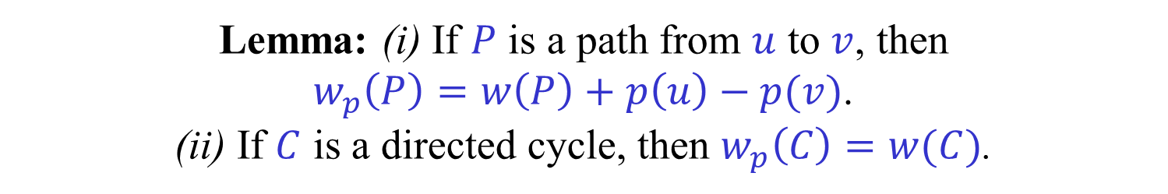
Potentials and modified weights
A function $p:V→ℝ$ is called a potential function.
If $w:E→ℝ$ is a weight (length) function, then the modified weight function $w_{p}:E→ℝ$ is defined as follows:
$w_{p}\left(u,v\right)=w\left(u,v\right)+p\left(u\right)−p(v)$ , $\left(u,v\right)∈E$
Lemma: (i) If $P$ is a path from $u$ to $v$, then $w_{p}\left(P\right)=w\left(P\right)+p\left(u\right)−p(v)$. (ii) If $C$ is a directed cycle, then $w_{p}\left(C\right)=w(C)$.
Corollary: Shortest paths with respect to $w_{p}$ are also shortest paths with respect to $w$.

Slide 4
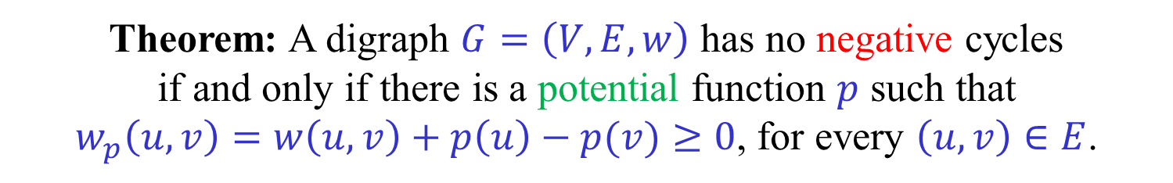
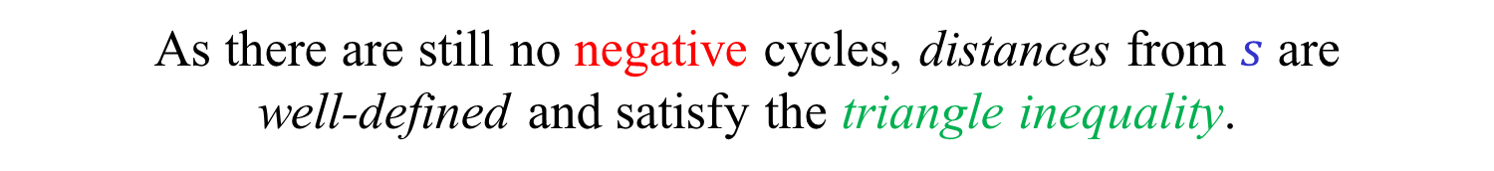
Potentials and negative cycles
Theorem: A digraph $G=\left(V,E,w\right)$ has no negative cycles if and only if there is a potential function $p$ such that $w_{p}\left(u,v\right)=w\left(u,v\right)+p\left(u\right)−p(v)≥0$, for every $\left(u,v\right)∈E$.
If there is such an admissible potential function, then by part (ii) of the previous lemma, there are no negative cycles.
Suppose that there are no negative cycles.
Add a vertex $s$ and an edge $(s,v)$ of weight 0 for each $v∈V$.
As there are still no negative cycles, distances from $s$ are well-defined and satisfy the triangle inequality.
Let $p\left(v\right)=δ\left(s,v\right)=$ distance from $s$ to $v$.
$δ\left(s,v\right)≤δ\left(s,u\right)+w(u,v)$ , $\left(u,v\right)∈E$
$w_{p}\left(u,v\right)=w\left(u,v\right)+δ\left(s,u\right)−δ\left(s,v\right)≥0$ , $\left(u,v\right)∈E$

Slide 5
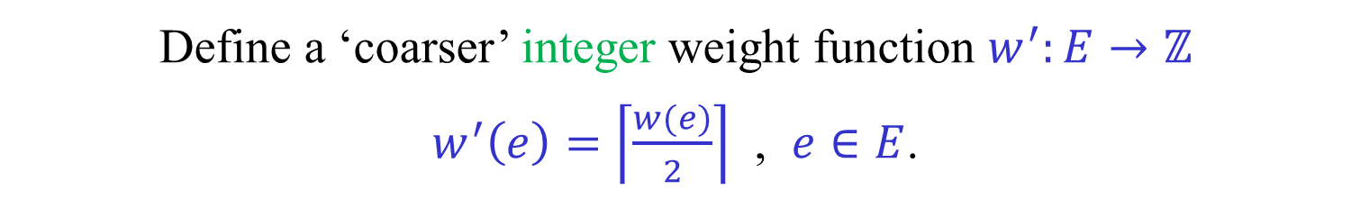

Scaling
We want to solve a problem with a given integer weight function $w:E→ℤ$
Define a ‘coarser’ integer weight function $w^{′}:E→ℤ$ $w^{′}\left(e\right)=\left\lceil \frac{w(e)}{2}\right\rceil$ , $e∈E$.
Solve the problem (recursively) with respect to $w′$.
Convert the solution for $w′$ into a solution for $w$.

Slide 6
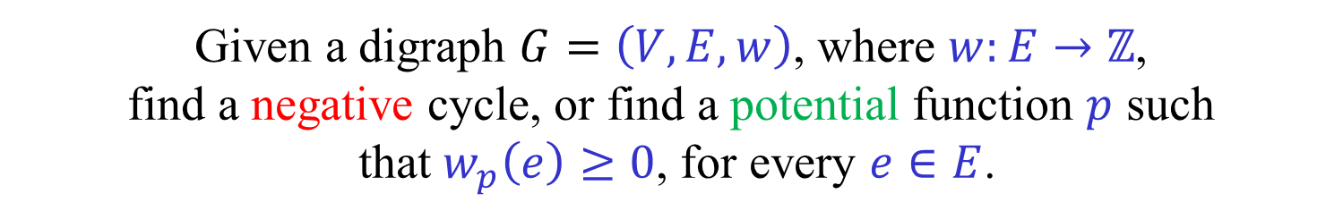


Scaling and negative cycles
Given a digraph $G=\left(V,E,w\right)$, where $w:E→ℤ$, find a negative cycle, or find a potential function $p$ such that $w_{p}\left(e\right)≥0$, for every $e∈E$.
Let $w^{′}\left(e\right)=\left\lceil \frac{w(e)}{2}\right\rceil$ , $e∈E$.
A negative cycle with respect to $w′$ is also a negative cycle with respect to $w$.
Otherwise, let $p^{′}:V→ℤ$ be such that $w_{p^{′}}^{′}\left(e\right)≥0$, $e∈E$.
Let $p\left(u\right)=2p′(u)$ , $u∈V$.
$w_{p}\left(u,v\right)=w\left(u,v\right)+p\left(u\right)−p\left(v\right)$ $$≥\left(2w^{′}\left(u,v\right)−1\right)+2p^{′}\left(u\right)−2p^{′}\left(v\right)≥−1$$
We thus only need to consider the case $w\left(e\right)≥−1$ , $e∈E$.

Slide 7


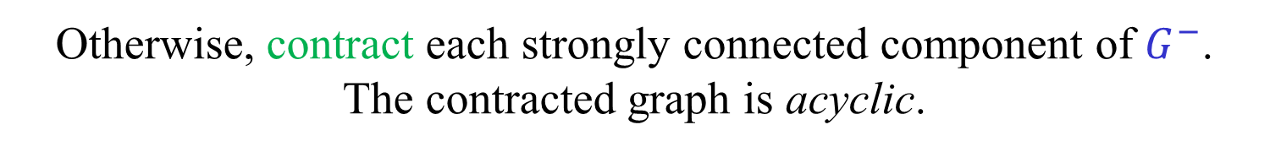

Goldberg’s algorithm
Let $G=\left(V,E,w\right)$, where $w:E→\{−1,0,1,…\}$.
Let $G^{−}=\left(V,E^{−},w\right)$, where $E^{−}=\left\{e∈E \right| w\left(e\right)≤0\}$.
If a strongly connected component of $G^{−}$ contains a negative edge, then a negative cycle in $G$ is easily found.
Otherwise, contract each strongly connected component of $G^{−}$. The contracted graph is acyclic.
Add a source vertex $s$ to $G^{−}$ and connect it with 0-edges to all vertices of $G^{−}$.
Compute the distances $δ^{−}\left(s,v\right)$, for all $v∈V$. Can be done in $O\left(m\right)$ time as $G^{−}$ is acyclic.
Let $L_{i}=\left\{v∈V \right|{ δ}^{−}\left(s,v\right)=−i\}$.

Slide 8







Goldberg’s algorithm
Layers:
$L_{i}=\left\{v∈V \right|{ δ}^{−}\left(s,v\right)=−i\}$.
$w\left(u,v\right)=0$ , $u∈L_{i}$ , $v∈L_{j}$ $⟹$ $i≤j$
$w\left(u,v\right)=−1$ , $u∈L_{i}$ , $v∈L_{j}$ $⟹$ $i<j$
s
$$0$$
$$−1$$
$$2$$
$$L_{0}$$
$$L_{1}$$
$$L_{2}$$
$$L_{r}$$

Slide 9




$≈$ Dilworth’s theorem $≈$
Let $r$ be the index of the last layer.
Let $k$ be the number of negative vertices, i.e., vertices with an incoming negative edge.
If $r≤\sqrt{k}$, there is a layer $L_{i}$ with at least $\sqrt{k}$ negative vertices.
If $r>\sqrt{k}$, there is a path with at least $\sqrt{k}$ negative vertices.
s
$$−1$$
$$0$$
$$L_{0}$$
$$L_{1}$$
$$L_{2}$$
$$L_{r}$$

Slide 10

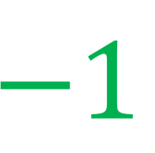

A layer with negative vertices
Suppose that $L_{i}$ contains many (at least $\sqrt{k}$) negative vertices.
Assign the vertices of $L_{0}∪L_{1}∪…∪L_{i−1}$ a potential of 0.
Assign the vertices of $L_{i}∪L_{i+1}∪…∪L_{r}$ a potential of $−1$.
Vertices of $L_{i}$ are no longer negative. No negative vertices introduced.
There are new 0 edges. Need to recompute $G^{−}$.
s
$$−1$$
$$0$$
$$−1$$
$$1$$
$$L_{0}$$
$$L_{1}$$
$$L_{i}$$
$$L_{r}$$

Slide 11











A path with negative vertices
$$1$$
$${ R}_{3}$$
$$−1$$
$$0$$
$$−1$$
$$0$$
$$−1$$
$$0$$
$$2$$
$$v_{1}$$
$$v_{2}$$
$$v_{3}$$
Let $R_{3}$ be the set of vertices reachable from $v_{3}$ by 0 and $−1$ edges.
(As $G^{−}$ is acyclic, $v_{3}$ is the only vertex on the path in $R_{3}$.)
(We cannot reach $−1$ edges if the path is ‘maximal’.)
Decrease the potential of all vertices in $R_{3}$ by 1.
$v_{3}$ is no longer negative. No new negative vertices.
But, there are new 0 edges.

Slide 12





A path with negative vertices
$R_{1}$
$$0$$
$${ R}_{2}$$
$${ R}_{3}$$
$$−1$$
$$0$$
$$−1$$
$$0$$
$$0$$
$$0$$
$$1$$
$$v_{1}$$
$$v_{2}$$
$$v_{3}$$
Let $R_{2}$ be the set of vertices reachable from $v_{2}$ by $0$ and $−1$ edges.
If $R_{2}$ contains a vertex preceding $v_{2}$ on the path → negative cycle.
Decrease the potential of all vertices in $R_{2}$ by 1.
(Vertices in $R_{3}$ have their potential decreased by 2.)

Slide 13
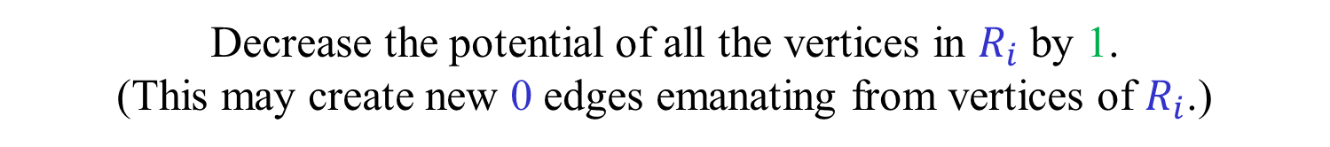
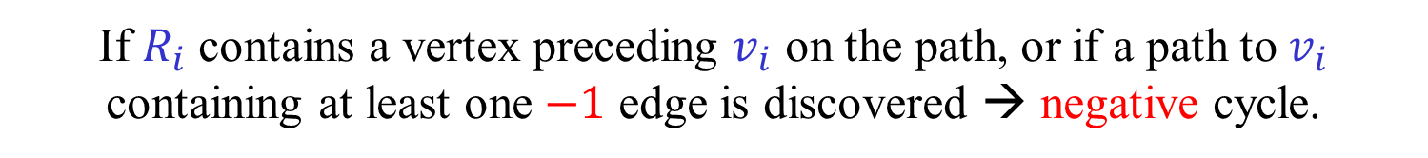
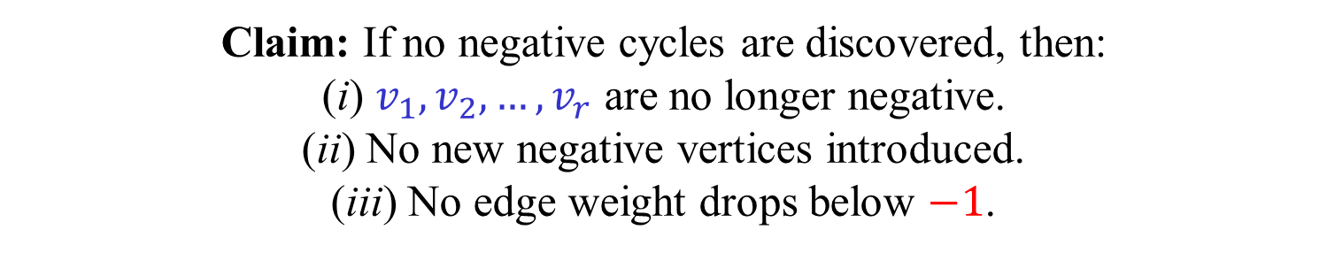
A path with negative vertices
Let $v_{1},v_{2},…,v_{r}$ be the negative vertices on the path.
For $i=r,r−1,…,1$ do:
Let $R_{i}$ be the vertices reachable from $v_{i}$ by $0$ and $−1$ edges.
If $R_{i}$ contains a vertex preceding $v_{i}$ on the path, or if a path to $v_{i}$ containing at least one $−1$ edge is discovered → negative cycle.
Decrease the potential of all the vertices in $R_{i}$ by 1. (This may create new 0 edges emanating from vertices of $R_{i}$.)
Claim: If no negative cycles are discovered, then: (i) $v_{1},v_{2},…,v_{r}$ are no longer negative. (ii) No new negative vertices introduced. (iii) No edge weight drops below $−1$.
Exercise 1: Prove the above claim.
Exercise 2: Implement the process above in $O\left(m\right)$ time.
(We will essentially solve these exercise below. Try to do it directly.)

Slide 14

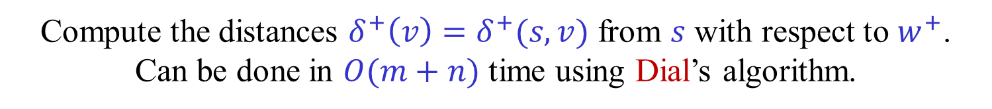
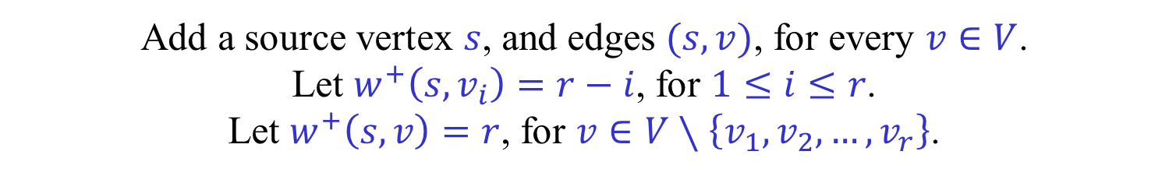
A path with negative vertices
A clever way of implementing the previous process.
Let $w^{+}\left(u,v\right)=\max\left\{0,w(u,v)\right\}$.
Add a source vertex $s$, and edges $(s,v)$, for every $v∈V$. Let $w^{+}\left(s,v_{i}\right)=r−i$, for $1≤i≤r$. Let $w^{+}\left(s,v\right)=r$, for $v∈V∖\left\{v_{1},v_{2},…,v_{r}\right\}$.
Compute the distances $δ^{+}\left(v\right)=δ^{+}(s,v)$ from $s$ with respect to $w^{+}$. Can be done in $O(m+n)$ time using Dial’s algorithm.
Let $p\left(v\right)=δ^{+}(v)$ , $v∈V$.
If the graph contains no negative cycles then: (i) $v_{1},v_{2},…,v_{r}$ are no longer negative. (ii) No new negative vertices introduced. (iii) No edge weight drops below $−1$.

Slide 15













A path with negative vertices
$$s$$
$$r−1$$
$$0$$
$$r−2$$
$$r−i$$
$$r$$
$$−1$$
$$0$$
$$−1$$
$$0$$
$$−1$$
$$0$$
$$−1$$
$$v_{1}$$
$$v_{2}$$
$$r$$
$$v_{i}$$
$$v_{r}$$
(ii) $w\left(u,v\right)≥0$ $⟹$ $\begin{matrix}w^{+}\left(u,v\right)=w(u,v) \\ δ^{+}\left(v\right)≤δ^{+}\left(u\right)+w(u,v) \\ w_{p}\left(u,v\right)≥0\end{matrix}$
(iii) $w\left(u,v\right)=−1$ $⟹$ $\begin{matrix}w^{+}\left(u,v\right)=0 \\ δ^{+}\left(v\right)≤δ^{+}\left(u\right) \\ w_{p}\left(u,v\right)≥−1\end{matrix}$

Slide 16





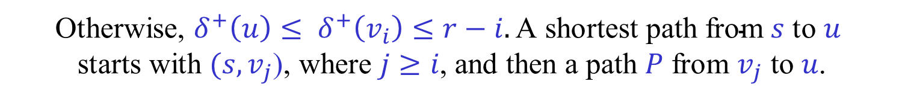





A path with negative vertices
$$s$$
$$r−1$$
$$r−i$$
$$r−j$$
$$0$$
$$−1$$
$$0$$
$$−1$$
$$0$$
$$−1$$
$$0$$
$$−1$$
$$v_{1}$$
$$−1$$
$$v_{i}$$
$$v_{j}$$
$$v_{r}$$
$$u$$
$$C$$
$$P$$
Suppose that $w\left(u,v_{i}\right)=−1$.
If $δ^{+}\left(u\right)>δ^{+}(v_{i})$, then $w_{p}\left(u,v_{i}\right)=w\left(u,v_{i}\right)+δ^{+}\left(u\right)−δ^{+}\left(v_{i}\right)≥0$.
Otherwise, $δ^{+}\left(u\right)≤ δ^{+}\left(v_{i}\right)≤r−i. \text{A} \text{shortest} \text{path} \text{from} s \text{to} u$ $$\text{starts} \text{with} (s,v_{j}\text{)}\text{, }\text{where} j≥i\text{, }\text{and} \text{then} \text{a} \text{path} P \text{from} v_{j} \text{to} u\text{.}$$
By the triangle inequality, ${w\left(P\right)≤w^{+}\left(P\right)=δ}^{+}(v_{j},u)≤j−i$.
Let $Q$ be the portion of the path from $v_{i}$ to $v_{j}$. Clearly $w\left(Q\right)=i−j$.
$Q,P,(u,v_{i})$ is a negative cycle. $w\left(C\right)≤\left(j−i\right)+\left(i−j\right)−1≤−1.$

Slide 17




Dial’s algorithm [Dial (1969)]
Let $G=(V,E,w)$, where $w:E→ℤ^{+}$. Let $s∈V$.
Let $D=\max_{v∈V}{δ_{w}(s,v)}$ be the maximum distance from $s$.
The SSSP from $s$ can be solved in $O(m+D)$ time.
Use a bucket-based priority queue to implement Dijkstra.
The priority queue used by Dijkstra is monotone. (Keys of extracted items cannot decrease.)
…
$$0$$
$$1$$
$$D$$
$$>D$$

Slide 18
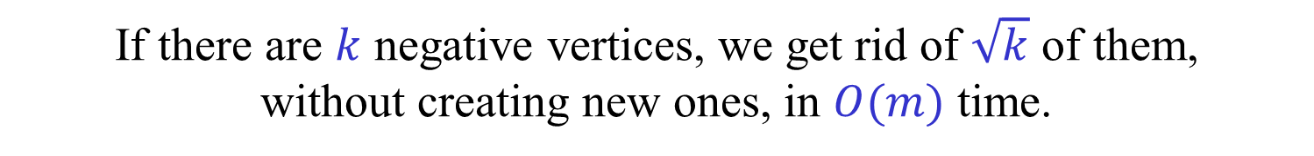
Complexity of Goldberg’s algorithm
Number of recursive calls is $\log{N}$.
After each recursive call, we adjust the potential, or find a negative cycle, by the process above.
If there are $k$ negative vertices, we get rid of $\sqrt{k}$ of them, without creating new ones, in $O(m)$ time.
How many such iterations, $k→k−\sqrt{k}$, do we need?
If $k≤\frac{1}{4}A^{2}$, then $k−\sqrt{k}<\frac{1}{4}{\left(A−1\right)}^{2}$. ($k−\sqrt{k}$ is increasing.)
As $k_{0}≤n≤\frac{1}{4}{\left(\sqrt{4n}\right)}^{2}$, number of iterations is at most $\sqrt{4n}$.
Thus, the total runtime is $O(m\sqrt{n}\log{N})$.

