Slide 1
Analysis of Algorithms
Applications of Maximum weight matching
Uri Zwick
December 22-29, 2021

Slide 2
Applications of weighted matching
Maximum/minimum weight perfect matchings
Travelling Salesperson Problem (TSP) (An approximation algorithm)
Chinese Postman Problem
$T$-joins
Shortest paths or negative cycles in undirected graphs
Degree constrained subgraphs, $f$-factors , $b$-matchings
Bidirected flows

Slide 3

Minimum weight perfect matching
The primal/dual method can be adapted to find maximum/minimum weight perfect matchings.
Exercise: Work out the high level details. (E.g., LP formulation, complementary slackness conditions, dual adjustments steps, etc.)
We can also do it using simple reductions.
To switch between maximum/minimum, negate all weights.
Maximum weight perfect matching → maximum weight matching
$w^{′}\left(u,v\right)=M+w\left(u,v\right)$ , for sufficiently large $M$.
Find a maximum weight matching with respect to $w′$. If is perfect it is a maximum weight perfect matching. Otherwise, there is no perfect matching in the graph.
There is also a simple reduction in the other direction.

Slide 4




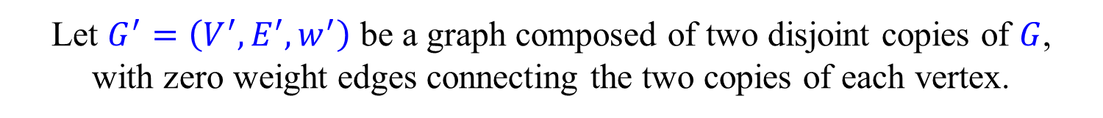

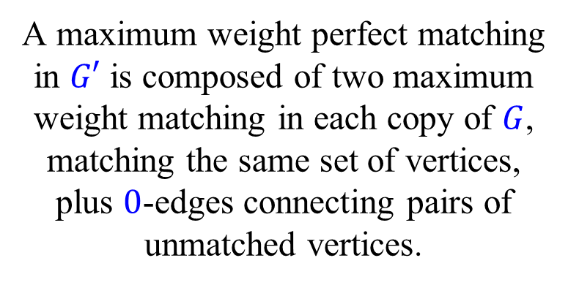



Maximum weight matching → maximum weight perfect matching
Let $G=\left(V,E,w\right)$ be the input graph.
Let $G^{′}=\left(V^{′},E^{′},w^{′}\right)$ be a graph composed of two disjoint copies of $G$, with zero weight edges connecting the two copies of each vertex.
A maximum weight perfect matching in $G′$ is composed of two maximum weight matching in each copy of $G$, matching the same set of vertices, plus $0$-edges connecting pairs of unmatched vertices.
$$u$$
$$0$$
$$u′$$
$$w(u,v)$$
$$w(u,v)$$
$$v$$
$$v′$$
$$0$$

Slide 5
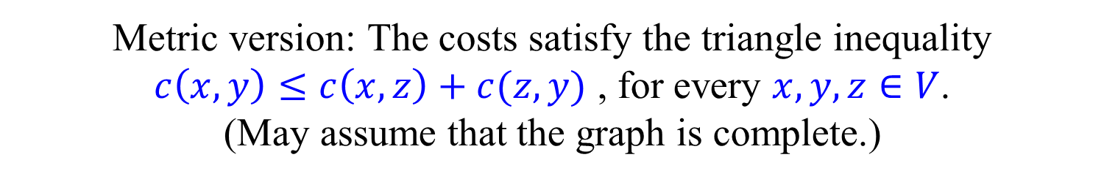
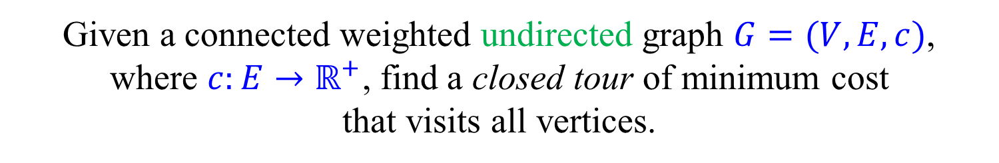
Travelling Salesperson Problem (TSP)
Given a connected weighted undirected graph $G=(V,E,c)$, where $c:E→ℝ^{+}$, find a closed tour of minimum cost that visits all vertices.
Metric version: The costs satisfy the triangle inequality $c\left(x,y\right)≤c\left(x,z\right)+c(z,y)$ , for every $x,y,z∈V$. (May assume that the graph is complete.)
In the metric case, the optimal tour is simple, i.e., a Hamiltonian cycle, as shortcuts can be used.
(Metric-)TSP is clearly NP-hard.

Slide 6
2-approximation for metric-TSP
Compute a Minimum Spanning Tree (MST)
Duplicate each edge.
Find an Eulerian tour
Use shortcuts to convert to a Hamiltonian cycle
$$c\left(MST\right)≤c\left(TSP\right)$$
$$c\left(ALG\right)≤2 c\left(MST\right)≤2 c\left(TSP\right)$$

Slide 7

3/2-approximation for metric-TSP [Christofides (1976)] [Serdyukov (1978)]
Compute a MST $T$ of the input graph.
Compute a minimum cost perfect matching $M$ in the subgraph induced by the vertices of odd degree in $T$.
Find an Eulerian tour in $T∪M$
Use shortcuts to convert to a Hamiltonian cycle
$$c\left(MST\right)≤c\left(TSP\right)$$
$c\left(M\right)≤\frac{1}{2}c\left(TSP\right)$
$c\left(ALG\right)≤c\left(MST\right)+c\left(M\right)≤\frac{3}{2} c\left(TSP\right)$
Uses shortest paths, minimum spanning trees and minimum weight perfect matching.
Very recently improved to $\frac{3}{2}−{10}^{−36}$. [Karlin-Klein-Gharan (2021)]

Slide 8




Chinese Postman Problem [Guan (1960)]
Given a connected weighted undirected graph $G=(V,E,c)$, where $c:E→ℝ^{+}$, find a closed tour of minimum cost that traverses each edge at least once.
If all vertices in $G$ have even degree, an Eulerian tour is the optimal solution.
Otherwise, let $V_{1}$ be the set of vertices of odd degree in $G$.
Construct a complete graph $G_{1}=(V_{1},E_{1},c_{1})$. $c_{1}\left(u,v\right)=dist_{G}(u,v)$ , for every $u,v∈V_{1}$.
Find a minimum cost perfect matching $M$ in $G_{1}$.
For every $\left(u,v\right)∈M$, duplicate the edges on a shortest path from $u$ to $v$ in $G$.
Find an Eulerian tour in the resulting graph.

Slide 9

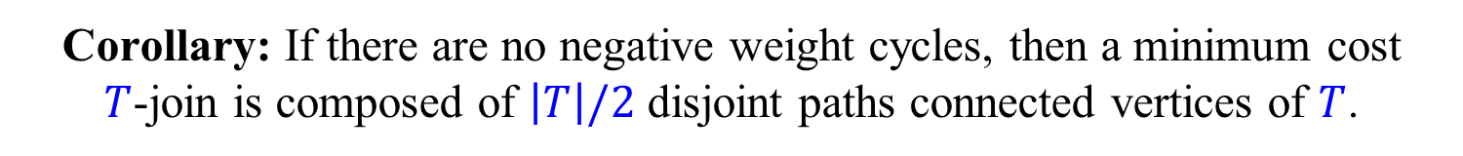

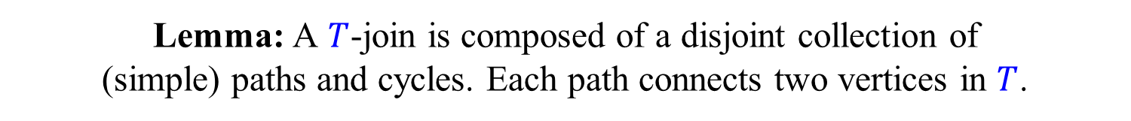
$T$-joins
Let $G=(V,E,c)$ be an undirected graph, $c:E→ℝ$.
Let $T⊆V$. Find a subset $J⊆E$ of minimum cost such that the degree of $v∈V$ in $G_{J}=(V,J)$ is odd iff $v∈T$.
Such a subset $J⊆E$ is called a $T$-join.
Lemma: A $T$-join is composed of a disjoint collection of (simple) paths and cycles. Each path connects two vertices in $T$.
Corollary: If there are no negative weight cycles, then a minimum cost $T$-join is composed of $\left|T\right|/2$ disjoint paths connected vertices of $T$.
If there are no edges of negative cost, we can use the same algorithm used for the Chinese Postman Problem.
How do we find shortest paths if there are negative edges but no negative cycles?
How do we solve the general $T$-join problem?

Slide 10

Algorithm for $T$-joins
Let $E^{−}=\left\{e∈E | c\left(e\right)<0 \right\}$ be the set of negative edges.
Let $V^{−}$ be the set of vertices with odd degrees in $G^{−}=(V,E^{−})$.
Let $T^{′}=T⊕V^{−}$
Let $w^{′}\left(e\right)=|w\left(e\right)|$, for $e∈E$.
Find a minimum $w′$-cost $T′$-join $J′$ in $G^{′}=(V,E,w^{′})$.
Return $J^{′}⊕E^{−}$.
Exercise: Prove the correctness of the algorithm.
The algorithm only needs to find shortest paths in a graph with non-negative edge costs.
Running time $O\left(n^{3}\right)$. (Why?)

Slide 11



Shortest paths in undirected graphs
There is an easy reduction from undirected to directed graphs, right?
$$c$$
$$c$$
→
$$c$$
A negative undirected edge introduces a negative directed cycle…
How do we check if there are simple negative cycles?
How do we find shortest paths if there are no negative cycles?
Finding a simple shortest path, if there may be negative cycles, is an NP-hard problem. (Why?)

Slide 12


Shortest paths in undirected graphs
Let $G=(V,E,c)$ be an undirected graph, $c:E→ℝ$.
Lemma: $G$ contains a negative cycle iff the cost of the minimum $∅$-join is negative.
Lemma: If there are no negative cycles in $G$, then a minimum cost $\left\{s,t\right\}$-join is a shortest path from $s$ to $t$.
This gives us an $O\left(n^{3}\right)$-time algorithm, for a single pair.
There is an $O\left(mn+n^{2}\log{n}\right)$-time algorithm for the APSP problem.

Slide 13




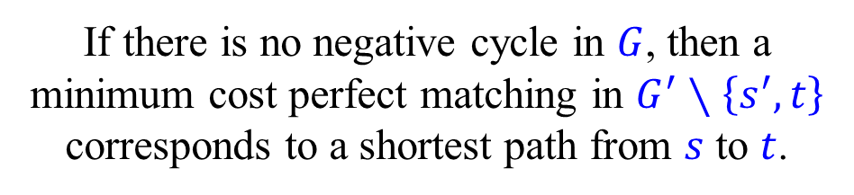



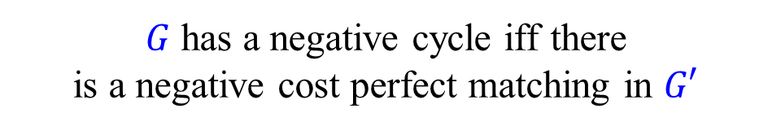

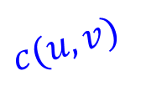

Shortest paths – directed graphs
Let $G=(V,E,c)$ be a directed graph, $c:E→ℝ$, $s,t∈V$.
Is there a negative cycle? If not, find a shortest path from $s$ to $t$.
Build a weighted bipartite graph:
$$s$$
$G′=\left(V,V′,E′,c′\right)$ , $V′=\left\{u′ | u∈V\right\}$
$$c(u,v)$$
$$v′$$
$E′=\left\{\left(u,u′\right) | u∈V\right\}∪\left\{\left(u,v′\right) | \left(u,v\right)∈E\right\}$
$$u$$
$$u′$$
$c′\left(u,u′\right)=0$ , $c′\left(u,v′\right)=c\left(u,v\right)$
$G$ has a negative cycle iff there is a negative cost perfect matching in $G′$
$$t′$$
$$V$$
$$V′$$
If there is no negative cycle in $G$, then a minimum cost perfect matching in $G^{′}∖\left\{s^{′},t\right\}$ corresponds to a shortest path from $s$ to $t$.

Slide 14
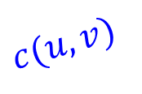










Shortest paths – directed graphs
Let $G=(V,E,c)$ be a directed graph, $c:E→ℝ$, $s,t∈V$.
Is there a negative cycle? If not, find a shortest path from $s$ to $t$.
Build a weighted bipartite graph:
$$c(u,v)$$
$G′=\left(V,V′,E′,c′\right)$ , $V′=\left\{u′ | u∈V\right\}$
$$u$$
$$v$$
$E′=\left\{\left(u,u′\right) | u∈V\right\}∪\left\{\left(u,v′\right) | \left(u,v\right)∈E\right\}$
$$⇒$$
$c′\left(u,u′\right)=0$ , $c′\left(u,v′\right)=c\left(u,v\right)$
$$0$$
$$v$$
$$v′$$
$$c(u,v)$$
$G$ has a negative cycle iff there is a negative cost perfect matching in $G′$
$$u$$
$$u′$$
$$0$$
If there is no negative cycle in $G$, then a minimum cost perfect matching in $G^{′}∖\left\{s^{′},t\right\}$ corresponds to a shortest path from $s$ to $t$.

Slide 15



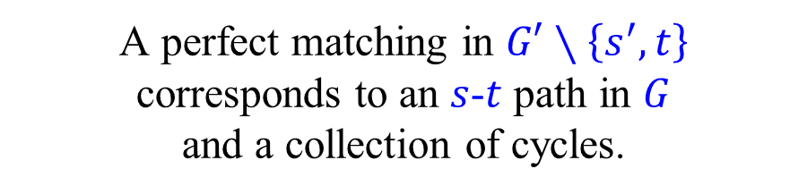








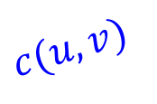
Shortest paths – directed graphs
A perfect matching $M$ in $G′$ corresponds to a collection of cycles in $G$.
Suppose that $\left(u_{0},u_{0}^{′}\right)∉M$. Then
$\left(u_{0},u_{1}^{′}\right) , \left(u_{1},u_{2}^{′}\right),…,\left(u_{k−1},u_{0}^{′}\right)∈M$ , where $u_{0},u_{1},…,u_{k−1}$ distinct.
($u_{i}$ cannot be matched to $u_{i}^{′}$, hence it must be matched to $u_{i+1}^{′}≠u_{i}^{′}$.)
This corresponds to the cycle $u_{0}u_{1}…u_{k−1}$ in $G$.
An edge $\left(u,u^{′}\right)$ corresponds to the ‘cycle’ $u$.
$$c(u,v)$$
A perfect matching in $G′∖\left\{s^{′},t\right\}$ corresponds to an $s$-$t$ path in $G$ and a collection of cycles.
$$u$$
$$v$$
$$⇒$$
If there are no negative cycles, we get a shortest $s$-$t$ path.
$$0$$
$$v$$
$$v′$$
$$c(u,v)$$
$$u$$
$$u′$$
$$0$$

Slide 16



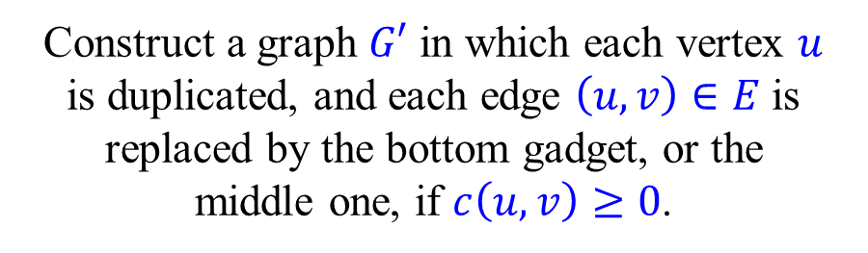
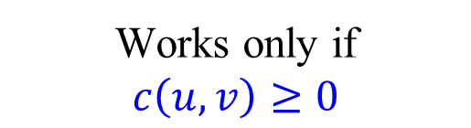
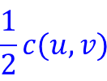




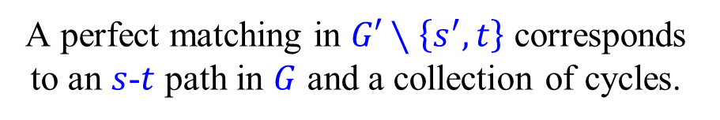





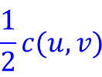



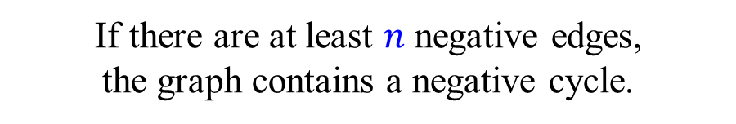






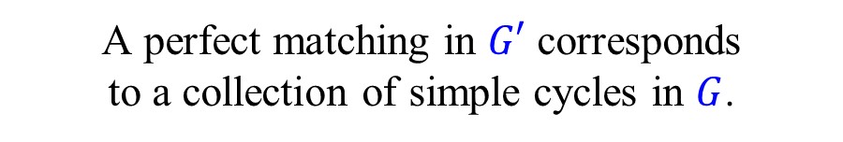
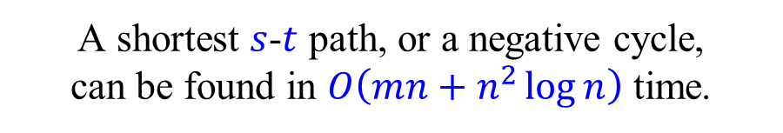
Shortest paths – undirected graphs
$$c(u,v)$$
Let $G=\left(V,E,c\right)$ be an undirected graph.
$$u$$
$$v$$
Construct a graph $G′$ in which each vertex $u$ is duplicated, and each edge $\left(u,v\right)∈E$ is replaced by the bottom gadget, or the middle one, if $c\left(u,v\right)≥0$.
$$⇒$$
$$v$$
$$0$$
$$v′$$
$$c(u,v)$$
$$c(u,v)$$
A perfect matching in $G′$ corresponds to a collection of simple cycles in $G$.
$$u$$
$$u′$$
$$0$$
Works only if $$c\left(u,v\right)≥0$$
A perfect matching in $G′∖\left\{s^{′},t\right\}$ corresponds to an $s$-$t$ path in $G$ and a collection of cycles.
If there are at least $n$ negative edges, the graph contains a negative cycle.
$$0$$
$$v$$
$$v′$$
Otherwise, $G′$ contains at most $4n$ vertices and at most $7m$ edges.
$$\frac{1}{2}c(u,v)$$
$$\frac{1}{2}c(u,v)$$
$$0$$
A shortest $s$-$t$ path, or a negative cycle, can be found in $O\left(mn+n^{2}\log{n}\right)$ time.
$$u$$
$$u′$$
$$0$$

