Slide 1

NEPAL ENGINEERING COLLEGE
Affiliated to Pokhara University | Department of Computer Engineering
NeuroScan
A Convolutional Neural Network Based Brain Tumor
Classification System from MRI Images
Individual Course Project Report — Image Processing and Pattern Recognition
Pranisha Baral | CRN: 023-345
11 Aug,2026 AD
01

Slide 2
CHAPTER 1 · INTRODUCTION
Introduction
NeuroScan is an automated brain tumor classification system that applies digital image processing and Convolutional Neural Network (CNN) based pattern recognition to brain MRI scans, built to support but not replace expert diagnosis.
1
Image Input Module
Accepts a brain MRI scan for analysis
2
Preprocessing Module
Resizing, normalization & augmentation
Built with Python, PyTorch and Streamlit, the system pairs a trained CNN with an interactive web app so a scan can be uploaded, preprocessed, classified, and explained with a confidence score — end to end.
3
CNN Feature Extraction & Classification
Learns discriminative features directly from image data
EVALUATED ON
Accuracy · Precision · Recall · F1-score, tested end-to-end from image upload to final prediction.
Output Module
4
Prediction, confidence score & performance visualizations
02

Slide 3
CHAPTER 1 · INTRODUCTION
Problem Statement
Brain tumors are among the most serious neurological disorders, arising from abnormal, uncontrolled cell growth and causing headaches, seizures, vision loss, and impaired motor coordination.
WHY IT MATTERS
Early diagnosis directly improves treatment outcomes and patient survival rates.
MRI is the leading imaging technique for detection, but manual interpretation by radiologists is time-consuming, subjective, and prone to fatigue-driven error especially across hundreds of slices.
4
MRI-derived tumor categories studied
Distinguishing between tumor types is further complicated by overlapping visual characteristics, motivating an automated, CNN-based classification approach.
100s
of slices reviewed manually per case
CNN
learns features without hand-engineering
03

Slide 4
CHAPTER 1 · INTRODUCTION
Objectives
1
Design and implement a CNN capable of classifying brain MRI images into Healthy and Tumor categories.
2
Apply digital image preprocessing (resizing, normalization, augmentation ) to improve model robustness.
3
Evaluate the trained model using accuracy, precision, recall, and F1-score.
4
Develop an interactive, user-friendly web application for uploading MRI images and viewing real-time predictions.
5
Reduce manual analysis workload and increase the speed and consistency of preliminary MRI screening.
04

Slide 5
CHAPTER 1 · INTRODUCTION
Scope of the Project
IN SCOPE
LIMITATIONS
•
Classification into four MRI categories: Glioma, Meningioma, Pituitary, No Tumor
✕
Tumor segmentation or localization within the image
•
Public Kaggle Brain Tumor MRI dataset (7,153 images)
✕
Estimating tumor size, stage, or severity
•
Preprocessing: resizing, normalization, data augmentation
✕
Treatment recommendations
•
Custom CNN trained from scratch for multi-class classification
✕
Clinical validation on real hospital data
•
Evaluation via accuracy, precision, recall, F1-score, confusion matrix
•
Streamlit web app for upload, prediction & confidence scores
The system is an academic demonstration of computer-aided diagnosis — not a replacement for professional medical diagnosis.
05

Slide 6
CHAPTER 2
Literature Review
Classical CAD Methods
Early systems relied on handcrafted features (SIFT, HOG, LBP, GLCM, PCA) with SVM / Random Forest / KNN classifiers — limited generalization.
Rise of CNNs
CNNs automatically learn hierarchical features — edges and textures in early layers, anatomical structures in deeper layers — surpassing handcrafted pipelines.
Transfer Learning
Pretrained networks (VGG16, ResNet50, DenseNet121, InceptionV3, EfficientNet) fine-tuned on medical images reduce training cost and boost accuracy.
Preprocessing & Augmentation
Resizing, normalization, skull stripping, flips and rotations reduce scanner variability and overfitting across datasets.
Evaluation Practice
Beyond accuracy, precision, recall, F1-score, confusion matrices and ROC/AUC are used given the clinical cost of misclassification.
06

Slide 7
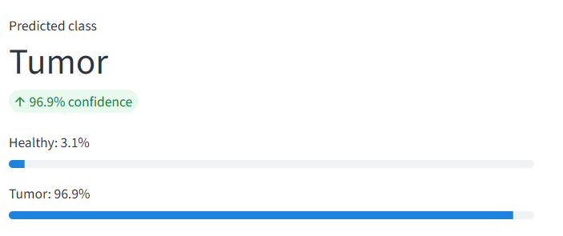
CHAPTER 3 · SYSTEM ANALYSIS & DESIGN
Dataset Description
Source: Kaggle — Brain Tumor MRI Data (tombackert) Total images: 7,153 labeled MRI scans, resized to 224×224 and normalized Reframing: Glioma, Meningioma & Pituitary → "Tumor"; No Tumor → "Healthy"
Class (Original) | Mapped Class | Approx. Images
No Tumor | Healthy | ≈ 1,600
Glioma | Tumor | ≈ 1,600
Meningioma | Tumor | ≈ 1,600
Pituitary | Tumor | ≈ 1,700
07

Slide 8
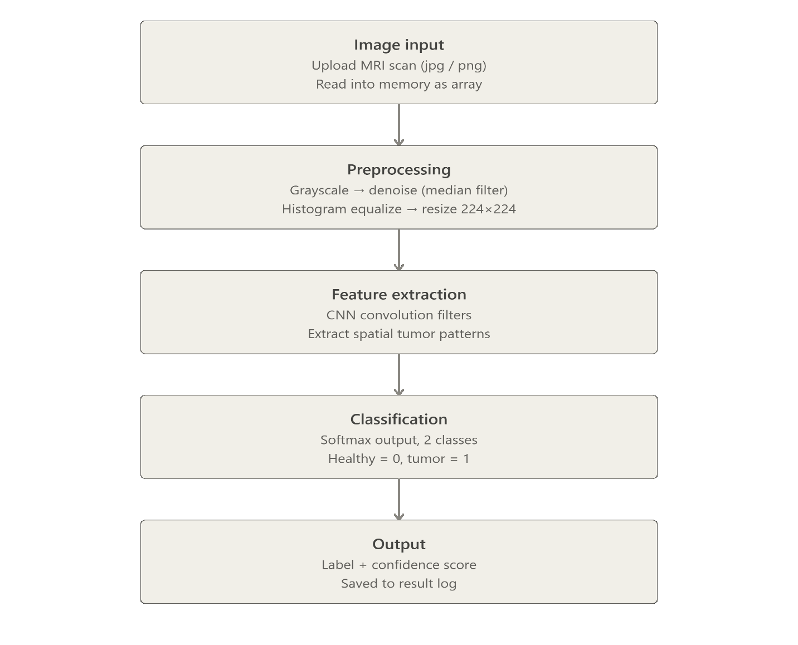
CHAPTER 3 · 3.3 SYSTEM FLOWCHART
How an MRI Image Becomes a Prediction
1
Image Input
Upload MRI (JPG/PNG) via Streamlit interface
2
Preprocessing
Resize to 224×224, normalize, augment (train time)
3
Feature Extraction
CNN convolution filters capture edges & patterns
4
Classification
Fully connected layers output Healthy / Tumor
5
Output
Label + confidence score returned to user
08

Slide 9
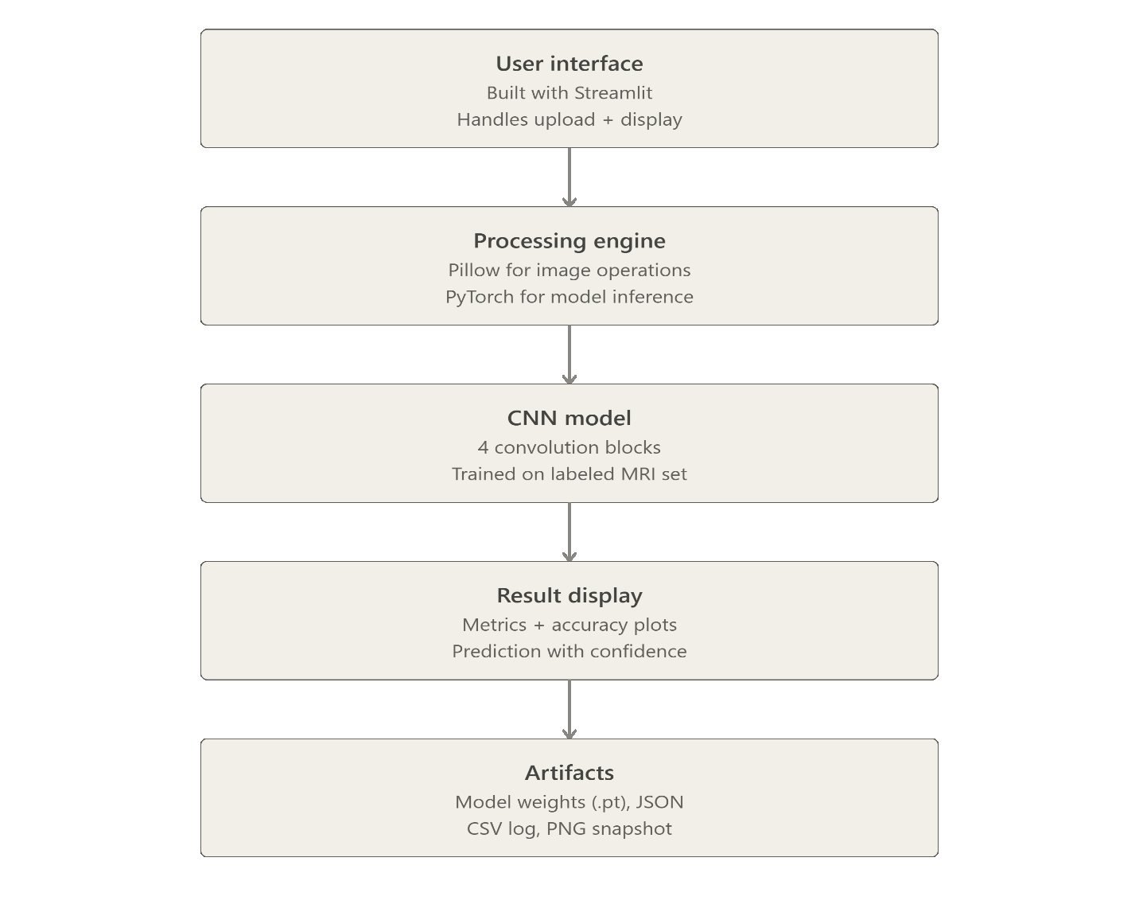
CHAPTER 3 · 3.4 ARCHITECTURE DIAGRAM
System Architecture
User Interface
Streamlit-based UI for image upload & display
Processing Engine
Pipeline for image preprocessing & inference
CNN Model
Convolutional blocks trained on labeled MRI set
Result Display
Metrics, accuracy & prediction with confidence
09

Slide 10
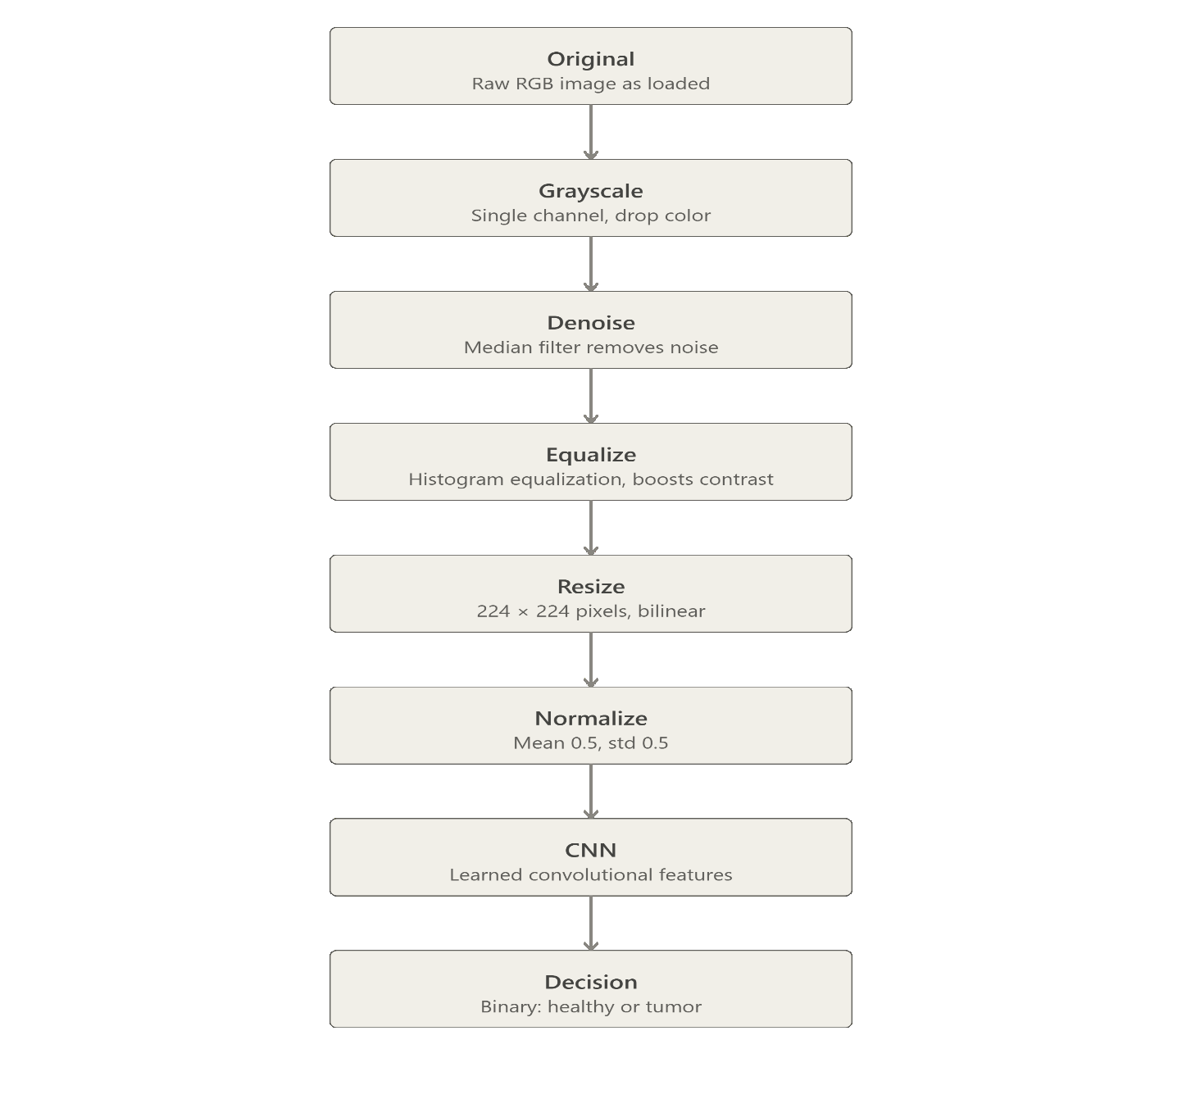
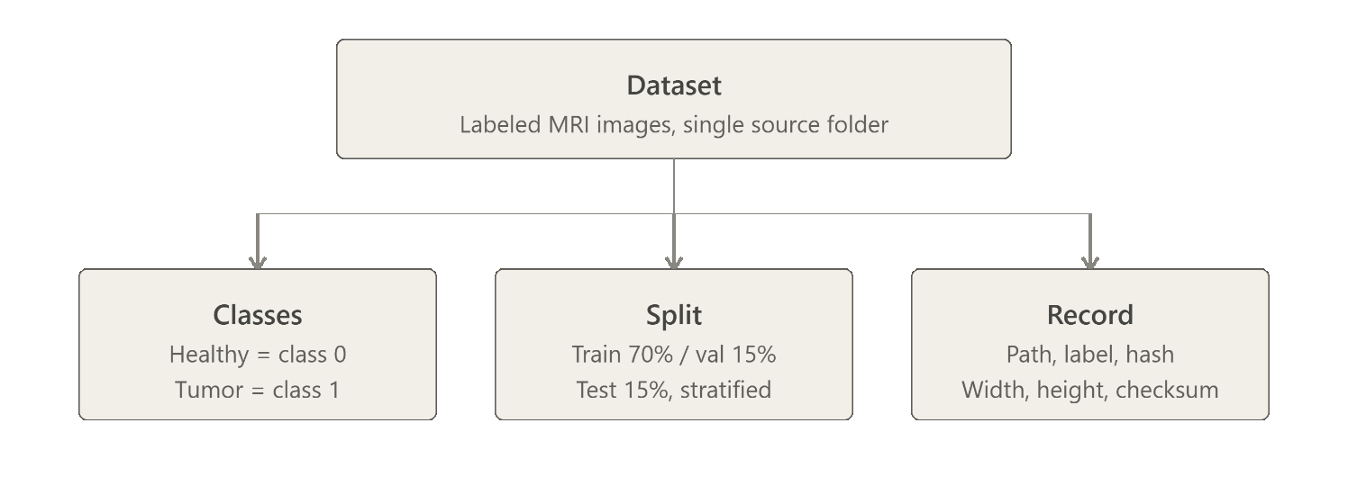
CHAPTER 3 · 3.5 – 3.6 DIAGRAMS
Dataset Organization & Processing Pipeline
Dataset / Class Diagram
Processing Pipeline
Dataset is discovered, split (train/val/test), and passed through resize → normalize → CNN → decision stages.
Seven stages take a raw MRI slice from original pixels through grayscale, denoising, equalization, resizing, and normalization before the CNN makes its healthy/tumor decision.
10

Slide 11
CHAPTER 4 · IMPLEMENTATION
Tools & Modules
TOOLS USED
Python 3.13
PyTorch
Torchvision
CORE PROCESSING (CNN)
A custom CNN extracts hierarchical spatial features via stacked convolutional and pooling layers, followed by fully connected layers producing a Healthy / Tumor classification with confidence score.
Streamlit
NumPy / Pandas
Matplotlib / Seaborn
Scikit-learn
OUTPUT MODULE
PIPELINE MODULES
Displays predicted class & confidence score; generates accuracy, precision, recall, F1-score, confusion matrix, and training curves.
Image Input
Upload JPG/PNG via Streamlit
Preprocessing
Streamlit App Pages
Resize 224×224, normalize, augment
Home · Dataset · Train · Predict · Results · Report
11

Slide 12
CHAPTER 4 · 4.3 ALGORITHMS USED
CNN Architecture & Training Setup
01
ReLU Activation
Max Pooling
Fully Connected
Sigmoid / Softmax
Convolution
02
03
04
05
→
→
→
→
Learnable filters slide across the image to generate feature maps capturing edges, textures & shapes.
Flattened features pass through dense layers for global reasoning.
Introduces non-linearity after each convolution, avoiding vanishing gradients.
Downsamples spatial dimensions, adding translation invariance and reducing compute.
Outputs a normalized probability for Healthy vs. Tumor classification.
Training uses Binary Cross-Entropy Loss with mini-batch gradient descent via the Adam optimizer.
TRAINING HYPERPARAMETERS
Hyperparameter | Value Used
Epochs | 12
Batch size | 32
Image size | 224 × 224
Learning rate | 0.0005
Optimizer | Adam
Loss function | Cross-Entropy Loss
12

Slide 13
CHAPTER 5 · TESTING
Functional Testing & Performance
Test Case | Expected Result | Status
Upload a valid MRI image | Image accepted and displayed | Pass
Upload a corrupted/invalid file | System shows an error, does not crash | Pass
Predict on a Healthy sample | Model classifies as Healthy | Pass
Predict on a Tumor sample | Model classifies as Tumor | Pass
View dataset statistics | Correct total image count (7,153) displayed | Pass
Train model from the UI | Training completes and metrics update | Pass
View results page | Confusion matrix and training curves render | Pass
PERFORMANCE TESTING
< 2s
per single-image prediction on CPU-only hardware
Robustness verified by testing images from each of the four original classes (glioma, meningioma, pituitary, no-tumor) after mapping to the binary scheme.
13

Slide 14
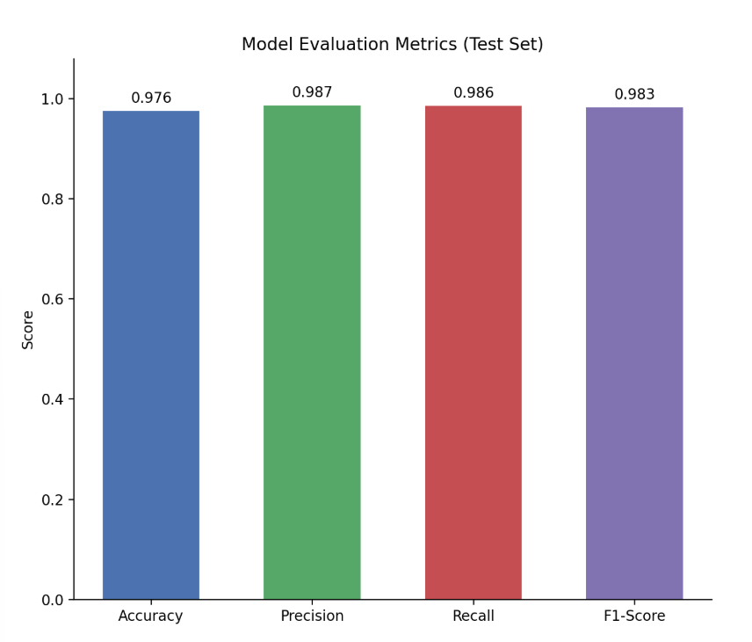
CHAPTER 5 · 5.3 RESULTS
Model Evaluation Metrics
0.976
0.987
0.986
0.983
ACCURACY
PRECISION
RECALL
F1-SCORE
14

Slide 15
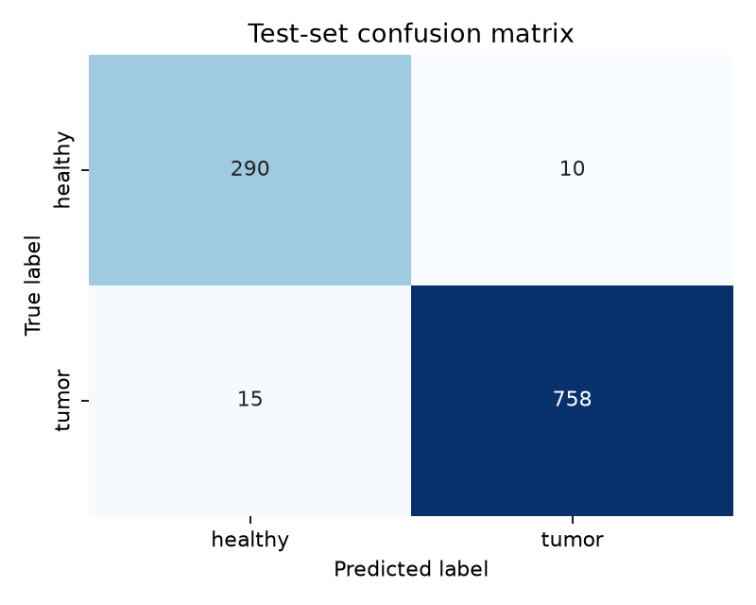
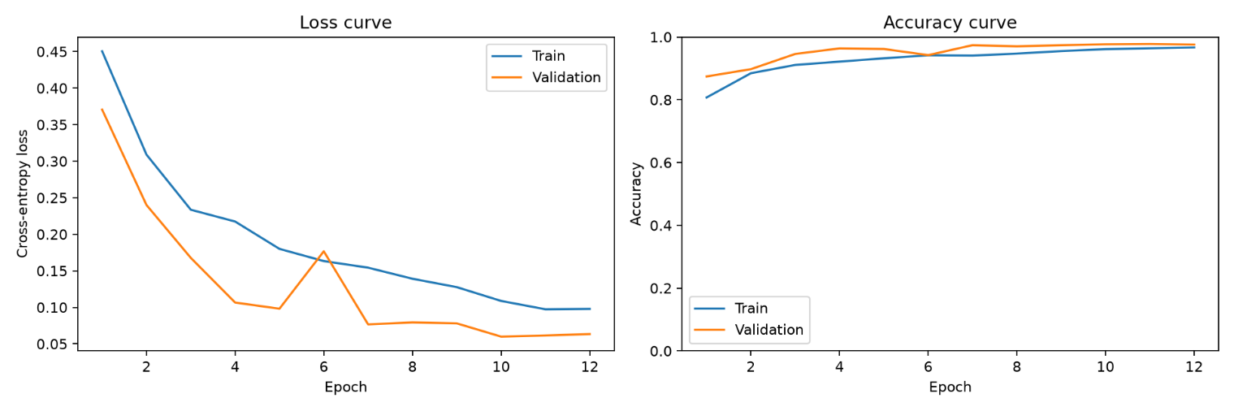
CHAPTER 5 · 5.3 RESULTS
Confusion Matrix & Training Curves
Confusion Matrix
Training & Validation Curves
290 healthy and 758 tumor cases correctly classified, with only 25 total misclassifications on the test set — loss and accuracy curves show stable convergence with no significant overfitting.
15

Slide 16
CHAPTER 6
Conclusion
Achievements
Limitations
Future Scope
—
End-to-end brain tumor classification system built successfully
—
Limited to 2D MRI slices; may not generalize across scanners
—
Extend to multi-class classification (glioma / meningioma / pituitary)
—
Streamlit app integrates dataset exploration, training, prediction & results
—
Binary classification only — no tumor sub-typing or localization
—
Add segmentation/localization (e.g. U-Net) to highlight tumor region
—
Strong test-set performance distinguishing Healthy vs. Tumor scans
—
CPU-only training limited experimentation; no clinical validation
—
GPU deployment and validation on larger, multi-institutional data
16

Slide 17
Thank You
NeuroScan — CNN-Based Brain Tumor Classification from MRI Images
Pranisha Baral | CRN: 023-345 | Department of Computer Science and Engineering
17

