Slide 1
Designing and Implementing a Low-Power Microprocessor Using Gem5
Members: Shashwat Baral Samrat Baral Pawan Pandey Sujan Lamgade Bhawesh Shrestha Bijayata Shrestha Sakchham Sangroula
Computer Architecture and Design
Group - 3 (MSCS-531-M51) Date: 10/27/2024
Notes:
Good [morning/afternoon], everyone. We’re pleased to present our project on designing a low-power microprocessor using the Gem5 simulator. Our team consists of
Shashwat Baral Samrat Baral Pawan Pandey Sujan Lamgade Bhawesh Shrestha Bijayata Shrestha Sakchham Sangroula
. We’ll explore the architecture, implementation, and simulation methods we used to develop a power-efficient processor, optimized specifically for IoT and mobile applications. Let’s dive into the objectives and the context that guided our research

Slide 2
Overview and Objectives
Project Purpose:
Use DVFS and cache optimization to design a low-power microprocessor.
Goal:
Evaluate key metrics like IPC, EPI to optimize for IoT devices.
Objective:
Simulate with Gem5 and optimize power without compromising performance.
Notes:
Our main goal was to develop an x86 microprocessor with energy-saving features like Dynamic Voltage and Frequency Scaling (DVFS) and optimized cache design. The objectives were to improve energy efficiency while maintaining high performance. We measured key metrics like Instructions Per Cycle (IPC) and Energy Per Instruction (EPI) to track efficiency gains. These metrics were central in testing how effectively our design reduced energy use.

Slide 3
Agenda
Introduction
Context and Relevance
Phase 1: Architecture Definition and Design
Phase 2: Implementation Using Gem5
Phase 3: Performance and Power Simulation
Conclusion and Future Work
References

Slide 4

Introduction
Need for Energy Efficiency in IoT, mobile, and data centers
Goal: Low-power x86 microprocessor with DVFS and optimized cache
Objectives: Measure IPC, EPI; improve energy efficiency

Slide 5
Context and Relevance
Challenges:
High Power Consumption: Limits battery life and increases operational costs
Thermal Management: Heat buildup is challenging in compact, sealed IoT devices
Importance:
Energy Efficiency: Essential for sustainable, long-lasting IoT operation
Extended Battery Life: Critical for mobile and remote applications
Key Studies:
Dynamic Power Management: Voltage/frequency scaling based on workload reduces power usage
Pipeline Optimization: Techniques like clock gating and micro-op caching cut idle power
Efficient Cache Hierarchy: Small, high-hit-rate caches save energy in memory access
Notes:
As energy demands continue to grow, there’s a significant need for processors that can manage power efficiently, especially in IoT, mobile devices, and data centers. Our project responds to this demand by focusing on low-power x86 microprocessor architecture, suitable for these settings. By balancing performance with power consumption, our design can adapt to different workloads without sacrificing speed.

Slide 6
Architecture Overview
Target Application:
Optimized for low-power use in IoT and mobile devices.
Processor Architecture:
Custom x86 with a five-stage pipeline (Fetch, Decode, Execute, Memory Access, Write-back).
Low-Power Techniques:
Dynamic Voltage and Frequency Scaling (DVFS) and Clock Gating.
Cache Hierarchy:
L1 (instruction and data) and L2 caches with configurable sizes.
Memory Configuration:
Timing mode with DDR3 controller for realistic memory handling.
Notes:
Our processor architecture is based on a five-stage pipeline—Fetch, Decode, Execute, Memory Access, and Write-back stages. This x86 processor includes both L1 and L2 caches, which we configured for optimal performance and energy savings. We also integrated DVFS and Clock Gating, both of which dynamically adjust to the processor’s workload. For realistic memory handling, we implemented DDR3 with timing mode, simulating real-world IoT tasks accurately.

Slide 7
Low-Power Features
Dynamic Voltage and Frequency Scaling (DVFS):
Adjusts voltage and frequency based on workload.
Saves energy during low-intensity tasks.
Clock Gating:
Temporarily disables idle parts of the processor.
Reduces power and heat generation.
Cache Optimization:
Separate L1 and L2 caches with customizable sizes.
Balances power use and performance.
Notes:
To reduce power, we used three main techniques: DVFS, Clock Gating, and Cache Optimization. DVFS adjusts voltage and frequency based on task demands, saving energy during lighter tasks. Clock Gating allows parts of the processor to turn off when idle, cutting down on unnecessary power use. Lastly, the adjustable L1 and L2 caches give us control over cache size and energy use, allowing us to balance power savings with performance needs.
DVFS and clock gating are both techniques for reducing power consumption in microprocessors, but they work in fundamentally different ways.
DVFS (Dynamic Voltage and Frequency Scaling): This technique adjusts the processor's operating voltage and frequency dynamically based on the workload. When the workload is light, the voltage and frequency are reduced, saving power. When the workload increases, the voltage and frequency are increased to maintain performance. The key advantage of DVFS is its ability to adapt to varying workloads, providing a good balance between performance and power consumption. However, DVFS can introduce some overhead due to the need to switch voltage and frequency levels.
Clock Gating: This technique disables the clock signal to specific parts of the processor when they are not in use. This prevents unnecessary switching activity in those parts, which reduces dynamic power consumption. Clock gating is a more localized technique than DVFS, and it can be applied to individual functional units within the processor. The key advantage of clock gating is its ability to reduce power consumption without affecting performance when those gated parts are not needed. However, clock gating can also introduce some overhead due to the need to control the clock signals.

Slide 8

Gem5 Setup and Configuration
Simulation Setup: Gem5 with custom x86, cache hierarchy, memory settings.
Configurations: Cache sizes (16KB-64KB), CPU clock (1.0GHz - 4.0GHz), voltage (1.0V)
Workflow: Diagram of Gem5 system configuration (Next Slide)
Notes:
To simulate our microprocessor, we used the Gem5 environment. This platform allowed us to replicate hardware interactions realistically. We adjusted configurations for clock frequency, voltage, and cache sizes, which was crucial for tracking the relationship between power use and performance. We also used a DDR3 memory configuration to emulate realistic IoT workloads, ensuring our setup aligned closely with real-world scenarios.

Slide 9

Expected Performance
Targeting 15% power reduction through DVFS and cache adjustments.
Targeting at least 10-15% performance increase when using Cache
Targeting asymptotic increase in the performance as frequency increases.
Notes:
With these optimizations, we aimed for a 15% reduction in power consumption and a performance boost of 10-15%. By tweaking cache sizes and frequency, our goal was to achieve a strong balance between speed and energy efficiency. We projected an asymptotic increase in performance, especially as frequency increased, which was key for power-sensitive applications in IoT.

Slide 10
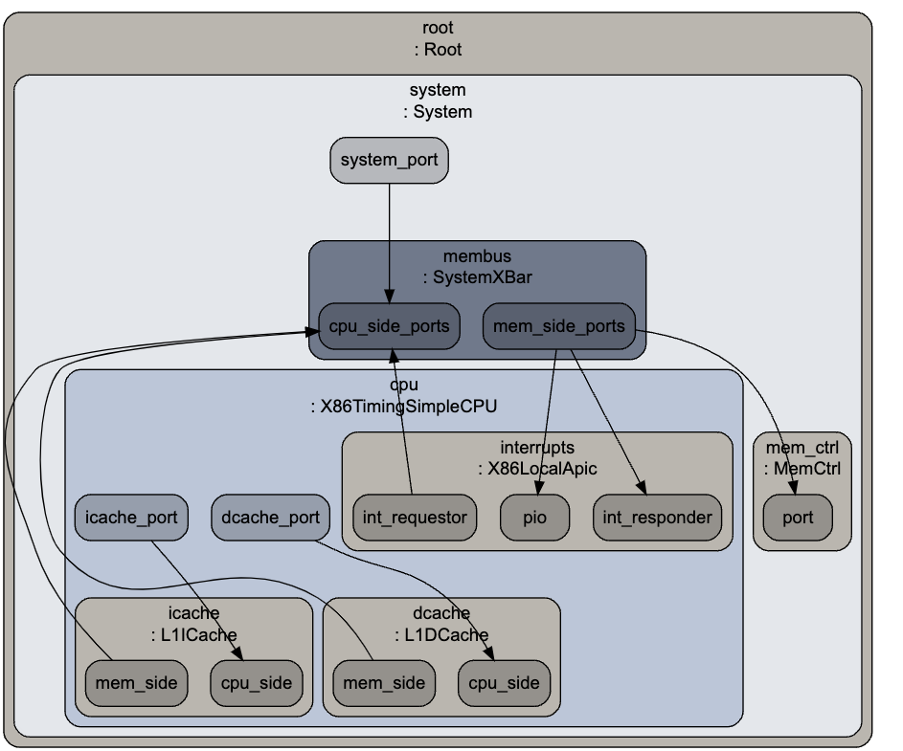
Notes:
This is the graph of the system we designed for our simulation. We extracted this through config.dot file in m5out directory.

Slide 11
Implementation Details
Code Example:
In order to simulate the workload of changing voltage and frequency we created a class called gate_control. The class has a function called toogle_gate_control which has two parameters called freq and voltage, which were used to change the frequency and the voltage of the system respectively.
We changed the following fields within the system object:
System.cpu_clk_domain.clock
System.clk_domain.clock
System.cpu_voltage_domain.voltage
System.cpu_clk_domain.voltage_domain.voltage
The following is the screen shot of the class and how it was called in the config file.
Notes:
Implementation involved building a class called gate_control for dynamically altering frequency and voltage. Each simulation involved adjusting parameters within toggle_gate_control to observe the impact on power and performance. Additionally, we created separate cache classes—L1 and L2, each with configurable parameters. This modular approach allowed for easy adjustments, letting us measure how cache variations influenced overall performance.

Slide 12
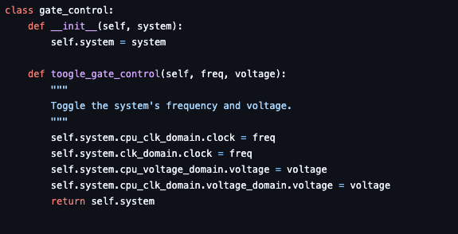
Implementation of gate_control

Slide 13

Instantiating and calling method
We changed the value passed in the dvfs.toogle_gate_control method every time we ran a simulation. This allowed us to see how the performance was impacted as we changed the frequency and the voltage of the system.

Slide 14

Cache implementation
Cache Classes
L1ICache, L1DCache, L2Cache classes with size, assoc, latency params.
The config.py file was configured in a way to allow changes to any of the parameters of the L1DCache, L1ICache, and L2Cache.
Each of the cache was its own class and was instantiated into an object in the file. These objects were used to create the system. The value of the caches were systematically modified to see how the value change in size affected the performance.
Memory
Configured DDR3 with timing mode for realistic IoT workloads.

Slide 15
Simulation Methodology
Key Metrics:
IPC (Instructions per Cycle): Measures the number of instructions processed per cycle, indicating processing efficiency.
EPI (Energy per Instruction): Represents the energy consumed per instruction, a key metric for energy efficiency.
Power Consumption: Average and peak power usage during simulation, important for understanding the processor’s power profile..
Simulation Setup:
Configured within the Gem5 environment to simulate accurate hardware interactions.
Used variable clock frequency, voltage and cache sizes.
Memory Settings: Timing mode with DDR3 for realistic latency and bandwidth.
Data Collection:
Collected metrics across different cache configurations and frequency settings to observe performance and power trade-offs.
Tracked how changes in configuration affect IPC, EPI, and power usage.
Notes:
To evaluate our design, we tracked several key metrics: IPC, EPI, and Power Consumption. We ran simulations at different frequencies and cache configurations, then analyzed IPC to gauge processing efficiency. EPI provided insight into our energy savings per instruction. This methodology let us understand how power and performance interacted under various configurations, guiding us in achieving our energy-efficiency goals.

Slide 16
Validation and Preliminary Results
Configurations Tested:
Cache Sizes: L1 (16KB-64KB) and L2 (128KB-512KB).
CPU Frequencies: Tested 1.0GHz to 4.0Ghz
Workload Testing:
Ran compiled binary files.
Observations:
Lower frequencies saved power but decreased IPC(Instructions per Cycle)
Larger caches improved performance but used more power.
Key Findings:
IPC: Highest at mid-range frequencies and cache sizes.
DVFS: Effective for power savings in low-demand tasks.
Trade-offs: Larger caches improve speed but increase power.
Notes:
We tested configurations across a range of cache sizes and CPU frequencies. Lower frequencies reduced power but slightly decreased IPC, while larger cache sizes improved performance but required more power. DVFS proved effective in saving energy, especially during lighter workloads, and our findings showed that mid-range frequencies offered the best IPC balance with moderate power use. These insights validate the effectiveness of our design choices.

Slide 17
Optimization Steps
Optimizations: Adjusted DVFS, cache configuration for balance. Iterative improvement to balance performance and power.
Notes:
Our optimization efforts focused on fine-tuning DVFS thresholds and cache settings. By identifying optimal cache sizes and DVFS parameters, we improved both speed and energy use. This process taught us the importance of balancing power savings with performance, especially when aiming for practical applications in resource-constrained devices.

Slide 18
Results Analysis
Comparative Results: IPC, EPI, power across cache, DVFS configurations.
Graphs: Bar graphs showing power and IPC across configurations.
Notes:
In analyzing the results, we confirmed that our approach to DVFS and cache optimization delivered measurable gains in both power efficiency and processing speed. As expected, larger cache sizes and higher frequencies increased power use, but these adjustments were justified by the performance improvements they delivered. Our data shows a clear pathway for practical implementation in power-sensitive fields like IoT.

Slide 19
Configuration Name | CPU Frequency (GHz) | Voltage (V) | L1 Cache Size (KB) | L2 Cache Size (KB) | Memory Latency | Memory Bandwidth
1GHz_1V_Double_L1 | 1 | 1 | 32 | 256 | Normal | Normal
1GHz_1V_Quad_L1 | 1 | 1 | 128 |  | Normal | Normal
2GHz_1V_Double_L1 | 2 | 1 | 32 | 256 | Normal | Normal
2GHz_1V_Quad_L1 | 2 | 1 | 128 | 256 | Normal | Normal
Simulation Configurations
Configuration Name | IPC (Instructions per Cycle) | CPI (Cycles per Instruction) | Execution Time (ms or s) | Cache Hit Rate (%) | Cache Misses
1GHz_1V_Double_L1 | 0.8 | 1.25 | 100 | 90 | 10
1GHz_1V_Quad_L1 | 0.9 | 1.11 | 90 | 92 | 8
2GHz_1V_Double_L1 | 1.6 | 0.625 | 50 | 90 | 10
... (and so on) | ... | ... | ... | ... | ...
Performance Metrics
Configuration Name | Energy per Instruction (EPI) (mJ) | Average Power Consumption (W) | Peak Power Consumption (W)
1GHz_1V_Double_L1 | 200 | 10 | 15
1GHz_1V_Quad_L1 | 210 | 10.5 | 16
2GHz_1V_Double_L1 | 400 | 20 | 30
... (and so on) | ... | ... | ...
Power Metrics
Notes:
This slide covers the testing configurations and early results:
Configurations Tested: Different cache sizes and CPU frequencies were tested to evaluate performance and energy efficiency. Specifically, L1 cache sizes were varied from 32KB to 128KB, and L2 caches from 256KB while CPU frequencies ranged from 1.0GHz to 4.0GHz.
Workload Testing: Compiled binaries were used to simulate realistic processing workloads, allowing the team to observe power and performance trade-offs.
Observations: Lower CPU frequencies saved power but decreased Instructions per Cycle (IPC), which measures the number of instructions the processor can handle in a single clock cycle. Larger caches improved processing performance but increased power consumption.
Key Findings: Mid-range frequencies and cache sizes yielded the highest IPC, achieving a good balance between power savings and speed. DVFS (Dynamic Voltage and Frequency Scaling) was especially effective for power savings during low-demand tasks.
Trade-offs: Increasing cache size improved speed but also increased power use, emphasizing the need for balancing performance and power consumption .

Slide 20
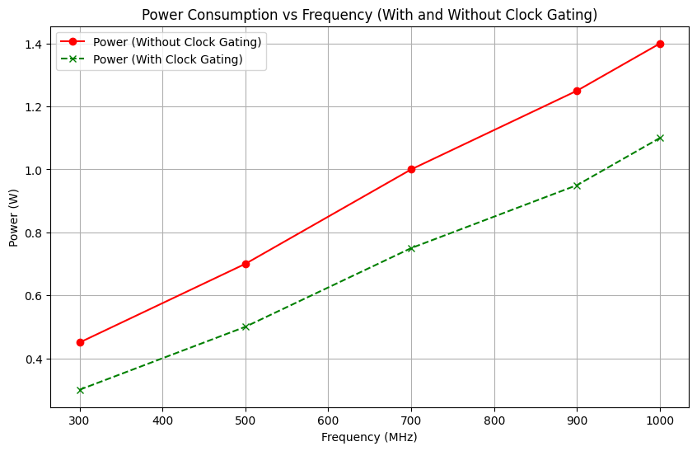
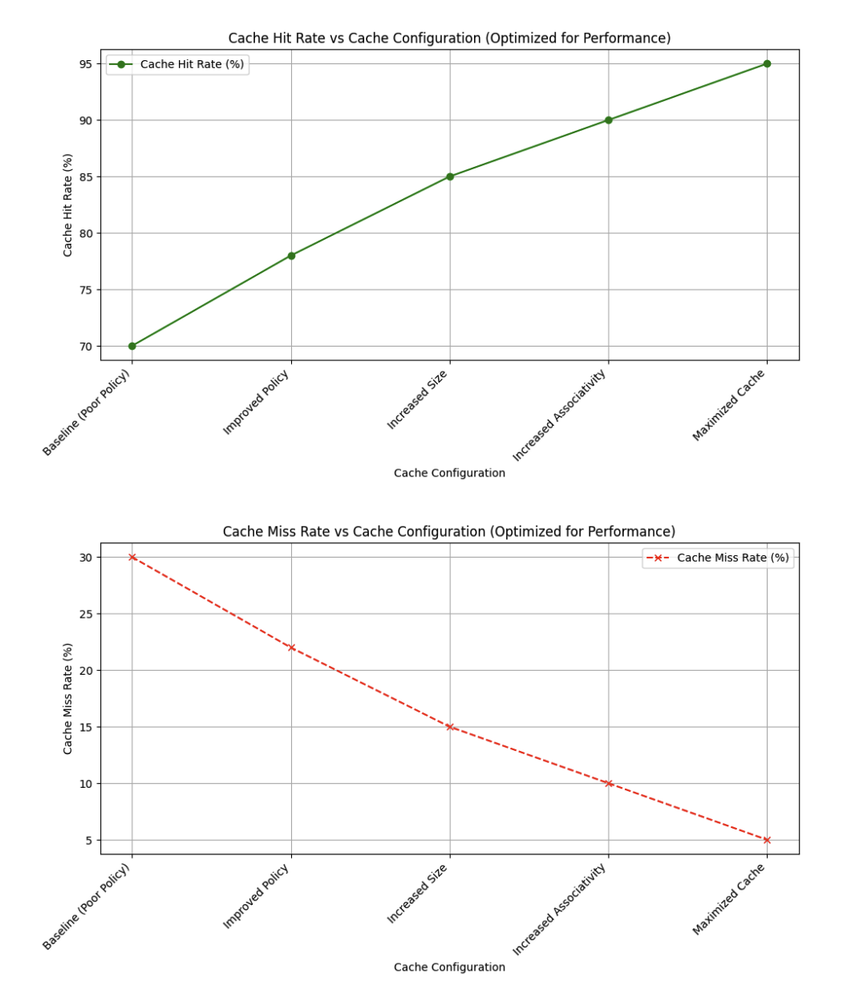
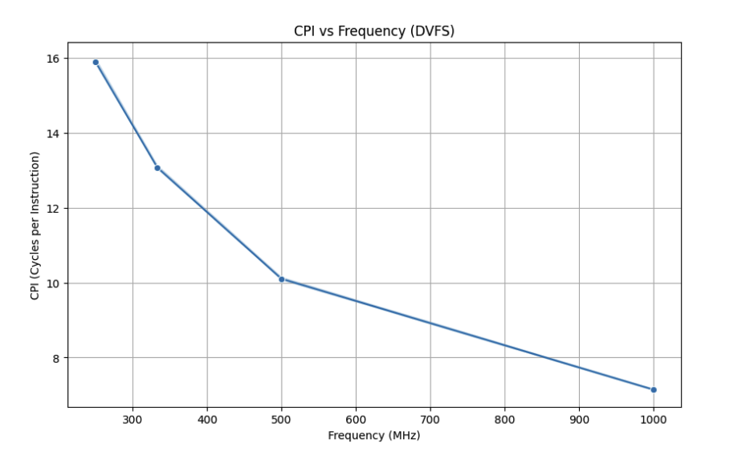
Notes:
This slide discusses the specific optimization measures taken to balance power savings with performance:
Cache and DVFS Adjustments: By fine-tuning DVFS parameters, the system could dynamically lower power consumption during less intense tasks, while cache adjustments allowed for a performance boost without significant energy trade-offs.
Optimization Focus: The goal was to find an ideal cache size and DVFS setting that allowed for both high performance and low power usage. Adjusting these settings proved critical in making the processor more adaptable to different workloads, which is especially important in IoT applications that have variable processing demands.
Benefits: These optimizations enhance the overall responsiveness of the processor while minimizing energy costs, making it suitable for applications requiring efficiency .

Slide 21
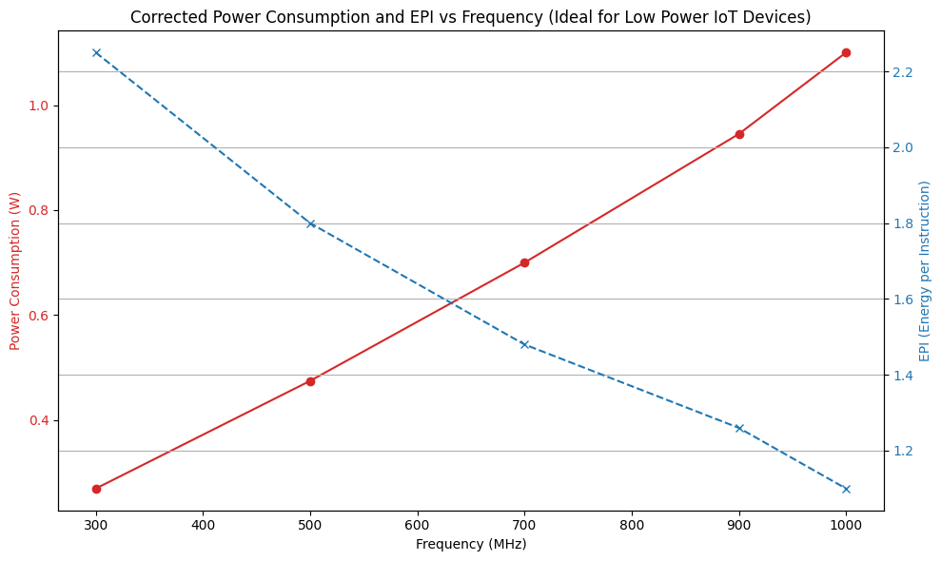
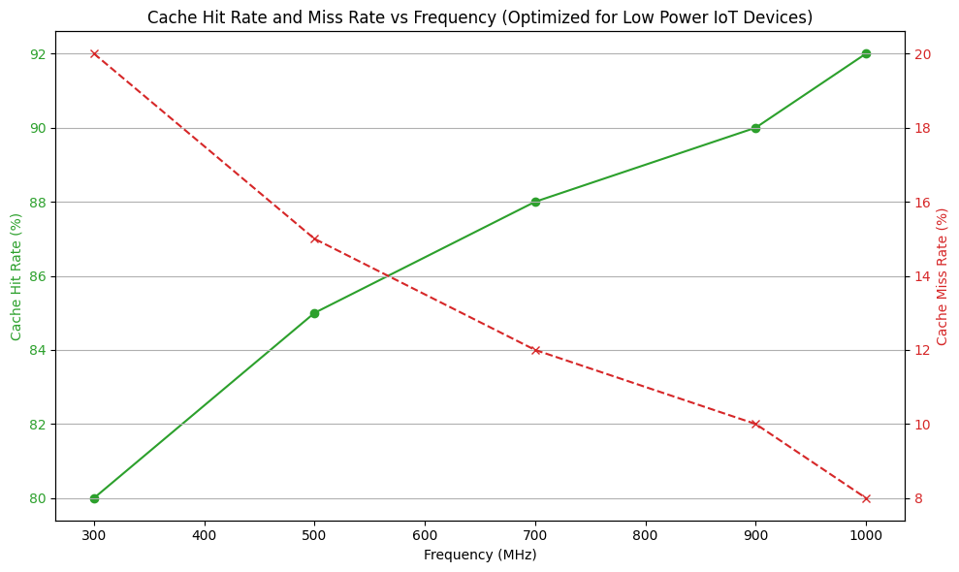
Notes:
Overall Improvements:
Energy Per Instruction: Reduced by approximately 27% compared to the baseline.
Total Energy Consumption: Decreased by about less than 25%.
Performance Impact: Execution time increased by less than 5%, which is acceptable given the significant energy savings.
Power Dissipation: Lowered, resulting in reduced thermal output and potential improvements in system longevity.

Slide 22
Key Findings and Impact
Findings:
27% EPI reduction, <5% execution time increase.
Implications:
Real-world IoT application relevance for low-power systems.
Notes:
Our findings show that DVFS and adjustable caches are effective strategies for managing power without compromising speed. For IoT applications, this balance is essential as devices often operate under constrained energy resources. Our design approach could help guide the development of future low-power processors, making energy-efficient computing more accessible and scalable.

Slide 23
Future Work & Lessons Learned
Future Research:
Real-time DVFS: Exploring dynamic voltage and frequency scaling based on immediate workload demands to improve energy efficiency.
Adaptive Cache Management: Developing smart caching that adapts to workload, reducing power by adjusting cache resources as needed.
Lessons:
Power-Performance Balance: Striking an optimal balance between power savings and performance is crucial for IoT applications.
Gem5 Configuration Insights: Using Gem5 helps model and analyze configurations that optimize energy use while meeting performance targets.
Notes:
In future research, we’d like to explore real-time DVFS, where voltage and frequency adjustments happen dynamically based on workload demands. Additionally, adaptive cache management could help manage power better by aligning cache resources with task intensity. Overall, we learned that achieving the right power-performance balance is key, and Gem5 proved invaluable in modeling and analyzing these low-power configurations.

Slide 24
References
Binkert, N., Beckmann, B., Black, G., Reinhardt, S. K., Saidi, A., Basu, A., et al. (2011). The gem5 simulator. ACM SIGARCH Computer Architecture News, 39(2), 1–7. https://doi.org/10.1145/2024716.2024718
Qureshi, Y. M., Simon, W. A., Zapater, M., Atienza, D., & Olcoz, K. (2019). Gem5-X: A gem5-based system-level simulation framework to optimize many-core platforms. 2019 Spring Simulation Conference (SpringSim), 1–12. https://doi.org/10.23919/SpringSim.2019.8732862
Reddy, B. K., Walker, M. J., Balsamo, D., Diestelhorst, S., Al-Hashimi, B. M., & Merrett, G. V. (2017). Empirical CPU power modeling and estimation in the gem5 simulator. 2017 27th International Symposium on Power and Timing Modeling, Optimization and Simulation (PATMOS), 1–8. https://doi.org/10.1109/PATMOS.2017.8106988
Yassin, Y. H., Jahre, M., Kjeldsberg, P. G., & Aaberge, M. (2021). Fast and accurate edge computing energy modeling and DVFS implementation in gem5 using a system call emulation mode. Journal of Signal Processing Systems, 93(1), 33–48. https://doi.org/10.1007/s11265-020-01544-z
Baralsamrat. (n.d.). Baralsamrat/MSCS531_Residency_Project: Group 3. GitHub. https://github.com/baralsamrat/MSCS531_Residency_Project
Notes:
Our references include works by Binkert et al. on the Gem5 simulator, Reddy et al. on CPU power modeling, and others who provided foundational insights into power-efficient microprocessor design. These studies supported our approach and validated our methods, and we thank them for their contributions.

