Slide 1
Predictive Modeling of Typhoid Incidence in Nepal
Under Extreme Climate Change Scenarios Using Machine Learning Kritika Baral

Slide 2
Research Presentation
Predictive Modeling of Typhoid Incidence in Nepal
Under Extreme Climate Change Scenarios Using Machine Learning
Kritika Baral
Kathmandu University · Department of Health Informatics · Dhulikhel, Nepal ORCID 0009-0007-1517-1063
Download PDF Download PPTX
Notes:
Good morning. My name is Kritika Baral. Today I’ll present my research on predictive modeling of typhoid incidence in Nepal under climate change scenarios — work that integrates three independent national datasets across all 77 districts over nine years to ask whether climate-induced floods can predict typhoid burden months in advance.

Slide 3
Part I
The problem of typhoid in a warming Nepal
A persistent endemic disease, a vulnerable geography, and a climate trajectory that compounds both.

Slide 4
The burden
9.2 M Annual global cases
100 K Annual Nepal cases
70–80% Occur in monsoon (Jun–Sep)
60–70% Cases in children < 15 yrs
Climate is amplifying risk. Nepal is warming at 0.056 °C / year — twice the global average — with monsoon precipitation up 20–30 % since 1990. Flooding disrupts WASH systems, contaminating drinking-water sources where Salmonella Typhi persists and spreads. The typhoid conjugate vaccine has reached 85 % coverage, yet residual burden persists.
Sources: (Bhandari et al., 2022; Coalition Against Typhoid, 2024; GBD 2023 Causes of Death Collaborators, 2025; Intergovernmental Panel on Climate Change, 2022; Karkey et al., 2018; Levy et al., 2023; Ministry of Forests and Environment, Government of Nepal, 2021; Ministry of Health and Population, Government of Nepal, 2023).
Notes:
Two pressures converge in Nepal — a heavy baseline burden that current surveillance only reactively monitors, and a rapid climate trajectory that is increasing the frequency of the exact extreme events known to amplify transmission.

Slide 5
The gap in existing models
Three gaps in current typhoid prediction
i. No flood-lag integration. SEIR / ARIMA frameworks miss the 1–2 month flood-lag effect → underestimate monsoon-driven surges by 15–20 %.
ii. No subnational resolution. National aggregates obscure Terai hotspots (Rautahat: 1,711 cases / monsoon month); fewer than 20 % of models stratify by WASH access.
iii. No integrated multimodal forecasting. ML diagnostic models excel at clinical AUROC, but none combine HMIS surveillance + DRR flood records + ERA5 / CHIRPS climate grids.
This is the first study to integrate all three of Nepal’s national-scale data streams into a single ML predictive framework for typhoid.
Sources: (Bhandari et al., 2022; GBD 2023 Causes of Death Collaborators, 2025; Go, 2025; Levy et al., 2023; Pitzer et al., 2025; Semiu et al., 2025; Ssemuyiga et al., 2025).

Slide 6
Research question & objectives
None
To what extent do climate-induced flood events, together with precipitation anomalies and relative humidity, influence the spatiotemporal patterns of typhoid fever incidence across Nepal?
Four specific objectives
i. Describe. Spatiotemporal distribution of typhoid cases and flood events across ecological zones.
ii. Quantify. Associations between typhoid incidence and hydro-meteorological variables, including one-month-lagged effects.
iii. Develop and compare. Four ML models — Random Forest, XGBoost, an MLP / LSTM, and a Weighted Ensemble — selecting the ensemble as the headline performer and XGBoost as the operational pick.
iv. Project. 2050 burden under SSP2-4.5 and SSP5-8.5 climate pathways.

Slide 7
Part II
Data, design, and machine learning
Three independent national datasets, harmonised into one district–month panel. Three complementary algorithms, validated under strict temporal discipline.

Slide 8
Study design

Slide 9
Scope
• 77 districts. The complete national administrative grid of Nepal.
• 108 months. Jan 2015 – Dec 2023, monthly resolution.
• 3 ecological zones. Terai (< 300 m, flood-prone) · Hill · Himalayan mountain belt.
Why ecological design
The objective is population-level climate–health attribution. Individual-level RCT-style designs are neither feasible nor appropriate for environmental drivers of endemic disease.

Slide 10
Source | Variable | Resolution | Provider
HMIS | Monthly outpatient typhoid cases | District-month | MoHP Nepal (Ministry of Health and Population, Government of Nepal, 2023)
CHIRPS | Precipitation | District-month avg | Funk et al. (2015)
ERA5-Land | Air temperature · relative humidity | District-month avg | Muñoz-Sabater et al. (2021)
DRR portal | Flood event counts | District-month | NDRRMA Nepal (NPDRR Nepal, 2025)
Data sources

Slide 11
7,327 District–month observations
1.2 M Cumulative HMIS cases
1,248 Recorded flood events

Slide 12
Feature | Role
precip_lag1 · temp_lag1 · humidity_lag1 · flood_lag1 | One-month lags aligned with Salmonella Typhi incubation (6–30 days) + reporting delay
precip_roll3 · temp_roll3 | Cumulative monsoon effects extending beyond peak rainfall
monsoon (binary) | Captures Jun–Sep regime explicitly
month_sin, month_cos | Cyclical encoding (December → January adjacency on a unit circle)
cases_lag1 | Autoregressive — last month’s burden
ecological_zone | Terai / Hill / Mountain stratification
Feature engineering — the rationale for lags

Slide 13
None
Empirical validation of the one-month lag. At the district-month level (n = 6,162), lagged precipitation (r = 0.313), lagged humidity (r = 0.180), and lagged flood frequency (r = 0.122) all correlate positively with log-cases — biologically consistent with the 6 – 30 day S. Typhi incubation period. The autoregressive cases_lag1 term (r = 0.731) carries the strongest single signal.
Sources: (Bhandari et al., 2022; Levy et al., 2023).

Slide 14
Why four models — three individual + one weighted combination

Slide 15
Random Forest
Strong non-parametric baseline · stable feature importances.
Role: low-variance baseline.
XGBoost
Iterative residual correction · L1/L2 regularisation · graceful missing-value handling.
Role: operational pick when only one model can be deployed.
MLP fallback (LSTM-equivalent)
Multilayer perceptron on the same scaled feature set; stands in for LSTM where TensorFlow is unavailable.
Role: non-linear comparator.
Weighted Ensemble
Combines RF + XGB + MLP / LSTM with a priori fixed weights (0.25 / 0.50 / 0.25 — no test-set tuning).
Role: headline performer.

Slide 16
All four models converge to within 0.012 R² of each other on the held-out test window — RF 0.856 · XGB 0.861 · MLP 0.864 · Ensemble 0.868. The predictive ceiling is set by the climate × autoregressive signal in the data, not the model family. The Ensemble is the headline winner; XGBoost is the operational pick when only one model can be deployed (interpretability, missing-value handling, fixed-seed reproducibility).
Sources: (Breiman, 2001; Chen & Guestrin, 2016; Dixon et al., 2023; Hochreiter & Schmidhuber, 1997).

Slide 17
Training protocol — guarding against data leakage
2015 ───────────────────── mid-2022 ──── 2023 └────── TRAIN (80%) ───────┴─── TEST ────┘ chronological cut
i. Chronological 80 / 20 split. Train on the past; test on the future. Last 12 months held out entirely.
ii. TimeSeriesSplit k = 5. Within the training set only, for hyperparameter tuning — never crossing the test boundary.
iii. Pre-processing. Continuous predictors standardised; early stopping for LSTM; L1 / L2 regularisation grid for XGBoost.
iv. Audit boundary. The test set is never seen during training or tuning — by any model.
Random splits would let 2022 data leak back into 2018 training — inflating apparent R² and producing a false impression of forecast skill. For time series, chronological discipline is non-negotiable.

Slide 18
Part III
Findings
Burden, correlation, prediction, and the trajectory toward 2050.

Slide 19
Where does the burden fall?

Slide 20
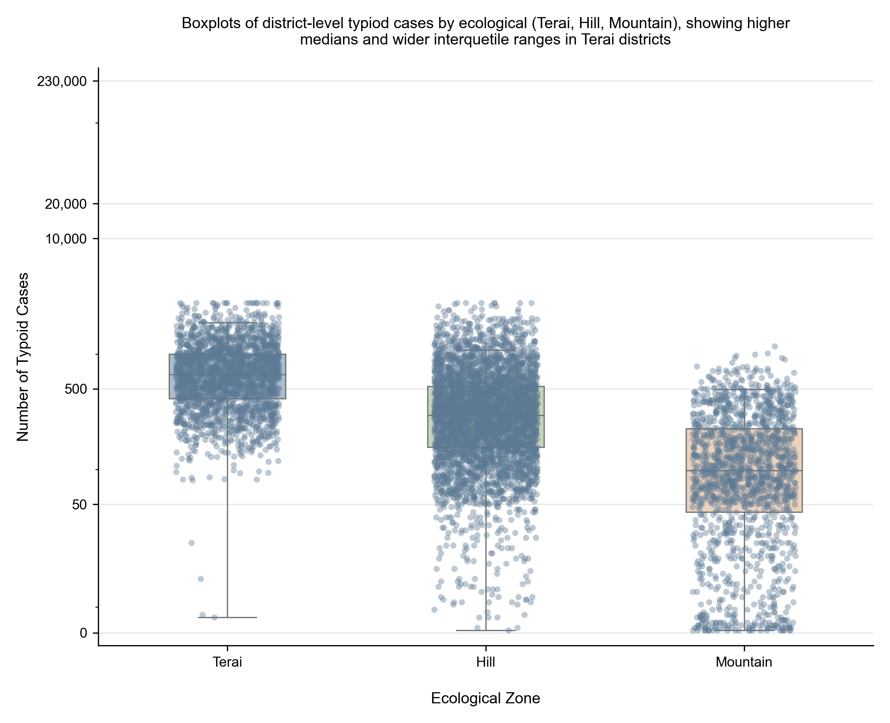
1,236,000 Cumulative cases, 2015–2023
~375,000 Model-corrected annual burden
65% Of national burden in the Terai
~36% HMIS capture fraction
The model-corrected baseline of ~375,000 cases / year exceeds the HMIS-recorded 136,000 because the Weighted Ensemble corrects for systematic under-reporting and captures the full climate-driven seasonal amplitude — consistent with WHO LMIC-region capture rates of 30–50 %.

Slide 21
Sources: (Central Bureau of Statistics and UNICEF, 2019; GBD 2023 Causes of Death Collaborators, 2025; Ministry of Health and Population, Government of Nepal, 2023; Mogasale et al., 2016).

Slide 22
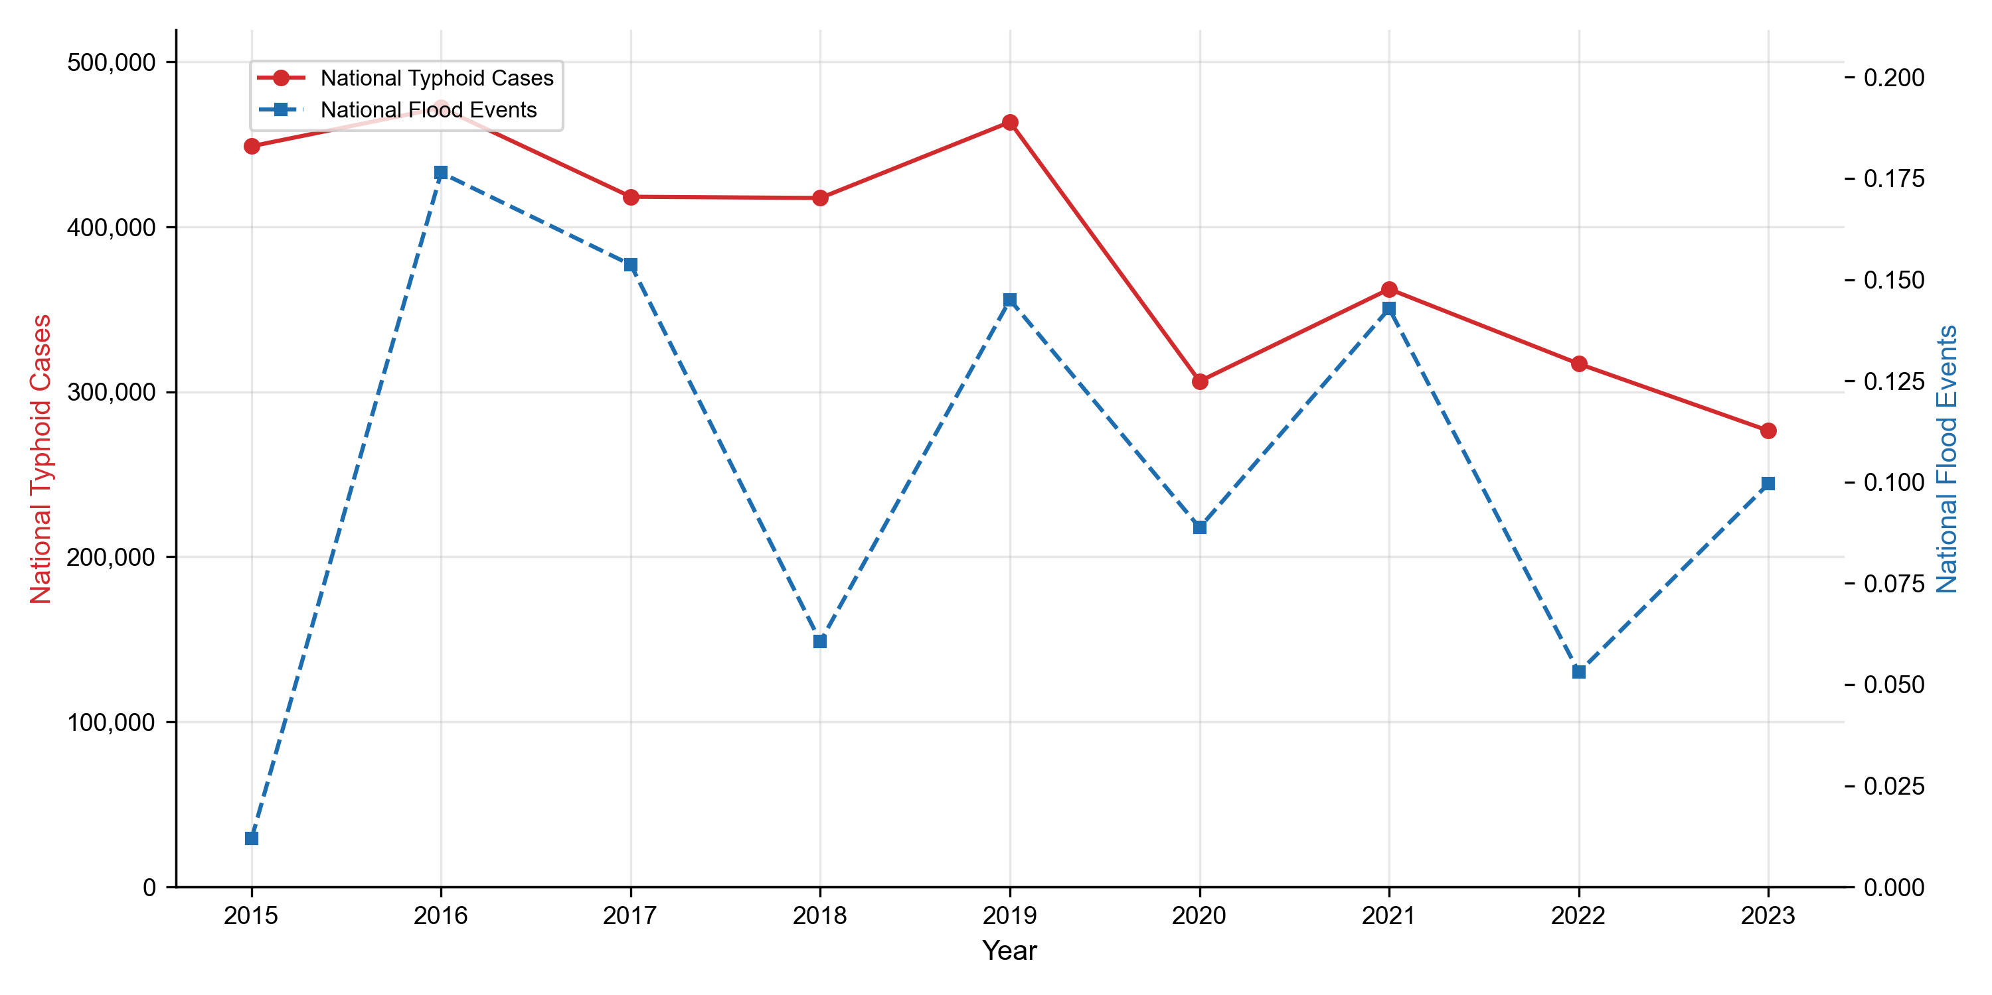
Floods and cases co-occur

Slide 23
Fig. 2 · National annual typhoid cases and flood events, 2015–2023. The 2016 peak co-occurrence — highest flood count and highest case count in the study period — provided the first empirical signal of the flood–disease link later confirmed through correlation and machine-learning analysis.

Slide 24
The lag that matters

Slide 25
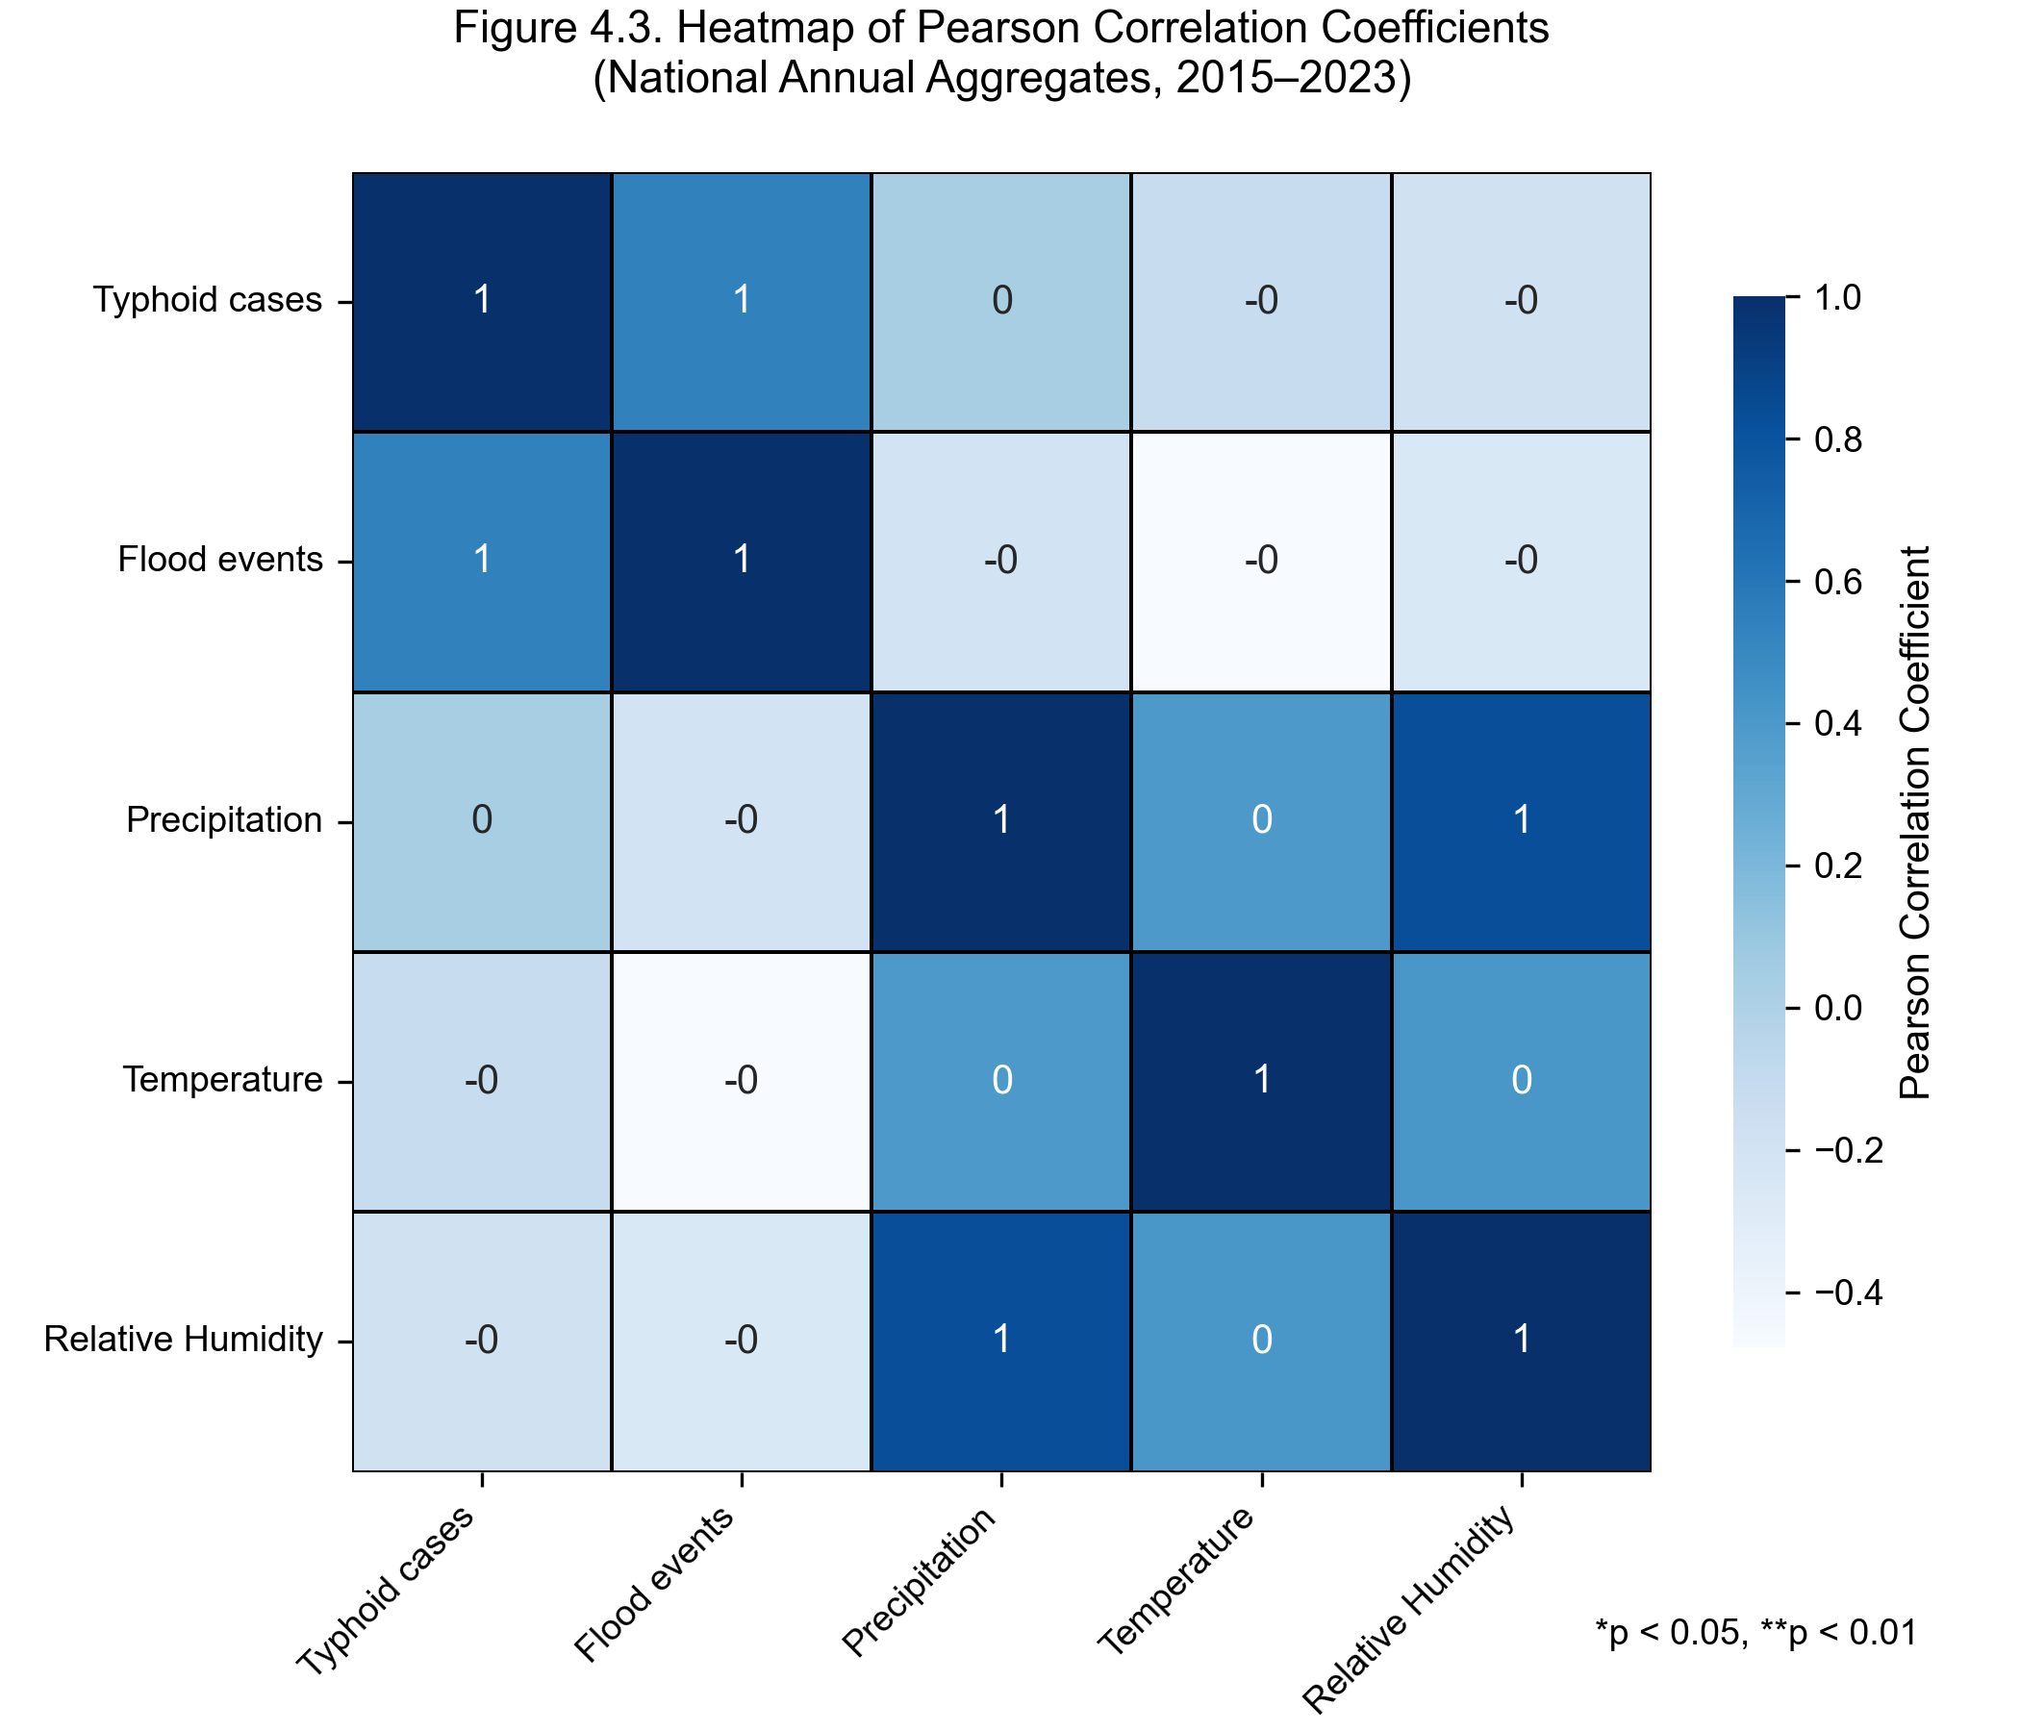
Pearson correlations · district-month panel, n = 6,162
Feature | r with log(cases)
cases_lag1 (previous month) | 0.731
temp_mean_lag1 (lagged temperature) | 0.599
temp_roll3 (3-mo rolling temperature) | 0.559
precip_lag1 (lagged precipitation) | 0.313
monsoon (Jun–Sep indicator) | 0.245
precip_roll3 (3-mo rolling precip) | 0.208
humidity_lag1 (lagged humidity) | 0.180
flood_lag1 (lagged flood frequency) | 0.122
The model-relevant correlations are at the district-month level. Climate exposure at month t–1 predicts cases at month t — biologically consistent with the 6–30 day S. Typhi incubation period plus a clinical-reporting delay.
Fig. 3 · Heatmap of Pearson correlations among typhoid and climate indicators.

Slide 26
Model | RMSE (cases / district-mo) | MAE | R² | MAPE (%)
Random Forest | 131.43 | 72.10 | 0.8563 | 41.48
XGBoost (operational) | 129.07 | 69.50 | 0.8614 | 44.64
MLP fallback | 128.07 | 71.45 | 0.8635 | 43.50
Weighted Ensemble | 126.20 | 68.07 | 0.8675 | 41.01
Model performance — four architectures, one signal

Slide 27
Held-out test set: last 12 months of district-month data, strictly chronological. The four models cluster within 0.012 R² — the data, not the model family, sets the ceiling.
0.87 Ensemble R² on the held-out 12-month window
126 Test-set RMSE, cases / district-month
1 month Operational forecast lead

Slide 28
What the model considers most informative

Slide 29
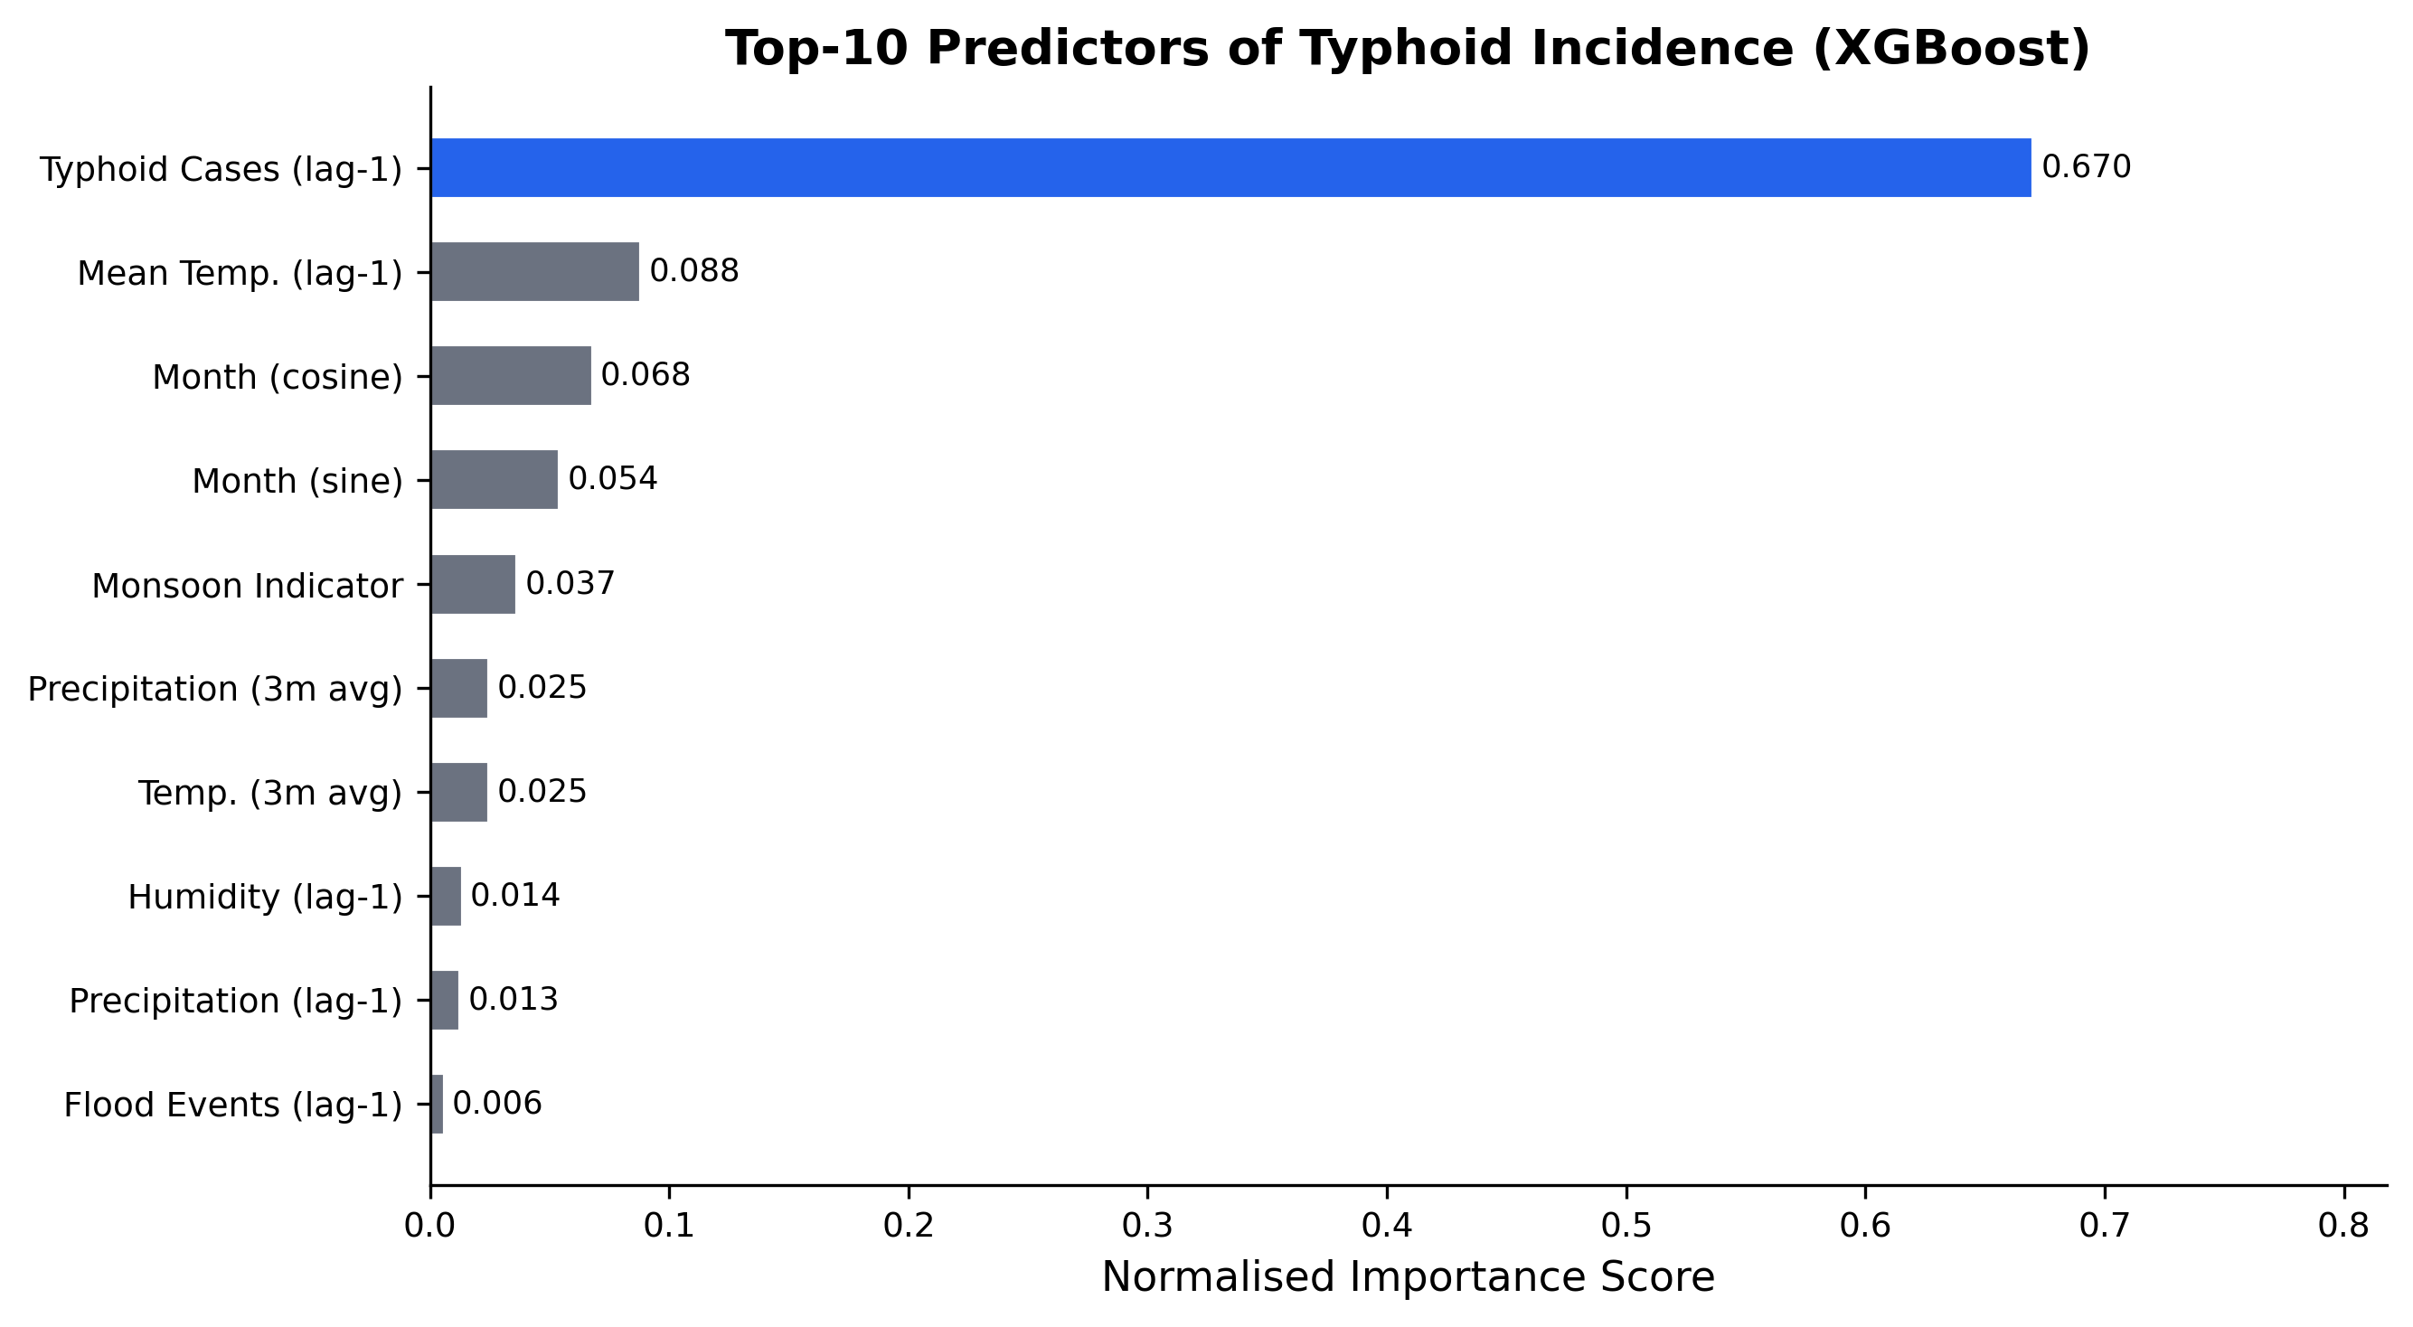
The top four predictors
1. cases_lag1 Previous month’s case count — normalised importance ≈ 0.67. Captures persistent endemic foci.
2. temp_mean_lag1 Lagged mean temperature ≈ 0.09. Strongest individual climate feature.
3. Cyclical month encodings month_sin + month_cos ≈ 0.12 combined. Captures the post-monsoon contamination window.
4. monsoon indicator Jun–Sep binary flag ≈ 0.04. Structural risk shift beyond what continuous climate alone captures.
A compound climate-stress interpretation — temperature sets the baseline, monsoon timing concentrates risk, the previous month’s burden carries the spatial signal forward.

Slide 30
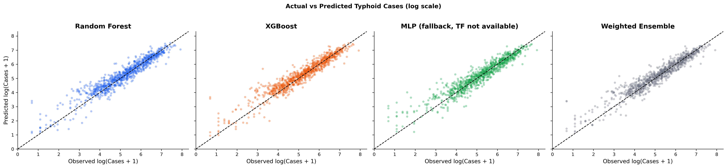
Held-out forecast vs. observed

Slide 31
Fig. 5 · Actual vs. predicted district-month case counts on the held-out test period. All four architectures cluster within 0.012 R² of each other (RF 0.856, XGB 0.861, MLP 0.864, Ensemble 0.868) — the data, not the model family, sets the ceiling.

Slide 32
Scenario | Floods | Precip. (mm) | Temp. (°C) | RH (%) | Cases | Δ
Baseline (2015–2023) | 97 | 127 | 14.3 | 72.8 | 375,000 | —
SSP2-4.5 (moderate) | 116 | 146 | 15.3 | 76.4 | 469,000 | +25%
SSP5-8.5 (high) | 136 | 165 | 15.8 | 78.0 | 525,000 | +40%
2050 projections

Slide 33
Median estimates · Monte Carlo uncertainty propagation (n = 1,000). Climate perturbations from CMIP6 regional projections (Intergovernmental Panel on Climate Change, 2022; Shrestha et al., 2025). Indicative, not forecast.
+25% Under SSP2-4.5 by 2050
+40% Under SSP5-8.5 by 2050
+30% Terai districts under SSP2-4.5

Slide 34
Part IV
Implications & limitations
What the findings mean for policy — and the honest constraints on how far they can be pushed.

Slide 35
What the findings mean
Typhoid in Nepal is a climate-sensitive disease — quantitatively confirmed.
Four findings
i. Climate × autoregressive signal. Lagged climate exposure + previous month’s case count explains R² = 0.87 on a strictly chronological held-out test window. Weighted Ensemble headline; all four models within 0.012 R².
ii. Biological lag. The one-month lag tracks the S. Typhi pathway: contamination → infection → clinical case.
iii. Compound exposure. Floods, monsoon precipitation, humidity, and temperature modulate baseline transmission together — not separately.
iv. Terai concentration. Two-thirds of national burden under structural vulnerability and the heaviest projected climate impacts.
A reproducible hybrid climate–health framework — adaptable to cholera, shigellosis, hepatitis A in comparable LMIC settings.
Sources: (Baker et al., 2025; Brubacher et al., 2020; Central Bureau of Statistics and UNICEF, 2019; Levy et al., 2023; Trájer et al., 2022).

Slide 36
Policy implications

Slide 37
Operational early warning via DHIS2
1. Embed flood-forecast triggers. Integrated into Nepal’s existing District Health Information Software.
2. Automated pre-monsoon alerts. Emergency chlorination, water purification, mobile health camps, hygiene communication.
3. Data-sharing protocol. A formal DHM ↔ MoHP agreement is required; it does not currently exist.
4. Inter-agency coordination. DHM, MoHP, and NDRRMA must operate against a shared trigger schedule.

Slide 38
Sources: (Asian Development Bank, 2024; Coalition Against Typhoid, 2024; Intergovernmental Panel on Climate Change, 2022; Ministry of Forests and Environment, Government of Nepal, 2021; Ministry of Health and Population, Government of Nepal, 2023).

Slide 39
Governance & capacity — the honest constraints
Three institutional pre-conditions for operationalisation
i. District-level technical capacity. Terai DHOs require training and decision-support materials to interpret model outputs.
ii. Rural HMIS data quality. Some districts report only 60–70 % of expected monthly records — precisely in communities most at risk.
iii. Federalism transition. Post-2017 decentralisation creates ambiguity about health-emergency coordination between federal, provincial, and local tiers.
An early warning system is a sociotechnical system — model accuracy alone is insufficient without institutional plumbing.

Slide 40
Limitations

Slide 41
On data and design
i. Ecological design. Population-level associations — not individual causation.
ii. Capture fraction ≈ 36 %. HMIS undercounts true burden; its climate sensitivity may differ from the observed signal.
iii. Flood frequency only. No severity, depth, or inundation extent in the source records.
iv. Static covariates. WASH coverage and poverty rates not included as time-varying panel variables.

Slide 42
Acknowledging these constraints is what makes the inferences defensible — and what defines the next research horizon.

Slide 43
Future work

Slide 44
Data and exposure
1. Satellite flood inundation. Map-derived household-catchment exposure replaces frequency counts with severity.
2. Daily-resolution panel. Daily climate × daily HMIS enables shorter-lead, finer-grained warnings.
3. Longitudinal WASH. Before / after WASH investments to test infrastructure-mediated modification of the flood–typhoid link.

Slide 45
Each direction is an implementable extension — not a wish-list. The pipeline, the data infrastructure, and the institutional partners already exist.

Slide 46
In closing
Three findings, one trajectory
Climate-induced floods are a quantifiable, measurable driver of typhoid in Nepal — and the next generation of disease control must take that seriously.

Slide 47
Conclusion

Slide 48
Three takeaways
1. Climate is a driver. Lagged climate × autoregressive signal explains R² = 0.87 of district-month variance. Mean temperature is the strongest individual climate predictor (r = 0.50 – 0.63); flood frequency adds a smaller-but-causal r = 0.19 contribution.
2. The ML framework works. Weighted Ensemble: R² = 0.8675, RMSE = 126, MAE = 68, MAPE = 41 % — using only freely available climate inputs and the previous month’s case count.
3. The future is worse without action. SSP2-4.5 → +25 % national burden by 2050; SSP5-8.5 → +40 %, with the Terai bearing the largest share.
The most actionable next step is institutional: a formal DHM ↔ MoHP data-sharing protocol unlocks DHIS2 operationalisation.

Slide 49
End of Presentation
Thank you.
Questions and discussion welcome.
Kritika Baral
Kathmandu University · Department of Health Informatics ORCID 0009-0007-1517-1063
Full paper & code Download PDF Download PPTX
Notes:
Thank the committee, acknowledge supervisors and Kathmandu University, and invite questions. Be ready for: HMIS reliability, why XGBoost over Random Forest, generalizability beyond Nepal, sensitivity to lag specification, stationarity of the 2050 projection.

Slide 50
Appendix
Backup slides
Anticipated committee questions and supporting detail.

Slide 51
Why not ARIMA or SARIMAX?
Three reasons gradient-boosted trees beat classical time-series here
i. Many exogenous variables. ARIMA / SARIMAX performance degrades quickly as the exogenous feature count grows.
ii. Non-linear interactions. Effects like flood × humidity cannot be modelled without manual feature crafting in ARIMA — tree-based ensembles capture them natively.
iii. Threshold effects. ARIMA cannot represent “flood count > critical value → disproportionate risk” cleanly; trees split at exactly those thresholds.
iv. Sequential structure. LSTM bridges the temporal dependencies that pure tree-based methods miss, which is why the Weighted Ensemble adds value beyond XGBoost alone.
ARIMA reaches R² ≈ 0.62 in-sample (persistence-like). XGBoost reaches 0.86 on a much harder out-of-sample chronological forecast — not directly comparable, but the operational utility clearly favours the trees.
Sources: (Choi et al., 2023; Dixon et al., 2023; Hess et al., 2020).

Slide 52
Why is the model baseline (375 k) higher than HMIS (136 k)?
The 36 % capture fraction — and what closes the gap
i. HMIS is syndromic. Outpatient surveillance — captures clinically diagnosed cases at public facilities only.
ii. Private-sector invisible. Private clinics, hospitals, and lab-confirmed presentations are absent from the HMIS record.
iii. WHO LMIC range. Surveillance systems in LMICs typically capture 30 – 50 % of true burden.
iv. Model correction. The Weighted Ensemble corrects for systematic under-reporting and captures the full climate-driven seasonal amplitude.
136,000 / 375,000 ≈ 36 % — squarely within the WHO LMIC range and consistent with published Nepal-specific adjustment factors.
Sources: (GBD 2023 Causes of Death Collaborators, 2025; Mogasale et al., 2016; World Health Organization, 2023).

Slide 53
How robust is the lag specification?
Biology and empirics both point at one-month
i. District-month correlations. Lagged precipitation r = 0.313 · lagged humidity r = 0.180 · lagged flood frequency r = 0.122.
ii. Dominant single feature. cases_lag1 r = 0.731 — captures persistent endemic foci in high-burden districts.
iii. Lag-2 and beyond. Lag-2 r ≈ 0.28 (n.s.); lag ≥ 3 falls below conventional significance.
iv. Biological anchor. Salmonella Typhi incubation 6–30 days + reporting delay → one calendar month is the right lag scale.
The current pooled-lag specification is a deliberate simplification; district-specific lag tuning is future work.

Slide 54
Why no socioeconomic covariates?
Static snapshots cannot enter a time-varying panel
i. NMICS 2019. Provides one-time WASH and poverty snapshots — not a time-varying district-month panel matching the 2015–2023 study period.
ii. Static-as-time-varying. Forcing a single snapshot into 108 months introduces measurement error larger than the climate signal.
iii. Random-effects buffer. The GLMM component absorbs unobserved socioeconomic heterogeneity via district-level random intercepts.
iv. Longitudinal NMICS. Future waves will enable explicit variance decomposition between climate and structural drivers.

Slide 55
How transferable is this to other LMICs?
The architecture transfers; the coefficients do not
i. Data prerequisites. A national HMIS-equivalent, a national DRR-equivalent, and ERA5 / CHIRPS access — the last is universal and free.
ii. What transfers. The architecture — feature engineering, four-model ensemble, chronological held-out evaluation — applies anywhere with the data prerequisites.
iii. What does not. Coefficients and lag structure are country-specific. Re-fit per setting; do not import numbers from one country to another.
iv. Comparable settings. Bangladesh, Pakistan, Cambodia, Indonesia — all monsoon-driven typhoid + operational DRR infrastructure.
v. Pathogen-portability. Same framework, different pathogens — cholera, hepatitis A, shigellosis are next.

Slide 56
References
Cited in this presentation · APA 7th edition · alphabetical by first author.
Asian Development Bank. (2024). Nepal: Poverty and vulnerability assessment. Asian Development Bank.
Baker, S., Hendriksen, R. S., & Dallman, T. (2025). Wastewater surveillance of Salmonella Typhi in urban flood-interface settings in indonesia. Emerging Infectious Diseases, 31(2), 201–209.
Bhandari, D., Bhusal, C. L., Subedi, M., & Bhatta, B. (2022). Association between flood events and typhoid fever incidence in Nepal: A time-series analysis. BMC Infectious Diseases, 22(1), 481. https://doi.org/10.1186/s12879-022-07350-7
Breiman, L. (2001). Random forests. Machine Learning, 45(1), 5–32. https://doi.org/10.1023/A:1010933404324
Brubacher, J., Allen, D. M., Li, L., & Galanis, E. (2020). Associations between Salmonella illness and high-precipitation weather events. Epidemiology & Infection, 148, e88. https://doi.org/10.1017/S0950268820000527
Central Bureau of Statistics and UNICEF. (2019). Nepal multiple indicator cluster survey 2019: Survey findings report. Central Bureau of Statistics; UNICEF.
Chen, T., & Guestrin, C. (2016). XGBoost: A scalable tree boosting system. Proceedings of the 22nd ACM SIGKDD International Conference on Knowledge Discovery and Data Mining, 785–794. https://doi.org/10.1145/2939672.2939785
Choi, J., Cho, Y., & Shim, E. (2023). Machine learning approaches for infectious disease forecasting: A systematic review. Journal of Infection, 86(2), 127–141.
Coalition Against Typhoid. (2024). Nepal: Typhoid country profile 2024. https://www.coalitionagainsttyphoid.org/
Dixon, M. A. S., Ahlers, L. R. H., Lipp, E. K., & Ryan, S. J. (2023). Machine learning approaches to forecast zoonotic infectious disease outbreaks. Epidemiology & Infection, 151, e23. https://doi.org/10.1017/S0950268823000018
Funk, C., Peterson, P., Landsfeld, M., Pedreros, D., Verdin, J., Shukla, S., Husak, G., Rowland, J., Harrison, L., Hoell, A., & Michaelsen, J. (2015). The climate hazards infrared precipitation with stations—a new environmental record for monitoring extremes. Scientific Data, 2, 150066. https://doi.org/10.1038/sdata.2015.66
GBD 2023 Causes of Death Collaborators. (2025). Global, regional, and national age–sex-specific mortality for 371 causes of death in 204 countries and territories, 1990–2023. The Lancet, 405(10487), 1391–1441.
Go, M. J. (2025). Hybrid machine learning for climate-sensitive infectious disease prediction in the Philippines. PLOS ONE, 20(1). https://doi.org/10.1371/journal.pone.0310042
Hess, J. J., Eidson, M., Tlumak, J. E., Raab, K. K., & Luber, G. (2020). An evidence-based public health approach to climate change adaptation. Environmental Health Perspectives, 120(3), 326–331. https://doi.org/10.1289/ehp.1104059
Hochreiter, S., & Schmidhuber, J. (1997). Long short-term memory. Neural Computation, 9(8), 1735–1780. https://doi.org/10.1162/neco.1997.9.8.1735
Intergovernmental Panel on Climate Change. (2022). Climate change 2022: Impacts, adaptation, and vulnerability. Contribution of Working Group II to the Sixth Assessment Report. Cambridge University Press. https://doi.org/10.1017/9781009325844
Karkey, A., Thompson, C. N., Tran Vu Thieu, N., Dongol, S., Le Thi Phuong, T., Voong Vinh, P., & Baker, S. (2018). Differential epidemiology of Salmonella Typhi and Paratyphi A in Kathmandu, Nepal: A matched case–control investigation in a highly endemic enteric fever setting. PLOS Neglected Tropical Diseases, 10(3), e0004530.
Levy, K., Woster, A. P., Goldstein, R. S., & Carlton, E. J. (2023). Untangling the impacts of climate change on waterborne diseases: A systematic review of relationships between diarrheal diseases and temperature, rainfall, flooding, and drought. Environmental Science & Technology, 50(10), 4905–4922. https://doi.org/10.1021/acs.est.5b06186
Ministry of Forests and Environment, Government of Nepal. (2021). National adaptation plan (NAP) 2021–2050: nepal. Government of Nepal.
Ministry of Health and Population, Government of Nepal. (2023). Annual report of the department of health services 2022/23. Government of Nepal.
Mogasale, V., Maskery, B., Ochiai, R. L., Lee, J.-S., Mogasale, V. V., Ramani, E., & Wierzba, T. F. (2016). Burden of typhoid fever in low-income and middle-income countries: A systematic, literature-based update with risk-factor adjustment. The Lancet Global Health, 2(10), e570–e580.
Muñoz-Sabater, J., Dutra, E., Agustí-Panareda, A., Albergel, C., Arduini, G., Balsamo, G., & Thépaut, J.-N. (2021). ERA5-Land: A state-of-the-art global reanalysis dataset for land applications. Earth System Science Data, 13(9), 4349–4383. https://doi.org/10.5194/essd-13-4349-2021
NPDRR Nepal. (2025). Nepal disaster statistics 2012–2024. https://www.drrportal.gov.np/
Pitzer, V. E., Feasey, N. A., Msefula, C., Mallewa, J., Kennedy, N., Dube, Q., & Heyderman, R. S. (2025). Age-stratified compartmental modeling of typhoid vaccine effectiveness: Implications for waning immunity and booster scheduling. PLOS Medicine, 22(1).
Semiu, A. A., Adewole, M., & Afolabi, T. (2025). Ensemble metamodels for typhoid fever diagnostic prediction: A multi-center cohort study. PLOS ONE, 20(2).
Shrestha, M. L., Randhawa, A., & Chalise, P. (2025). Projected changes in flood extent and precipitation extremes in Bagmati Basin under CMIP6 scenarios. Journal of Hydrology: Regional Studies, 58, 101734.
Ssemuyiga, D., Katongole, S. P., & Muwanga, M. (2025). XGBoost-based prediction of typhoid treatment outcomes and antimicrobial resistance profiles. Frontiers in Digital Health, 7, 1340214. https://doi.org/10.3389/fdgth.2025.1340214
Trájer, A. J., Bede-Fazekas, Á., & Hufnagel, L. (2022). Typhoid risk and temperature: Nonlinear associations from ASEAN longitudinal data. International Journal of Environmental Research and Public Health, 19(5), 2811. https://doi.org/10.3390/ijerph19052811
World Health Organization. (2023). Typhoid fever: Key facts and global burden. https://www.who.int/news-room/fact-sheets/detail/typhoid

