Slide 1

Predicting Carbon Emission Levels of Neural Network Architectures
Baran Deniz Korkmaz, Baris Tura, Niklas Kemper
Supervisor: Bertrand Charpentier
21.07.2022

Slide 2
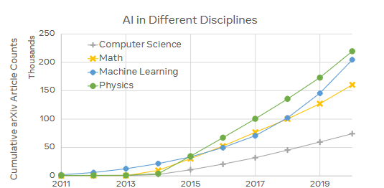
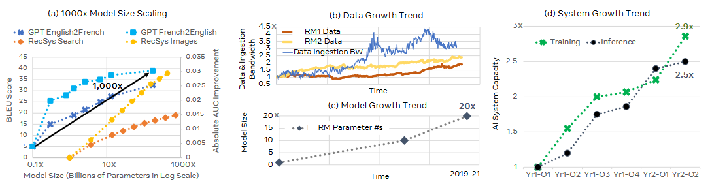
Why care about carbon footprint?
ML research and development has increased significantly in volume.
65 times more publications in 7 years (on arXiv)
Models, data, and embodiment systems grow as well.

Slide 3
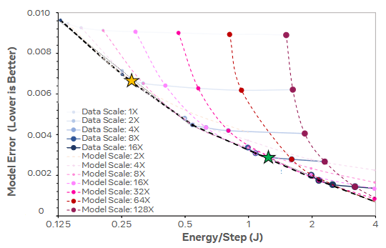
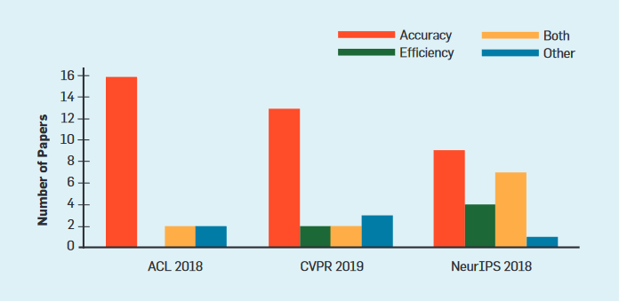
Why care about carbon footprint?
Common metrics include accuracy, efficiency, etc.
These metrics obfuscate the ecological effect.
Four times energy saving can be achieved with only 0.004 model quality degradation.

Slide 4



Why care about carbon footprint?
Model | Training Carbon Emission (Million kg)
RM - 1 | 0.41
GPT- 3 | 0.552
BERT - NAS | 0.62
$$4.6×$$
$$3.4×$$
$$3150×$$
Product | Carbon Emission (Million kg)
NY-SF Round trip | 0.18
Car (lifetime) | 0.12
Refrigerator (yearly) | 0.00013

Slide 5
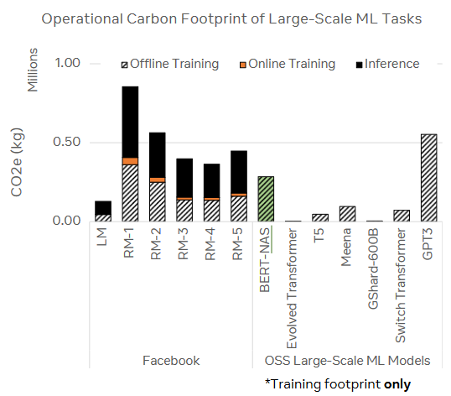
Why care about carbon footprint?
Running 1000 models with similar size to that of RM – 1 for a year: 30 million kg CO2
5% of greenhouse gas effect created by agriculture industry
Agricultural GHG constitutes 11% of total greenhouse effect

Slide 6
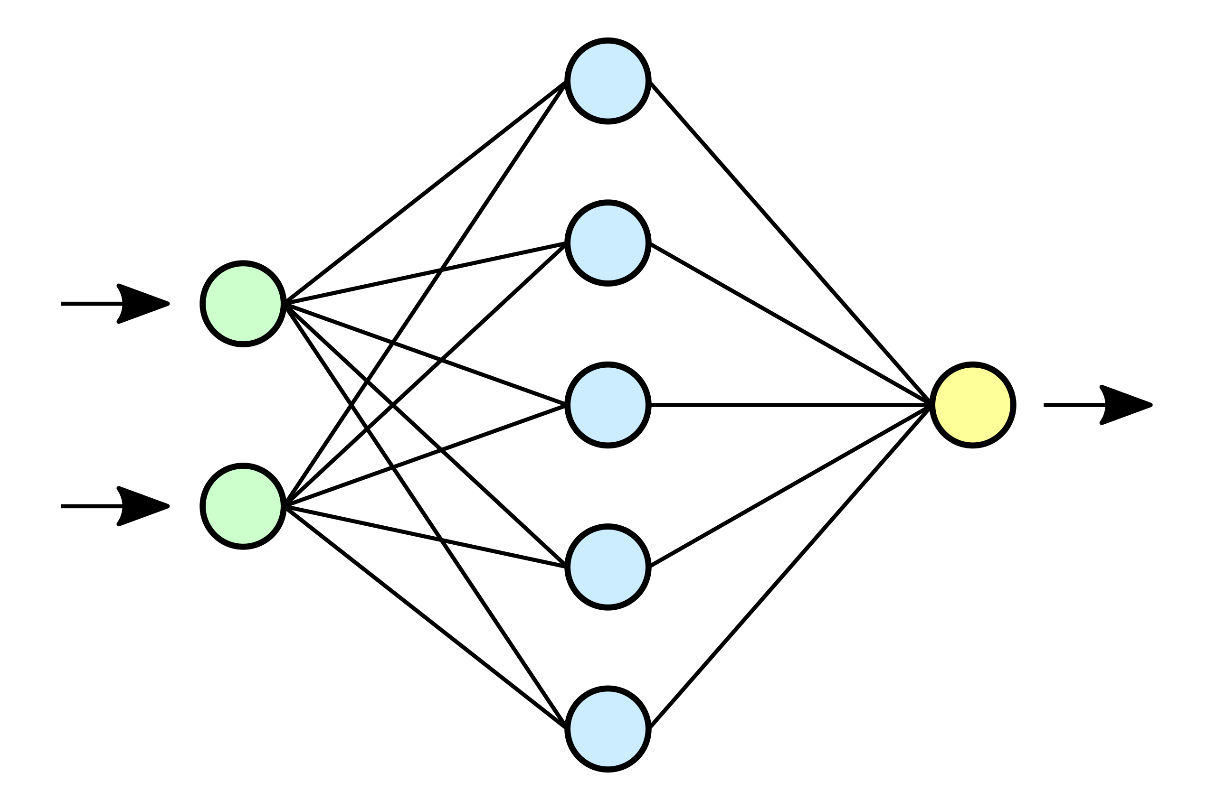


Problem Definition
Given a neural architecture, assess the power consumption levels. Directly correlated with carbon emission
Intel RAPL / Nvidia-smi
Predictor / Regressor
$$Power [kW]$$
$$Energy [kWh]$$

Slide 7
Problem Definition
Given a neural architecture, assess the power consumption levels. Directly correlated with carbon emission
Focus: Inference
Predict the power consumption of the architecture before running
Intel RAPL / Nvidia-smi
Predictor / Regressor
$$Energy [kWh]$$
$$Power [kW]$$

Slide 8



Setup
Measurement tool: Codecarbon
Framework: TensorFlow
Data sources: Pretrained models (Keras Applications)

Slide 9
Challenges
No dataset
Configuration space of Deep NNs is quite large
Abstraction layer of TensorFlow:
Models are created on a high-level interface; operations are implemented on a lower and hidden level (CUDA, cuDNN)
Hidden factors within the framework such as garbage collection

Slide 10
Dataset Generation
Layer-wise
Model-wise

Slide 11
Dataset Generation
Layer-wise
Model-wise
Model | Layer | Batch Size | Input Size | Energy Consumption
DenseNet121 | Conv2D | 16 | 300
 | Pooling | 16 | 300
 | Dense | 16 | 300
 | ⋮ | ⋮ | ⋮ | ⋮
VGG16 | Conv2D | 32 | 400
 | Conv2D | 32 | 400
 | Pooling | 32 | 400
 | ⋮ | ⋮ | ⋮ | ⋮

Slide 12
Dataset Generation
Layer-wise
Model-wise
Model | Layer | Batch Size | Input Size | Energy Consumption
DenseNet121 | Conv2D | 16 | 300
 | Pooling | 16 | 300
 | Dense | 16 | 300
 | ⋮ | ⋮ | ⋮ | ⋮
VGG16 | Conv2D | 32 | 400
 | Conv2D | 32 | 400
 | Pooling | 32 | 400
 | ⋮ | ⋮ | ⋮ | ⋮
$$x^{conv}=\left[input_shape, output_shape, filters, kernel_size, stride\right] , y=[layer_energy]$$

Slide 13
Dataset Generation
Layer-wise
Model-wise
Model | Layer | Batch Size | Input Size | Energy Consumption
DenseNet121 | Conv2D | 16 | 300
 | Pooling | 16 | 300
 | Dense | 16 | 300
 | ⋮ | ⋮ | ⋮ | ⋮
VGG16 | Conv2D | 32 | 400
 | Conv2D | 32 | 400
 | Pooling | 32 | 400
 | ⋮ | ⋮ | ⋮ | ⋮
$$x^{pool}=\left[input_shape, output_shape, filters, pool_size, stride\right], y=[layer_energy]$$

Slide 14
Dataset Generation
Layer-wise
Model-wise
Model | Layer | Batch Size | Input Size | Energy Consumption
DenseNet121 | Conv2D | 16 | 300
 | Pooling | 16 | 300
 | Dense | 16 | 300
 | ⋮ | ⋮ | ⋮ | ⋮
VGG16 | Conv2D | 32 | 400
 | Conv2D | 32 | 400
 | Pooling | 32 | 400
 | ⋮ | ⋮ | ⋮ | ⋮
$$x^{dense}=\left[input_shape, output_shape, hidden_size\right] , y=[layer_energy]$$

Slide 15

Dataset Generation
Layer-wise
Model-wise
Model | Batch Size | Input Size | Energy
DenseNet121 | 16 | 500
VGG16 | 32 | 300
⋮ | ⋮ | ⋮ | ⋮
$$x_{model}∈ ℝ^{num_layers×8}$$
$$x_{model,layer}=[op_type, input_shape, output_shape,batch_size]$$
$$y=[model_energy]$$

Slide 16
Dataset Generation
Number of Models in the Dataset Splits
Split | # of Models
Training (incl. Validation) | 159
Test | 37
Total | 196

Slide 17
Data Analysis and Insights
Number of Occurences for Each Layer Type

Slide 18
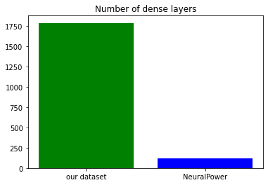
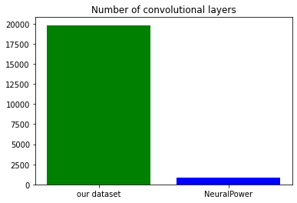
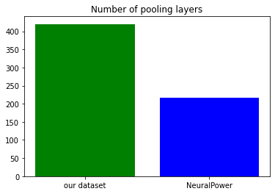
Data Analysis and Insights
Comparison of dataset size with NeuralPower (Cai et. Al)
NeuralPower (Cai et al, 2017): 116 Fully-Connected, 858 Convolutional, and 216 Pooling Layers.
Cai, Ermao, et al. "NeuralPower : Predict and Deploy Energy-Efficient Convolutional Neural Networks", ACML 2017, 2017.

Slide 19
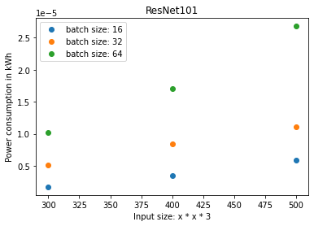
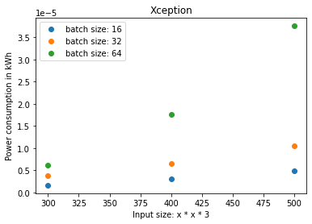
Data Analysis and Insights
Linear correlation between input size and power consumption when considering one specific model

Slide 20
Proposed Methods
Layer-Wise
Polynomial Regression
Baseline
Inspired by NeuralPower
Did we manage to obtain similar results?
Prediction
Sum
Ensemble Learning-Based Methods
What did we expect?
Did we achieve our goal?
Methods:
CatBoost
XGBoost
Random Forest
Predictor
Convolutional
Predictor
Dense
Predictor
Pooling
Deep Learning-Based Methods
Which techniques did we use? Why?
Why did they fail?

Slide 21
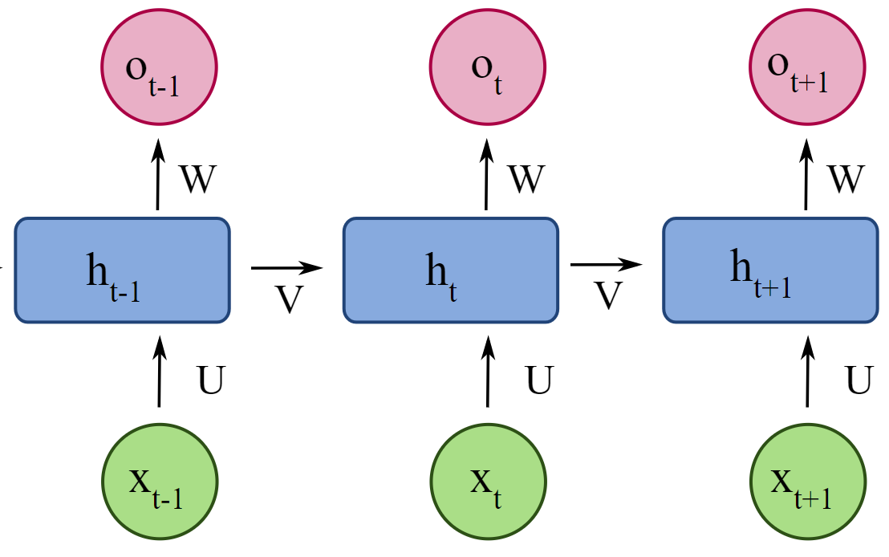
Proposed Methods
Model-wise
Prediction
MLP

Slide 22
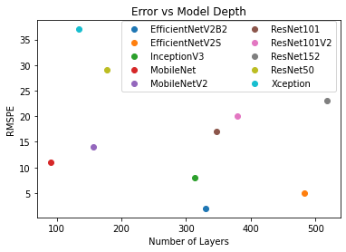
Evaluation: Model-Wise Approaches
Overall Test Error [RMSPE]
41%
Linear dependency vs model depth, but only within an architecture family.
Low-level plays a large role (compute graph optimization etc.)

Slide 23
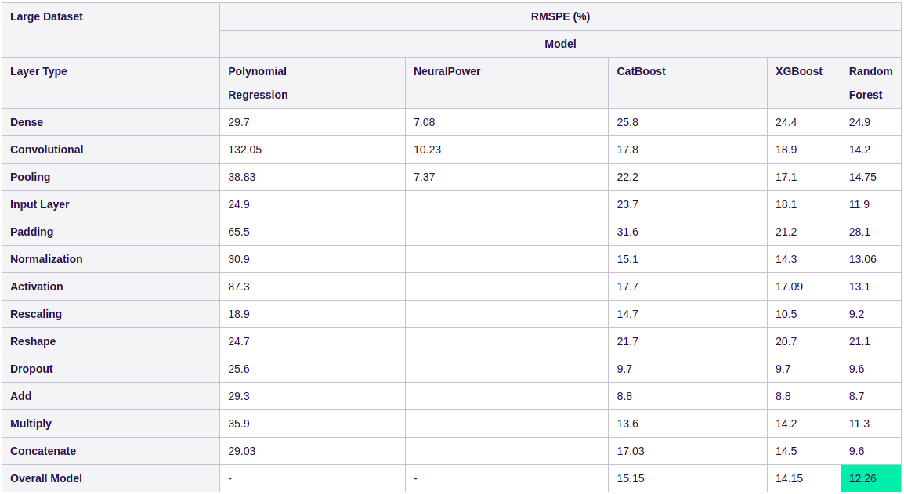
Evaluation: Layer-Wise Approaches
Cai, Ermao, et al. "NeuralPower : Predict and Deploy Energy-Efficient Convolutional Neural Networks", ACML 2017, 2017.

Slide 24
Evaluation: Layer-Wise Approaches
Caption: Evaluation of Layer-Wise Approaches on the Prediction of Overall Power Consumption
Caption: Evaluation of Random Forest on Predicting the Layer-wise Power Consumption

Slide 25
Conclusion
Layer-wise approaches outperform model-wise approaches.
Best Model: Random Forest
RMSPE: 12.26%
Fast training – Eco-friendly!
Good generalization
Captures different scales of consumption levels
Robust against the increase in the size of the dataset
Possible Future Directions
Working on the compute graph
Operation-wise Approaches
Isolation of GPU

Slide 26
Q&A

