Slide 1

Notes:
CineEmbed — Intermediate Report Presentation SENG 474, Spring 2026, TED University Authors: Baran Dinçoğuz, Arda Arvas, Kaan Kaya Render to PDF: marp PRESENTATION.md --pdf --allow-local-files Render to PPTX: marp PRESENTATION.md --pptx --allow-local-files Render to HTML: marp PRESENTATION.md --html --allow-local-files

Slide 2
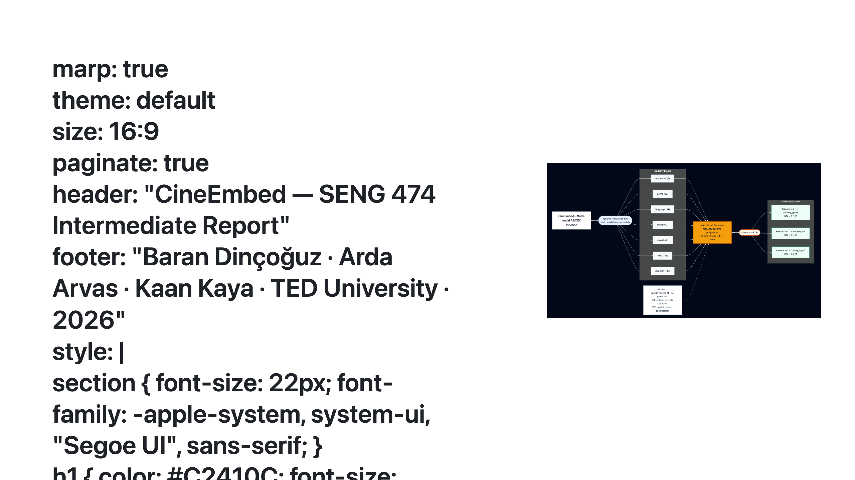
Notes:
Speaker notes: - 90-second hook: heterogeneous movie metadata (TMDB + awards + Wikipedia bios) → 329K films, 564-dim feature matrix. - Goal: learn 64-dim representations that recover three orthogonal label axes (genre, decade, language) without labels. - Headline result: deep pipeline beats KMeans-on-raw by +205% on genre_NMI. All three pre-registered hypotheses pass. - This is the modeling MVP closing the intermediate report; full study (VAE, k-sweep, ablations) reserved for the final report.

Slide 3
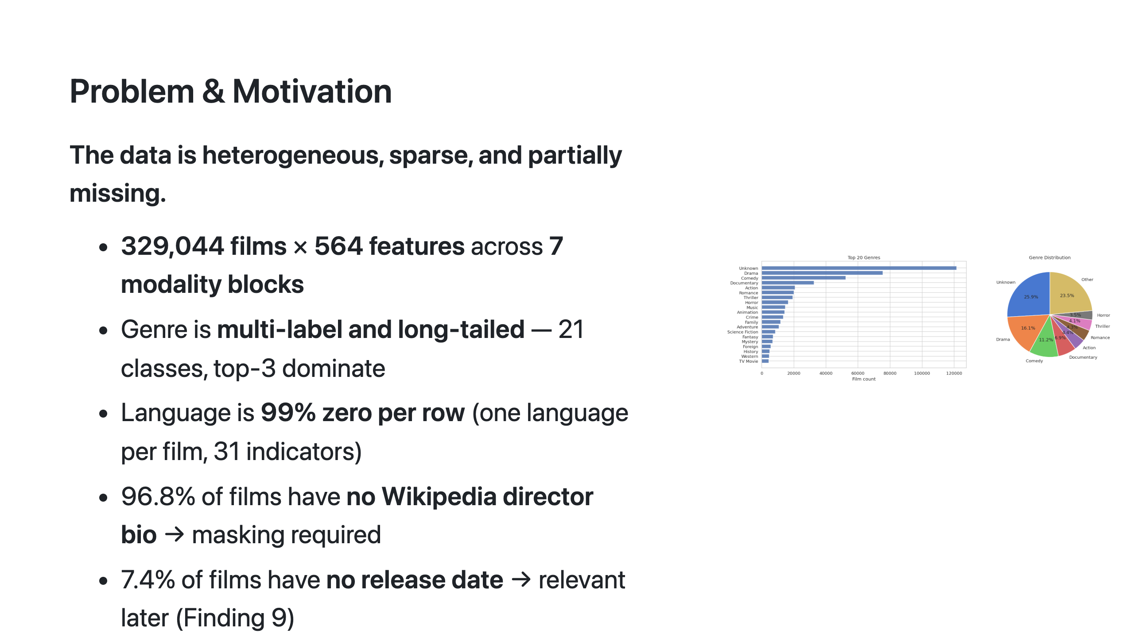
Notes:
Speaker notes: - Heterogeneity is the central challenge. Numerical, one-hot, sentence embeddings, awards counts — all in one matrix. - Show genre distribution figure: "Drama and Comedy dominate; documentary subgenres are the long tail." - The hard question: can deep representation learning produce a 64-dim space where Euclidean distance is meaningful across modalities? That's what we measure.

Slide 4
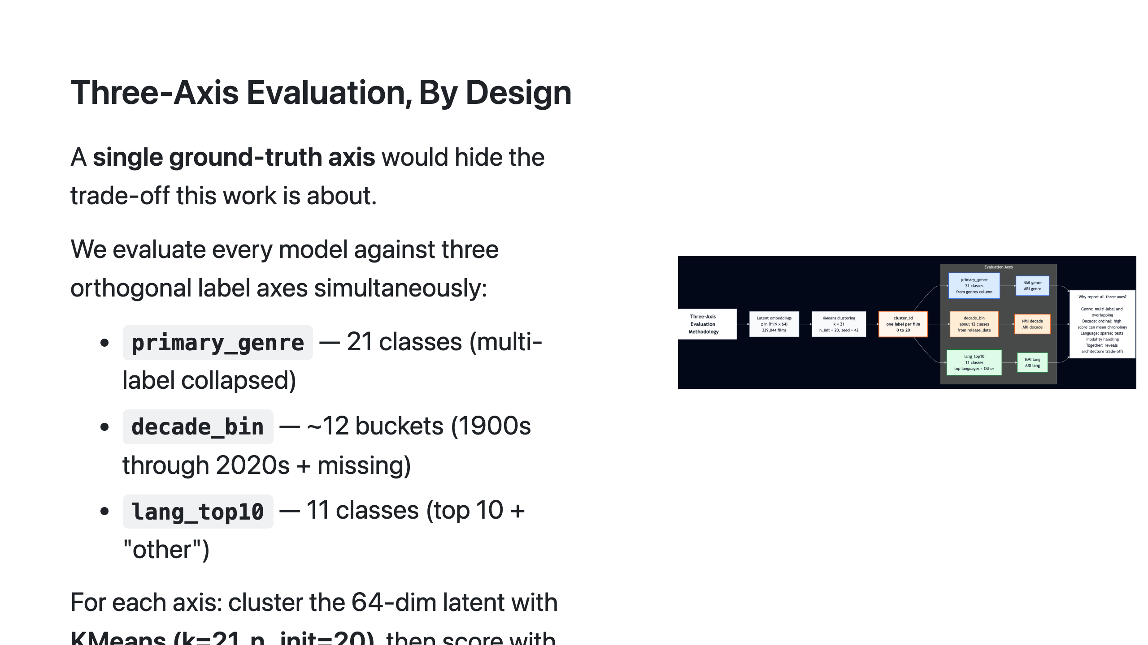
Notes:
Speaker notes: - Justify the three-axis decision: a genre-only benchmark would have hidden our biggest architectural win (language) and our biggest regression (decade). - KMeans k=21 matches genre cardinality; we acknowledge in the report that NMI is partition-cardinality-aware so the comparison across axes is honest.

Slide 5
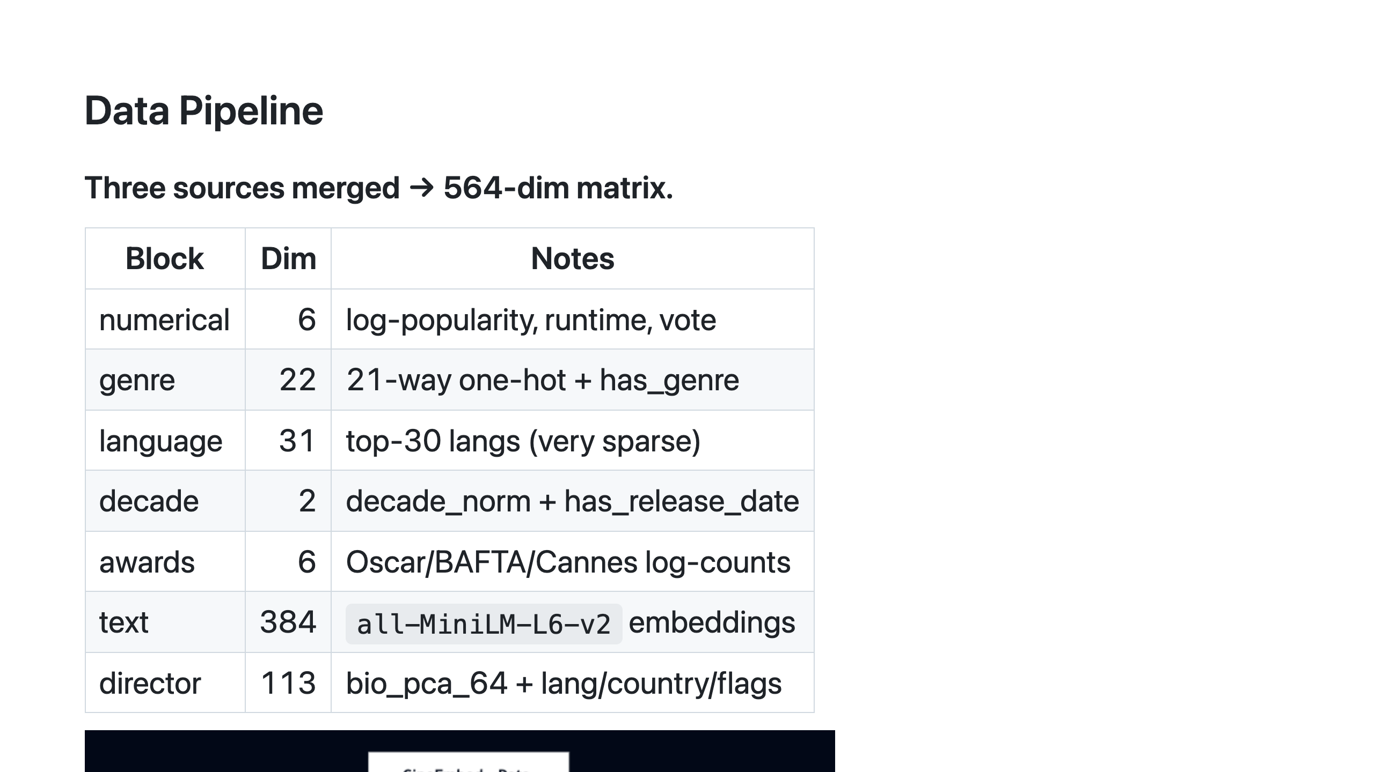
Notes:
Speaker notes: - Three input sources: TMDB, awards records, Wikipedia bios. - The text block is 68% of the input dimensionality but variance per dim is small — this is exactly why W2 inverse-variance weighting matters. - G2 masking: 96.8% of films have no bio, so we mask the bio_pca_64 reconstruction loss to avoid training the AE to predict zeros from zeros.

Slide 6
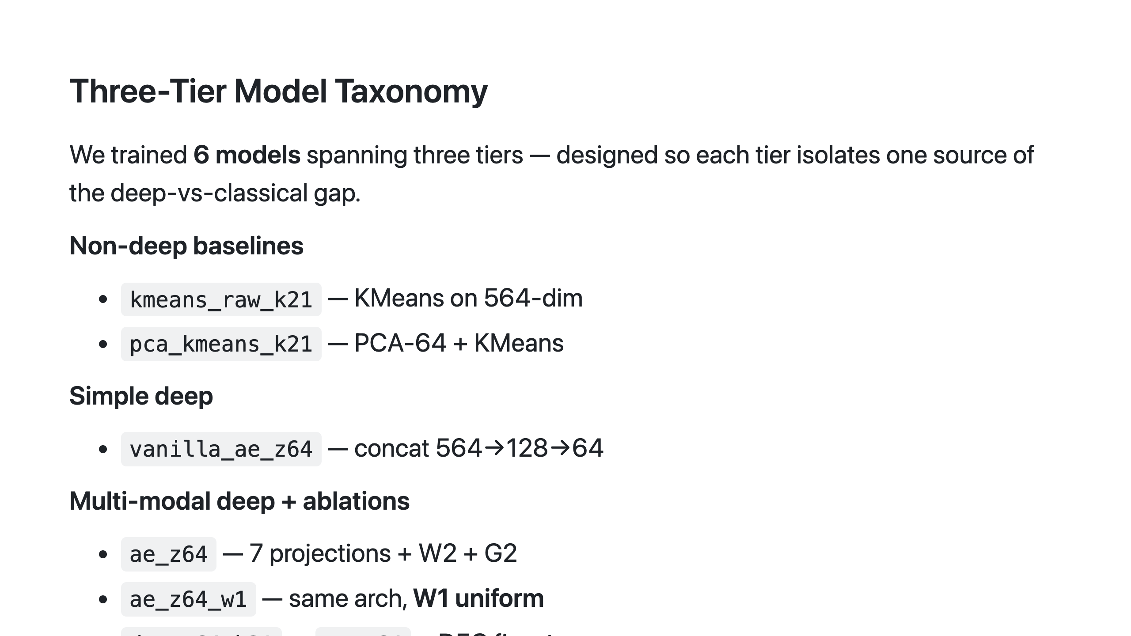
Notes:
Speaker notes: - Tier 1 vs Tier 2 isolates "deep vs not deep". Tier 2 vs Tier 3 isolates "modality projection vs not". Within Tier 3, W2 vs W1 isolates "inverse-variance weighting vs uniform". DEC vs AE isolates "explicit clustering vs not". - Six models, four ablations, every comparison clean.

Slide 7
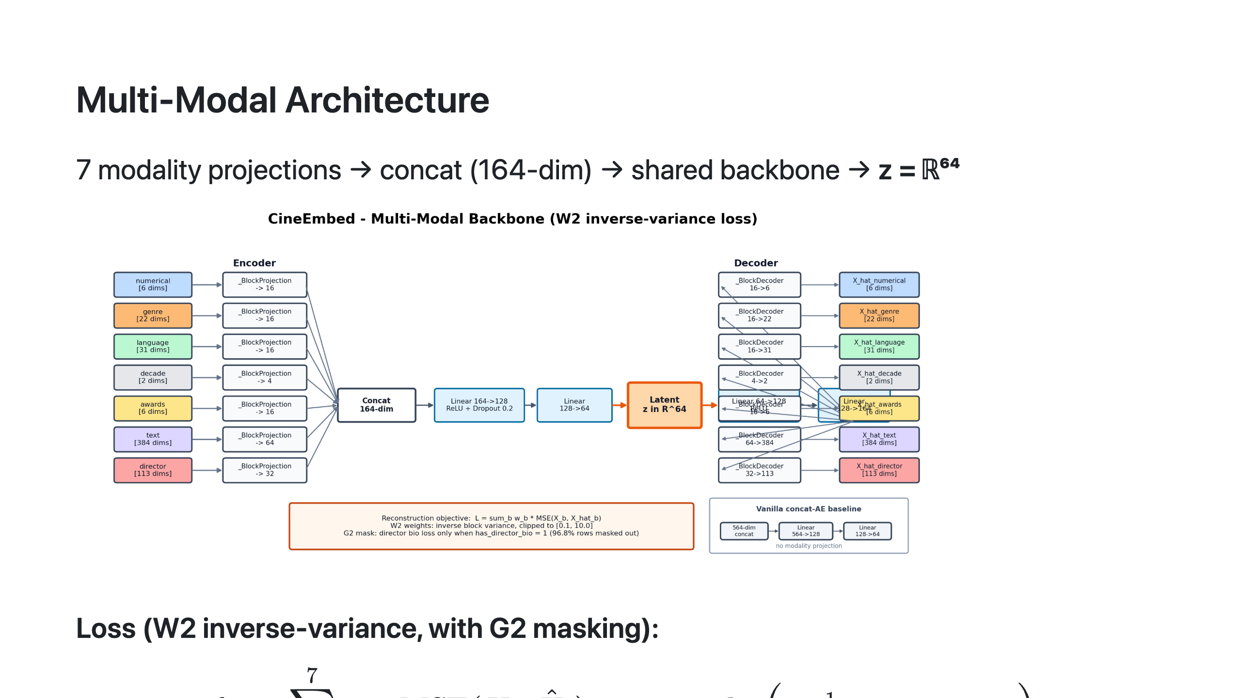
Notes:
Speaker notes: - Modality projection sizes: text→64 (largest), numerical/genre/language/awards→16, director→32, decade→4. Total 164 dim concat. - W2 weight clipping [0.1, 10.0] is a peer-review fix (D9) — prevents the language block from dominating early training before the encoder has learned anything. - DEC P target computed batch-wise (D10), 10× speedup over full-dataset, no quality regression.

Slide 8
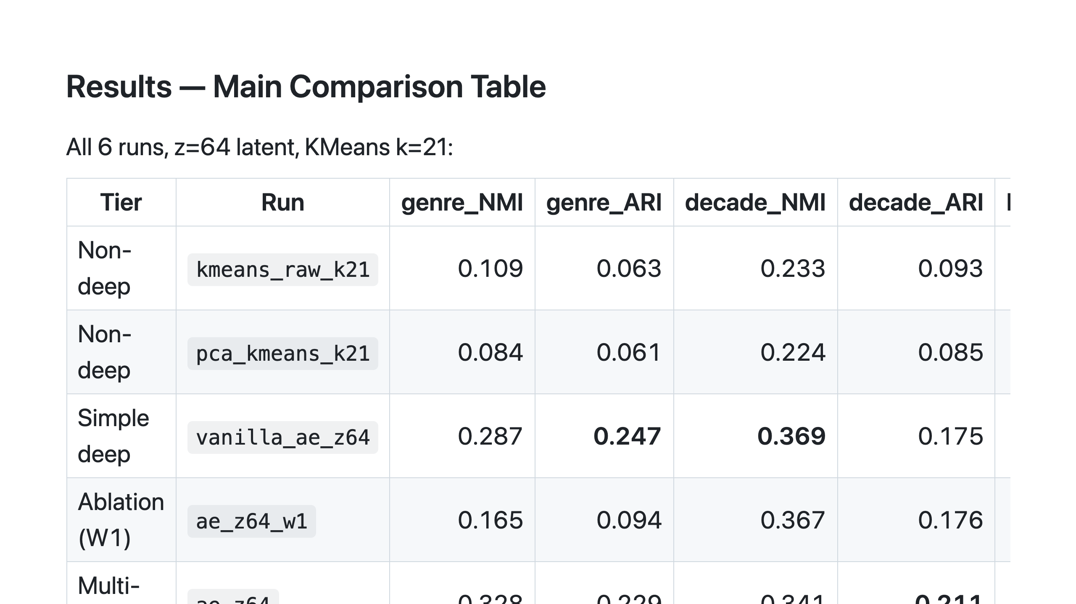
Notes:
Speaker notes: - Don't read the whole table — point at it. The audience reads numbers faster than you can speak them. - Key narration: "Notice that no single model wins all six metrics. Vanilla wins decade and genre_ARI; multi-modal wins decade_ARI; DEC wins three. That's the principled trade-off." - All three pre-registered hypotheses (H1, H2, H3) pass — covered on slide 12.

Slide 9
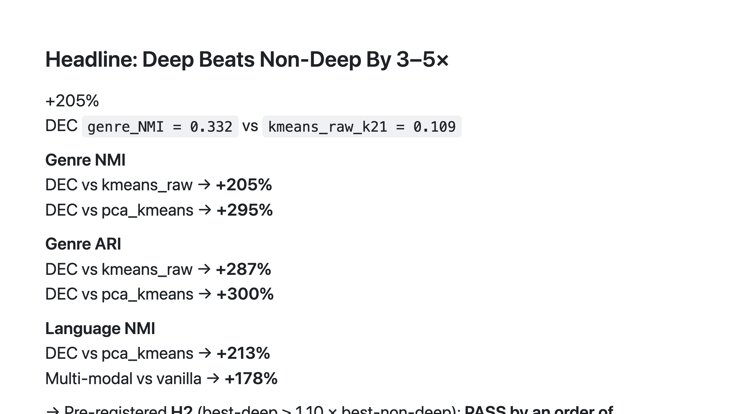
Notes:
Speaker notes: - This is the single number to memorize: +205% on genre_NMI. - Why so dramatic: KMeans on raw 564-dim treats "0.5 difference in log_popularity" and "0.5 difference in is_action" as equivalent distances. They aren't. Deep representation learning learns a space where Euclidean distance is meaningful across modalities. That's the gap classical methods cannot close. - H2's threshold was +10% relative — we're at +205%. Spec was conservative; the gap was bigger than predicted.

Slide 10
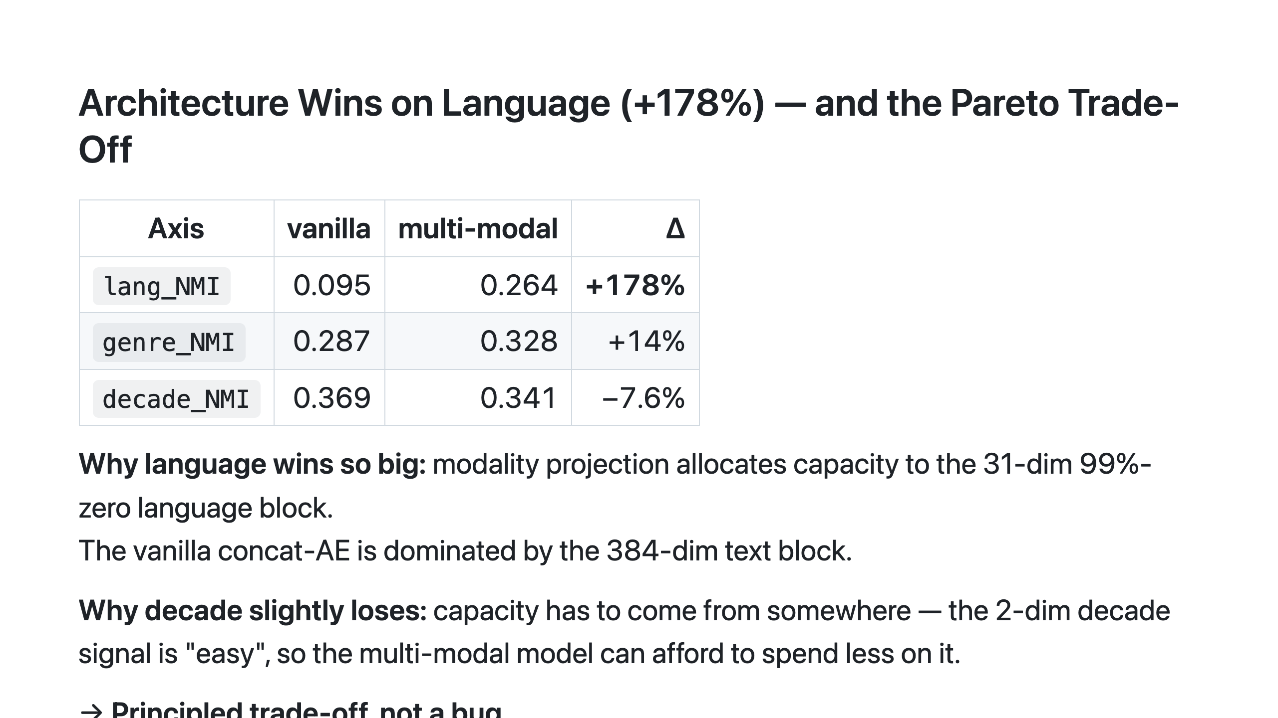
Notes:
Speaker notes: - The +178% language win is the architectural contribution proving its value. - The −7.6% decade regression is what you should flag honestly — a single-axis benchmark would either falsely report uniform improvement (if it picked language) or hide the language win (if it picked decade). - Implication for downstream: a recommender that cares about content+language similarity should use multi-modal latents. A recommender that only cares about era can do nearly as well with vanilla.

Slide 11
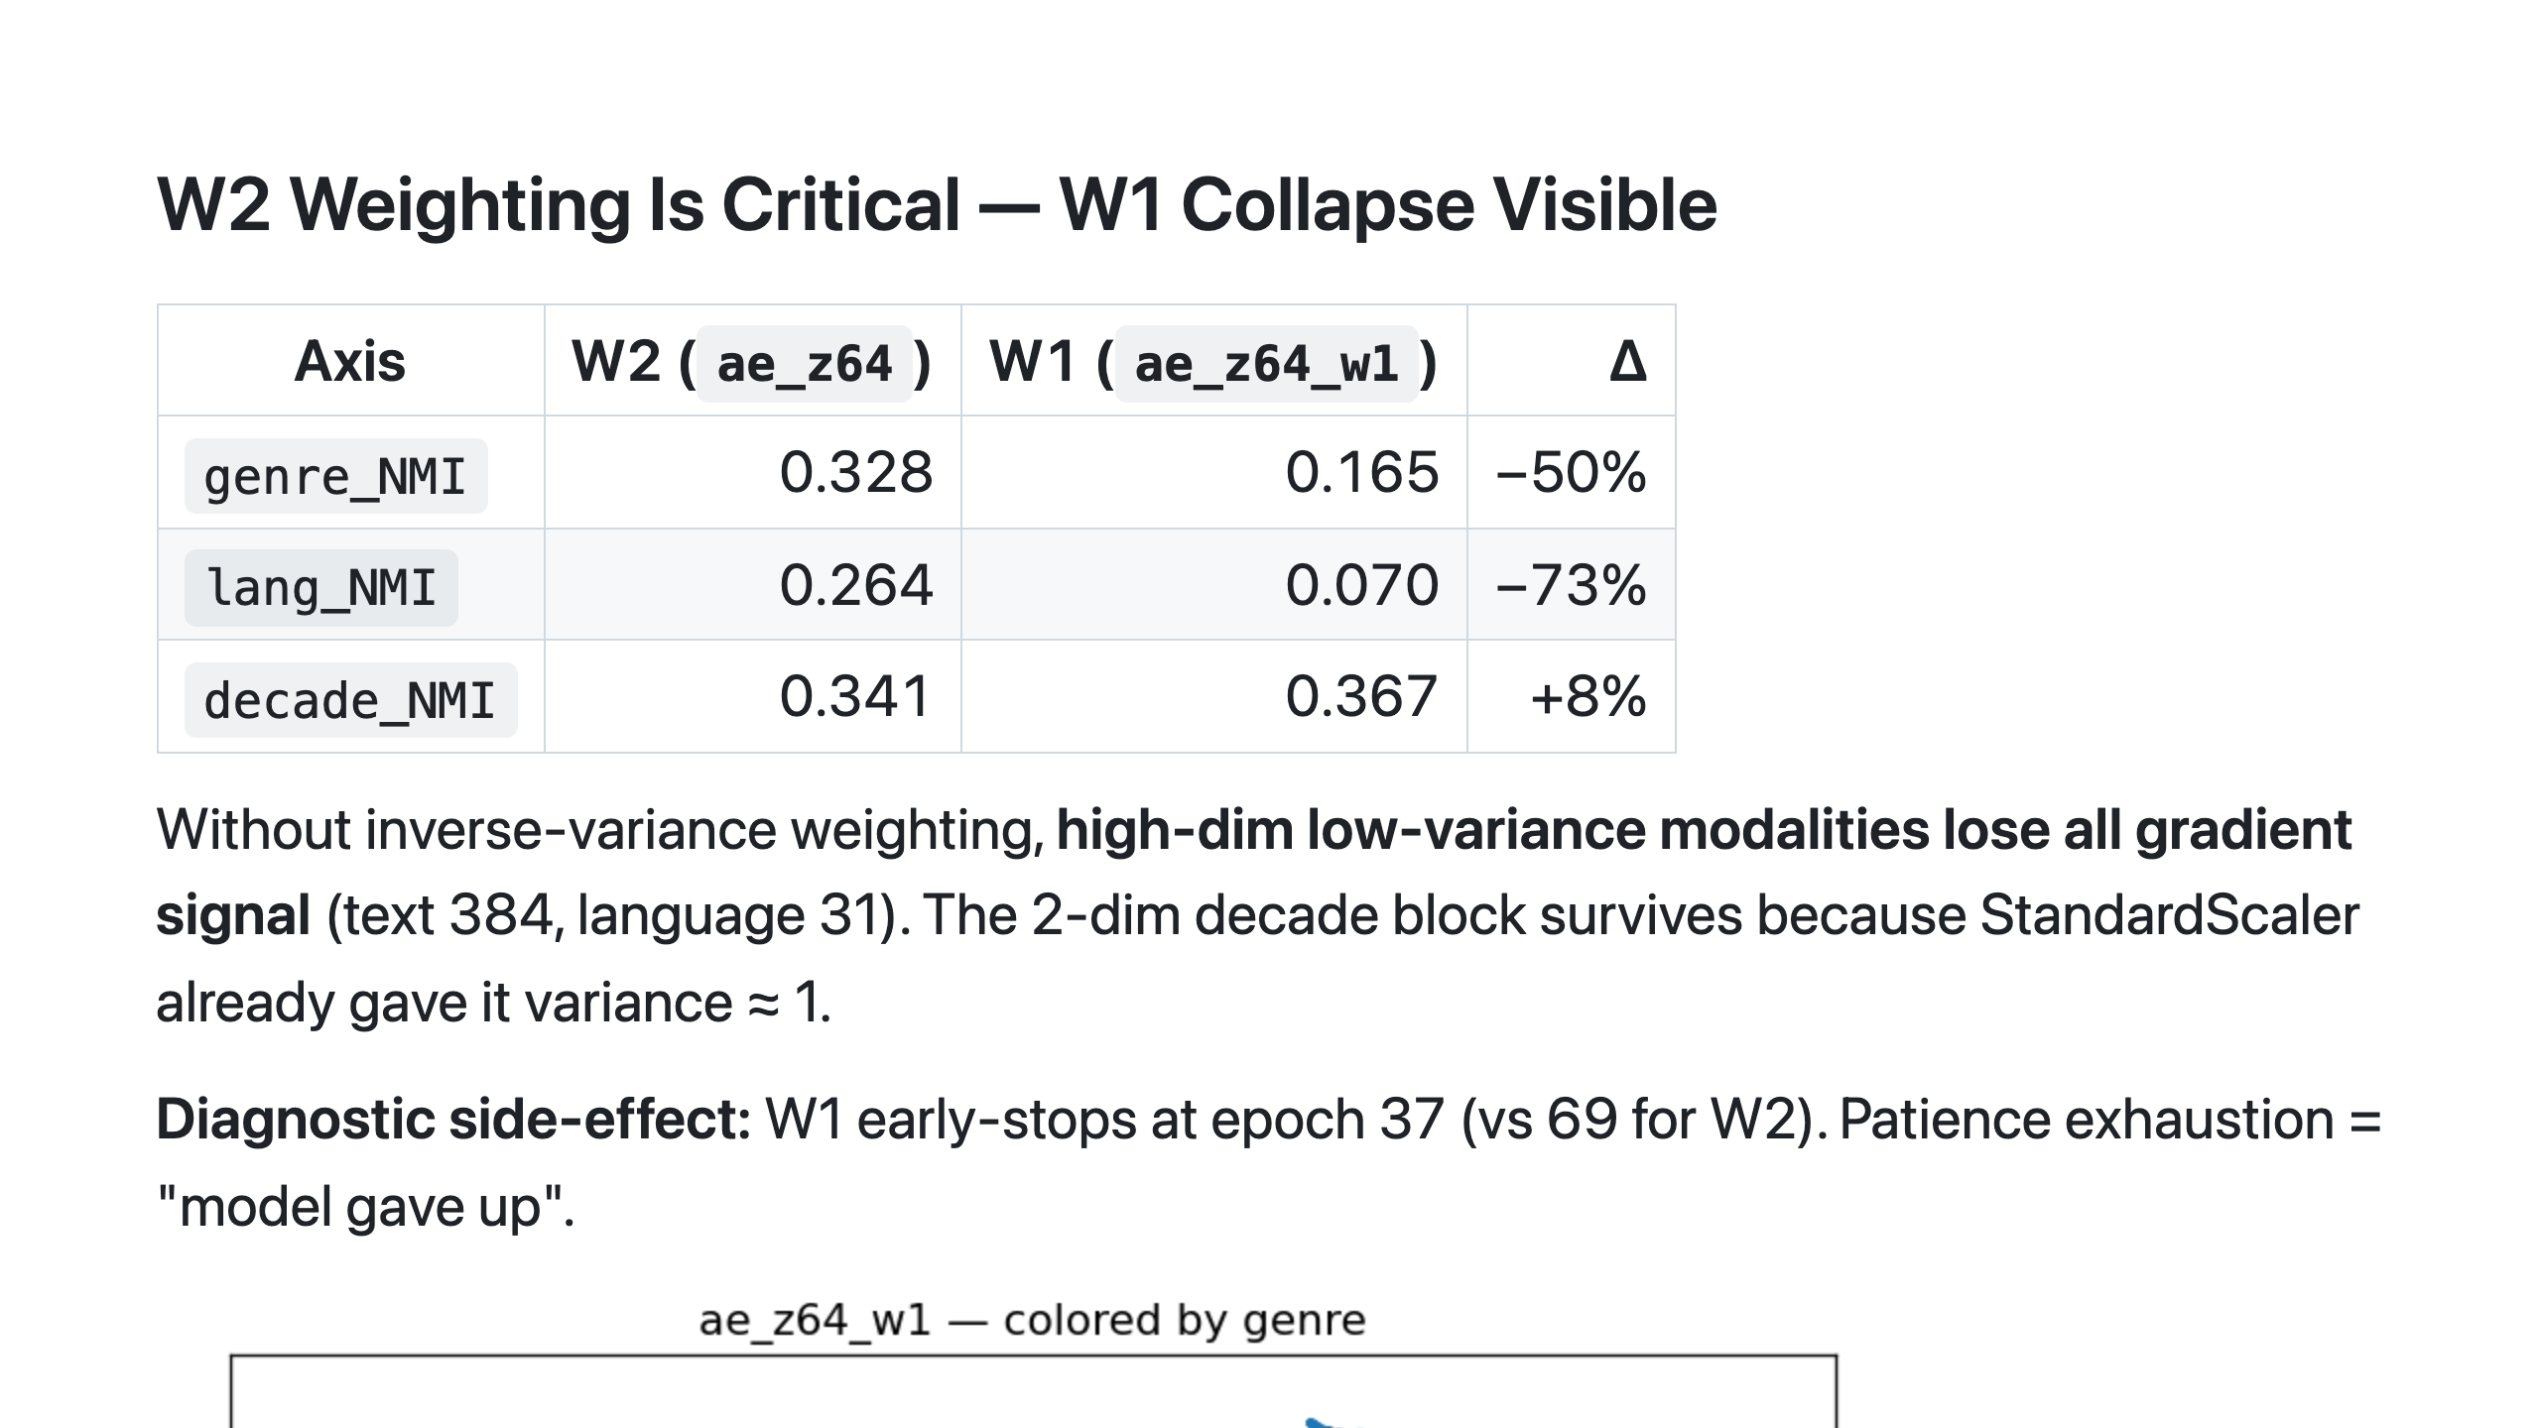
Notes:
Speaker notes: - W1 is *not* a foolish baseline — it's a controlled ablation. Same architecture, same training schedule. Only the loss weighting differs. - The fact that decade survives W1 collapse is itself diagnostic — it shows the failure mode is dimension-asymmetric, not a global broken-training event. - Patience exhaustion at epoch 37 is a model-health signal, not a hyperparameter incident.

Slide 12
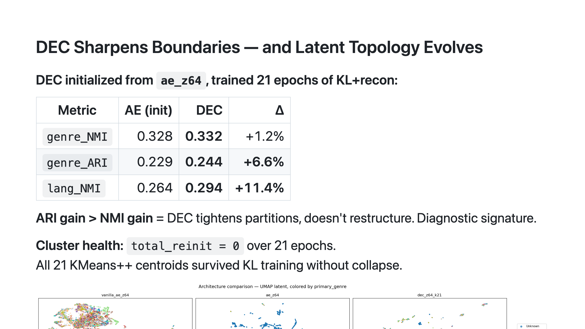
Notes:
Speaker notes: - DEC's contribution is *cluster compactness*, not new structural information. The KL self-training tightens what AE has already discovered; it doesn't generate new latent variables. - The diagnostic signature is "ARI gains more than NMI" — information content stays roughly fixed, but partition crispness improves. - This 3-panel comparison figure is, for our money, the single most informative figure in the entire study. Modality projection creates structural diversity (panel 2), KL pressure sharpens it (panel 3).

Slide 13
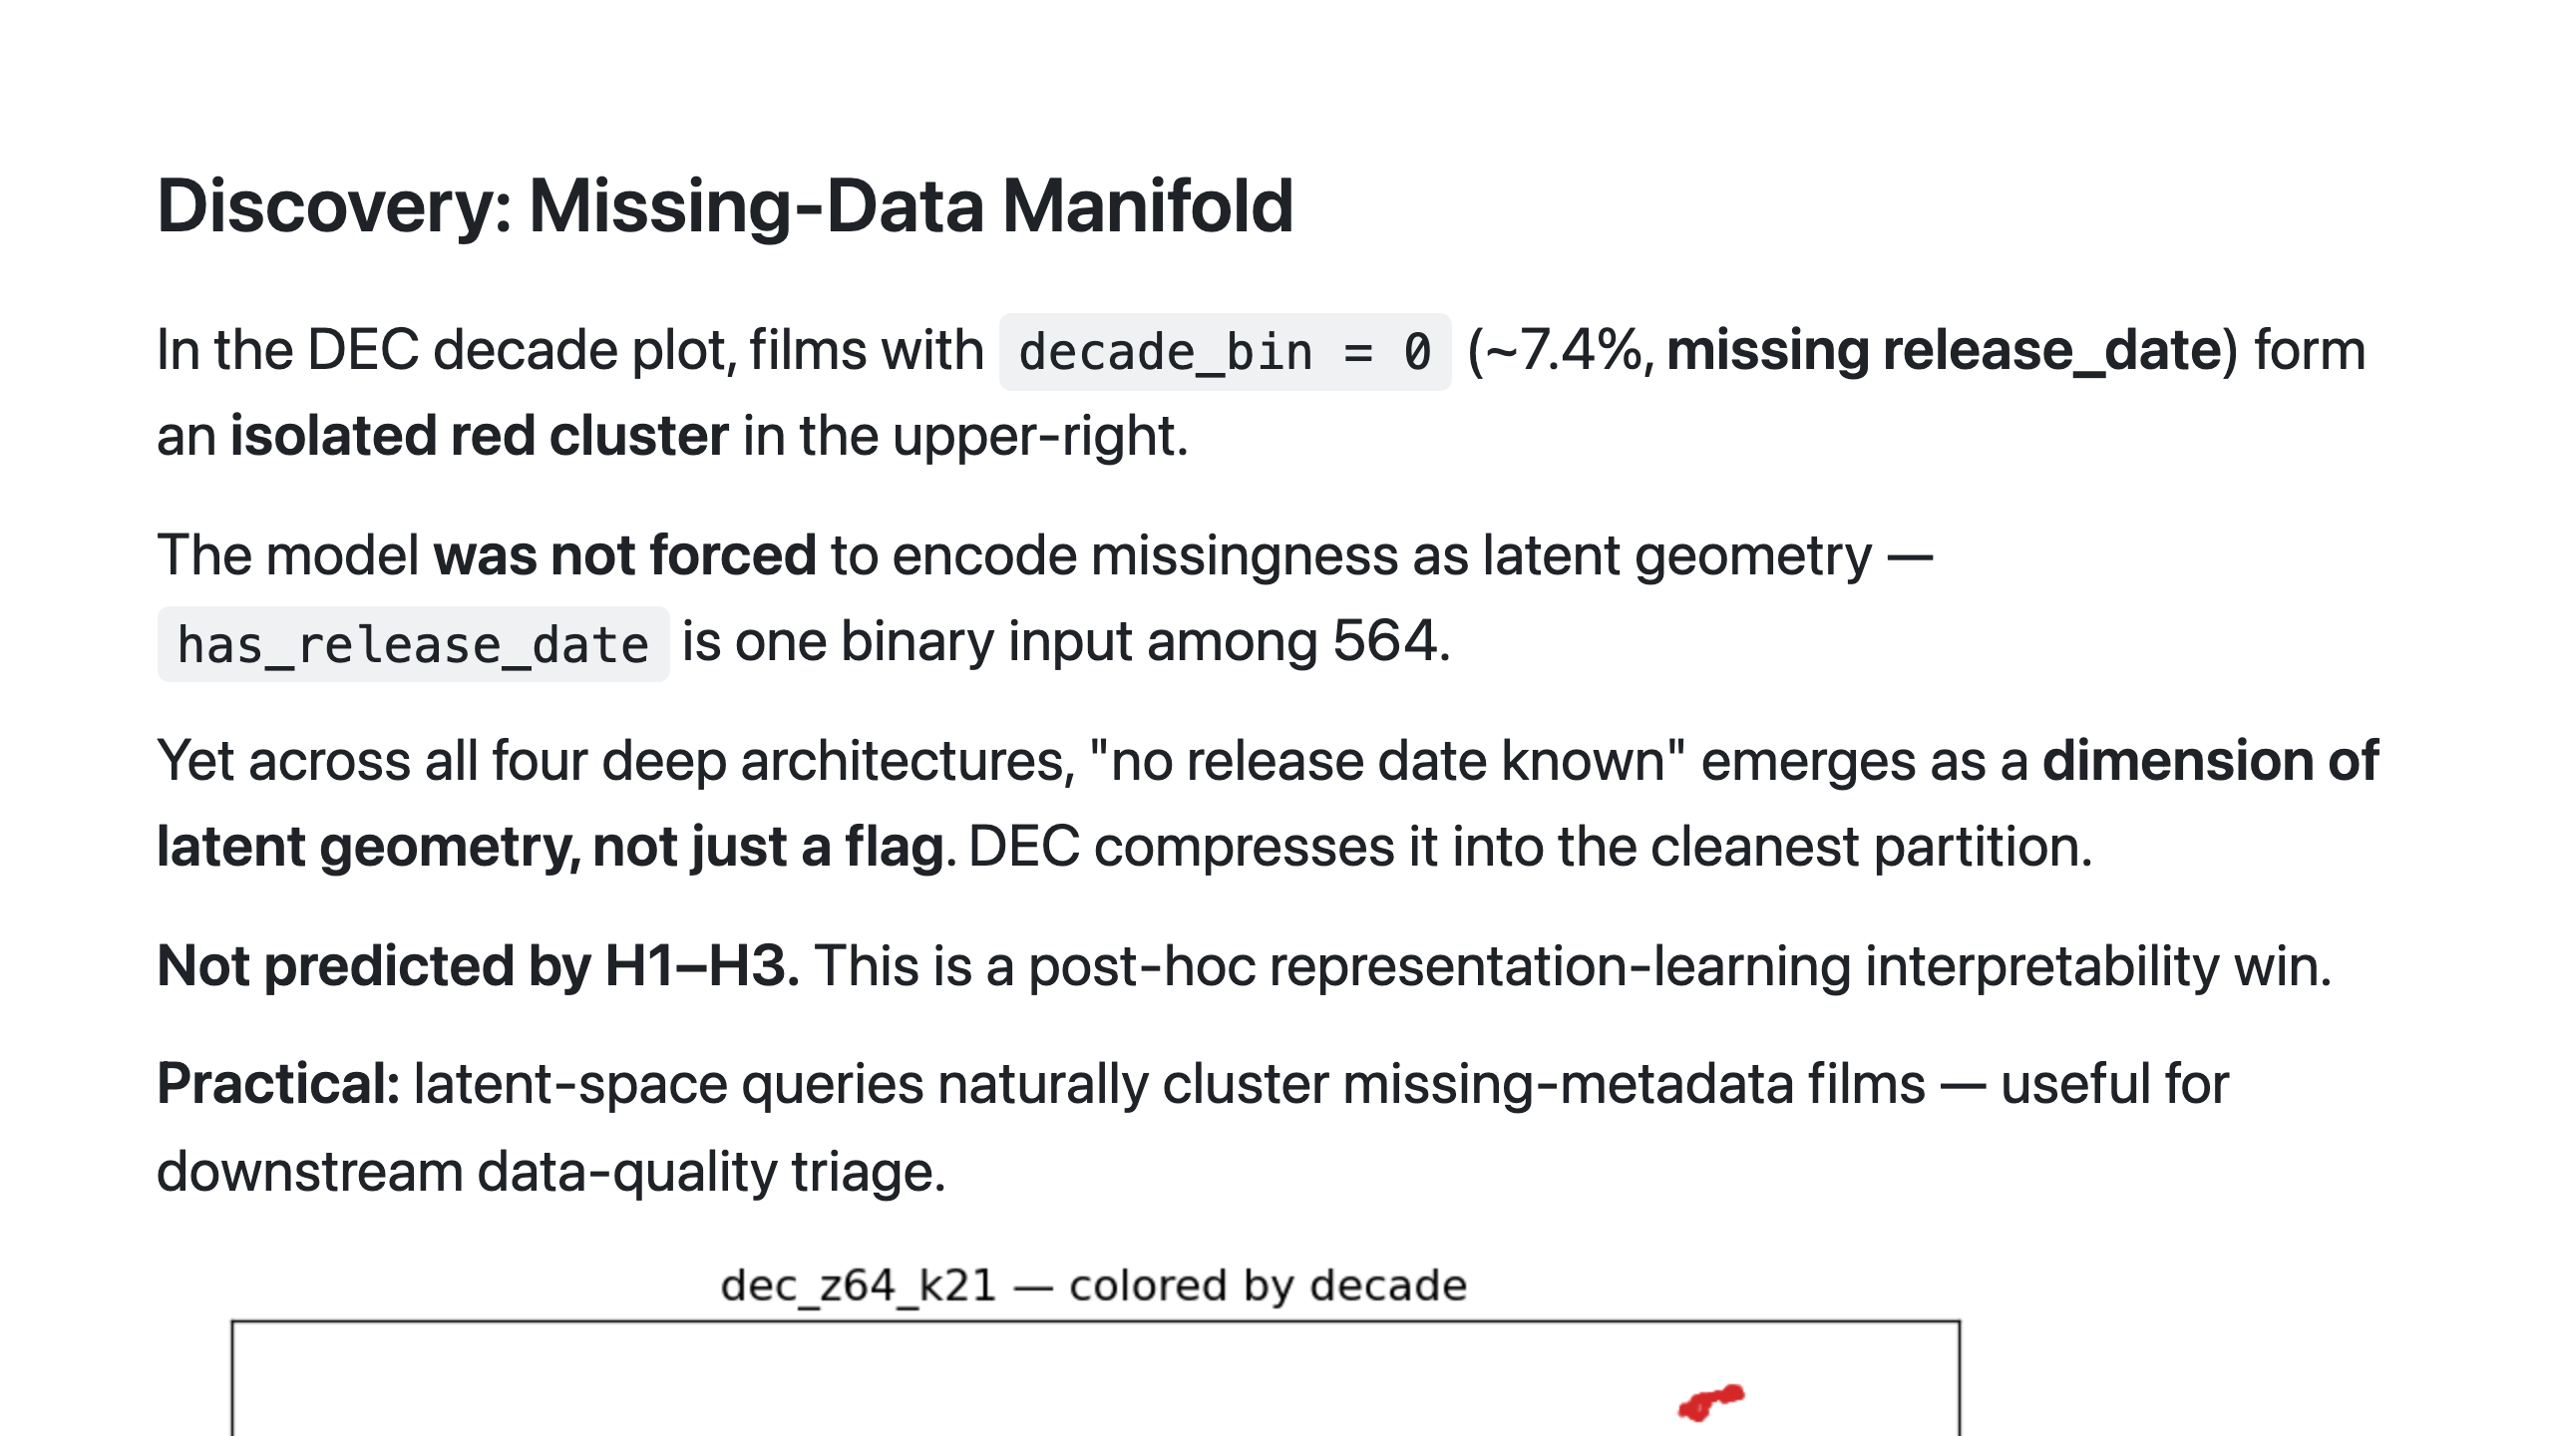
Notes:
Speaker notes: - Frame this slide as bonus content: "While we were doing UMAP analysis for the report, we noticed something we hadn't predicted." - The cluster is visible in vanilla and multi-modal too, but DEC's KL pressure makes it most explicit. - The interpretability angle: representation learning surfaces structure the modeler didn't engineer for. That's the dividend.

Slide 14
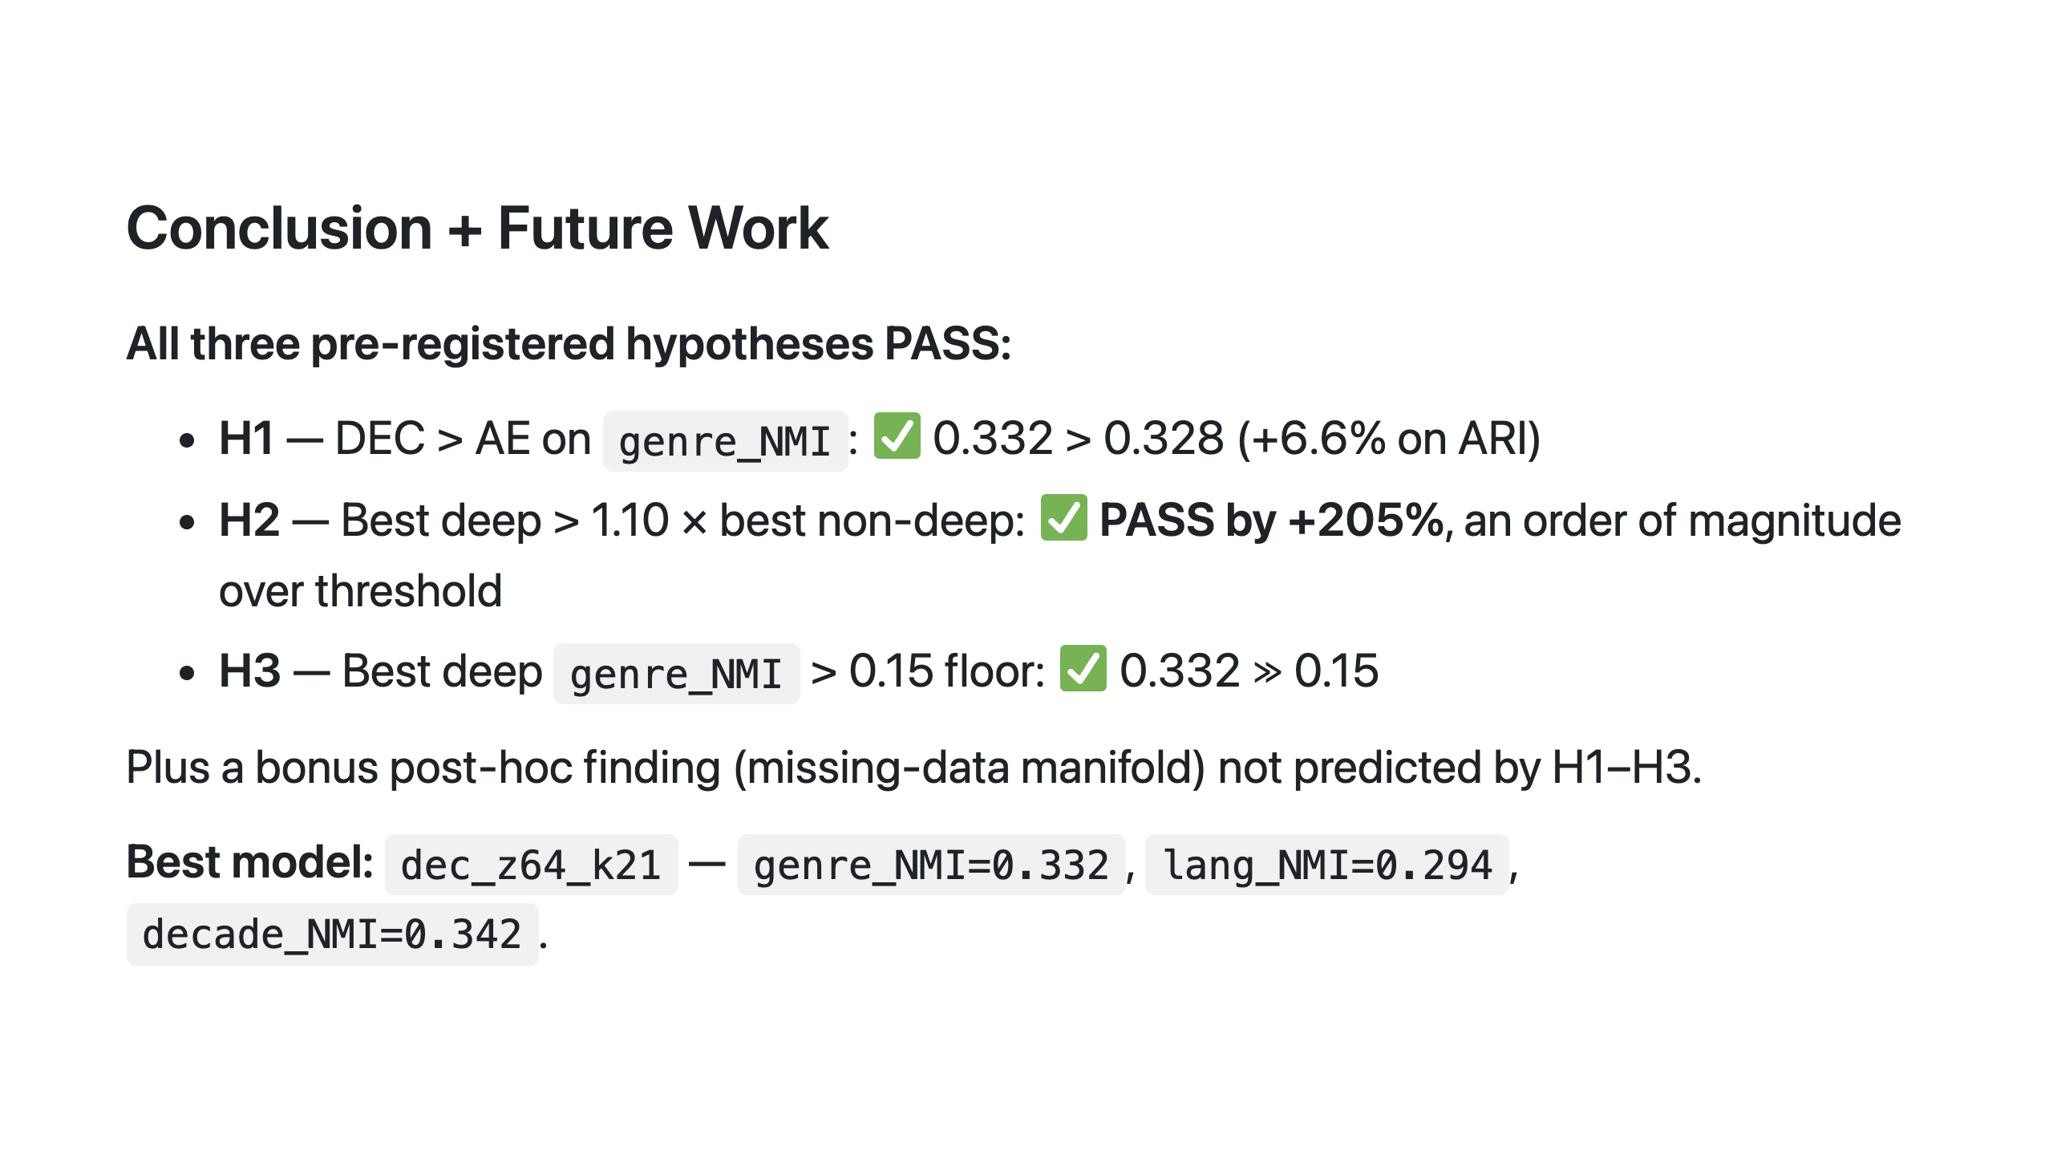

Slide 15
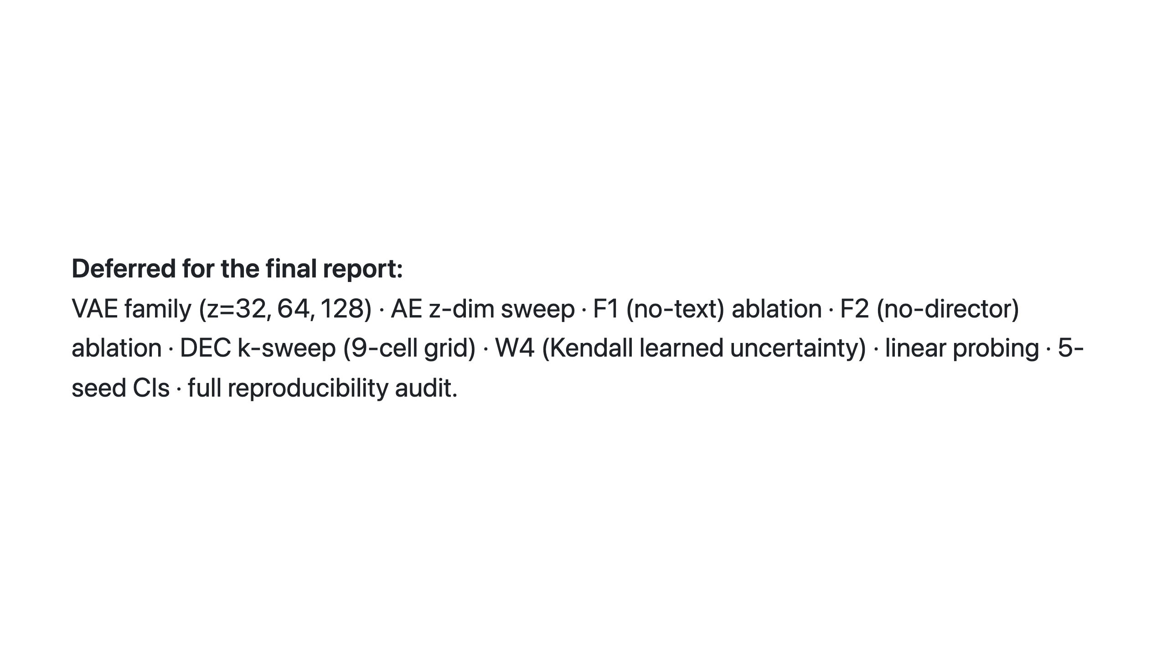
Notes:
Speaker notes: - Close on "all three hypotheses passed, plus a bonus" — high-confidence positive landing. - Explicitly enumerate what's deferred so the audience knows the intermediate report is honest about scope, not pretending to be the full study. - Best model is dec_z64_k21 — single number to remember from the talk: +205%.

