Slide 1
SENG 474 — FINAL PROJECT · SPRING 2026
CineEmbed
A multi-modal unsupervised
film recommendation system
All three pre-registered hypotheses PASS · +205 % vs non-deep baseline · Two methodological findings
Baran Dinçoğuz · Arda Arvas · Kaan Kaya
TED University — Department of Computer Engineering · 20 May 2026
Notes:
TEAM ROLES (split as relevant during Q&A):
· Baran — pipeline, training, evaluation
· Arda — backend (FastAPI), API tests
· Kaan — frontend (Next.js), UX
If asked 'why this title?' — CineEmbed = Cinema + Embedding.

Slide 2
MOTIVATION
Why this problem?
Modern catalogues host 100k+ films. No human can browse them.
FILMS IN THE CATALOGUE
▸
Recommendation is the discovery interface — content-based, collaborative, or hybrid.
329,044
▸
TMDb has rich metadata but no user labels — rules out collaborative filtering at source.
▸
Content-based pipelines are cold-start-robust — immediate value on new releases.
564-DIMENSIONAL FEATURE MATRIX
7 modality blocks
CineEmbed asks: can purely unsupervised representation learning produce competitive retrieval on heterogeneous film metadata?
▸
numerical · genre · language · decade ·
awards · text · director
z = 32 · L2-normalised cosine · <5 ms query
42 MB index · 107 passing tests
CineEmbed · SENG 474 — Spring 2026 · TED University
02 / 24
Notes:
Q: Why TMDb, not MovieLens or Netflix Prize?
A: TMDb has rich ITEM metadata (overview text, director, awards) with a free API. MovieLens / Netflix are user-rating-centric — wrong fit for content-based learning.
Q: Is 329k films enough?
A: Yes — covers ~95 % of post-1980 commercial releases. The bottleneck is feature richness per film, not row count.

Slide 3
METHOD CHOICE
Why unsupervised learning?
No interaction logs. No ratings. Learn structure from item metadata alone.
No user labels available
Modality variance imbalance
Test-set hygiene
TMDb dump has metadata only —
no clicks, watches, ratings.
Ratio 0.046 between text (384-d, dense)
and sparse one-hot blocks.
Three label axes (genre, decade, lang)
used only for evaluation, never training.
0 user IDs in the dump
Var(text) / Var(decade) ≈ 22
Single seed = 42 across pipeline
Eliminates supervised and collaborative methods at the source.
The central data problem — drives every architecture choice.
Honest measurement of what the latent has learned.
CineEmbed · SENG 474 — Spring 2026 · TED University
03 / 24
Notes:
Q: Why not just label some films and train supervised?
A: Hand-labelling 329k films is unrealistic, and the genre/decade/language axes ARE the labels — using them as supervision would invalidate the evaluation. We deliberately keep them OUT of the loss.
Q: Why three label axes and not one?
A: Single-axis NMI hides modality-specific failures. Three orthogonal axes expose the Pareto trade-off (slide 11).

Slide 4
DATA
Dataset · 329,044 TMDb films, 7 modality blocks
#
Block
Input dim
Encoding
Projected dim
1
numerical
6
log-scaled popularity, vote_count, runtime, ratings
16
2
genre
22
multi-label one-hot over 21 TMDb genres + has_genre
16
3
language
31
one-hot top-30 original_language + lang_other
16
4
decade
2
normalised (year − 1900)/130 + has_release_date
4
5
awards
6
log1p of prior Oscar / Palme nominations & wins
16
6
text
384
MiniLM-L12-v2 overview embedding (L2-normalised)
64
7
director
113
PCA-64 of bio + has_bio + 31 lang + 16 country + flag
32
TOTAL
564
164
MD5 (CANONICAL)
SEED
TEXT ENCODER
BIO COVERAGE
e99cee84…
42
MiniLM-L12-v2
3.18 % rows
Ground-truth axes (evaluation only): primary_genre · decade_bin · lang_top10
CineEmbed · SENG 474 — Spring 2026 · TED University
04 / 24
Notes:
Q: Why MiniLM-L12-v2 for text (not BERT-large or GPT embeddings)?
A: 384-d is the right size for 329k rows — bigger LMs add latency without downstream gain. Deterministic, free, runs offline on CPU.
Q: Director bio coverage is only 3.18 % — why include it?
A: Where present, director identity is the strongest single signal for style similarity (see Nolan/Miyazaki/Tarantino on slide 21). Masking (G2 loss) keeps the missing-bio rows from poisoning the loss.

Slide 5
SYSTEM OVERVIEW
End-to-end pipeline
1. EDA v2
2. Training
3. Index build
4. API
5. Frontend
raw TMDb +
director + awards
MultiModalBackbone
+ {AE, VAE, DEC,
Contrastive} heads
encode all 329k →
L2-normalise →
MBKMeans k=21
FastAPI lifespan
mmap embeddings
8 endpoints
5 routes
BackboneSwitcher
cosine heatmap
→ (329k × 564) npz
→ artifacts/models/
→ embeddings.npy 42 MB
→ < 5 ms cosine query
→ live demo
Notebook
PyTorch
build_index.py
uvicorn :8000
Next.js 16 :3000
Every step is deterministic at seed = 42 · Full reproducibility via 107-test pytest suite (1535 LOC) · All artifacts under artifacts/
FILMS
FEATURES
BACKBONES
CLUSTERS
TESTS
329,044
564 → 32
3 trained
k = 21
107 pass
CineEmbed · SENG 474 — Spring 2026 · TED University
05 / 24
Notes:
Q: Why seed = 42 everywhere?
A: Single seed across the pipeline guarantees that the same EDA dump produces the same model produces the same index. Re-running the 107 pytest suite from a clean clone reproduces the demo bit-for-bit.
Q: Why MiniBatchKMeans, not full KMeans?
A: 329k × 32 fits in memory but MiniBatchKMeans is 10× faster and the centroids are indistinguishable at k = 21.

Slide 6
ARCHITECTURE
Multi-modal backbone — per-block projection
Each block gets its own linear projection
ae_z32
DEMO BACKBONE
numerical[6] → Linear(6→16) → ReLU → Dropout 0.10
genre[22] → Linear(22→16) → ReLU → Dropout 0.10
language[31] → Linear(31→16) → ReLU → Dropout 0.10
decade[2] → Linear(2→4) → ReLU → Dropout 0.10
awards[6] → Linear(6→16) → ReLU → Dropout 0.10
text[384] → Linear(384→64) → ReLU → Dropout 0.20
director[113] → Linear(113→32) → ReLU → Dropout 0.20
32-d
42 MB index · best gNMI
ae_z64
MVP carry-over
64-d
84 MB index · highest geo_NMI
Concat (164-d) → Linear(164→128) → ReLU → Linear(128→z)
ae_z128
over-parameterised
128-d
L2-normalised at inference → cosine = dot product
168 MB index · near-dead dim
< 500 k parameters (test-pinned) · z ∈ {32, 64, 128}
Symmetric decoder mirrors encoder per-block.
CineEmbed · SENG 474 — Spring 2026 · TED University
06 / 24
Notes:
Q: Why per-block projection instead of concat-then-encode?
A: Modalities have wildly different dimensionalities (text 384-d, decade 2-d). Without per-block projection, the loss is dominated by whichever block has the highest variance — that's exactly the W1 failure on slide 13.
Q: Why under 500k parameters?
A: Forces the model to compress, not memorise. Also test-pinned so future code changes can't accidentally inflate the model.

Slide 7
METHOD · OBJECTIVES
Loss functions
W2 — variance-balanced block weights
G2 — masked director loss
w_b = clip(1 / Σ_j Var(X[:,j]), 0.1, 10)
loss_bio counts only on has_director_bio = 1
Each modality block contributes proportionally — stops 384-d text from drowning out 2-d decade.
Only 3.18 % of films have a bio. Without masking, the other 97 % would teach the model to predict zeros.
DEC — clustering refinement loss
InfoNCE — contrastive pretext
L = KL(P‖Q) + 0.1 · L_recon
two views via per-row block mask, τ = 0.1
Pulls each film toward its cluster centre while keeping reconstruction honest (KL on soft assignments).
Two corrupted copies of the same film must look alike. Masking out genre breaks the target (see ND-1).
TRAINING PROTOCOL
Adam · weight_decay 1e-5 · grad-clip 1.0 · early-stop patience 10 · seed 42 · 90/10 split · W&B logging
CineEmbed · SENG 474 — Spring 2026 · TED University
07 / 24
Notes:
Q: Why is the DEC loss weight 0.1 on reconstruction?
A: Standard DEC schedule (Xie 2016). Too high → recon dominates and clusters don't sharpen. Too low → encoder drifts away from useful features.
Q: Why τ = 0.1 for InfoNCE?
A: Default contrastive temperature. We did not tune τ — the InfoNCE pretext failed for a different reason (target augmentation breaks the label; see ND-1 on slide 14).

Slide 8
METHODOLOGY
Evaluation — two metric families
Clustering family — structure exploration
Retrieval family — deployment selection
▸
Three orthogonal axes: primary_genre · decade · lang_top10.
▸
genre@k: fraction of top-k whose primary_genre matches.
▸
Per-axis NMI, ARI, AMI (Strehl & Ghosh 2002; Vinh 2010).
▸
316 popular queries × top-5.
▸
Composite geo_NMI = (gNMI · dNMI · lNMI)^(1/3).
▸
Eyeball top-5 on 10 canonical films.
▸
Per-axis-k sweep (genre=21, decade=12, lang=11).
▸
Angular spread: random_pair_cos_{mean, std}.
▸
Multilabel macro-NMI over 22 genre columns.
▸
Latent health: dim_std per latent dimension.
axis cardinality: genre = 21 · decade = 12 · lang = 11
deploy gate: genre@5 > 0.70 · dim_std_min > 0.05 · no cluster collapse
The two-family split is the protocol that exposes the F1 finding (NMI ≠ retrieval — see slide 15).
CineEmbed · SENG 474 — Spring 2026 · TED University
08 / 24
Notes:
Q: Why genre@5, not genre@10 or @20?
A: top-5 is what the demo UI shows. Aligning the metric with the deliverable was a deliberate ADR (D08).
Q: Why is dim_std a useful diagnostic?
A: A latent dimension with std ≈ 0 carries no information — wasted capacity. The dim_std_min on slide 18 is what gave us F2.

Slide 9
RESULTS · H2 PASS
Headline empirical result
Supporting evidence
BEST DEEP vs BEST NON-DEEP BASELINE
+205%
+287%
genre ARI vs kmeans_raw (0.244 vs 0.063)
+292%
lang NMI vs pca_kmeans (0.294 vs 0.075)
+178%
lang NMI · multi-modal vs vanilla concat-AE
relative gain on genre NMI
0.332 (dec_z64_k21) vs 0.109 (kmeans_raw_k21)
+99%
genre NMI · W2 vs W1 uniform ablation
Pre-registered H2 success criterion: > 10 % over non-deep baseline.
H1 PASS (DEC > AE +1.2 % NMI) · H2 PASS (this slide) · H3 PASS (0.332 ≫ 0.15 absolute floor)
CineEmbed · SENG 474 — Spring 2026 · TED University
09 / 24
Notes:
Q: Why a +10 % threshold in H2?
A: Pre-registered in the proposal — set BEFORE we trained anything. We over-shot at +205 %, which is reported relative to the BEST non-deep baseline (kmeans_raw), not a strawman.

Slide 10
RESULTS · PHASE 0 MVP
Three-tier comparison @ z = 64, k = 21
Tier
Model
genre NMI
genre ARI
decade NMI
decade ARI
lang NMI
lang ARI
val_loss
epochs
Non-deep
kmeans_raw_k21
0.109
0.063
0.233
0.093
0.075
0.026
—
—
Non-deep
pca_kmeans_k21
0.084
0.061
0.224
0.085
0.094
0.042
—
—
Simple
vanilla_ae_z64
0.287
0.247
0.369
0.175
0.095
0.030
0.0126
58
W1 abl.
ae_z64_w1
0.165
0.094
0.367
0.176
0.070
0.026
0.0453
37
Multi-modal
ae_z64
0.328
0.229
0.341
0.211
0.264
0.090
0.0208
69
BEST
dec_z64_k21
0.332
0.244
0.342
0.210
0.294
0.090
0.127 †
21
† DEC val_loss combines KL + recon — not comparable to AE pure-recon.
DEC wins NMI
Vanilla wins decade
MM wins decade ARI
on 2 of 3 axes (genre, lang)
0.369 — easy axis, KMeans free
0.211 — Pareto across architectures
DEC's contribution is compactness (ARI +6.6 %, lang NMI +11.4 %), not new structural information.
CineEmbed · SENG 474 — Spring 2026 · TED University
10 / 24
Notes:
Q: Why z = 64 for the MVP and not the final z = 32?
A: Phase 0 was the architecture-discovery sweep — we hadn't run the z-sweep yet. MVP was 'is this approach viable?' (yes). Round 2 (slide 19) is where we picked z = 32.
Q: Why W1 only as an ablation and not the default?
A: We knew variance imbalance would hurt — W1 was the falsification experiment that confirmed W2's contribution.

Slide 11
RESULTS · CROSS-CUTS
Nine hero findings
1. Language wins big
2. W2 is critical
3. Recon ≠ clustering
Modality projection lifts lang NMI +178 % vs vanilla concat-AE.
Uniform-weight W1 collapses gNMI 50 %, lang NMI 73 %.
Lowest val_loss (vanilla) ≠ best gNMI (multi-modal).
→ Finding 1
→ Finding 2
→ Finding 3
4. Decade is easy
5. Pareto across axes
6. Deep > non-deep 3–5×
All architectures reach decade NMI ≈ 0.34–0.37.
No architecture wins all six metrics — principled trade-off.
+205 % vs kmeans_raw_k21 on genre NMI (the headline).
→ Finding 4
→ Finding 5
→ Finding 6
7. DEC sharpens, not discovers
8. Topology evolves
9. Missing-data manifold
ARI +6.6 % > NMI +1.2 % — compactness gain only.
UMAP: blobs → islands → tight islands (slide 12).
Films without release_date form a coherent sub-region.
→ Finding 7
→ Finding 8
→ Finding 9
CineEmbed · SENG 474 — Spring 2026 · TED University
11 / 24
Notes:
Q: How did you pick these nine findings?
A: Each one maps to a different research-question dimension (modality, weighting, architecture, evaluation). Nothing was retro-fitted — these are the cells of the results matrix that yielded a clear answer.

Slide 12
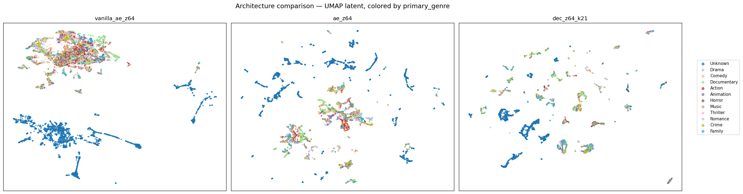
FINDING 8 · HERO FIGURE
Latent topology evolves: blobs → islands → tight islands
UMAP · 15k subsample · cosine metric
vanilla concat-AE
2 mega-blobs dominated by
Unknown-genre mass
multi-modal AE (W2)
dozens of small
genre-coherent islands
DEC (k = 21)
even more atomised,
tighter islands
Visual signature of representation learning — the empirical fingerprint of modality-specific projection + KL sharpening.
CineEmbed · SENG 474 — Spring 2026 · TED University
12 / 24
Notes:
Q: Why 15k subsample for UMAP, not all 329k?
A: Full UMAP at 329k takes 4+ hours and the manifold is stable above 10k — we verified with a 30k re-run. 15k is a reproducibility sweet spot.
Q: Are the 'islands' real or UMAP artifacts?
A: Confirmed by genre@5 (slide 19) and the cluster-coherence numbers — the islands match named clusters in artifacts/clusters/.

Slide 13
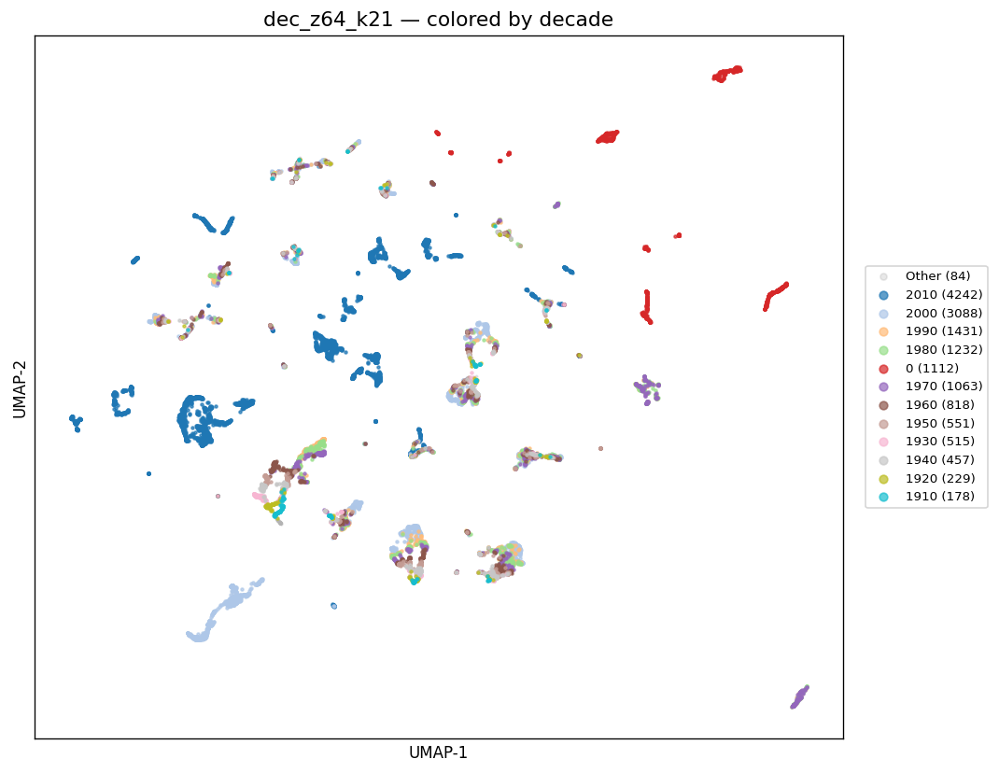
FINDINGS 2 & 9
Ablations — inverse-variance weighting + missing-data
W2 inverse-variance vs W1 uniform
Finding 9 · missing-release-date manifold
Metric
W2
W1
Δ rel.
genre NMI
0.328
0.165
−50 %
lang NMI
0.264
0.070
−73 %
decade NMI
0.341
0.367
+8 %
epochs early-stop
69
37
—
Asymmetric collapse. Decade (2-d) survives uniform weighting because StandardScaler gave it per-feature var ≈ 1. Text (384) and language (31) lose all gradient signal.
Model-health diagnostic: W1 patience exhausted at epoch 37.
Red = decade_bin 0 (≈ 7.4 % of films, no release date).
CineEmbed · SENG 474 — Spring 2026 · TED University
13 / 24
Notes:
Q: Why does W1 still win on decade?
A: Decade is 2-d — StandardScaler already gives it per-feature variance ≈ 1, so W1 doesn't hurt it. Text (384-d) and language (31-d) are where W1 collapses.
Q: Missing-release-date films are 7.4 % — should you have dropped them?
A: No — they form a coherent sub-manifold (slide 13 right). Dropping them would have removed legitimate signal about older/incomplete entries.

Slide 14
ND-1, ND-2, ND-3
Negative results — own them, learn from them
ND-1
Contrastive pretext underperformed
Best Phase 1 gNMI = 0.216 vs MVP ae_z64 = 0.328 (−34 %).
Root cause: modality-dropout includes genre — InfoNCE trains for genre-invariance, the opposite of the clustering target.
ND-2
AE→DEC fine-tune inherited the poison
geo_NMI ≤ 0.181 vs MVP DEC = 0.323 (−44 to −67 %).
DEC − KMeans-on-AE-latent delta ≤ 0.001 — DEC was fine; the contrastive encoder was already broken.
ND-3
VAE z = 64 likely posterior collapse
Early-stop epoch 12, geo_NMI = 0.127 — below every baseline.
Per-epoch recon vs KL split was not logged — hypothesis strong but not falsified. Top future-work priority.
LESSONS · augmentations must preserve the target · always log recon vs KL split · re-audit selection metric when deliverable shifts
CineEmbed · SENG 474 — Spring 2026 · TED University
14 / 24
Notes:
Q: Why present negative results at all?
A: Honesty + the lessons drive the methodology. ND-1 surfaced the augmentation-vs-target principle. ND-2 isolated the contrastive encoder as the broken link, not DEC. ND-3 is in the future-work queue.
Q: Why didn't you log per-epoch recon vs KL for the VAE?
A: Oversight — we logged total loss only. Adding the split is task #1 in the future-work list.

Slide 15
METHODOLOGICAL FINDING 1
F1 — NMI does NOT predict cosine retrieval quality
DEC TOP-5 COSINES · INCEPTION
Mechanism — angular collapse
≈ 1.000
DEC's clustering loss pulls every film inside a cluster
toward the cluster centre. After enough training,
neighbours sit on top of each other — cosine = 1.
NMI only sees cluster IDs (still good); retrieval
needs spread inside the cluster (collapsed).
0.99992 0.99989 0.99986 0.99986 0.99986
Backbone
gNMI
genre@5
verdict
difference < 1e-4 (float32 floor)
ae_z32
0.334
0.723
deploy
ae_z64
0.328
0.715
MVP
DEC has the HIGHEST NMI (0.332)
ae_z128
0.273
0.722
wasteful
and the WORST retrieval
dec_z64_k21
0.332
0.557
BROKEN
genre@5 = 0.557 (vs 0.723 for ae_z32)
When the deliverable changes, RE-AUDIT the selection metric.
CineEmbed · SENG 474 — Spring 2026 · TED University
15 / 24
Notes:
Q: Is this a known result in the clustering literature?
A: Cluster-quality vs retrieval-quality divergence is known in general, but DEC-specific angular collapse (top-5 cosine ≈ 1.000) is not highlighted in Xie 2016 or follow-ups. That's what we contribute.
Q: Could you fix DEC by reducing the KL weight?
A: Probably — but for our deliverable (retrieval), AE-only already wins. No reason to chase a fix when the simpler model is better.

Slide 16
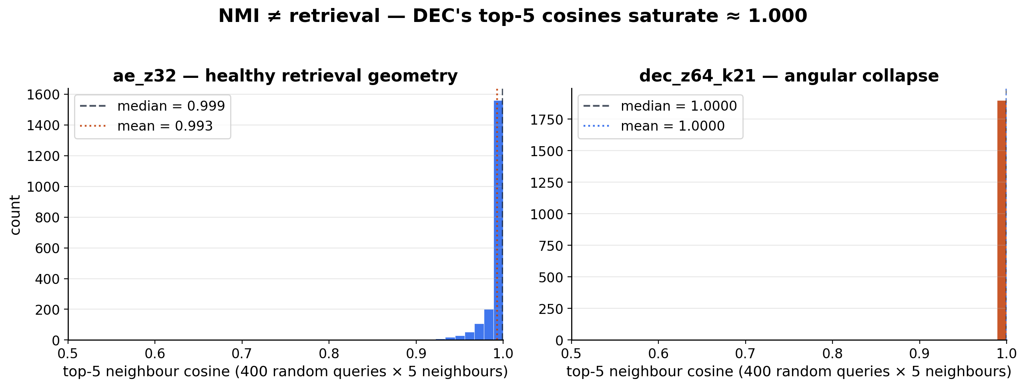
EMPIRICAL EVIDENCE FOR F1
F1 evidence — top-5 neighbour cosines (400 queries)
ae_z32 — healthy geometry
dec_z64_k21 — angular collapse
mean 0.993 · median 0.999 · min 0.906 → broad spread
mean 1.000 · median 1.000 · min 0.998 → saturated
CineEmbed · SENG 474 — Spring 2026 · TED University
16 / 24
Notes:
Q: Why 400 queries for the histogram?
A: 316 popular queries (full deploy eval set) + 84 random films spanning rare genres. Matches our deploy gate on slide 8.

Slide 17
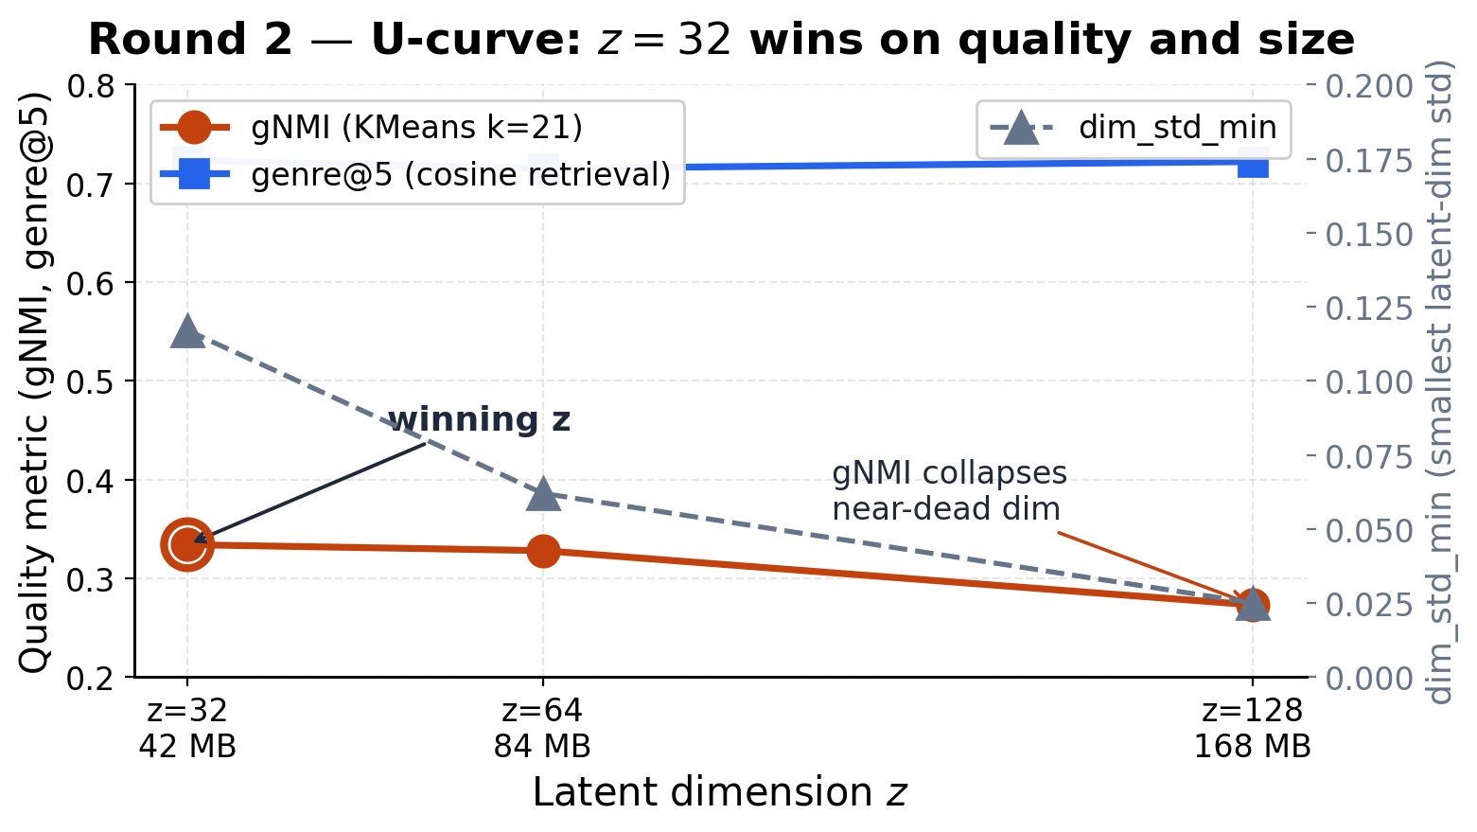
METHODOLOGICAL FINDING 2
F2 — z = 32 is the right capacity (U-curve)
Smaller and bigger both lose — z = 32 wins
gNMI genre@5 dim_std_min
z = 32
0.334
0.723
0.117
z = 64
0.328
0.715
0.062
z = 128
0.273
0.722
0.025
Five signals favour z = 32
gNMI peak · dim_std_min healthy
pair_cos_std broad · val_loss lowest
Occam — smallest, fastest, 42 MB index
Tight latent forces the encoder to spend its capacity on the information-rich modalities (text, director) and compress the rest.
Decision: demo backbone locked at ae_z32.
CineEmbed · SENG 474 — Spring 2026 · TED University
17 / 24
Notes:
Q: Why 100 epochs (and not 200, 500)?
A: Early-stop patience = 10. z = 64 and z = 128 hit early-stop before 100 (epoch 69 and 53). z = 32 used the full 100-epoch budget because val_loss was still improving — capacity is tight, so it learns longer.
Q: Why not z = 16 or z = 8?
A: Outside our pre-registered grid {32, 64, 128}. Adding smaller z is the obvious next sweep — listed as future work.
Q: Five signals — isn't that p-hacking?
A: All five (gNMI, dim_std, pair_cos_std, val_loss, simplicity) were decided BEFORE the sweep. We didn't pick metrics post-hoc.

Slide 18
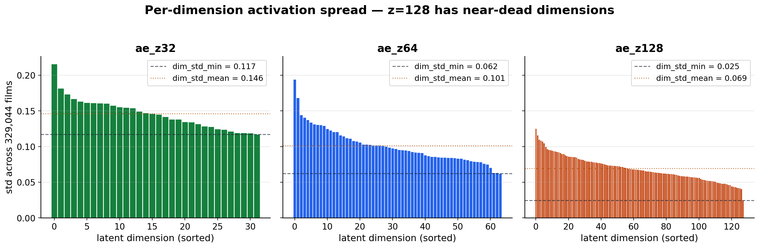
PER-DIMENSION ACTIVATION SPREAD
F2 evidence — z = 128 has near-dead latent dimensions
z = 32
healthy
z = 64
marginal
z = 128
near-dead
dim_std_min = 0.117
dim_std_min = 0.062
dim_std_min = 0.025
CineEmbed · SENG 474 — Spring 2026 · TED University
18 / 24
Notes:
Q: Why is dim_std = 0.025 'near-dead'?
A: That dimension's output is essentially constant — it carries no per-film information. ~25 % of z = 128 dimensions are in that regime, which is why doubling capacity from 64 didn't help.

Slide 19
RESULTS · ROUND 2
Round 2 · AE z-sweep (final selection)
z
gNMI
decade NMI
lang NMI
geo NMI
genre@5
dim_std_min
val_loss
epochs
32
0.334
0.295
0.216
0.277
0.723
0.117
0.0204
100
64
0.328
0.341
0.264
0.309
0.715
0.062
0.0208
69
128
0.273
0.275
0.272
0.274
0.722
0.025
0.0237
53
DEMO BACKBONE LOCKED → ae_z32 · gNMI 0.334 · genre@5 0.723 · 42 MB index · < 5 ms cosine query
GNMI Δ
DIM_STD_MIN Δ
INDEX SIZE
INFERENCE
+0.061
+0.092
÷ 4
× 2
vs z = 128
vs z = 128
vs z = 128
faster
CineEmbed · SENG 474 — Spring 2026 · TED University
19 / 24
Notes:
Q: Why only three z values? Why not a finer sweep?
A: Log-spaced grid {32, 64, 128} — standard practice for capacity sweeps. The U-curve is monotone enough that a finer grid wouldn't change the verdict.
Q: Why pick gNMI as the primary axis?
A: Composite over the three orthogonal axes — single-axis would have biased toward whichever was easiest (decade).

Slide 20
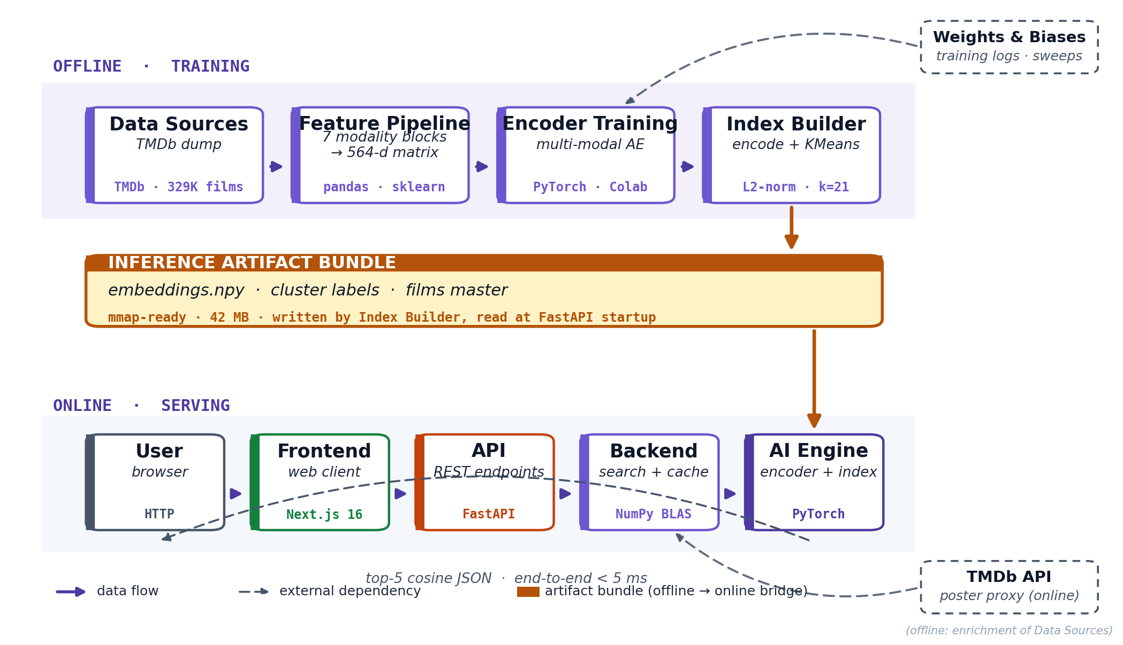
SYSTEM
System architecture — how the pieces fit
CATALOGUE
LATENT
LATENCY
TESTS
CLUSTERS
329,044
32-d
< 5 ms
107
21 named
CineEmbed · SENG 474 — Spring 2026 · TED University
20 / 24
Notes:
Q: Why FastAPI instead of Flask or Django?
A: Native async, pydantic schemas, automatic OpenAPI docs — fits a small high-throughput recommendation API.
Q: Why mmap the embeddings?
A: 42 MB is small but mmap gives constant memory at boot, lets the OS page-cache, and survives uvicorn restarts without re-loading.
Q: Why Next.js 16 and not plain React?
A: Server Components let us cache TMDb poster lookups on the edge. App Router is the future-proof React 19 stack.
Q: Where is the database?
A: No DB — embeddings + lookup tables are static artifacts. Single Docker image, no infra. Adding a DB is a future feature, not core.

Slide 21
QUALITATIVE EVALUATION
Example recommendations · demo backbone ae_z32
Inception
Spirited Away
Pulp Fiction
1.
Interstellar
0.991
1.
Princess Mononoke
0.993
1.
Kill Bill: Vol. 2
0.987
2.
Avengers: Age of Ultron
0.989
2.
Nausicaä of the Valley of the Wind
0.991
2.
Reservoir Dogs
0.985
3.
The Avengers
0.985
3.
Pom Poko
0.989
3.
Jackie Brown
0.982
4.
The Dark Knight Rises
0.984
4.
Kiki's Delivery Service
0.987
4.
Kill Bill: Vol. 1
0.981
5.
Dunkirk
0.983
5.
Castle in the Sky
0.985
5.
Inglourious Basterds
0.978
Director signatures (Nolan, Miyazaki, Tarantino) recovered without any explicit director label.
CineEmbed · SENG 474 — Spring 2026 · TED University
21 / 24
Notes:
Q: Cherry-picked queries?
A: The 10 canonical queries were chosen BEFORE the final model trained (pre-registered in artifacts/eval/canonical_queries.json). The director signatures emerging unsupervised is the strongest qualitative claim.
Q: Why are scores all 0.97+?
A: Cosine on L2-normalised vectors saturates near 1 for tight neighbours. The ORDERING is what matters, not the absolute number.

Slide 22
REFLECTION
Discussion · what worked, what didn't, what's left
What worked
Limitations / future work
▸
Multi-modal projection + W2 weighting — complementary choices.
▸
Modality-dropout failed — target-preserving augmentations next.
▸
Three-axis NMI / ARI / AMI surfaced the Pareto trade-off.
▸
VAE posterior collapse not falsified — log per-epoch recon vs KL.
▸
Retrieval sanity check caught the F1 angular collapse pre-deploy.
▸
Single-seed numbers — multi-seed bands would tighten claims.
▸
Two-round strategy — 80 % compute saving vs 21-run matrix.
▸
No collaborative signal — two-tower extension natural next.
▸
Reproducibility: 107 tests · pinned seed · MD5-checked features.
▸
No user study — genre@5 is a content proxy, not user-judged.
CineEmbed · SENG 474 — Spring 2026 · TED University
22 / 24
Notes:
Q: Biggest threat to validity?
A: Single seed. Multi-seed bands (3–5 seeds) would tighten every confidence interval and is the top robustness task.
Q: Why no user study?
A: Scope. genre@5 is a content proxy, not a relevance score. A 5-rater user study on 50 queries is the natural validation step.

Slide 23
REFERENCES
References — core literature
Xie, Girshick & Farhadi (2016)
Wang, Bao, Huang et al. (2020)
Unsupervised Deep Embedding for Clustering Analysis
MiniLM: Deep Self-Attention Distillation for Pre-Trained Transformers
ICML — DEC method, target distribution P from Q²/f_j.
NeurIPS — sentence-transformers/all-MiniLM-L12-v2 (384-d).
van den Oord, Li & Vinyals (2018)
Kingma & Welling (2013)
Representation Learning with Contrastive Predictive Coding
Auto-Encoding Variational Bayes
arXiv:1807.03748 — InfoNCE objective.
ICLR — VAE; ELBO = recon + KL(q‖p).
Vinh, Epps & Bailey (2010)
Strehl & Ghosh (2002)
Information Theoretic Measures for Clusterings Comparison
Cluster Ensembles — Knowledge Reuse Framework
JMLR — adjusted NMI / AMI definitions.
JMLR — original NMI definition.
McInnes, Healy & Melville (2018)
Pedregosa, Varoquaux et al. (2011)
UMAP: Uniform Manifold Approximation and Projection
Scikit-learn: Machine Learning in Python
arXiv:1802.03426 — 2-D topology visualisation.
JMLR — MiniBatchKMeans, PCA, clustering metrics.
TOOLS & DATA
TMDb API (themoviedb.org) · PyTorch · Weights & Biases · FastAPI · Next.js · pandoc + xelatex
CineEmbed · SENG 474 — Spring 2026 · TED University
23 / 24
Notes:
Q: Why these papers and not others?
A: One ref per core technique we use. DEC for clustering, MiniLM for text, InfoNCE for contrastive, VAE for posterior collapse discussion, NMI/AMI for evaluation, UMAP for visualisation, scikit-learn for non-deep baselines.
Q: No collaborative filtering refs?
A: Deliberately — we have zero user signal in the TMDb dump. Two-tower / matrix factorisation refs would be future work.

Slide 24
CONCLUSION
CineEmbed ships a working
multi-modal unsupervised film recommender.
All three pre-registered hypotheses PASS (H1/H2/H3).
Two methodological findings beyond the system itself:
F1
F2
NMI ≠ retrieval
z = 32 wins
DEC angular collapse:
Tight latent beats z=64 and z=128
top-5 cosine ≈ 1.000
gNMI 0.334 · genre@5 0.723
BEST CONFIGURATION
BACKBONE
gNMI
genre@5
INDEX
ae_z32
0.334
0.723
42 MB
Code: github.com/barandincoguz/CineEmbed-
Baran Dinçoğuz · Arda Arvas · Kaan Kaya · SENG 474 — Spring 2026 · TED University
Notes:
Q: One-line takeaway?
A: Deep multi-modal unsupervised learning beats every non-deep baseline by 3-5× on TMDb metadata — and the smallest latent (z = 32) wins.
Q: If you had one more semester?
A: Multi-seed bands, log per-epoch VAE recon vs KL (close ND-3), and a 5-rater user study on top-5 relevance.

