Slide 1
CineEmbed
Multi-Modal Unsupervised Embedding of 329,044 Films
Intermediate Progress Report · v1.2
Ahmet Baran Dincoguz · Arda Arvas · Bertan Kaan Kaya
SENG 474 — Deep Learning · Spring 2026 · TED University · 2026-05-06
github.com/barandincoguz/CineEmbed-

Slide 2
Project Status: ON TRACK
Modeling MVP delivered. Hypotheses H1, H2, H3 all PASS.
COMPLETE
• Six runs trained, evaluated against 3 orthogonal label axes (genre · decade · language).
• Best deep model dec_z64_k21 reaches genre_NMI = 0.332, +205 % over best non-deep baseline.
• Three controlled ablations (modality projection · loss weighting · DEC fine-tune) — see slide 9.
• Bonus finding: films with missing release date form a coherent latent sub-manifold.
+205 %
DEC genre_NMI vs KMeans on raw features (0.332 vs 0.109)
SENG 474 · CineEmbed · Slide 2 / 14

Slide 3
Project Goal & Scope
What we set out to do, on what data.
• Train unsupervised 64-dim representations of movie metadata.
• 329,044 films from TMDB + awards records + Wikipedia director bios.
• 564-dim feature matrix organized into 7 modality blocks.
• Recover 3 orthogonal label axes without labels: genre, decade, language.
• Evaluate via KMeans clustering of the latent → NMI / ARI.
Block | Dim | Notes
numerical | 6 | popularity, runtime, votes
genre | 22 | 21-way one-hot + flag
language | 31 | top-30 langs (~99% zero)
decade | 2 | decade_norm + flag
awards | 6 | Oscar/BAFTA/Cannes counts
text | 384 | MiniLM-L6-v2 embeddings
director | 113 | bio_pca_64 + lang/country
SENG 474 · CineEmbed · Slide 3 / 14

Slide 4
Schedule & Milestones
Aligned to the SENG 474 Spring 2026 syllabus (W1–W15, 11/02–20/05).
Week | Date | Milestone | Status
W3 | 25/02 | Team formation submitted | COMPLETE
W5 | 11/03 | Project proposal / abstract | COMPLETE
W7 | 25/03 | Midterm exam (course-wide) | COMPLETE
W9–W11 | — | Six runs trained and evaluated | COMPLETE
W11 | 22/04 | UMAP latent analysis | COMPLETE
W11 | 22/04 | Intermediate Report Submission | COMPLETE
W12–W14 | — | VAE + F1/F2/k-sweep ablations | PLANNED
W14 | 13/05 | Project demo (presentation 1) | PLANNED
W15 | 20/05 | Project demo (presentation 2) | PLANNED
W15 | 20/05 | Final Report + Demo Video | PLANNED
SENG 474 · CineEmbed · Slide 4 / 14

Slide 5
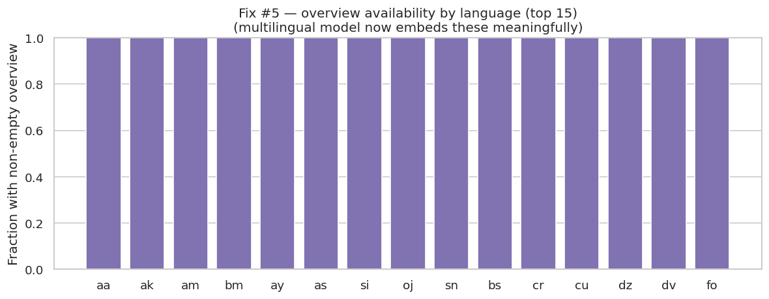
Work Completed: Data Engineering
564-dim feature matrix, 7 modality blocks, frozen v1.2.
COMPLETE
• Three sources merged: TMDB, awards records, Wikipedia director bios.
• Sparse modalities preserved as one-hot (interpretable).
• Missing release date encoded as binary flag — turned out to be structurally relevant (slide 12).
• Director-bio reconstruction loss masked by has_director_bio flag (G2 masking).
Multilingual coverage — long tail motivates sparsity-aware design.
SENG 474 · CineEmbed · Slide 5 / 14

Slide 6
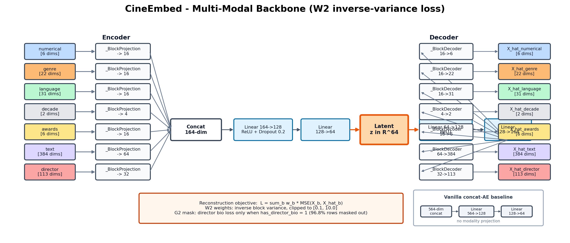
Work Completed: Architecture Design
Multi-modal backbone, W2 inverse-variance loss, G2 bio masking, DEC head.
COMPLETE
SENG 474 · CineEmbed · Slide 6 / 14

Slide 7
Metrics — How We Measure Cluster Quality
Cluster the 64-dim latent with KMeans (k=21); score the partition against three orthogonal label axes.
NMI
Normalized Mutual Information
Range: 0 to 1 (1 = perfect overlap, 0 = independent)
Measures: shared information between partition and labels
Robust to: label permutations (cluster IDs can be relabeled freely)
Best when: the latent encodes axis information richly
ARI
Adjusted Rand Index
Range: −1 to 1 (1 = perfect, 0 = random, < 0 = worse than random)
Measures: partition agreement, adjusted for chance
Sensitive to: crisp cluster boundaries — penalizes smearing
Best when: clusters cleanly partition by axis labels
Prefix | NMI variant | ARI variant | Axis (ground truth) | Cardinality
g (genre) | gNMI | gARI | primary_genre | 21
d (decade) | dNMI | dARI | decade_bin | ~12
l (language) | lNMI | lARI | lang_top10 (top 10 + other) | 11
Why both NMI and ARI? NMI alone can be inflated by smearing structure across many small clusters; ARI penalizes that. Reporting both lets us tell signal apart from partition crispness — DEC's diagnostic signature is ARI gain > NMI gain, indicating tighter cluster boundaries rather than new structural information.
SENG 474 · CineEmbed · Slide 7 / 14

Slide 8
Work Completed: Modeling MVP — Six Runs
Three tiers, six metrics, four different column winners.
COMPLETE
Run | gNMI | gARI | dNMI | dARI | lNMI | lARI
kmeans_raw_k21 | 0.109 | 0.063 | 0.233 | 0.093 | 0.075 | 0.026
pca_kmeans_k21 | 0.084 | 0.061 | 0.224 | 0.085 | 0.094 | 0.042
vanilla_ae_z64 | 0.287 | 0.247 | 0.369 | 0.175 | 0.095 | 0.030
ae_z64_w1 (W1 ablation) | 0.165 | 0.094 | 0.367 | 0.176 | 0.070 | 0.026
ae_z64 | 0.328 | 0.229 | 0.341 | 0.211 | 0.264 | 0.090
dec_z64_k21 (BEST) | 0.332 | 0.244 | 0.342 | 0.210 | 0.294 | 0.090
z = 64, KMeans k = 21. No model wins all six metrics — the principled-trade-off result. (Metric definitions on slide 7.)
SENG 474 · CineEmbed · Slide 8 / 14

Slide 9
Ablation Evidence — Each Choice Tested in Isolation
Three controlled tests isolate the contribution of each architectural decision.
COMPLETE
Ablation | Controlled test | Best Δ | Verdict
Modality projection | Vanilla concat-AE → multi-modal AE | lang_NMI +178 % | Wins big on language; modest on genre.
Loss weighting | W1 uniform → W2 inverse-variance | lang_NMI +277 % | Critical: W1 collapses high-dim sparse blocks.
DEC fine-tuning | AE alone → AE + 21 KL+recon epochs | genre_ARI +6.6 % | Sharpens partitions; ARI gain > NMI gain.
Why ablations matter:
Each ablation isolates one architectural decision and quantifies its contribution. Without controlled tests, gains from W2 weighting (+99 % on gNMI, +277 % on lNMI) would be conflated with gains from modality projection itself. Diagnostic side-effect: W1 early-stopped at epoch 37 vs W2's 69 — a model-health signal that the optimizer cannot escape modality imbalance under uniform weighting.
Deferred to final report (W12–W14): F1 (no-text) · F2 (no-director-profile) · VAE family (z = 32 / 64 / 128) · AE z-dim sweep · DEC k-sweep (9-cell grid) · W4 (Kendall learned uncertainty).
SENG 474 · CineEmbed · Slide 9 / 14

Slide 10
Headline Result — H2
Best deep model vs best non-deep baseline on genre_NMI.
+205 %
dec_z64_k21: 0.332 vs kmeans_raw_k21: 0.109
+295 %
+287 %
+213 %
DEC vs PCA-KMeans (gNMI)
DEC vs raw-KMeans (gARI)
DEC vs PCA-KMeans (lNMI)
SENG 474 · CineEmbed · Slide 10 / 14

Slide 11
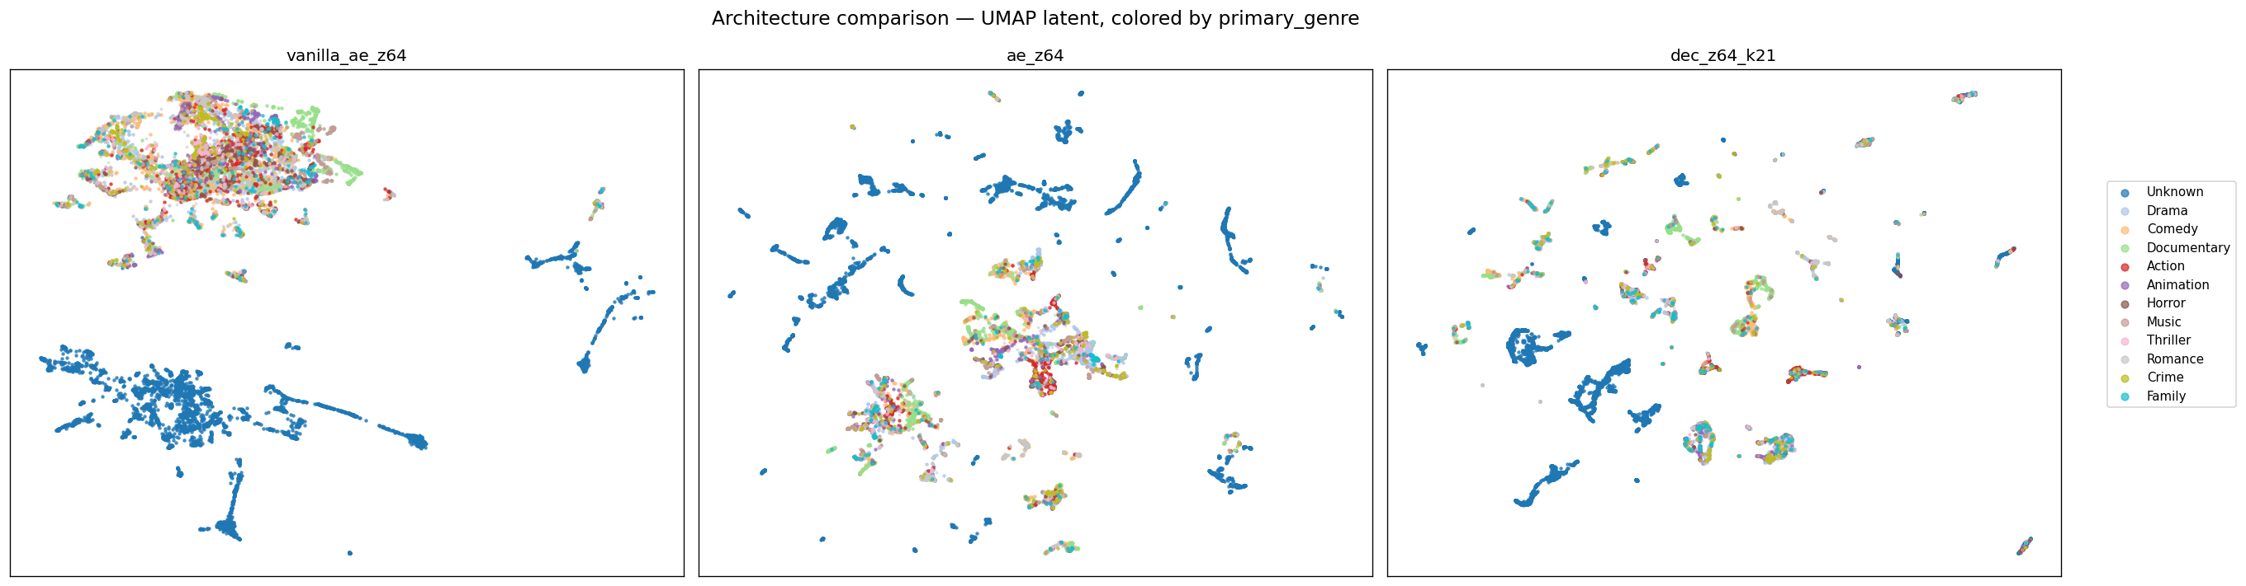
Latent Topology Evolves
vanilla → multi-modal → DEC: blobs → islands → tight islands.
UMAP, 15K subsample, cosine metric. Same projection settings; only the underlying 64-dim latent differs.
SENG 474 · CineEmbed · Slide 11 / 14

Slide 12
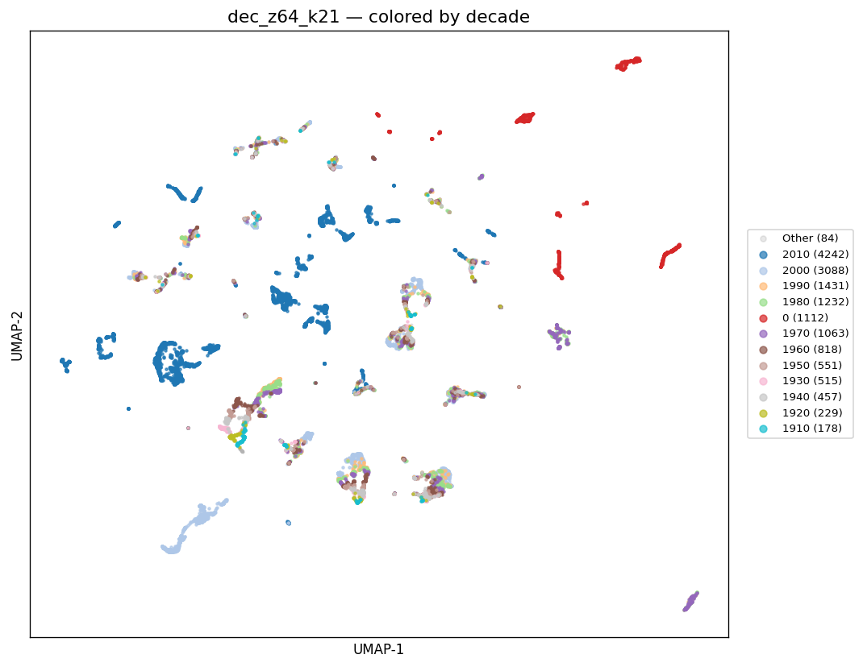
Bonus Finding — Missing-Data Manifold
Films with no release date form a coherent latent sub-manifold.
• ~7.4 % of films have no release date (decade_bin = 0).
• These films form an isolated red cluster (upper-right) across all 4 deep architectures.
• DEC compresses them into the cleanest partition.
• Not predicted by H1–H3 — post-hoc interpretability win.
• Practical use: latent-space queries naturally cluster missing-metadata films for triage.
SENG 474 · CineEmbed · Slide 12 / 14

Slide 13
Plan to the Final Report
Deferred experiments with target completion windows (W13–W15).
Item | Why deferred | Target
VAE family (z = 32 / 64 / 128) | Probabilistic head not yet trained. | 2026-05-09 (W13)
AE z-dim sweep (z = 32, 128) | MVP fixed z = 64. | 2026-05-09 (W13)
F1 ablation (no text) | Quantify text-block contribution. | 2026-05-12 (W14)
F2 ablation (no director profile) | Quantify director-block contribution. | 2026-05-12 (W14)
DEC k-sweep (9-cell z×k grid) | MVP runs only z=64 × k=21. | 2026-05-15 (W14)
W4 (Kendall learned uncertainty) | Stretch loss; learnable per-block weights. | 2026-05-15 (W14)
Linear probing on frozen latents | Held-out classifier evaluation per axis. | 2026-05-16 (W14)
5-seed confidence intervals | MVP single-seed → CIs needed. | 2026-05-17
Reproducibility audit | Single deterministic run script. | 2026-05-18
Final report submission target: 2026-05-20 (W15) — coincides with Project Demo session 2.
SENG 474 · CineEmbed · Slide 13 / 14

Slide 14
Status Summary · Q & A
All three pre-registered hypotheses PASS.
ID | Statement | Result | Status
H1 | DEC genre_NMI > AE genre_NMI | 0.332 > 0.328 | COMPLETE
H2 | Best-deep ≥ 1.10 × best-non-deep on genre_NMI | +205 % | COMPLETE
H3 | Best-deep genre_NMI > 0.15 absolute floor | 0.332 ≫ 0.15 | COMPLETE
Best model: dec_z64_k21 — genre_NMI = 0.332, lang_NMI = 0.294, decade_NMI = 0.342
github.com/barandincoguz/CineEmbed- · Thank you. Questions?
SENG 474 · CineEmbed · Slide 14 / 14

