Slide 1
Facebook Data - EDA Report
Barani Babu Nonburaj

Slide 2

Outline
Domain & Topic of Project
Introduction to Facebook Data
Data Preparation & Cleaning
Exploratory Analysis and Visualizations
Summary & Conclusion

Slide 3
Domain & Topic of Project

Slide 4
Domain & Topic of Project
The Topic of Project is Facebook Data provided by INSAID team
Domain of the project Dataset is Social Networking.The data from the project is corresponds to a typical dataset of Facebook.
Facebook, Inc., is an American technology based in Menlo Park, California. It was founded by Mark Zuckerberg, along with his fellow roommates and students at Harvard College, who were Eduardo Saverin, Andrew McCollum, Dustin Moskovitz and Chris Hughes, originally as the”Facebook.com”—today's “Facebook”, a popular global social networking service.
Facebook, is accessible from large number of devices Mobile - Android, IOS phones and also accessible through internet via browsers.
Facebook requires user to be at least 13 years old before they can create an account (in some jurisdictions, this age limit may be higher).
Once Facebook account is created, users can add other users as “friends”, exchange messages, share story,photos, videos, and receive notification of activity.
During Crisis Period, Facebook helped a users to check another users (family/friends) are they safe by having them marking “I’mSafe”.

Slide 5
Introduction to Facebook Data

Slide 6
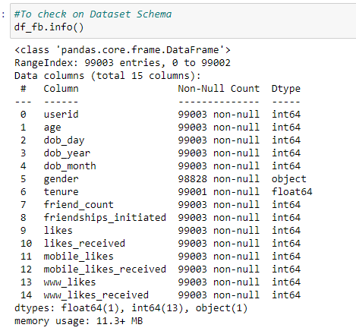
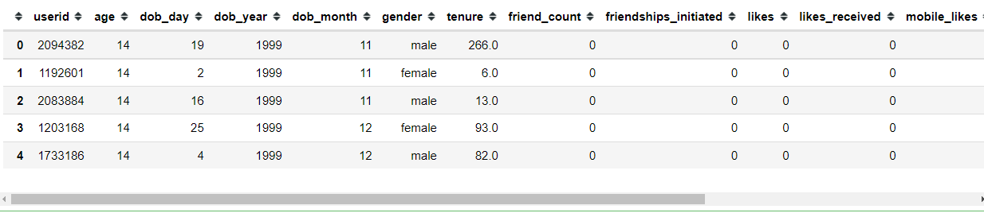
Introduction to Facebook Data
Facebook Data consists of typical dataset at social networking site
Goal : Analyse and understand the behaviour of users & demographics.
Approach: EDA (Exploratory Data Analysis) to analyse the underlying patterns in the data.
Filetype : CSV file with 15 columns

Slide 7
Data Preparation & Cleaning

Slide 8
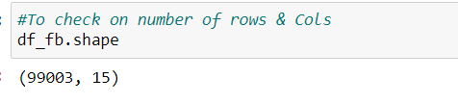
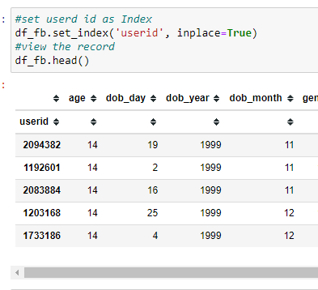
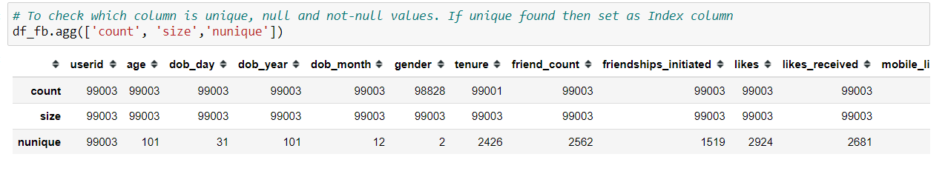
Data Preparation & Cleaning
Dataset consists of 99003 Rows & 15 Columns
Identify the null & unique objects
In this Dataset Gender has 175 rows as NaN and Tenure has 2 rows as blank
Set User ID Column as Index for easy sorting using Set Index method

Slide 9
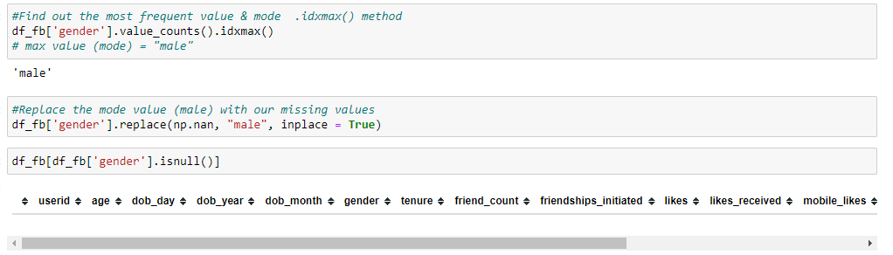
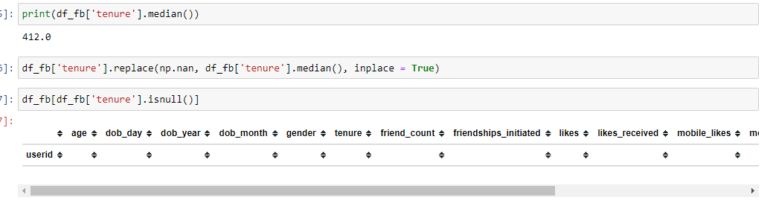
Data Preparation & Cleaning - Contd..
Replace Gender blank rows with most frequent method, Mode (IDMax)
Replace Tenure Blank rows with Median value

Slide 10
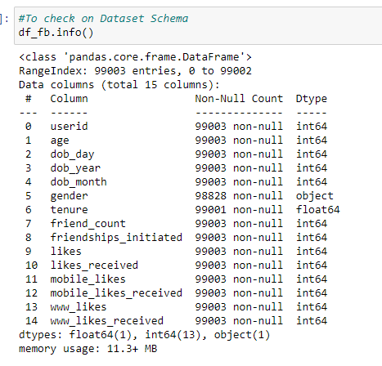
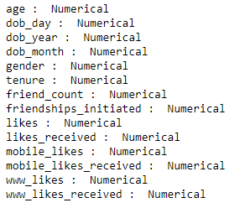
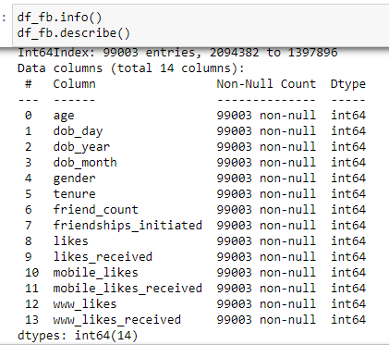
Data Preparation & Cleaning - Contd..
For Data Integrity and visualization - convert all data in the rows to numeric values using “to_numeric function
Before Data Cleanup | After Data Cleanup

Slide 11
Exploratory Analysis & Visualizations

Slide 12
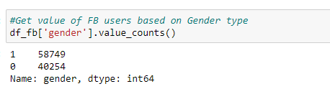
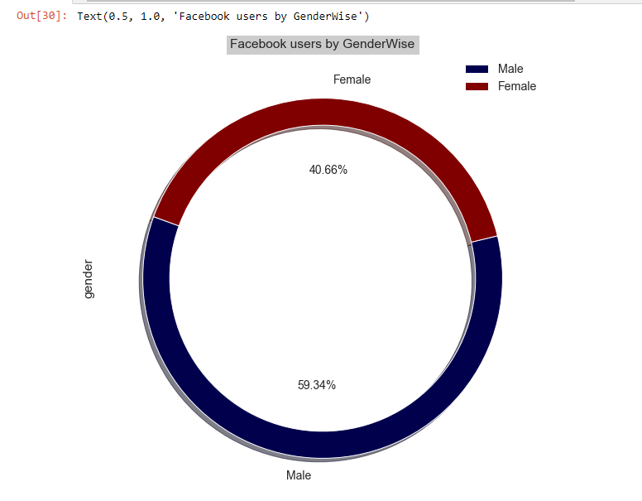
Exploratory Analysis & Visualizations
Question 1 : How many users are using FB based on Gender Type?
Chart Type : Pie Chart
Findings & Visualizations: it’s an 60:40 ratio where Male gender group users are more likely to use Facebook than female users.
Male - 59.34%
Female - 40.66%
This gives an Insight Facebook should focus more promotions to attract more female facebook users.

Slide 13
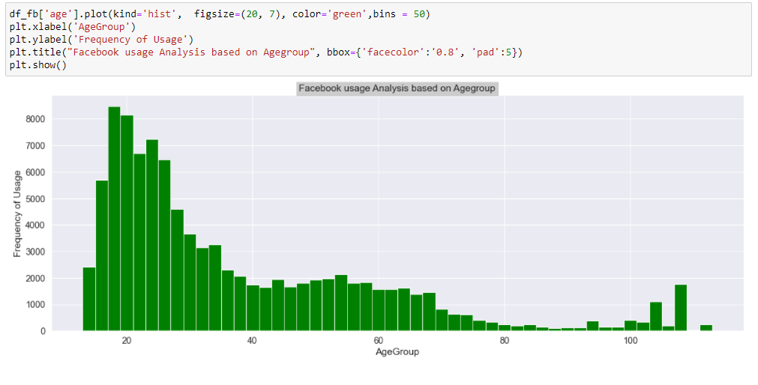
Exploratory Analysis & Visualizations
Question 2 : Which Age groups are frequent users of Facebook application?
Chart Type : Histogram
Findings & Visualizations: We observed the graph is skewed towards left indicating young people in the Age of 20-30 years is heavy users of Facebook application. This gives an insight that marketing efforts should be focussed on young people who has time and active interest.

Slide 14
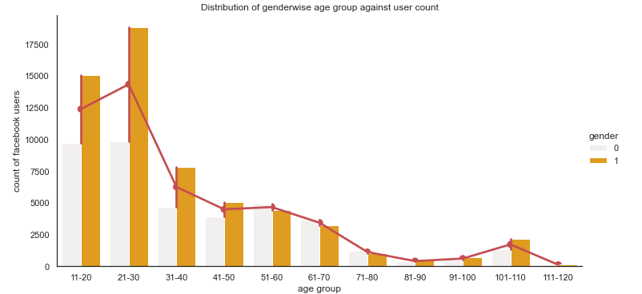
Exploratory Analysis & Visualizations
Question 3 : Which Age groups are frequent users of Facebook app by Gender type?
Chart Type : Factorplot Chart
Findings & Visualizations: It shows between age of 11 to 30 years users are using facebook twice more than 31 ownwards age group.Facebook used by Male is higher than Female user between 11 to 50 year age but after 51 age onwards female usage is gradually increased in comparison to male population.
Gender
0 - Female
1 - Male

Slide 15
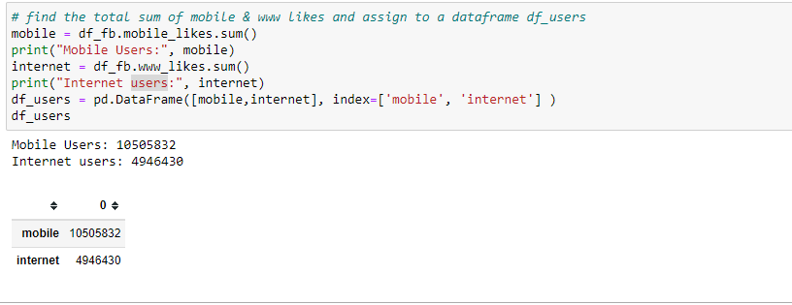
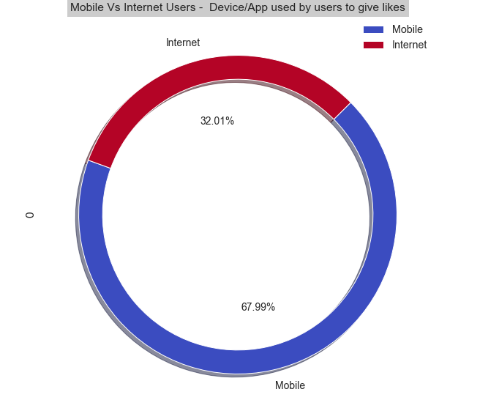
Exploratory Analysis & Visualizations
Question 4 : Among the users, which Device/App were used by users to give likes?
ChartType : Pie-Chart
Findings & Visualizations: it’s an 70:30 ratio where Mobile users are more likely to use Facebook than Internet (www) users.
Internet(www) - 32.01%
Mobile - 67.99%
This insight shows the user preferences and FB should focus more on Mobile users and ensuring the app is running without any downtime and also gives a view Internet users are less may be its not handy when compared to mobile app.

Slide 16
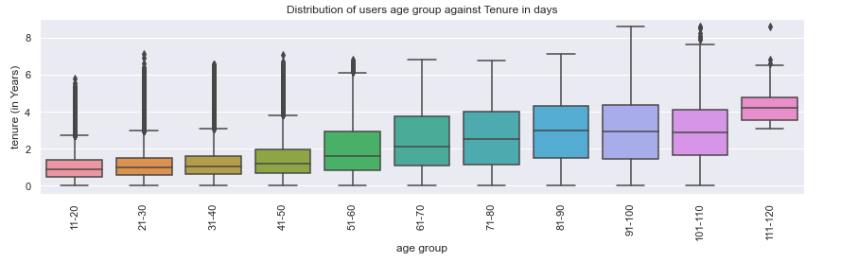
Exploratory Analysis & Visualizations
Question 5 : How long the users are in FB(tenure) and based on their Age Group
Chart Type : BoxPlot
Findings & Visualizations: It shows age group 90-99, 10 year ago started using Facebook for socialising. Even it is surprising to see age group 20-29 where using Facebook almost 6-7 years ago i.e. 2006-2007.

Slide 17
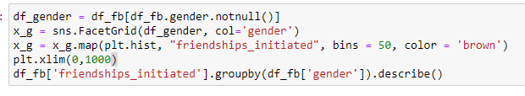
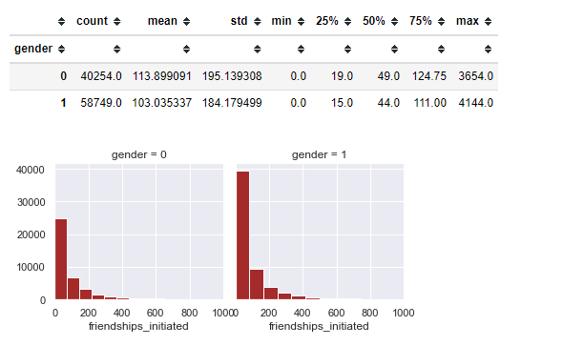
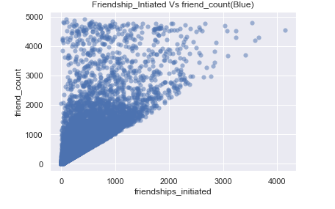
Exploratory Analysis & Visualizations
Question 6 & 7 : Which Gender group has initiated more friends request & friends count
Chart Type : FacetGrid,ScatterPlot
Findings & Visualizations:
Friendship requests initiated by Male gender is more than female gender.
Maximum friend request generated by Male is 4144 where as Female gender is 3654.
Friendship_initiated and Friend count are in correlation
Gender
0 - Female
1 - Male

Slide 18
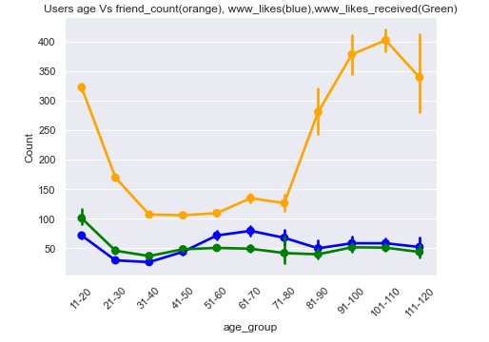
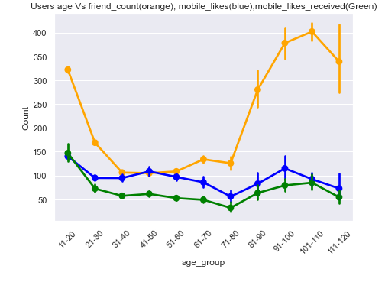
Exploratory Analysis & Visualizations
Question 8 : Which Age group have provided more like (Given & Received)Vs Friend Count
Chart Type : Pointplot
Findings & Visualizations: Friends count for Age group 100 to 110 years is relatively high when compared to users in Age group 30 to 70.
Browser based users given likes are high at age 51-80 where are mobile app based users are gradually same for entire age except 71-80 and 111-120.
Mobile and Browser based received likes are in correlation for age group 81-110.

Slide 19
Exploratory Analysis & Visualizations
Question 8 : HeatMap Correlation based on different variables?
Chart Type : Heatmap
Findings & Visualizations:
Heatmap for all columns, it is observed that there are two squares that get my attention:
Friend_Count Vs Friendship_initiated
Variable combination : 'likes' & 'mobile_likes', 'likes' & 'www_likes', 'likes_received' & 'mobile_likes_received', 'likes_received' & 'www_likes_received', 'www_likes_received' & 'mobile_likes_received'
These combination shows how significant the correlation is between these variables. Actually, this correlation is so strong that it can indicate a situation of multicollinearity.
Age and tenure are 50/50 correlated.

Slide 20
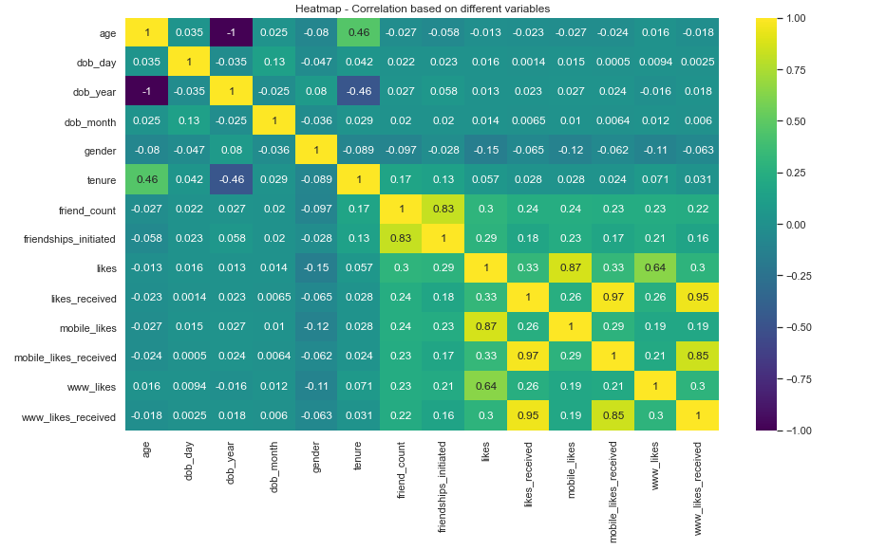
Exploratory Analysis & Visualizations

Slide 21
Summary & Conclusion

Slide 22
Summary & Conclusion
Summary:
Facebook has more number of male user group than female.
Age group of 20-30 are heavy users of facebook application and this gives an insight that marketing efforts should be focussed on young people who has time and active interest.
It shows between age of 11 to 30 years users are using facebook twice more than 31 ownwards age group.Facebook used by Male is higher than Female user between 11 to 50 year age but after 51 age onwards female usage is gradually increased in comparison to male population.
Users have tendency to use facebook more on mobile than web browsers.
Insight shows age group 90-99, 10 year ago started using Facebook for socialising. Even it is surprising to see age group 20-29 where using Facebook almost 6-7 years ago i.e. 2006-2007.
FB friend requests initiated by Male users is more than female users.
In the age group of 81-110,mobile and browser given likes are in high when compared to lower age group.
Friendship initiated and Friend count are in correlation and similarly the likes (www_likes, mobile_likes, recieved_likes).
Age and Tenure are partially correlated and it increase as the age increases.

Slide 23
Summary & Conclusion
Conclusion:
Market more female oriented products to promote Facebook with female genders.
Market more education materials for teenagers in age group 20-30.
Since Male Friend initiated and friend count is high, it looks Male user group are open to have new friends and accept new friends.
Since the mobile user base is high, Facebook should focus more on UI design on Mobile apps to keep the users engaged and it will increase the revenue of FB in form of sponsored ad clicks.

Slide 24
Thank You !!

